Slide 1
Higgs boson at 10: tribute to Peter Higgs
Jiří Chýla, Institute of Physics, CAS
There are many myths about the role of Higgs boson in the Standard model and the works of Higgs, Brout and Englert and Guralnik, Hagen and Kibble, while real importance of Higgs boson is often ignored.
The myths are recycled by most authors, including professionals, with the exception of two eminent theorists: Gerard 't Hooft and TWB Kibble.
To understand the true essence of the Higgs mechanism is important not only from historical point of view but also for extensions of the SM which usually employ the concept of spontaneous symmetry breaking (SSB).
We owe the Higgs boson and Higgs mechanism primarely to Peter Higgs. But even he was wrong on the key point of relevance of SSB in SM.

Slide 2
The first myth:
the Higgs mechanism of mass generation makes use of spontaneous symmetry breaking (SSB). This is not true, as emphasized by Gerard 't Hooft in his Nobel lecture
The mass generation mechanism discussed here should, strictly speaking, not be regarded as spontaneous symmetry breaking, since in these theories, the vacuum does not break the gauge symmetry. "Hidden symmetry" is a better phrase", Let us simply refer to this mechanism as the "Higgs mechanism".
and in more detail in his article
THE CONCEPTUAL BASIS OF QUANTUM FIELD THEORY
in Handbook of the Philosophy of Science, Elsevier, 2004

Slide 3
The shift (5.2) in the definition of the fields, gives all interactions an asymme-tric appearance. This is why, in the literature, one talks of „spontaneous breaking of the local symmetry". Actually, this is something of a misnomer. In the case of a global symmetry, spontaneous breakdown means that vacuum state is degenerate. After a global symmetry transformation, the vacuum state is transformed into a physically inequivalent vacuum state, which is not realized in the system. The existence of a massless Goldstone boson testifies to that.

Slide 4
In the case of a local symmetry, nothing of the sort happens. There is only one vacuum state, and it is invariant under the local symmetry, always. This is why the Goldstone boson became unphysical. In fact, all physical states are formally invariant under local gauge transformations.
In view of all of this, it is better not to say that a local symmetry is spontaneously broken, but, rather, to talk of the Brout-Englert-Higgs mechanism, which is the phenomenon that the spectrum of physical particles do not form a representation of the local symmetry group.
The local symmetry can only be recognized by shifting the scalar fields back to their symmetric notation, the original field phi.
Local symmetry must not be regarded as a property of the physical states, but rather as a property of our way of describing the physical states.

Slide 5
We should agree on what is ment as spontaneous symmetry breaking. Standard definition is based on Goldstone theorem.
SSB is thus a statement on the quantum level as it concerns the properties
of the vacuum, the ground state of QFT, which in SSB is degenerate, as in ferromagnets or superconductor.
It is thus important to define precisely what is understood by the invariance
of the ground state, because this determines the condition of applicability
of Goldstone theorem.

Slide 6
TWB Kibble in Spontaneous symmetry breaking in gauge
theories, Phil. Trans. R. Soc. A 373: 20140033.
How then did we manage to avoid the conclusions of the Goldstone theorem? The answer lies in a well-known peculiarity of the electromagnetic field (and other gauge fields). Gauge invariance means that we can make a transformation
together with the matching transformation of the electromagnetic potentials, without changing anything physical. Thus, the same physical state can be represented by many different solutions of the field equations related to each other in this way.
Correspondingly, there may be oscillations in the field variables that look like physical particles, but actually represent only oscillations in the value of the function α. These are not real physical particles but only ‘gauge modes’, spacetime dependent gauge transformations.

Slide 7
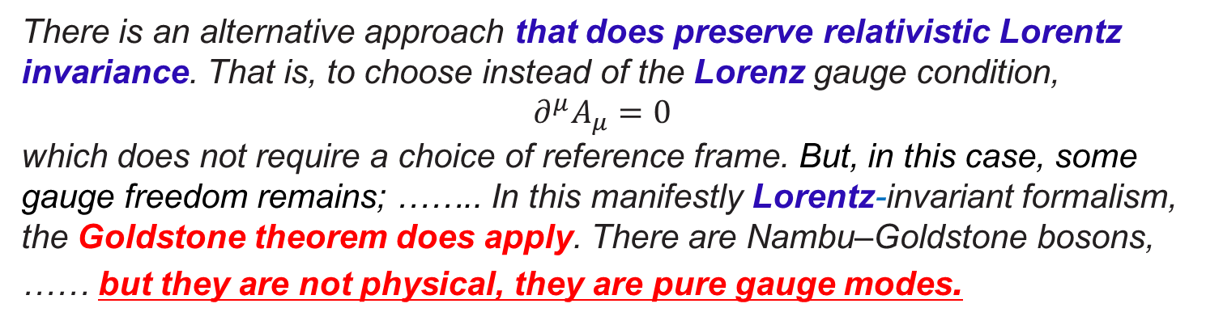
It is convenient to impose a specific gauge condition, a rule for choosing one specific representation for each physical state. One of the simplest is the so-called Coulomb or radiation gauge condition, which is not relativistically invariant.
There is an alternative approach that does preserve relativistic Lorentz invariance. That is, to choose instead of the Lorenz gauge condition,
$$∂^{μ}A_{μ}=0$$
which does not require a choice of reference frame. But, in this case, some gauge freedom remains; …….. In this manifestly Lorentz-invariant formalism, the Goldstone theorem does apply. There are Nambu–Goldstone bosons, …… but they are not physical, they are pure gauge modes.
Moreover, it should be emphasized that, unlike for example the distinct degenerate ground states of a freezing liquid, our distinct vacuum states are all physically equivalent. …… there is no true physical degeneracy of the vacuum.

Slide 8
To find a genuine SSB in QFT is very rare. The well known example of genuine SSB of non-gauge symmetry in QFT is SSB of chiral symmetry in QCD, where the MC simulations indicate that quark condensate is nonzero even in the case of massless quarks (more later).
But we can meaningfully talk about SSB and Goldstone bosons on the classical level, as part of the search for suitable field parametrization. This is what actually happens in the Standard model a what is meant by Gerard 't Hooft.

Slide 9
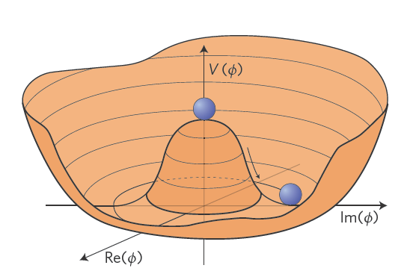
Goldstone phenomena in classsical and quantum physics
Dynamical laws are invariant under some continuous symmetry, but the ground state is not and is thus degenerate. Consider first Mexican hat in normal two dimensional space.
Classical analog of Goldstone
boson: motion of the ball along
the bottom of the hat, classical
analog of the Higgs boson:
oscillations around the minimum.
V(x₁,x₂)
SSB is obvious and trivial at
the classical level as there are
many degenerate ground states
of the ball.
X₁
X₂
But if we put this potential into Schrödinger equation, we find that the ground state is unique and indepedent of the angle due to uncertainty relation between the angle and angular momentum.

Slide 10

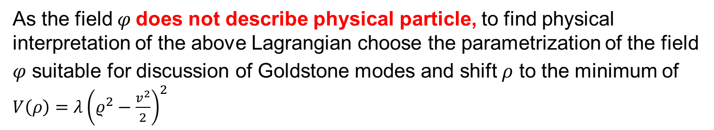
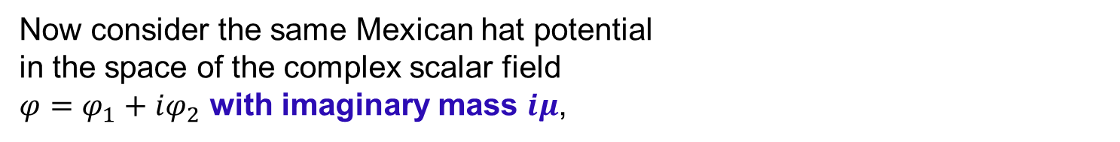
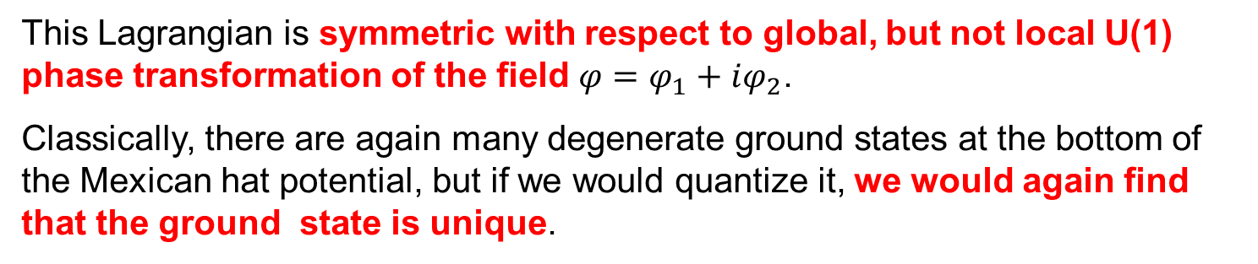
Now consider the same Mexican hat potential
in the space of the complex scalar field
$φ=φ_{1}+iφ_{2}$ with imaginary mass $iμ$,
$$L\left(φ\right)=∂_{μ}φ∂^{μ}φ^{\begin{aligned}∗ \\ \end{aligned}}−V\left(φ\right)$$
$$V\left(φ\right)=−μ^{2}φφ^{∗}+λ{(φφ^{∗})}^{2}$$
This Lagrangian is symmetric with respect to global, but not local U(1) phase transformation of the field $φ=φ_{1}+iφ_{2}$.
Classically, there are again many degenerate ground states at the bottom of the Mexican hat potential, but if we would quantize it, we would again find that the ground state is unique.
As the field $φ$does not describe physical particle, to find physical interpretation of the above Lagrangian choose the parametrization of the field $φ$ suitable for discussion of Goldstone modes and shift $ρ$ to the minimum of $V\left(ρ\right)=λ{\left(ρ^{2}−\frac{v^{2}}{2}\right)}^{2}$

Slide 11
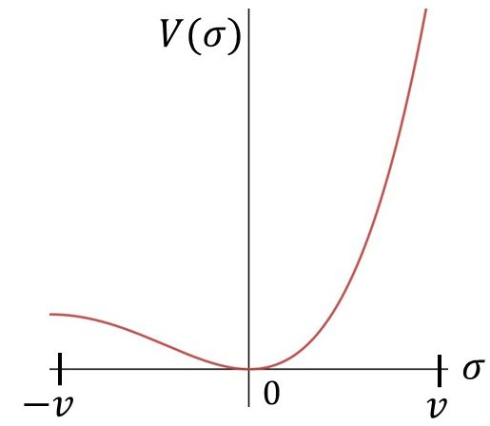
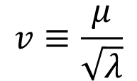
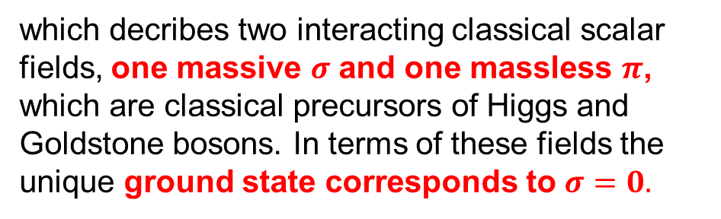
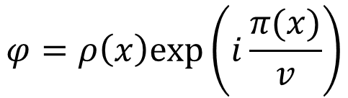
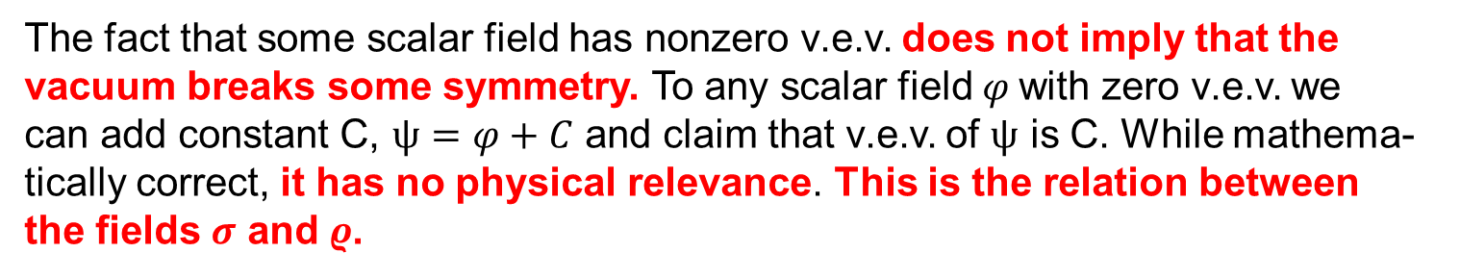
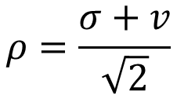
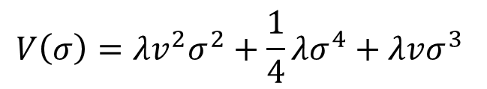
$$φ=ρ\left(x\right)exp⁡\left(i\frac{π(x)}{v}\right)$$
$$v≡\frac{μ}{\sqrt{λ}}$$
$$ρ=\frac{σ+v}{\sqrt{2}}$$
In terms of these new fields the Lagrangian takes the form
$L=\frac{1}{2}∂_{μ}σ∂^{μ}σ+\frac{1}{2}∂_{μ}π∂^{μ}π+\frac{1}{2v^{2}}σ^{2}∂_{μ}π∂^{μ}π+\frac{1}{v}σ$ $∂_{μ}π∂^{μ}π−V(σ)$
$$V\left(σ\right)=λ{v^{2}σ}^{2}+{\frac{1}{4}λσ}^{4}+λvσ^{3}$$
which decribes two interacting classical scalar fields, one massive $σ$ and one massless $π$, which are classical precursors of Higgs and Goldstone bosons. In terms of these fields the unique ground state corresponds to $σ=0.$
The fact that some scalar field has nonzero v.e.v. does not imply that the vacuum breaks some symmetry. To any scalar field $φ$with zero v.e.v. we
can add constant C, $ψ=φ+C$ and claim that v.e.v. of $ψ$ is C. While mathema-tically correct, it has no physical relevance. This is the relation between the fields $σ$ and $ρ$.

Slide 12

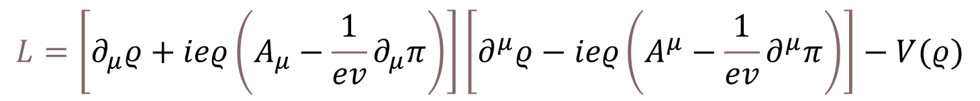
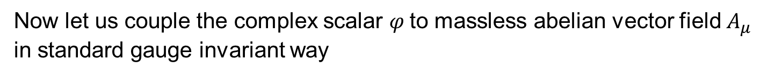


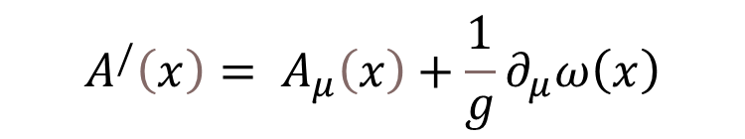


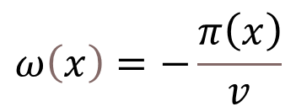
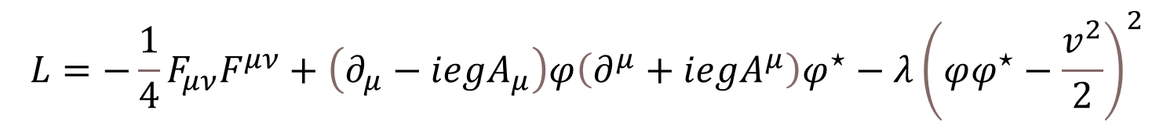

Now let us couple the complex scalar $φ$to massless abelian vector field $A_{μ}$ in standard gauge invariant way
$$L=−\frac{1}{4}F_{μν}F^{μν}+\left(∂_{μ}−iegA_{μ}\right)φ\left(∂^{μ}+iegA^{μ}\right)φ^{⋆}−λ{\left(φφ^{⋆}−\frac{v^{2}}{2}\right)}^{2}$$
Gauge transformations
$$V(ρ)$$
$$A^{/}\left(x\right)= A_{μ}\left(x\right)+\frac{1}{g}∂_{μ}ω\left(x\right)$$
$$φ^{/}\left(x\right)=e^{iω\left(x\right)}φ\left(x\right)$$
read in new coordinates for scalar fields $ρ$ and $π$
$$ρ^{/}\left(x\right)=ρ\left(x\right)$$
$$π^{/}\left(x\right)=π\left(x\right)+vω\left(x\right)$$
$$ω\left(x\right)=−\frac{π\left(x\right)}{v}$$
We can choose the gauge transformation
or perform the derivatives to get rid of the field $π$
to find that the Lagrangian contains only gauge invariant quantities: vector field $B_{μ}$ and neutral scalar $ϱ:$
$$L=\left[∂_{μ}ρ+ieρ\left(A_{μ}−\frac{1}{ev}∂_{μ}π\right)\right]\left[∂^{μ}ρ−ieρ\left(A^{μ}−\frac{1}{ev}∂^{μ}π\right)\right]−V(ρ)$$
$$B_{μ}$$
$$B^{μ}$$

Slide 13
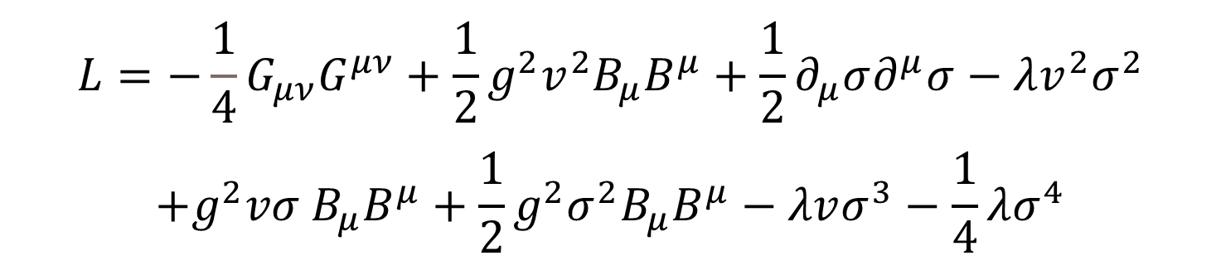
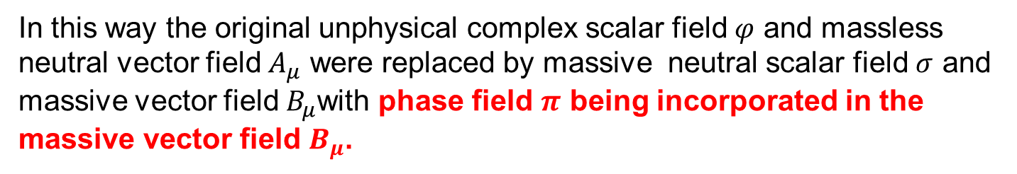
Inserting $ρ=(σ+v)/\sqrt{2}$ we find that this lagrangian describes massive vector field $B_{μ}$ and massive neutral scalar $σ$ plus their interactions
$$L=−\frac{1}{4}G_{μν}G^{μν}+\frac{1}{2}g^{2}v^{2}B_{μ}B^{μ}+\frac{1}{2}∂_{μ}σ∂^{μ}σ−λv^{2}σ^{2}$$
$$+g^{2}vσ B_{μ}B^{μ}+\frac{1}{2}g^{2}σ^{2}B_{μ}B^{μ}−λvσ^{3}−\frac{1}{4}λσ^{4}$$
In this way the original unphysical complex scalar field $φ$ and massless neutral vector field $A_{μ}$ were replaced by massive neutral scalar field $σ$ and massive vector field $B_{μ}$with phase field $π$ being incorporated in the massive vector field $B_{μ}$.
This is what Higgs did in less suitable notation in his basic paper and what defines Higgs mechanism also in the nonabelian generalization.

Slide 14


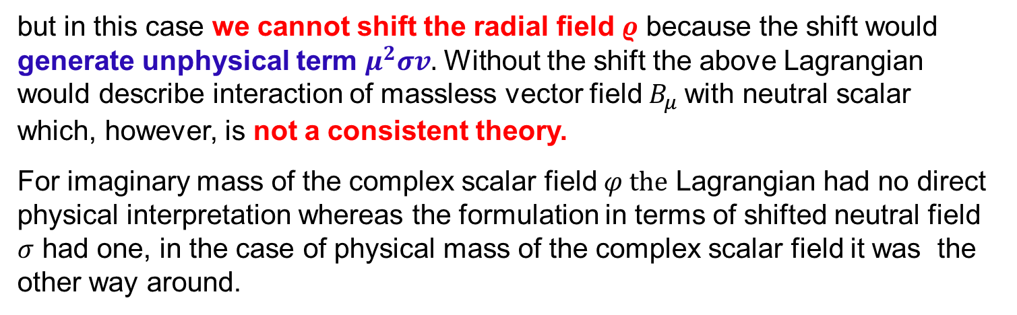
The expression for the Lagrangian in term of fields $ρ$ and $π$
$$L=\left[∂_{μ}ρ+ieρ\left(A_{μ}−\frac{1}{ev}∂_{μ}π\right)\right]\left[∂^{μ}ρ−ieρ\left(A^{μ}−\frac{1}{ev}∂^{μ}π\right)\right]−V(ρ)$$
holds also for the standard potential with physical mass
$$V\left(φ\right)=μ^{2}ρ^{2}+λρ^{4}$$
but in this case we cannot shift the radial field $ρ$ because the shift would generate unphysical term $μ^{2}σv.$ Without the shift the above Lagrangian
would describe interaction of massless vector field $B_{μ}$with neutral scalar
which, however, is not a consistent theory.
For imaginary mass of the complex scalar field $φ the$ Lagrangian had no direct physical interpretation whereas the formulation in terms of shifted neutral field $σ$ had one, in the case of physical mass of the complex scalar field it was the other way around.
This demonstrates that the choice of field parametrization is crucial for proper physical interpretation.

Slide 15
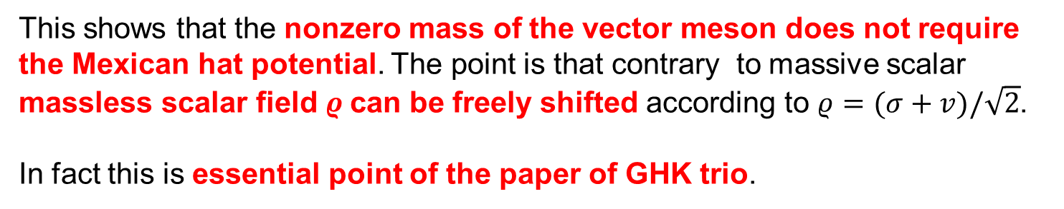
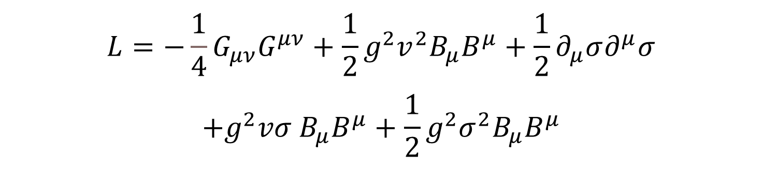

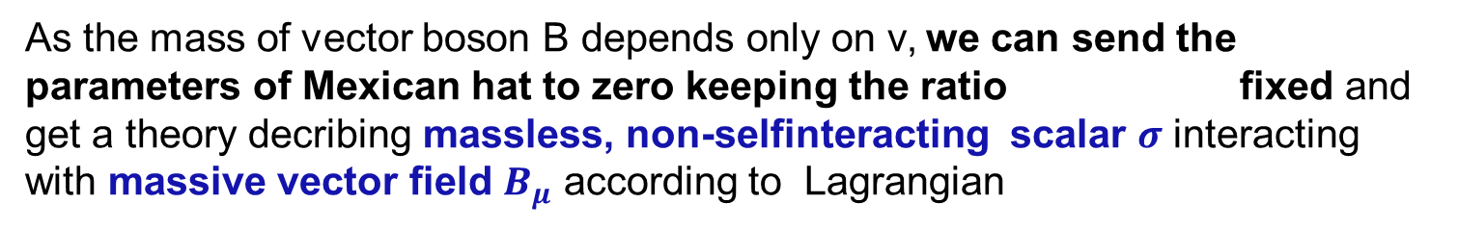
Massless Higgs boson?
As the mass of vector boson B depends only on v, we can send the parameters of Mexican hat to zero keeping the ratio fixed and get a theory decribing massless, non-selfinteracting scalar $σ$ interacting with massive vector field $B_{μ}$ according to Lagrangian
$$v≡μ/{\sqrt{λ}}$$
$$L=−\frac{1}{4}G_{μν}G^{μν}+\frac{1}{2}g^{2}v^{2}B_{μ}B^{μ}+\frac{1}{2}∂_{μ}σ∂^{μ}σ$$
$$+g^{2}vσ B_{μ}B^{μ}+\frac{1}{2}g^{2}σ^{2}B_{μ}B^{μ}$$
This shows that the nonzero mass of the vector meson does not require the Mexican hat potential. The point is that contrary to massive scalar massless scalar field $ρ$can be freely shifted according to $ρ=(σ+v)/\sqrt{2}$.
In fact this is essential point of the paper of GHK trio.

Slide 16
Interesting testimony of Higgs´ view of his boson
From My Life as a Boson Talk at Kings College, Nov. 2010
In 1960 Jeffrey Goldstone …….introduced the so-called wine bottle or Mexican hat potential, and it is then very easy to see how spontaneous symmetry breaking occurs, because the lowest-energy state of the system is down in the trough of the wine bottle, not at the symmetry point. This Goldstone-type model is similar to the Ginzburg-Landau theory in the history of superconductivity.
This is obvious in classical, but not quantum physics. The primary signature of SSB, as specified in Goldstone Theorem, is degenerate ground state.
Shape of the cassical potential written out in terms of field that has no simple physical interpretation tells nothing about the properties of the ground state of quantized version of the corresponding lagrangian.

Slide 17
So now we come to 1964. How to evade the Goldstone theorem? ……..The result of the differential form of a conservation law and Lorentz invariance is that you are driven to the conclusion that there is a zero-mass pole in the spectrum of particles.
I had read papers by Julian Schwinger in 1962 on the subject of gauge invariance and mass. Schwinger was a devotee of the Coulomb gauge in electrodynamics, which is not relativistically invariant.
So over the weekend, that side of my memory infiltrated the problems that I was thinking about on the other side of my memory. I saw that what was likely was that you had to have a gauge theory.
This is no real argument, as one can use relativistically invariant Lorenz gauge and should arrive at the same conclusions. The point is elsewhere, as emphasized above by TWB Kibble.

Slide 18
Comments on Higgs and Brout-Englert basic papers
Higgs (and BE and others) often talked about the need to avoid the consequences of the Goldstone theorem, but as illustrated by the following excerpts from his basic paper
Higgs never seriously addressed the crucial question of the possible degeneracy of the ground state, which is the primary indication of genuine SSB. And as emphasized by ´t Hooft, just the existence of Higgs mechanism testifies against the SSB.

Slide 19
Locally describe
Mexican hat
This is true on classical level, but genuine SSB concerns the properties of quantized ground state, not the form of classical potential.

Slide 20
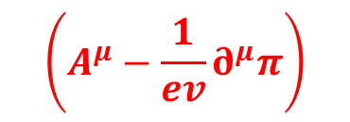
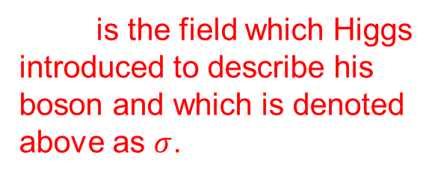

is the field which Higgs introduced to describe his boson and which is denoted above as $σ$.
$$Δφ_{2}$$
Gauge invariant massive
vector field. Key step in his
paper, identical to my
$$\left(A^{μ}−\frac{1}{ev}∂^{μ}π\right)$$

Slide 21
What is called Higgs mechanism
is formulated on the classical level,
amounts to suitable choice of parameterization of fields,
corresponding to physical particles with physical masses,
is not based on SSB,
the resulting lagrangian can by quantized in a standard way,
but is unsuitable for the proof of renormalizability.
The name Higgs mechanism for this procedure is appropriate because only original Higgs paper of 1964 contains all its essential points including Higgs boson and its coupling to vector bosons.
The terms Higgs boson and Higgs mechanism were coined by Benjamin W. Lee at 1972 International Conference on High Energy Physics in Fermilab.

Slide 22
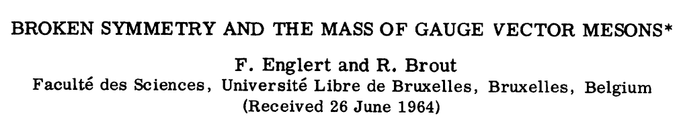
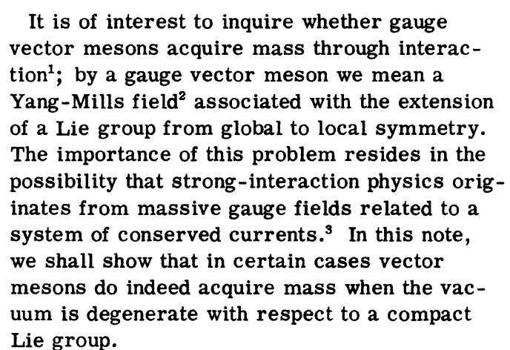
Schwinger

Slide 23
But in gauge theories vacuum is not degenerate!!

Slide 24
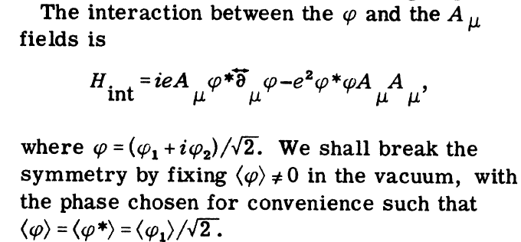

Slide 25
φ₂
No mass term was explicitly specified, but if φ describes charged boson it must be standard mass term and thus the abelian theory BE start with is essentially identical to scalar QED. To discuss the possible mechanism for SSB, i.e. why vacuum should choose some nonzero value of the field φ and would be degenerate should thus be of utmost importance, because in scalar QED SSB does not occur.
Brout and Englert also did not demonstrate
that their assumed Goldstone boson entirely disappears from
the theory
while the ground state remains degenerate,
why there should be the Higgs boson.

Slide 26
But why so many people talked and talk about SSB in connection with Higgs mechanism, when in fact there is
no SSB in electroweak part of Standard model?
I think that this is in part because of enormous influence of Nambu and his work on genuine SSB of chiral symmetry in strong interactions and in part due to oversimplified terminology.

Slide 27
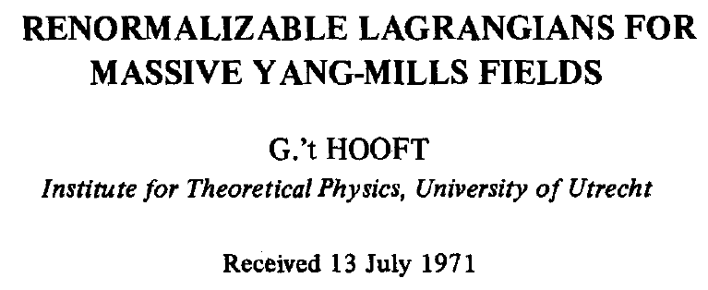
Contradiction with
later statements?
Dear professor ’t Hooft,
Could you please comment on the apparent contradiction between your quoted statements, or should I interpret the statement in Nuclear Physics article in the sense of the footnote in your Nobel lecture?
Dear Jiri Chyla,
You are quite right in saying that the wording I chose in my Nobel lecture and in the lecture notes on QFT, was more precise than in the earlier paper. I did use the words "seems" and "evident" there, which were indirect indications that, also at that time, I did understand what I was talking about, but I just didn't want to spend too much time and space to say these things precisely right.

Slide 28
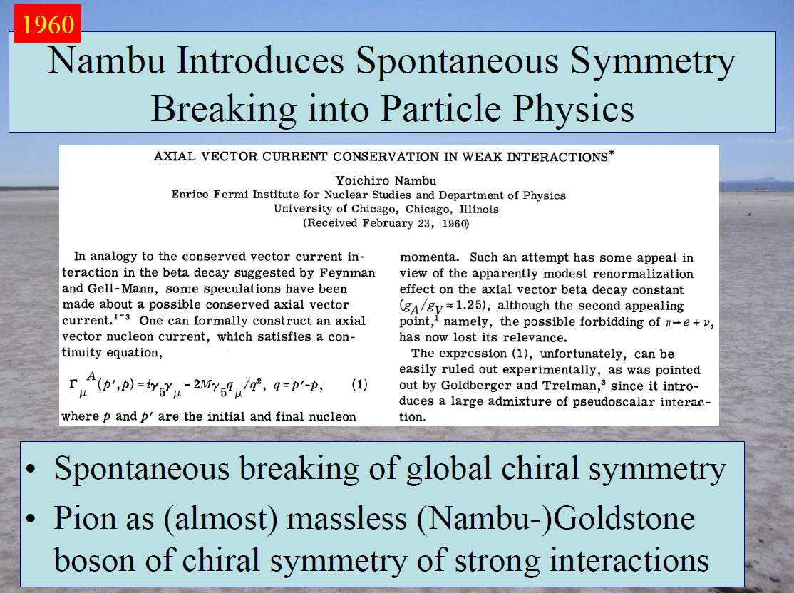
John Ellis on the occasion of 10th anniversary of Higgs boson discovery

Slide 29
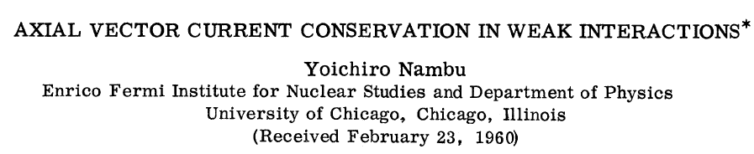
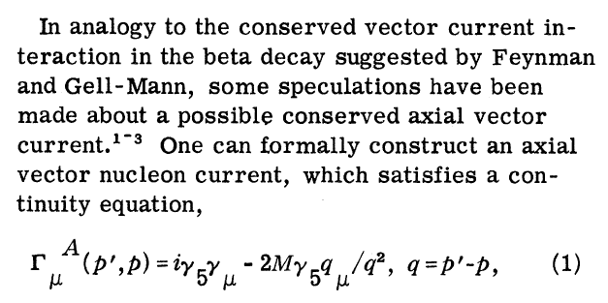
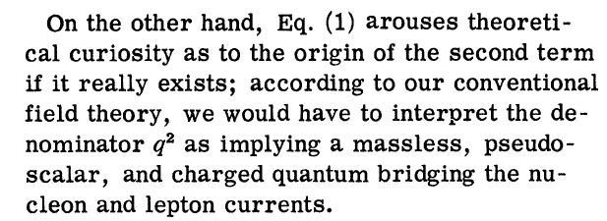
First mention of
NG bosons

Slide 30
i.e. p→n+π⁺

Slide 31
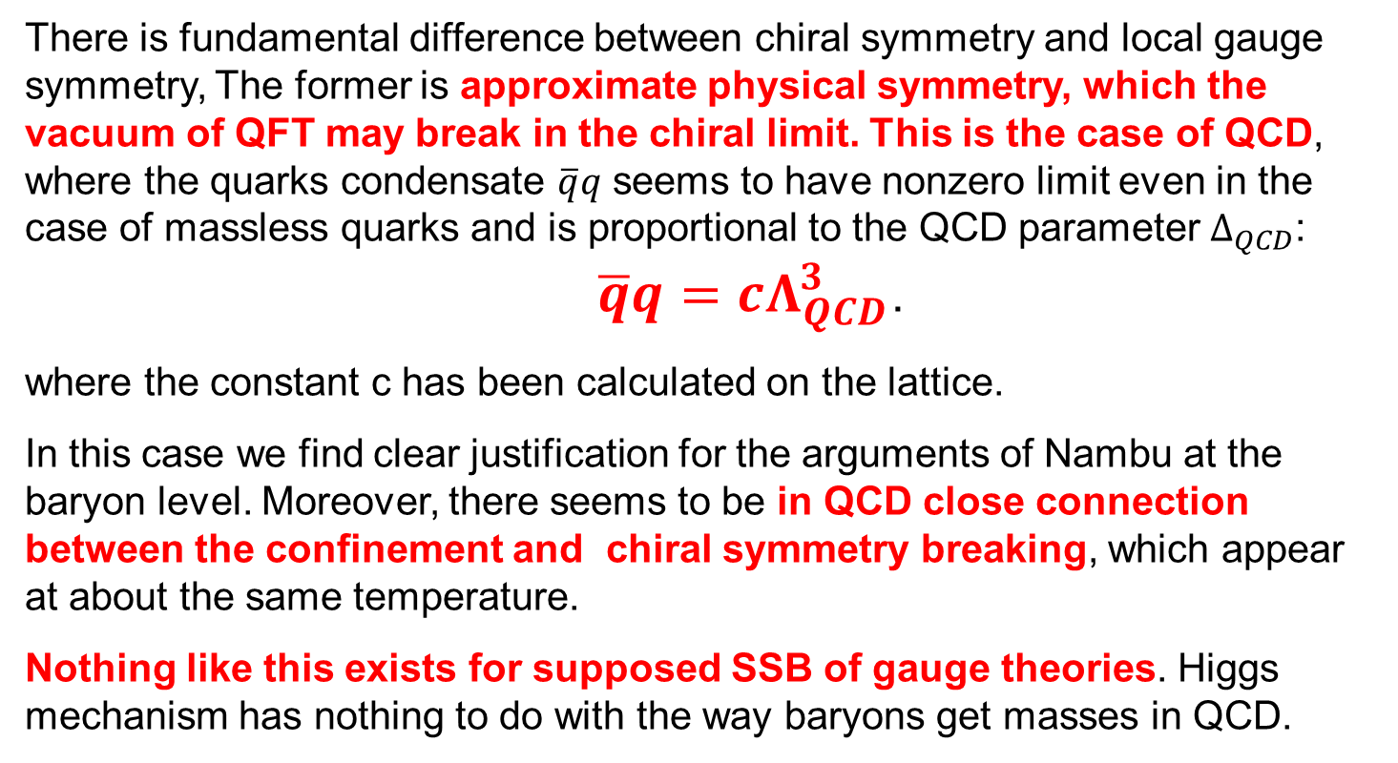
There is fundamental difference between chiral symmetry and local gauge symmetry, The former is approximate physical symmetry, which the vacuum of QFT may break in the chiral limit. This is the case of QCD, where the quarks condensate $\overline{q}q$ seems to have nonzero limit even in the case of massless quarks and is proportional to the QCD parameter $Δ_{QCD}$:
$\overline{q}q=cΛ_{QCD}^{3}$.
where the constant c has been calculated on the lattice.
In this case we find clear justification for the arguments of Nambu at the baryon level. Moreover, there seems to be in QCD close connection between the confinement and chiral symmetry breaking, which appear at about the same temperature.
Nothing like this exists for supposed SSB of gauge theories. Higgs mechanism has nothing to do with the way baryons get masses in QCD.

Slide 32
The second myth:
Higgs boson gives mass to SM particles. In fact it is the other way around: SM partices have masses and their interactions with Higgs boson are necessary to make the SM consistent (renormalizable).
Fermion masses cause no problem in QED as well as QCD, which are perfectly consistent theories without Higgs.
In Abelian case one can even make the vector boson massive by putting mass by hand and no Higgs is needed.
Higgs is relevant only for weak interactions. If there were no weak interactions certain vital processes would not operate and Universe would look differently, but atoms would look almost exactly the same as now.
Higgs boson does not explain the mass hierarchy of fermions just parametrize them via Yukawa couplings and provides thus no explanation for the crucial fact that m_{d} >m_{u} .

Slide 33
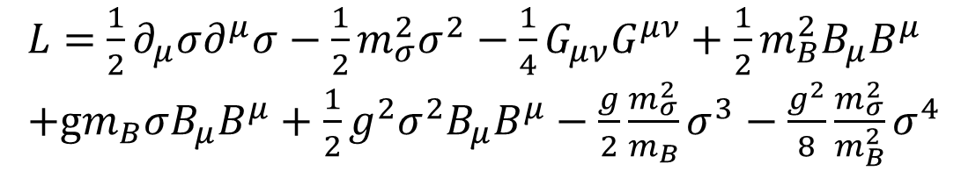
The Lagrangian specifying interactions of Higgs boson with gauge boson can alternatively be expressed in terms of these masses and gauge coupling constant g:
Higgs
Massive vector boson
$L=$ $\frac{1}{2}∂_{μ}σ∂^{μ}σ−\frac{1}{2}m_{σ}^{2}σ^{2}−\frac{1}{4}G_{μν}G^{μν}+\frac{1}{2}m_{B}^{2}B_{μ}B^{μ}$
+g$m_{B}σB_{μ}B^{μ}+\frac{1}{2}g^{2}σ^{2}B_{μ}B^{μ}−\frac{g}{2}\frac{m_{σ}^{2}}{m_{B}}σ^{3}−\frac{g^{2}}{8}\frac{m_{σ}^{2}}{m_{B}^{2}}σ^{4}$
Interaction terms
This ilustrates the fact that masses determine Higgs boson couplings to other particles. These terms can entirely be deduced from the requirement that the theory is renormalizable and unitary without using the principle of local gauge invariance. This is the true role of Higgs boson!

Slide 34
This is known already for 50 years. In
J.M. Cornwall, D. N. Levin, G. Tiktopoulos, Phys. Rev. Lett. 30 (1973) 1268
C. H. Llewellyn Smith, Phys. Lett. 46B (1973) 233.
J. M. Cornwall, D. N. Levin, G. Tiktopoulos, Phys. Rev. D10 (1974) 1145
S. D. Joglekar, Ann. Phys. (NY) 83 (1974) 427.
the complete SM in the unitary gauge was constructed by adding to the massless SM lagrangian beside the explicit gauge boson and fermion masses also terms with scalar boson required by tree unitarity. In other words, masses determine the couplings of the Higgs boson.
For details see Jiří Hořejší: Elektroslabé sjednocení a stromová unitarita.

Slide 35
Misleading claim from CERN web page:
https://home.cern/science/physics/higgs-boson
You and everything around you are made of particles. But when the universe began, no particles had mass; they all sped around at the
speed of light.
In fact, it is impossible to consistently formulate interactions of only massless particles. QED with massless electron makes no sense, because it would imply electron instability, as it would immediatelly decay into a cascade of photons and these photons would in turn decay into pairs of electrons and positrons etc.
In QED photon can be massless but not electron as its mass acts as the regulator of mass singularities

Slide 36
The CERN article continues with the usual claim
In the Higgs boson's case, the field came first. The Higgs field was proposed in 1964 as a new kind of field that fills the entire Universe and gives mass to all elementary particles. The Higgs boson is a wave in that field. Its discovery confirms the existence of the Higgs field.
Particles get their mass by interacting with the Higgs field; they do not have a mass of their own.
All claims in red are wrong or highly misleading.
As we saw, Higgs was interested in ecaping the consequences of
Goldstone theorem in general and BE were doing the same for strong interactions.
Higgs field does not fill the entire universe, its v.e.v. is ZERO,
it is the constant v, which in a sense, fills the Universe, but Higgs
boson is NOT a WAVE IN THIS CONSTANT.

Slide 37
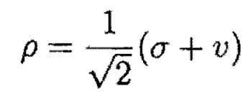
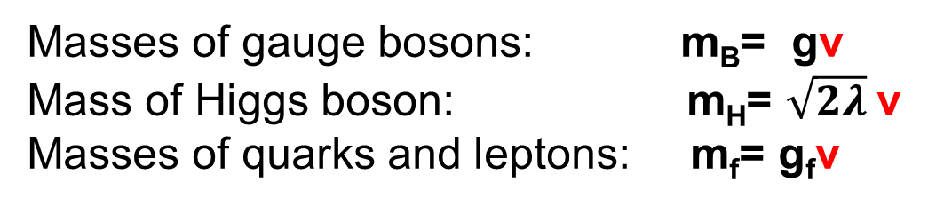
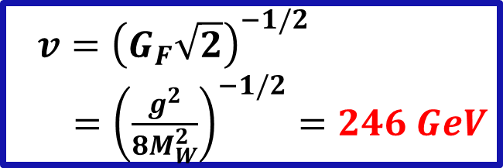
Any explanation of how particles get masses should reflect the fact, that masses of SM particles are proportional to the constant v and various coupling constants. And it should use correct terminology. Higgs field is the field of which one particle excitation is the Higgs boson.
Masses of gauge bosons: m_{B}= gv
Mass of Higgs boson: m_{H}= $\sqrt{2λ}$v
Masses of quarks and leptons: m_{f}= g_{f}v
$$v={\left(G_{F}\sqrt{2}\right)}^{−1/2}$$
$={\left(\frac{g^{2}}{8M_{W}^{2}}\right)}^{−1/2}=246 GeV$
Unphysical
„Goldstone“
field
Higgs
field
Constant v
„condensate“

Slide 38
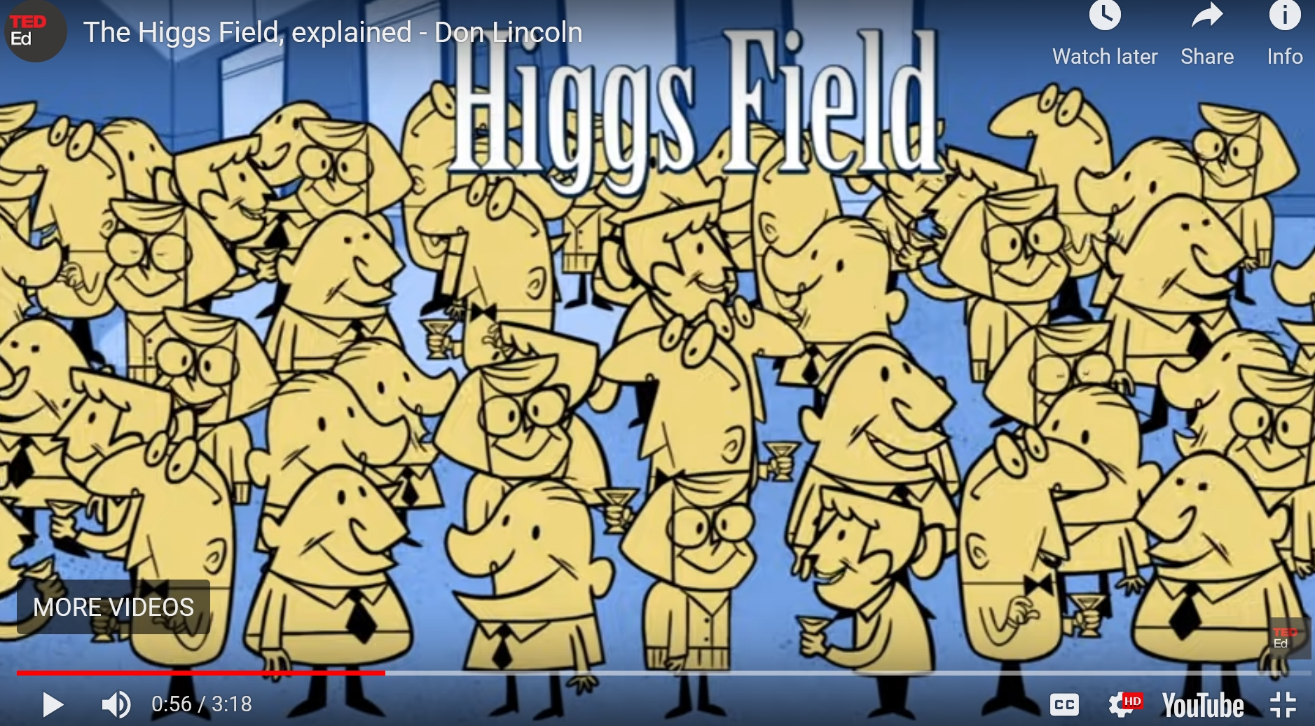
Why this explanation of how particles get masses is wrong
http://home.web.cern.ch/about/updates/2013/08/fermilabs-don-lincoln-explains-higgs-field
Crowd of physicist at CERN supposedly represents the Higgs field.

Slide 39
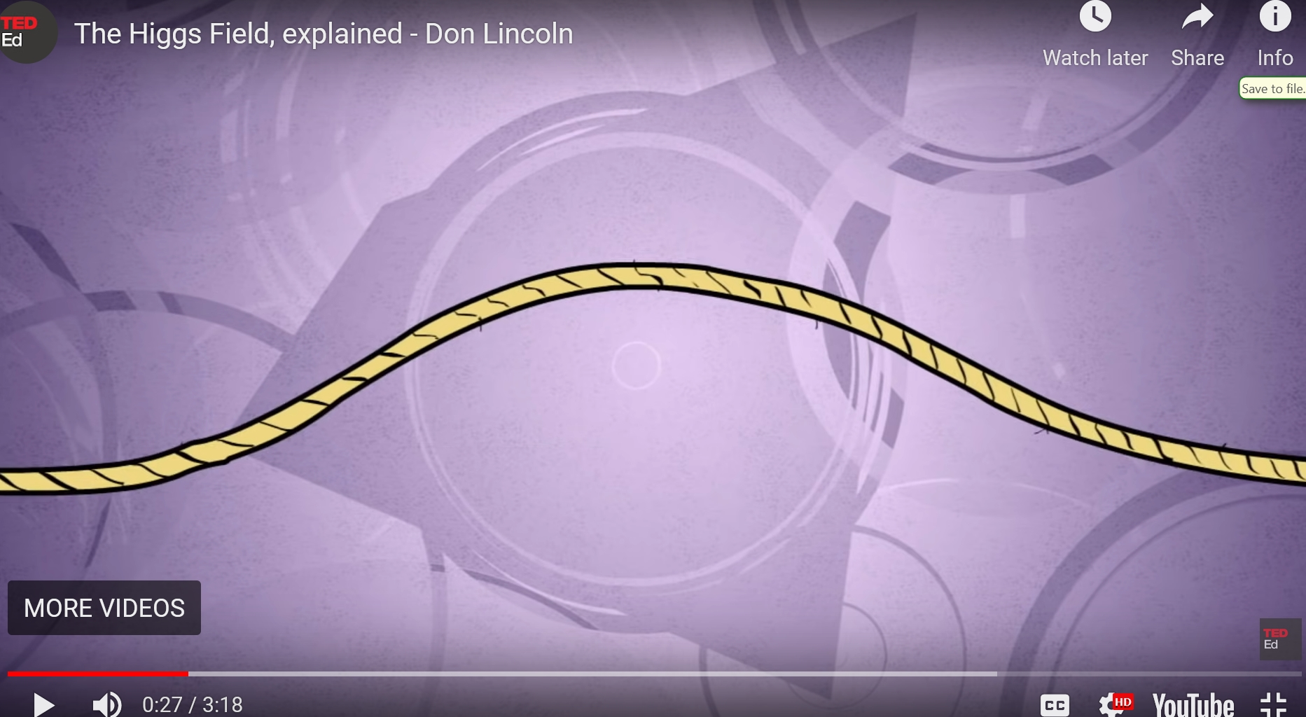
Higgs boson are wiggles in the Higgs field. Yes, but the crowd
of physicists does not represent the Higgs field.

Slide 40
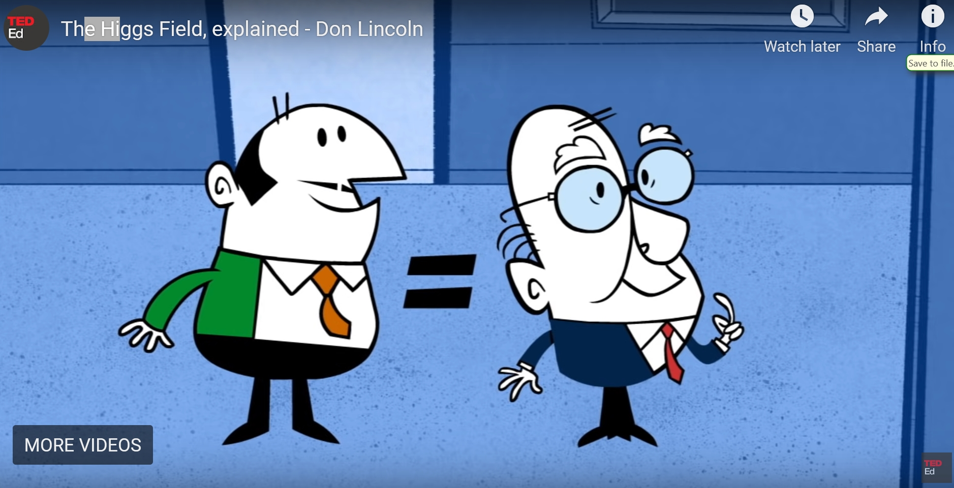
All particles are equal (massless) when they enter the room: highly
misleading

Slide 41
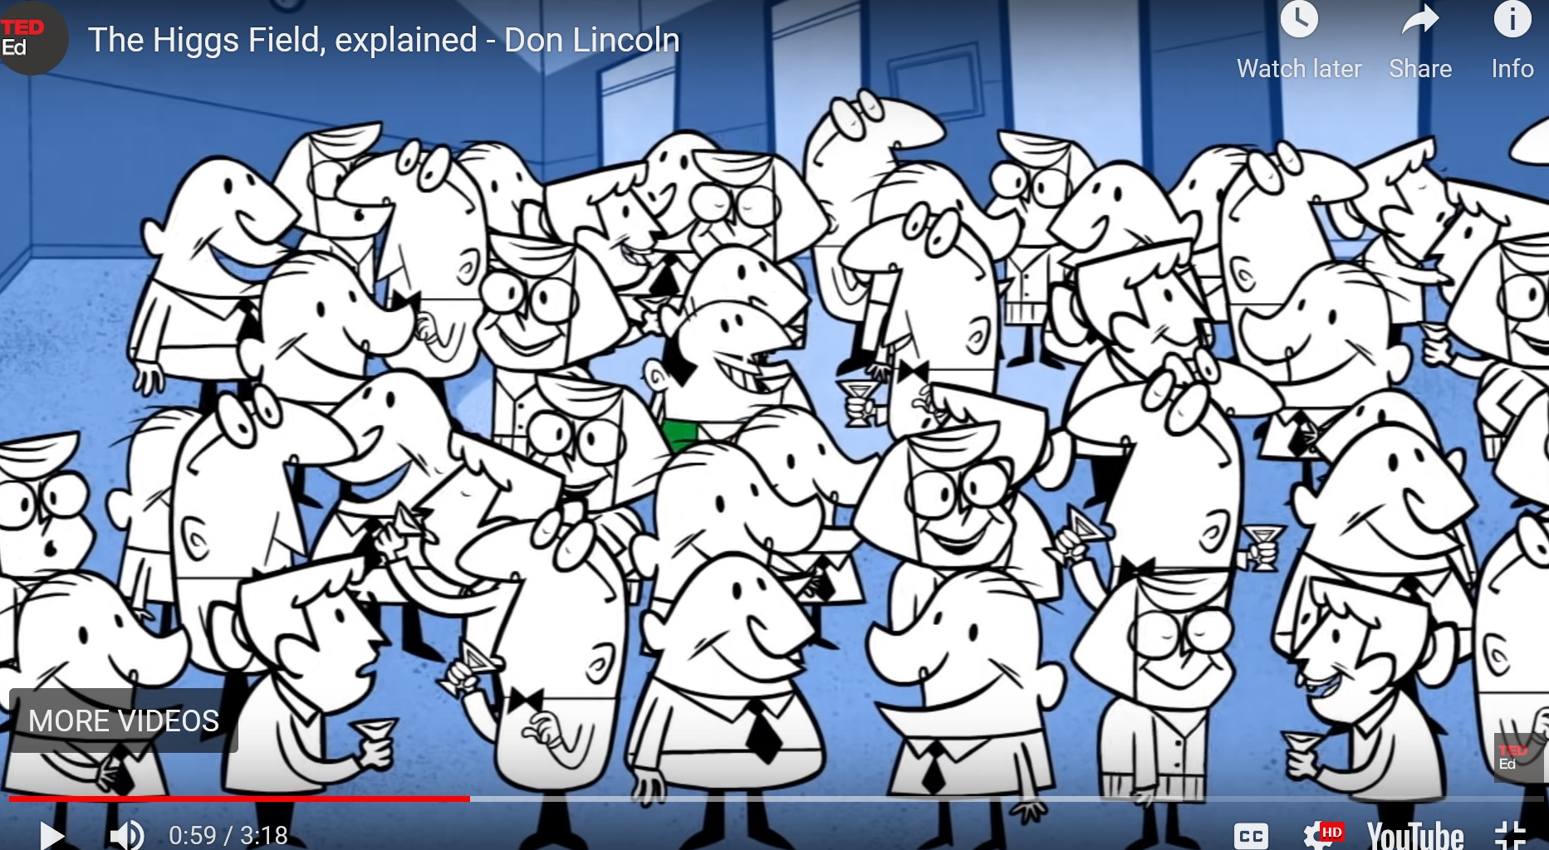
Tax collector
Nobody pays attention to tax collector, who can easily go through the crowd, analog of massless particle.

Slide 42
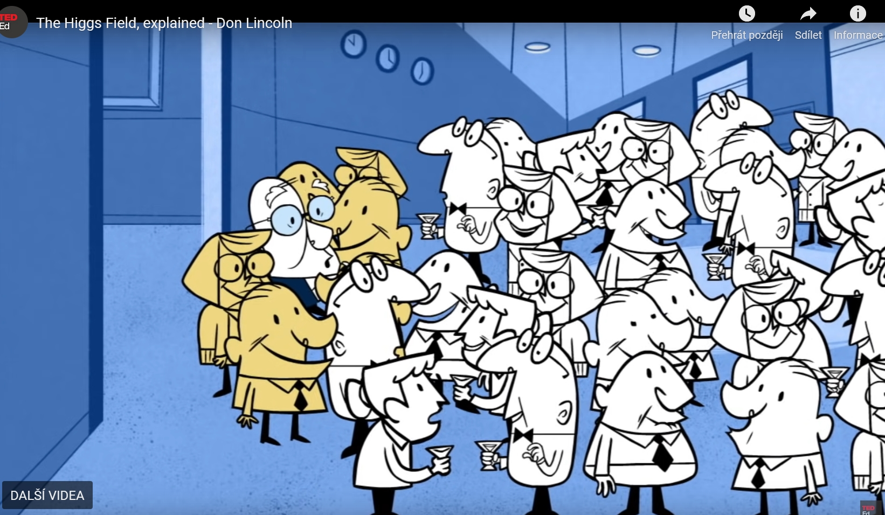
Peter Higgs
People clump around Peter Higgs and cause him to slow motion
It is the interaction with the crowd that gives particles the mass: yes, but
not with Higgs field.

Slide 43
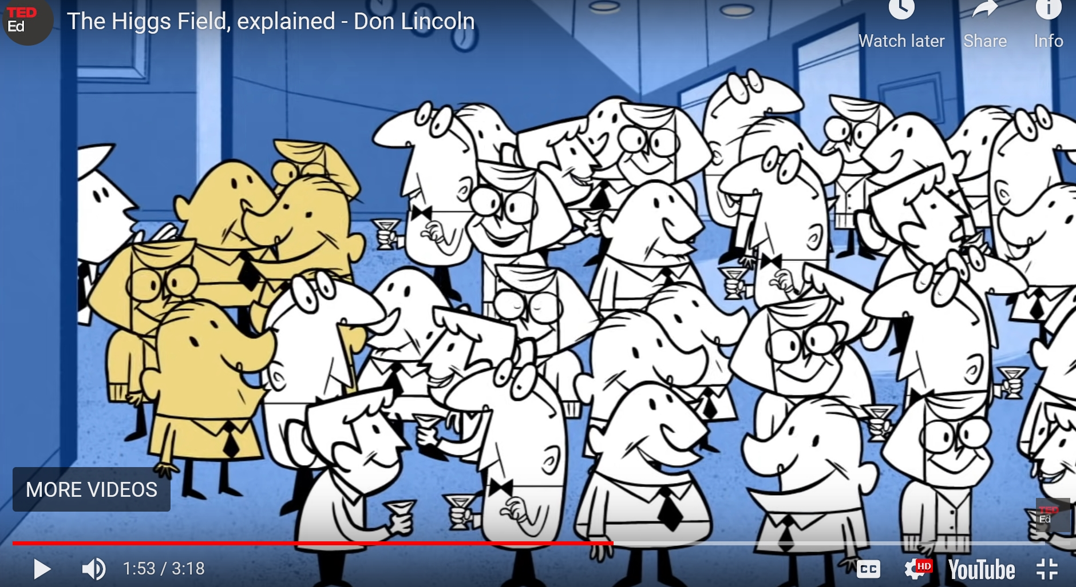
Rumour of a discovery in some distant laboratory enters the room

Slide 44
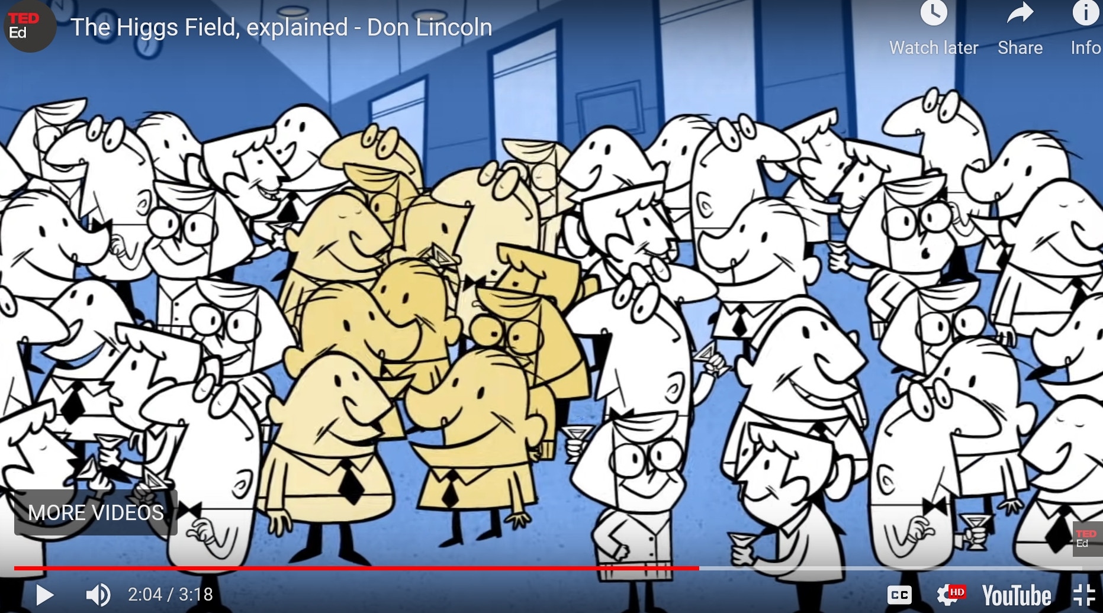
and propagates through crowd. This epresents Higgs boson:
Wrong, Higgs gets mass in the same way as other particles.

Slide 45

Basic message of the analogy: It is the interaction with the crowd
representing the Higgs field that causes particles to have mass.
This explanation is wrong because particles do not get mass from interactions with Higgs field. The analogy confuses Higgs field with the condensate v, which is actually represented by the crowd.
Moreover, Higgs boson is excitation of the Higgs field, NOT of the crowd of partygoers representing the condensate v and gets its mass in the same way as other particles.
Better analogy:
Higgs plugs the
hole in SM.

Slide 46
Summary
In all three cases, superconductivity, chiral symmetry as well as Standard model, the essence of their description lies in the fact that the physical degrees of freedom are different from those appearing in the original symmetric lagrangian.
Superconductivity: electrons vs BV quasiparticles
Chiral symmetry: massless fermions vs massive fermions
SM: Goldstone field and massless vector mesons vs Higgs field and massive vector mesons
The principal difference between the first two cases and SM lies in the fact that in superconductivity as well as chiral symmetry genuine SSB occurs and the proper degrees of freedom are consequences of the properties of the quantum ground states, whereas in SM they are results of suitable choice of the parametrization of classical fields and do not rely on SSB.

Slide 47
BACKUP

Slide 48
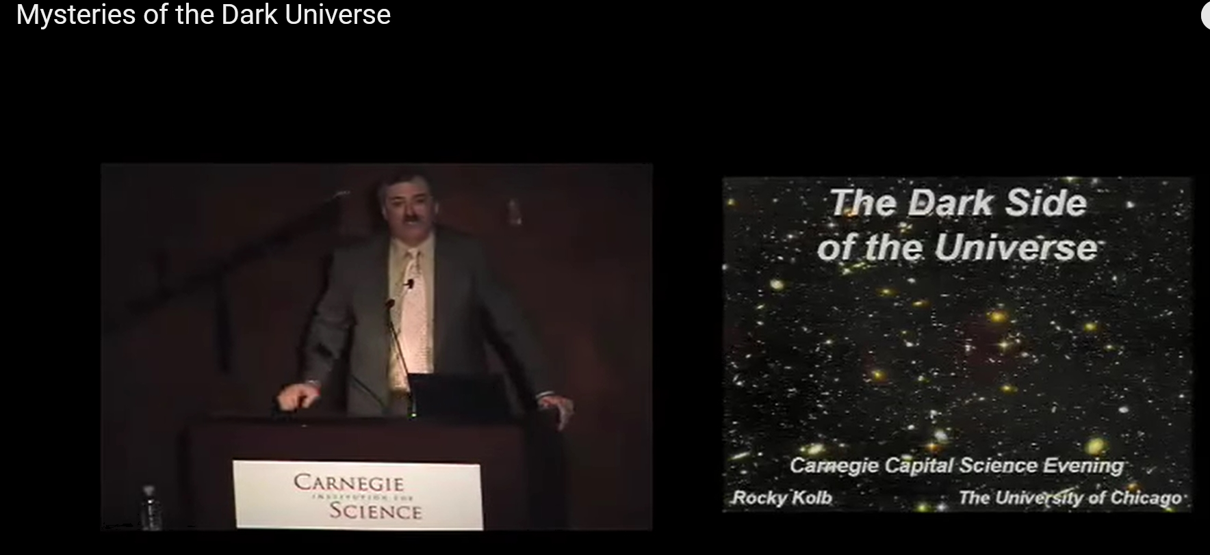
Example of profound misunderstanding of the meaning of the value of condensate v by eminent cosmologist.
Rocky Kolb: Mysteries of the Dark Universe
https://www.youtube.com/watch?v=nKmFKh3obLE

Slide 49
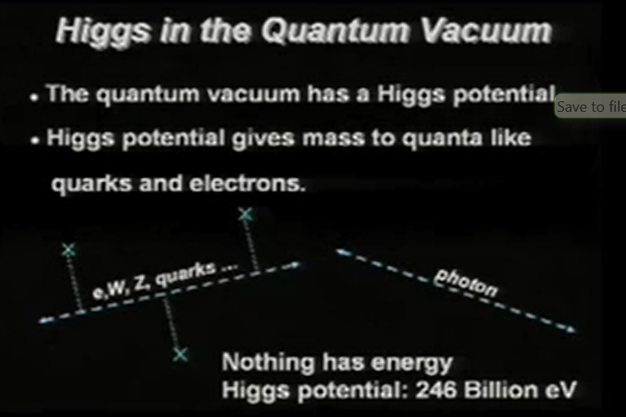

„At every point of space there is Higgs potential energy of 246 thousand million electron volts“: utter nonsense.

Slide 50
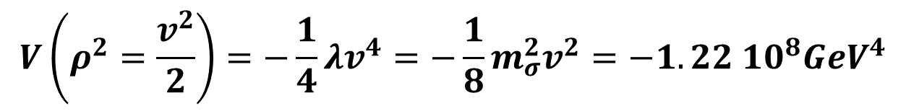
Potential energy density at the minimum of the potential equals
$$V\left(ρ^{2}=\frac{v^{2}}{2}\right)=−\frac{1}{4}λv^{4}=−\frac{1}{8}m_{σ}^{2}v^{2}=−1.22{ 10}^{8}{GeV}^{4}$$
which, if taken seriously, would imply NEGATIVE potential energy of about -1.5 10⁵⁵ GeV/m³ to be compared to current critical energy density of the Universe of about 6 GeV/m³ and thus imply dramatic decelerated expansion of the Universe.
But in QFT the potential energy is defined up to a constant, so the above large numbers are irrelevant.

Slide 51
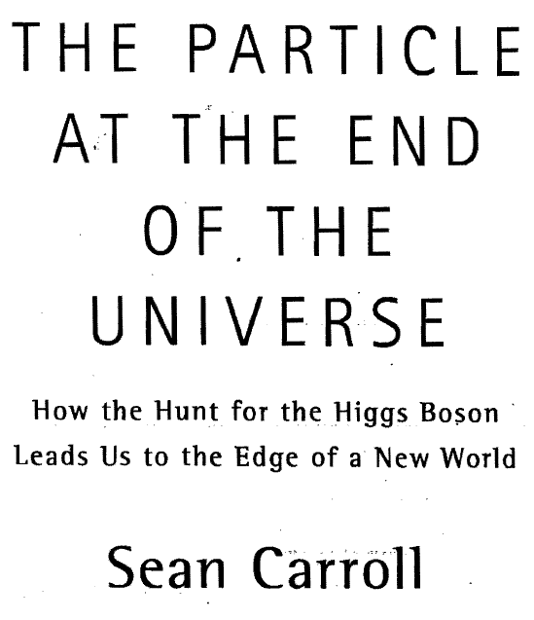
Another example of wrong claims concerning the Higgs boson made by famous cosmologist, which
confuses Higgs field with the unphysical scalar Goldstone field.

Slide 52
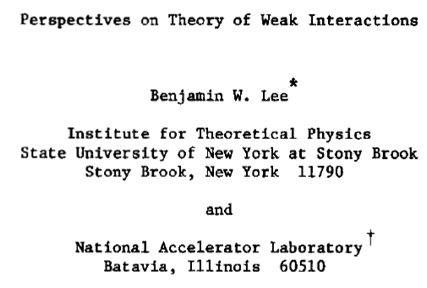

1972 International Conference on High Energy Physics, Fermilab
Not true
in fact

Slide 53



Slide 54

This conclusion is nontrivial and does not follow directly
from the evaluation of the diagrams below
but, as emphasized by BE themselves,
R. Brout, F. Englert, C. R. Physique 8 (2007) 973–985
Involves resummation of the whole geometric series
and its analytic continuation. Nonzero mass of vector
mesons is thus nonperturbative effect.

Slide 55

Nonzero mass of vector bosons is nonperturbative effect which results from resummation of infinite geometrical series of the type

Slide 56



Interesting
possibility.
Massless
Higgs!!
Intractable notation
Unsubstantiated SSB condition:
NONSENSE!!

Slide 57
Spontaneous Symmetry Breaking in Particle Physics: a Case of Cross Fertilization, Nobel Lecture, December, 2008
SSB in quantum mechanics occurs typically in a uniform medium consisting of a large number of elements. It is a dynamical effect. A symmetry allows some freedom of action to each of them but the interaction among them forces them, figuratively speaking, to line up like a crowd of people looking into the same direction. Then it is not easy to change the direction wholesale even if it is allowed by the symmetry hence does not take energy, because the action is not a local operator. So the symmetry appears to be lost. It is still possible to recover the lost symmetry by a global operation, but it would amount to a kind of phase transition. Some of the examples:
physical system broken symmetry
ferromagnets rotational invariance (with respect to spin)
crystals translational and rotational invariance
superconductors local gauge invariance (particle number)
NO!!!
YES!!!

Slide 58
Spontaneous Symmetry Breaking in Particle Physics: a Case of Cross Fertilization, Nobel Lecture, December, 2008
SSB in a medium has the following characteristic properties:
The ground state has huge degeneracy. A symmetry
operation takes one ground state to another.
2. Only one of the ground states and a complete set of
excited states built on it are realized in a give situation.
3. SSB is in general lost at sufficiently high temperatures.
In relativistic quantum field theory, this phenomenon becomes also possible for the entire space-time, for the “vacuum” is not void, but has many intrinsic degrees of freedom. In this context, it may play an important role in cosmology. As the universe expands and cools down, it may undergo one or more SSB phase transitions from states of higher symmetries to lower ones, which change the governing laws of physics.
This happens in QCD in the case of chiral symmetry and
color confinement phase trantransition.

Slide 59

In the language of Feynman diagrams
+
+
Lead to unphysical result
The sum is OK!

