Slide 1
FZU Computing Center
Jiří Chudoba
VS - Meeting with users, 8.12.2022

Slide 2
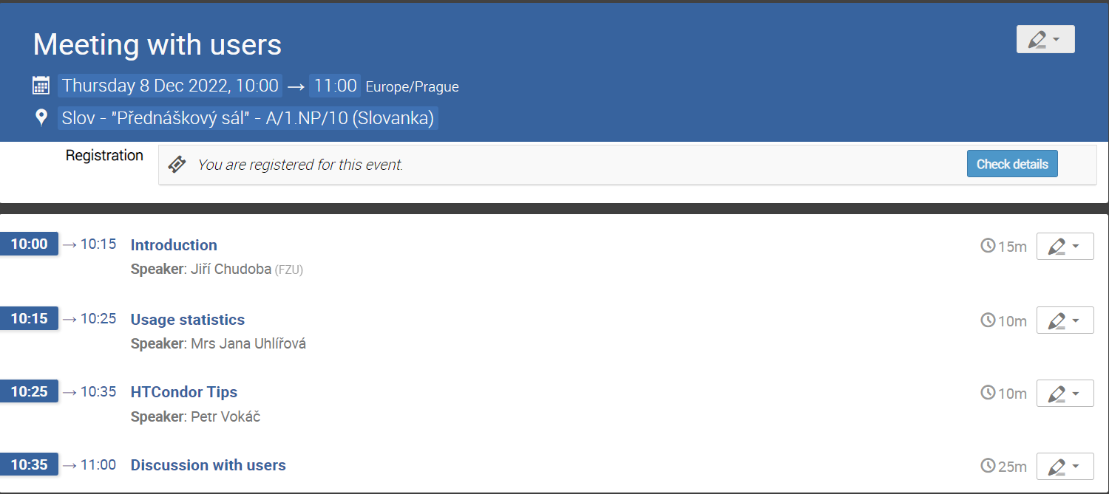
Welcome

Slide 3
Major recent hardware
2020
dpmpool25 (770 TB: Auger 273 TB + ATLAS 497 TB)
nfs20 – 23 (4 * 115 TB, Auger)
cluster minis (Auger): 12 x 1 CPU (16 cores), 64 GB RAM, 1 Gbps, 10.47 HS06/HTcore, 384 jobslots
luna96-99: 4 servers (2 CPUs, 64 cores, 512 GB RAM)
2021
virtualization infrastructure
3 servers virt07-09
HA disk array 77 TB (raw) SSD
8 disk servers ds26-33, 4.6 PB raw (3.6 PB ATLAS + 1 PB Fermilab), 36x 16 TB HDD, 2x25 Gbps
GPU server gpu01, 1x 16-core CPU + NVIDIA A30
luna100-105: 6 servers (2 CPUs, 64 cores, 1 TB RAM)
2022
Cisco Nexus 93180YC-FX – main router
cluster milan: 29 servers (7x4 + 1), 2xCPU AMD Epyc 7543, 32c, 512 GB RAM, 3.84 TB SSD, 17.8 HS06/HTcore, 2278 HS06 per server
3712 jobslots, 66 kHS06, CERN : Fermilab : Auger = 35 : 13 : 18 kHS06
cluster phoebe (4 GPU servers, 20 computing servers)
luna201-206: 6 servers (2 CPUs, 64 cores, 512 GB RAM, GPU A40)

Slide 4
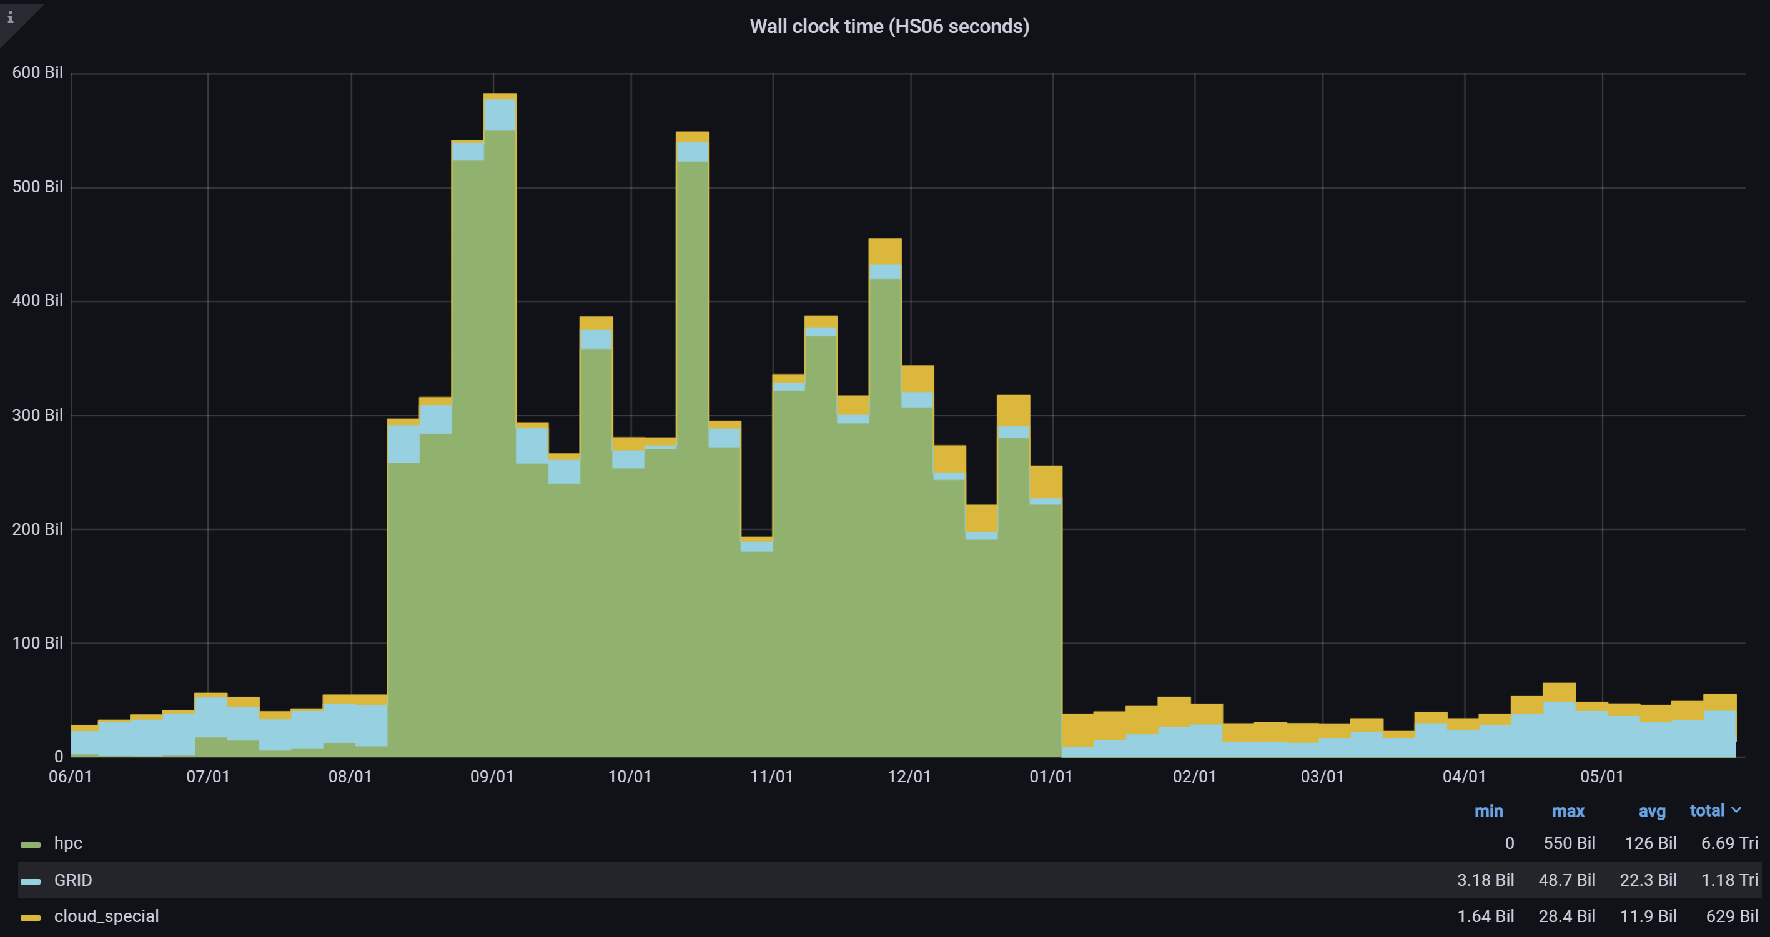
External resources: IT4I

Slide 5
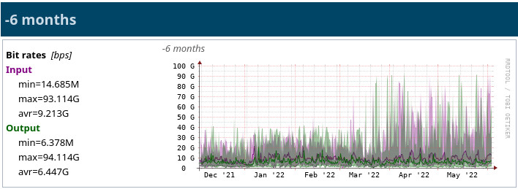
New router

Slide 6
DPM migration
DPM to dCache migration
during planned electricity outage from 14.5. to 15.5.2022
the biggest site migrated until now
downtime less than 24 hours
almost transparent to users

Slide 7
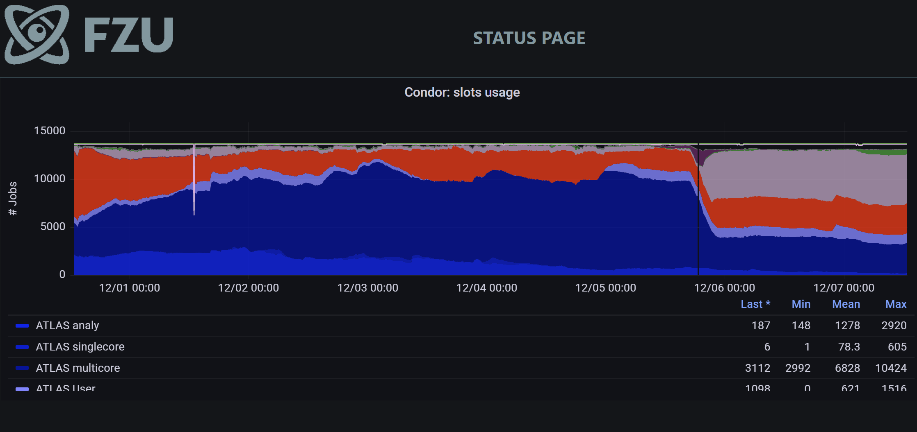
Monitoring
Notes:
https://www.farm.particle.cz/status/

Slide 8
Energy consumption
increase of price from 1.8 (2.5) + VAT CZK/kWh to 6.8 CZK/kWh from 1.1.2023
switch off old clusters lilium (2013, 16.5 kW) and malva (2013, 4.2 kW)
aplex (2014, 7.2 kW) and magic (2016, 10.8 kW) will follow
2022-01: 9680 cores
2022-11: 12160 cores
2023-01: 10272 cores

Slide 9
Energy consumption
increase of price from 1.8 (2.5) + VAT CZK/kWh to 6.8 CZK/kWh from 1.1.2023
switch off old clusters lilium (2013, 16.5 kW) and malva (2013, 4.2 kW)
aplex (2014, 7.2 kW) and magic (2016, 10.8 kW) will follow
- 38.7 kW = 280 kCZK/month (PUE = 1.5)
2022-01: 9680 cores
2023-01: 10272 cores
2023-0x: 7760 cores

Slide 11
Miscellaneous
plans for OS change from CentOS7 to Rocky9
singularity (apptainer) containers
Metacentrum: Debian11
dCache for NFS servers?

Slide 12
Thank you for your attention

