Slide 1
50 years of discoveries of neutral currents
and asymptotic freedom
Jiří Chýla
The year 1973 brought two major discoveries, one experimental and one theoretical, that set the stage for the formulation of Standard Model and lead to further discoveries confirming the basic ideas on which it is based - quarks and leptons as fundamental particles interacting via intermediate vector bosons - and culminating with Higgs boson discovery in 2012.
While the discovery of neutral currents was to some extent expected, the discovery of asymptotic freedom of nonabelian gauge theories came as complete surprise to all theorists.
I will recall both discoveries, but concenrtate on the second as
it brings important lesson for current situation in particle physics.

Slide 2
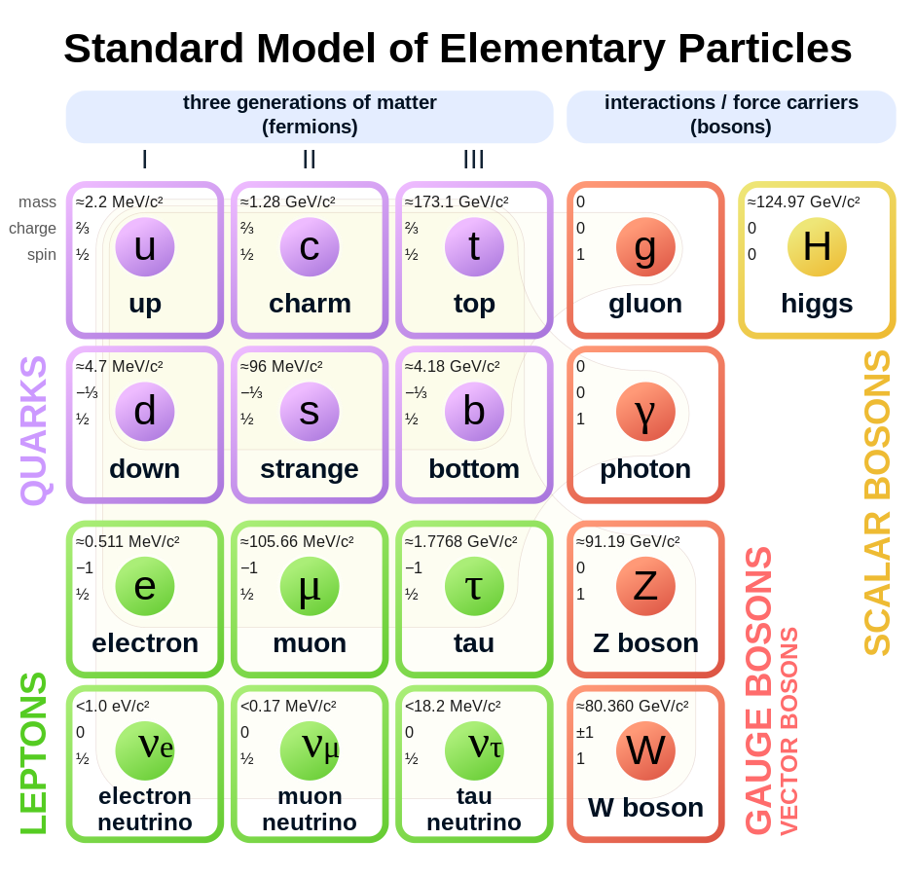
today
Each
quark
exists
in three
colors

Slide 3
What was known at the beginning of 1973 experimentally

Slide 4
and theoretically
Quantum electrodynamics: very successful but with shaky foundations.
Glashow, Weinberg model unifying electromagnetic and weak interactions, but essentially untested.
No theory of strong interactions, just
unsuccessfull attempt to formulate gauge theory of strong interactions on analogy with QED (Sakurai),
Unitary symmetry, (Eightfold Way), Gell-mann and Neeman
quark model (Zweig, MGM), but no observed quarks
analytic S-matrix (Chew),
parton model (Feynman), but no understanding why it works

Slide 5
Quantum
Electrodynamics

Slide 6
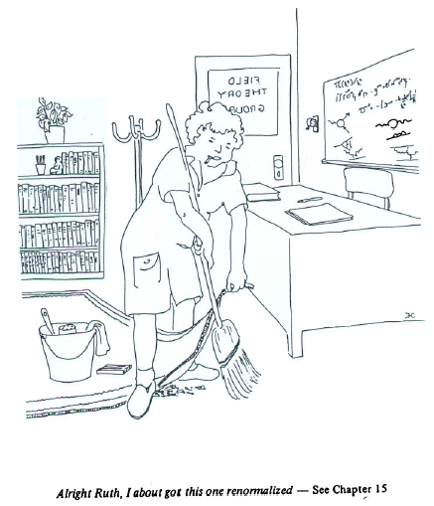
Premature burial of QFT
From Nambu’s book Quarks
The renormalization procedure, developed by Dyson, Feynman, Schwinger and Tomanaga was spectacularly successful in QED. However, the physical meaning of renormalization was not truly understood and the renormalization was rejected, among other theorists, for different reasons by Dirac and Landau.
The prevalent feeling was that
renormalization simply swept the infinities under the rug, but that they were still there.

Slide 7
Dirac on renormalization of QED in 1974
Hence most physicists are very satisfied with the situation. They say: “Quantum electrodynamics is a good theory, and we do not have to worry about it any more.”
I must say that I am very dissatisfied with the situation, because this so-called “good theory” does involve neglecting infinities which appear in its equations, neglecting them in an arbitrary way. This is just not sensible mathematics.
Sensible mathematics involves neglecting a quantity when it turns out to be small – not neglecting it just because it is infinitely great and you do not want it!
Of course, the proper inference from this work is that the basic equations are not right.There must be some drastic change introduced into them so that no infinities occur in the theory at all and so that we can carry out the solution of the equations sensibly, according to ordinary rules.
As we shall see Dirac critique does not apply to QCD, as
there are no genuine infinities there.

Slide 8
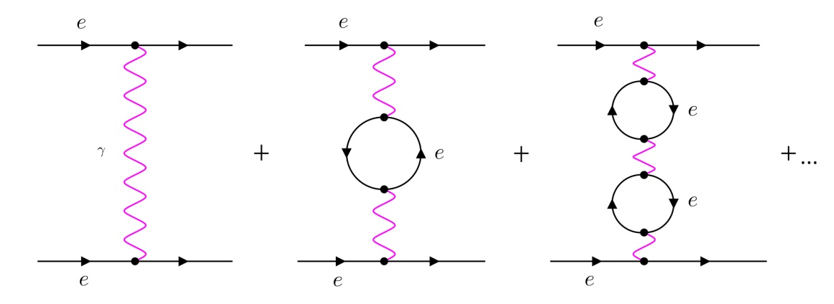
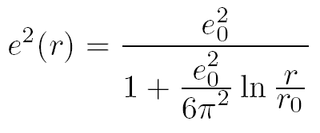
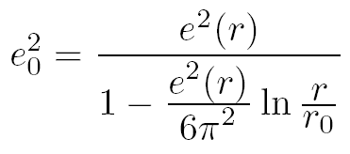
In middle 1950’s Landau and Pomeranchuk attempted to give the renorma-lization procedure in QED good physical meaning and mathematical sense. They put a finite “bare” electric charge e₀=e(r₀) on a sphere of radius r₀ , placed it in the QED vacuum and calculated how it appears at a finite distance r>r₀.
……….
bare charge
e₀ must be a function of the radius r₀!
Sending the radius of bare electron to zero and keeping the bare charge e₀ constant, the effective charge e²(r) vanishes for any fixed distance r! This is the problem of “zero charge”,
i.e. the QED vacuum screens the bare electric charge!

Slide 9
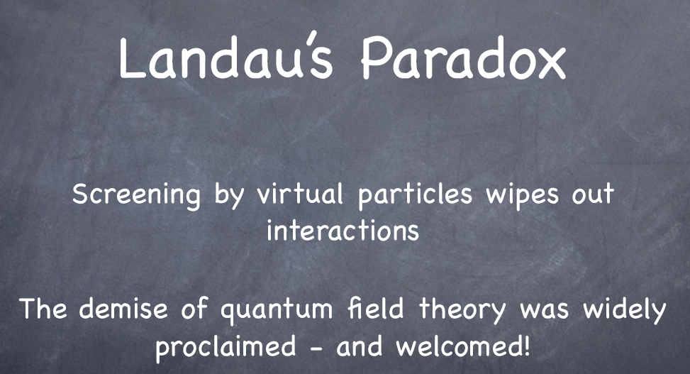
Frank Wilczek at EPS HEP Conference in Manchestru 2007:

Slide 10
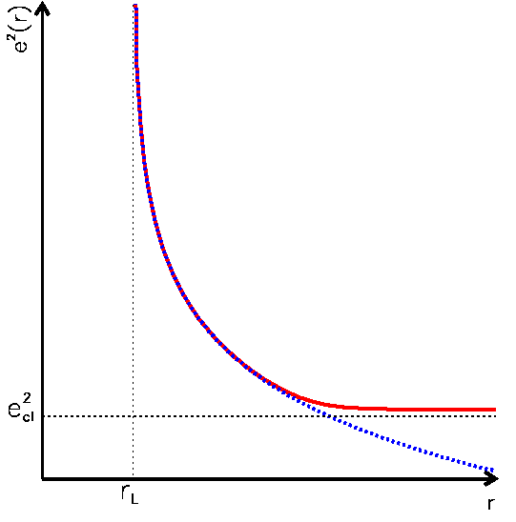
Landau pole in QED
Turning the argument around, they have asked how would the bare charge e₀=e(r₀) or rather α(r₀) have to depend on r₀ to yield a finite effective electric coupling α(r) at distance r when r₀ vanishes.
The second formula suggests that it would have to grow to infinity at finite distance r_{L} defining the so called “Landau pole”.
In fact, the problem with the renormalization procedure in QED is not the fact that bare electric charge diverges, but that it does so at a finite (though very small) distance!

Slide 11
Electroweak interactions

Slide 12
Masses of vector mesons
put in by hand
Glashow in Nobel Lecture: I wrote a notorious paper. I alleged that a softly-broken gauge theory, with symmetry breaking provided by explicit mass terms, was renormalizable. It was quickly shown that this is false.
We recently introduced the notion of partial-symmetry - invariance of only part of the Lagrange function under a group of infinitesimal transformations. The part of the Lagrange function bilinear in the field variables which produces masses of the elementary particles need not be invariant under a partial-symmetry. Corresponding "partial-conservation laws" become conservation laws only with the neglect of appropriate masses.
Ústav jaderné fyziky Řež

Slide 13
Glashow paper of 1961 contains SU(2)xU(1) Standard model in the sector of IVB, introduces the mixing angle absurdly called „Weinberg angle“, but without mechanism to generate masses of IVB.
In order to achieve a partially-symmetric theory of weak and electromagnetic interactions, we must go beyond the hypothesis of only a triplet of vector bosons and introduce an additional neutral vector boson Z₃
„Weinberg angle“
Had he listened to what Higgs told him in discussions or had Higgs realized that his mechanism to generate masses of vector bosons is just what Glashow needs, both could jointly formulate current SM already in 1964, 3 years before Weinberg.

Slide 14
Peter Higgs, My Life as a Boson
All of us, Brout, Englert and myself, had been going in the wrong direction, looking at hadron symmetries. After the Harvard seminar Shelley Glashow came up and said ‘that is a nice model, Peter’, but he did not see that it had anything to do with his work in 1960/61…. I missed hearing about it in 1960, or I might have thought of applying my ideas about spontaneous symmetry breaking to the electroweak interactions.
Sheldon Lee Glashow, Nobel Lecture, 8 December, 1979
In pursuit of renormalizability, I had worked diligently but I completely missed the boat. The gauge symmetry is an exact symmetry, but it is hidden. One must not put in mass terms by hand. The key to the problém is the idea of spontaneous symmetry breakdown: the work of Goldstone as extended to gauge theories by Higgs and Kibble in 1964. These workers never thought to apply their work on formal field theory to a phenomenologically relevant model. I had had many conversations with Goldstone and Higgs in 1960. Did I neglect to tell them about my SU (2)xU (1) model, or did they simply forget?

Slide 15

This note will describe a model in which the symmetry between the electromagnetic and weak interactions is spontaneously broken, but in which the Goldstone bosons are avoided by introducing the photon and the intermediate boson fields as gauge fields³. The model maybe renormalizable.
³P. W. Higgs, Phys. Letters 12, 132 (1964), Phys. Rev. Letters 13, 508 (1964);
F. Englert and R. Brout, Phys. Rev. Letters 13, 321 (1964);
G. S. Guralnik, C. R. Hagen, and T. W. B. Kibble, Phys. Rev. Letters 13, 585
¹A model similar to ours was discussed by S. Glashow, Nucl. Phys. 22, 579 (1961); the chief difference is that Glashow introduces symmetry-breaking terms into the Lagrangian, and therefore gets less definite predictions.
Clear prediction of neutral currents in neutrino electron scattering
$$ν_{μ}+e^{−}→ν_{μ}+e^{−}$$

Slide 16
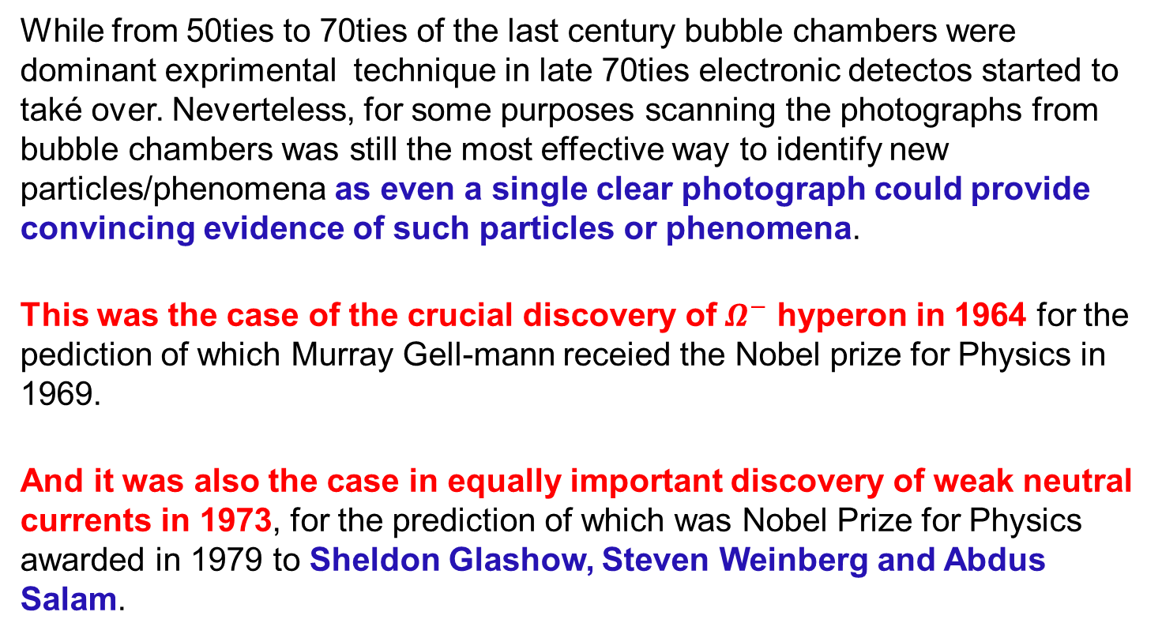
Power of old technique
While from 50ties to 70ties of the last century bubble chambers were dominant exprimental technique in late 70ties electronic detectos started to také over. Neverteless, for some purposes scanning the photographs from bubble chambers was still the most effective way to identify new particles/phenomena as even a single clear photograph could provide convincing evidence of such particles or phenomena.
This was the case of the crucial discovery of $Ω^{−}$ hyperon in 1964 for the pediction of which Murray Gell-mann receied the Nobel prize for Physics in 1969.
And it was also the case in equally important discovery of weak neutral currents in 1973, for the prediction of which was Nobel Prize for Physics awarded in 1979 to Sheldon Glashow, Steven Weinberg and Abdus Salam.

Slide 17
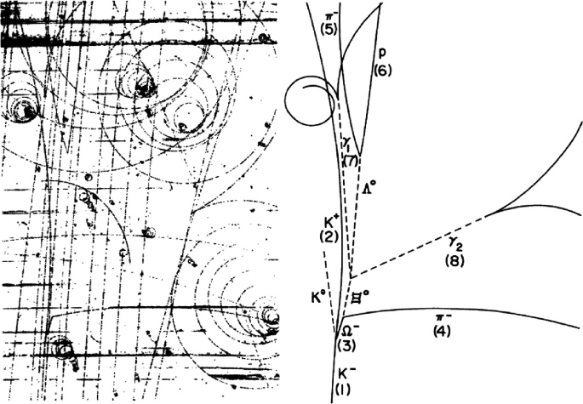
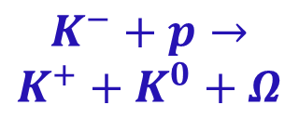
The first Ω− observed in bubble chamber experiment at Brookhaven on 31.1.1964
$$K^{−}+p→$$
$$K^{+}+K^{0}+Ω$$

Slide 18
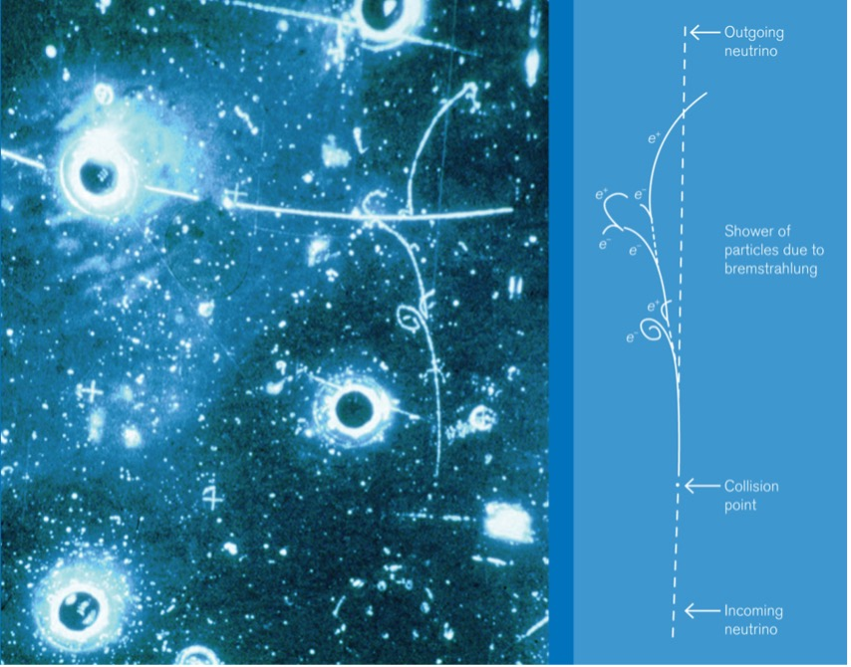
Half a century ago, a series of tiny tracks in a bubble chamber Gargamelle at CERN filled with freon changed the course of particle physics
The first leptonic neutral current event spotted with Gargamelle shows an incoming neutrino arriving from below where it then interacts with an electron. The interaction radiates photons and then produces electron–positron pairs.

Slide 19
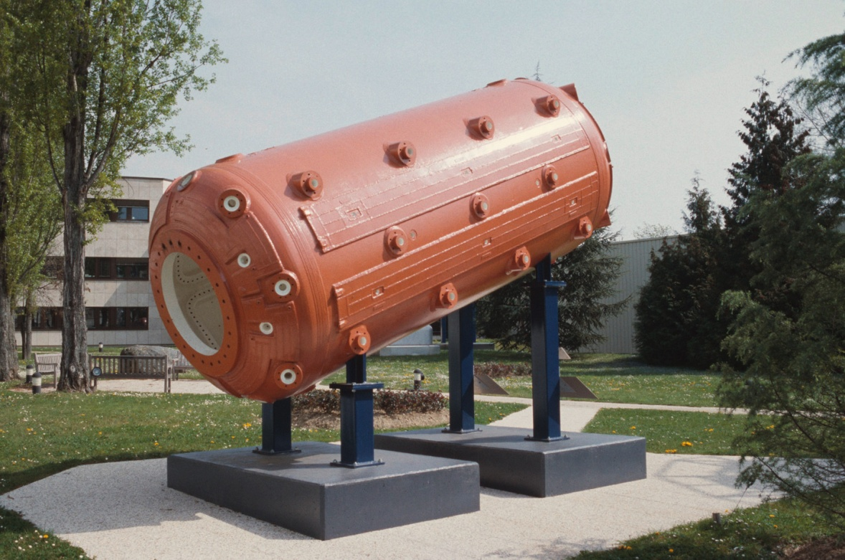
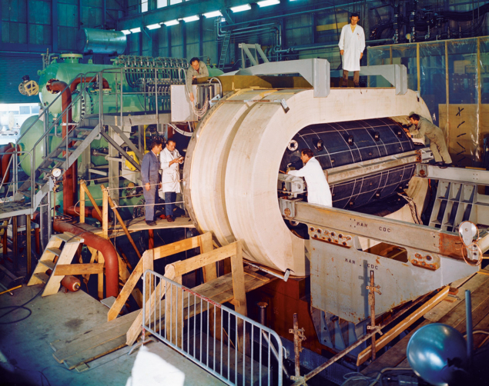
The observation of weak neutral currents, announced on 19 July 1973 by the Gargamelle collaboration, suggested that the electromagnetic and weak forces are facets of a more fundamental electroweak interaction.

Slide 20
This paper was shortly followed by a paper reporting observation of neutral
current events on hadrons, which are much more copious.

Slide 21
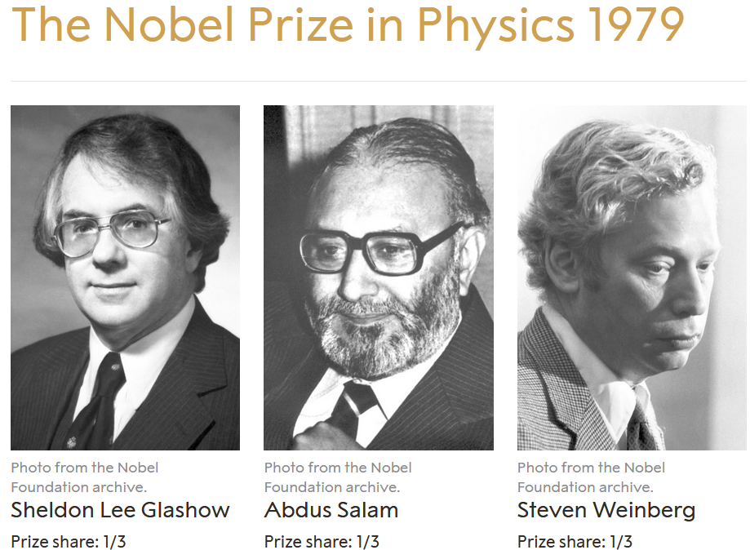
The Nobel Prize in Physics 1979 was awarded jointly to Sheldon Lee Glashow, Abdus Salam and Steven Weinberg for their contributions to the theory of the unified weak and electromagnetic interaction between elementary particles, including, inter alia, the prediction of the weak neutral current.

Slide 22
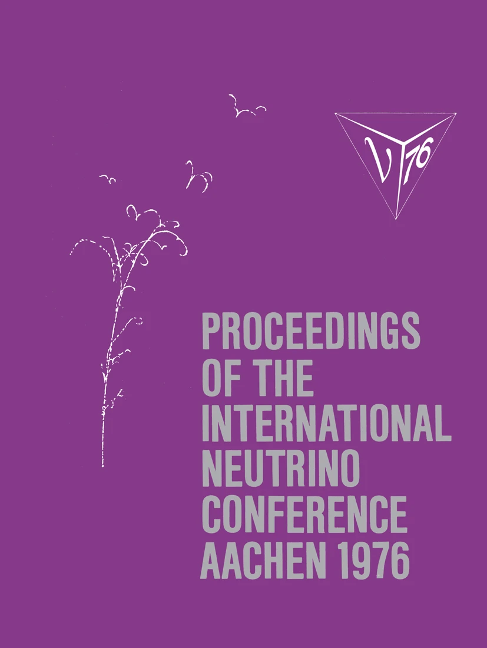
8 - 12 June
Preprint of March 1976
even before SPS was
officially commissioned
on June 17, 1976 .

Slide 23
CERN DG John Adams wasn’t happy that as soon as the SPS had been built, it should be converted it into a antiproton-proton collider. But he accepted the suggestion and following the Initial Cooling Experiment, which showed that the luminosity target was achievable with stochastic cooling, the SppS was approved in May 1978 and the construction of the Antiproton Accumulator (AA) by van der Meer began. The UA1 and UA2 experiments began hunting for the W and Z bosons in 1981.
Two years later, in a seminar on 20 January 1983 held in CERN’s Main Auditorium, Rubbia, spokesperson of the UA1 collaboration, revealed six candidate collision events for the W boson. The following afternoon, Luigi Di Lella of the UA2 collaboration presented four candidate W events and, on 25 January 1983, CERN delivered the news of the discovery of the new particle to the world.
The W boson discovery was followed a few months later by that of the Z boson, indirect evidence for which had been obtained a decade earlier at CERN’s Gargamelle bubble chamber.

Slide 24
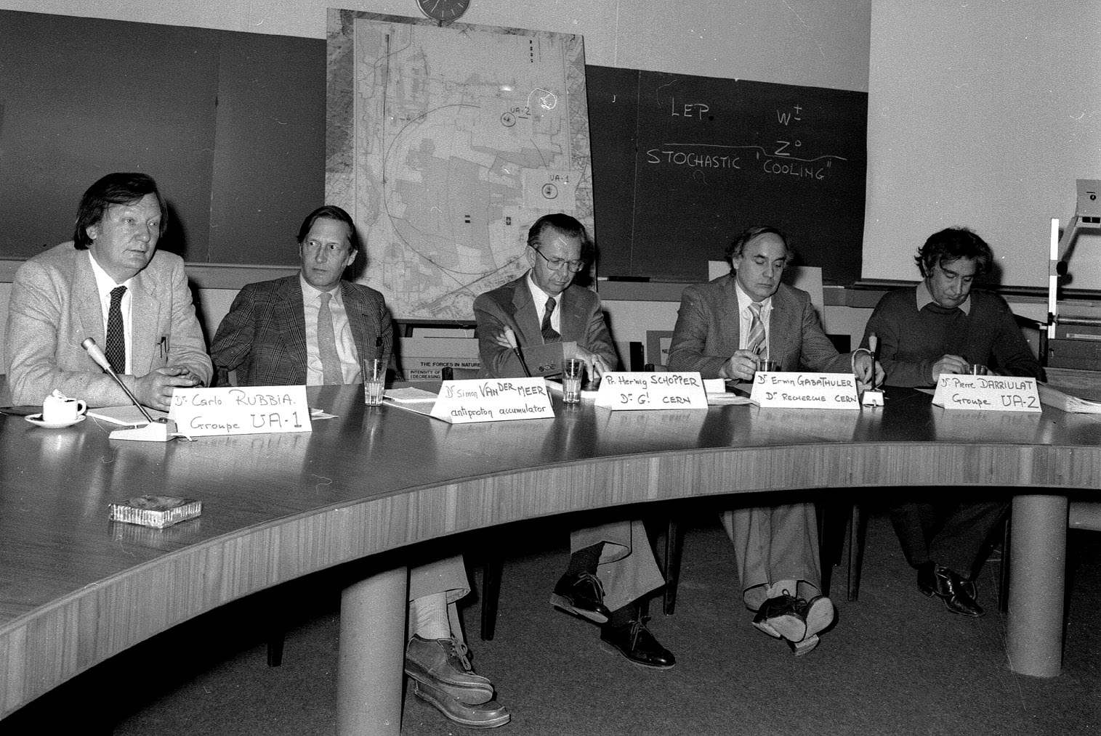
On 25 January 1983, CERN announced the discovery of the W boson. Left to right: Carlo Rubbia, Simon van der Meer, Herwig Schopper, Erwin Gabathuler, Pierre Darriulat

Slide 25
In both cases Drell-Yan production of dileptons: $q+\overline{q} →e^{±}$ $+ ν$

Slide 27


$$W^{+}→e^{+}+ν_{e}$$

Slide 29
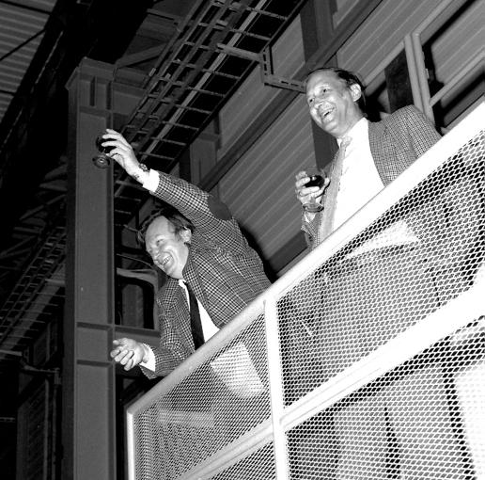
Second fastest Nobel
Prize in Physics, after
T.D.Lee and C.N. Yang
In 1957.
With Simon van der Meer, toasting the award to them both of the Nobel prize in October 1984.

Slide 30
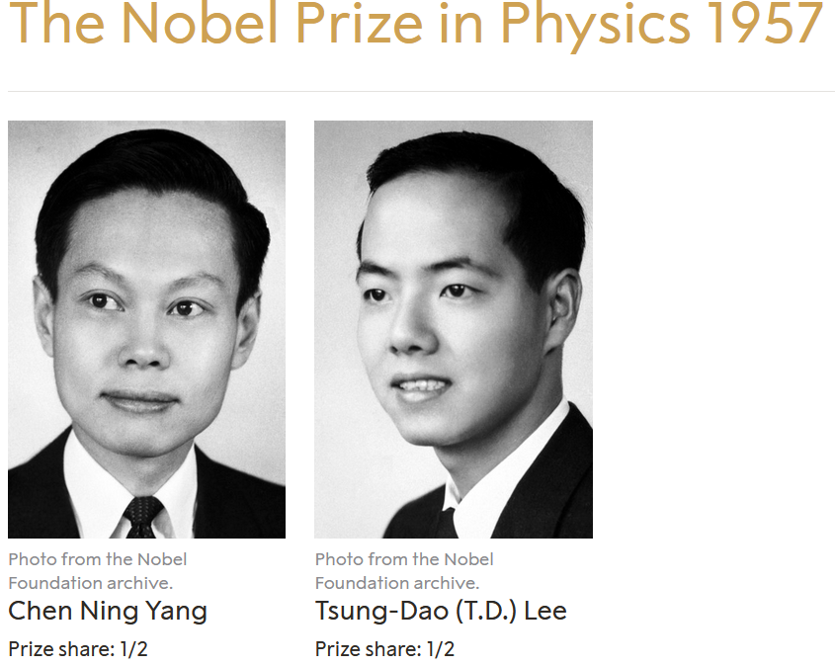
The Nobel Prize in Physics 1957 was awarded jointly to Chen Ning Yang and Tsung-Dao Lee "for their penetrating investigation of the so-called parity laws which has led to important discoveries regarding the elementary particles"
Without any nomination for NP in Physics for 1957

Slide 31
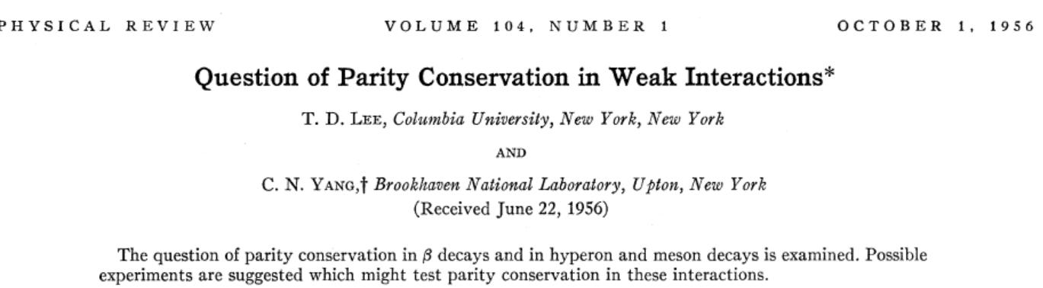
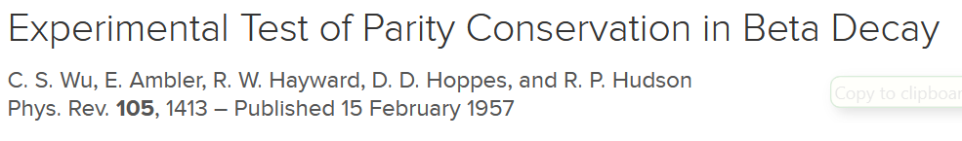
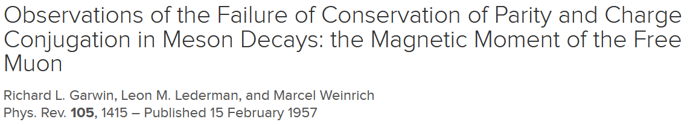
Problem for Nobel Committe: no experimentalist awarded NP

Slide 32
Road to asymptotic
freedom

Slide 33
What was known at the beginning of 1961 experimentally

Slide 34
General programme for strong interactions
Following Yang and Mills we require that the gauge transformations that are associated with the three “internal” conservation laws, baryon conservation, hypercharge conservation, and isospin conservation, be consistent with the local field concept that underlies the usual physical theories.
In analogy with electromagnetism there emerge three kinds of couplings such that in each case a massive vector field is coupled three kinds of couplings such that in each case a massive vector field is coupled linearly to the conserved current in question. Each of the three fundamental couplings is characterized by a single universal constant.
Precursor of Eightfold way, but with three separate couplings.

Slide 35
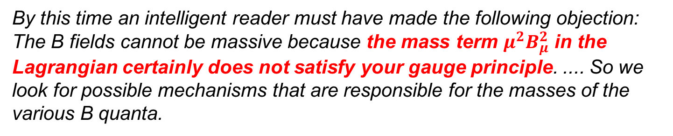
The paper appeared before any vector mesons were dicovered and
Sakurai clearly cared about the fact that vector mesons of gauge theory
should be massless.
By this time an intelligent reader must have made the following objection: The B fields cannot be massive because the mass term $μ^{2}B_{μ}^{2}$ in the Lagrangian certainly does not satisfy your gauge principle. .... So we look for possible mechanisms that are responsible for the masses of the various B quanta.
Several critics of our theory have suggested that, since we are not likely to succeed in solving the mass problem, we might as well take (6)-(8) with massive B fields as the starting point of the theory, forgetting about, the possible connection with the gauge principle. This attitude is satisfactory for all practical purposes. However, the author believes that in any theory every effort should be made to justify the fundamental couplings on a priori theoretical grounds.

Slide 36
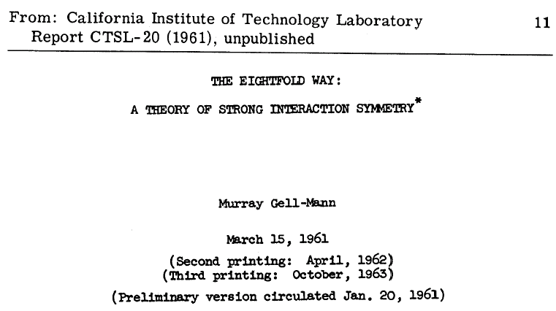
Eightfold way of M. Gell-Mann
is remarkable for its clear formulation of extension of Yang-Mills theory to SU(3) group.
but has never been published as MGM did withdraw it because he feared
that It might be wrong.

Slide 37
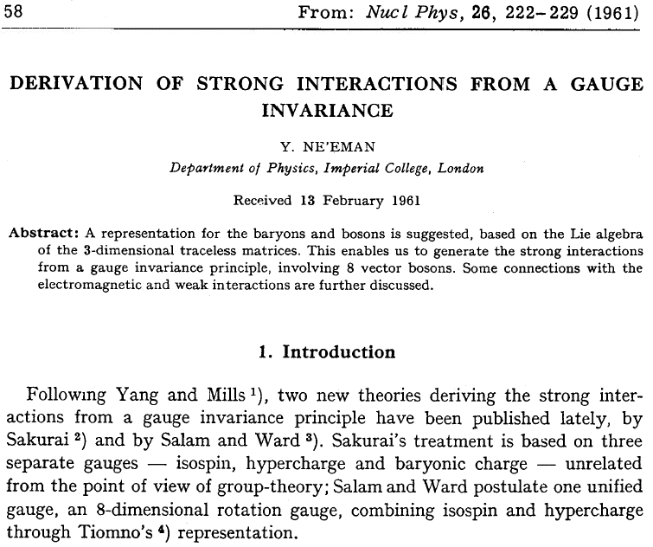
Eightfod Way according to Y. Neeman

Slide 38
Blind avenue: S-matrix and bootstrap
From G. Chew: S-Matrix Theory, (W.A. Benjamin Inc, 1963).
I believe the conventional association of fields with strong interacting particles to be empty. It seems to me that no aspect of strong interactions has been clarified by the field concept. Whatever success theory has achieved in this area is based on the unitarity of the analytically continued S-matrix plus symmetry principles.
I do not wish to assert (as does Landau) that conventional field theory is necessarily wrong, but only that it is sterile with respect to the strong interactions and that, like an old soldier, it is destined not to die but just to fade away… The notion, inherent in conventional Lagrangian field theory, that certain particles are fundamental while others are complex, is becoming less and less palatable …
On this point close to opinion of Gell-Mann

Slide 39
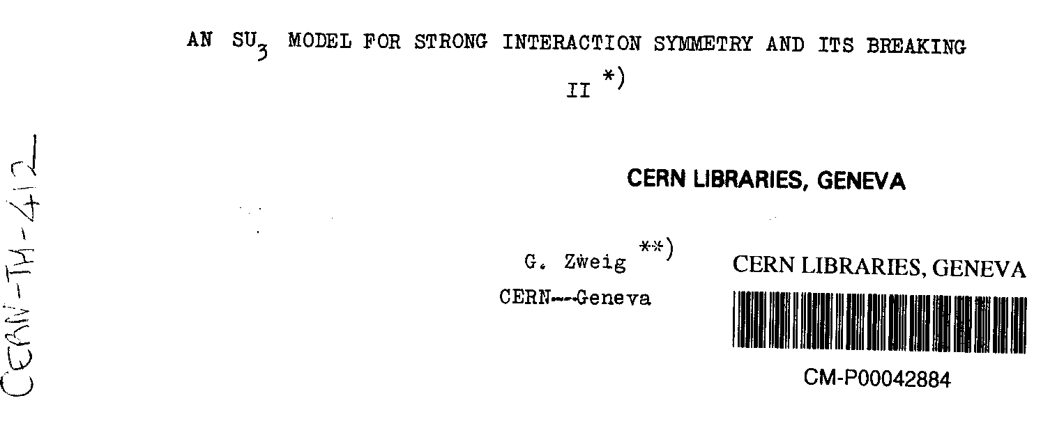
Quark model according to Zweig

Slide 40
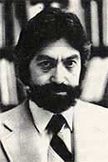
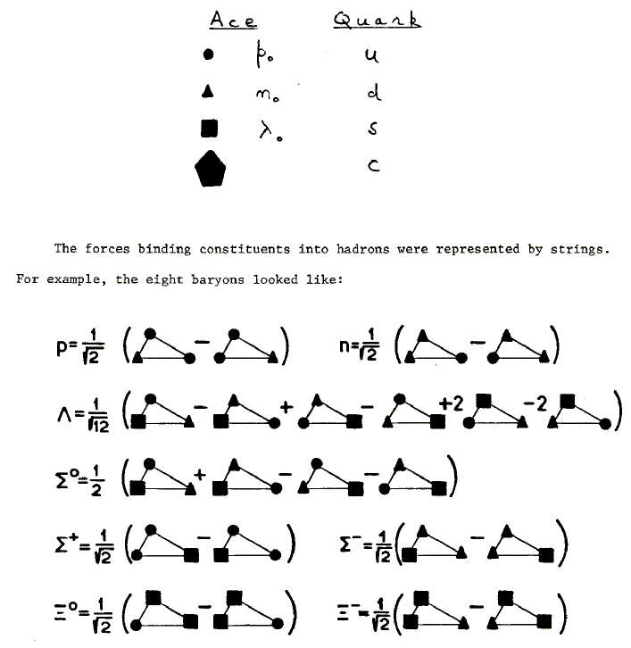
Both mesons and baryons are constructed from a set of three fundamental particles, called aces.
Each ace carries baryon number 1/3 and is fractionally charged.
SU(3) is adopted as a higher symmetry for the strong interactions.
Extensive space-time and group theoretic structure is then predicted for both mesons and baryons …
An experimental search for the aces is suggested.

Slide 41
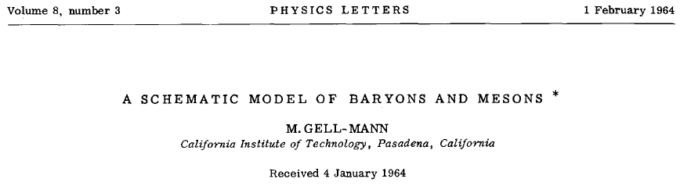
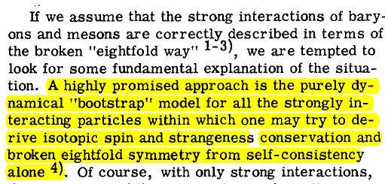
Quark model according to Gell-Mann
Typical MGM: It may by this way

Slide 42
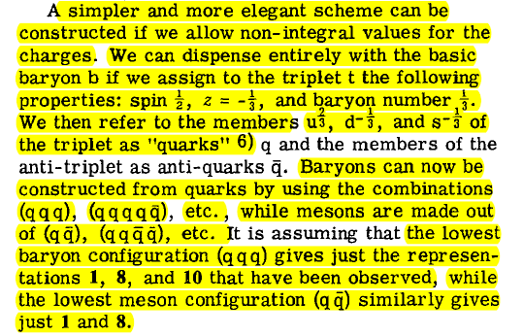
or this way

Slide 43
The concept of colored quarks
has been introduced in late 1964 primarily in order to explain the apparent problem of quark statistics implied by the success of SU(6) symmetric quark model. To reconcile this model with Pauli principle Greenberg proposed to interpret quarks as parafermions of rank 3.
It soon became clear that this assumption is equivalent to assigning to each quark flavor another internal quantum number, which could take three different values and which, following Pais’ suggestion at 1965 Erice Summer School, has been called color.

Slide 44
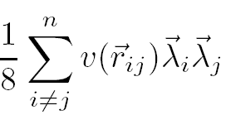
While for most of theorists color was introduced to solve the quark statistics problem
Nambu had used it since early 1965 as a dynamical variable generating the force between quarks, assuming furthermore that the force between colored quarks is due to the exchange of octet of colored gauge bosons, which induce the effective four quark coupling of the type
and lead to (potentially infinite) gap between colorless and colored states.
In this way his model contained all essential elements of QCD, except that it was not Quantum Field Theory.

Slide 45
Gell-Mann on quarks in summer 1967
The idea that mesons and baryons are made primarily of quarks is difficult to believe, since we know that, in the sense of dispersion theory, they are mostly, if not entirely, made up out of one another. The probability that a meson consists of a real quark pair rather than two mesons or a baryon and antibaryon must be quite small. Thus it seems to me that whether or not real quarks exist, the q or q we have been talking about are mathematical entities ......
If the mesons and baryons are made of mathematical quarks, then the quark model may perfectly well be compatible with bootstrap hypothesis, that hadrons are made up out of one another.
This documents that Chew had great influence of Gell-Man.

Slide 46
Even in 1972 quarks were still not taken seriously
In Summer 1972 Gell-Mann and Fritzsch presented their view
at XVI ICHEP in Chicago in a contribution called
Current Algebra: Quarks and What Else?
We assume here that quarks do not have real counterparts that are detectable in isolation in the laboratory – they are supposed to be permanently bound inside mesons and baryons ...
It might be a convenience to abstract quark operators themselves, or other non–singlets with respect to color, …, but it is not a necessity.
It may not even be much of a convenience since we would .... be discussing a fictitious spectrum for each fictitious sector of Hilbert space, and we probably don’t want to load ourselves with so much spurious information.

Slide 47
Their hope that
We might eventually abstract from the quark vector–gluon field theory model enough algebraic information about the color singlet operators in the model to describe all the degrees of freedom that are present.
and thus
We would have a complete theory of the hadrons and their currents, and we need never mention any operators other than color singlets.
has not been born out by further theoretical developments and experimental results, in particular those on
heavy quarkonia spectra and
jet phenomena
which require that we treat quarks and gluons in the same way as leptons and basically forget about confinement.

Slide 48
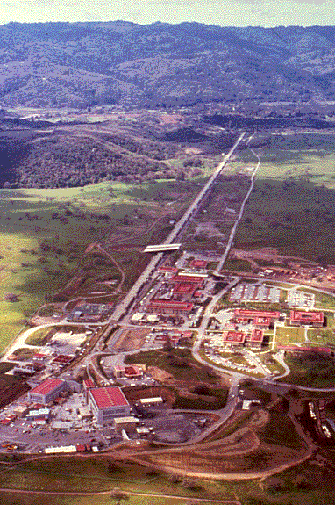
(UN)pleasant
surprize at SLAC
Since 1968 experiments using linear accelerator at SLAC investigated inelastic collisions of electrons with protons which were expected to have similar features as elastic ones measured at smaller accelarator earlied, but which led to quite unexpected results.
5 km

Slide 49
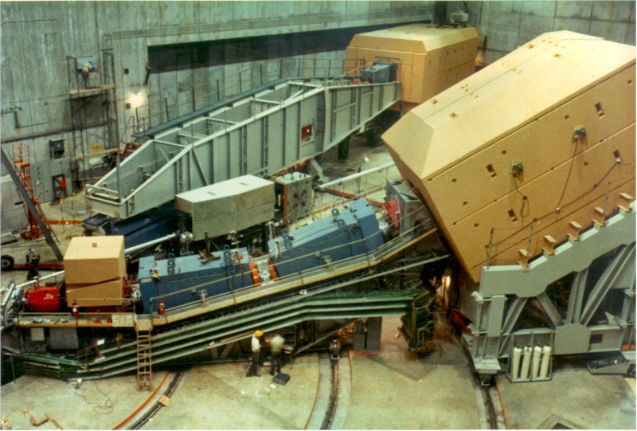
Two arms spectrometer at SLAC
Enlarged Rutherford experiment

Slide 50
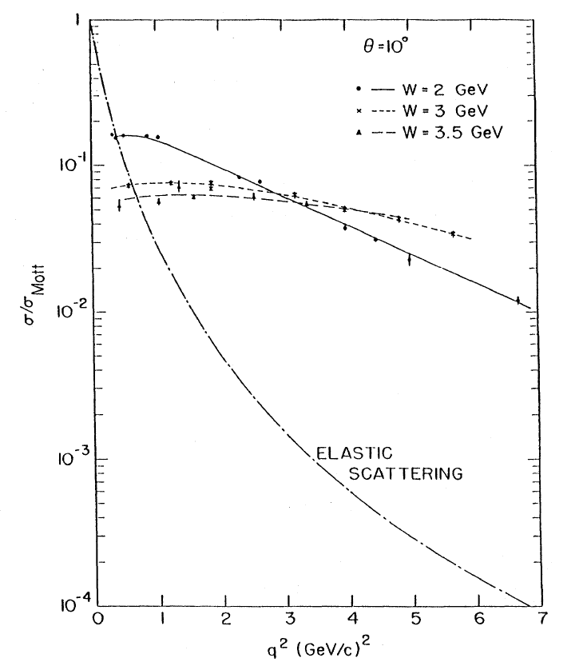
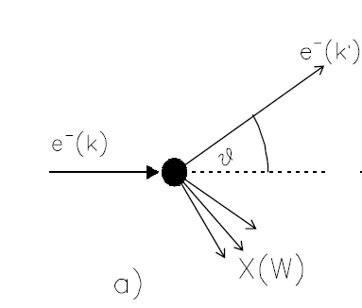


What was measured
at SLAC?

Slide 51
Experimenty at SLAC showed that in deep inelastic collisions proton behaves as a beam of almost noninteracting point-like particles with spin ½.
For explanation of this behaviour Feynman formulated parton model, in which partons were related to but not identical with Zweig quarks.
Space-time description of scattering process according parton
model of Feynman
The incoming electron scatters on a single parton, while the remaining diquark flies unperturbed on, until the forces of confinement, acting between them at distances larger than about 1 fm, cause their conversion into observable hadrons.

Slide 52
But parton model had two serious problems
How to reconcile parton model with the experimental fact that
quarks/partons could not be found as free particles.
Is the phenomenon of scaling compatible with the quark model?
Many theorists, like Bjorken expected the data on deep inelastic electron-proton scattering to rule out the quark model! Just as the first experiment at SLAC started data taking, Bjorken closed his talk at the International Sympo-sium on Electron and Photon Interactions in September 1967 with the words:
But the indication is that there does not yet seem to be any large cross sections which this model of point-like constituents suggests. Additional data is necessary and very welcome in order to completely destroy the picture of elementary constituents.
In such situation David Gross attempted to destroy Quantum Field Theory as a basic tool for describing microworld, BUT FAILED.

Slide 53
D. Gross: QFT must be destroyed!
David J. Gross: Twenty Five Years of Asymptotic Freedom
The emergence of QCD is a wonderful example of the evolution from farce to triumph. During a very short period, a transition occurred from experimental discovery and theoretical confusion to theoretical triumph and experimental confirmation.
By the end of 1972, I had learned enough field theory, especially renormalization group methods from Ken Wilson, to tackle the problem of scaling head on. I decided, quite deliberately, to prove that local field theory could not explain the experimental fact of scaling and thus was not an appropriate framework for the description of the strong interactions. Thus, deep inelastic scattering would finally settle the issue as to the validity of quantum field theory. The plan of the attack was twofold.
First, I would prove that “ultraviolet stability,” the vanishing of the efective coupling at short distances, later called asymptotic freedom, was necessary to explain scaling.

Slide 54
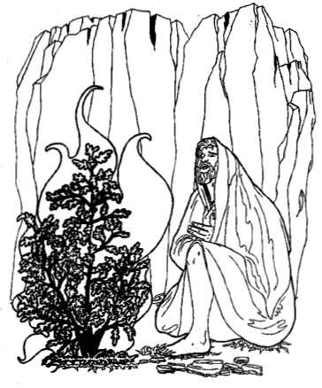
Second, I would show that there existed no asymptotically free field theories. The latter was to be expected. After all the paradigm of quantum field theory –QED- was infrared stable; in other words, the efective charge grew larger at short distances and no one had ever constructed a theory in which the opposite occurred
Together with Frank Wilczek they succeeded in the first step, but failed in the second because nonabelian gauge theories have turned out to be (under certain circumstances) asymptotically free!
D. Gross: For me the discovery of asymptotic freedom was totally unexpected. Like an atheist who has just received a message from a burning bush, I became an immediate true believer. Field theory was not wrong, instead scaling must be explained by an asymptotically free gauge theory of the strong interactions.

Slide 55
Exodus Chapter 3
The burning bush (or the unburnt bush) refers to an event recorded in the Jewish Torah (as also in the biblical Old Testament). It is described in the third chapter of the Book of Exodus as having occurred on Mount Horeb. According to the biblical account, the bush was on fire, but was not consumed by the flames, hence the name. In the biblical narrative, the burning bush is the location at which Moses was appointed by Yahweh to lead the Israelites out of Egypt and into Canaan.
The text portrays Yahweh as telling Moses that he is sending him to the Pharaoh in order to bring the Israelites out of Egypt, an action that Yahweh is described as having decided upon as a result of noticing that the Israelites were being oppressed by the Egyptians.
Despite the signs, Moses is described as being very reluctant to take on the role, arguing that he lacked eloquence, and that someone else should be sent instead.

Slide 56
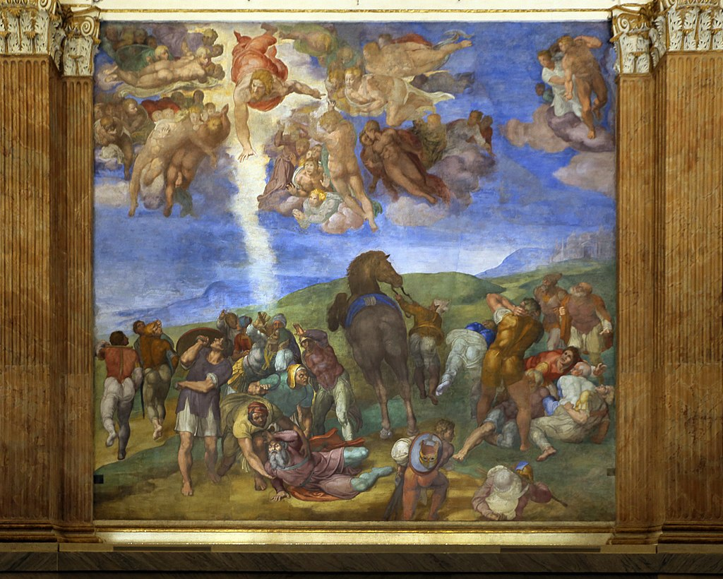
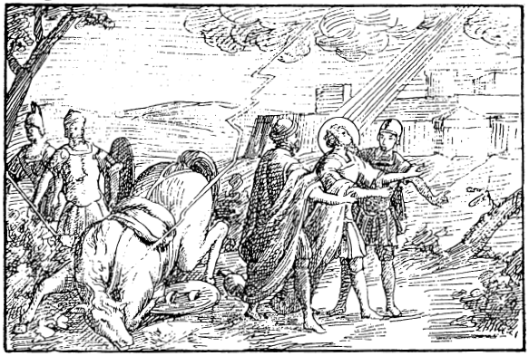
Much better analogy: conversion of Saul of Taurus to St. Paul.

Slide 57
New Testament, Acts of the Apostles
Acts 22:6–21
While I was on my way and approaching Damascus, about noon a great light from heaven suddenly shone about me. ⁷I fell to the ground and heard a voice saying to me,
‘Saul, Saul, why are you persecuting me?’
I answered,
‘Who are you, Lord?’
Then he said to me,
‘I am Jesus of Nazareth whom you are persecuting.
Now those who were with me saw the light but did not hear the voice of the one who was speaking to me.I asked,
‘What am I to do, Lord?’
The Lord said to me,
‘Get up and go to Damascus; there you will be told everything that has been assigned to you to do.’
Since I could not see because of the brightness of that light, those who were with me took my hand and led me to Damascus. ¹²“A certain Ananias, who was a devout man according to the law and well spoken of by all the Jews living there,came to me; and standing beside me, he said, ‘Brother Saul, regain your sight!’ In that very hour I regained my sight and saw him. ¹

Slide 58
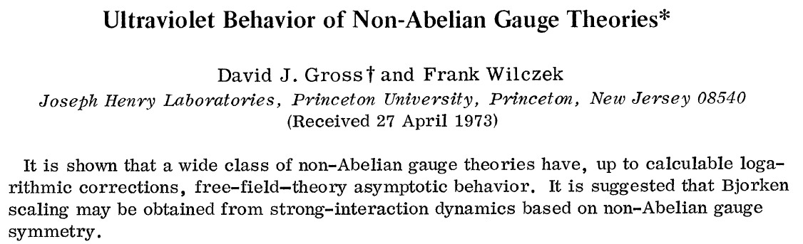
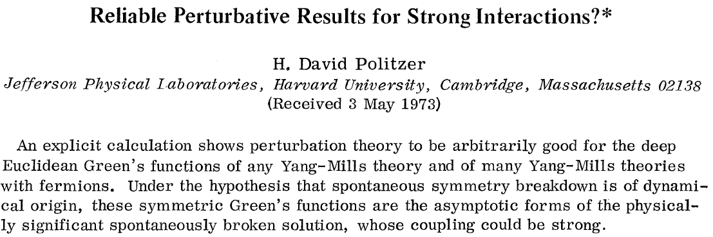
Asymptotic freedom had been discovered in these two papers

Slide 59
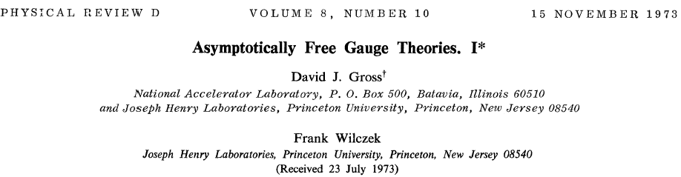
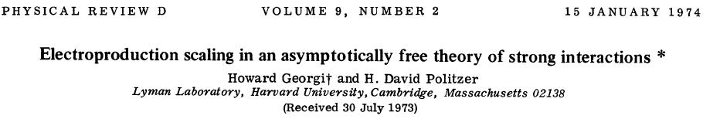
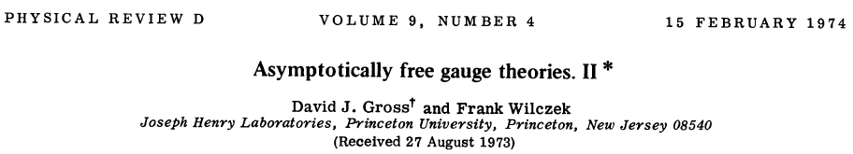
shortly followed by three papers containing complete formulation of QCD, together with elaboration of its application to DIS.
All these papers existed as preprints by the date of their submissions and thus
months before the submission of the paper which is often, but incorrectly,
credited with the formulation of QCD.

Slide 60
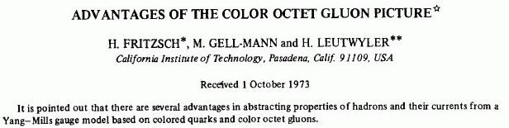
A fourth apparent advantage of the color octet gluon scheme has recently been demonstrated ……the behavior of light cone commutators comes closer to scaling behavior than in the color singlet vector gluon case. However, actual Bjorken scaling does not occur…..
For us, the result that the color octet field theory model comes closer to asymptotic scaling than the color singlet model is interesting, but not necessarily conclusive, since we conjecture that there may be a modification at high frequencies that produces true asymptotic scaling.
They missed the essence of the meaning of asymprotic freedom!!!

Slide 61
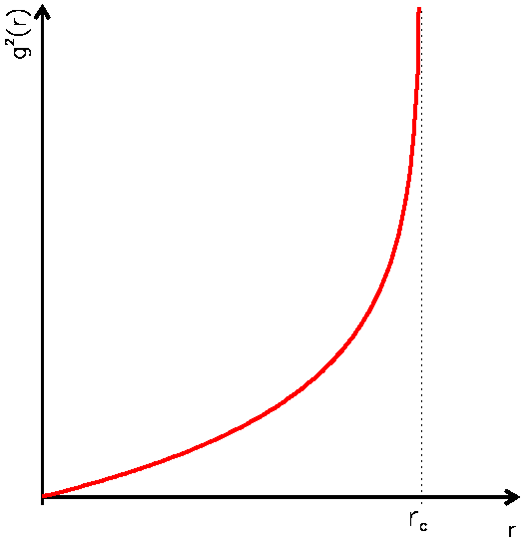
Physical meaning of
aymptotic freedom:
antiscreening.
Divergence here is no
problem, it only means that
perturbation theory is not
applicable at large distances.
Moreover, at large distances
perturbation expansions are
hugely ambigous.

Slide 62
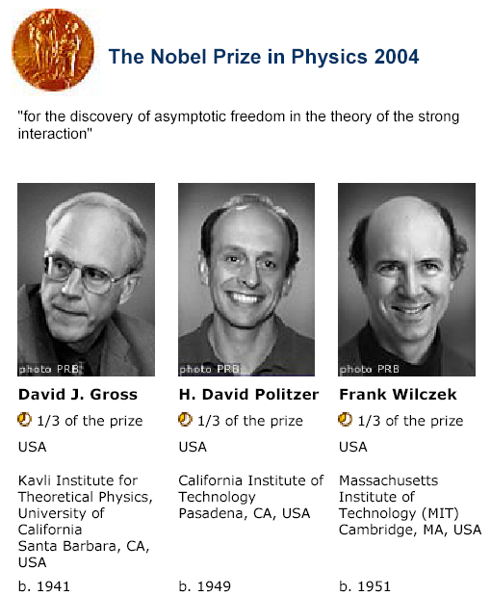

Slide 63

People knowing without understanding
G. ‘t Hooft: When was asymptotic freedom discovered? hep-th/9808154
I knew about the beautiful scaling behaviour of non-Abelian gauge theories. Suspecting that this feature should be known by now by the experts on the subject of scaling, I did not speak up louder. Veltman … warned me that no-one would take such an idea seriously as long as it could not be explained why quarks cannot be isolated one from another.
In June, 1972, at small meeting in Marseille. I announced my finding that the coefficient determining the running of the coupling strength for non-Abelian gauge theories is negative and wrote down on the black board
Symanzik was surprised and skeptical. “If this is true, it will be very important, and you should publish this result quickly, and if you won’t, somebody else will,” he said. I did not follow his advice.

Slide 64
We should not forget that
50+50=100

Slide 65
Final nail into the coffin of efforts to reconcile classical picture of continuous radiation with Bohr quantization conditions.

Slide 66
Backup

Slide 67
We have observed, in a fiducial volume of 3 m³, 102 NC, 428 CC and 15 AS in the neutrino run and 64 NC, 148 CC and 12 AS in the antineutrino run.
Our best estimates of the NC/CC ratios are

Slide 68
What was known at the end of 1984 experimentally

Slide 69
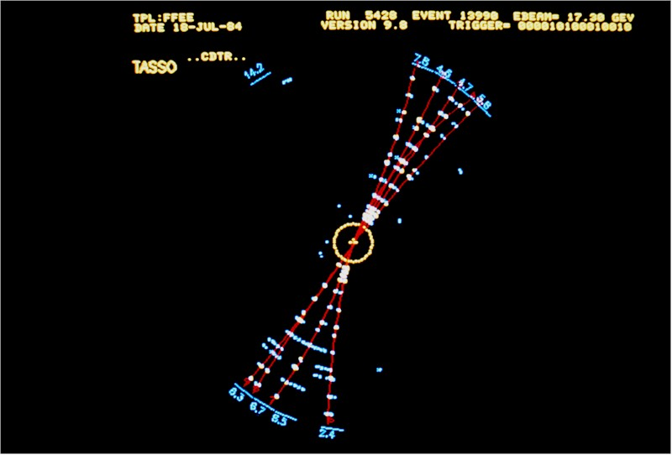
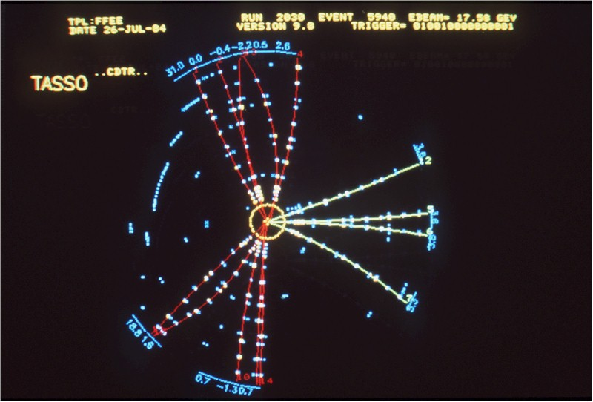
Shortly afterwards further important discoveries followed
1974: J/psi et al., i.e. charmed quark
1975: tau lepton
1977: Upsilon et al., i.e. bottom quark followed
1984: gluon observed
First gluon jet in experiment TASSO at DESY

Slide 70
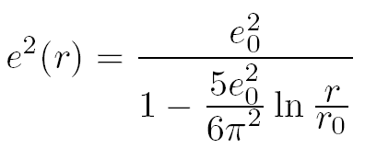
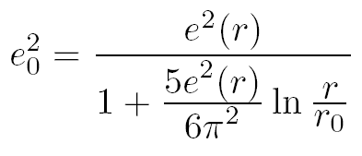
People knowing without understanding
Perhaps the first who observed this behaviour of a coupling constant were V. S. Vanyashin and M. V. Terentev in 1965.
Studying the effects of vacuum polarization due to loops of charged vector bosons on the renormalized electric charge they found the expression
and noted that these loops give the opposite sign that those of fermion loops in standard QED, but they attributed this result to the fact that the theory with charged vector bosons coupled to photons is not renormalizable.

