Slide 1

TOP kvark 20 let
a po té…..

Slide 2
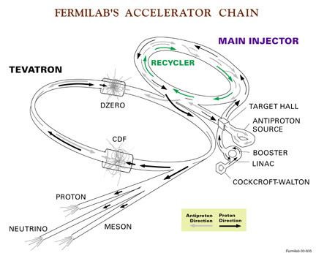
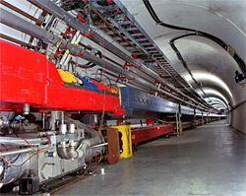
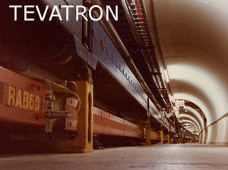
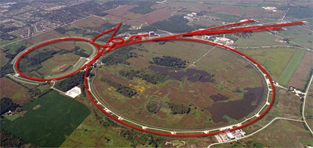

Slide 3
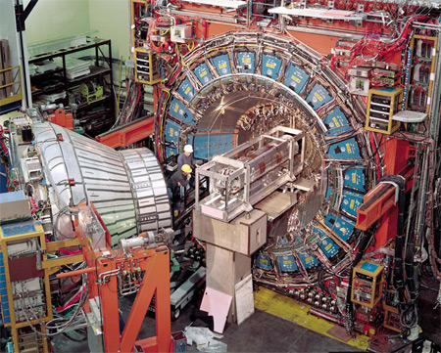
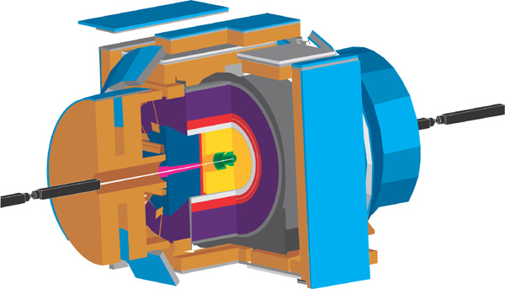
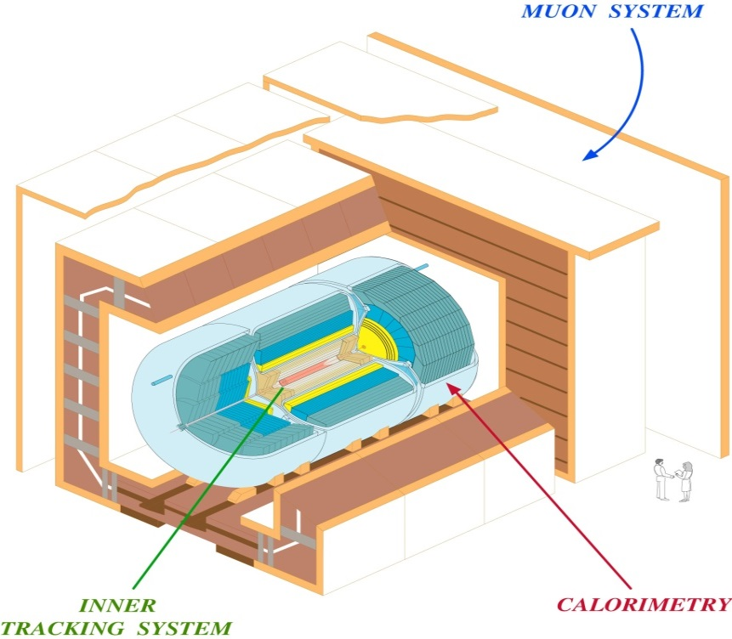
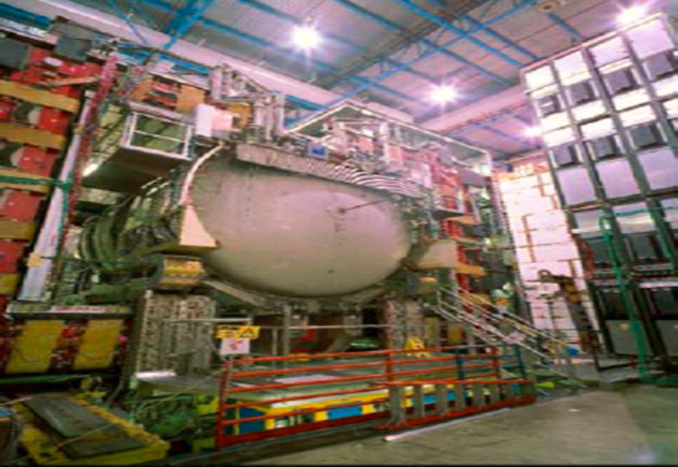

CDF

Slide 4
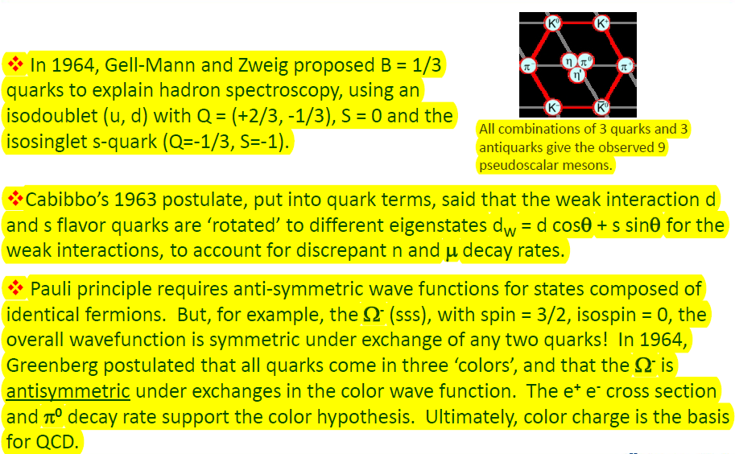

Slide 5
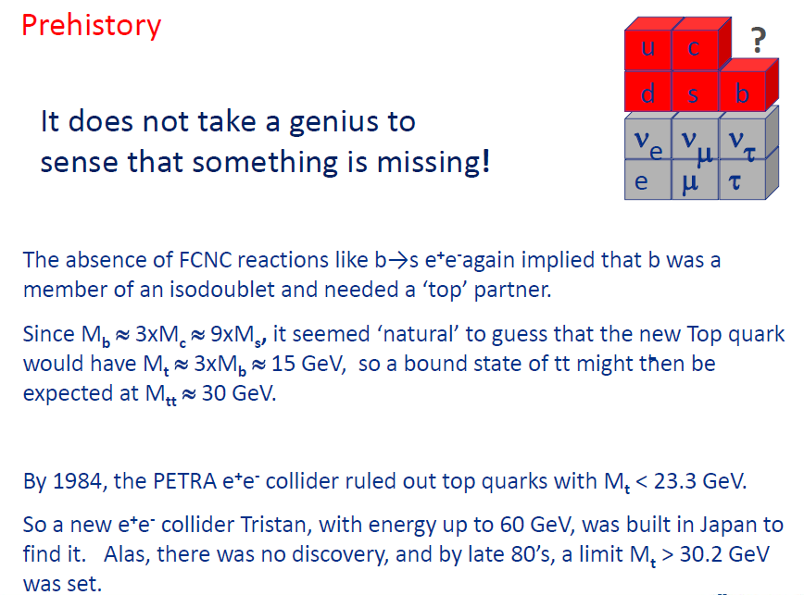

Slide 6
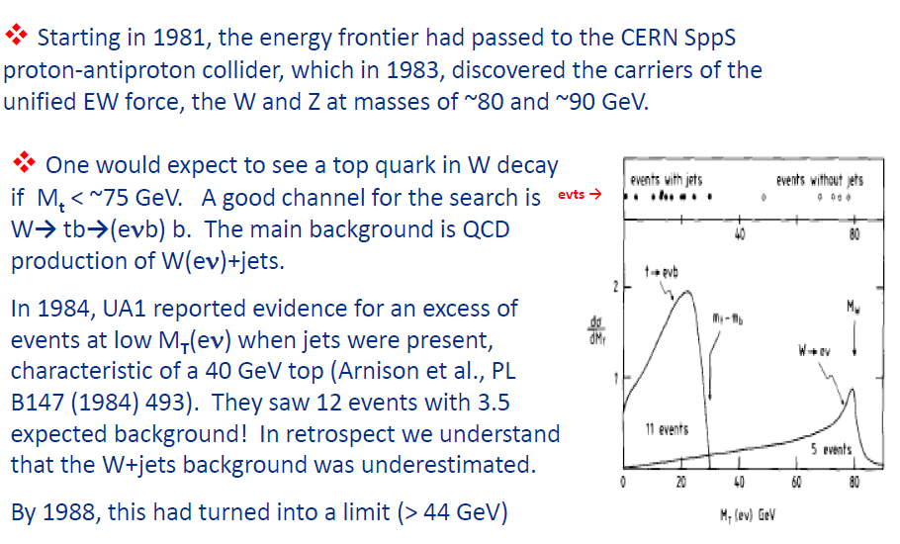

Slide 7
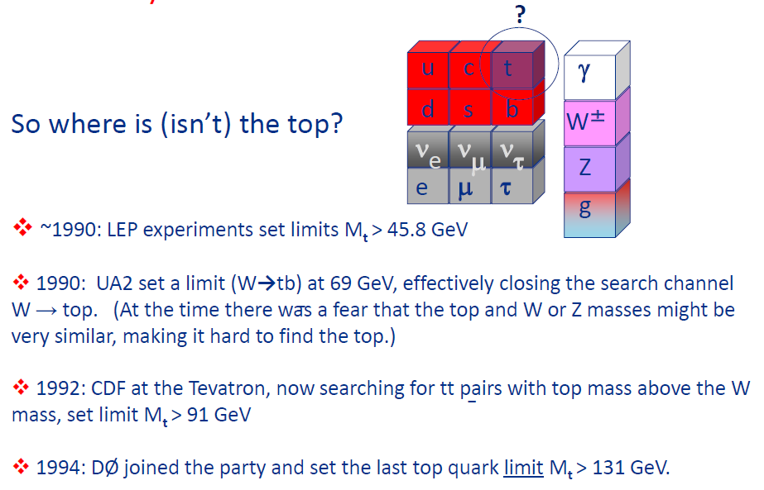

Slide 8
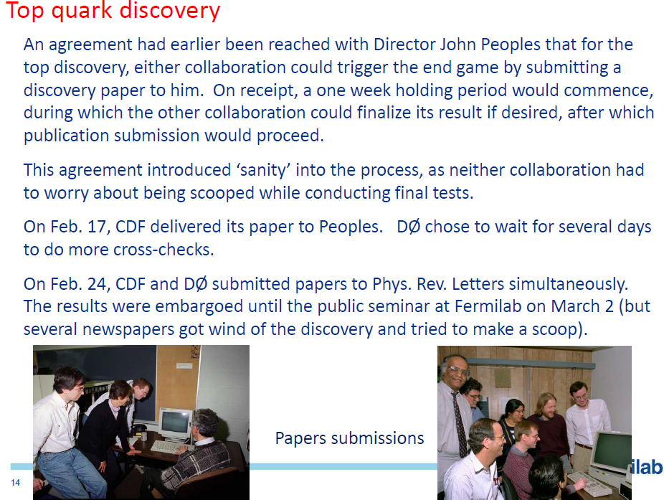

Slide 9
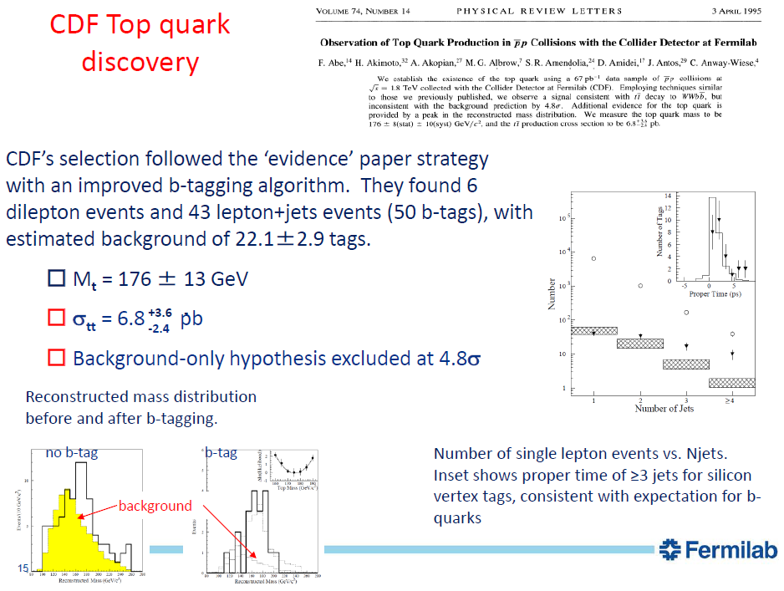

Slide 10
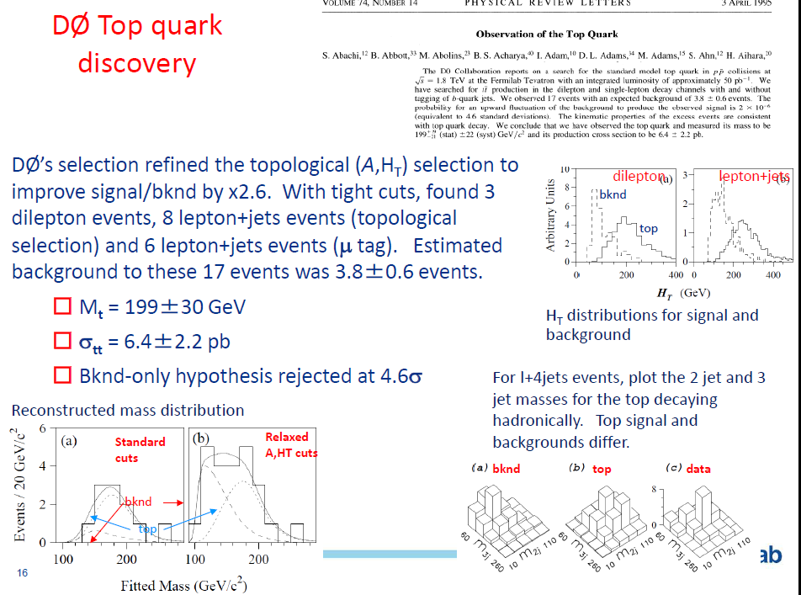

Slide 11
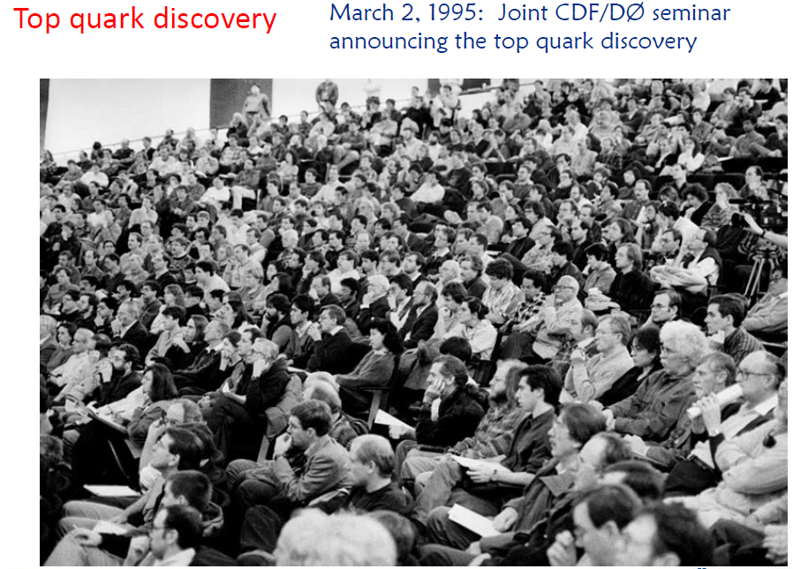

Slide 12
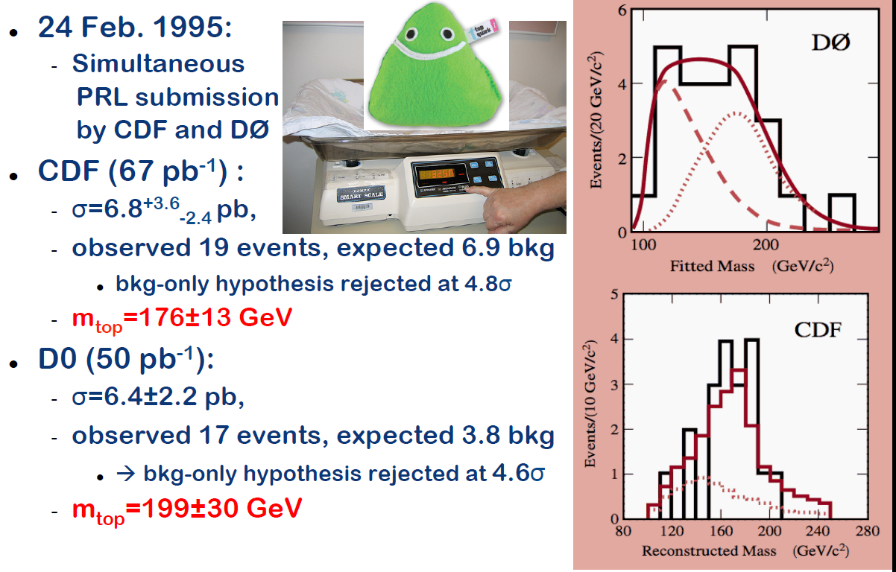

Slide 13
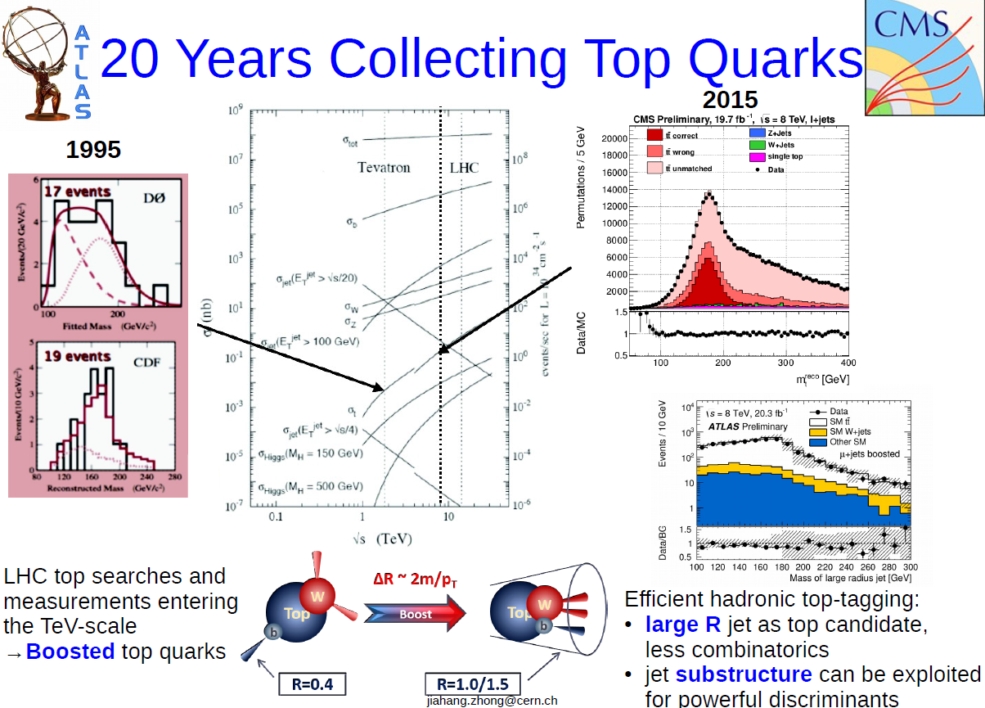

Slide 14

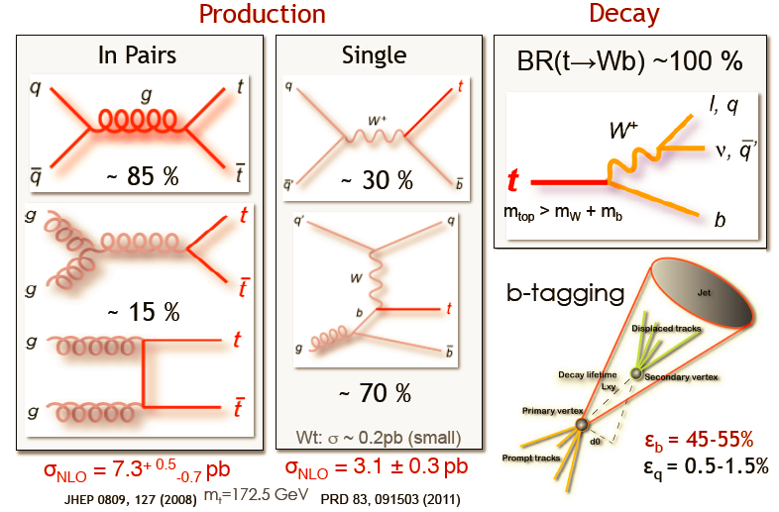

Slide 15
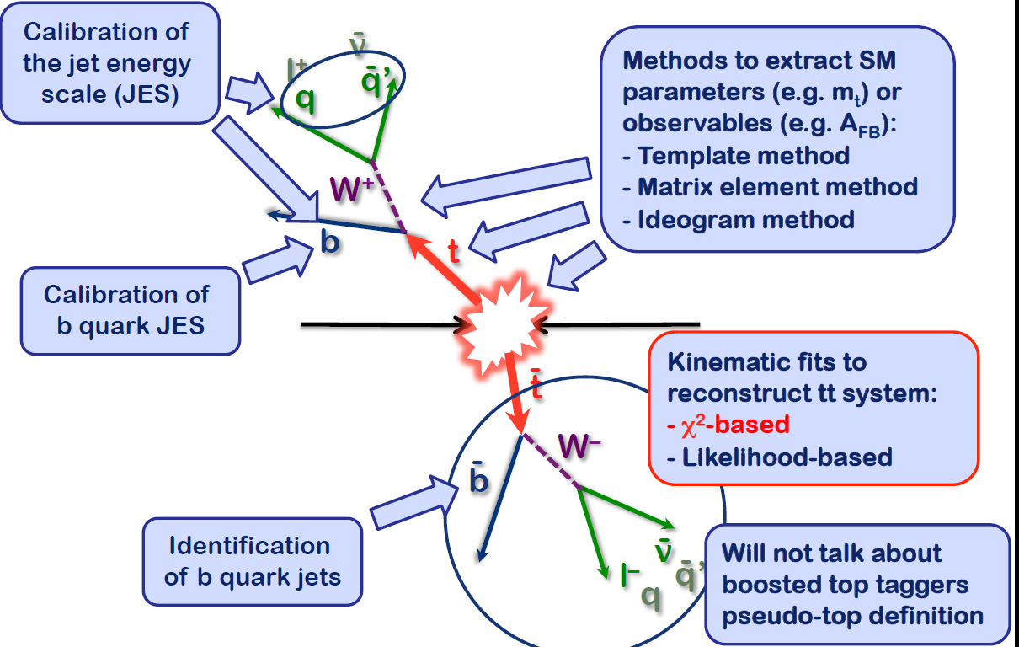

Slide 16
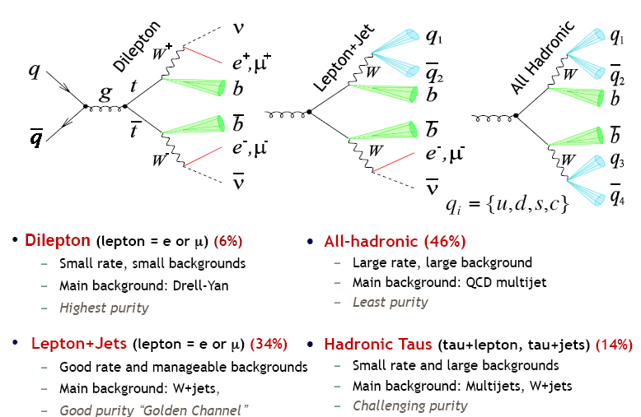

Slide 17
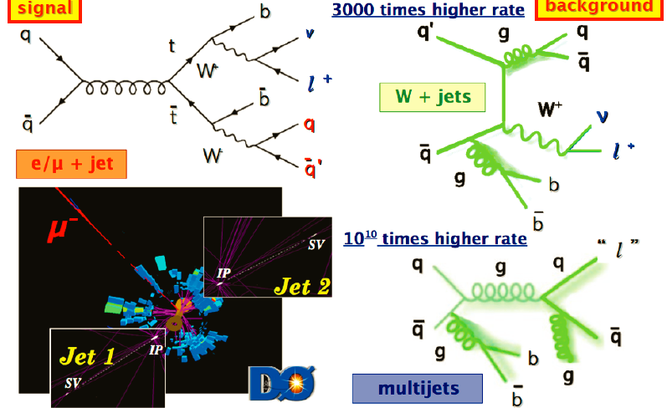

Slide 18
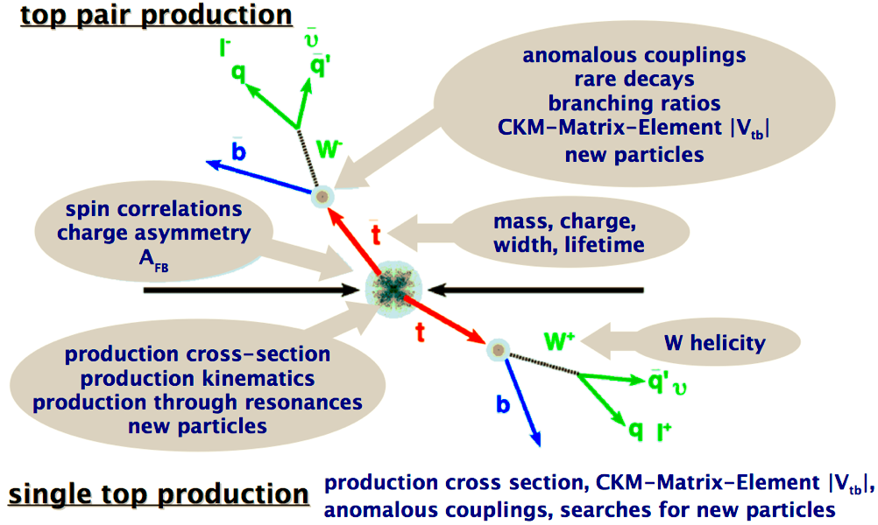
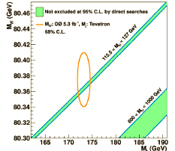

Slide 19
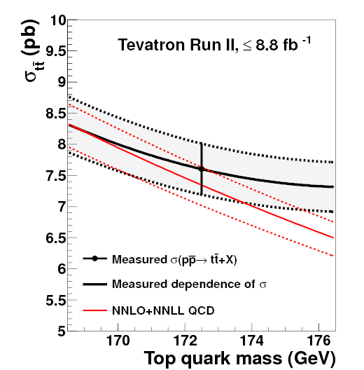
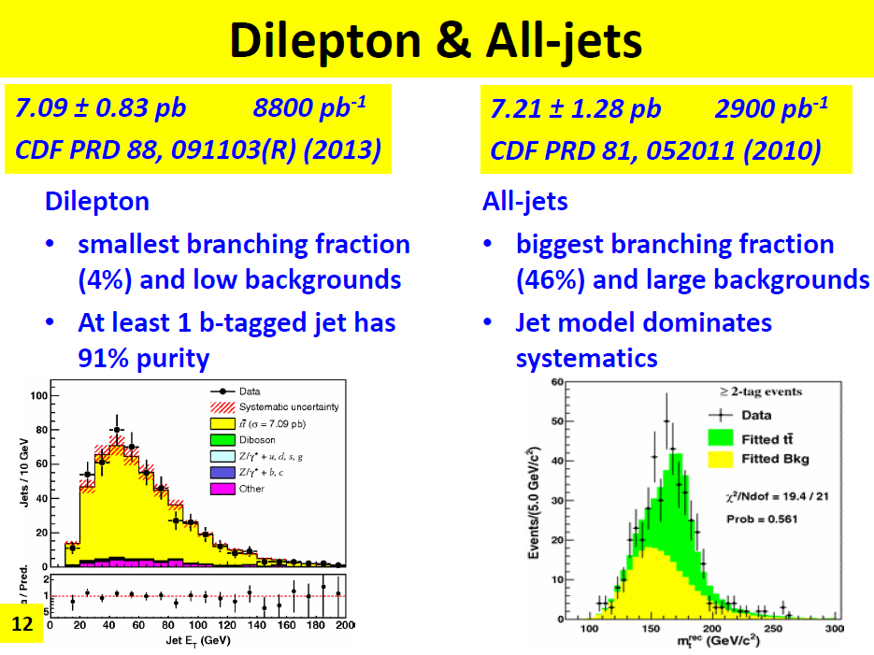
Rekostrukce

Slide 20
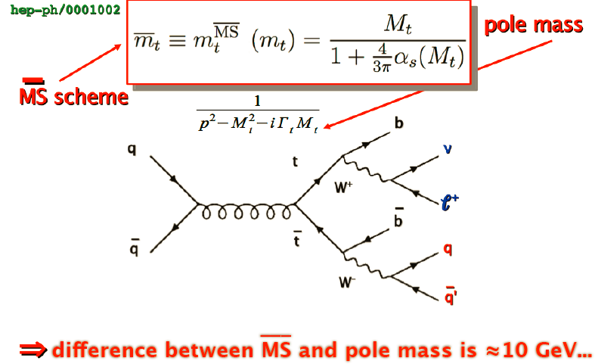

Slide 21
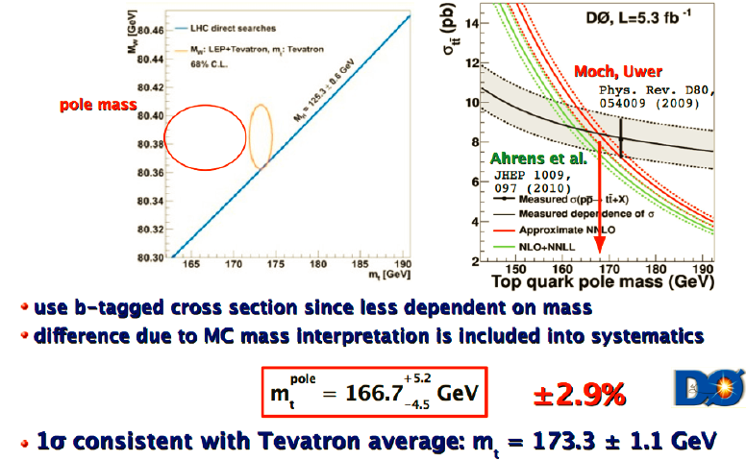

Slide 22
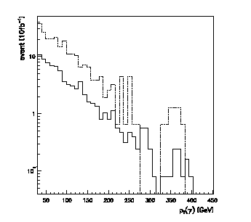

  t coupling to photon
    can be probed via t tbar γ events
    can also be used to confirm Q=2/3
SM:
Br(t →Wb) ≈ 99.9%
  Br(t → Ws) ≈ 0.1%,
  Br(t → Wd) ≈ 0.01%
  Many Beyond SM models involve anomalous top couplings
  Several possible rare decay modes (eg. FCNC) have clear experiment signatures and, if observed at the LHC, would be evidence for new physics
Q_{t} = +2/3
Q_{t} = -4/3
Atlas
pT(γ) [GeV]

Slide 23
TOP physics in Prague
spin correlation (opening angles (MC – ATLFAST+ (PYUPEV)
kinematics reconstruction of topology in 2L fs.
spin correlation with full topology reconstruction
correlation analyses with W spin (Prague + Marseille)
New phenomena with spin correlations:
KK graviton – ADD (spin 2) - ED
- “ - RS (4 dimensions)
Z’ (spin 1-)

Slide 24
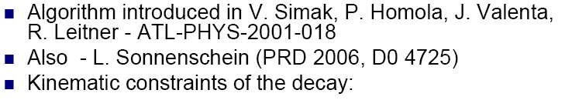
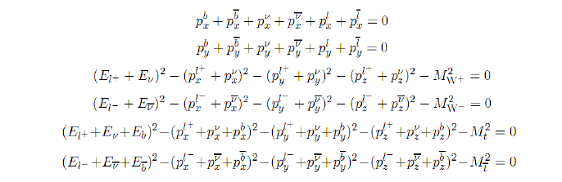
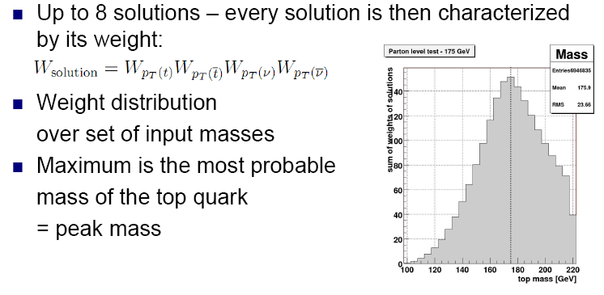
Kamil Augsten, CTU, D0
Attempt to a Mass
Measurement in the
Dilepton Channel
279 candidate events were reconstructed and
statistically analyzed with result
mtop = 169.3 ± 4.3 (stat.) GeV

Slide 25
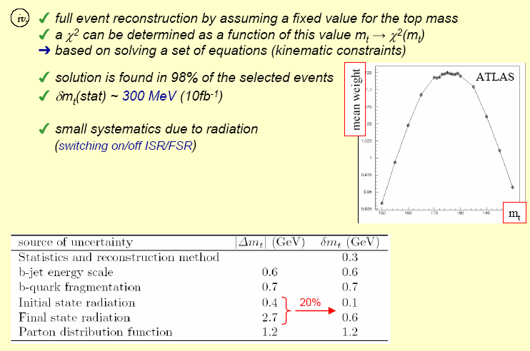
Dilepton channel
hep-ex/0403021,
EPJCdir0403

Slide 26
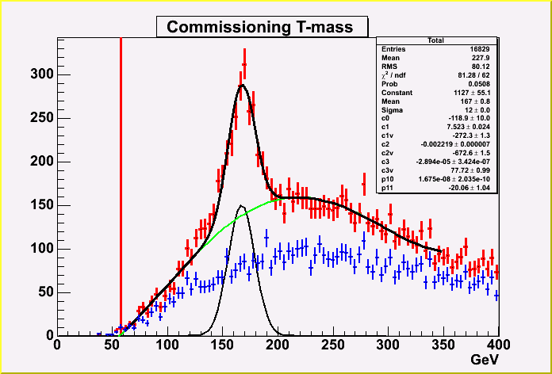
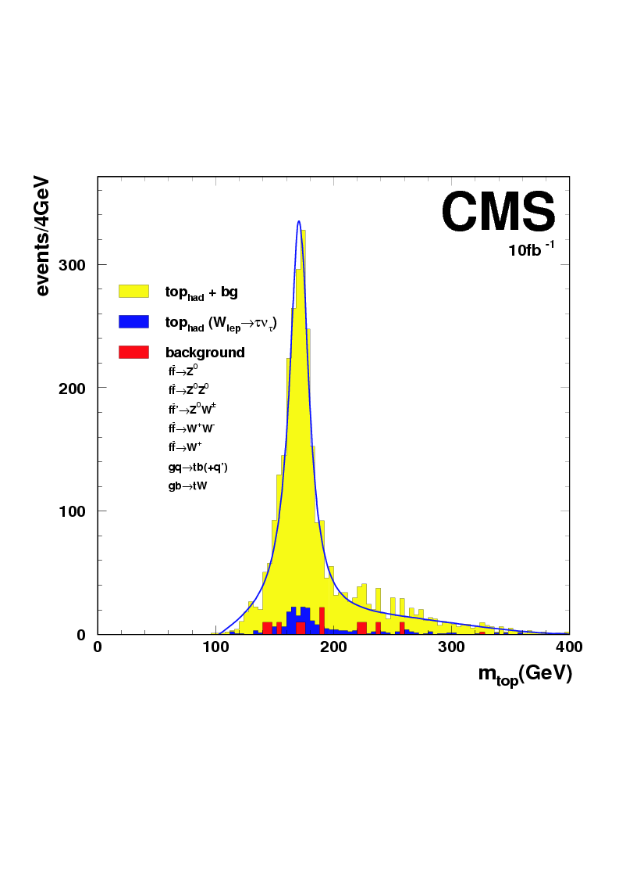
Semileptonic channel:
0.2% efficiency
Total background 5%
Mass extracted from jjb system
(-> large error from jet scale uncertainty)
Stat. error: ±0.25 GeV
Error from P_{t}(t) spectrum: ±0.4 GeV
Jet scale: ΔE_{j}/E_{j}~1% -> ΔM~±0.3 GeV
Atlas
  Require:
  Isolated lepton with p_{T}(l) > 20 GeV
  Exactly 4 jets (ΔR=0.4), each with p_{T}(j) > 40 GeV
  No b-tagging used
  Plot m(jjj) of combo with max p_{T}
Δm_{t} ≈ ± 1-2 GeV

Slide 27
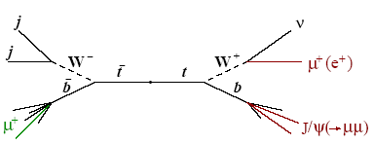
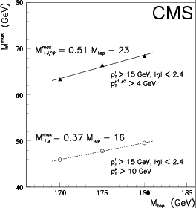
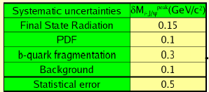
Unfeasible at low luminosity
Independent from jet scale
Promising at high luminosity
Among main systematics:
b fragmentation
Δm_{t} ≈ ± 1 GeV

Slide 28
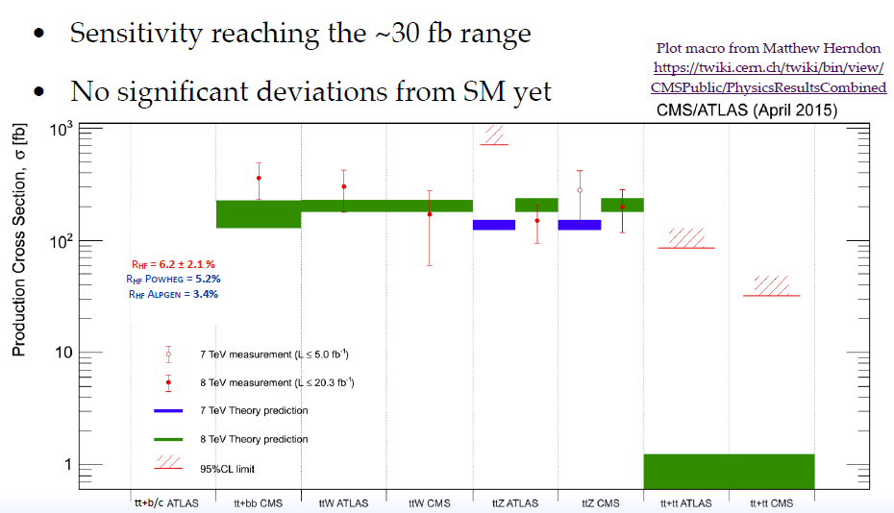

Slide 29
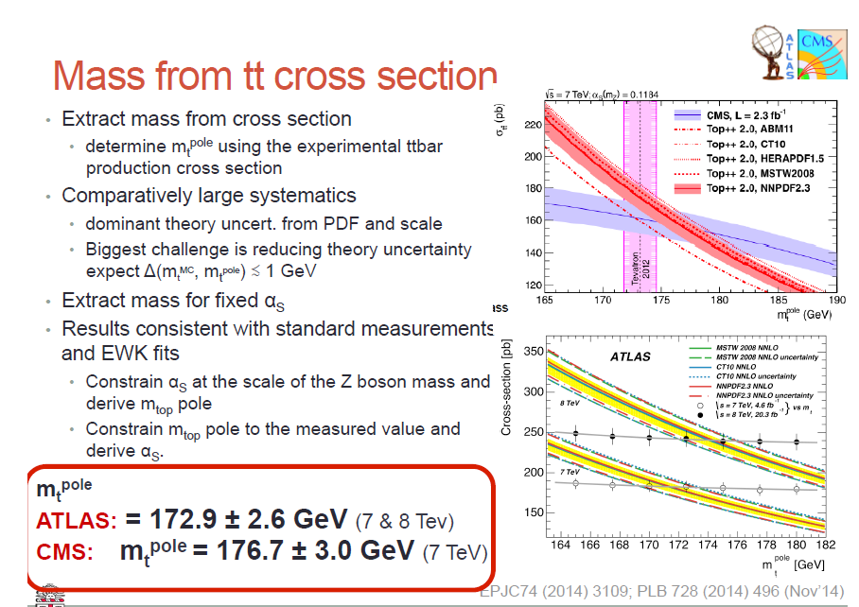

Slide 30
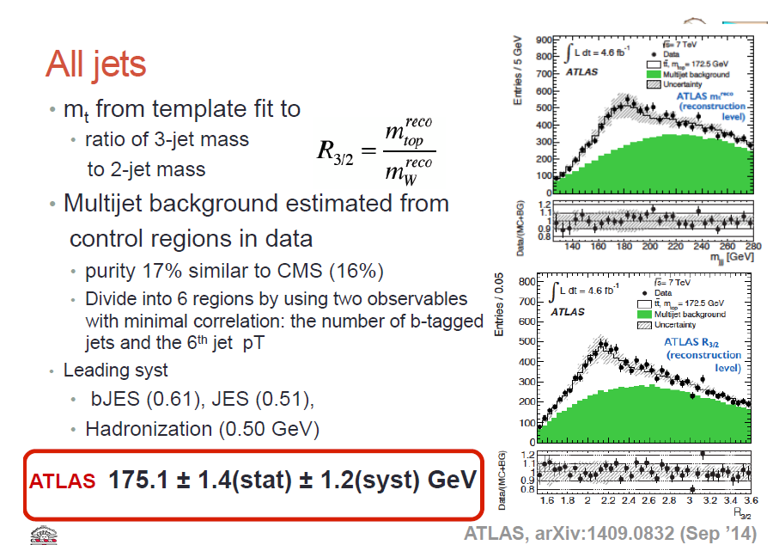

Slide 31
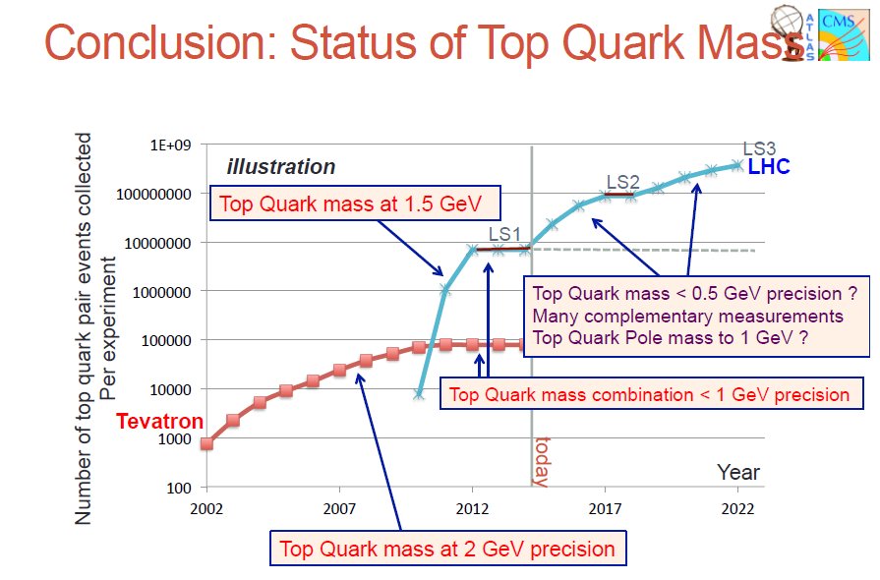

Slide 32
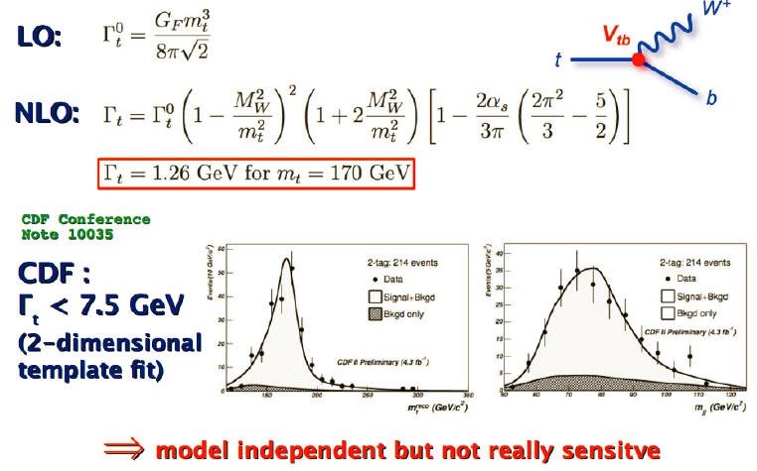

Slide 33

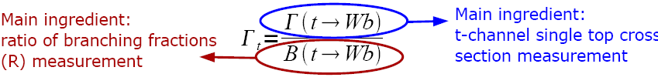
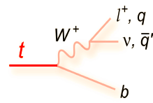


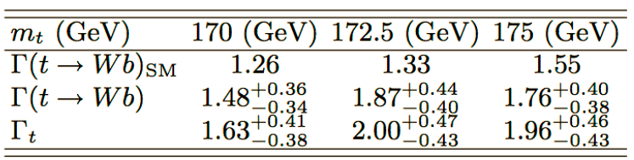

Slide 34
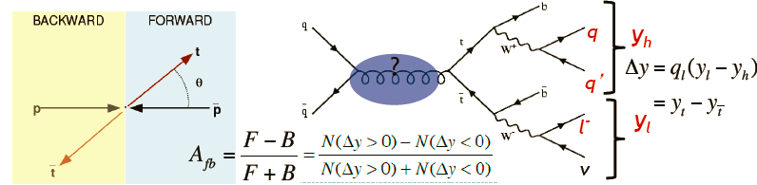
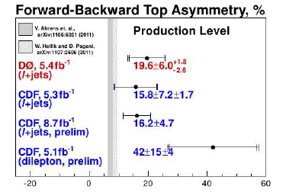
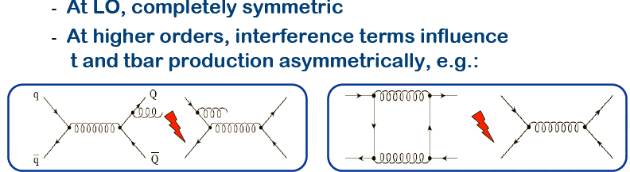
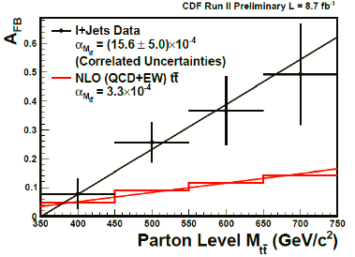
Electroweek physics
TOP

Slide 35



Slide 36


Slide 37

Single Top Production
3,000,000 events/yr

Slide 38


Slide 39


Single Top production
T

Slide 40

there are large bkgnds (eg. tt [830 pb], Wbb [>300 pb]) with similar final states
ability to extract signal depends critically on detector performance, including
look at lepton, jet, bjet multiplicities, as well as kinematic distributions, to separate single top processes from ttbar, Wjj, Wbb, as well as from each other
Atlas

Slide 41


Each process is sensitive to possible new physics in different ways
  Some examples:
    heavy W’ ⇒ enhancement in s-channel W*
    FCNC gu → t ⇒ enhancement in “Wg fusion”
  It is important to measure each process separately
Also want to measure W, top helicities
  Eg. sensitivity to V+A, anomalous couplings

Slide 42






Slide 43


Slide 44


Slide 45






Spin Correlation

Slide 46





Openning angles Theta, Phi of two leptons
Smolik, Simak ATLAS Note 1997, TDR
Smolik, Simak, A.Lagata , ATLAS Note ATL-COM-PHYS-99-049
1+a*cos(θ)
1- a’*cos(θ)
if a ≠ a’ CPV tn top production
κ= 0
κ= -0.34 SM LO
D0 1999

Slide 47



Spin Correlations of Top-Antitop Pairs

Slide 48



Atlas
κ= 0
κ= -0.34 SM LO

Slide 49



Slide 50


Slide 51


Slide 57


Slide 58


Slide 59

Graviton ?
Only for
Gravitation
would be
visible

Slide 60
While supersymmetry is required for supergravity, it was normally assumed that any unification of forces would occur at the
Planck scale ~10¹⁹ GeV
very large hierarchy between the electroweak scale and gravitational scales
Gravity may propagate in extra dimensions, while the gauge particles and fermions remain trapped in 3+1 dimensional spacetime
extra dimensions n not necessarily small in size (millimeters)
true Planck scale may be as low as the electroweak scale
Gravity could start to play a role in experiments at ~ TeV
LHC
[hep-ph/9905257]

Slide 61
[hep-ph/9811501,
hep-ph/0010010]
Errors on SM LHC
For 0.3 0.5 1.0 pb
ADD model, Phys. Lett. B 429, 261 (1998)
n | 2 | 4 | 6
Lower bounds Ms [TeV] | 6.5 (13.4) | 6.1 (4.9) | 5.8 (4.1)
Two models

Slide 62
For pp collider
Sensitivity large in forward/backward
regions
e.g.

Slide 63
Measurement of Top-antitoSpin Correlations in Experiment ATLAS
V. Simak, J. Smolik, A.Lagata ATL-COM-PHYS-99-049
Influence of graviton on top-antitop production at the LHC.
Karel Smolek (IEAP CTU, Prague) , Masato Arai (Helsinki U. & Helsinki Inst. of Phys.) , Nobuchika Okada (KEK, Tsukuba) , Vladislav Simak (Prague, Tech. U. & Prague, Tech. U., Mech. Eng.) . 2008. 3pp.
Published in J.Phys.Conf.Ser.110:072040,2008.
The ATLAS Experiment at the CERN Large Hadron Collider.
By ATLAS Collaboration (G. Aad et al.). 2008. 437pp.
Published in JINST 3:S08003,2008.
Top quarks spin correlations with graviton in ADD and RS models at the Large Hadron Collider.
Masato Arai (Helsinki U. & Helsinki Inst. of Phys.) , Nobuchika Okada (KEK, Tsukuba) , Karel Smolek (IEAP CTU, Prague) , Vladislav Simak (IEAP CTU, Prague & Prague, Inst. Phys.) .
18th Hadron Collider Physics Symposium 2007 (HCP 2007) 20-26 May 2007, La Biodola, Isola d'Elba, Italy.
Published in Nucl.Phys.Proc.Suppl.177-178:333-334,2008.
Top quark spin correlations in the Randall-Sundrum model at the CERN Large Hadron Collider.
Masato Arai (Helsinki U. & Helsinki Inst. of Phys.) , Nobuchika Okada (KEK, Tsukuba) , Karel Smolek (IEAP CTU, Prague) , Vladislav Simak (Prague, Tech. U.) . HIP-2007-01-TH, KEK-TH-1128, Jan 2007. 18pp.
Published in Phys.Rev.D75:095008,2007.
e-Print: hep-ph/0701155
Measurement of spin correlations of top-antitop pairs in the ATLAS experiment and influence of heavy Higgs boson.
K. Smolek, V. Simak (Prague, Tech. U., Mech. Eng.) . 2004.
Prepared for Advanced Studies Institute: Physics at LHC (LHC-Praha-2003), Prague, Czech Republic, 6-12 Jul 2003.
Published in Czech.J.Phys.54:A451-A454,2004.
Investigation of top mass measurements with the ATLAS detector at LHC.
I. Borjanovic et al. Mar 2004. 47pp.
Published in Eur.Phys.J.C39S2:63-90,2005.
e-Print: hep-ex/0403021

Slide 64







Slide 65


Slide 66


Slide 67

Děkuji

Slide 68

Lorentz invariance - CPT

Slide 69
(Mike Beger, General Top meeting, 10-DEC-2009)

Slide 70
If Lorentz invariant is violated in t-tbar production and decay then according to the SME the matrix element for t-tbar is modified in the following way:
where is the standard matrix element for t-tbar production and decay and the terms (..)^{μν} are given for reference in the following page. The modifications to the SM matrix element were calculated for D0 by:

Slide 71

Lorentz invariance - CPT

Slide 72

Lorentz invariance - CPT

Slide 73

Lorentz invariance - CPT

Slide 74

Lorentz invariance - CPT

Slide 75

Lorentz invariance - CPT

Slide 76
The rotation frequency is 23 hrs 56 min 4.1 sec. It is not 24 hours because since the earth revolves around the sun the coordinate axis of the sun and the earth line up in less that 24 hours. This is also the time that very distant stars repeat on the sky and is known as sidereal time.
If there is an effect one would expect to see an oscillation in the number of events as a function of sidereal time.
How does the data look like when plotted as a function of sidereal time?
For the analysis we are using the Run IIb top mass data. The data corresponds to 2.6 fb⁻¹ and it starts in 23-JUN-2006 and ends in 12-SEP-2008. The data as a function of sidereal time is shown in the following slide.

Slide 77
Two examples of ensemble tests performed without event repetition and entering the event weight in the histogram. There are 610 events per ensemble.

Slide 79
Děkuji

Slide 84
Děkuji

