Slide 1
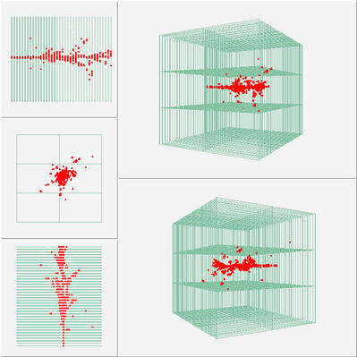


Imaging Calorimetry for Lepton Colliders
José Repond
Argonne National Laboratory
Seminar at the
Prague, Czech Republic
September 5, 2013

Slide 2
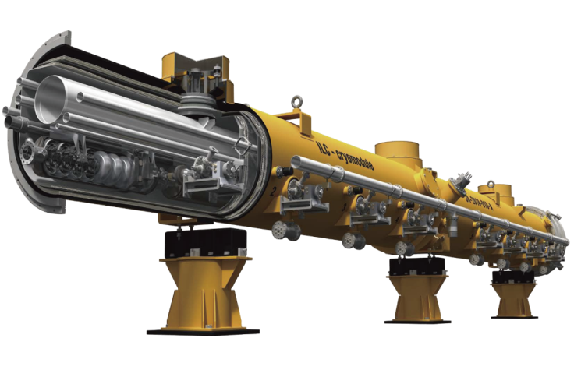
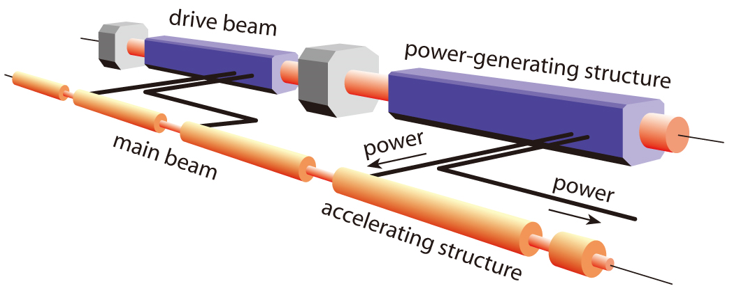

Linear Colliders
ILC – International Linear Collider
Superconducting technology
250 – 500 GeV
Upgradable to 1,000 GeV
ILC technical design report – released on 12 June, 2013
CLIC – Compact Linear Collider
Two-beam acceleration scheme
1,000 – 3,000 GeV
Conceptual design report – last update 12 October 2012
Linear Collider Collaboration – Accelerator and Detectors

Slide 3
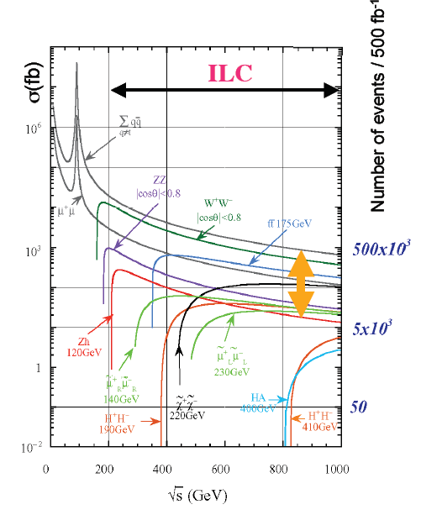
The International Linear Collider
Baseline Machine
E_{CM} of operation 200 – 500 GeV
Luminosity and reliability for 500 fb⁻¹ in 4 years
Energy scan capability with <10% downtime
Beam energy precision and stability below 0.1%
Electron polarization of >80%
E_{CM} down to 90 GeV for calibration
Upgrades
E_{CM} about 1 TeV
Capability of running at any E_{CM} < 1 TeV
L and reliability for 1 ab⁻¹ in 3 – 4 years
Options
Extend to 1 ab⁻¹ at 500 GeV in ~2 years
e⁻e⁻, γγ, e⁻γ operation
e⁺ polarization ~ 50%
Giga-Z with L = several 10³³ cm⁻²s⁻¹
WW – threshold scan with L = 10³³ cm⁻²s⁻¹

Slide 4
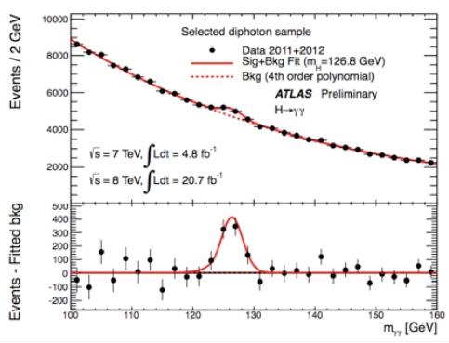
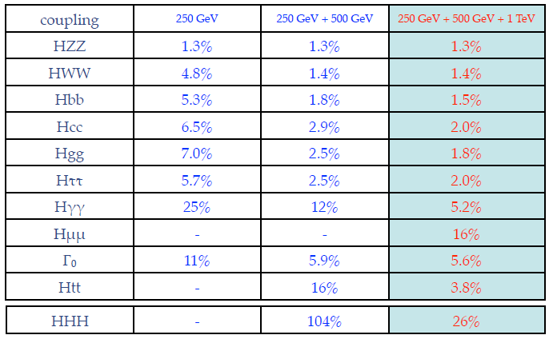
Higgs Boson
Recently discovered at the LHC
Precision measurements needed to
establish nature of new particle
Linear collider running at various
center-of-mass energies (staged approach) could provide
necessary precision
K.Fujii @ ECFA LCWS 2013
Model-independent
global fit for couplings

Slide 5
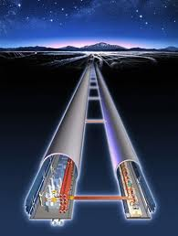
ILC Timeline
Slide from Nan Phinney
20 years from first idea to prototype linear collider
1965 Maury Tigner, Nuovo Cimento 37 (1965) 1228
1988–98 SLAC Linear Collider (SLC)
25 years to complete the ILC design
2013 Technical design report
Cost review done
Linear Collider Collaboration is being formed
Japan selected a site
2013 – 16
Prepare a proposal to the funding agencies
2016
The ILC is Good to Go

Slide 6

ILC Site Options

Slide 7
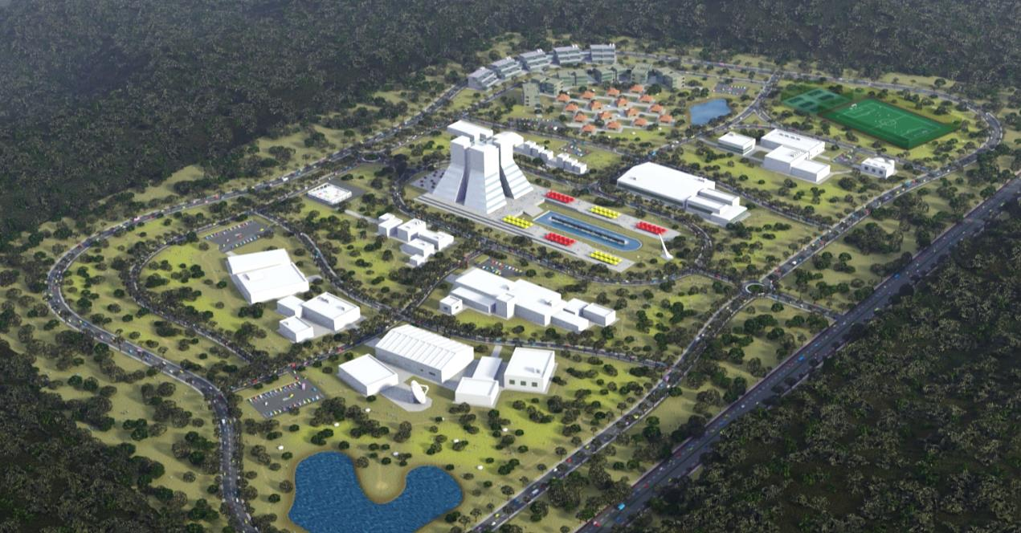
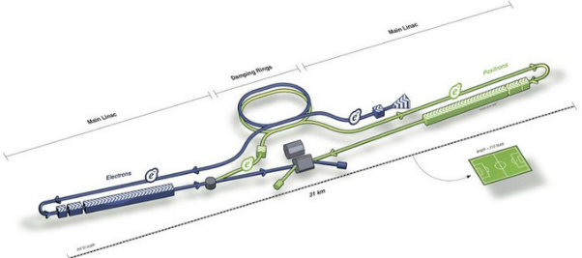
ILC Site Selection
Announcement on August 23, 2013
Kitakami – Northern site

Slide 8
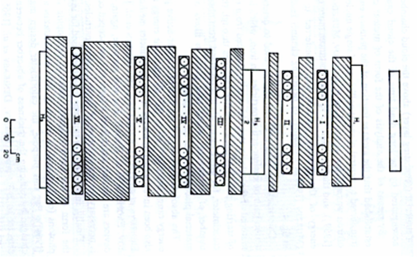
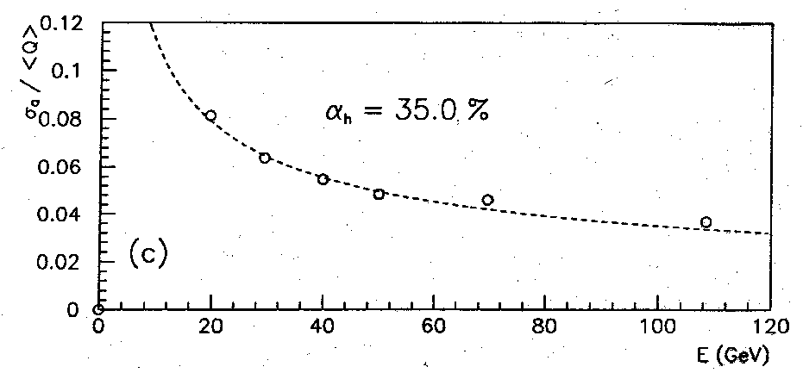

Calorimeters in HEP – a very short history
Measure energy of single particles or jets
1930 – First calorimetric measurement (β spectrum)
1954 – First sandwich calorimeter (cosmic rays)
1968 – First total absorption calorimeter (NaI(Tl) for π⁰ spectroscopy)
1970 – First hadron calorimeter (GARGAMELLE – discovery of neutral currents)
1980’s – Calorimeters at colliders (SPEAR, PETRA, PEP, SppS…)
1982 – First compensating calorimeter with e/h ~ 1 (Axial field spectrometer)
1992 – Compensating calorimeter at collider: ZEUS at HERA
1990 – First application of energy flow (ALEPH for Higgs search)
2000 → Design work on calorimeters optimized for Particle
Flow Algorithms (PFAs) starts
In general, response to same energy electrons and hadrons unequal: e/h ≠ 1

Slide 9
Need new approach
Particle Flow Algorithms
K_{L}
The idea…
HCAL
ECAL
Charged particles Tracker
measured with the
Neutral particles Calorimeter
π⁺
γ
Particles in jets | Fraction of energy | Measured with | Resolution [σ²]
Charged | 65 % | Tracker | Negligible
Photons | 25 % | ECAL with 15%/√E | 0.07² E_{jet}
Neutral Hadrons | 10 % | ECAL + HCAL with 50%/√E | 0.16² E_{jet}
Confusion |  |  | ≤ 0.24² E_{jet}
18%/√E
Required for 30%/√E
In the past, typical jet energy resolutions > 50%/√E

Slide 10
How PFAs work
How PFAs work
Example taken from L Xia
Calorimeter Hits
Tracker Hits
Clustering
Algorithm
Track finding
Algorithm
Calorimeter Clusters
Reconstructed Tracks
Photon
Identification
EM Clusters
Hadron Clusters
Track-cluster
matching
‘Neutral’ Clusters
Matched Clusters
Charge fragment
identification
Neutral Clusters
Fragments
EM sampling
fraction
Hadron sampling
fraction
Total
event
energy
E_{photon}
E_{neu-had}
0
0
P_{track}

Slide 11
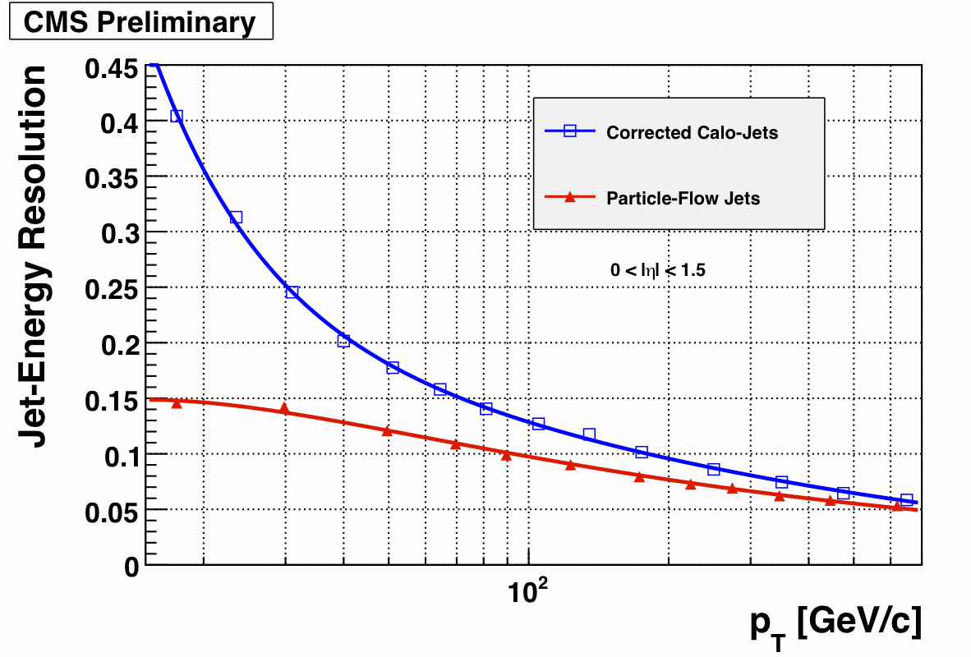
Imaging Calorimeters
Are needed for the application of Particle Flow Algorithms (PFAs) to the measurement of
hadronic jets at colliders
In the past PFAs (or equivalent) have been used by ALEPH, ZEUS, CDF…
Now being applied by CMS
( ← detector NOT optimized for PFAs)
Future lepton collider
(→ detectors to be optimized for PFAs)

Slide 12
What to measure at a future Lepton Collider
● Single charged particles → YES → use the tracker
● Single photons → YES → use the ECAL
● Single neutral hadrons → ???
● Hadronic jets → YES → how?
Dijet masses
K_{L}
HCAL
ECAL
γ
π⁺
YES
Not necessarily with a calorimeter with the best
possible single particle energy resolution
But with a detector providing the best possible
jet energy and dijet mass resolution
Detector optimized for PFAs

Slide 13
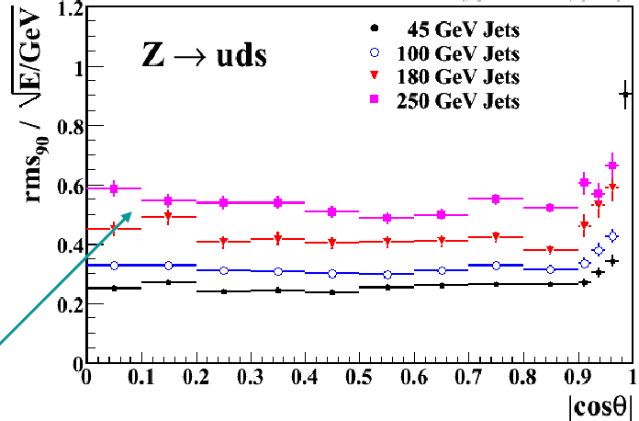
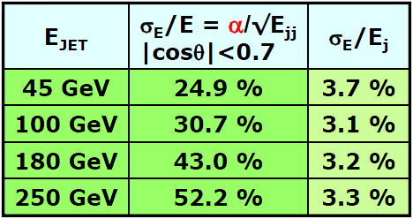
Example: Pandora PFA
Developed by
Mark Thomson (University of Cambridge)
Based on GEANT4
Current performance
Leakage at high jet energies
ILC/CLIC performance goals achieved
Open – ended development
Resolution still mostly dominated by confusion
Second order corrections (e.g. leakage, SW compensation) not yet implemented

Slide 14
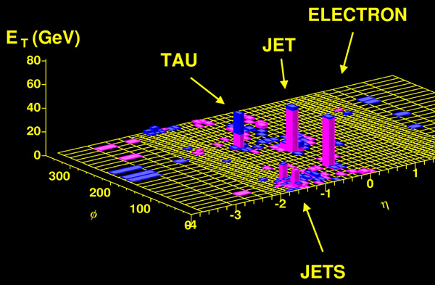
Implications for Calorimetry
PFA
Attempt to measure each particle in a event/jet individually
with the subsystem providing the best resolution
● Need a calorimeter optimized for photons: separation into ECAL + HCAL
● Need to place the calorimeters inside the coil (to preserve resolution)
● Need to minimize the lateral size of showers
● Need the highest possible segmentation of the readout
● The role of the HCAL reduced to measure the part of showers from neutral hadrons
leaking from the ECAL
● Need to minimize thickness of the active layer or the depth of the HCAL
Two performance measures of a hadronic calorimeter optimized for PFAs
Χ
Energy resolution for Identification of energy deposits
single neutral hadrons (minimize confusion)

Slide 15
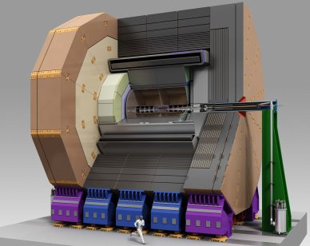
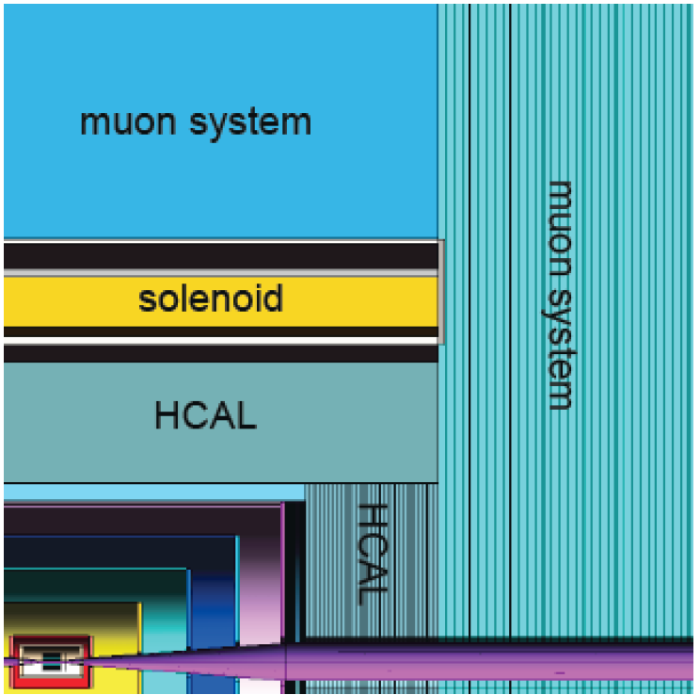
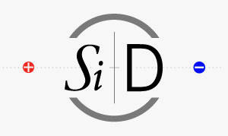
The PFA Detector Concepts: ILD and SiD
Similarities between SiD and ILD
Pixel vertex detector
Highly granular electromagnetic calorimeter
Highly granular hadron calorimeter
Calorimeters located inside the coil
High magnetic field between 3 – 5 Tesla
Instrumented return yoke for muon identification
(Joint effort on) forward calorimetry
Being developed for both the ILC and CLIC
First detectors to be optimized for PFA applications
ILD
Major difference between SiD and ILD
SiD – Pure Silicon tracker
ILD – Time Projection Chamber + Silicon layers

Slide 16
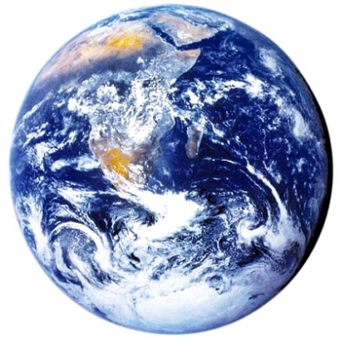
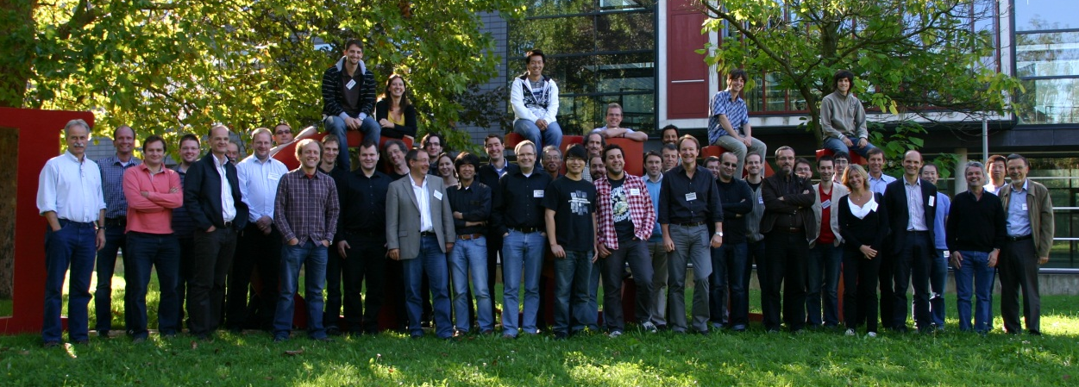
Collaboration
2nd largest R&D
collaboration in HEP
Goal
Development and study of finely segmented calorimeters for PFA applications
Large prototypes built and tested so far
Silicon-W ECAL, Scintillator-W ECAL, Scintillator-Fe/W HCAL,
RPC-Fe/W HCAL, RPC-Fe HCAL
A year ago at the collaboration meeting in Heidelberg
4 continents
19 countries
59 institutes
361 physicists/
engineers

Slide 17
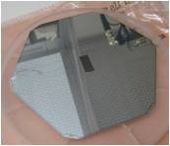
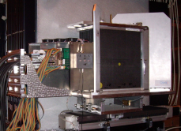
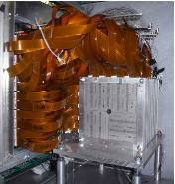
Development of Imaging Electromagnetic Calorimeters
Silicon pads
Silicon pads
Scintillator tiles
MAPS
W
W
W
W

Slide 18


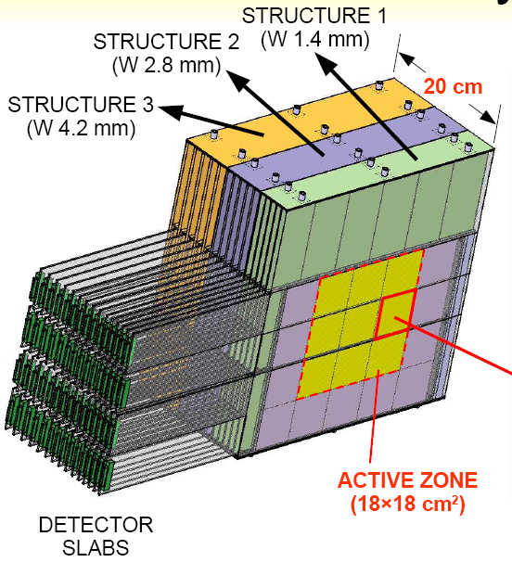
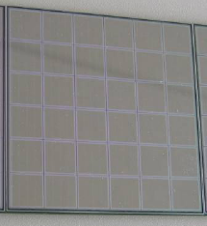
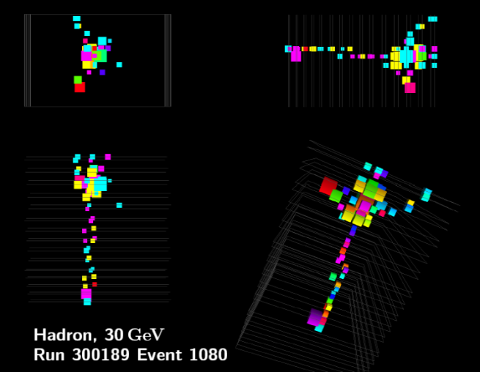
Silicon – Tungsten ECAL
Physics prototype
3 structures with different W thicknesses
30 layers; 1 x 1 cm² pads
18 x 18 cm² instrumented
→ 9720 readout channels
Tests at DESY/CERN/FNAL
Electrons 1 – 45 GeV
Pions 1 – 180 GeV
X₀^{W} = 3.5 mm
1 X₀(W) = 3.5 mm
Electronic Readout
Front-end boards located outside of module
Digitization with VME – based system (off detector)

Slide 19
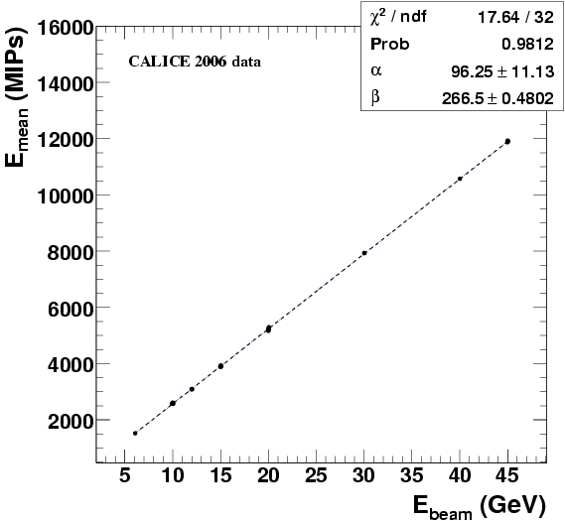
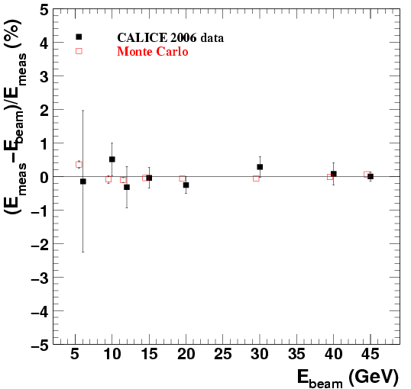
Linearity of the response to electrons
Linear response between 6 and 45 GeV
Residuals < ± 1%
Excellent agreement with simulation

Slide 20
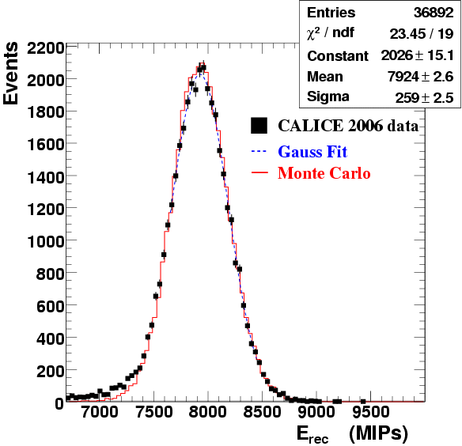
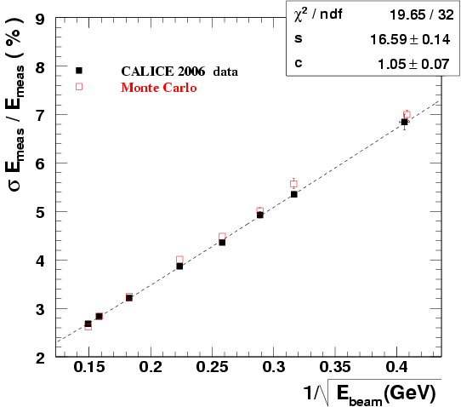
Resolution for electrons
Good agreement with simulation
Energy resolution as expected
(and sufficient for PFA)

Slide 21
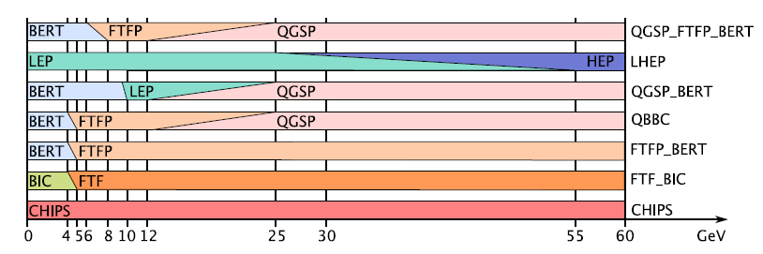
Monte Carlo Simulations: GEANT4
Electromagnetic shower simulation
Reproduces results at the < 1 % level
Multiple scattering still challenging
Excellent tool to test understanding of detector
Hadronic shower simulation
Greatly improved in the last few years
Precision better than 10% (shapes < 20%)
Choice of different models combined into various Physics lists
Adequate simulations are a
prerequisite for understanding

Slide 22
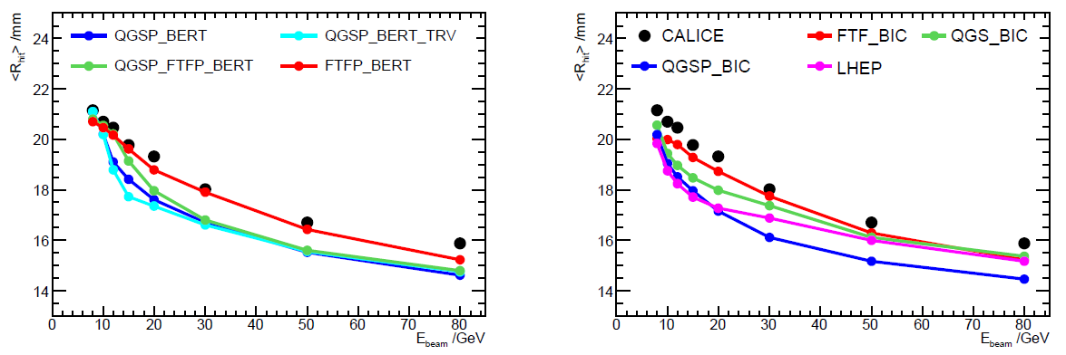
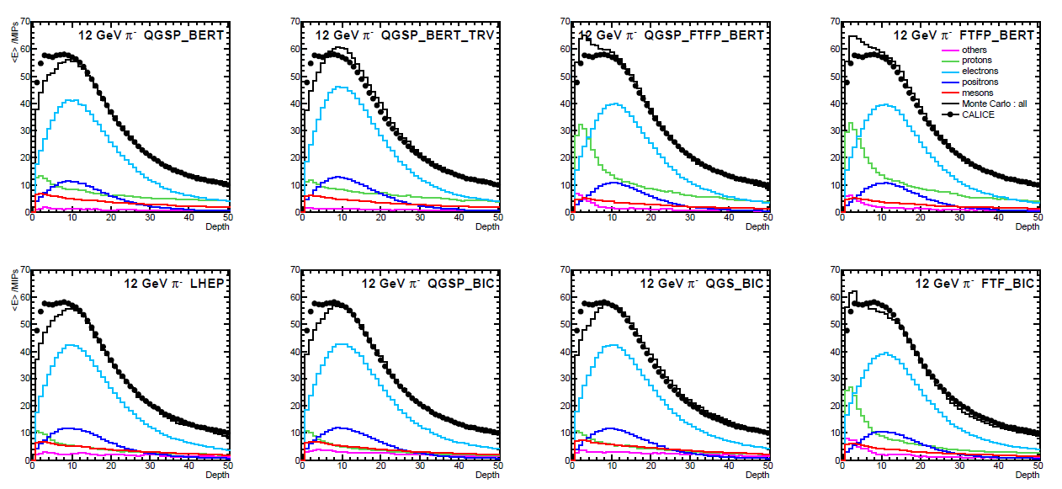
Pions in the ECAL
Radial shower shape
Weighted shower radii versus E_{π}
Comparison with various GEANT4 models
Longitudinal shower shape
For E_{π}= 12 GeV (taken from first hadronic interaction)
Comparison with various GEANT4 models
Decomposition into contributions from different particle species
The power of imaging calorimeters
Separate
contributions
from
• photons
• nuclear fragments
• energetic hadrons
2010 JINST 5 P05007

Slide 23
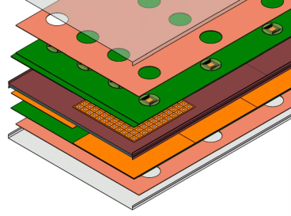
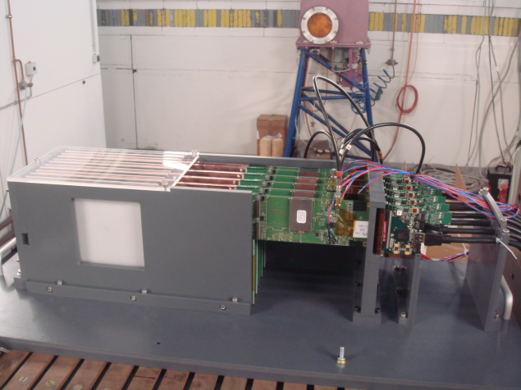
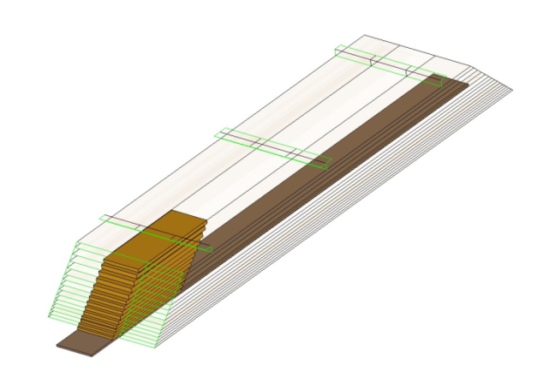
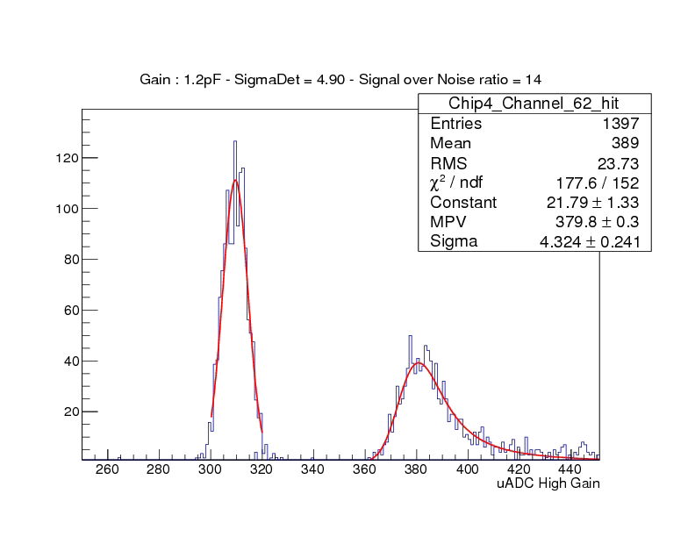
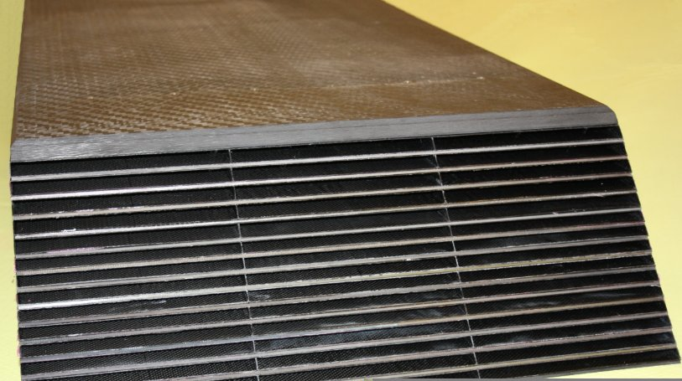
CALICE Si-W ECAL
2nd Prototype (technical)
2 structures with different W thicknesses
30 layers with 0.5 x 0.5 cm² pads
30 gaps (each ~ 3.3 mm)
Effective Moliere radius ~ 15 mm
Embedded front-end electronics
Power pulsing
Sensors
9 x 9 cm² wafer
Readout
SKIROC2 ASIC with 64 channels
12-bit dynamic range
Status
Exposed to first test beams

Slide 24
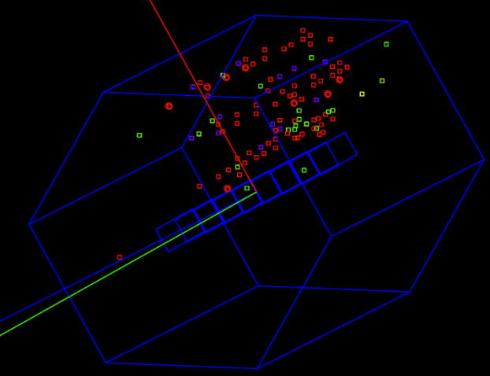
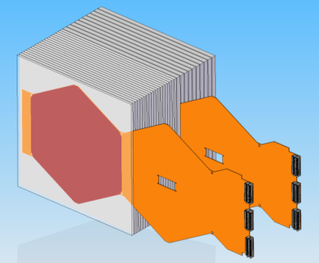
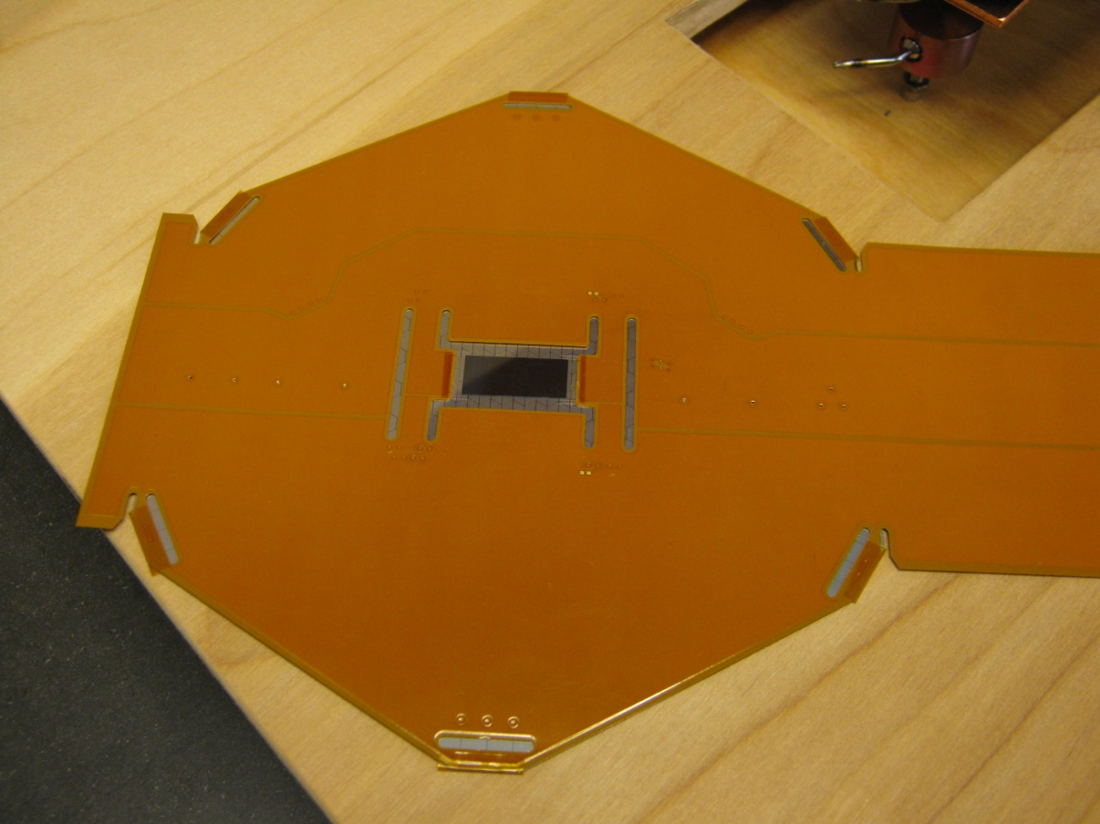
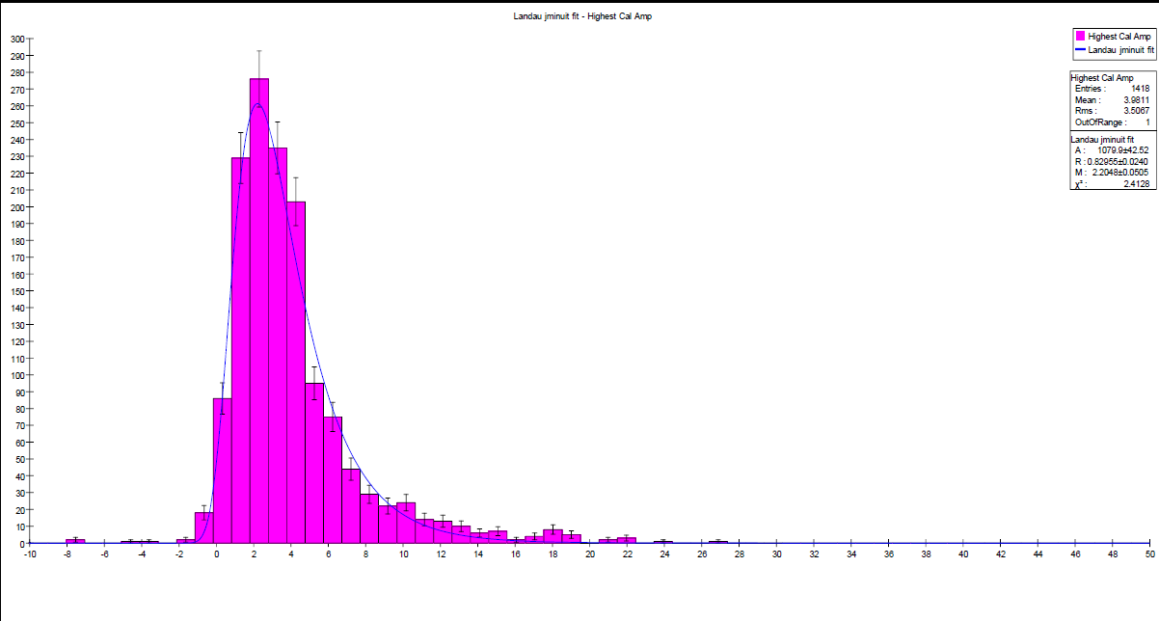
SiD Si-W ECAL
Prototype
20 layers with 2.5 mm W (5/7 X₀)
10 layers with 5.0 mm W (10/7 X₀)
30 gaps (each 1.25 mm) with Si Pixel sensors
Effective Moliere radius = 13 mm
Sensors
6” Silicon wafer
1024 pixels, each 0.13 cm²
Readout
KPiX ASIC
Bump bonded to wafer
1024 readout channels
17 bit dynamic range
Power pulsing (O(x100) reduction)
Status
Measured response to cosmic rays
Prototype being assembled
First tests in particle beams

Slide 25
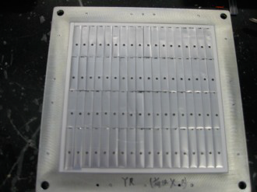
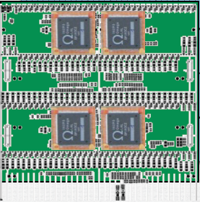
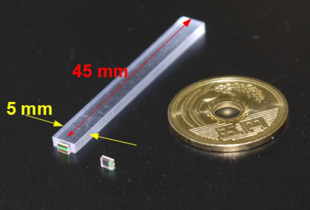
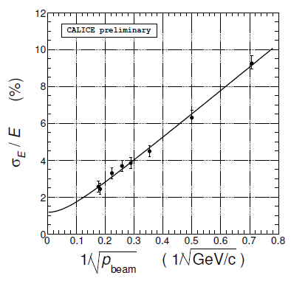
CALICE Scintillator-W ECAL
1st Prototype (physics)
30 layers of 3.5 mm thick W
30 layers with 4.5 x 1.0 x 0.3 cm³ scintillator pads
18 x 18 cm² instrumented
Readout with WLSF+Hamamatsu MPPC (SiPM)
→ 2160 readout channels
Digitization off the detector
Measurements in test beams
Data taking at DESY/FNAL
Electrons 1 – 32 GeV
Pions 1 – 32 GeV
Results
Proof of concept
2nd Prototype (technical)
30 layers of 3.5 mm thick W
30 layers with 4.5 x 0.5 x 0.1 cm³ pads
18 x 18 cm² instrumented
Readout with Hamamatsu MPPC (SiPM)
Embedded front-end SPIROC ASIC
Measurements in test beams
Data taking at DESY
Electrons 1 – 6 GeV

Slide 26
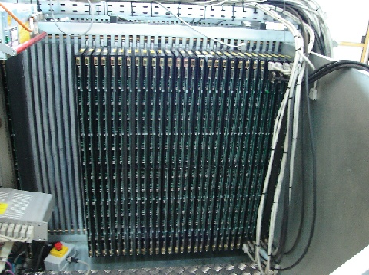
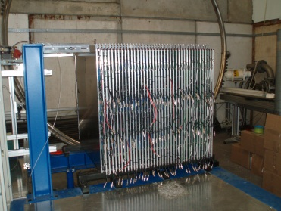
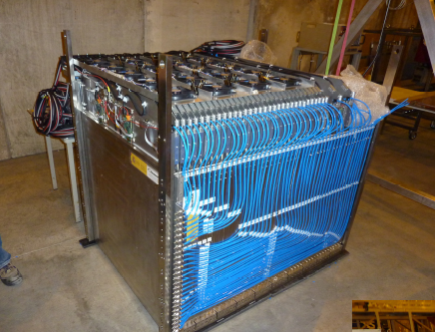
R&D for Imaging Hadronic Calorimeters
16-bit
1-bit
2-bit
Scintillator tiles
RPC
GEM
RPC
μMegas
Fe
W
Fe
W
Fe
Fe

Slide 27
The absorber
Steel
Discussion has boiled down to three choices Tungsten
Crystals
Element | ρ [gcm⁻³] | X₀ [cm] | λ_{I} [cm] | λ_{I} /X₀
Fe | 7.87 | 1.758 | 16.8 | 9.6
W | 19.30 | 0.350 | 9.94 | 28.4
e.g. BGO | 7.13 | 1.118 | 22.3 | 20.0
Sampling
Given space restrictions, best choice not obvious
~2 cm Fe-absorber corresponding to 1.2 X₀ or 0.13 λ_{I} sampling
~1 cm W-absorber corresponding to 2.9 X₀ or 0.10 λ_{I} sampling
Have been tested
Impact on measurement of electromagnetic sub-showers

Slide 28
The large prototypes
Needed to contain hadronic showers

Slide 29
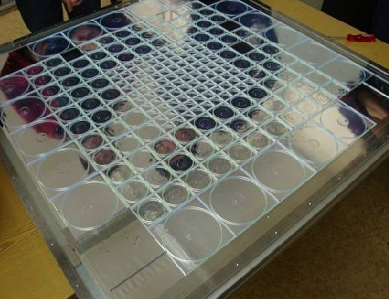

Large Prototype I
Scintillator – AHCAL
Description
38 active layers
Scintillator pads of 3 x 3 → 12 x 12 cm²
→ ~8,000 readout channels
Complemented by a Scintillator strip tail-catcher (TCMT)
Electronic readout
Silicon Photomultipliers (SiPMs)
Digitization with VME-based system (off detector)
Tests at DESY/CERN/FNAL
with Iron absorber in 2006 - 2009
Tests at CERN
with Tungsten absorber 2010-2011
1st use in large system

Slide 30


Large Prototype II
RPC – HCAL (DHCAL)
Description
54 active layers
Resistive Plate Chambers with 1 x 1 cm² pads
→ ~500,000 readout channels
Main stack and tail catcher (TCMT)
Electronic readout
1 – bit (digital)
Digitization embedded into calorimeter
Tests at FNAL
with Iron absorber in 2010 - 2011
Tests at CERN
with Tungsten absorber 2012
1st time in calorimetry

Slide 31


Large Prototype III
RPC – HCAL (SDHCAL)
Description
48 active layers
Resistive Plate Chambers with 1 x 1 cm² pads
→ ~430,000 readout channels
Electronic readout
2 – bit (semi-digital) → 3 thresholds
Digitization embedded into calorimeter
Power pulsing
Tests at CERN
with Steel absorbers 2012

Slide 32
Some of the many results…

Slide 33


Response – Scintillator - AHCAL
Should be linear: but is it necessary?
Steel -Absorber
Tungsten -Absorber
Linear response up to 10 GeV
(higher energies still being analyzed)
5mm scintillator + 10 mm W
→ Compensation : e/h ~1
-- Electrons
Linear response to hadrons at the <1% level
Under-compensating: e/h ~ 1.2

Slide 34



Response – Fe-DHCAL
Deviations from
linear response
due to finite
readout pad
size
e⁺ - uncalibrated
π⁺
e⁺ – well described by power law αE^{β}
π⁺ - appear to be linear up to 60 GeV
Over-
Compensation
This is surprising: simulation predicted ~10% saturation
Functional form a priori not known, but needed for energy reconstruction

Slide 35


Response – (Semi) - Digital HCALs
Tungsten – DHCAL
Should be linear: but is this necessary?
30% fewer hits compared to steel
Non-linear response
to both e± and hadrons
Both well described by
power law αE^{β}
Badly over-compensating
e/h ~ 0.9 – 0.5
→ need smaller readout pads
uncalibrated
Steel – SDHCAL (1-bit mode)
Deviations from
linear response
due to finite
readout pad
size
uncalibrated
Functional form a priori not known, but needed for energy reconstruction

Slide 36




Resolutions
For PFAs this is only part of the story…
Steel – DHCAL
Tungsten – DHCAL
Resolution
~ 25% worse
than with steel
Leveling off at higher energies
(can be improved with software
compensation)
Steel – SDHCAL
Measurements using either 1 or 3 thresholds
Improvement at higher energies with 3 thresholds

Slide 37

Software compensation – Scintillator AHCAL
Apply different weights to ‘hadronic’ or ‘electromagnetic’ sub-showers
based on energy density
Large improvement (~20%)
Stochastic term 58%/√E → 45%/√E
Similar stochastic terms of
Steel – DHCAL and ‘raw’ AHCAL
→ Resolution dominated by sampling
Software compensation should also work
for the DHCAL: how well?
The power of imaging calorimeters

Slide 38

Leakage correction
Select showers (80 GeV π) starting in first part of AHCAL
Apply corrections depending on
Interaction layer (shower start)
Fraction of energy in last 4 layers
Mean value restored
RMS reduced by ~24%
The power of imaging calorimeters

Slide 39



Shower shapes
Identification of
layer with shower start
Comparison with various hadron shower models
The power of imaging calorimeters

Slide 40

Validation of PFA performance
Shower separation
Showers reconstructed with
PandoraPFA
Excellent agreement with
simulation
GEANT4 can be trusted to
optimize detector design for
PFA performance

Slide 41




Timing measurements
Measurement of shower timings using
Scintillator pads or
RPC with pads
Positioned downstream of
Steel stack or
Tungsten stack
Comparison with hadron shower models
Average 60 GeV shower in 4D
Use reconstructed interaction
point in Tungsten - AHCAL
The power of imaging calorimeters

Slide 42





R&D beyond current prototypes
Embedded readout for AHCAL
1 m² μMegas as alternative to RPCs
32 x 96 cm² GEMs as alternative to RPCs
Ultra-thin 1-glass RPCs
High-rate RPCs

Slide 43





AHCAL – Technical prototype
40 layers
3 slabs of 6 PCBs/layer
16 x 2 wedges
First test beam (DESY) results

Slide 44




DHCAL – New RPCs
High-rate RPCs
RPCs loose efficiency at high particle rates (> 100 Hz/cm²)
Controlling parameter is the bulk resistivity of the plates
→ Low resistivity Bakelite
→ Low resistivity glass
1-glass RPCs
Offers many advantages: pad multiplicity close to one,
thinner, higher rate capability…
Calibration only dependent on MIP detection efficiency (~ 95%)
Built several large chambers
Tests with Cosmic rays very successful

Slide 45



Micromegas
Advantages
High-rate capability
Signal charge proportional to ionization
Issues
Cost → alternative designs being investigated
Sparks → resistive layer being investigated
Measurement in CERN test beam
4 layers + SDHCAL (identification of shower start)

Slide 46



ECAL Summary
SiD’s Silicon Tungsten Very high-segmentation (0.13 cm² pixels)
Very thin active layer (1.25 mm)
Beam tests have started
Very ambitious project!
Challenging technical problems, such as bump bonding
CALICE Silicon Tungsten Successful test of 1st prototype
Technical prototype being assembled and being tested
Small pixels of 0.25 cm²
Somewhat thicker active layer (~ 3mm)
CALICE Scintillator Tungsten Successful test of 1st prototype
Technical prototype being assembled and being tested
Smaller tiles of 4.5 x 0.5 x 0.1 cm³
Thickness of active layer ~ 2 mm
Of course, much cheaper than Silicon!

Slide 47


HCAL Summary
Scintillator Analog HCAL First use SiPMs in large prototype
Demonstration of software compensation
Demonstration of leakage corrections
Detailed measurements of shower shapes
RPC-Digital HCAL First large prototype with embedded electronics
First digital pictures of hadronic showers
Record channel number in calorimetry
Demonstrated viability of concept of digital calorimetry
RPC-Semi-Digital HCAL First use of power pulsing within CALICE
Demonstrated benefit from 3 thresholds (semi-digital)
Further R&D Many different activities

Slide 48


Summary
of the summary
This is only a prototype
For real detector x50
Technical feasibility of imaging hadron calorimetry proven
new endeavor
Measurement of hadronic showers with unprecedented spatial resolution ongoing
Detailed comparison with GEANT4 based MCs → valuable information for further tuning
Further work needed to design/build modules for a colliding beam detector
ILD

