Slide 1


Aktivity skupiny ultrarelativistických těžkých iontů ÚJF AVČR v experimentech ALICE a STAR
Michal Šumbera
Nuclear Physics Institute AS CR, Řež/Prague

Slide 2
Vybrané aktivity skupiny ultrarelativistických těžkých iontů ÚJF AVČR v experimentu STAR
Michal Šumbera
Nuclear Physics Institute AS CR, Řež/Prague
EPJ Web of Conferences 28,
03006 (2012)
arXiv:1201.6163 [nucl-ex]
arXiv:1301.7224 [nucl-ex]

Slide 3
Outline
Introduction
Freeze-out Dynamics via Charged Kaon Femtoscopy
Open charm production in pp and AA collisions

Slide 4
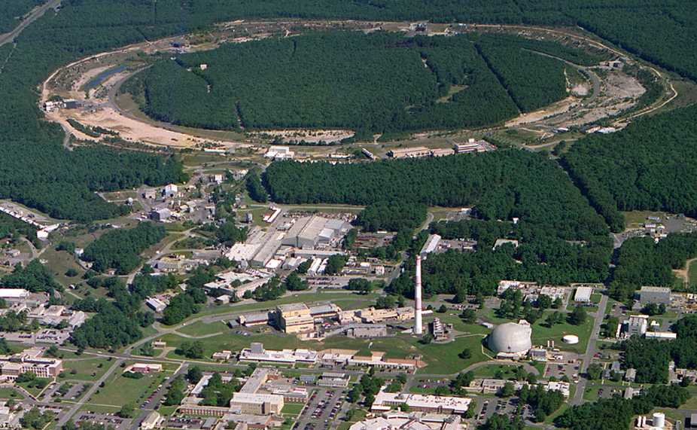
Relativistic Heavy Ion Collider
Brookhaven National Laboratory (BNL), Upton, NY
Year | System | √s_{NN} [GeV]
2000 | Au+Au | 130
2001 | Au+Au | 200
2002 | p+p | 200
2003 | d+Au | 200
2004 | Au+Au p+p | 200, 62.4 200
2005 | Cu+Cu | 200, 62.4, 22
2006 | p+p | 62.4, 200, 500
2007 | Au+Au | 200
2008 | d+Au p+p Au+Au | 200 200 9.2
2009 | p+p | 200, 500
2010 | Au+Au | 200, 62.4, 39, 11.5, 7.7
2011 | Au+Au p+p | 200,19.6,27 500
2012 | U+U Cu+Au p+p | 193 200 200,510
PHOBOS
BRAHMS
RHIC
PHENIX
STAR
AGS
TANDEMS
Animation M. Lisa
World’s (second) largest operational heavy-ion collider
World’s largest polarized proton collider

Slide 5
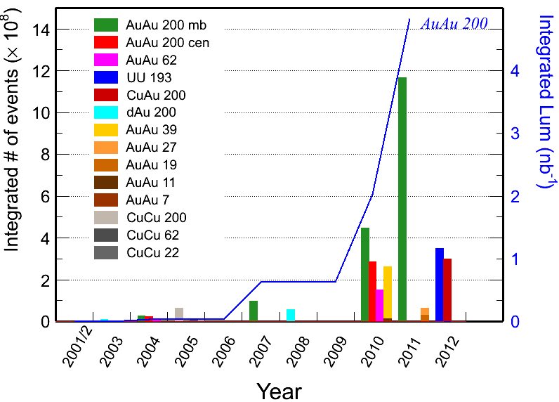
Recorded Datasets
Fast DAQ + Electron Based Ion Source + 3D Stochastic cooling

Slide 6
Remarkable discoveries at RHIC
  Perfect liquid BRAHMS, PHENIX, PHOBOS, STAR, Nuclear Physics A757 (2005)1-283
  Number of constituent quark scaling PHENIX, PRL 91(2003)072301; STAR, PR C70(2005) 014904
  Jet quenching PHENIX, PRL 88(2002)022301; STAR, PRL 90(2003) 082302
  Heavy-quark suppression PHENIX, PRL 98(2007)172301, STAR, PRL 98(2007)192301
  Production of exotic systems
    Discovery on anti-strange nucleus STAR, Science 328 (2010) 58
    Observation of anti-⁴He nucleus STAR, Nature 473 (2011) 353
  Indications of gluon saturation at small x STAR, PRL 90(2003) 082302; BRAHMS, PRL 91(2003) 072305; PHENIX ibid 072303

Slide 7
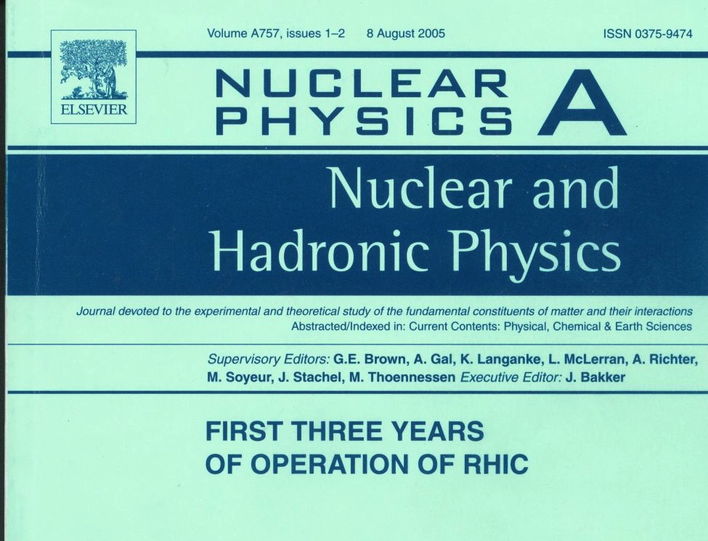
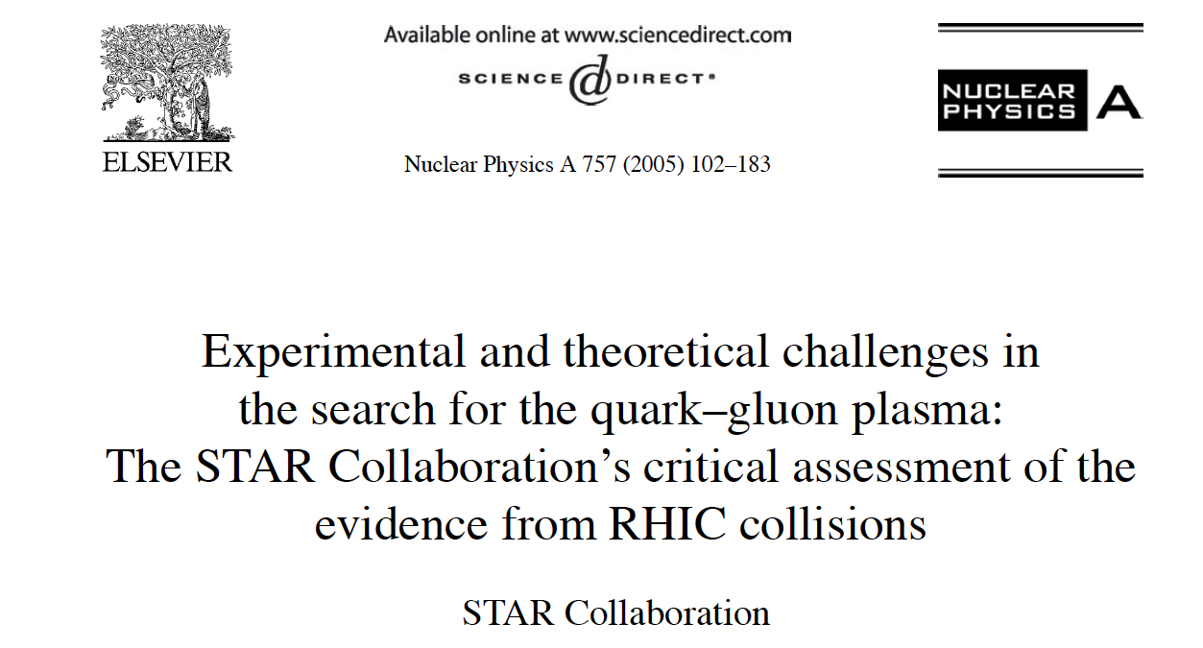
~1600 citations (18.4.2013)

Slide 8
The ‘Standard Model’ of
high energy heavy ion collisions
1) Quenching
All hard hadronic process are strongly quenched
2) Flow
Panta rhei: All soft particles emerge from the common flow field
Urs Wiedemann: QM2012, Washington DC

Slide 9

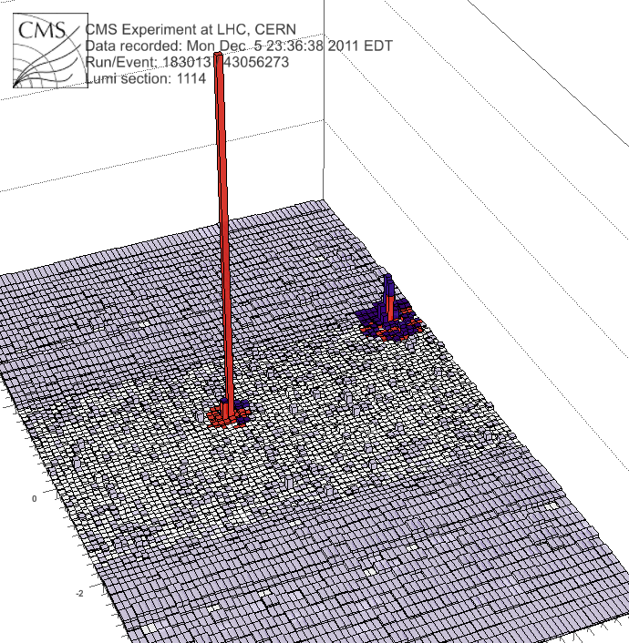
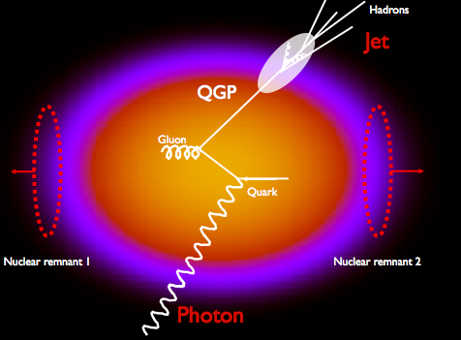
Quenching: γ+jet at LHC
Photon
(191GeV)
Jet
(98 GeV)
Photon tag:
Identifies jet as u,d quark jet
Provides initial quark direction
Provides initial quark p_{T}
April 18, 2013

Slide 10


Elliptic Flow: LHC vs. RHIC
ALICE: PRL 105 (2010) 252302
The same flow properties from √s_{NN}=200 GeV to 2.76 TeV

Slide 11
Freeze-out Dynamics via Charged Kaon Femtoscopy in √s_{NN}=200GeV Central
Au+Au Collisions
Paul Chung, M.Š.,
Róbert Vértesi
+ Richard Lednický
PoS EPS-HEP2011 (2011) 117
Physics of Particles and Nuclei Letters, 8 (2011) 1019
arXiv:1302.3168 [nucl-ex], submitted to Phys. Lett. B

Slide 12
Correlation femtoscopy in a nutshell (1/2)
Correlation function of
two identical bosons shows effect of quantum statistics (Bose-Einstein enhancement)
when their momentum difference q=p₁–p₂ is small.
Height of the BE bump λ equals the fraction (λ^{½}) of particles participating in the BE enhancement. Its width scales with the emission radius as R⁻¹.
C(q)-1
1/R
λ
q (MeV/c)

Slide 13
Correlation femtoscopy in a nutshell (2/2)
p₂
2.0
x₂
1.5
~1/R B-E
R
x₁
1.0
0.5
~1/R F-D
p₁
0.0
0.0
0.5
1.0
1.5
2.0

Slide 14
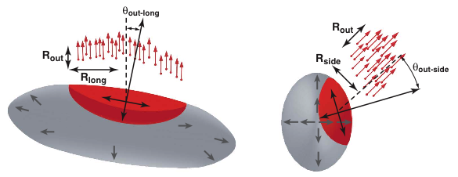
Femtoscopy: what is actually measured?
The correlation is determined by the size of region from
which particles with roughly the same velocity are emitted
⇒ Femtoscopy measures size, shape, and orientation of homogeneity regions
Notes:
The function S(r) is a Gaussian parameterization of the source, which is convoluted with the kernel (wavefunction-squared)

Slide 15
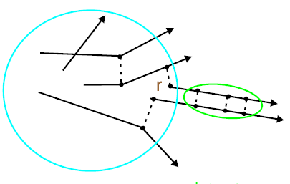
Source imaging
Technique devised by
D. Brown and P. Danielewicz
PLB398:252, 1997
PRC57:2474, 1998
Inversion of linear integral equation to obtain source function
1D Koonin-Pratt equation
Encodes FSI
Source function
(Distribution of pair separations in the pair rest frame)
Emitting source
Correlation
function
Kernel is independent
of freeze-out conditions
Model-independent analysis of emission shape
(goes beyond Gaussian shape assumption)

Slide 16

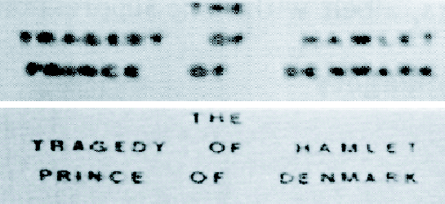
Imaging
Geometric information from imaging. General task:
From data w/ errors, R(q), determine the source S(r).
Requires inversion of the kernel K.
Optical recognition: K - blurring function, max entropy method
R:
Any determination of source characteristics from data, unaided by reaction theory, is an imaging.
S:

Slide 17
Inversion procedure
Freeze-out occurs after the last scattering. ⇒ Only Coulomb & quantum statistics effects included in the kernel.
Expand into B-spline basis Vary S_{j} to minimize χ²
April 18, 2013

Slide 18
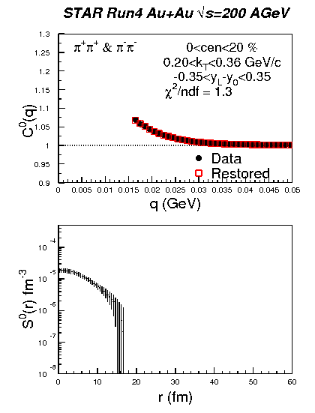
Particle correlations at low relative momenta:
How far we can go and what it means for the source function.
(1D example)

Slide 19
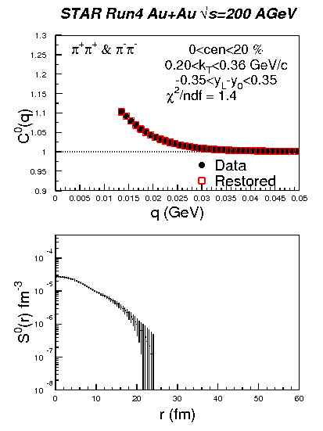
Particle correlations at low relative momenta:
How far we can go and what it means for the source function.
(1D example)

Slide 20
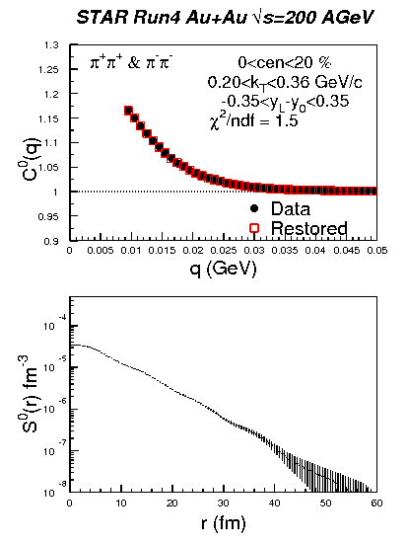
Particle correlations at low relative momenta:
How far we can go and what it means for the source function.
(1D example)

Slide 21
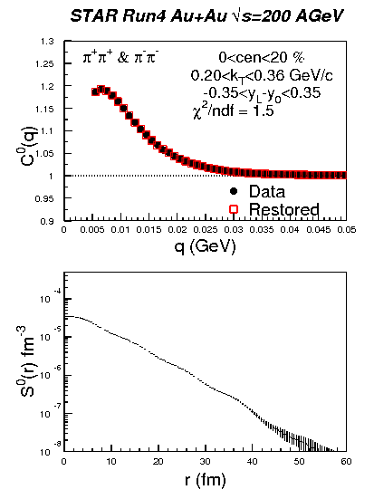
Particle correlations at low relative momenta:
How far we can go and what it means for the source function.
(1D example)

Slide 22
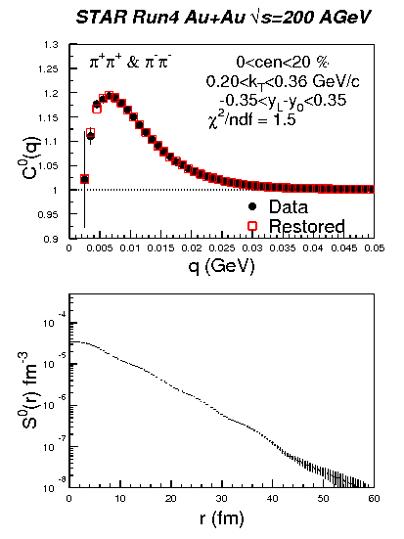
Particle correlations at low relative momenta:
How far we can go and what it means for the source function.
(1D example)

Slide 23
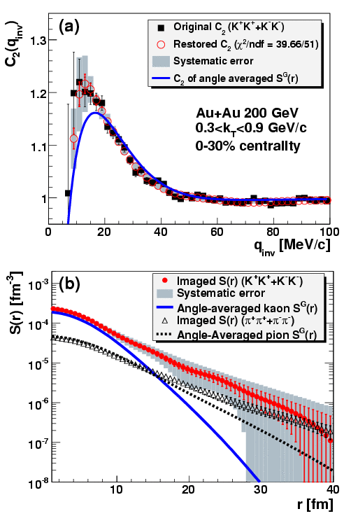
Previous source imaging results
PHENIX, PRL 98:132301,2007
PHENIX, PRL 103:142301,2009
Observed long non-gaussian tail was attributed to non-zero particle emision duration ∆τ≠0 and contribution of long-lived resonances

Slide 24
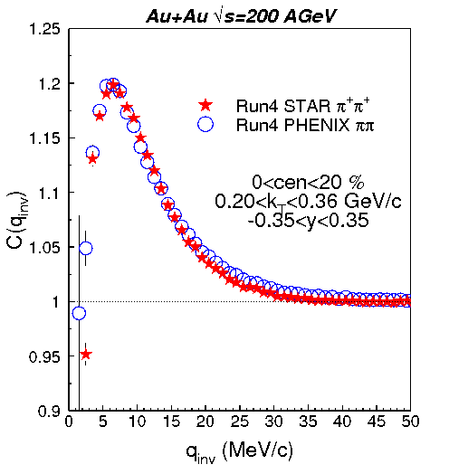
Pions: STAR vs PHENIX
arXiv:1012.5674 [nucl-ex]
STAR preliminary
Excellent agreement among two very different detectors

Slide 25
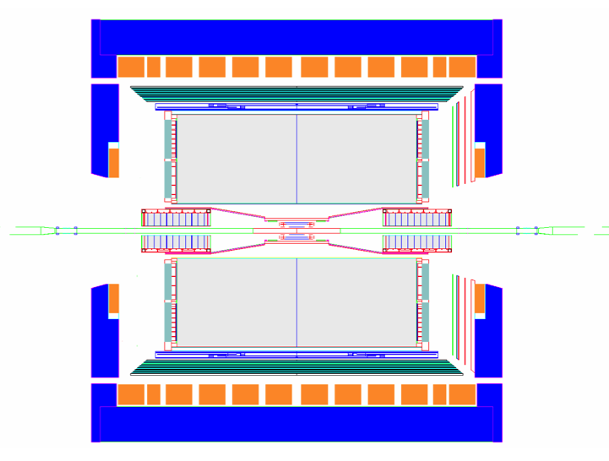
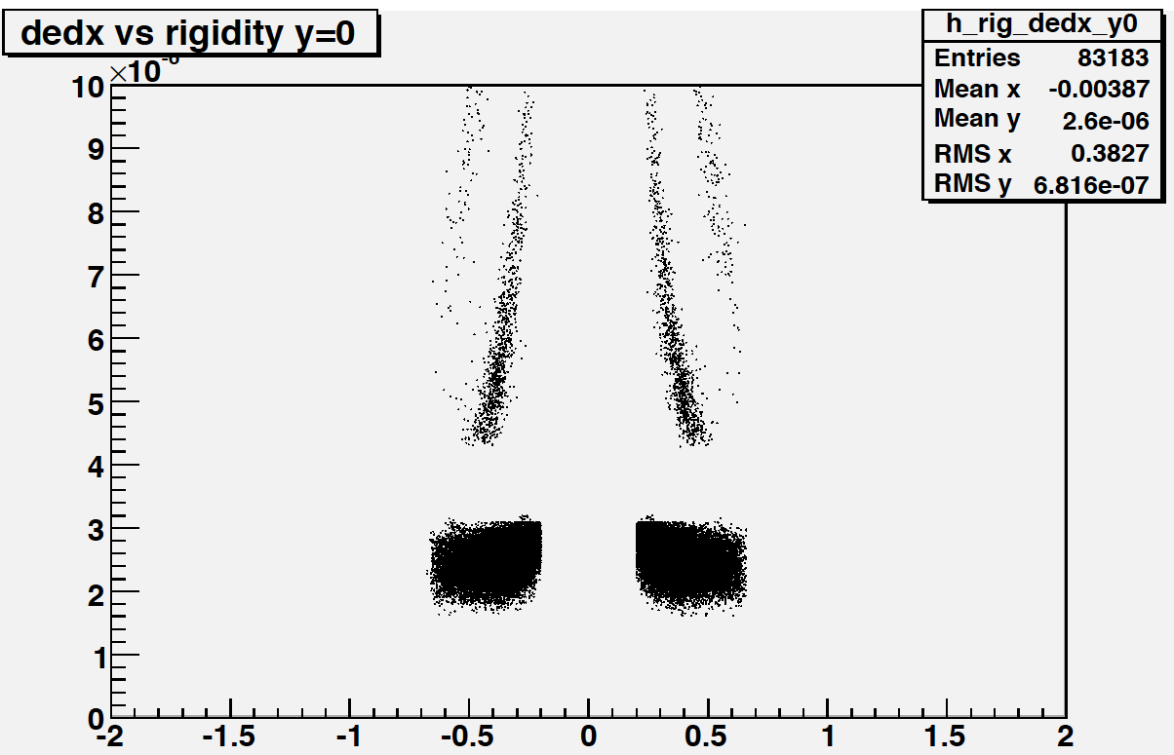
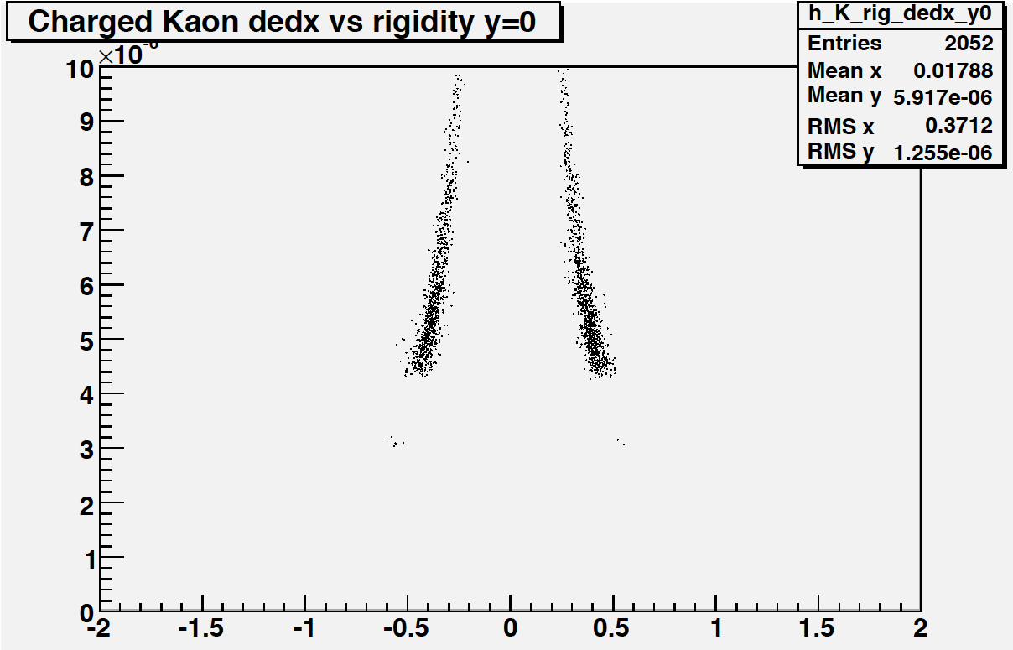
Kaon data analysis
20% most central Au+Au @ √s_{NN}=200 GeV
Run 4: 4.6 Mevts, Run 7: 16 Mevts
30% most central Au+Au @ √s_{NN}=200 GeV
Run 4: 6.6 Mevts
Particle ID selection via TPC dE/dx:
NSigmaKaon<2.0 && NSigmaPion>3.0
&& NSigmaElectron>2.0
TPC
dE/dx vs rigidity:
before after
PID
cuts
|y| < 0.5 & 0.2 < p_{T} < 0.4 GeV/c

Slide 26
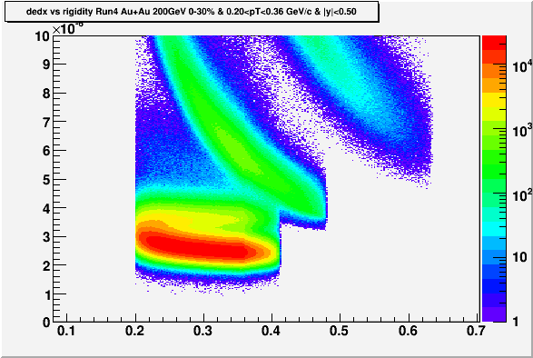
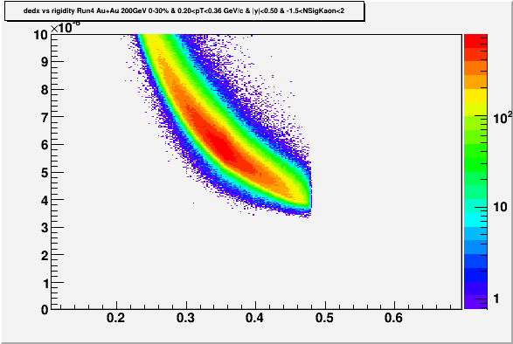
Kaon PID @ 0.2<p_{T}<0.36 GeV/c
Au+Au (0-30%)
No PID selection
-1.5<Number of Sigma<2.0
dE/dx
Rigidity (GeV/c)
Rigidity (GeV/c)

Slide 27
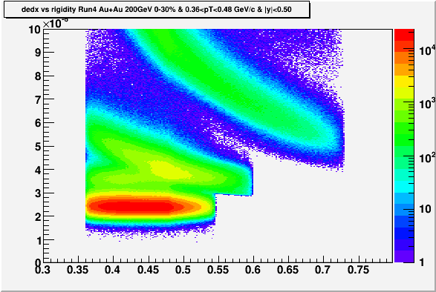
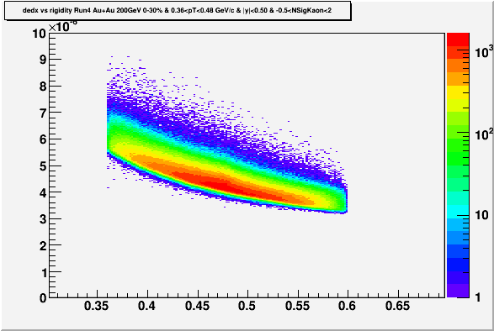
Kaon PID @ 0.36<p_{T}<0.48 GeV/c
Au+Au (0-30%)
No PID selection
-0.5<Number of Sigma<2.0
dE/dx
STAR PRELIMINARY
STAR PRELIMINARY
Rigidity (GeV/c)
Rigidity (GeV/c)
Rigidity (GeV/c)

Slide 28
STAR kaon 1D source shape result
PHENIX, PRL 103:142301,2009
34M+83M=
117M
K⁺K⁺ & K⁻K⁻ pairs
STAR data are
well described
by Gaussian.
Contrary to
PHENIX no
non-gaussian
tails are observed.
May be due
to a different
k_{T}-range:
STAR bin is
4x narrower.

Slide 29
3D source shape analysis:
Cartesin Harmonics basis
Danielewicz and Pratt,
Phys.Lett. B618:60, 2005
α_{i} = x, y or z
x = out-direction
y = side-direction
z = long-direction
3D Koonin-Pratt:
Plug (1) and (2) into (3)
⇒
Invert (1)
⇒
Invert (2)
⇒

Slide 30
Kaon vs. pion 3D source shape
arXiv:1012.5674 [nucl-ex]
PRL 98:13230
Very good agreement on 3D pion source
shape between PHENIX and STAR
Pion and kaon 3D source shapes
are very different: Is this due to
the different dynamics?

Slide 31
Comparison to thermal BW model
Therminator (A. Kisiel et al., Phys. Rev. C 73:064902 2006) basic ingredients:
Longitudinal boost invariance.
Blast-wave expansion with transverse velocity profile semi-linear in transverse radius ρ: v_{r}(ρ)=(ρ/ρ_{max})/(ρ/ρ_{max}+v_{t}). Value of v_{t} =0.445 comes from the BW fits to particle spectra from Au+Au @ 200GeV: STAR, PRC 79:034909, 2009.
Thermal emission takes place at proper time τ, from a cylinder of infinite longitudinal size and finite transverse dimension ρ_{max}.
Freeze-out occurs at τ = τ₀ +aρ. Particles which are emitted at (z, ρ) have LAB emission time t² = (τ₀ +aρ)²+z² .
Emission duration is included via Δτ.

Slide 32
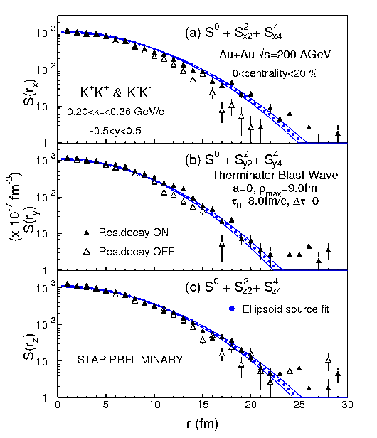
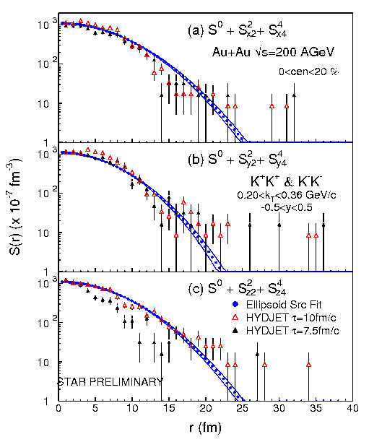
… and to the HYDJET++ model
Therminator: Comp.Phys.Com. 174, 669 (2006)
HYDJET++: Comp.Phys.Com. 180, 779 (2009)
HYDJET++ gives larger source lifetime than Terminator

Slide 33
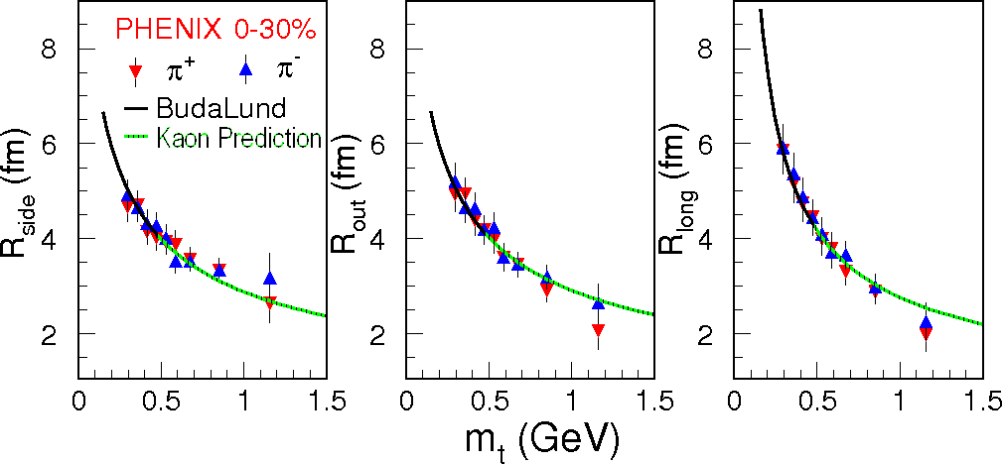
m_{T}-dependence of pion radii in LCMS confronted with hydrodynamics
M. Csanad and T. Csorgo: arXiv:0800.0801[nucl-th]
Au+Au √s_{NN}=200GeV
Excellent description of the PHENIX pion data

Slide 34
m_{T}-dependence of the radii in LCMS
Buda-Lund: arXiv:0800.0801[nucl-th]
HKM: PRC81, 054903 (2010)
R_{out}=R_{x}/γ , R_{side}=R_{y} , R_{long}=R_{z}
Buda-Lund describes m_{T}–dependence of R_{out} & R_{side} but fails for R_{long} at low m_{T} ⇒ violation of m_{T} -scaling between pion and kaon Gaussian radii.
HKM is more representative of fireball expansion dynamics than the simpler perfect fluid hydrodynamics.
STAR preliminary

Slide 35
Conclusions
First model-independent extraction of kaon 3D source shape.
Source function of mid-rapidity, low-momentum kaons from central Au+Au collisions at √s_{NN}=200 GeV is Gaussian – no significant non-Gaussian tail observed.
Comparison with the Therminator model indicates kaon emission from a fireball with transverse dimension and lifetime consistent with values from two-pion interferometry.
3D source function shapes for kaons and pions are very different. The narrower shape observed for the kaons indicates a much smaller role of resonance decays and/or of the exponential emission duration width ∆τ on kaon emission.

Slide 36
Conclusions
The Gaussian radii for the kaon source function display monotonic decrease with increasing transverse mass over the interval of 0.55≤ m_{T} ≤ 1.15 GeV/c².
In the outward and sideward directions this decrease is adequately described by the m_{T}–scaling. However, in the longitudinal direction the scaling is broken, favoring the HKM model as more representative of the expansion dynamics of the fireball than the pure hydrodynamics model calculations.

Slide 37
Open charm production in pp collisions at √s=200 and 500GeV and in Au+Au at √s_{NN}=200GeV
David Tlustý,
Jaroslav Bielčík
arXiv:1208.0057 [hep-ex]
arXiv:1211.5995 [hep-ex]
J.Phys.Conf.Ser. 389 (2012) 012024
Phys. Rev. D 86 (2012) 72013

Slide 38
How to measure charm quarks
Indirect measurements through decay Leptons
    can be triggered easily (high p_{T})
    Higher B.R.
    Indirect access to the heavy quark kinematics
    mixing contribution from all charm and bottom hadron decays
Direct reconstruction
    direct access to heavy quark kinematics
    hard to trigger (high energy trigger only for correlation measurements)
    smaller Branching Ratio (B.R.)
    large combinatorial background (need handle on decay vertex)
April 18, 2013

Slide 39
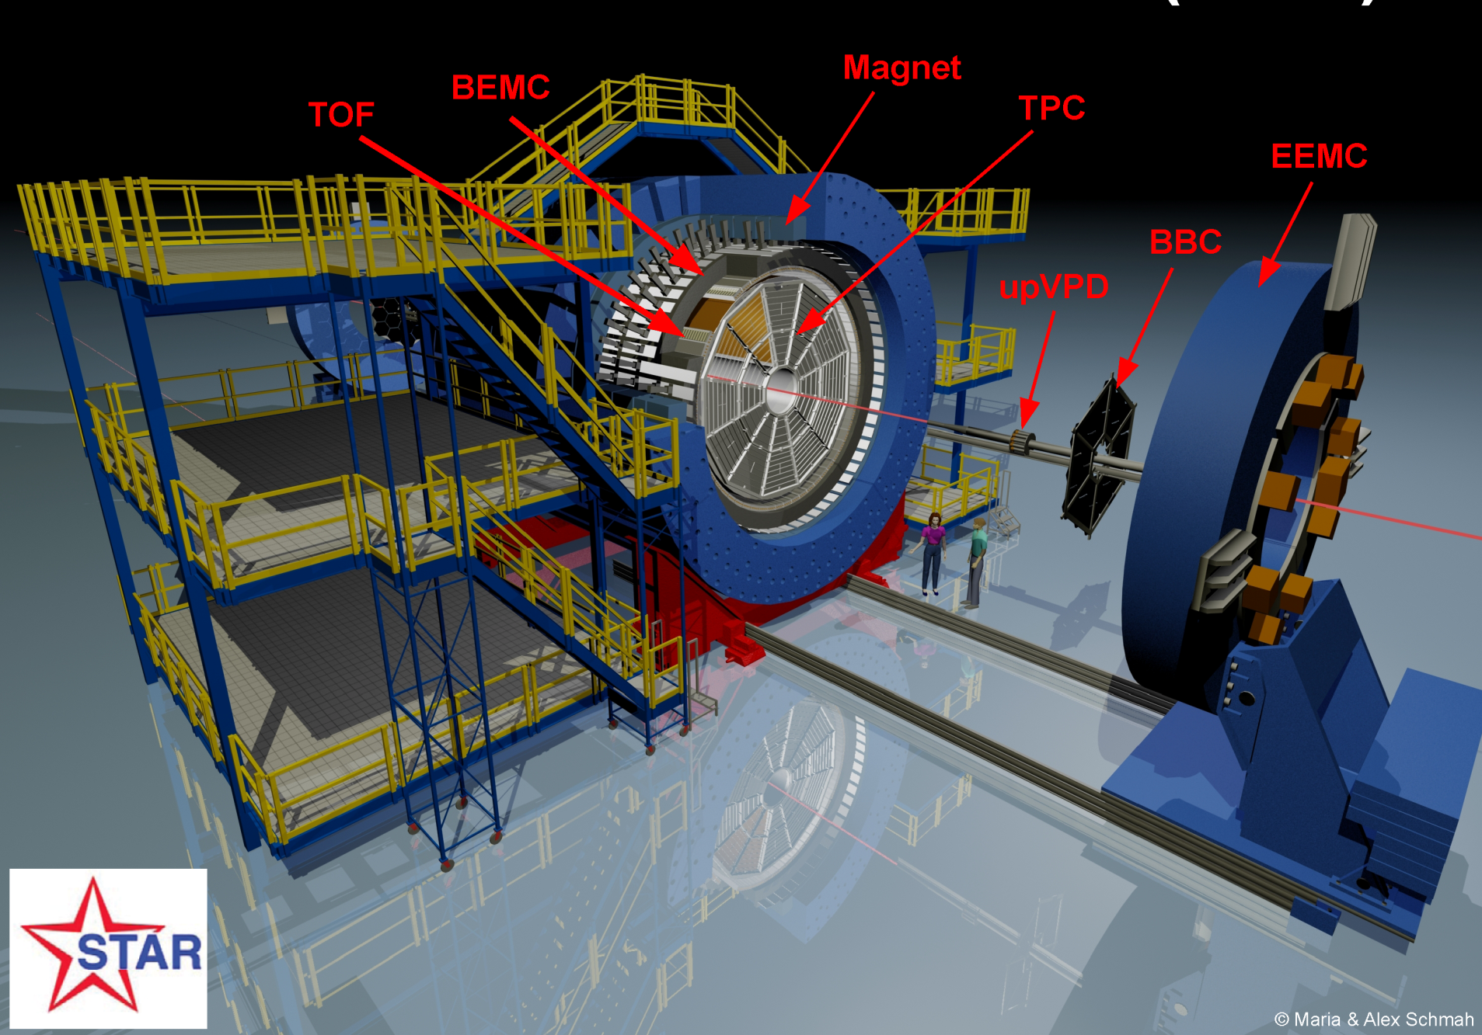
TPC:
Detects Particles in the |η|<1 range
π, K, p through dE/dx and TOF
K⁰_{s}, Λ, Ξ, Ω, φ through invariant mass
Coverage: 0 < φ < 2π |η| < 1.0
Uniform acceptance: All energies and particles

Slide 40
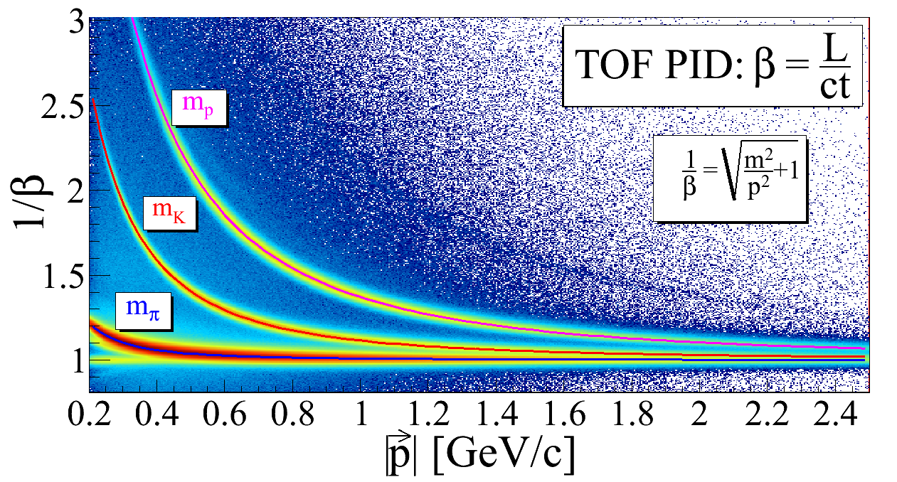
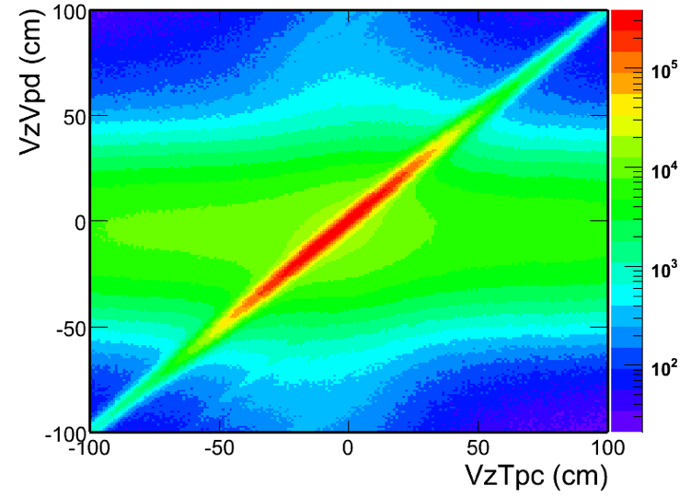
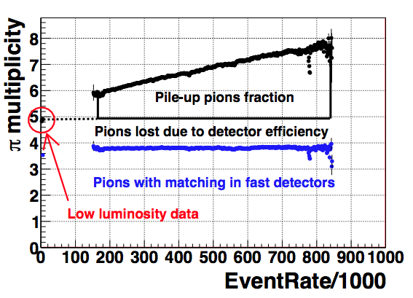
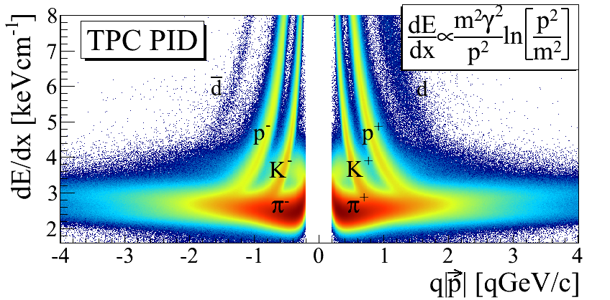
Event Selection and Hadron Identification
arXiv: 1204.4244
Pile-up events
Triggered events
Pile-up events
STAR preliminary
STAR preliminary
STAR preliminary
Event Rate [kHz]

Slide 41
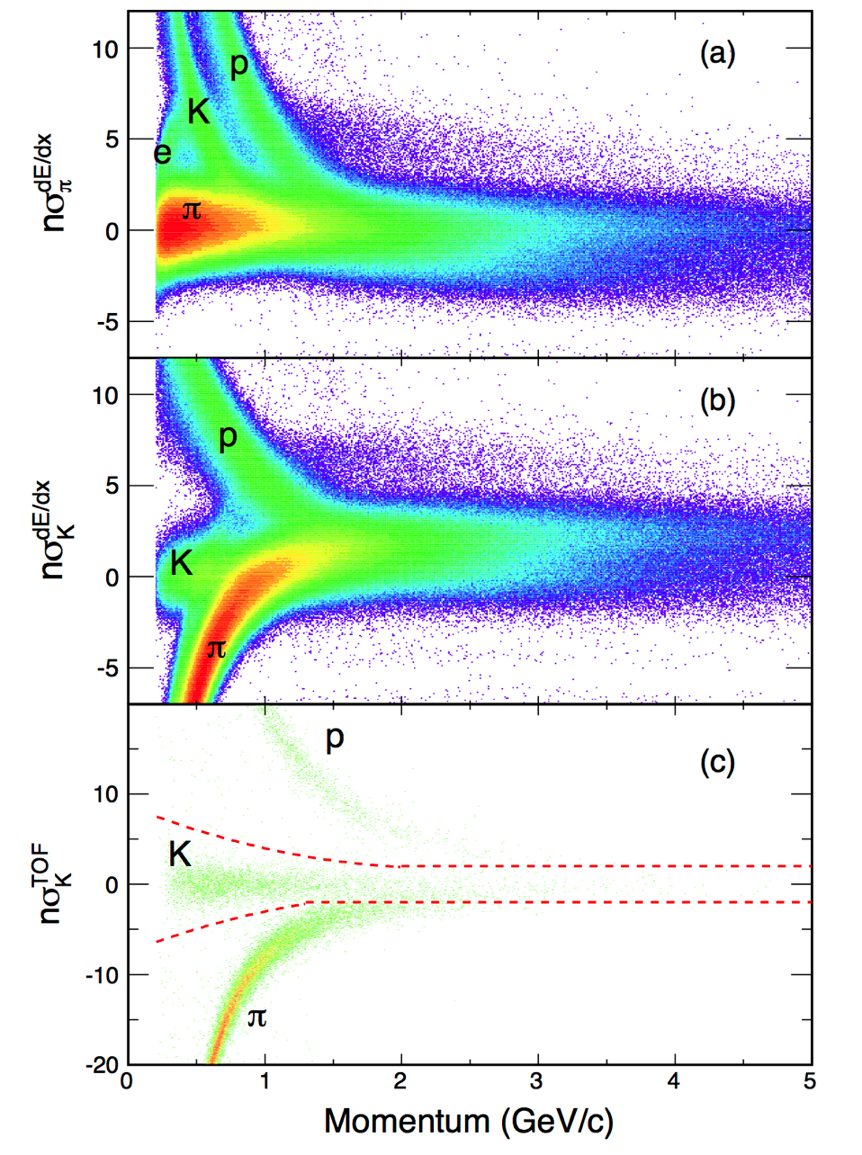
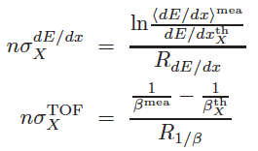
Hadron Identification
Phys. Rev. D 86 (2012) 72013

Slide 42

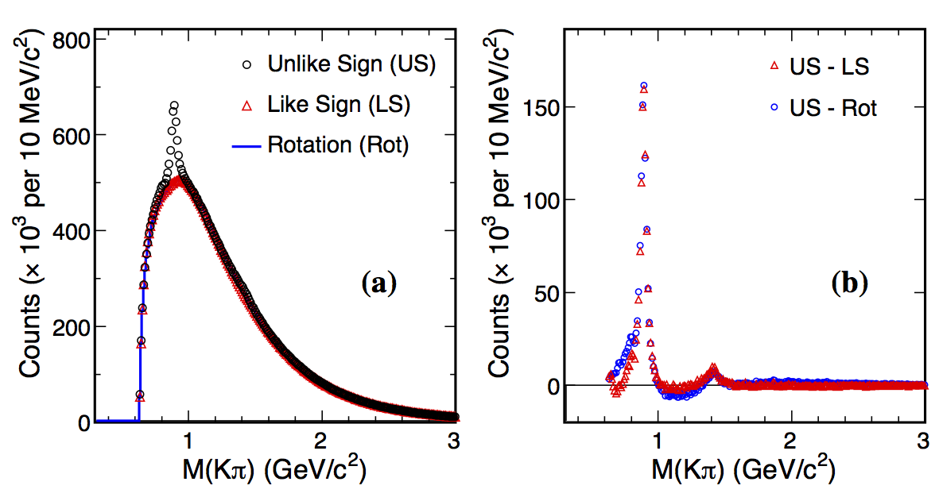
D⁰ Signal in p+p 200 GeV
K*(892)
K₂*(1430)
105 Min Bias events were used for the charmed-hadron analysis
Phys. Rev. D 86 (2012) 72013

Slide 43
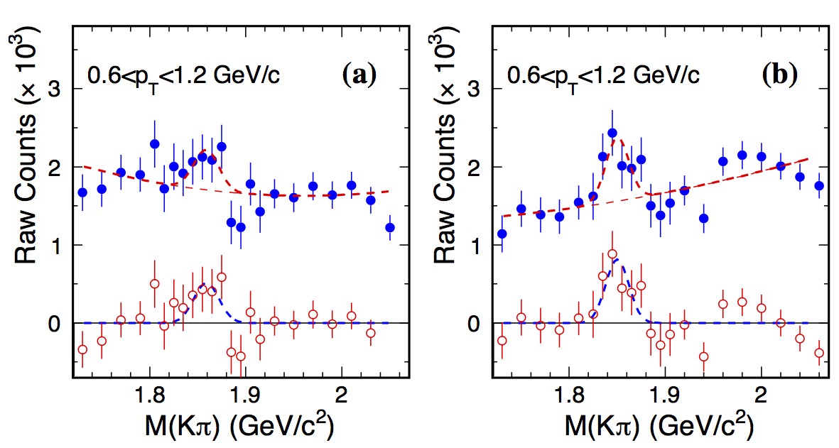
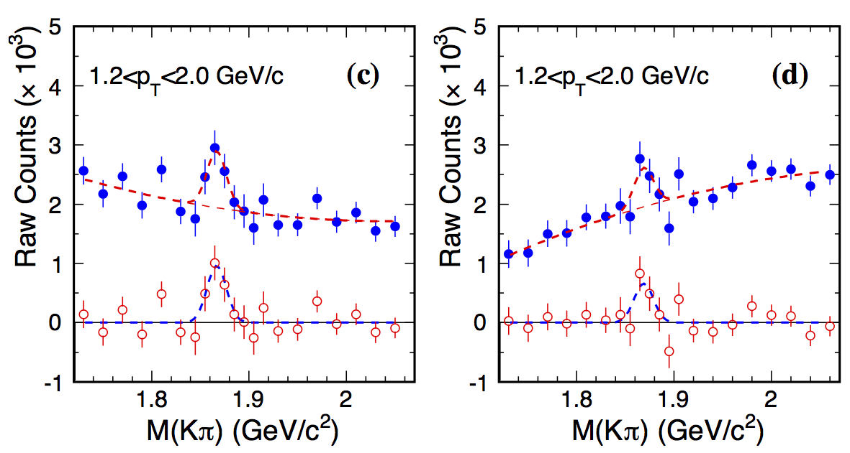
D⁰ Signal in p+p 200 GeV
(a) track-rotation
(b) background subtraction
(c) track-rotation
(d) background subtraction
S/√(S+B) ~ 14; Mass = 1866 ± 1 MeV/c² (PDG: 1864.5 ± 0.4 MeV/c²)
split into 7 pT and 3 centrality bins
Phys. Rev. D 86 (2012) 72013

Slide 44
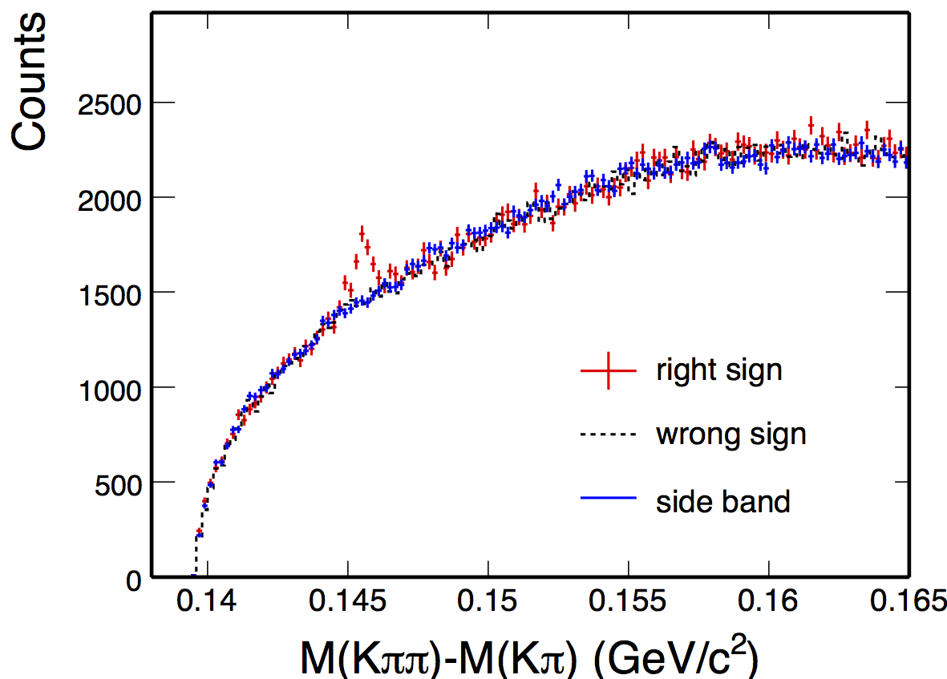
D* Signal in p+p 200 GeV
Phys. Rev. D 86 (2012) 72013

Slide 45
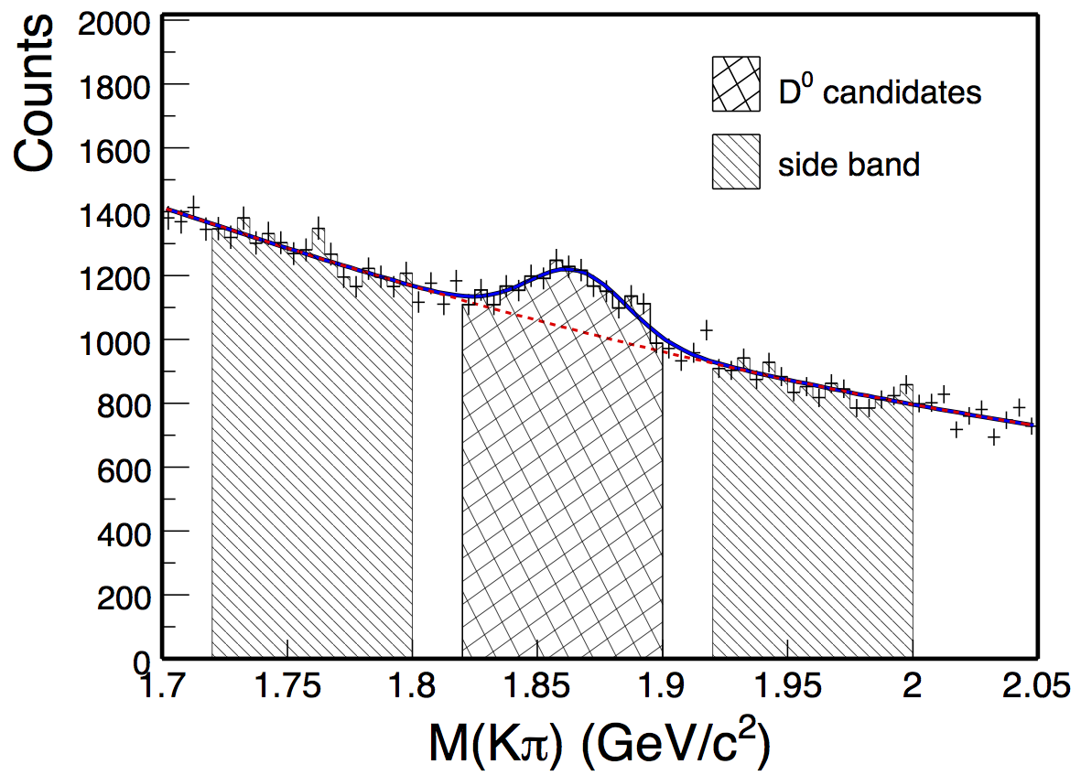
D⁰ signal after requiring the D* candidate
Phys. Rev. D 86 (2012) 72013

Slide 46
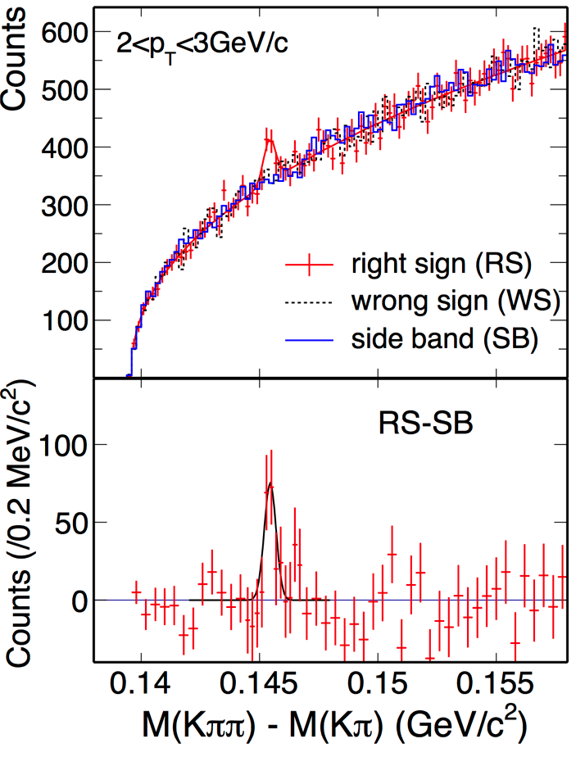
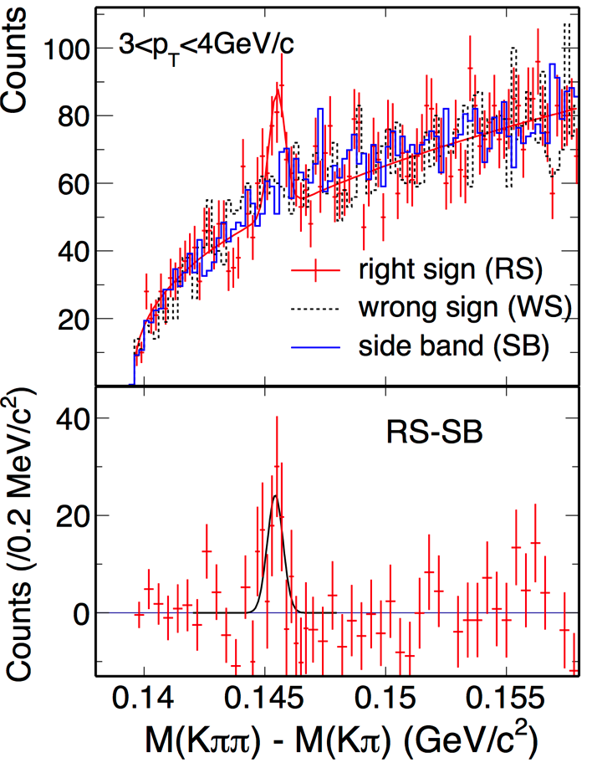
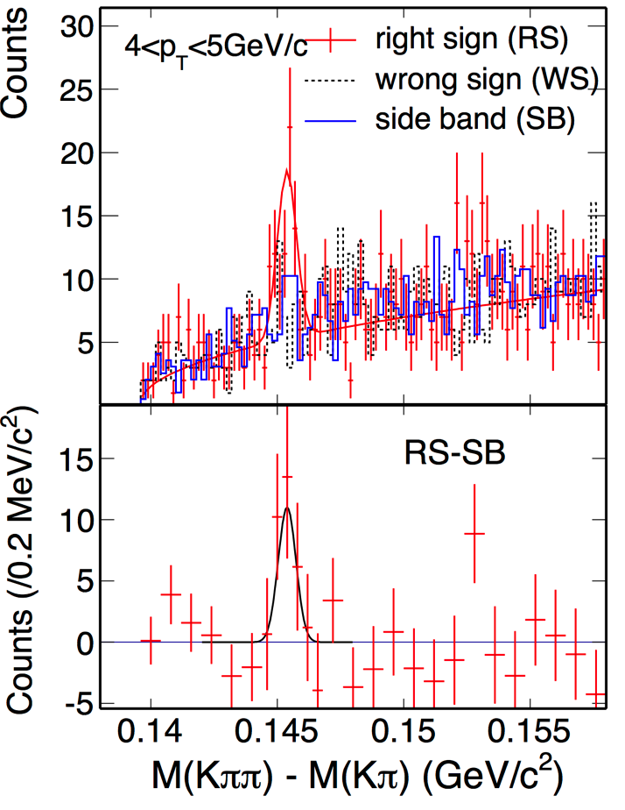
D* Signal in p+p 200 GeV
Phys. Rev. D 86 (2012) 72013

Slide 47
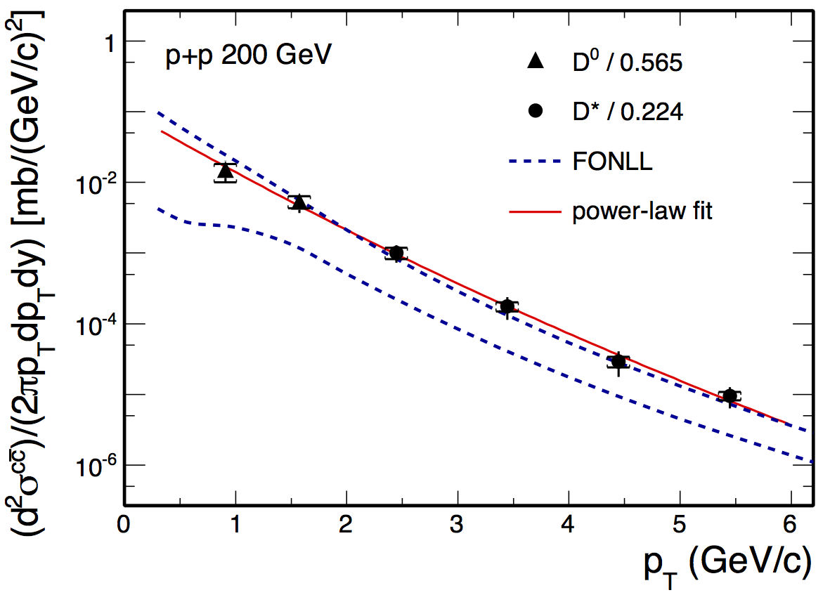
cc⁻ cross section as inferred from D⁰ and D*
Phys. Rev. D 86 (2012) 72013

Slide 48
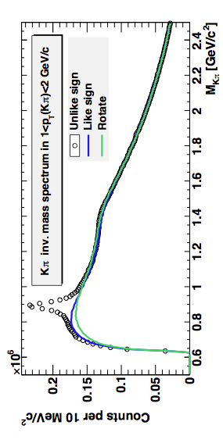
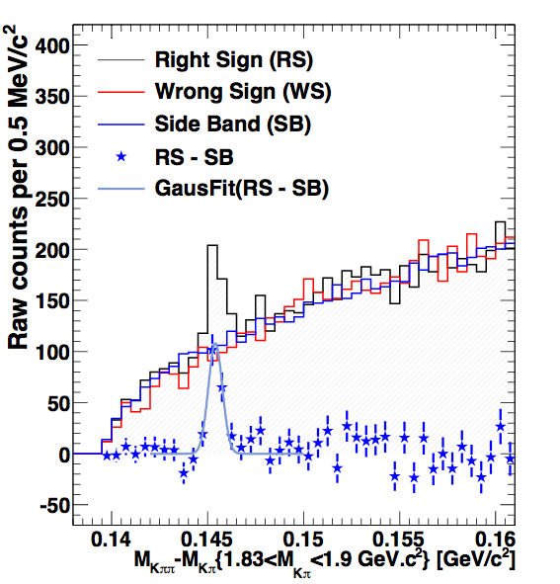
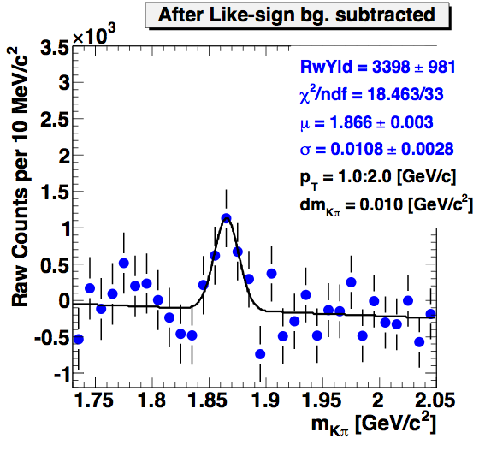
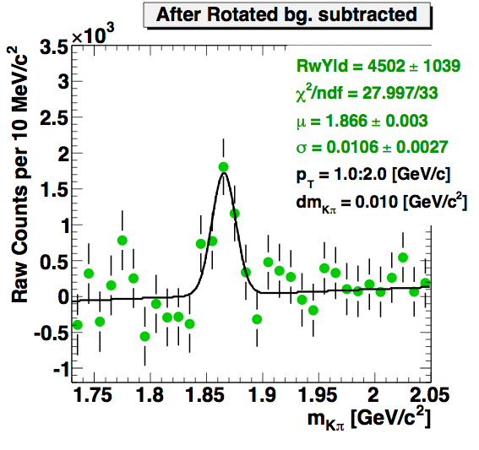
D⁰ and D* Signal in p+p 500 GeV
K*⁰
K₂*(1430)
STAR preliminary
D⁰
STAR preliminary
right sign : 1.83<M(Kπ)<1.9 GeV/c²
wrong sign : K⁻π⁺π⁻ + K⁺π⁻π⁺
side band : 1.7<M(Kπ)<1.8 + +1.92<M(Kπ)<2 GeV/c²
minimum bias L⁻¹=1.53 nb⁻¹
Different methods reproduce combinatorial background.
Consistent results from two background methods.
STAR preliminary
STAR preliminary

Slide 49
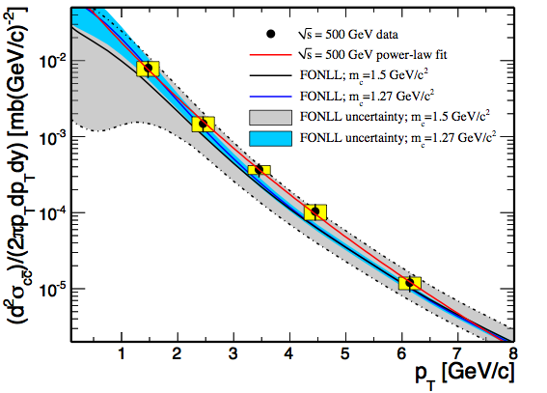
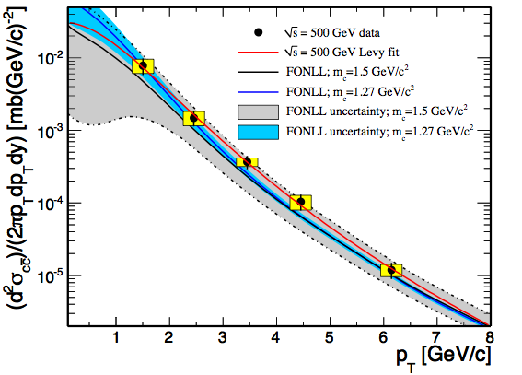



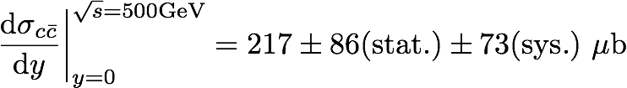


D⁰ and D* p_{T} spectra in p+p 500 GeV
D⁰ yield scaled by N_{D0}/N_{cc}= 0.565^{[1]}
D* yield scaled by N_{D*}/N_{cc}= 0.224^{[1]}
STAR preliminary
[1] C. Amsler et al. (Particle Data Group), PLB 667 (2008) 1.
[2] FONLL calculation:
Ramona Vogt
µF = µR = mc, |y| < 1

Slide 50
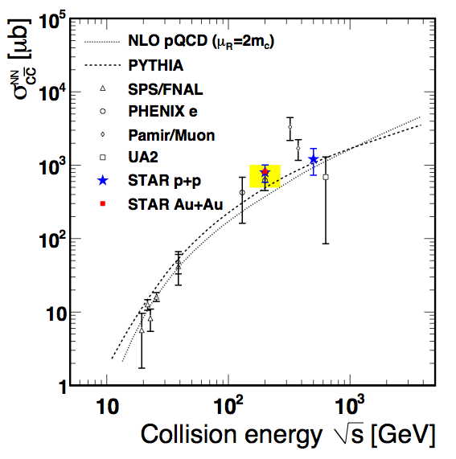



Total Charm Cross Section
500 GeV, F = 5.6
200 GeV, F = 4.7
STAR preliminary

Slide 51







D⁰ signals in Au+Au 200 GeV
Combining data from Year2010 & 2011.
Total: ~ 800 M Min. bias events.
Significant signals are observed
in collisions of all centralities.
David Tlusty
arXiv:1208.0057 [hep-ex]

Slide 52
D⁰ Au+Au 200 GeV Invariant Yield Spectra
arXiv:1208.0057 [hep-ex]

Slide 53
D⁰ Au+Au 200 GeV R_{AA}
arXiv:1208.0057 [hep-ex]

Slide 54







D⁰ Au+Au 200 GeV spectra & R_{AA}
Suppression at high p_{T} in central and mid-central collisions
Enhancement at intermediate p_{T}
D decouples earlier that ordinary hadrons
Gossiaux: arXiv:1207.5445, Boltzmann & pQCD with running coupling
He: arXiv:1204.4442 Focker-Planck Resonance recombination
STAR preliminary

Slide 55





D⁰ elliptic flow in Au+Au 200 GeV
Need HFT for more precise measurement:
- to study the coalescence scenarios.
- to study the energy dependence.
y
x
55

Slide 56

Heavy Flavor Tracker (HFT)
Inner Field Cage
Magnet
Return Iron
Outer Field Cage
FGT
TPC Volume
Solenoid
EAST
WEST

Slide 57

Heavy Flavor Tracker (HFT)
HFT
Detector | Radius (cm) | Hit Resolution R/ϕ - Z (μm - μm) | Radiation length
SSD | 22 | 20 / 740 | 1% X₀
IST | 14 | 170 / 1800 | <1.5 %X₀
PIXEL | 8 | 12/ 12 | ~0.4 %X₀
 | 2.5 | 12 / 12 | ~0.4% X₀
SSD
IST
PXL
PIXEL
two layers
18.4x18.4 μm pixel pitch
10 sectors, delivering ultimate Pointing resolution that allows for direct topological identification of charm.
New monolithic active pixel sensors (MAPS) technology
SSD
Existing single layer detector, double side strips (electronic upgrade)
IST One layer of silicon strips along the beam direction (r-φ) , guiding tracks from the SSD to PIXEL detector. - proven technology

Slide 58


PXL – Layout
2 layers
5 sectors / half (10 sectors total)
4 ladders / sector
Insertion from east side, can be
done after STAR roll-in
Ladder with 10 MAPS sensors (~ 2×2 cm each)
RDO
buffers/
drivers
MAPS
4-layer kapton cable with aluminium Ladder Flex Cable
Aluminum conductor

Slide 59



First Engineering run sector on metrology stage

Slide 60
Physics of the Heavy Flavor Tracker at STAR
Direct HF hadron measurements (p+p and Au+Au)
  (1) Heavy-quark cross sections: D^{0±}*, D_{S}, Λ_{C} , B, …
  (2) Both spectra (R_{AA}, R_{CP}) and v₂ in a wide p_{T} region: 0.5 - 10 GeV/c
  (3) Charm hadron correlation functions, heavy flavor jets
  (4) Full spectrum of the heavy quark hadron decay electrons
Physics
  (1) Measure heavy-quark hadron v₂, heavy-quark collectivity, to study the medium properties e.g. light-quark thermalization
  (2) Measure heavy-quark energy loss to study pQCD in hot/dense medium e.g. energy loss mechanism
  (3) Analyze hadro-chemistry including heavy flavors
Notes:
Need to go through formatting

Slide 61

Summary
D⁰ and D* are measured in p+p 200 GeV up to 6 GeV/c and in p+p 500 GeV up to 6 GeV/c
consistent with FONLL upper limit.
D⁰ are measured in Au+Au 200 GeV up to 6 GeV/c for 3 centrality bins.
Charm cross sections at mid-rapidity follow number of binary collisions scaling
Strong suppression above 2.2 GeV/c in central collisions, consistent with resonance recombination model
Further improvement with Heavy Flavor Tracker

Slide 62
STAR Collaboration
Argonne National Laboratory, Argonne, Illinois 60439
Brookhaven National Laboratory, Upton, New York 11973
University of California, Berkeley, California 94720
University of California, Davis, California 95616
University of California, Los Angeles, California 90095
Universidade Estadual de Campinas, Sao Paulo, Brazil
University of Illinois at Chicago, Chicago, Illinois 60607
Creighton University, Omaha, Nebraska 68178
Czech Technical University in Prague, FNSPE, 115 19 Prague,
Czech Republic
Nuclear Physics Institute ASCR, 250 68 Řež/Prague,
Czech Republic
University of Frankfurt, Frankfurt, Germany
Institute of Physics, Bhubaneswar 751005, India
Indian Institute of Technology, Mumbai, India
Indiana University, Bloomington, Indiana 47408
Alikhanov Institute for Theoretical and Experimental Physics, Moscow, Russia
University of Jammu, Jammu 180001, India
Joint Institute for Nuclear Research, Dubna, 141 980, Russia
Kent State University, Kent, Ohio 44242
University of Kentucky, Lexington, Kentucky, 40506-0055
Institute of Modern Physics, Lanzhou, China
Lawrence Berkeley National Laboratory, Berkeley, California 94720
Massachusetts Institute of Technology, Cambridge, MA
Max-Planck-Institut fűr Physik, Munich, Germany
Michigan State University, East Lansing, Michigan 48824
Moscow Engineering Physics Institute, Moscow Russia
NIKHEF and Utrecht University, Amsterdam, The Netherlands
Ohio State University, Columbus, Ohio 43210
Old Dominion University, Norfolk, VA, 23529
Panjab University, Chandigarh 160014, India
Pennsylvania State University, University Park, Pennsylvania 16802
Institute of High Energy Physics, Protvino, Russia
Purdue University, West Lafayette, Indiana 47907
Pusan National University, Pusan, Republic of Korea
University of Rajasthan, Jaipur 302004, India
Rice University, Houston, Texas 77251
Universidade de Sao Paulo, Sao Paulo, Brazil
University of Science & Technology of China, Hefei 230026, China
Shandong University, Jinan, Shandong 250100, China
Shanghai Institute of Applied Physics, Shanghai 201800, China
SUBATECH, Nantes, France
Texas A&M University, College Station, Texas 77843
University of Texas, Austin, Texas 78712
University of Houston, Houston, TX, 77204
Tsinghua University, Beijing 100084, China
United States Naval Academy, Annapolis, MD 21402
Valparaiso University, Valparaiso, Indiana 46383
Variable Energy Cyclotron Centre, Kolkata 700064, India
Warsaw University of Technology, Warsaw, Poland
University of Washington, Seattle, Washington 98195
Wayne State University, Detroit, Michigan 48201
Institute of Particle Physics, CCNU (HZNU), Wuhan 430079, China
Yale University, New Haven, Connecticut 06520
University of Zagreb, Zagreb, HR-10002, Croatia
Thank You

Slide 63
Timeline for RHIC’s Next Decade
Years | Beam Species and Energies | Science Goals | New Systems Commissioned
2013 | 500 GeV 15 GeV Au+Au | Sea antiquark and gluon polarization QCD critical point search | Electron lenses upgraded polarised source STAR HFT
2014 | 200 GeV Au+Au and baseline data via 200 GeV p+p (needed for new det. subsystems) | Heavy flavor flow, energy loss, thermalization, etc. quarkonium studies | 56 MHz SRF full HFT STAR Muon Telescope Detector PHENIX Muon Piston Calorimeter Extension (MPC-EX)
2015-2017 | High stat. Au+Au at 200 and ~40 GeV U+U/Cu+Au at 1-2 energies 200 GeV p+A 500 GeV | Extract η/s(T_{min}) + constrain initial quantum fluctuations further heavy flavor studies sphaleron tests @ μ_{B}≠0 gluon densities & saturation finish p+p W prod’n | Coherent Electron Cooling (CeC) test Low-energy electron cooling STAR inner TPC pad row upgrade
2018-2021 | 5-20 GeV Au+Au (E scan phase 2) long 200 GeV + 1-2 lower √s Au+Au w/ upgraded dets. baseline data @ 200 GeV and lower √s 500 GeV 200 GeV | x10 sens. increase to QCD critical point and deconfinement onset jet, di-jet, γ-jet quenching probes of E-loss mechanism color screening for different qq states transverse spin asyms. Drell-Yan & gluon saturation | sPHENIX forward physics upgrades Steve Vigdor DNP Town Meeting Oct. 25, 2012

