Slide 1
FZU Computing Center
Jiří Chudoba
VS - Meeting with users, 30.11.2023

Slide 2
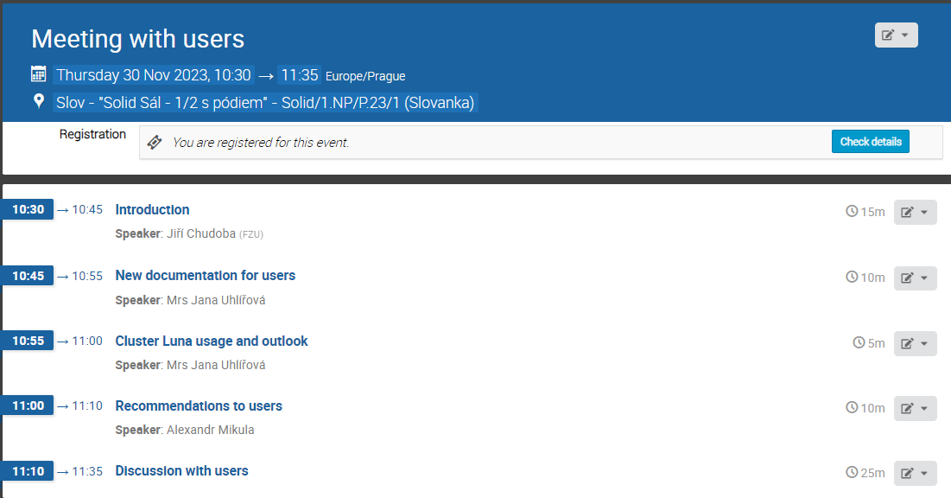
Welcome

Slide 3
Changes in 2023
12/2022
clusters aplex (2014, 32 servers, 7 kW), malva (2013, 12 servers, 4 kW) and lilium (2013, 47 servers, 16 kW) switched off
migration of some central servers to OS rocky 9, later to Alma Linux 9
05/2023
dpmpool18 and dpmpool19 (both from 2014) drained and switched off
6/2023
cluster magic (2016, 36 servers, 11 kW) switched off (moved to MFF UK)
11/2023
100 Gbps PASNET connection
lids6 switched off
24 disks (á 22 TB) delivered (FERMILAB)

Slide 4
Energy consumption
increase of price from 1.8 (2.5) + VAT CZK/kWh to 6.8 CZK/kWh from 1.1.2023
switch off old clusters lilium (2013, 16.5 kW) and malva (2013, 4.2 kW)
aplex (2014, 7.2 kW) and magic (2016, 10.8 kW) will follow
- 38.7 kW = 280 kCZK/month (PUE = 1.5)
2022-01: 9680 cores
2023-01: 10272 cores
2023-0x: 7760 cores

Slide 5
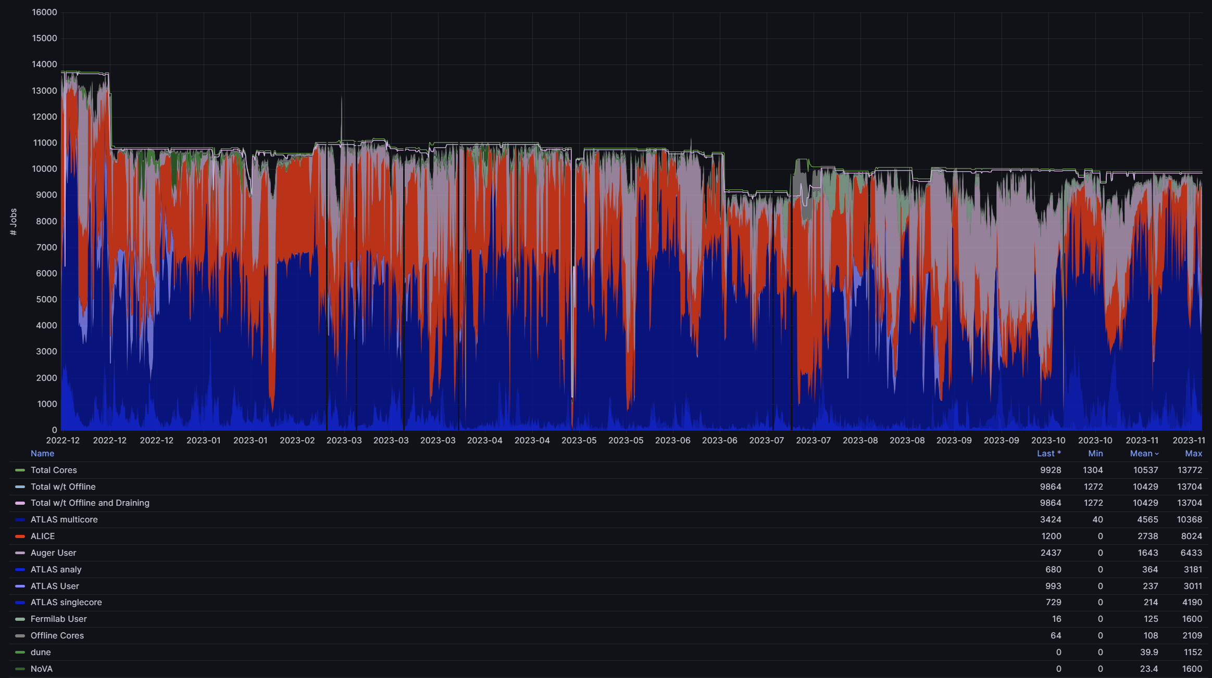
Grafana plots

Slide 6
Computing servers - Golias

Slide 7
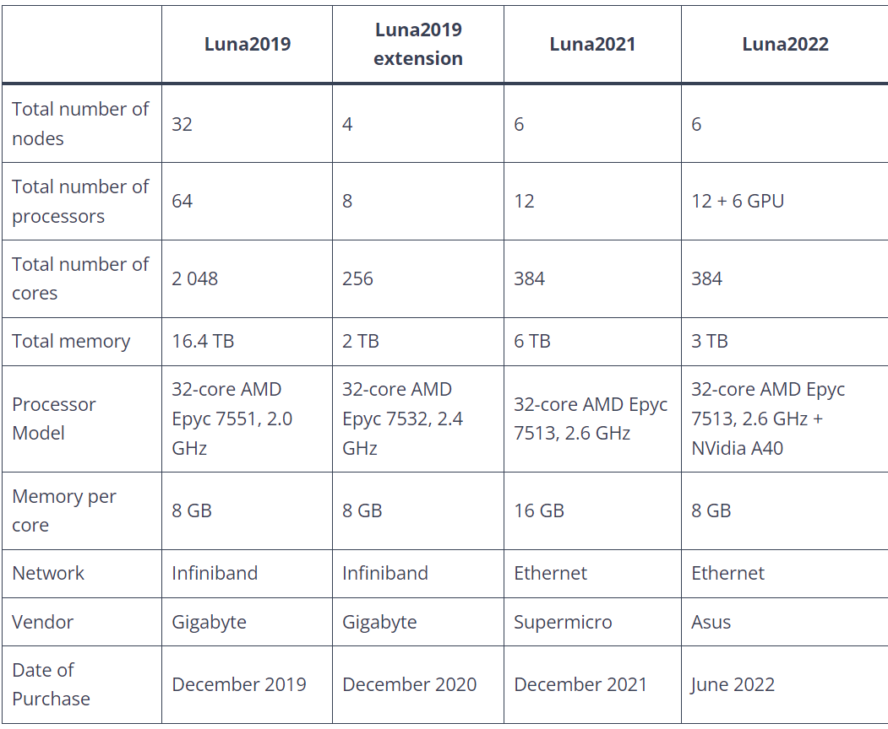
Luna servers

Slide 8
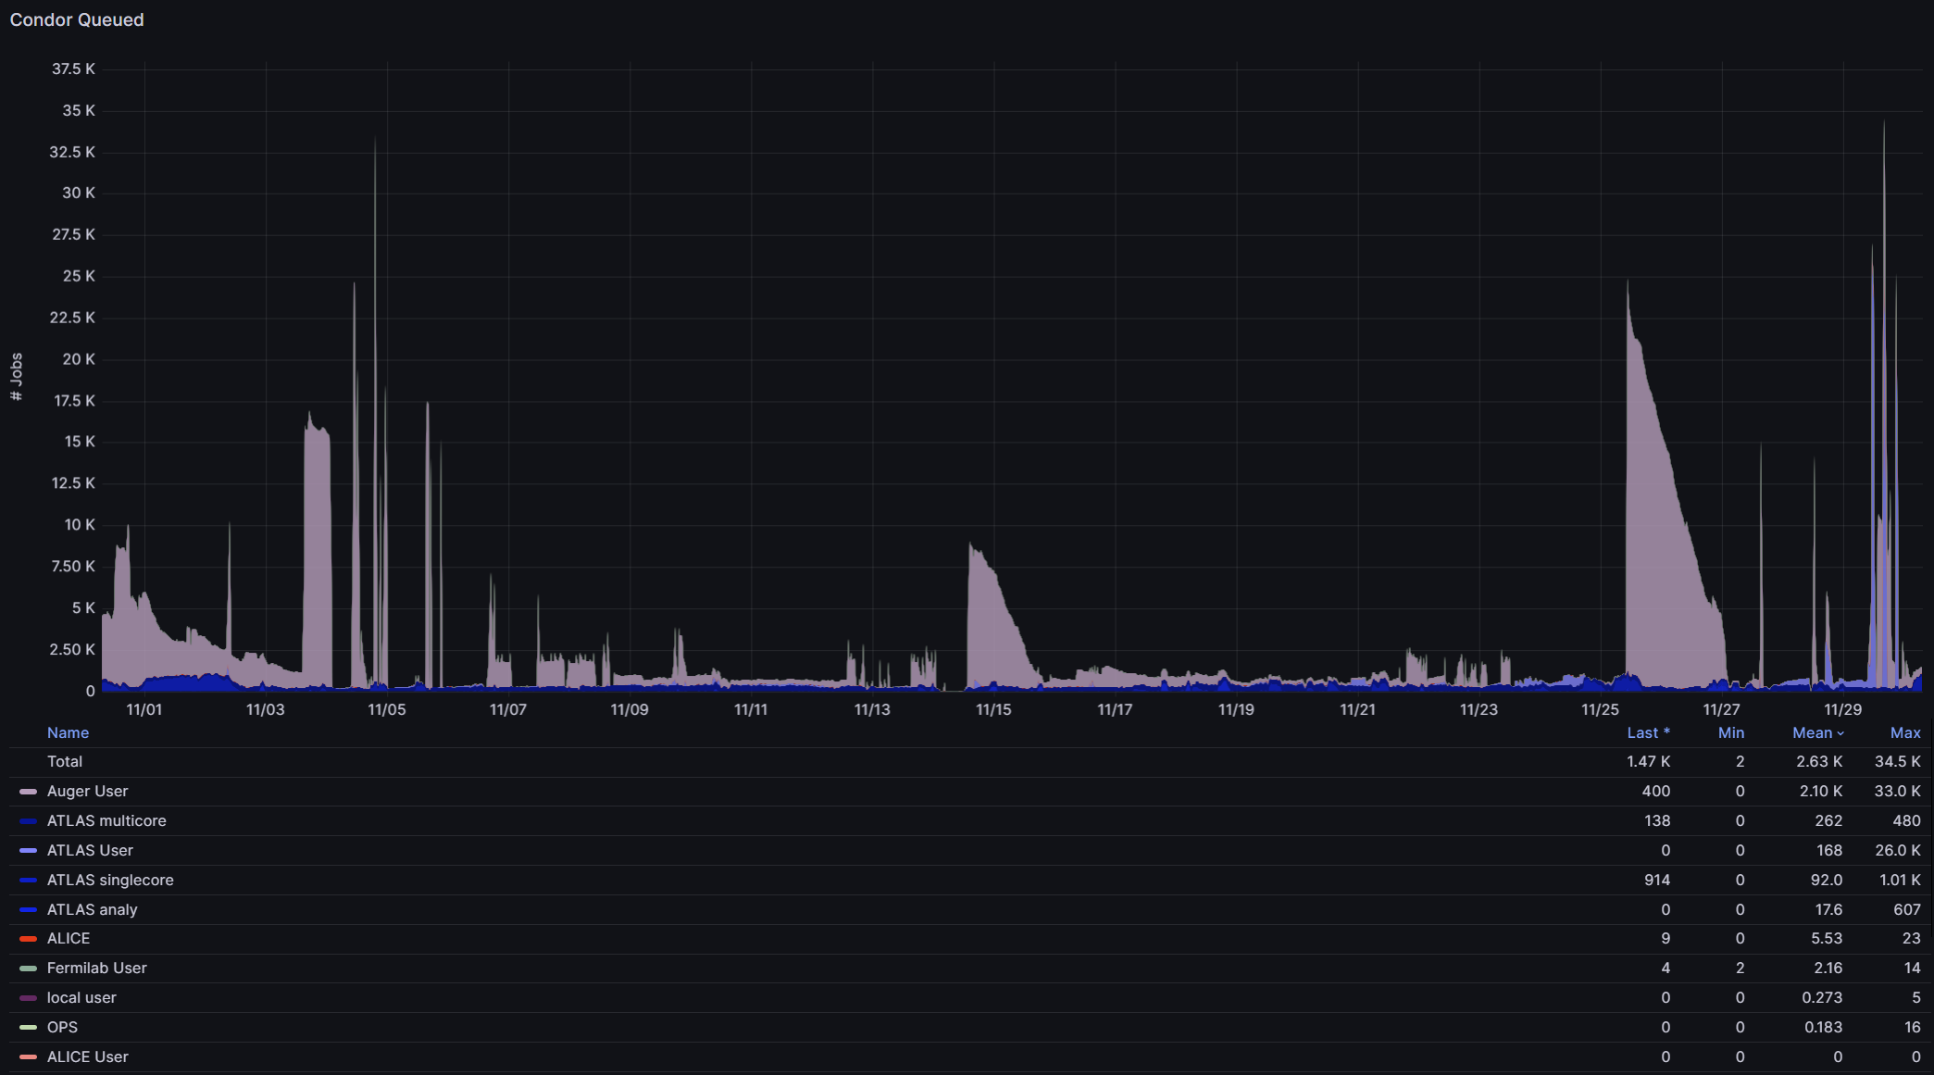
Grafana plots

Slide 9
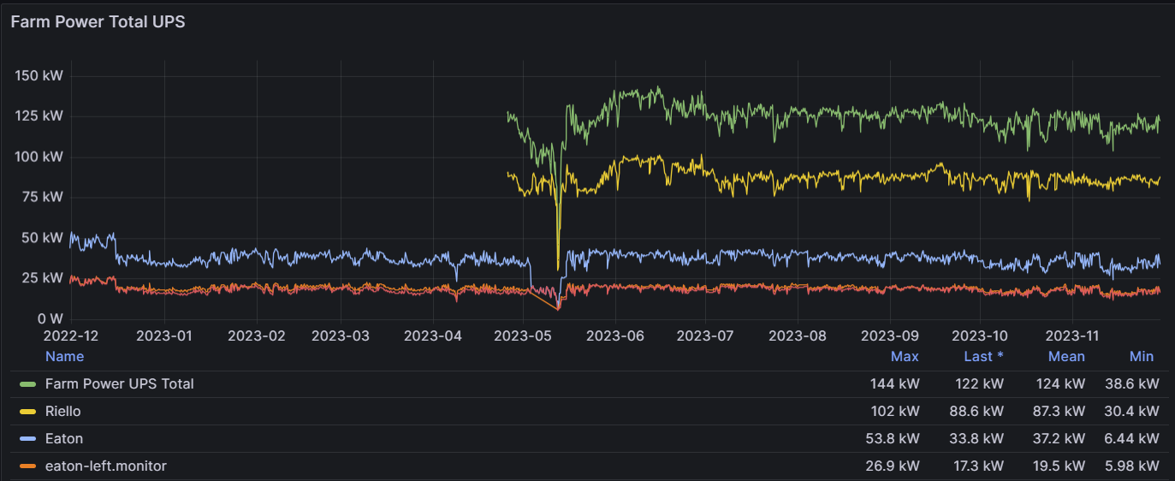
Electricity consumtion

Slide 10
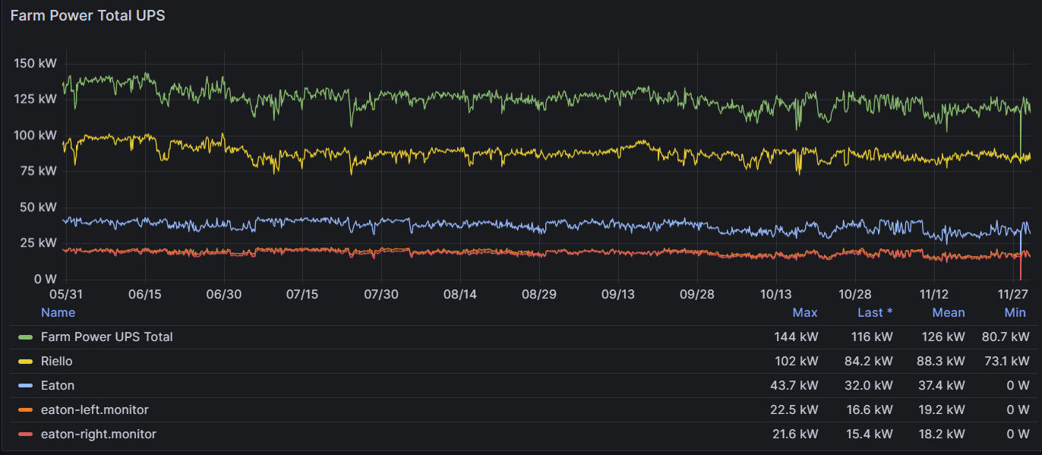
Electricity consumption 2
mean 126 kW (without cooling)

Slide 11
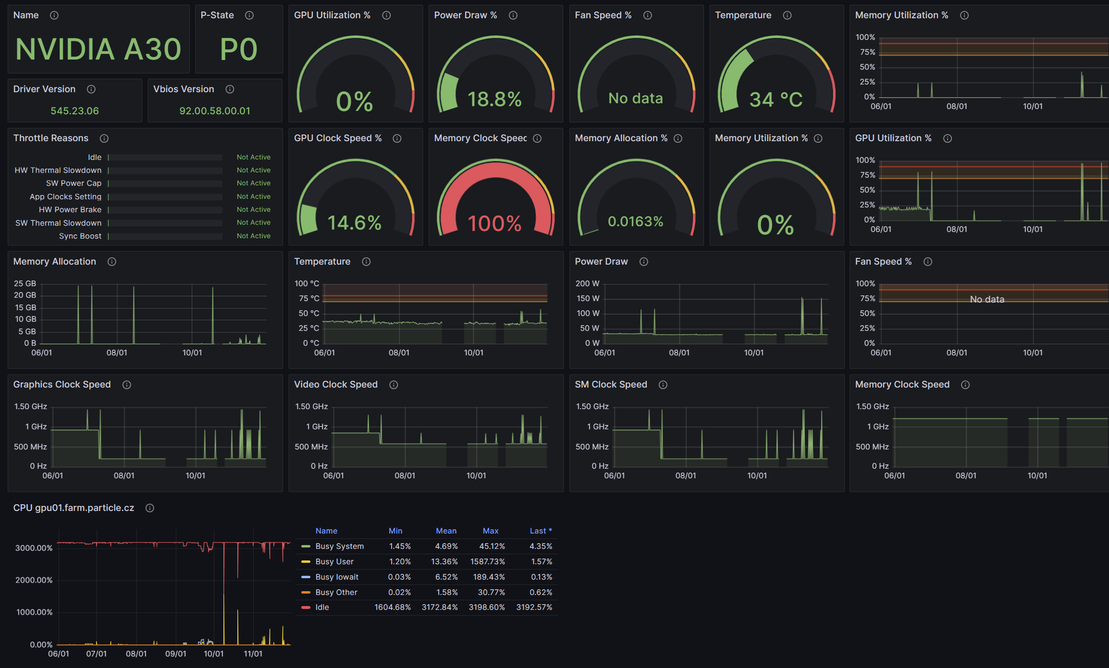
gpu01

Slide 12
Miscellaneous
New NFS servers early 2024
astro (Lumina, Forte)
Investments from OP JAK – results not yet known
CERN, Auger, Fermilab
plans for OS change from CentOS7 to Rocky9
singularity (aptainer) containers
Metacentrum: Debian11
dCache for NFS servers?

Slide 13
Thank you for your attention

