Slide 1
On 25th November 1924 Louis de Broglie defended his Thesis
Recherches sur la Théorie des Quanta
published in January 1925 as
de Broglie was well aware of the results of Compton experiments and Einstein concept of the photon and after extensive historical survey of physical phenomena involving light, matter and Planck quantum concluded:
In short, the time appears to have arrived, to attempt to unify the corpuscular and undulatory approaches in an attempt to reveal the fundamental nature of the quantum. This attempt I undertook some time ago and the purpose to this work is to present a more complete description of the successful results as well as known deficiencies.

Slide 2
The Centenary of wave-particle duality and the birth of Quantum Mechanics
Jiří Chýla
Institute of Physics, Czech Academy of Sciences
Wien (NP 1911)
Planck (NP 1918)
Einstein (NP for 1921 awarded in 1922, lecture in 1923)
Bohr (NP 1922)
Millikan (NP 1923)
Compton (NP 1927)
de Broglie (NP 1929)
Heisenberg (NP for 1932 awarded in 1933)
Schrödinger (NP 1933)
Davisson (NP 1937) and Germer
Born (NP 1954)
During the selection process in 1921 and 1932, the Nobel Committee for Physics decided that none of the year’s nominations met the criteria as outlined in the will of Alfred Nobel. According to the Nobel Foundation‘s statutes, the Nobel Prize can in such a case be reserved until the following year.
but many more made important contributions: Sommerfeld,
Pauli (NP 1945), Dirac (NP 1933), Goudsmit, Uhlenbeck, …

Slide 3
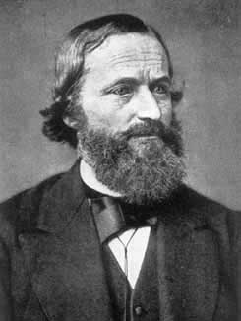
The road to quantum started in 1859 when Gustav Kirchhoff formulated the concept of
absolute black body
and proved that
spectral distribution of density of electro-magnetic radiation emitted from such body depends only on its temperature.
Gustav Kirchhoff
(1824-1887)
Experimental investigation of this spectum accompanied by efforts to to derive its form based on existing idea of the strucure of matter preoccupied physicists for the next 40 years.
For a long time nothing suggested that this problem will lead to the break with classical physics in describing the laws of microworld.

Slide 4
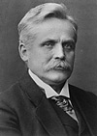
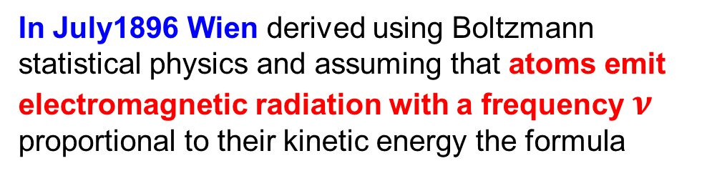
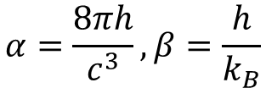

Wilhelm Wien (1864-1928)
In July1896 Wien derived using Boltzmann statistical physics and assuming that atoms emit electromagnetic radiation with a frequency $ν$ proportional to their kinetic energy the formula
$$u\left(ν,T\right)=αν^{3}e^{\left(−βν/T\right)}$$
$$α=\frac{8πh}{c^{3}}, β=\frac{h}{k_{B}}$$
where in current notation
which had been confirmed by first measurements of Paschen. At that time physicists had no idea how the black body radiation originates. There was Maxwell theory but it was not clear how to use it. Atoms were considered as indivisible and nothing was known about their structure, even electron was discovered only in 1897.
Wien law nicely ilustrates how wrong methods may lead to correct result.
Until the last days of 19. century nobody realized that Wien formula actually hides quantum physics.

Slide 5
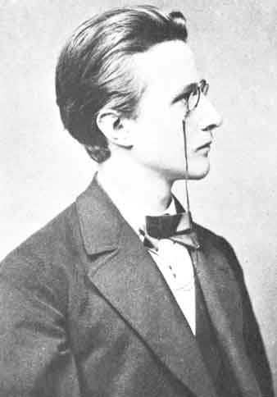
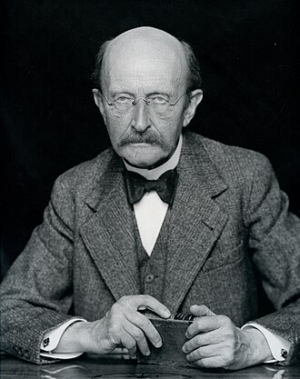
Max Planck (1858-1947)
1878
1938

Slide 6
I will just outline how Planck derived his formula, emphasizing what he did not do and recall the basic steps that lead him to his formula.
Fairy-tale and nonsense in Stanford Encyclopedia of Philosophy
Copenhagen Interpretation of Quantum Mechanics
In 1900 Max Planck discovered that the radiation spectrum of black bodies occurs only with discrete energies separated by the value hν, where ν is the frequency and h is a new constant, the so-called Planck constant.
According to classical physics, the intensity of this continuous radiation would grow unlimitedly with growing frequencies, resulting in what was called the ultraviolet catastrophe. But Planck’s suggestion was that if black bodies only exchange energy with the radiation field in a proportion equal to hν that problem would disappear.
The fact that the absorption and the emission of energy is discontinuous is in conflict with the principles of classical physics. A few years later Albert Einstein used this discovery in his explanation of the photoelectric effect. He suggested that light waves were quantized, and that the amount of energy which each quantum of light could deliver to the electrons of the cathode, was exactly hν

Slide 7
His considerations were based on Maxwell theory of electromagnetism and he worked out mutual interaction of electromagnetic radiation and Hertz oscillators
which Planck assumed to generate it in thermal equilibrium.
Planck was convinced that Second Law of Thermodynamics expressed in terms of entropy rise provides dynamical principle from which Wien law follows. He even claimed to have proved it.
He was therefore shocked when in the last days of 19th century the measurements of Lummer and Pringsheim slightly exceeded the Wien formula at large wavelenths and this deviation was confirmed and strengthened in October 1900 by measurements of Kurlbaum and Rubens.

Slide 8
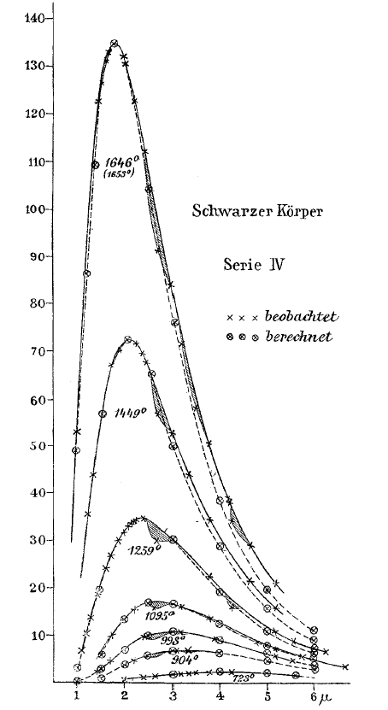
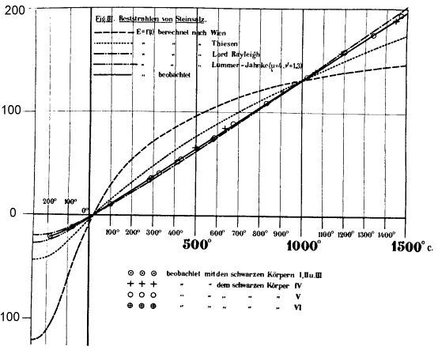
The first signals that
someting is wrong
with Wien forrmula
Wien
Left: O. Lummer and E. Pringsheim, Verhandlungen der Deutschen PhysikalischenGesellschaft 1 (November 1899), 215–235
Above: F. Kurlbaum, H. Rubens: Sitzungsberichte der Akad. Wiss. Berlin, Oct. 25, 1900 for wavelengths 20-30 μm confirming the deviation from Wien formula.

Slide 9
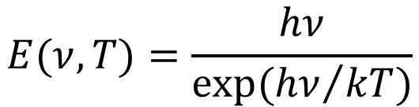
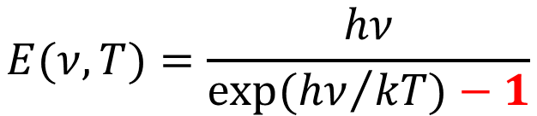
In frantic efforts to save his beloved Second law Planck in October-December of 1900 derived in two ways the new formula which represented simple modification of the Wien law
$$E(ν,T)=\frac{hν}{exp⁡({hν}/{kT)}}$$
$$E(ν,T)=\frac{hν}{exp⁡({hν}/{kT)−1}}$$
The first deivation
On an Improvement of Wien’s Equation of October 19, 1900
amounted essentially just to fitting the data, wheras in the second attempt
On the Theory of the Energy Distribution Law of the Normal Spectrum of December 14, 1900
in order to give it some theoretical basis, Planck adopted the language of Boltzmann statistical physics. In a key step of his derivation of the expression for entropy of his oscillator, Planck assumed without justification (From the theory of permutations we get…) particular formula for certain probabability distribution.
Historians have widely and plausibly assumed that Planck arrived at Eq. (7) by working backwards from his October 1900 extrapolation.
Key point:
Planck did not quantize electromagnetic radiation, only
the energy of his ocillators and even this assumption he
used in fact only to calculate their entropy.

Slide 10
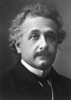
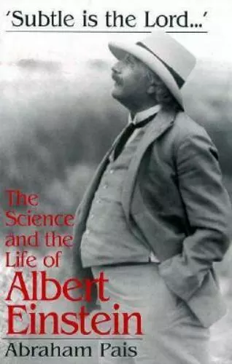
Albert Einstein (1979-1955)

Slide 11
Roger H. Stuewer:
Einstein’s revolutionary light–quantum hypothesis
The Centenary of the Photon Conference, 30 August 2005, Warsaw
Albert Einstein signed his light-quantum paper
Concerning a Heuristic Point of View about the Creation and Transformation of Light
in Bern on March 17, 1905, three days after his twenty-sixth birthday.
It was the only one of his great papers of 1905 that he himself called “very revolutionary”.
Einstein was correct: His light-quantum hypothesis was not generally accepted by physicists for another two decades.
The idea of wave-particle duality was borne in this paper.

Slide 12
Key observation
The wave theory of light, which operates with continuous spatial functions, has worked well in the representation of purely optical phenomena and will probably never be replaced by another theory.
It should be kept in mind, however, that the optical observations refer to time averages rather than instantaneous values.
In spite of the complete experimental confirmation of the theory as applied to diffraction, reflection, refraction, dispersion, etc.,
it is still conceivable that the theory of light which operates with continuous spatial functions may lead to contradictions with experience when it is applied to the phenomena of emission and transformation of light.
and these phenomena are better understood if
the energy of a light ray spreading out from a point source is not continuously distributed over an increasing space but consists of a finite number of energy quanta which are localized at points in space, which move without dividing, and which can only be produced and absorbed as complete units.

Slide 13
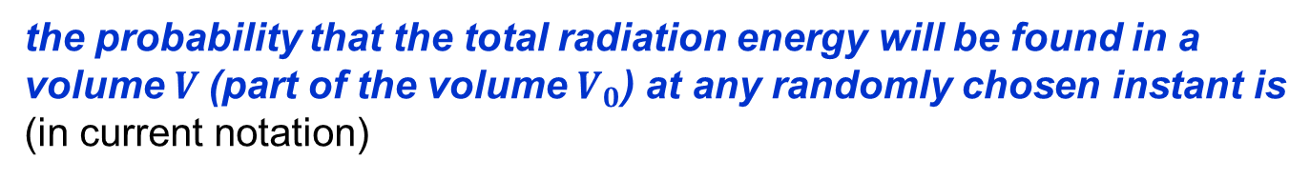
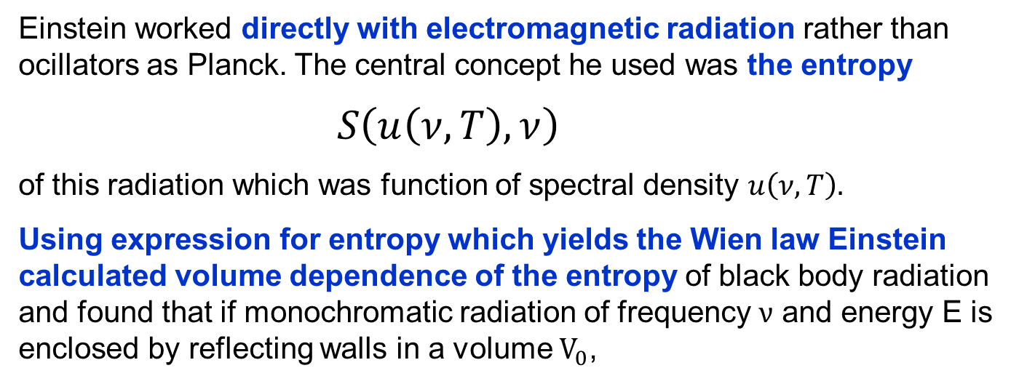
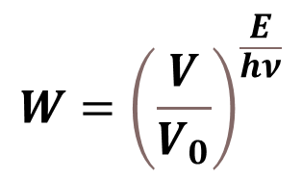
Einstein worked directly with electromagnetic radiation rather than ocillators as Planck. The central concept he used was the entropy
$S\left(u\left(ν,T\right),ν\right)$
of this radiation which was function of spectral density $u\left(ν,T\right).$
Using expression for entropy which yields the Wien law Einstein calculated volume dependence of the entropy of black body radiation
and found that if monochromatic radiation of frequency $ν$ and energy E is enclosed by reflecting walls in a volume $V_{0}$,
the probability that the total radiation energy will be found in a volume $V$(part of the volume $V_{0}$) at any randomly chosen instant is (in current notation)
$$W={\left(\frac{V}{V_{0}}\right)}^{\frac{E}{hν}}$$

Slide 14
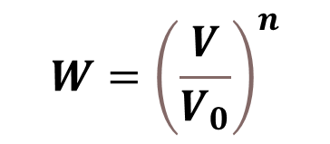
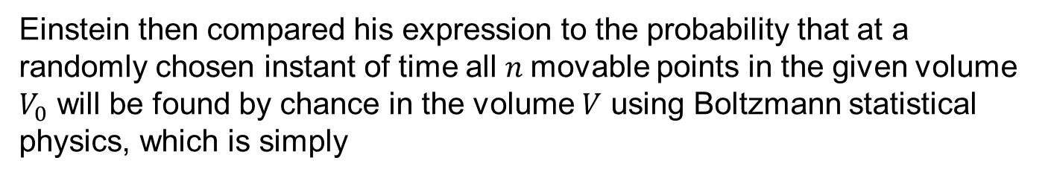
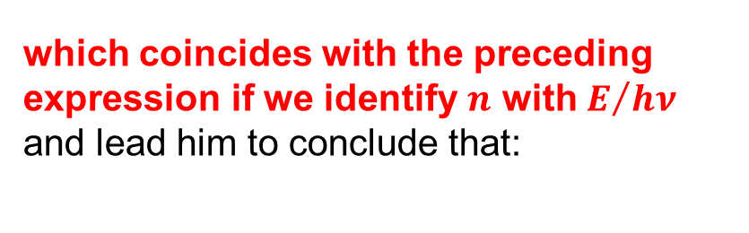
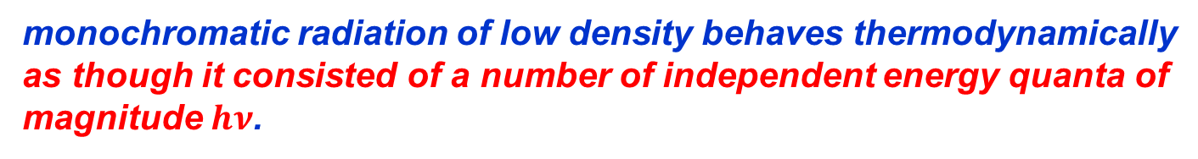
Einstein then compared his expression to the probability that at a randomly chosen instant of time all $n$movable points in the given volume $V_{0}$ will be found by chance in the volume $V$ using Boltzmann statistical physics, which is simply
$$W={\left(\frac{V}{V_{0}}\right)}^{n}$$
which coincides with the preceding expression if we identify $n$ with $E/{hν}$ and lead him to conclude that:
monochromatic radiation of low density behaves thermodynamically as though it consisted of a number of independent energy quanta of magnitude $hν$.
This motivated him :
to investigate whether the laws of emission and transformation of light are also of such a nature that they can be interpreted or explained by considering light to consist of such energy quanta.

Slide 15
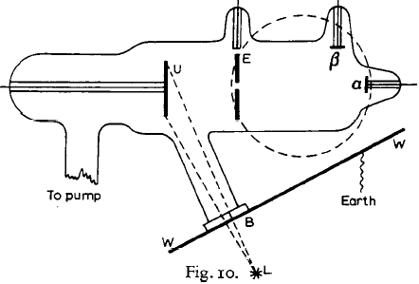
Philippe von Lenard: On cathode rays Nobel Lecture, May 28, 1906
Device used by Lenard in investiga-ting cathode rays originating by irradiation of cathode U by ultraviolet light from the source L Measuring the voltage on electrode E
Lenard measured the maximal velocity and thus energy of electrons knocked out from cathode U.
I have also found that the velocity is independent of the ultraviolet light intensity and thus concluded that the energy at escape does not come from the light at all, but from the interior of the particular atom. The light only has an initiating action, rather like that of the fuse in firing a loaded gun.
No reference to Einstein and his paper Concerning an Heuristic Point of View Toward the Emission and Transformation of Light of a year ago.
No investigation of dependence on wavelength of light.

Slide 16
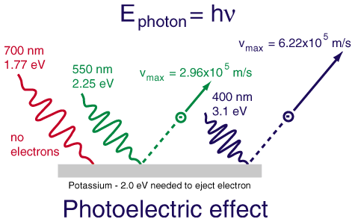
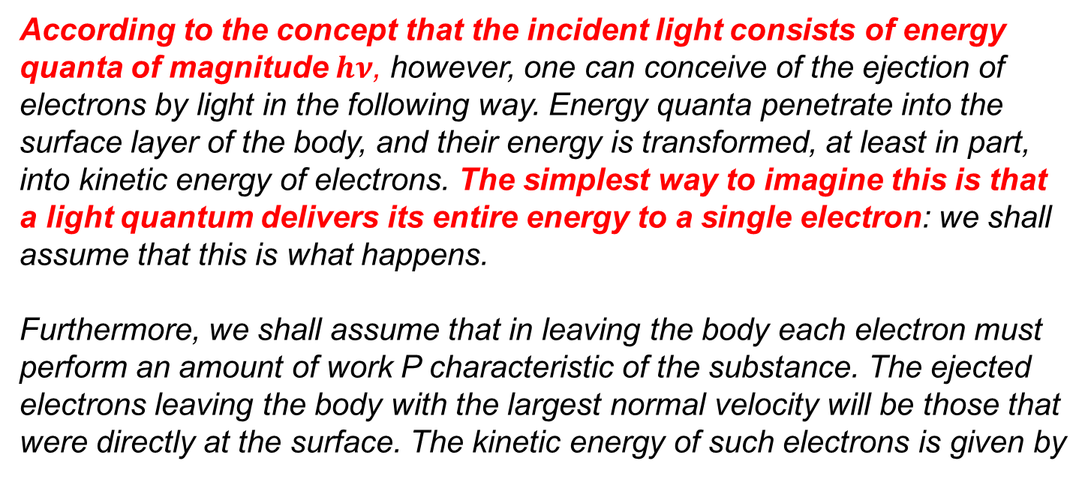
Einstein:
According to the concept that the incident light consists of energy quanta of magnitude $hν$, however, one can conceive of the ejection of electrons by light in the following way. Energy quanta penetrate into the surface layer of the body, and their energy is transformed, at least in part, into kinetic energy of electrons. The simplest way to imagine this is that a light quantum delivers its entire energy to a single electron: we shall assume that this is what happens.
Furthermore, we shall assume that in leaving the body each electron must perform an amount of work P characteristic of the substance. The ejected
electrons leaving the body with the largest normal velocity will be those that were directly at the surface. The kinetic energy of such electrons is given by
Clear prediction of the dependence of kinetic energy of knocked out electrons on the frequency of light. It took a decade to test it.

Slide 17
In On the Quantum Theory od Radiation Phys. Zs. 18 (1917) 121,
Einstein went even further and argued that
Photon carries not only energy, but also momentum
If a radiation bundle has the effect that a molecule struck by it absorbs a quantity of energy hv in the form of radiation, then a momentum hv/c is always transferred to the molecule. For an absorption of energy, this takes place in the direction of propagation of the radiation bundle….
If the molecule undergoes a loss in energy of magnitude hv….by emitting this energy in the form of radiation then this process, too, is directional. …During the elementary process of radiative loss, the molecule suffers a recoil of magnitude hv/c in a direction which is only determined by 'chance‘

Slide 18
Response to Einstein photon hypothesis
Planck nd Rubens recommending Einstein for election to the Prussian Academy in 1913: That he may sometimes have missed the target in his speculations, as, for example, in his hypothesis of light quanta, cannot really be held too much against him….
Millikan in his book, The Electron in 1917:
Despite the apparently complete success of the Einstein equation, the physical theory of which it was designed to be the symbolic expression is found so untenable that Einstein himself, I believe, no longer holds to it, and we are in the position of having built a very perfect structure and then knocked out entirely the underpinning without causing the building to fall.
Experiment has outrun theory, or, better, guided by erroneous theory, it has discovered relationships which seem to be of the greatest interest and importance, but the reasons for them are as yet not at all understood.

Slide 19
The Nobel Prize in Physics 1921 was awarded to Albert Einstein "for his services to Theoretical Physics, and especially for his discovery of the law of the photoelectric effect“
Award ceremony speech by S. Arrhenius on December 10, 1922
Albert Einstein Nobel Lecture
The Nordic Assembly of Naturalists at Gothenburg, July 11, 1923
Fundamental ideas and problems of the theory of relativity
At the same Award ceremony by S. Arrhenius on December 10, 1922
The Nobel Prize in Physics 1922 was awarded to Niels Henrik David Bohr „for his services in the investigation of the structure of atoms and of the radiation emanating from them“
Bohr in his Nobel lecture, December 11, 1922
In spite of its heuristic value, however, the hypothesis of light-quanta, which is quite irreconcilable with so-called interference phenomena, is not able to throw light on the nature of radiation.

Slide 20
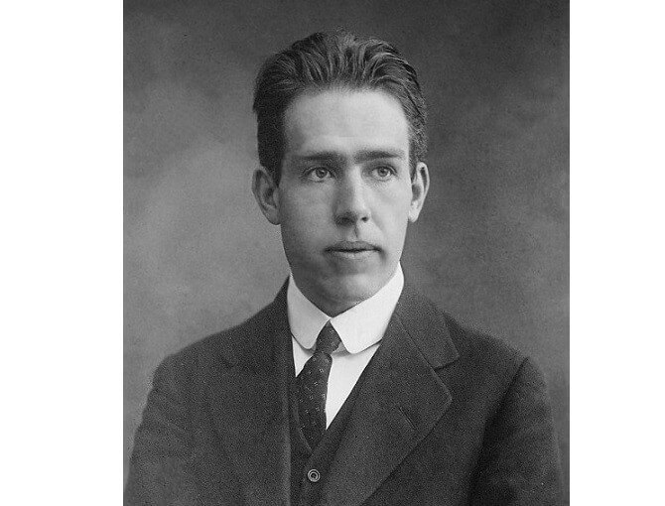
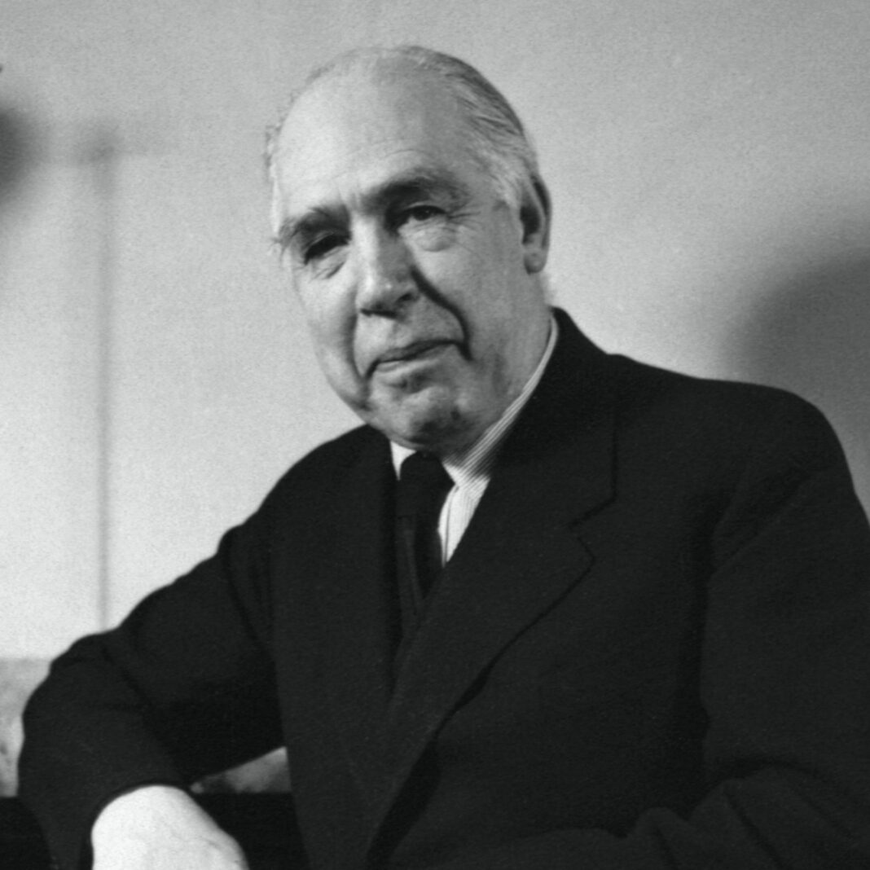
Niels Bohr (1885-1962)

Slide 21
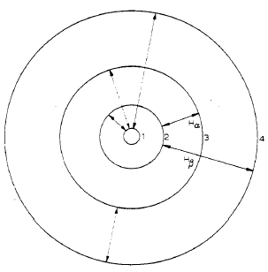
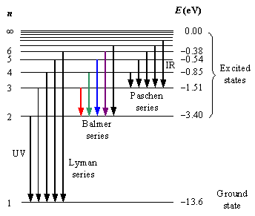
Bohr model of Hydrogen atom
Bohr assumed that electron captured on orbit with classical frequency ω emitts n quanta of frekvenci

Slide 23
Max Planck on Bohr model in his Nobel Lecture, June 2, 1920
What serves in Bohr’s theory as a basis to build up the laws of action, is assembled out of specific hypotheses which, up to a generation ago, would undoubtedly have been flatly rejected altogether by every physicist.
The fact that in the atom certain quite definite quantum-selected orbits play a special role, might be taken still as acceptable, less easily however, that the electrons, circulating in these orbits with definite acceleration, radiate no energy at all. The fact that the quite sharply defined frequency of an emitted photon should be different from the frequency of the emitting electron must seem to a theoretical physicist, brought up in the classical school, at first sight to be a monstrous and, for the purpose of a mental picture, a practically intolerable demand.

Slide 24
In
Fantastic paper!
extended Bohr model by
considering elliptical orbits,
used quantization based on Maupertius Principle and
introduced quantization of orbital momentum.
He thus formulated the basis of what is called Old Quantum Mechanics.
He should have received the Nobel Prize together with Bohr in 2022.
84 nomination, from 1917-1951, 7x Planck, 4x Max von Laue, Millikan, Goedel, Franck, Thirring Fermi, …..never Bohr or Einstein

Slide 25
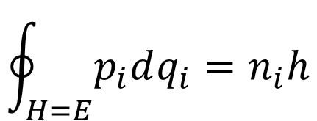

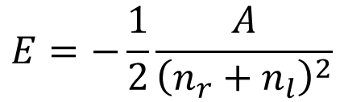
Quantization using
Maupertius Principle
$$\oint_{H=E}{p_{i}dq_{i}=n_{i}h}$$
where the integral is taken over one period of the motion at constant energy E.
For Hydrogen atom
$$E=−\frac{1}{2}\frac{A}{{\left(n_{r}+n_{l}\right)}^{2}}$$
$$n_{r}+1$$
in current Quantum Mechanics

Slide 26
Correspondence Principle: bridge to classical physics
Bohr model of atom required dramatic departure from the concepts and laws of classical physics. Important bridge to classical physics was provided by the correspondence principle, which concerns the circumstances when the behaviour of quantum system is close to laws of classical physics.
For the case of electron in the electric field of charge Z this is reflected by the fact that in stationary states with large n electrons behave almost classically as the difference of energies between two such highly excited states
$$E_{n}−E_{n+1}=\frac{2π^{2}Z^{2}e^{4}m}{n^{2}h^{2}}−\frac{2π^{2}Z^{2}e^{4}m}{{\left(n+1\right)}^{2}h^{2}}≅h\frac{4π^{2}Z^{2}e^{4}m}{n^{2}h^{3}}=hω_{n}≪E_{n}$$
is approximately equal to energy of the classical orbital electron frequency and much smaller than both energies.
Bohr made correspondence principle the basic principle his attempt to construct Quantum Mechanics without Einstein concept of the photon which heavily relied on the classical concepts of electron orbitals and their Fourier decomposition. It ultimately failed but was the starting point for Heisenberg matrix mechanics.

Slide 27
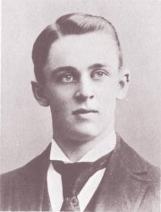
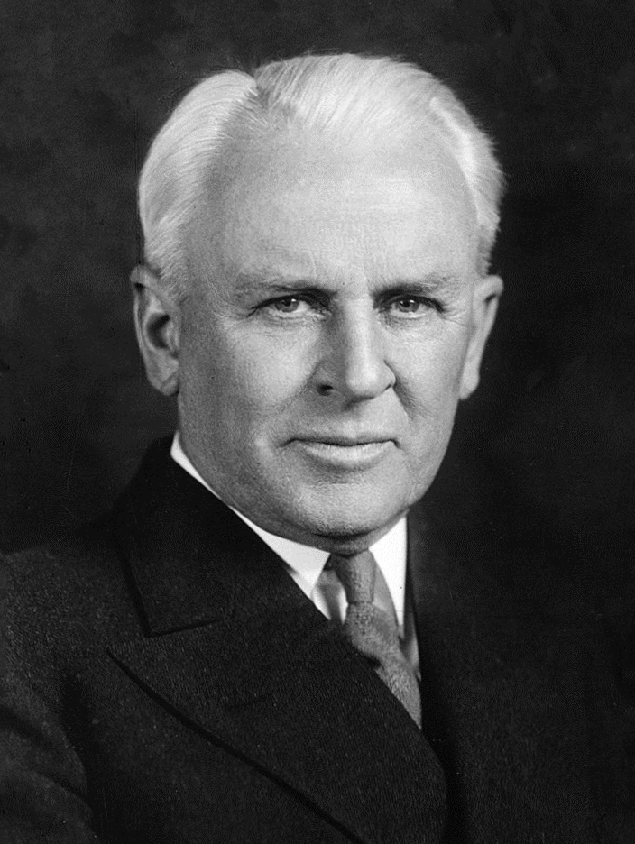
Robert Millikan (1865-1953)

Slide 28
Millikan began his photoelectric effect experiments in 1912 and found that radiation over a wide range of frequencies ejected photoelectrons from alkali metals, lithium, sodium, and potassium. His results of 1916 left no doubt about the complete validity of Einstein’s equation of the photoelffect.

Slide 29
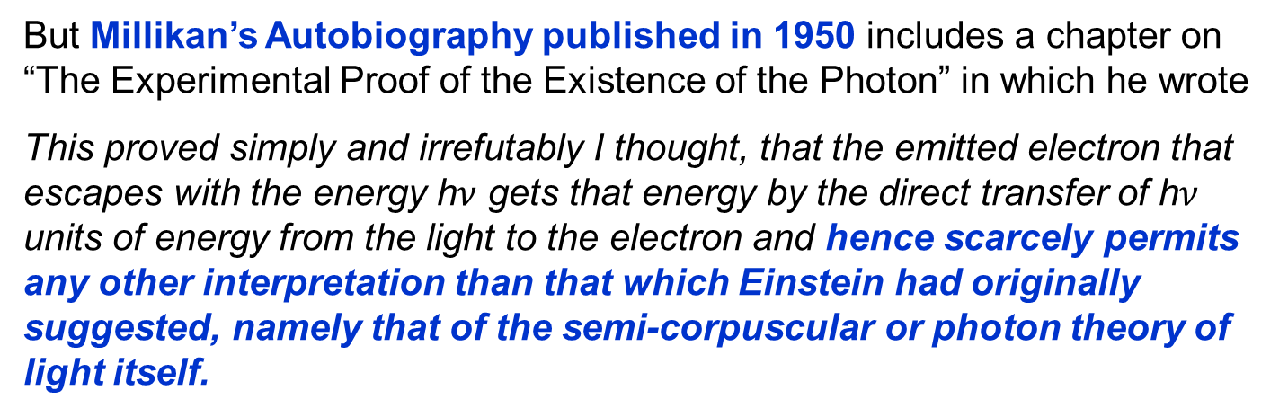
R. A. Millikan A Direct Photoelectric Determination of Planck's "ℎ"
Phys. Rev. 7, 355 – 1 March 1916
It was in I905 that Einstein' made the first coupling of photo effects
and with any form of quantum theory by bringing forward the bold, not
to say the reckless, hypothesis of an electromagnetic light corpuscle of energy hv. This hypothesis may well be called reckless because it flies in the face of the thoroughly established facts of interference.
But Millikan’s Autobiography published in 1950 includes a chapter on “The Experimental Proof of the Existence of the Photon” in which he wrote
This proved simply and irrefutably I thought, that the emitted electron that escapes with the energy h$ν$ gets that energy by the direct transfer of h$ν$ units of energy from the light to the electron and hence scarcely permits any other interpretation than that which Einstein had originally suggested, namely that of the semi-corpuscular or photon theory of light itself.

Slide 30
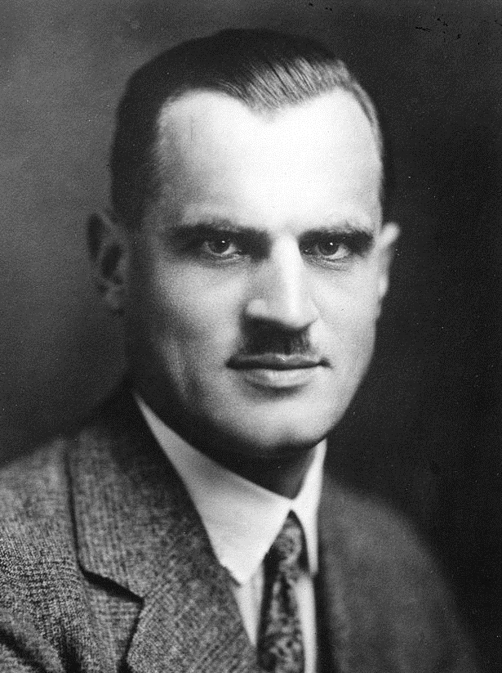
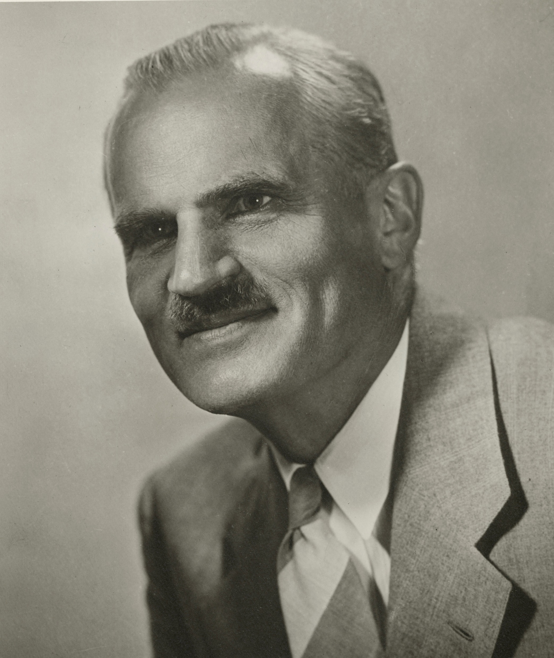
Arthur Compton (1892-1962)

Slide 31
A series of experiments performed during the last few years* has shown that secondary X-rays are of greater wavelength than the primary rays which produce them. This work is too well-known to require description
. ….An examination of the spectrum of the secondary X-rays shows that the primary beam has been split into two parts, as shown in Fig. 8, one of the same wavelength and the other of increased wavelength.

Slide 32
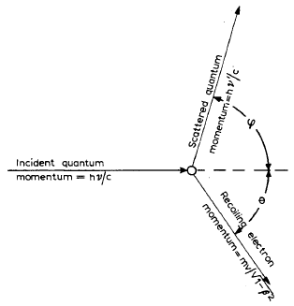
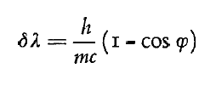
According to the classical theory, an electromagnetic wave is scattered when it sets the electrons which it traverses into forced oscillations, and these oscillating electrons reradiate the energy which they receive.
In order to account for the change in wavelength of the scattered rays, however, we have had to adopt a wholly different picture of the scattering process, as shown in Fig. 9.
Here we do not think of the X-rays as waves but as light corpuscles, quanta, or, as we may call them, photons.
Moreover, there is nothing here of the forced oscillation pictured on the classical view, but a sort of elastic collision, in which the energy and momentum are conserved.

Slide 33
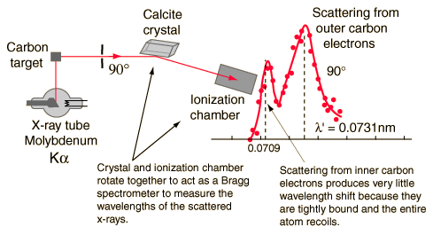
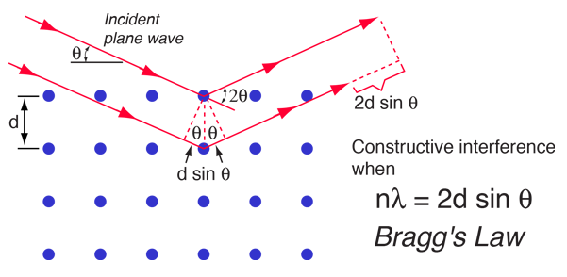
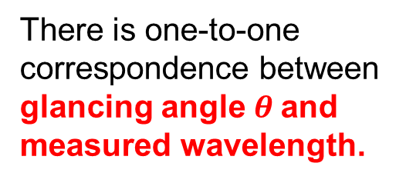
There is one-to-one
correspondence between glancing angle $θ$and measured wavelength.

Slide 34
The Bohr-Kramers-Slater Theory (1924-1925)
The last attempt to reconcile Old Quantum Theory with classical picture of continuous electromagnetic radiation based on Maxwell equation.
The BKS paper predicted that energy and momentum are conserved only statistically in the interactions between an incident light quantum and an electron.
After Geiger and Bothe disproved the BKS theory in coincidence experiments in April 1925 and Compton and Simon carried out an even more conclusive experiments disproving the BKS theory reported June 1925, Bohr gave up and wrote to R.R. Fowler:
"It seems therefore that this is nothing else to do than to give our
revolutionary efforts as honorable a funeral as possible."

Slide 35
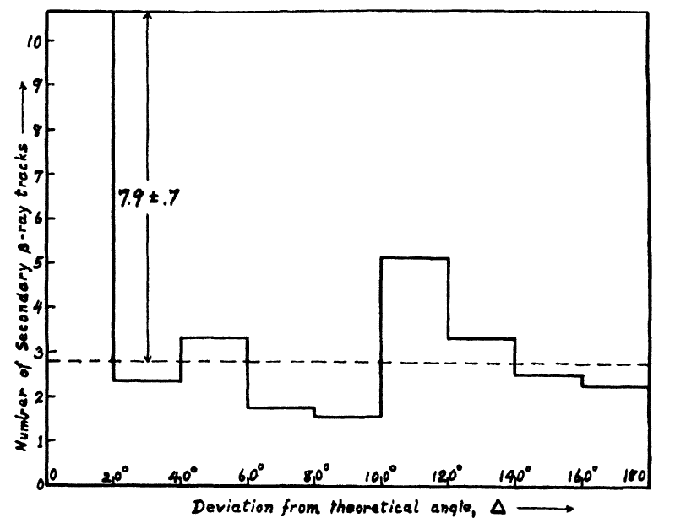
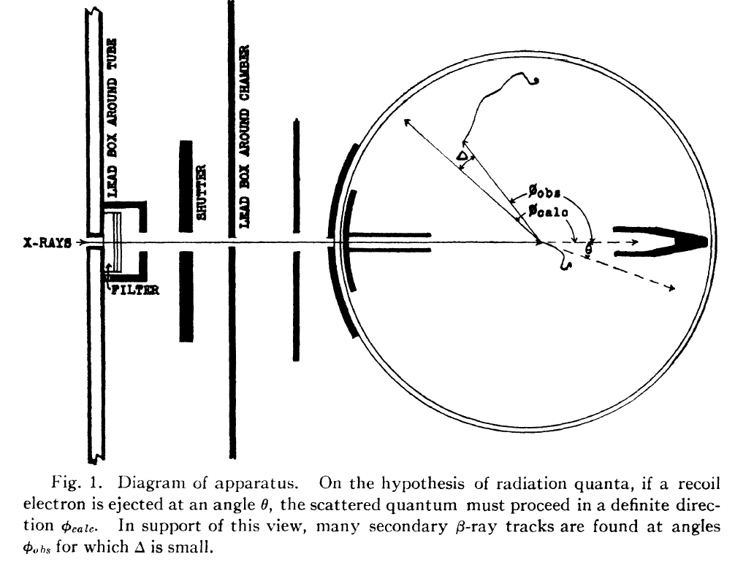
In response to BKS
Scattered
quantum
Recoiling
electron

Slide 36
In response to BKS
It has been shown by cloud expansion experiments previously described, that for each recoil electron produced, an average of one quantum of x-ray energy is scattered by the air in the chamber.
An increasingly large group of phenomena has recently been investigated which finds its simplest interpretation in the hypothesis of radiation quanta, proposed by Einstein to account for heat radiation and the photo-electric effect. It has not been possible, however, to show that any of these phenomena necessarily demand this hypothesis for its explanation.
Concluding paragraph:
These results do not appear to be reconcilable with the view of the statistical production of recoil and photo-electrons proposed by Bohr, Kramers and Slater. They are, on the other hand, in direct support of the view that energy and momentum are conserved during the interaction between radiation and individual electrons.

Slide 37
Compton scattering was decisive for accepting Einstein‘s idea of the photon, clearly demonstrated the meaning of wave-particle duality and ilustrated the importance of Einstein‘s statement in his 1905 paper:
It should be kept in mind, however, that the optical observations refer
to time averages rather than instantaneous values.
In Compton scattering the photon behaves in the collision with electron as partilcle, but in the measurement of its wavelength as wave. To reconcile these seemingly cotradictory statements two facts must be taken into account:
As emphasized by Dirac: “Each photon interferes only with itself. Interference between different photons never occurs.”
Standard beams of electromagnetic radiation contain huge number of photons.
The diffraction pattern seen by Compton in his experiment when only the scattered beam of photons was detected was the result of the passage of many photons.
But his 1925 experiment did not measure photon wavelength but looked for coincidences of recoling electron and electron from interaction of the single photon with matter, i.e essentially electron from photoeffect.

Slide 38
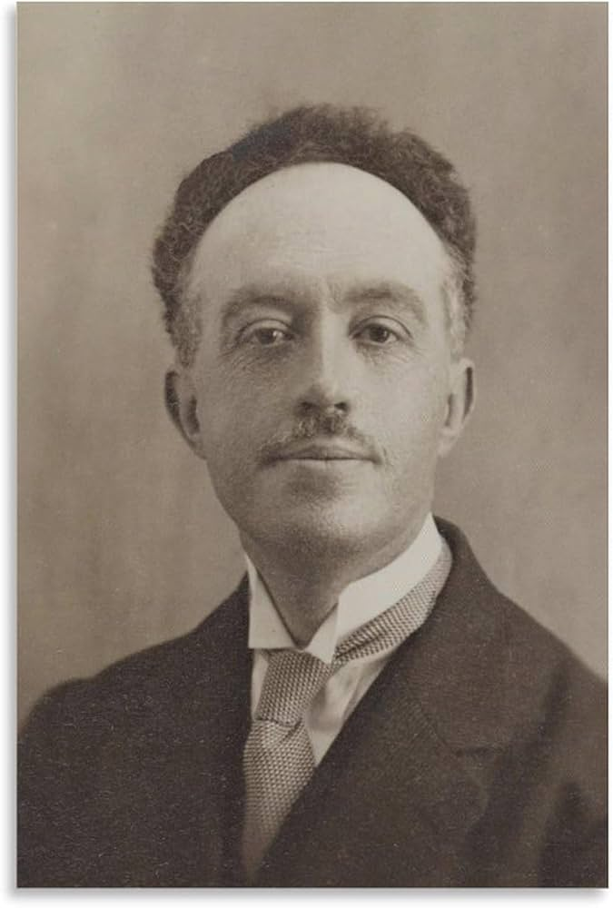
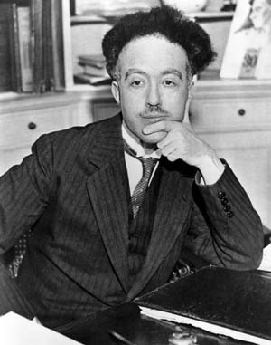
Louis de Broglie (1892-1987)

Slide 39
Louis de Broglie: The wave nature of the electron
Nobel Lecture, December 12, 1929
Concluding paragraph:
Thus, to describe the properties of matter as well as those of light, waves and corpuscles have to be referred to at one and the same time. The electron can no longer be conceived as a single, small granule of electricity; it must be associated with a wave and this wave is no myth; its wavelength can be measured and its interferences predicted.
And it is on this concept of the duality of waves and corpuscles in Nature…..that the whole recent development of theoretical physics has been founded and that all future development of this science will apparently have to be founded.

Slide 40

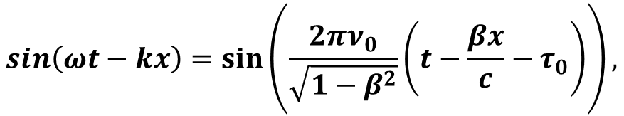

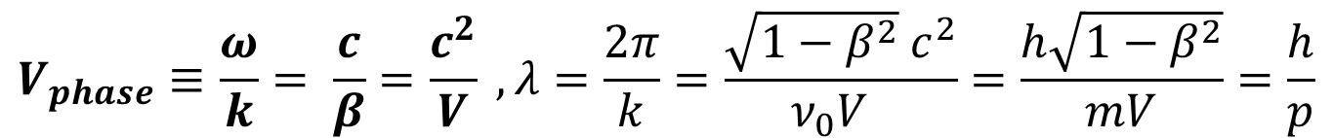
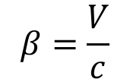
De Broglie assumed that particle with mass $m$ at rest is associated with a wave that has frequency $ν_{0}$given by relation
$$E={mc}^{2}=hν_{0}$$
In this system the wave will be stationary with phase the same at every point and represented by an expression of the form
$$\sin\left(2πν_{0}\left(t_{0}−τ_{0}\right)\right),$$
He further assumed that in a system where this particle moves with velocity V$,$the phase of the wave will be given by Lorentz transformation
$$\sin\left(ωt−kx\right)=sin\left(\frac{2πν_{0}}{\sqrt{1−β^{2}}}\left(t−\frac{βx}{c}−τ_{0}\right)\right),$$
$$β=\frac{V}{c}$$
and thus
$$V_{phase}≡\frac{ω}{k}= \frac{c}{β}=\frac{c^{2}}{V} , λ=\frac{2π}{k}=\frac{\sqrt{1−β^{2}} c^{2}}{ν_{0}V }=\frac{h\sqrt{1−β^{2}}}{mV}=\frac{h}{p}$$

Slide 41
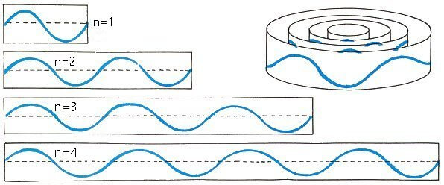
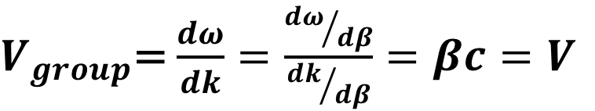
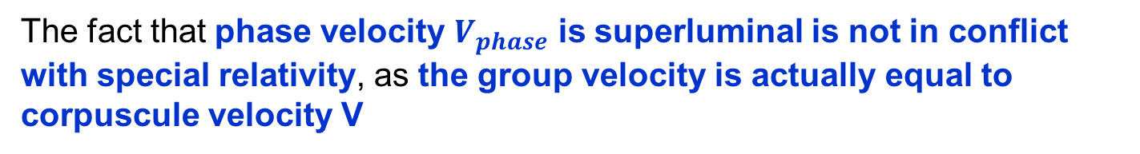
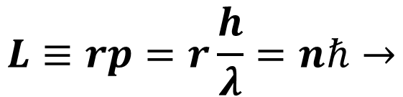

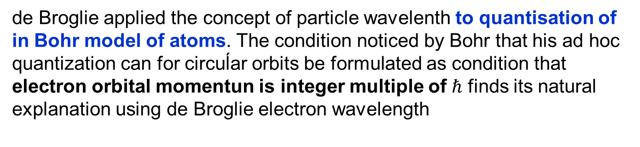
These basic assumptions, which lie at the heart of de Broglie theory were not justified and do not hold in current Quantum Theory.
Nevertheless, the main result of his approach, the concept of de Broglie wavelength and its momentum dependence played key role in the development of Quantum Mechanics.
The fact that phase velocity $V_{phase}$ is superluminal is not in conflict with special relativity, as the group velocity is actually equal to corpuscule velocity V
$V_{group}$= $\frac{dω}{dk}=\frac{{dω}/{dβ}}{{dk}/{dβ}}=βc=V$
de Broglie applied the concept of particle wavelenth to quantisation of in Bohr model of atoms. The condition noticed by Bohr that his ad hoc quantization can for circuĺar orbits be formulated as condition that electron orbital momentun is integer multiple of $ℏ$ finds its natural explanation using de Broglie electron wavelength
$$L≡rp=r\frac{h}{λ}=nℏ→$$
$$2πr=nλ$$

Slide 42



Göttingen trio
Werner Heisenberg
1901-1976
Max Bon
1882-1970
Pascual Jordan
1902-1980

Slide 43
In 1925 the Göttingen trio formulated without reference to de Broglie idea
of matter waves in three papers
On the quantum reinterpretation of kinematical
and mechanical relationships
Matrix mechanics which builds on the Old Qunatum Theory and is based on Heisenberg‘s idea that only measurable quantities should be used in theoretical description of properties of atomic phenomena.
This strategy is reminiscent of Gell-Mann approach to quarks that proved
unproductive in development of Quantum Chromodynamics.

Slide 44


Erwin Schrödinger (1887-1961)

Slide 45
de Broglie idea was taken up by Schrödinger who during 1926 published 5 papers in which his equation was derived and applied. The first paper has eloquent title
§ 1. In this communication I would like first to show, in the simplest case of the (non-relativistic and unperturbed) hydrogen atom, that the usual prescription for quantisation can be substituted by another requirement in which no word about “integer numbers” occurs anymore. Rather, the integerness emerges in the same natural way as, for example, the integerness of the number of knots of a vibrating string.
First of all, I would like not to leave unmentioned, that I owe the stimula-
tion to these reflections in the first place to the brilliant thesis of Mr. Louis de Broglie and to the thought about the spatial distribution of those “phasewave”, for which he has shown that always an integer number of them, measured along the trajectory, are allotted to each period or quasiperiod of the electron. The main difference is that de Broglie thinks of propagating waves, whereas we, if we put underneath our formulae the idea of vibration, are led to standing proper oscillations.

Slide 46




Schrödinger adopted the idea of de Broglie, but not his basic assumptions how to associate material particle with wave. He started with Hamilton-Jacobi formulation of classical mechanics, which does not describe motion of individual particles, but is based on the concept of Action that can be understood as waveform and is conceptually close to Quantum Mechanics.
$$S\left(x,t,x_{0},t_{0}\right)=\int_{x_{O},t_{0}}^{x,t}{ℒ(x,\dot{x},t)dτ=}\int_{x_{O},t_{0}}^{x,t}{\left(T(x\left(τ\right), \dot{x}\left(τ\right))−V(x(τ\right))}dτ$$
S satisfies the Hamilton-Jacobi equation
which for conservative force has the form
$$H\left(q,\frac{∂S}{∂q},t\right)=−\frac{∂S}{∂t}=E$$
For the case interaction is given by spherically symmetric potential V and
setting this can be written as
$$S=K\ln{ψ}$$
$${\left(\frac{∂ψ}{∂x}\right)}^{2}+{\left(\frac{∂ψ}{∂y}\right)}^{2}+{\left(\frac{∂ψ}{∂y}\right)}^{2}−\frac{2m}{K^{2}}\left(E−V\right)ψ^{2}=0$$
Will be $ℏ$
Schrödinger looked for real, single-valued, finite and continuously differen- tiable functions, which extremize the integral over the whole space of this expression. He thus substituted the quantum conditions with this variation problem.

Slide 47




Equation for extremum
$$δ\iiint{dxdydz}\left[{\left(\frac{∂ψ}{∂x}\right)}^{2}+{\left(\frac{∂ψ}{∂y}\right)}^{2}+{\left(\frac{∂ψ}{∂y}\right)}^{2}−\frac{2m}{K^{2}}(E−V)ψ^{2}\right]=0$$
implies
$$\iiint{dxdydzδ}\left[Δψ+\frac{2m}{K^{2}}(E−V)ψ\right]$$
and thus finally
$Δψ+\frac{2m}{K^{2}}\left(E−V\right)ψ=$ 0
which is his celebrated equation for time independent wave functions
describing stationary states with given energy $E.$
  He then showed that the established requirement is satisfiable for all positive, but only for a discrete set of negative, values of E. The discrete spectrum corresponds to the Balmer terms, whereas the continuous one corresponds to the energies of the hyperbolic orbits. In order for numerical agreement to exist, K must get the value h/2π.
But Schrödinger in no way justified this procedure, which, moreover, obviously concerns only the radial dependence of wave functions.

Slide 48




But in the second paper just a month later Schrödinger derived his equation in a different way based on the analogy between Hamiltonian mechanics and optics. He used de Broglie idea of phase waves and assuming that the action
S$=−Et+W(x,y,z)$
represents after scaling by $ℏ$ the phase of sinusoidal wave
𝜓$=A(x,y,z)\sin\left[{−Et}/ℏ+{W(x,y,z)}/ℏ\right]$
satisfiing the
wave equation
$$\frac{∂^{2}ψ}{{∂t}^{2}}=u^{2}\left(\frac{∂^{2}ψ}{{∂x}^{2}}+\frac{∂^{2}ψ}{{∂y}^{2}}+\frac{∂^{2}ψ}{{∂z}^{2}}\right)$$
Taking for the phase velocity $u$the expression
$u=\frac{E}{\left|gradW\right|}=\frac{E}{\sqrt{2m(E−V)}}$
which follows for force described by potential $V$ from Hamilton-Jacobi equation,
inserting it into wave equation and performing the time derivative yields the same equation Schrödinger derived in the first paper.

Slide 49

Schrödinger‘s view on physical interpretation of wave functions is expressed in his summary paper of September 3, which appeared in December issue of The Physical Review
the charge of the electron is not concentrated in a point, but is spread out through the whole space, proportional to the quantity $ψ\overline{ψ.}$
In other words he interpreted the solution of his equation as real matter
waves, similar to acoustic waves. This interprertation was shown by Born to be untenable exprerimentally as well as theoretically, but Schrödinger stood by it throughout his life.

Slide 50


Clinton Davisson (1881-1958)
Lester Germer

Slide 51

Clinton J. Davisson
The discovery of electron waves, Nobel Lecture, December 13, 1937
Then appeared the brilliant idea which was destined to grow into that marvelous synthesis, the present-day quantum mechanics. Louis de Broglie put forward in his doctor’s thesis the idea that even as light, so matter has a duality of aspects; that matter like light possesses both the properties of waves and the properties of particles.
Perhaps no idea in physics has received so rapid or so intensive development as this one. De Broglie himself was in the van of this development but the chief contributions were made by the older and more experienced Schrödinger.

Slide 52
That evidence for the wave nature of particle mechanics would be found in the reaction between a beam of electrons and a single crystal was predicted by Elsasser two years ago shortly after the appearance of L. de Broglie's original papers on wave mechanics.

Slide 53
Max Born (1882-1970)
The Nobel Prize in Physics 1954 was divided equally between Max Born
for his fundamental research in quantum mechanics, especially for his statistical interpretation of the wavefunction"
and Walther Bothe "for the coincidence method and his discoveries made therewith"
M.Born:The motion of particles follows probability laws, but the probability itself propagates according to the law of causality.

Slide 54


Born in his Nobel lecture, December 11, 1954
Schrödinger thought that his wave theory made it possible to return to deterministic classical physics. He proposed (and he has recently empha-sized his proposal), to dispense with the particle representation entirely, and instead of speaking of electrons as particles, to consider them as a continuous density distribution ${\left|ψ\right|}^{2}$ (or electric density ${e\left|ψ\right|}^{2}$).
To us in Göttingen this interpretation seemed unacceptable in face of well-established experimental facts. At that time it was already possible to count particles by means of scintillations or with a Geiger counter, and to photograph their tracks with the aid of a Wilson cloud chamber.
Again, an idea of Einstein’s gave me the lead. He had tried to make the duality of particles - light quanta or photons - and waves comprehensible by interpreting the square of the optical wave amplitudes as probability density for the occurrence of photons. This concept could at once be carried over to the $ψ$-function ${\left|ψ\right|}^{2}$ ought to represent the probability density for electrons (or other particles).
But Einstein in a letter to Born on December 4, 1926:
I, at any rate, am convinced that He is not playing at dice.

Slide 55

Einstein was advocate of ensemble
interpretation of the wave funcion and wrong in his prediction.
QM lead to Quantum Field Theory

Slide 56

Dirac was right:
interference with
single particles
Modern diffraction experiments with area detectors like CCDs, composed of thousands of tiny light sensitive pixels, reveal that the pattern instead emer-ges gradually with time through an increasing number of pixels lighting up through hits by single photons. This is beautifully revealed in the experime-nt shown below. It shows the evolution of the double slit diffraction pattern recorded with an incident green laser beam that was attenuated so that at an instance of time only a single photon was in the vicinity of the slits.
From T. L. Dimitrova, and A. Weis, American Journal of Physics 76, 137 (2008)

Slide 57


Demonstration of single-electron buildup of an interference pattern. A. Tonomura, J. Endo, T. Matsuda, T. Kawasaki, and H. Ezawa. American Journal of Physics 57, 117 (1989)
(b) 100 electrons, (c) 3,000 electrons, (d) 20,000 electrons, (e) 70,000 elecrons

Slide 58
The end

Slide 59



Einstein worked directly with electromagnetic radiation rather than ocillators as Planck. The central concept he used was the entropy
$S\left(u\left(ν,T\right),ν\right)$
of this radiation which was function of spectral density $u\left(ν,T\right).$ The black body radiation was defined by the condition that for fixed total (integrated over $ν$) radiation energy E the entropy Is maximal.
Using Wien law Einstein calculated volume dependence of the entropy of black body radiation ín Wien high frequency) regime and found that If monochromatic radiation of frequency $ν$ and energy E is enclosed by reflecting walls in a volume $V_{0}$,
the probability that the total radiation energy will be found in a volume $V$(part of the volume $V_{0}$) at any randomly chosen instant is (in current notation)
$$W={\left(\frac{V}{V_{0}}\right)}^{\frac{E}{hν}}$$

Slide 60
It is surprising that the second important application of de Broglie matter waves, namely their behaviour of electrons as waves in diffraction scattering was not suggested by de Broglie himself, but shortly after the appearance of his Thesis by Walter Elsasser on the suggestion from Max Born
Bemerkungen zur Quantenmechanik freier Elektronen.
W.Elsasser, Naturwiss. 13, 711 (1925).

Slide 61
The paper starts with the following words
A profound formal distinction exists between the theoretical concepts which physicists have formed regarding gases and other ponderable bodies and the Maxwellian theory of electromagnetic processes in so–called empty space…..
According to the Maxwellian theory, energy is to be considered a continuous spatial function in the case of all purely electromagnetic phenomena including light, while the energy of a ponderable object should, according to the present conceptions of physicists, be represented as a sum carried over the atoms and electrons.
The energy of a ponderable body cannot be subdivided into arbitrarily many or arbitrarily small parts, while the energy of a beam of light from a point source (according to the Maxwellian theory of light or, more generally, according to any wave theory) is continuously spread an ever increasing volume.

Slide 62
The evidence for the existence of directed quanta of radiation afforded by this experiment is very direct. The experiment shows that associated with each recoil electron there is scattered X-ray energy enough to produce a secondary β- ray, and that this energy proceeds in a direction determined at the moment of ejection of the recoil electron.
Distribution of the difference between measuremed angle of the recoiling electron and its prediction based on the direction of scatterred photon..

Slide 63
Planck on his derivation
Planck in a letter to Robert Wood Planck spoke of his work as an ‘‘act of desperation,’’ and said:
A theoretical interpretation therefore had to be found at any cost, no matter how high.
This approach was opened to me by maintaining the two laws of thermo-dynamics. The two laws, it seems to me, must be upheld under all circumstances. For the rest, I was ready to sacrifice every one of my previous convictions about physical laws. …
[One] finds that the continuous loss of energy into radiation can be prevented by assuming that energy is forced at the outset to remain together in certain quanta. This was purely a formal assumption, and I really did not give it much thought….
Key point:
Planck did not quantize electromagnetic radiation, only
the energy of his ocillators and even this assumption he
used in fact only to calculate their entropy.

Slide 64
Max Planck on his teacher‘s view of physics at Munich University in 1878.
„As I began my university studies, I asked my venerable teacher Philipp von Jolly for advice regarding the conditions and prospects of my chosen field of study.
He described physics to me as a highly developed, nearly fully matured science, that through the crowning achievement of the discovery of the principle of conservation of energy it will arguably soon take its final stable form.
It may yet keep going in one corner or another, scrutinizing or putting in order a jot here and a tittle there, but
the system as a whole is secured, and theoretical physics is noticeably approaching its completion to the same degree as geometry did centuries ago.
That was the view fifty years ago of a respected physicist.

Slide 65
Fairy-tale in Wikipedia - Planck law
At the end of the 19th century, physicists were unable to explain why the observed spectrum of black-body radiation, which by then had been accurately measured, diverged significantly at higher frequencies from that predicted by existing theories.
Facts:
Until the very end of 19th. century the Wien law was the only theoretical prediction and it agreed with all data.
In June 1900 Rayleigh suggested its modification but only at large waveelength
The Rayleigh-Jeans formula appeared first in 1905 and was formulated also by Einstein in his seminal1905 paper.
The so called „ultraviolet catastrophe“ was formulated by Ehrenfest only in 1911.
Key point:
Planck did not quantize electromagnetic radiation, only
the energy of his ocillators and even this assumption he
used in fact only to calculate their entropy.

Slide 66
Measurements of Photoeffect by Philippe Lenard in 1902
Device used by Lenard in investigating cathode rays originating by irradiation of cathode U by ultraviolet light from the source L Measuring the voltage on electrode E Lenard measured the maximal velocity and thus energy of electrons knocked out from cathode U.

Slide 67

In 1909 in the paper On the development of our understanding of the nature and composition of radiation Einstein made important observation on Planck law
To interpret the Planck law at large frequences as discretization of oscillator energies $E$($ν,T),$it is necessary that the energy quantum $ε=hν$ is much smaller than average resonator energy $E(ν,T)$, i.e
$ε=hν≪E(ν,T)$
However, for the wavelength $λ=0.5μm$ and T = 1700 K it is just tte oposite: the average oscillator energy $E\left(ν,T\right)$is 65 milion times smaller than the quantum $ε=hν$.
Second key step towards the wave-particle duality came in 1916 in the
paper
ON THE QUANTUM THEORY OF RADIATION
Phys. Zs. 18 (1917) 121, first printed in Mitteilungen der Physikalischen Gesellschaft Zurich, No. 18, 1916.

Slide 68

and simple explanation of the independence on the intensity of light, which, howeer, differed fundamentaly from that of Lenard.
As far as I can see, there is no contradiction between these conceptions and the properties of the photoelectric observed by Herr Lenard. If each energy quantum of the incident light, independently of everything else, deliver its energy of electrons, then the velocity distribution of the ejected electrons will be independent of the intensity of the incident light; on the other hand the number of electrons leaving the body will, if other conditions are kept constant, be proportional to the intensity of the incident light.

Slide 69

Interestingly, even before the measutements of Kurlbaum and Rubens and without the knowledge of meaurements of Lummer nad Pringsheim Rayleigh suggested on theoretical grounds the modification of Wien formula for large temperatures and wavelengths.
June
John William Strutt, 3rd Baron Rayleigh
Viewed from the theoretical side the result appears to me to be little more than a conjecture. It is, however, supported upon general thermodynamic grounds by Planck.
Upon the experimental side, Wien's law (2) has met with important
confirmation. Paschen finds that his observations are well represented
Nevertheless, the law seems rather difficult of acceptance, especially
the implication that as the temperature is raised, the radiation of given wavelength approaches a limit.
and suggested to modify Wien formua for large values of the ratio T/$ν$ by multiplying it Wien by this ratio to get
$$u\left(ν,T\right)=αν^{2}Te^{\left(−βν/T\right)}$$
which still satisfies Wien displacement law and which for large values of
T/$ν$ is numerically very close to the full Planck formula.

Slide 70

As a mathematical tool the concept of a real number represented by a nonterminating decimal fraction is exceptionally important and fruitful. As the measure of a physical quantity, it is nonsense. If $π$ is taken to the 20th or the 25th place of decimals, two numbers are obtained which are indistinguisha-ble from each other and the true value of p by any measurement.
According to the heuristic principle used by Einstein in the theory of relativity, and by Heisenberg in the quantum theory, concepts which correspond to no conceivable observation should be eliminated from physics.
In short, ordinary mechanics must also be statistically formulated….I should like only to say this: the determinism of classical physics turns out to be an illusion, created by overrating mathematico-logical concepts. It is an idol, not an ideal in scientific research and cannot, therefore, be used as an objection to the essentially indeterministic statistical interpretation of quantum mechanics.

Slide 72


Slide 73




The content of these papers was summarised in The Physical Review
which starts with reference to de Broglie and his Thesis
The theory which is reported in the following pages is based on the very interesting and fundamental researches of L. de Broglie‘ on what he called "phase-waves" ("ondes de phase") and thought to be associated with the motion of material points, especially with the motion of an electron or proton. The point of view taken here, which was first published in a series of German papers, is rather that material points consist of, or are nothing but, wave-systems.
𝜓$=A(x,y,z)\sin\left[{−Et}/ℏ+{S(x,y,z)}/ℏ\right]$
$$W=−Et+S(x,y,z)$$
$u=\frac{E}{\sqrt{2m(E−V)}}$
$$\frac{∂^{2}ψ}{{∂t}^{2}}=u^{2}\left(\frac{∂^{2}ψ}{{∂x}^{2}}+\frac{∂^{2}ψ}{{∂y}^{2}}+\frac{∂^{2}ψ}{{∂z}^{2}}\right)$$

Slide 74
Schlul3bemerkungen. Die beschriebenen Versuehe sind mi~
der Bohrschen Deutung des Comptoneffekts nieht vereinbar. Sie
Compton, Somin paper
Ryerson Physical Laboratory, Univestity of Chicago.
June 23, 1925.

Slide 75
The Nobel Prize in Physics 1954 was divided equally between Max Born "for his fundamental research in quantum mechanics, especially for his statistical interpretation of the wavefunction" and Walther Bothe "for the coincidence method and his discoveries made therewith"
Walther Bothe
Nobel Lecture
It was in 1924 that I came across the theoretical paper by Bohr, Kramers, and Slater, which had just been published and which suggested a possible interpretation of the wave-particle dualism in the accepted description of the properties of light. This must be understood to mean the experimental fact that light of all wavelengths behaves as a wave process (interference) with pure propagation, but behaves as particles (light quanta: photo-effect, Compton effect) on conversion into other types of energy. The new idea consisted in denying strict validity to the energy-impulse law. In the individual or elementary process, so long as only a single act of emission was involved, the laws of conservation were held to be statistically satisfied only, to become valid for a macroscopic totality of a very large number of elementary processes only, so that there was no conflict with the available empirical evidence. It was immediately obvious that this question would have to be decided experimentally, before definite progress could be made. That such a decision was possible, Geiger and I agreed immediately, when I discussed the paper by Bohr, Kramers, and Slater with Geiger.

Slide 76
The Nobel Prize in Physics 1921 was awarded to Albert Einstein "for his services to Theoretical Physics, and especially for his discovery of the law of the photoelectric effect“
Award ceremony speech
Presentation Speech by Professor S. Arrhenius, Chairman of the Nobel Committee for Physics of the Royal Swedish Academy of Sciences, on December 10, 1922*
The Nobel Prize in Physics 1922 was awarded to Niels Henrik David Bohr „for his services in the investigation of the structure of atoms and of the radiation emanating from them“
Award ceremony speech
Presentation Speech by Professor S. Arrhenius, Chairman of the Nobel Committee for Physics of the Royal Swedish Academy of Sciences, on December 10, 1922
Albert Einstein
Nobel Lecture
Lecture delivered to the Nordic Assembly of Naturalists at Gothenburg, July 11, 1923
Fundamental ideas and problems of the theory of relativity

Slide 77


Slide 78
Zhe-Yu Jeff Ou: Multi-Photon Quantum Interference
2007 Springer Science+Business Media
Optical interference has played some essential roles in the understanding oflight. It has fascinated Dirac, the pioneer of the quantum theory of light, since the very beginning, as seen in his famous statement on photon interference: “Each photon ... interferes only with itself. Interference between different photons never occurs.” Feynman, who was one of the founders of quantum electrodynamics, wrote, in his well-known lecture series on physics, that the interference phenomenon “has in it the heart of quantum mechanics..., it contains the only mystery.” As we explore into the quantum regime in the 21st century, we will find even more presence of quantum interference in our life. Most commonly-occurring interference phenomena are optical interference, in the form of some beautiful interference fringe patterns. These phenomena have been well-studied by the classical theory of coherence and documented in Born and Wolf’s classic book Principle of Optics. In terms of the language of photon, these phenomena can be categorized as the single-photon interference effect and described by the first part of Dirac’s statement given above. On the other hand, in the situation when more than one photon is involved, the second part of Dirac’s statement is not correct.

Slide 79
Louis de Broglie: The wave nature of the electron
Nobel Lecture, December 12, 1929
I thus arrived at the following overall concept which guided my studies:
for both matter and radiations, light in particular, it is necessary to introduce the corpuscle concept and the wave concept at the same time. In other words the existence of corpuscles accompanied by waves has to be assumed in all cases.
However, since corpuscles and waves cannot be independent because, according to Bohr’s expression, they constitute two complementary forces of reality, it must be possible to establish a certain parallelism between the motion of a corpuscle and the propagation of the associated wave. The first objective to achieve had, therefore, to be to establish this correspondence.

Slide 81


Slide 82

průchod částic jednotlivými segmenty detektoru
6 m
z části
ve FZÚ
z části
ve FZÚ

Slide 83


Slide 84


Slide 85
Finally, whenever a photon is deflected at an angle ϕ, the electron should recoil at an angle q given by the relation approximately.

Slide 86
P. A. M. Dirac: “Each photon interferes only with itself. Interference between different photons never occurs.”
P. Dirac, The Principles of Quantum Mechanics, Clarendon
Press, Oxford, UK, 1947.
Joachim Stöhr
Professor Emeritus at Stanford University

Slide 87
Na tomto původním místě Bellových laboratoří provedli C. J. Davisson a L. H. Germer v roce 1927 první demonstraci vlnového chování elementárních částic, předpovězeného L. de Broglie v roce 1923. Experiment Davissona a Germera poskytl klíčové empirické svědectví pro tehdy se rychle rozvíjející teorii kvantové mechaniky. V těchto a následujících letech bylo ve stejné laboratoři učiněno mnoho důležitých vědeckých a technologických objevů.

Slide 88




Schrödinger adopted the basic idea of de Broglie, but none of the two basic
assumptions how to associate material particle with wave. He started with Hamilton-Jacobi formulation of classical mechanics, which is equivalent to Lagangian or Hamiltonian formulation, but does not describe motion of individual particles, but is based on the concept of Action that can be understood as waveform and is conceptually close to Quantum Mechanics.
$$S\left(x,t,x_{0},t_{0}\right)=\int_{x_{O},t_{0}}^{x,t}{ℒ(x,\dot{x},t)=}\int_{x_{O},t_{0}}^{x,t}{\left(T(x\left(τ\right), \dot{x}\left(τ\right))−V(x(τ\right))}dτ$$
S satisfies the Hamilton-Jacobi equation
which for conservative force has the form
$$H\left(q,\frac{∂S}{∂q},t\right)=−\frac{∂S}{∂t}=E$$
For the case interaction is given by potential V
$$\frac{∂S}{∂t}+\frac{1}{2m}\left[{\left(\frac{∂S}{∂x}\right)}^{2}+{\left(\frac{∂S}{∂y}\right)}^{2}+{\left(\frac{∂S}{∂y}\right)}^{2}\right]+V\left(x,y.z\right)=0$$
From whch we get
$$\left|gradS\right|=\sqrt{2m(E−V)}$$

Slide 89











For the case Hamiltonian does not explicitly depend on time we have
$$W=−Et+S(x,y,z)$$
Schrödinger assumed that the phase of the materiál wave is given by Action
𝜓$=A(x,y,z)\sin\left[{−Et}/ℏ+{S(x,y,z)}/ℏ\right]$
similarly as in standard simple sinusoidal wave
$$k=\frac{dV(x)}{dx},$$
$$V_{phase}≡\frac{ω}{k}$$
A$\sin\left(−ωt+V\left(x\right)\right)=A sin\left(−ωt+kx\right),$
The analog of $k={dV}/{dx}$ is
$$\left|gradW\right|=\sqrt{2m(E−V)}$$
And the corresponding phase velocity is given as
$u=\frac{E}{\sqrt{2m(E−V)}}$
Frequency
equals
$$ν=\frac{E}{2πℏ}=\frac{E}{h}$$
$$λ=\frac{u}{ν}=\frac{h}{\sqrt{2m\left(E−V\right)}}=\frac{h}{mv}=\frac{h}{p}$$
For free particle:
E= $\frac{1}{2}mv^{2}$

Slide 90




Schrödinger adopted the basic idea of de Broglie, but none of the two basic
assumptions how to associate materiál particle with wave.
Schrödinger started with Hamilton-Jacobi formulation of classical mechanics, which is equivalent to Lagangian or Hamiltonian formulation, but does not describe motion of individual particles, but is based on the concept of Action given as integral over classical trajectories that can be understood as waveform and is conceptually very close to Quantum Mechanics..
$$W\left(x,t,x_{0},t_{0}\right)=\int_{x_{O},t_{0}}^{x,t}{ℒ(x,\dot{x},t)=}\int_{x_{O},t_{0}}^{x,t}{\left(T(x\left(τ\right), \dot{x}\left(τ\right))−V(x(τ\right))}dτ$$
Action satisfies the Hamilton-
Jacobi equation
$$−\frac{∂W}{∂t}=H\left(q,\frac{∂W}{∂q},t\right)$$
For the case interaction is given by potential V
$$\frac{∂W}{∂t}+\frac{1}{2m}\left[{\left(\frac{∂W}{∂x}\right)}^{2}+{\left(\frac{∂W}{∂y}\right)}^{2}+{\left(\frac{∂W}{∂y}\right)}^{2}\right]+V\left(x,y.z\right)=0$$
From whch we get
$$\left|gradW\right|=\sqrt{2m(E−V)}$$

Slide 91
For the case Hamiltonian does not explicitly depend on time we have
$$W=−Et+S(x,y,z)$$
Schrödinger assumed that the phase of the materiál wave is given by Action
𝜓$=A(x,y,z)\sin\left[{−Et}/ℏ+{S(x,y,z)}/ℏ\right]$
similarly as in standard simple sinusoidal wave
$$k=\frac{dV(x)}{dx},$$
$$V_{phase}≡\frac{ω}{k}$$
A$\sin\left(−ωt+V\left(x\right)\right)=A sin\left(−ωt+kx\right),$
The analog of $k={dV}/{dx}$ is
$$\left|gradW\right|=\sqrt{2m(E−V)}$$
And the corresponding phase velocity is given as
$u=\frac{E}{\sqrt{2m(E−V)}}$
Frequency
equals
$$ν=\frac{E}{2πℏ}=\frac{E}{h}$$
$$λ=\frac{u}{ν}=\frac{h}{\sqrt{2m\left(E−V\right)}}=\frac{h}{mv}=\frac{h}{p}$$
For free particle:
E= $\frac{1}{2}mv^{2}$

Slide 92




Schrödinger inserted the above expression for phase velocity
$u=\frac{E}{\sqrt{2m(E−V)}}$
into wave equation
$$\frac{∂^{2}ψ}{{∂t}^{2}}=u^{2}\left(\frac{∂^{2}ψ}{{∂x}^{2}}+\frac{∂^{2}ψ}{{∂y}^{2}}+\frac{∂^{2}ψ}{{∂z}^{2}}\right)$$
Taking into account that the time derivative of $ψ$equals
$$\frac{∂^{2}ψ}{{∂t}^{2}}=−\frac{E^{2}ψ}{ℏ^{2}}=−\frac{4π^{2}E^{2}ψ}{h^{2}}$$
he got his equation
$$h^{2}∆ψ+8π^{2}m(E−V)ψ=0$$

Slide 93
de Broglie was well aware of the results of Compton scatterng experiments as illustrated by the following paragraph from his Thesis
Two additional light phenomena have been discovered recently by clever experimentation, including that by M. A. H. Compton. One is that it appears that diffusion in the direction of the stimulus radiation is accompanied by a reduction of frequency and the other is ejection of the scattering electron. Practically simultaneously both MM. P. Debye and A. H. Compton each in his own way has found an explanation for these phenomena based on classical physics principles and the existence of photons.

