Slide 1
FZU Computing Center
Jiří Chudoba
VS - Meeting with users, 5.12.2024

Slide 2
Welcome
Notes:
https://indico.fzu.cz/event/266/

Slide 3
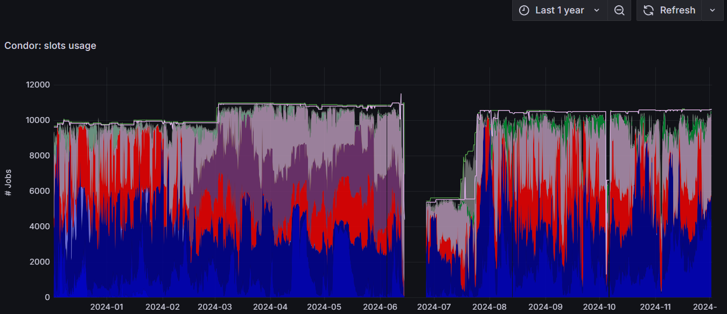
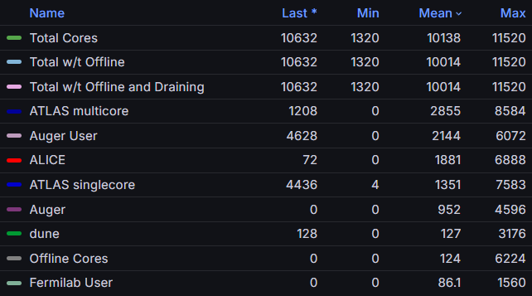
Usage in 2024 (Tier-2 part)

Slide 4
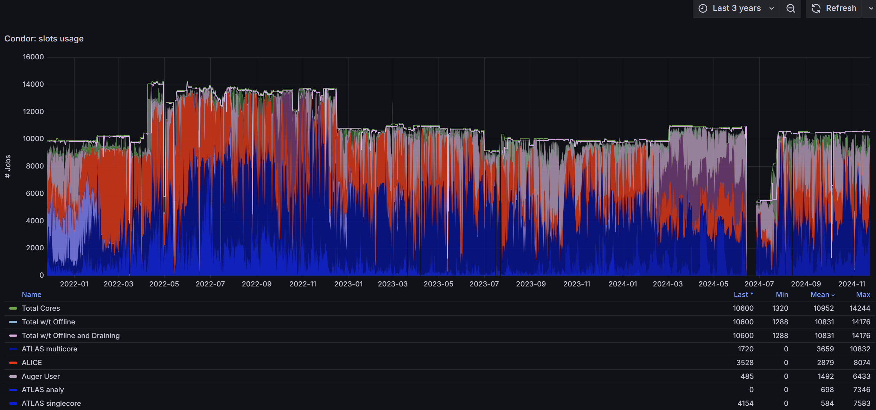
Number of slots evolution – last 3 years

Slide 5
Changes in 2024
12/2023
3 luna servers (luna2023, luna106-108)
5 new disks (5x22 TB) to nfs17
2/2024
WLCG DC24
3/2024
dpmpool20 update (10 TB disks – 12 TB disks)
4/2024
ds26-ds33 disks high temperature
6/2024
migration of computing servers to Alma Linux 9
new racks configuration
update of electricity distribution
2x100 Gbps LHCONE link
100 Gbps PASNET link
7/2024
200 Gbps network tests
8/2024
LUMI successful usage
10/2024
3 new disk servers nfs26-28 available
NFS data migration finished
new ui2 and ui3 (each: 2x32 cores, 768 GB RAM)
11/2024
magma cluster installed
12/2024
new stable HTCondor version 24.0.2

Slide 6
Computing servers - Golias

Slide 7
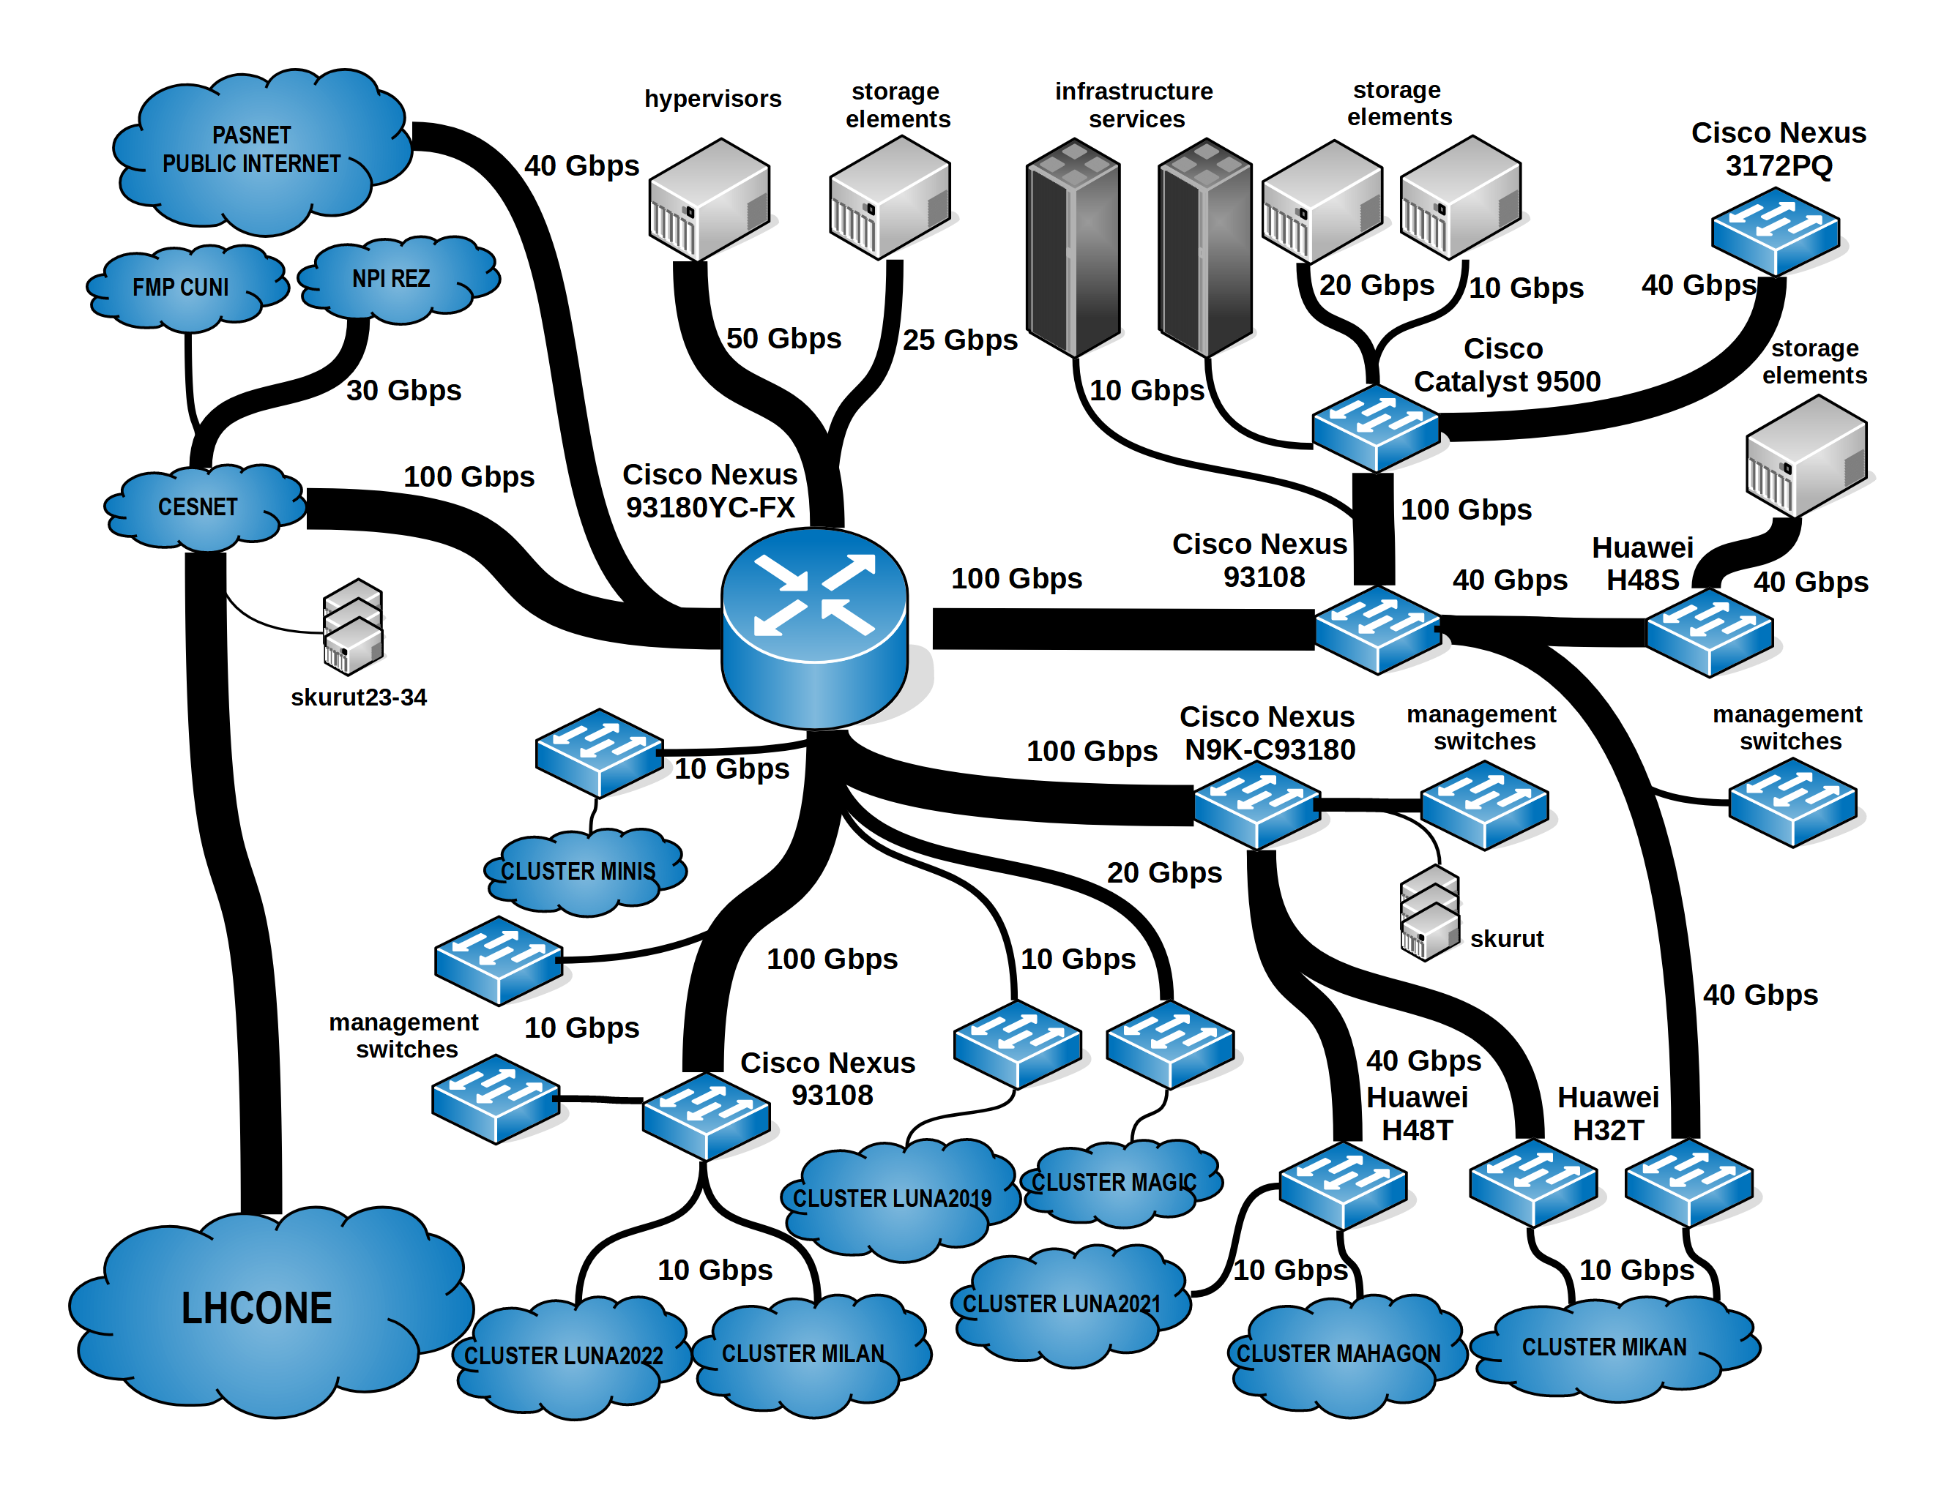
Network 2023
Excellent external connection thanks to CESNET
Notes:
different switch vendors, long delays for CISCO switches delivery

Slide 8
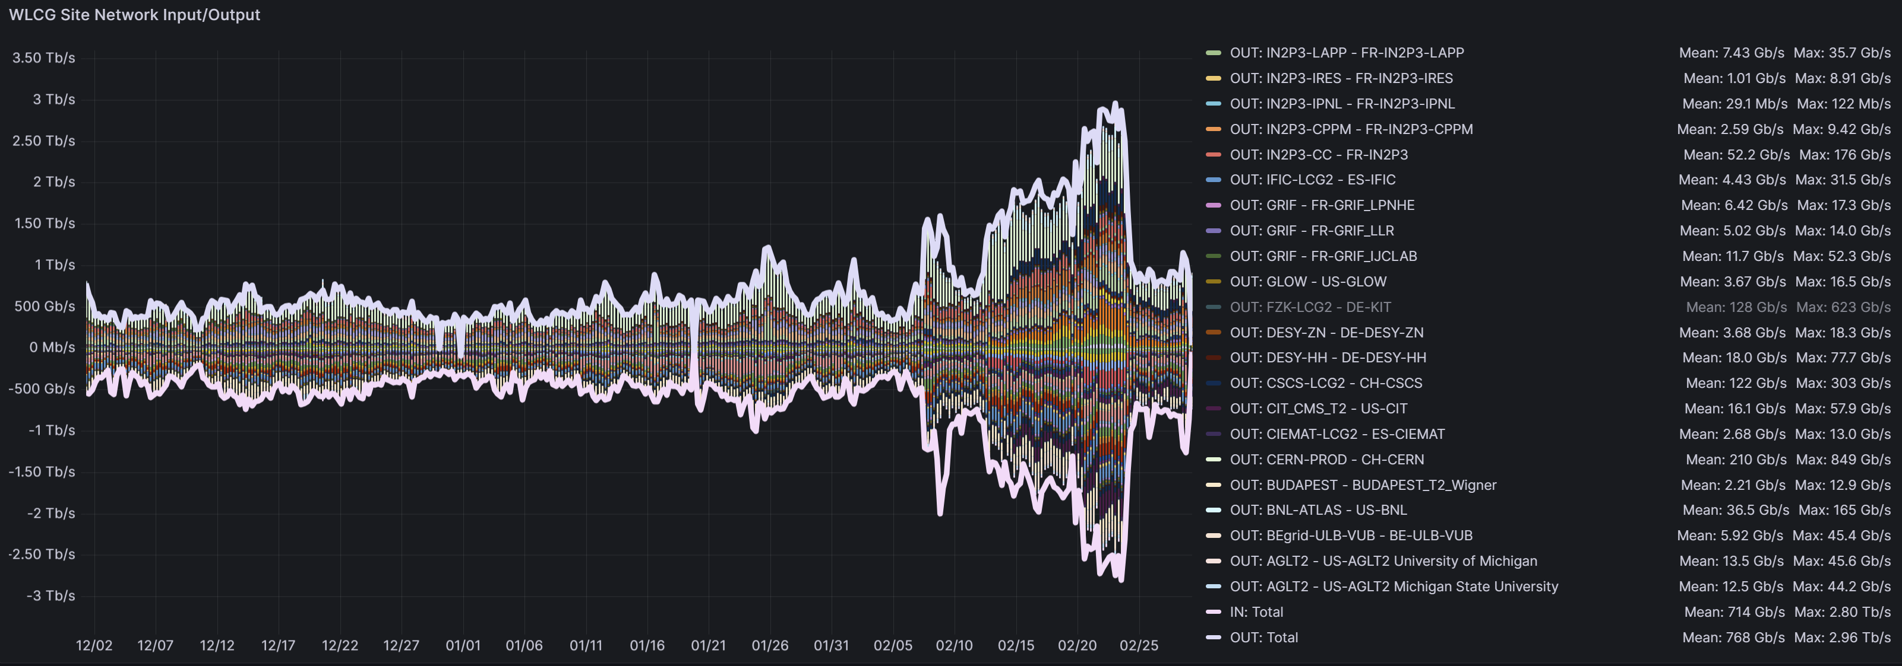
WLCG DC24
90 days before and during DC24, bin – 1 h
peaks at 3 Tb/s

Slide 9
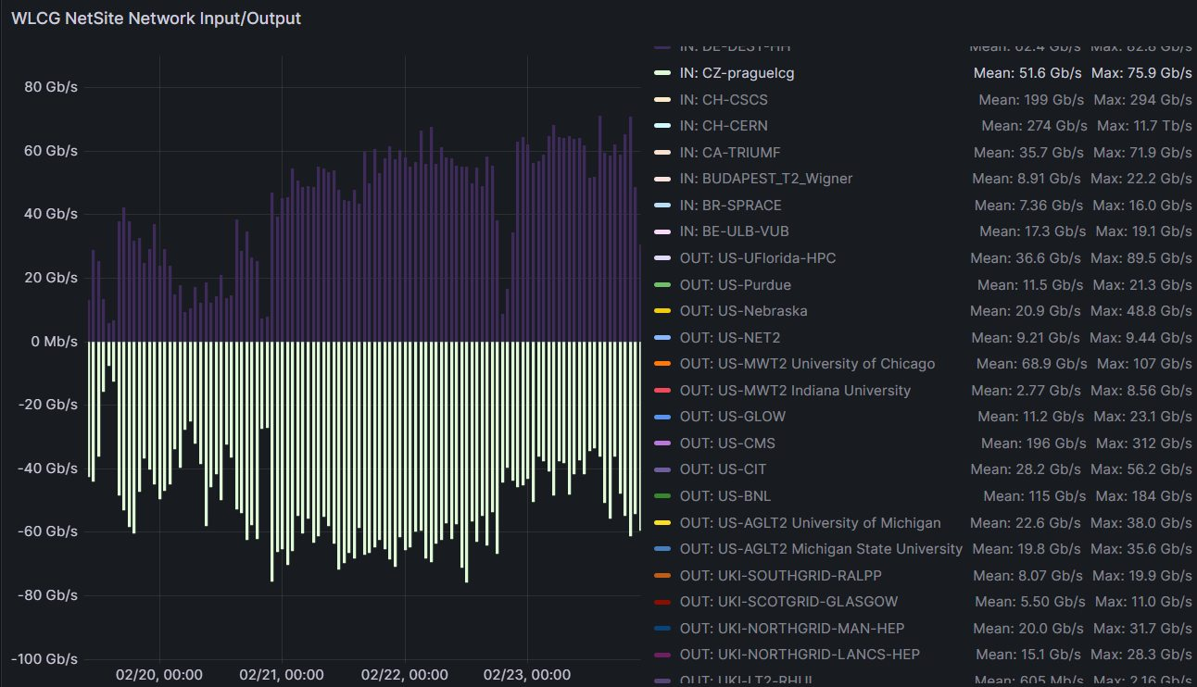
DC24
CZ
(in 4.5 days)
in: 2,5 PB
out: 2,1 PB

Slide 10
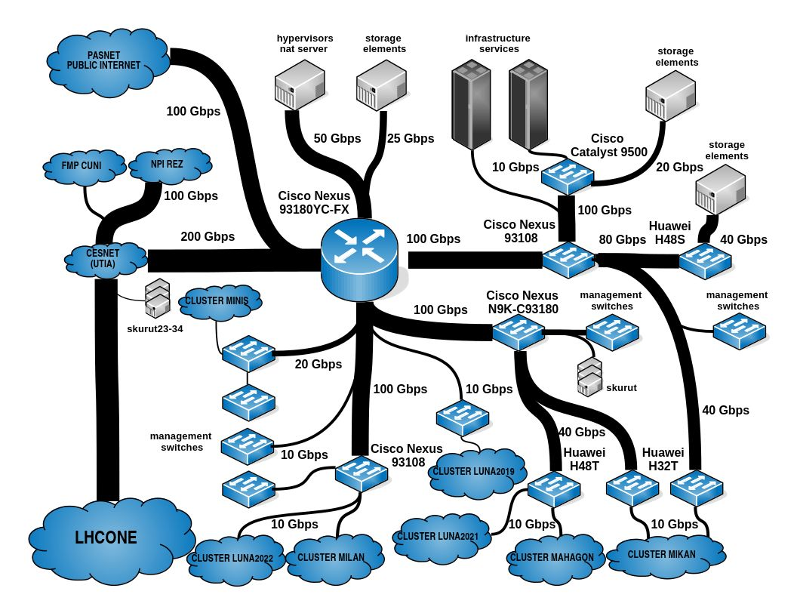
Network since 06.2024
Notes:
different switch vendors, long delays for CISCO switches delivery

Slide 11
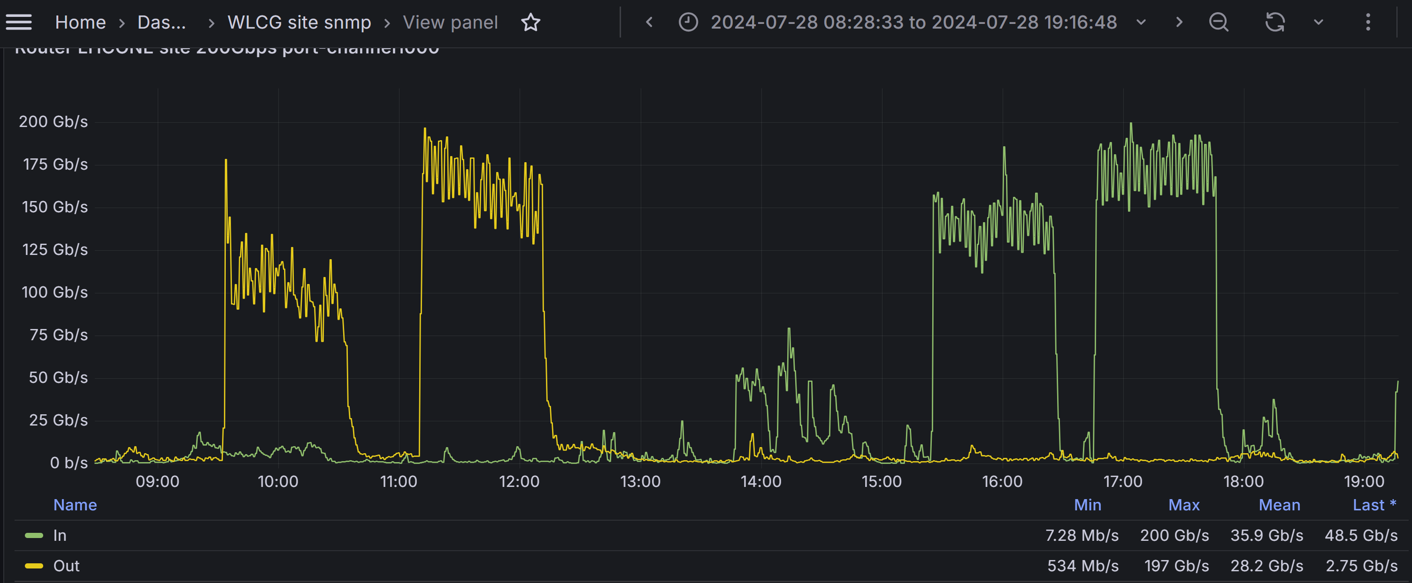
Tests - July 2024
WLCG (CERN) monitoring, 1 min avg

Slide 12
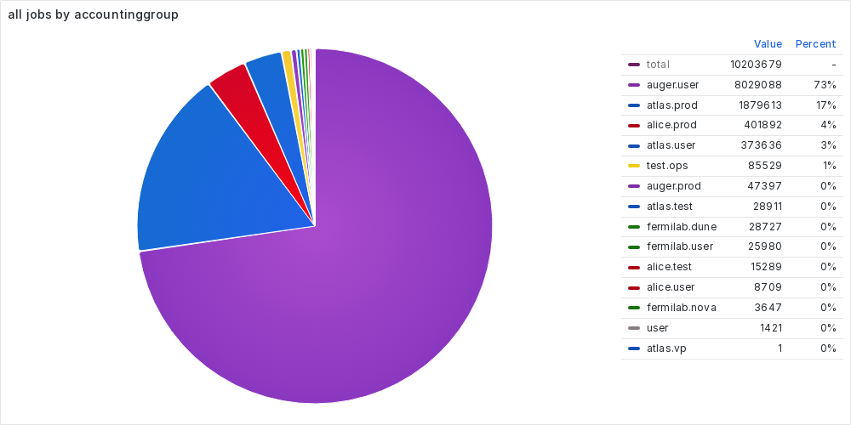
Statistics 2024 (Jan – Sep)

Slide 13
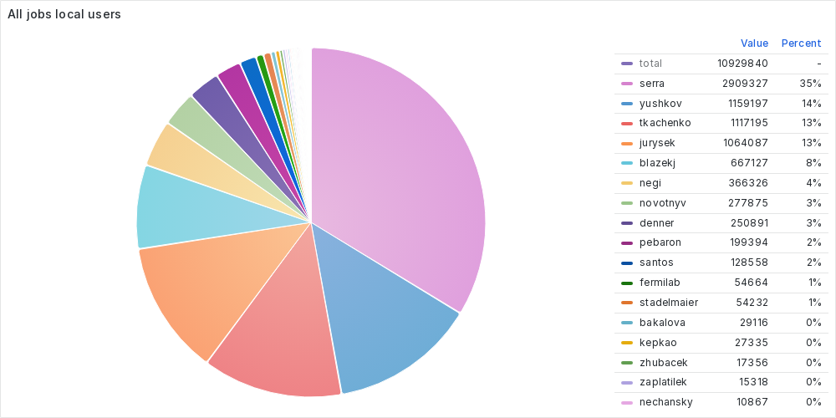
Statistics 2024 (Jan – Sep)

Slide 14
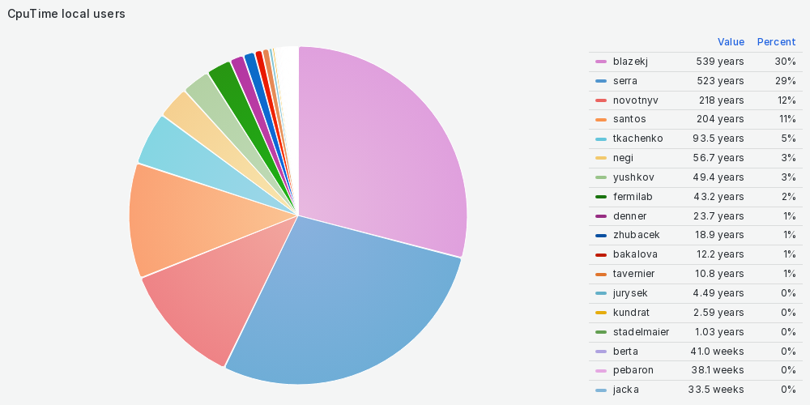
Statistics 2024 (Jan – Sep)

Slide 15
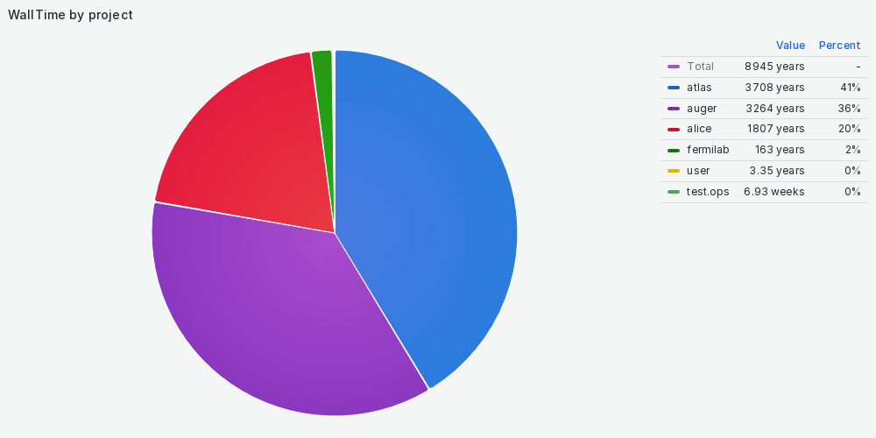
Statistics 2024 (Jan – Sep)
Notes:
(RemoteWallClockTime * RequestCpus * ScalingFactorMachine / ScalingFZUAplex)

Slide 16
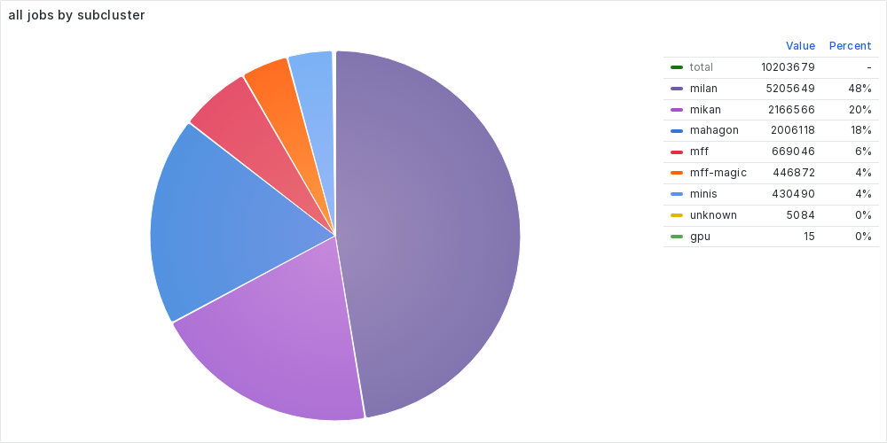
Statistics 2024 (Jan – Sep)

Slide 17
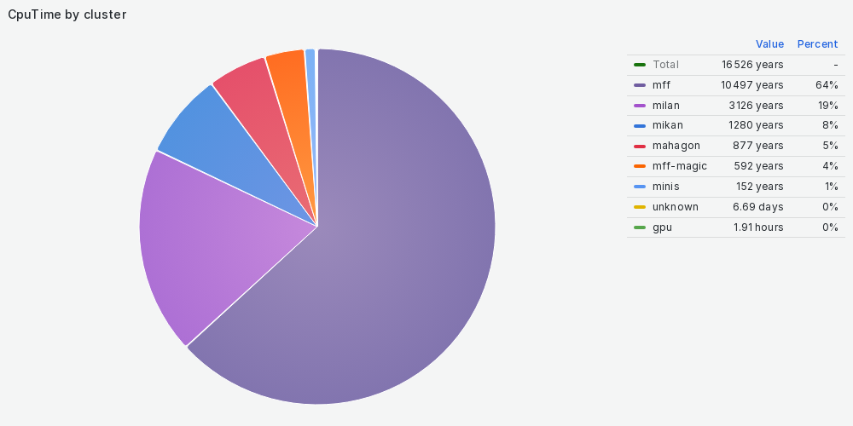
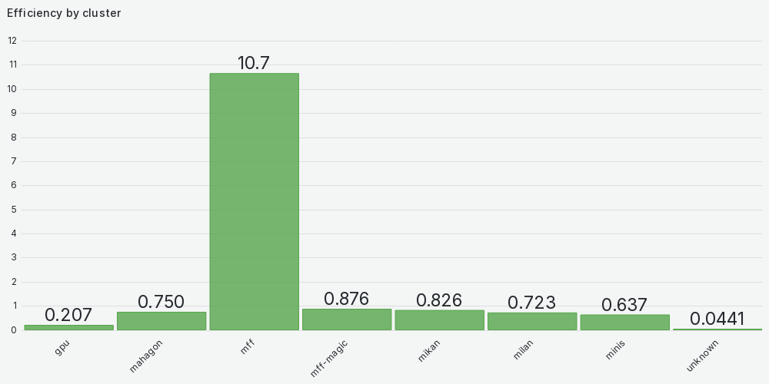
Statistics 2024 (Jan – Sep)
To be corrected!

Slide 18
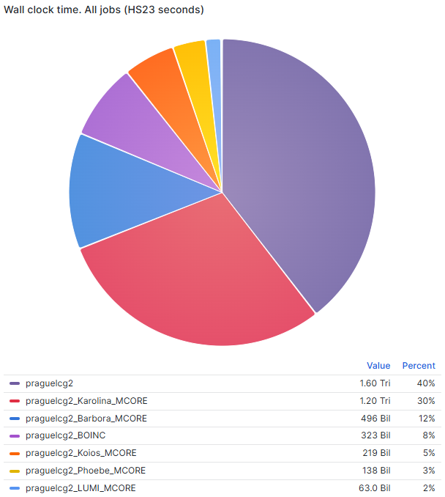
Operations – external resources (ATLAS)
2024
1.6 Tri
40 %
total: 4 Tri
(Jan – Nov)
Notes:
graphs – 2024 until Nov 25th, ATLAS grafana

Slide 19
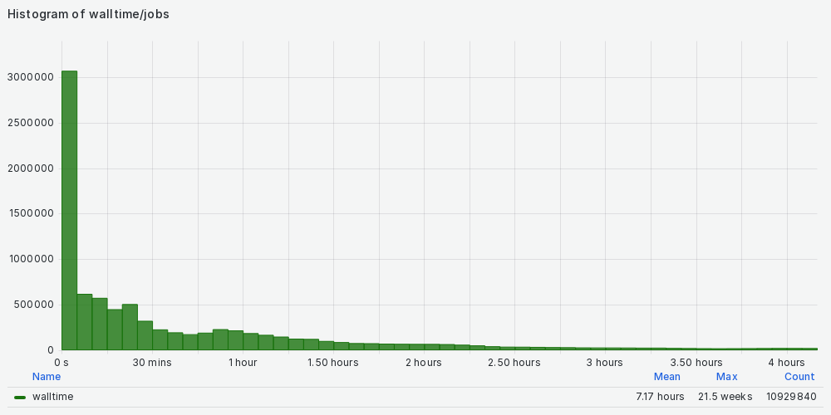
Statistics 2024 (Jan – Sep)
Walltime | Number of jobs
0 – 5 m | 3 069 571
5 – 10 m | 619 695
10 – 15 m | 575 835
15 – 20 m | 450 982
20 – 25 m | 507 324
25 – 30 m | 323 603
30 – 35 m | 229 279
35 – 40 m | 197 053
40 – 45 m | 176 530
45 – 50 m | 193 403
50 – 55 m | 231 741
55 – 60 m | 218 301
1 – 2 h | 1 322 477
2 – 3 h | 541 423
3 – 4 h | 308 199
1 – 2 d | 280 295
2 – 3 d | 215 302

Slide 20
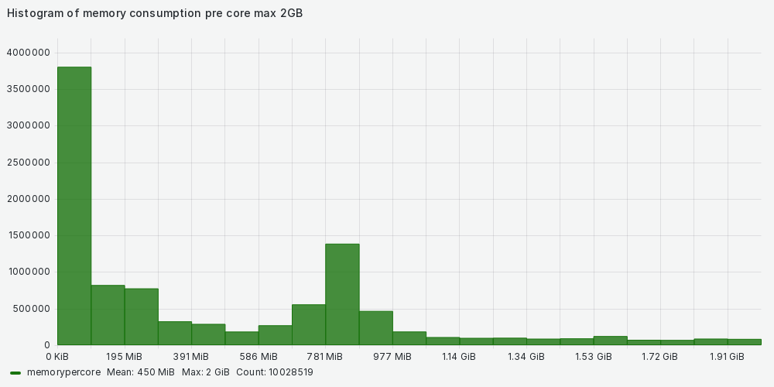
Statistics 2024 (Jan – Sep)

Slide 21
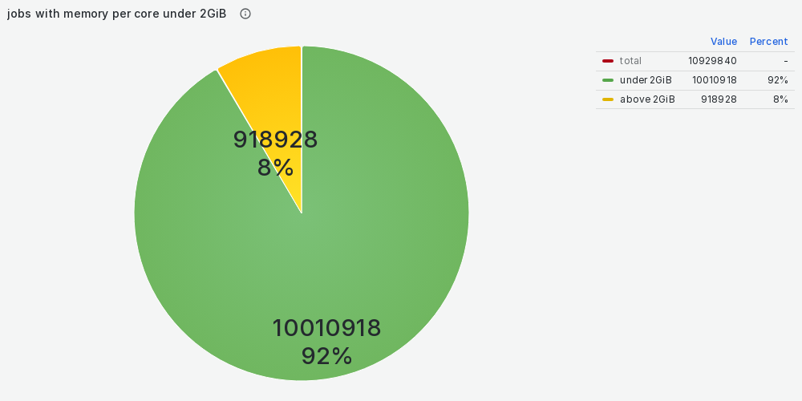
Statistics 2024 (Jan – Sep)

Slide 22
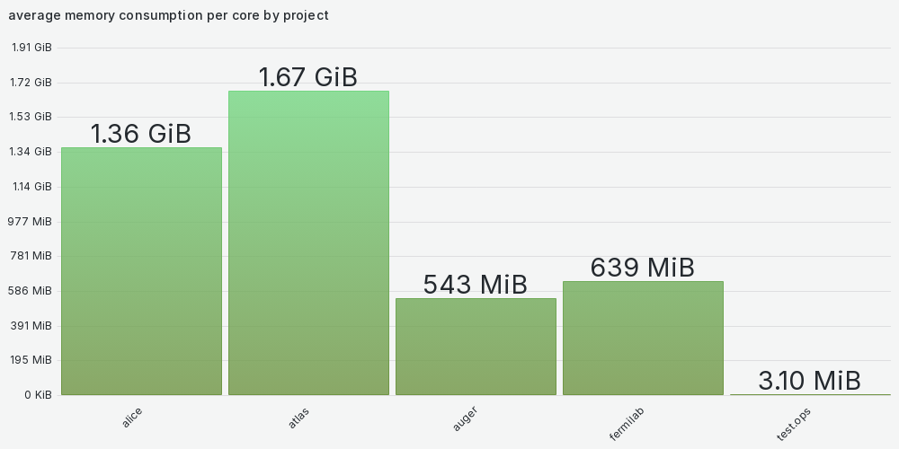
Statistics 2024 (Jan – Sep)

Slide 23
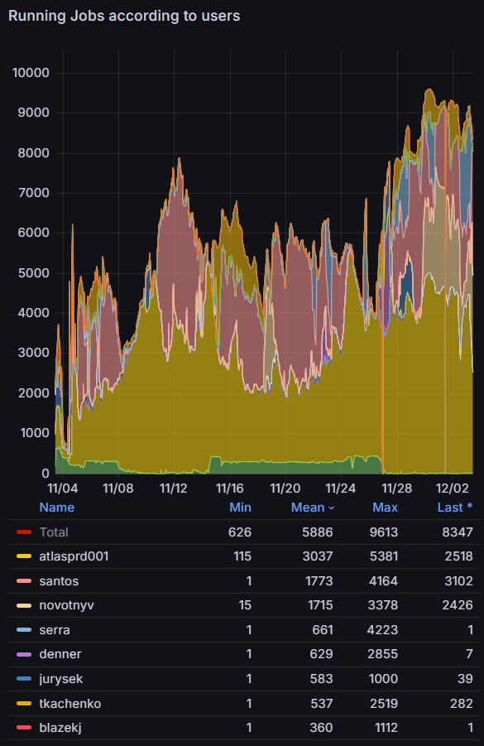
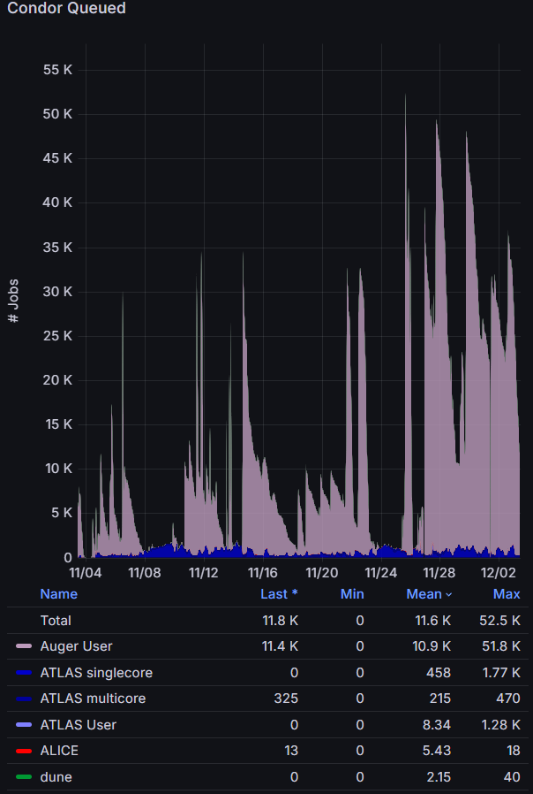
Grafana plots
Notes:
last 30 days

Slide 24
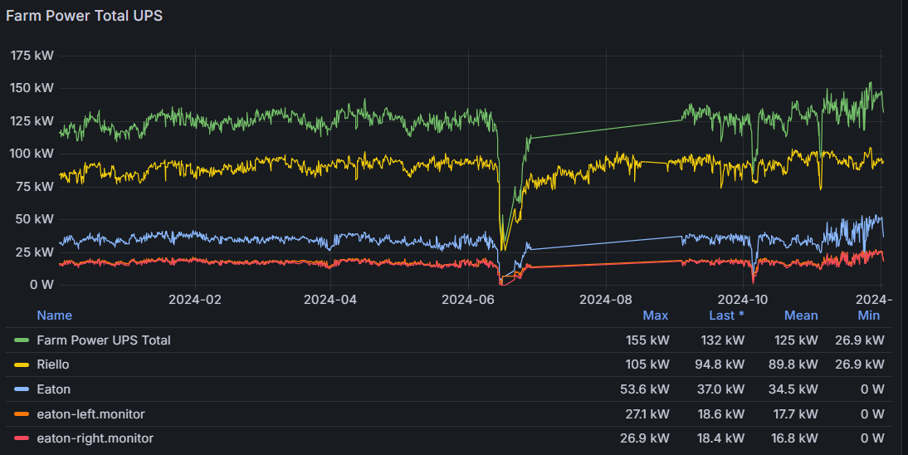
Electricity consumption
2023:
4.30 CZK/kWh (plus 40 %)
1536 MWh total (- 12 %)
avg: 178 kW (-32 %)
total: 6.6 MCZK
2024 (prelim):
5.53 CZK/kWh (plus 29 %)
1533 MWh total
avg: 177 kW
total: 8.5 MCZK
(without magma cluster)
Notes:
mean in 2023: 124 kW

Slide 25
gpu01

Slide 26
Manpower
lack of manpower
Lukáš Míča and Filip Neubauer left

Slide 27
Discussion
new cluster in 2025 - how much memory per core?
storage for local users: NFS vs ceph vs dcache

Slide 28
Thank you for your attention

