Slide 1
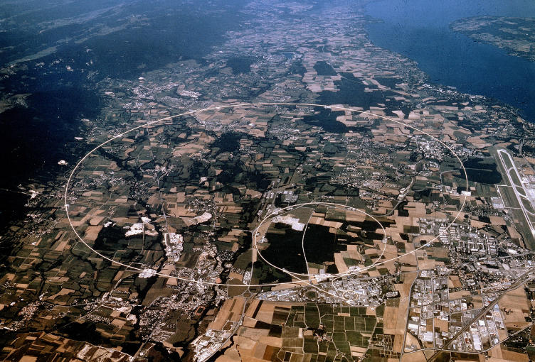
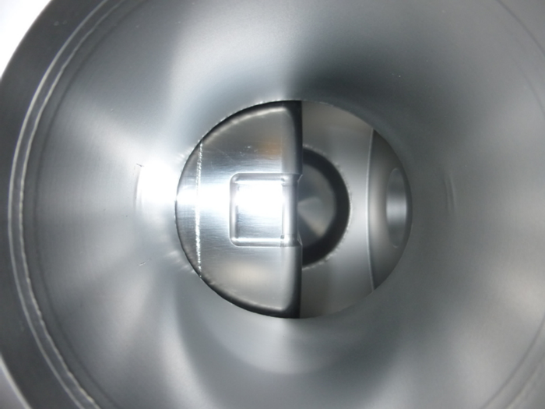
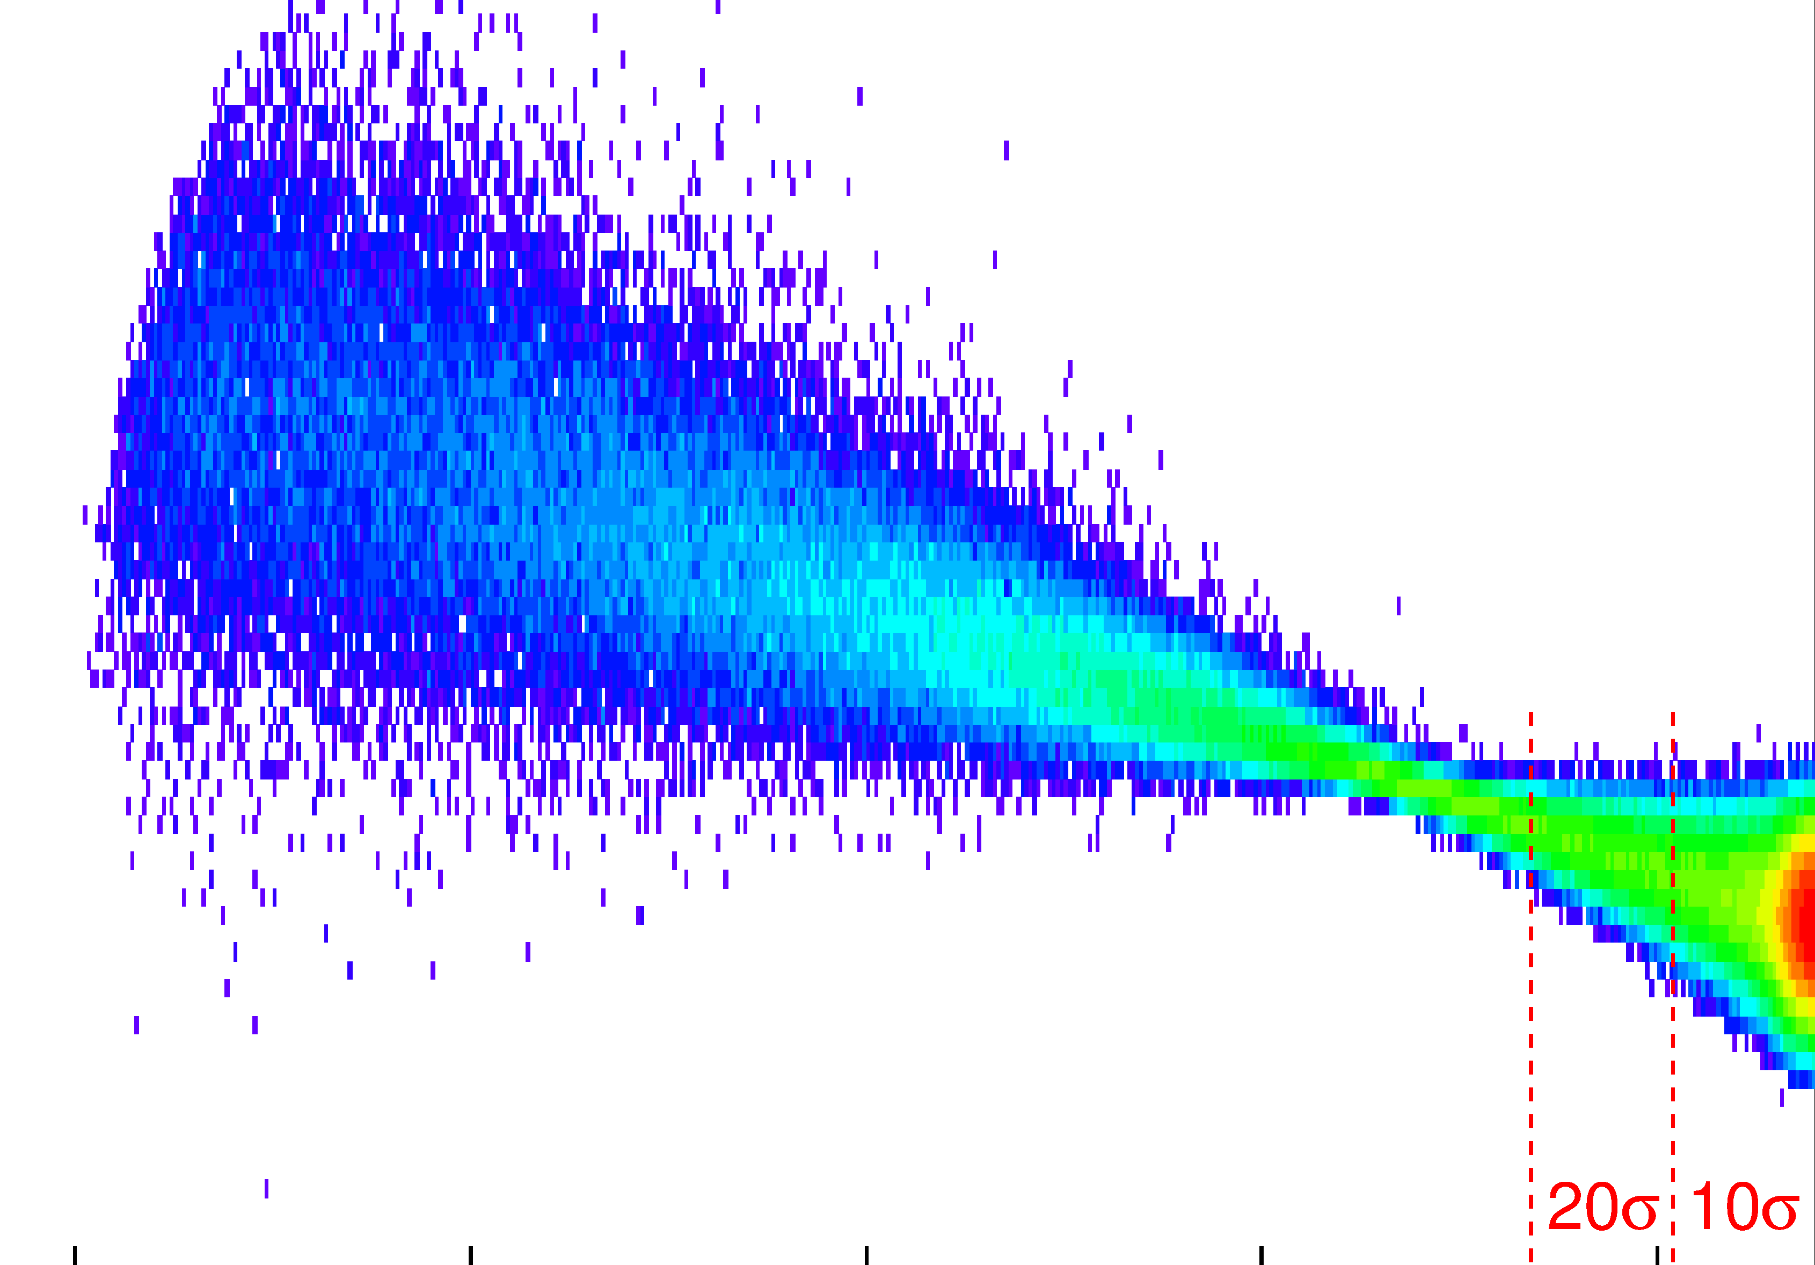

Exclusivity as a road to New Physics
Beam view: looking downstream through the beam pipe at a fully inserted Roman pot
Marek Taševský
Institute of Physics, Czech Academy of Sciences, Prague
FZU seminar FZU Prague 27/02/2025

Slide 2
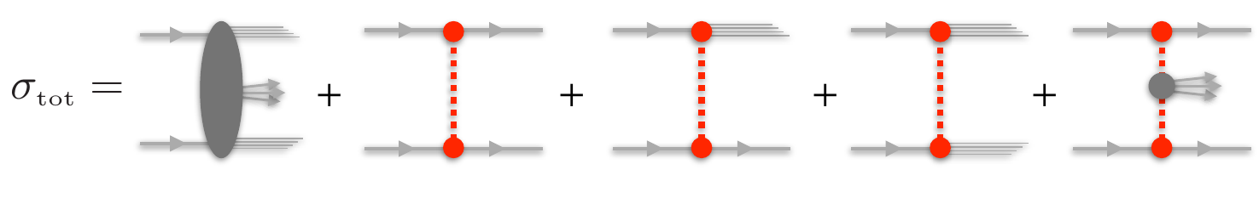
Proton-proton collisions

Slide 3
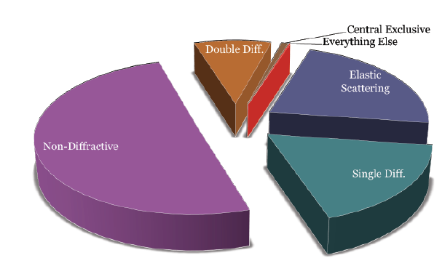
Proton-proton collisions

Slide 4
Proton-proton collisions
My region of interest:
Diffraction & Exclusivity
Forward physics

Slide 5
What is “Forward” Physics?

Slide 6
Forward physics → Astroparticle physics
… because most of CR collisions
is pretty much forward!

Slide 7
Forward physics → Astroparticle physics
Clearly, forward physics measurements from LHC may be of interest
for astroparticle community
For example, neutron spectra measured by LHCf
Or production of di-lepton from beam protons,
both surviving the interaction, going very forward
and being detected in AFP.
were showing (in 2018) how all models desperately
failed to describe the data.

Slide 8
LHC this year: pO and OO runs!
slide by J.Liu
& L.Beresford

Slide 9
LHC this year: pO and OO runs!
Proton-Oxygen with ATLAS+LHCf:
Motivation: Particle identification in air showers
Low en: main background for Gamma-ray telescopes
High en: Muon puzzle: starts at ~ LHC en.
Of special interest: diffraction and pion exchange via forward neutrals (LHCf)
and central activity (ATLAS)
C. Leitgeb
slide by J.Liu
& L.Beresford

Slide 10
Forward physics → New physics
Slide by F. Kling

Slide 11
Forward physics → New physics
Slide by F. Kling

Slide 12
Forward physics → New physics
Slide by F. Kling

Slide 13
Forward physics → New physics
Slide by F. Kling

Slide 14
New LHC Forward Physics Experiments
Slide by F. Kling

Slide 15
Slide by F. Kling

Slide 16
Slide by F. Kling

Slide 17
Slide by F. Kling

Slide 18
But: typical proton-proton interaction is not forward
A lot of activity in the central detector:
Hard scattering
Multi-parton interactions
Initial-state radiation
Final-state radiation
Hadronization + decays
Most of time at LHC: no (or small) rapidity gaps
observed.
More precisely: Most of time the rapidity gap
distribution is exponentially falling.

Slide 19
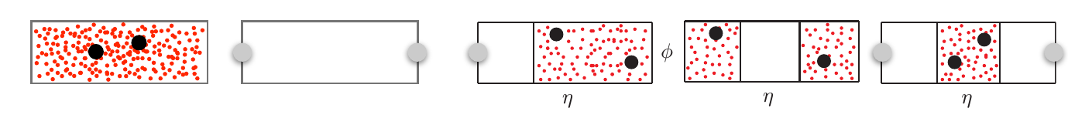
Diffractive interactions
Identified by the presence of an intact leading particle (measured in FPD = Forward
Proton Detector) and/or a large rapidity gap (LRG)
Diffractive reactions at hadron colliders are defined as reactions in which a color singlet object (Pomeron) is exchanged between colliding particles.

Slide 20
Diffractive interactions
Identified by the presence of an intact leading particle (measured in FPD = Forward
Proton Detector) and/or a large rapidity gap (LRG)
Diffractive reactions at hadron colliders are defined as reactions in which a color singlet object (Pomeron) is exchanged between colliding particles.

Slide 21
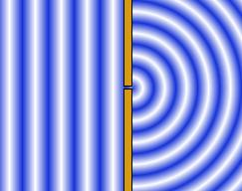
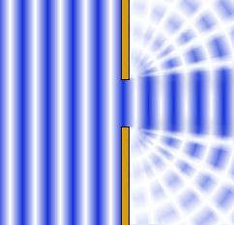
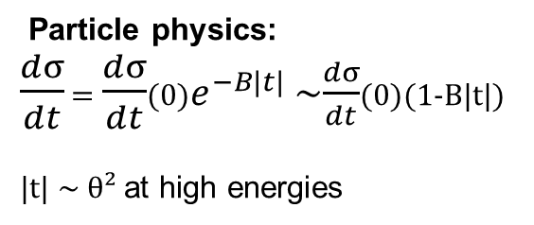
Diffractive interactions: why diffractive?
Diffraction in high-energy particle physics is analogy of diffraction in classical optics:
“bending of waves around the corners of an obstacle or through an aperture into the region of
geometrical shadow of the obstacle/aperture”
Diffraction on a point slit
Diffraction on a slit of R~λ
Optics: intensity of diffracted light
at small angles and large wave nr. k
I(θ) = I(0)(1-Bk²θ²)
B~R²(radius of obstacle)
Elastic scattering at LHC
Particle physics:
$\frac{dσ}{dt}$ = $\frac{dσ}{dt}$(0)$e^{−B|t|}$ ~$\frac{dσ}{dt}$(0)(1-B|t|)
|t| ~ θ² at high energies

Slide 22
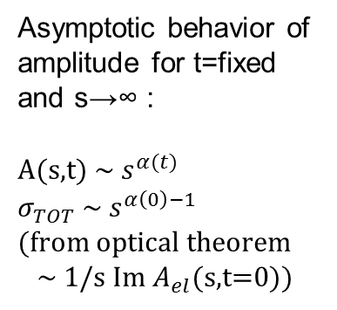
Definition of Diffraction in HEP
1) Interactions where no quantum numbers
between colliding particles are exchanged
2) Presence of Large Rapidity Gap
(non-exponentially suppressed)
in the final state
Regge theory: describes soft (e.g. $σ_{TOT}$) and soft diffractive (e.g. Single Diffraction) phenomena
using unitarity and analyticity of S-matrix & crossing symmetry and Regge trajectories (Reggeon)
Asymptotic behavior of
amplitude for t=fixed
and s→∞ :
A(s,t) ~ $s^{α(t)}$
$σ_{TOT}$ ~ $s^{α\left(0\right)−1}$
(from optical theorem
~ 1/s Im $A_{el}$(s,t=0))
J = total angular momentum

Slide 23

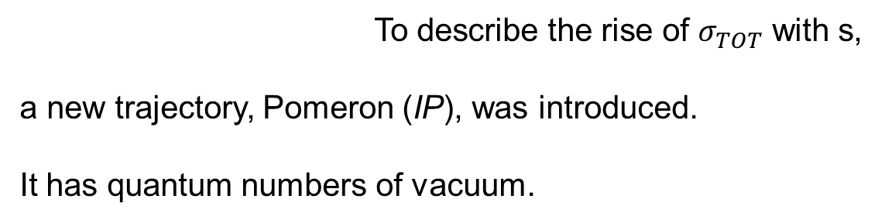
Introduction of Pomeron
To describe the rise of $σ_{TOT}$ with s,
a new trajectory, Pomeron (IP), was introduced.
It has quantum numbers of vacuum.
J = total angular momentum
$σ_{TOT}$ = $As^{0.0808}$ + $Bs^{−0.4525}$
Pomeron Reggeon

Slide 25
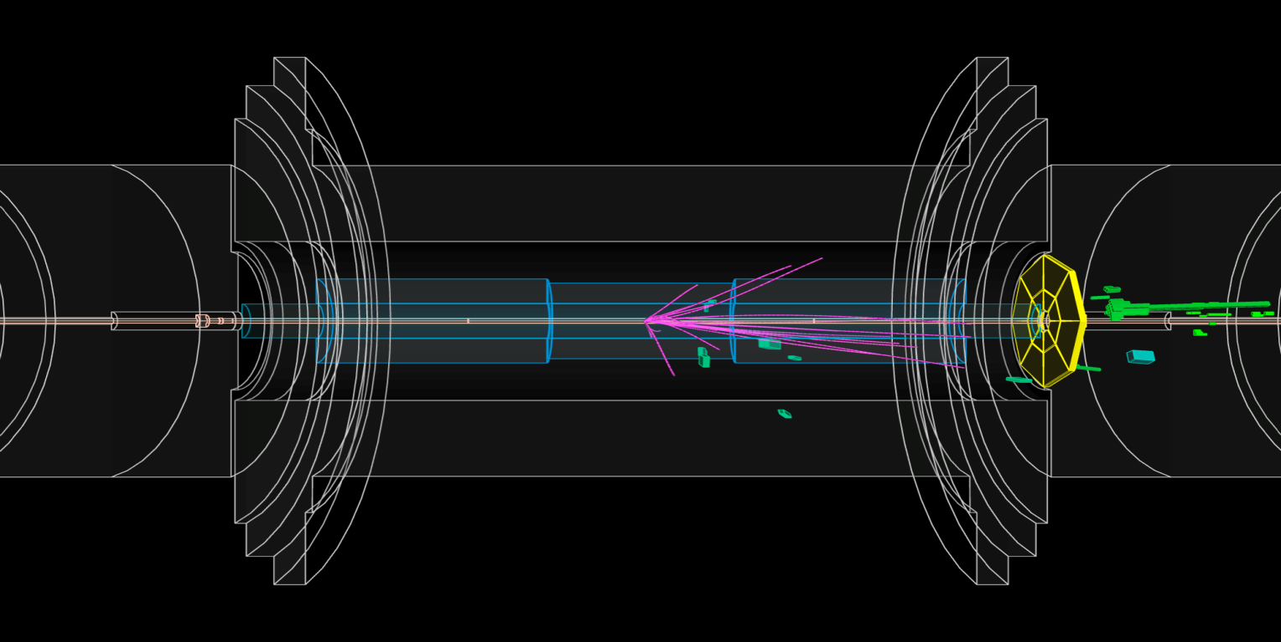
Rapidity gaps in LHC Central detector
Large Rapidity Gap (LRG) :
Region in η devoid of hadronic activity due to the exchange of colorless object (Pomeron)
Detector-level LRG definition : Δη^{F}
Largest region in η (starting at the edge of the detector η = ±4.8) absent of clusters
and tracks
Non-pileup environment optimal since multiple soft pp interactions could fill the gap
Δη_{F} ~ 6 ⬄ ξ ~ 10⁻⁴
Intact proton
LRG

Slide 26
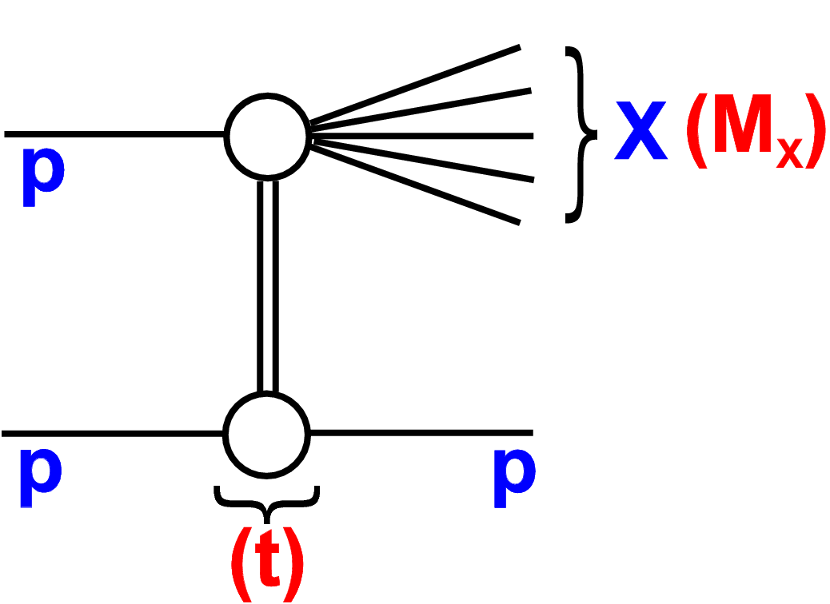



Single Diffraction
Fractional proton momentum loss
ξ = $M_{X}^{2}$/s
Final state (e.g. jets) measured in
central detector (less precise)
Δη ≈ - lnξ
ξ = 1 - $\frac{E_{p_{i}^{′}}}{E_{p_{i}}}$ (i=1,2)
Protons measured in Forward Proton
Detector (more precise)
t = (p-p’)

Slide 28
Forward Proton Detector: Principle

Slide 29
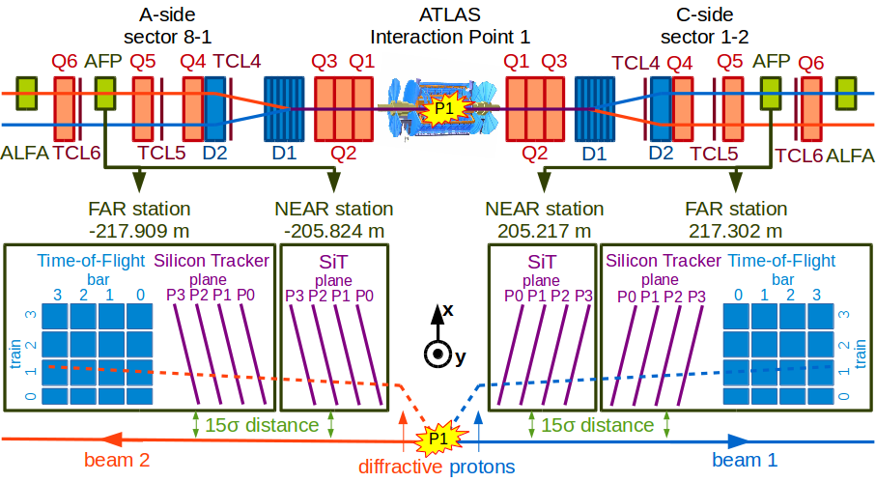
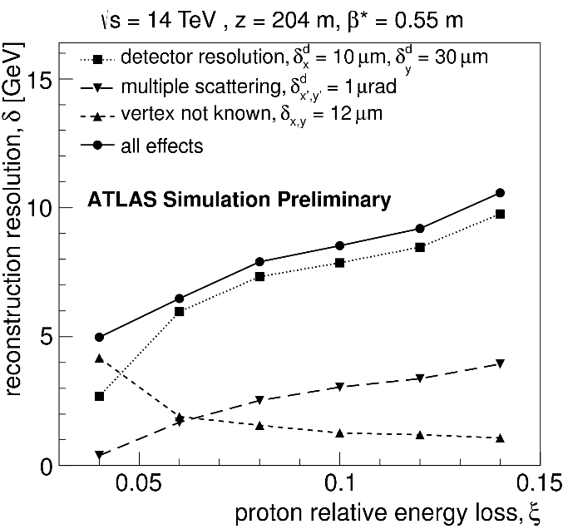
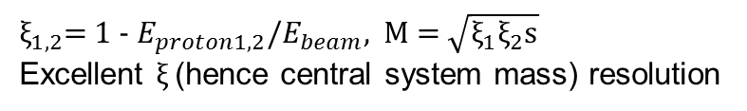
Forward Proton detectors (FPDs) at LHC
AFP
[AFP TDR, CERN-LHCC-2015-009]
$ξ_{1,2}$= 1 - $E_{proton1,2}$/$E_{beam}$, M = $\sqrt{ξ_{1}ξ_{2}\text{s}}$
Excellent $ξ_{ }$(hence central system mass) resolution
CT-PPS
[CT-PPS TDR, CERN-LHCC-2014-021]

Slide 30

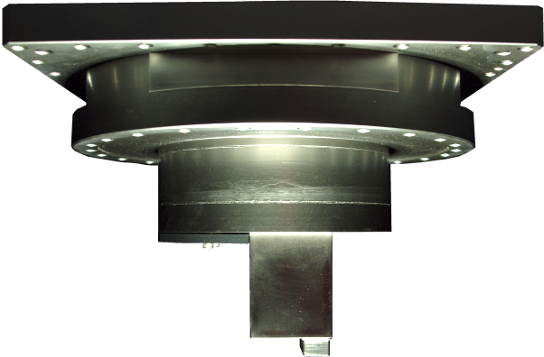
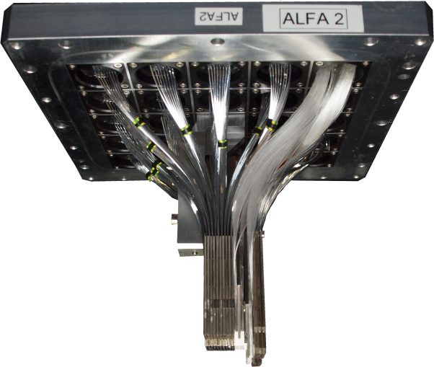
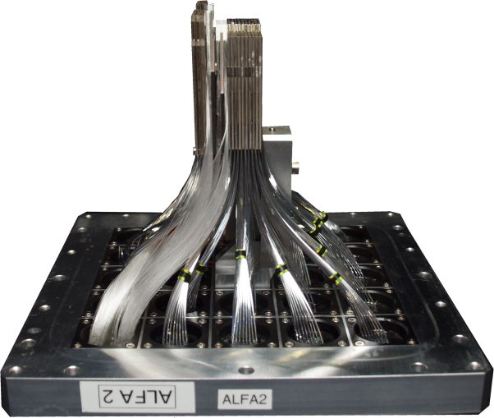
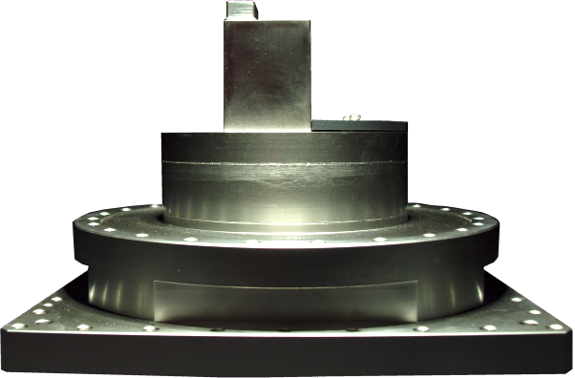
Absolute Luminosity For ATLAS - ALFA
Approach the beam to few mm with Roman Pot
Beam pipe
Beam pipe
Only used in dedicated high β* runs
Sune Jakobsen

Slide 31

LHC Forward Proton Detector
Beam view: looking downstream through the beam pipe at a fully inserted Roman pot

Slide 32
LHC Forward Proton Detector

Slide 33
Roman Pot technology (AFP)

Slide 34
Roman Pot technology (AFP)

Slide 35
Roman Pot technology (AFP)

Slide 36
Roman Pot technology (AFP)

Slide 37
Roman Pot technology (AFP)

Slide 38
Roman Pot technology (AFP)

Slide 39
Roman Pot technology (AFP)

Slide 40
Roman Pot technology (AFP)

Slide 41
Roman Pot technology (AFP)

Slide 42
Roman Pot technology (AFP)

Slide 43
Roman Pot technology (AFP)

Slide 44
Roman Pot technology (AFP)

Slide 45
Roman Pot technology (AFP)

Slide 46
Roman Pot technology (AFP)

Slide 47
Roman Pot technology (AFP)

Slide 48
Roman Pot technology (AFP)

Slide 49
Roman Pot technology (AFP)

Slide 50
Roman Pot technology (AFP)

Slide 51
Roman Pot technology (AFP)

Slide 52
Roman Pot technology (AFP)

Slide 53
Roman Pot technology (AFP)

Slide 54
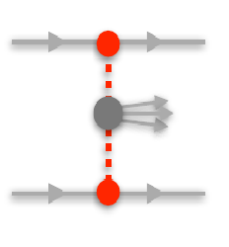
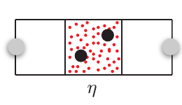
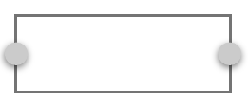



(Semi) exclusive processes
Proton detected in Forward Proton Detector (FPD)
IP
IP
Semiexclusive production
Exclusive
production
Large rapidity gap
detected in central detector
At high energies, Pomeron reveals structure: sum of multi-particle ladders built
by the exchange of two t-channel gluons (QCD Pomeron)
QCD Pomeron exchange → QCD-induced exclusive process

Slide 55
(Semi) exclusive processes
Proton detected in Forward Proton Detector (FPD)
γ
γ
Semiexclusive production
Exclusive
production
Large rapidity gap
detected in central detector
Incoming protons (or nuclei) radiate photons!
γ+γ → QED-induced exclusive process

Slide 56
(Semi) exclusive processes
Proton detected in Forward Proton Detector (FPD)
IP or γ
IP or γ
Semiexclusive production
Exclusive
production
Large rapidity gap
detected in central detector
ATLAS, CMS, LHCb:
measure QED exclusive processes routinely.
without FPDs: γγ→μμ/ee; γγ→WW; γγ→γγ
with FPDs: γγ→μμ/ee; γγ→γγ
(all in presence of pile-up, without timing
detectors)

Slide 57
(Semi) exclusive processes
Proton detected in Forward Proton Detector (FPD)
IP or γ
IP or γ
Semiexclusive production
Exclusive
production
Large rapidity gap
detected in central detector

Slide 58
Ingredients to calculate cross sections
Photon-induced (QED)
Photon flux derived from EM form factors (measured precisely)
QED Matrix element
Soft survival probability (S² ~ 1.0 since p-p impact parameter large)
Both outgoing protons stay intact (can be detected in FPD)
No color flow between incoming protons in S² fraction of events
Final state particles and nothing else in central detector
Important constraints on the kinematics of final state
Pomeron-induced (QCD)
Gluon un-integrated PDF (2 couplings to each proton)
Sudakov suppression (prob of no extra g radiation from incoming g)
QCD Matrix element (perturbative QCD thanks to large energy scale)
Soft survival probability (S² << 1 since p-p impact parameter small)

Slide 59
Ingredients to calculate cross sections
Photon-induced (QED)
Photon flux derived from EM form factors (measured precisely)
QED Matrix element
Soft survival probability (S² ~ 1.0 since p-p impact parameter large)
Photon+Pomeron-induced
Both outgoing protons stay intact (can be detected in FPD)
No color flow between incoming protons in S² fraction of events
Final state particles and nothing else in central detector
Important constraints on the kinematics of final state
Gluon un-integrated PDF (2 couplings to each proton)
Sudakov suppression (prob of no extra g radiation from incoming g)
QCD Matrix element (perturbative QCD thanks to large energy scale)
Soft survival probability (S² << 1 since p-p impact parameter small)

Slide 60
Cross sections of exclusive processes
Did I mention that exclusive processes are rare??
Tiny cross section → Need for big integrated luminosities
→ High instantaneous luminosities
→ Dense proton bunches
→ Large pile-up

Slide 61
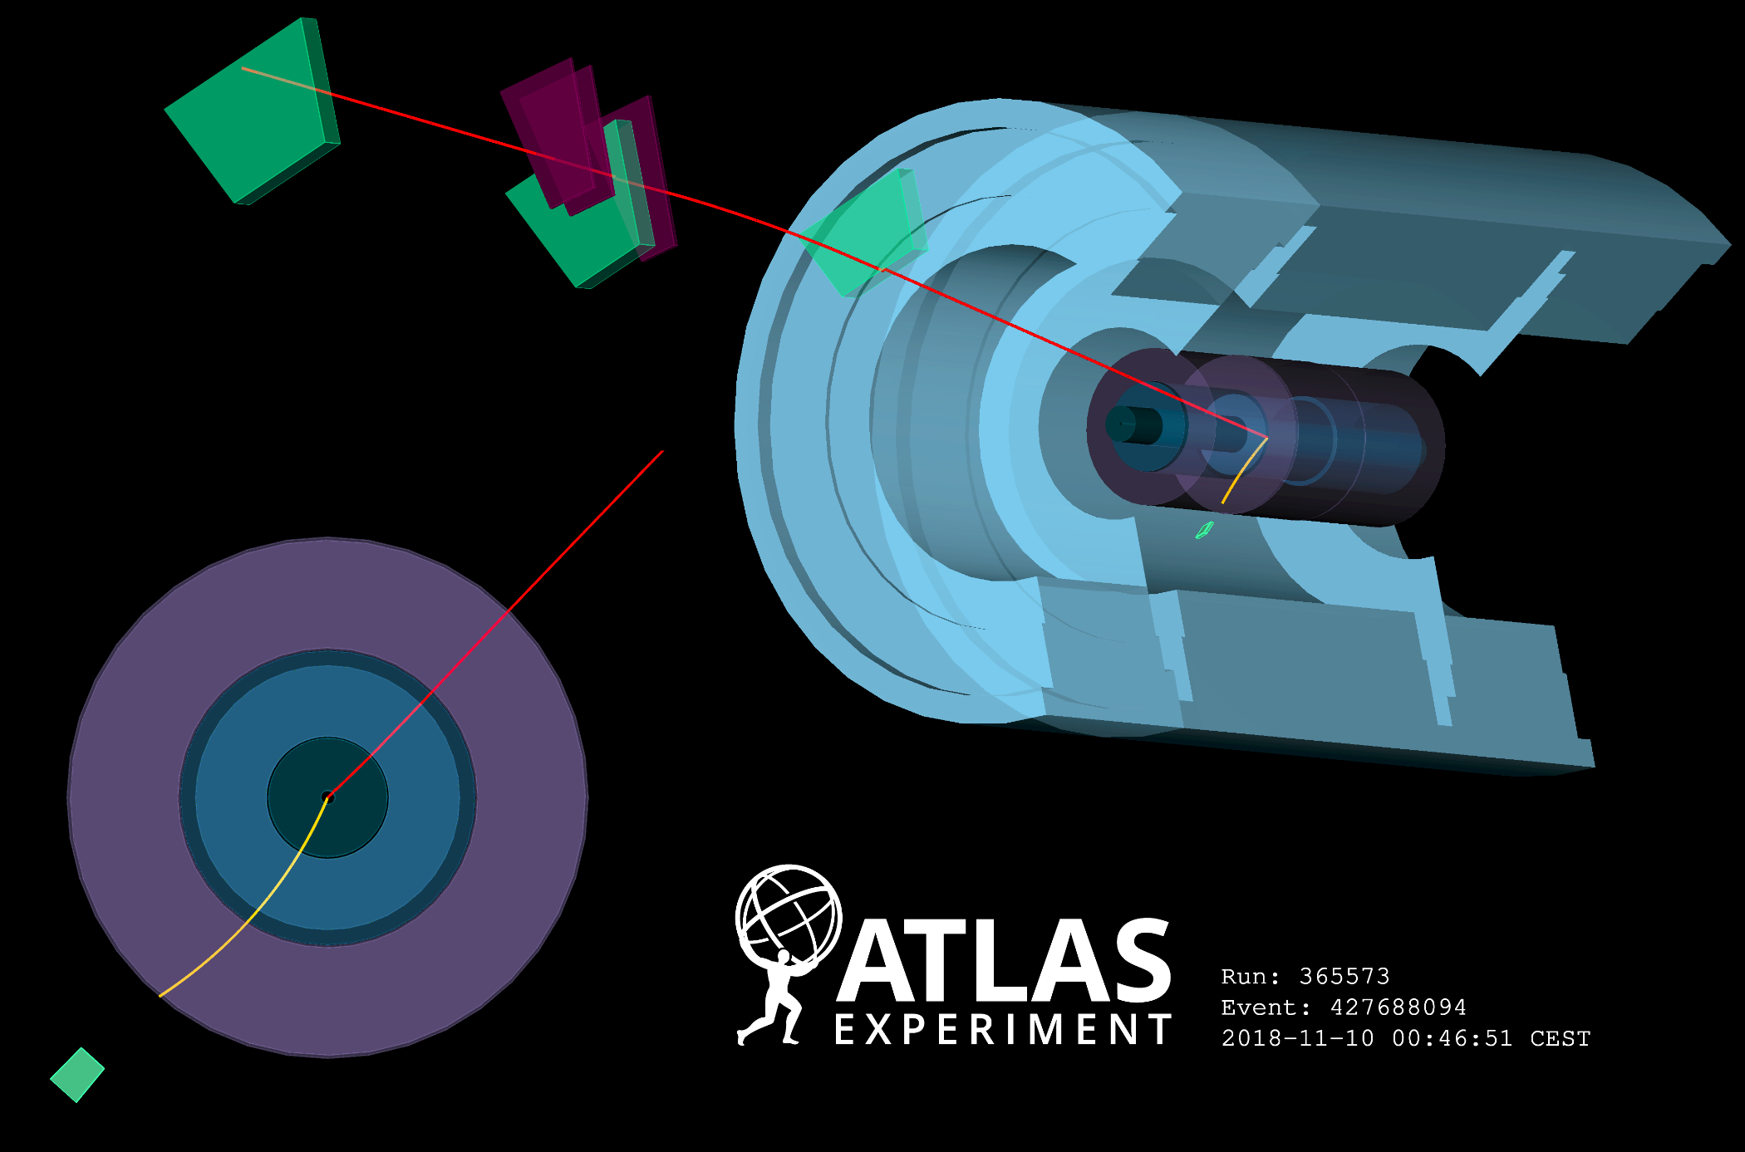
Ideal exclusive event at LHC: no pile-up

Slide 62
Real exclusive event at LHC : with pile-up
PILE-UP vertices!

Slide 63
Experimental evidence of (semi) exclusive processes
TEVATRON:
Exclusive di-jets: gg → jj:
CDF (PRD77 (2008) 052004)
D0 (PLB705 (2011) 193)
LHC:
Exclusive di-leptons γγ → μμ/ee:
without FPDs: ATLAS (PLB 749 (2015) 242)
ATLAS (PLB 777 (2018) 303)
with FPDs: ATLAS (PRL 125 (2020) 261801) Exclusive top: γγ → tt :
CMS, TOTEM (JHEP 07 (2018) 153) with FPDs: CMS (JHEP 06 (2024) 187)
Exclusive di-bosons: γγ → WW/ZZ:
without FPDs: ATLAS (PLB 816 (2021) 136190)
with FPD: CMS (JHEP 07 (2023) 229), CMS (EPJC 83 (2023) 827)
Exclusive di-photons: PbPb → γγ → γγ: pp → γγ → γγ:
CMS (PLB 797 (2019) 134826) with FPDs: ATLAS (JHEP 07 (2023) 234)
ATLAS (PRL 123 (2019) 052001) with FPDs: CMS (PRL 129 (2022) 011801)
ATLAS (JHEP 03 (2021) 243) with FPDs: CMS (PRD 110 (2024) 012010)

Slide 64
PILE-UP
Did I mention that pile-up is an issue?
Lots of soft particles produced in numerous vertices!
How can you even think of exclusivity in such an environment??

Slide 65
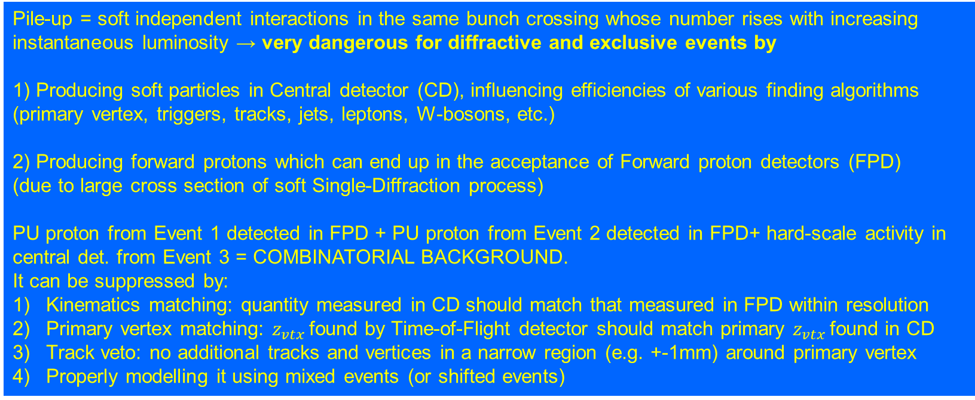
PILE-UP effects
Pile-up = soft independent interactions in the same bunch crossing whose number rises with increasing
instantaneous luminosity → very dangerous for diffractive and exclusive events by
1) Producing soft particles in Central detector (CD), influencing efficiencies of various finding algorithms
(primary vertex, triggers, tracks, jets, leptons, W-bosons, etc.)
2) Producing forward protons which can end up in the acceptance of Forward proton detectors (FPD)
(due to large cross section of soft Single-Diffraction process)
PU proton from Event 1 detected in FPD + PU proton from Event 2 detected in FPD+ hard-scale activity in central det. from Event 3 = COMBINATORIAL BACKGROUND.
It can be suppressed by:
Kinematics matching: quantity measured in CD should match that measured in FPD within resolution
Primary vertex matching: $z_{vtx }$found by Time-of-Flight detector should match primary $z_{vtx }$found in CD
Track veto: no additional tracks and vertices in a narrow region (e.g. +-1mm) around primary vertex
Properly modelling it using mixed events (or shifted events)

Slide 66
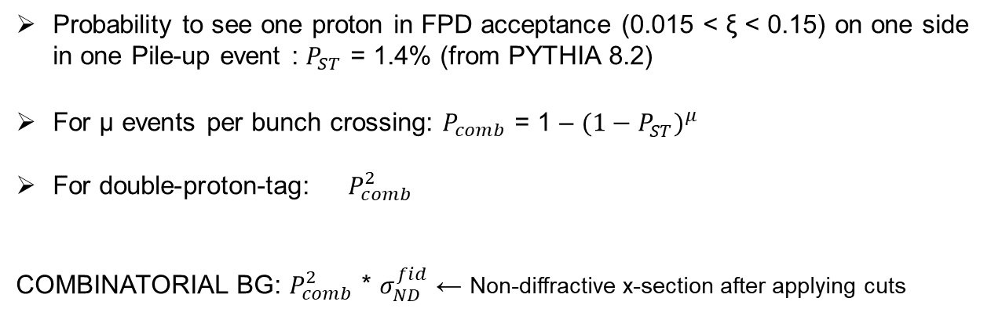
Combinatorial background
Signal: proton in FPD on side A
& proton in FPD on side C
& hard-scale final state in central detector
But what if we have 50 p-p interactions per bunch
crossing (μ ~ 50)?
(Compare with dedicated Forward Detectors LHCf, SND
FASER or FPF: final state only in Forward region)
Probability to see one proton in FPD acceptance (0.015 < ξ < 0.15) on one side
in one Pile-up event : $P_{ST}$ = 1.4% (from PYTHIA 8.2)
For μ events per bunch crossing: $P_{comb}$ = 1 – ${(1−P_{ST}^{})}^{μ}$
For double-proton-tag: $P_{comb}^{2}$
COMBINATORIAL BG: $P_{comb}^{2}$ * $σ_{ND}^{fid}$ ← Non-diffractive x-section after applying cuts
Most dangerous combination: 2x soft SD events + hard-scale event (usually ND)

Slide 67

Suppressing combinatorial background:
kinematics matching
This difference
has big impact
on comb-bg
rejection
Pile-up
$∆y=(η_{jet1}$+ $η_{jet2}$)/2 - $y_{X}$

Slide 68
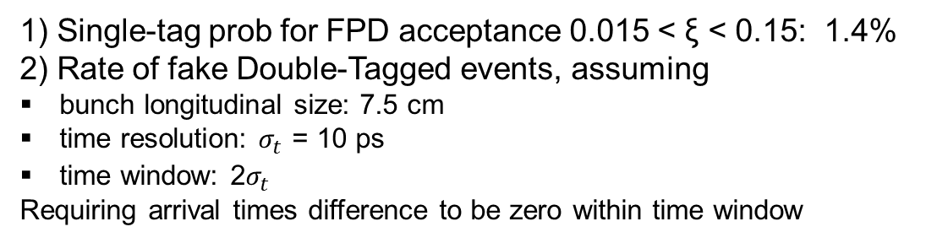
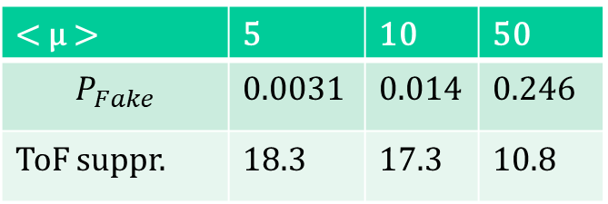
2) Suppressing combinatorial background: primary vertex matching using ToF detector
JINST 16 (2021) 01, P01030
Difference of times of flight (ToF):
Leads to longit. position of vertex
1) Single-tag prob for FPD acceptance 0.015 < ξ < 0.15: 1.4%
2) Rate of fake Double-Tagged events, assuming
bunch longitudinal size: 7.5 cm
time resolution: $σ_{t}$ = 10 ps
time window: 2$σ_{t}$
Requiring arrival times difference to be zero within time window
< μ > | 5 | 10 | 50
$$P_{Fake}$$ | 0.0031 | 0.014 | 0.246
ToF suppr. | 18.3 | 17.3 | 10.8

Slide 69
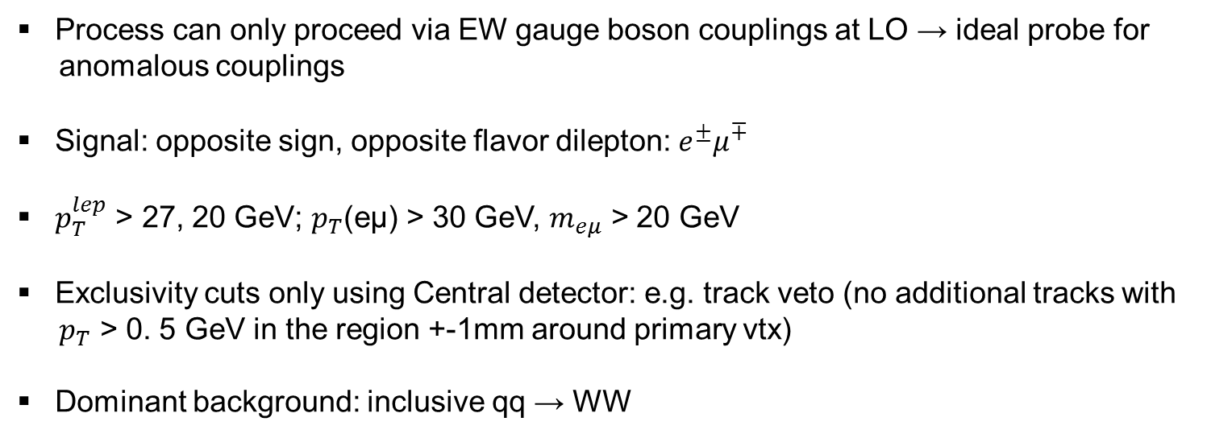
Exclusive γγ → WW (without FPDs)
PLB 816 (2021) 136190
Process can only proceed via EW gauge boson couplings at LO → ideal probe for
anomalous couplings
Signal: opposite sign, opposite flavor dilepton: $e^{±}μ^{∓}$
$p_{T}^{lep}$ > 27, 20 GeV; $p_{T}$(eμ) > 30 GeV, $m_{eμ}$ > 20 GeV
Exclusivity cuts only using Central detector: e.g. track veto (no additional tracks with
$p_{T}$ > 0. 5 GeV in the region +-1mm around primary vtx)
Dominant background: inclusive qq → WW

Slide 70
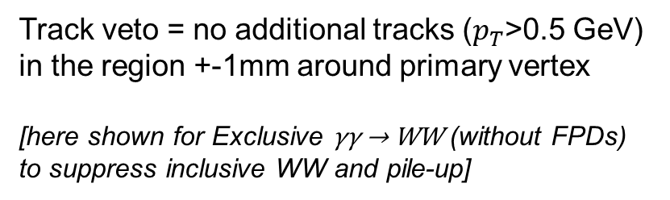
3) Suppressing combinatorial background: track veto
Track veto = no additional tracks ($p_{T}$>0.5 GeV)
in the region +-1mm around primary vertex
[here shown for Exclusive γγ → WW (without FPDs)
to suppress inclusive WW and pile-up]
Background hypothesis
rejected with significance
of 8.4σ
Rare process:
measured cross section:
3.13 ± 31(stat) ± 28(syst) fb
0 30 70
Average number of interactions
Efficiency drops with incr. pile-up

Slide 71
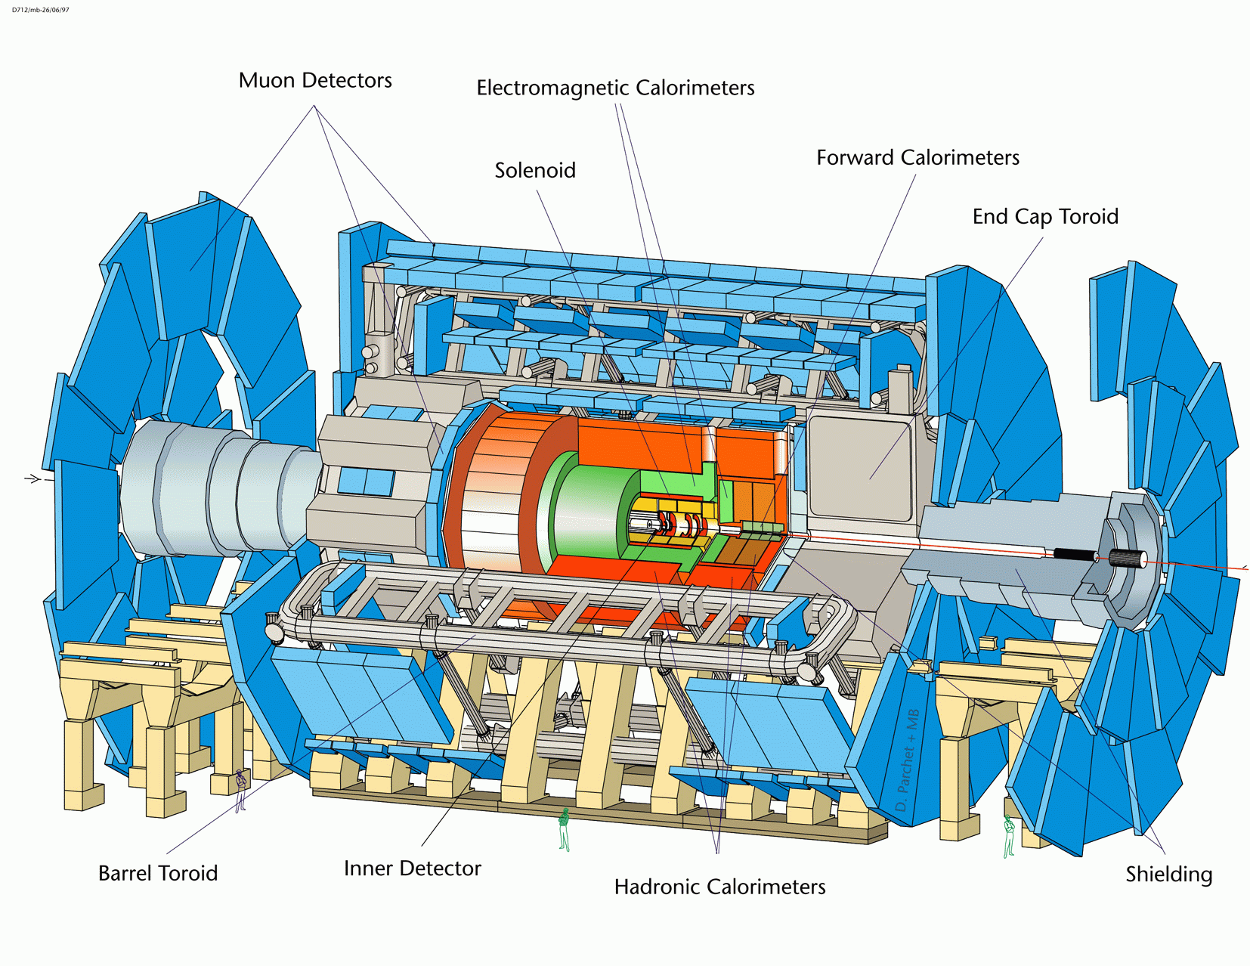


Exclusive γγ → ll (with FPDs)
PRL 125 (2020) 26, 261801
At least 1 proton tagged required → signal is a sum
of pure exclusive and Single-Dissociation
Large rapidity gap
$$pp →pγγp →p □ l^{+}l^{−} □ p$$
beam
LHC magnets
$l^{+}l^{−}$
p’
p’
AFP Detector
Z→ll+PU

Slide 72
Exclusive γγ → ll (with FPDs)
SR = Signal Region = Kinematics matching: |$ξ_{AFP}$ - $ξ_{ll}$| < 0.005 required

Slide 73

γγ → $e^{+}e^{−}$: manifold use

Slide 74
Vibrant FPD science program
Diffractive jets
ATLAS PHYS-PUB-2017-012
CMS+TOTEM 2002.12146
Exclusive jets
Khoze et al. hep-ph/0605113
Hatta et al. 1706.01765
Pasechnik & MT 2310.10793 (review)
Top quarks
Goncalves et al. 2007.04565
Ernani et al. 2202.01257
Howarth 2008.04249
Higgs boson
Heinemeyer et al. 0708.3052
MT 1407.8332 (review)
Cox et al. 0709.3035
Instantons
MT et al. 2208.14089
Leptons
CMS+TOTEM 1803.04496
ATLAS 2009.14537
W bosons
Kepka et al. 0912.5161
Tizchang et al. 2004.12203
Baldenegro et al. 2009.08331
Axion-like particles
Harland-Lang & MT 2208.10526
Baldenegro et al. 1803.10835
SUSY Dark Matter
MT et al. 1812.04886
Beresford et al. 1811.06465

Slide 75
Vibrant FPD science program
Diffractive jets
ATLAS PHYS-PUB-2017-012
CMS+TOTEM 2002.12146
Exclusive jets
Khoze et al. hep-ph/0605113
Hatta et al. 1706.01765
Pasechnik & MT 2310.10793 (review)
Top quarks
Goncalves et al. 2007.04565
Ernani et al. 2202.01257
Howarth 2008.04249
Higgs boson
Heinemeyer et al. 0708.3052
MT 1407.8332 (review)
Cox et al. 0709.3035
Instantons
MT et al. 2208.14089
Leptons
CMS+TOTEM 1803.04496
ATLAS 2009.14537
W bosons
Kepka et al. 0912.5161
Tizchang et al. 2004.12203
Baldenegro et al. 2009.08331
Axion-like particles
Harland-Lang & MT 2208.10526
Baldenegro et al. 1803.10835
SUSY Dark Matter
MT et al. 1812.04886
Beresford et al. 1811.06465

Slide 76
Vibrant FPD science program
Diffractive jets
ATLAS PHYS-PUB-2017-012
CMS+TOTEM 2002.12146
Exclusive jets
Khoze et al. hep-ph/0605113
Hatta et al. 1706.01765
Pasechnik & MT 2310.10793 (review)
Top quarks
Goncalves et al. 2007.04565
Ernani et al. 2202.01257
Howarth 2008.04249
Higgs boson
Heinemeyer et al. 0708.3052
MT 1407.8332 (review)
Cox et al. 0709.3035
Instantons
MT et al. 2208.14089
Hadron structure
Leptons
CMS+TOTEM 1803.04496
ATLAS 2009.14537
W bosons
Kepka et al. 0912.5161
Tizchang et al. 2004.12203
Baldenegro et al. 2009.08331
Axion-like particles
Harland-Lang & MT 2208.10526
Baldenegro et al. 1803.10835
SUSY Dark Matter
MT et al. 1812.04886
Beresford et al. 1811.06465

Slide 77
Vibrant FPD science program
Diffractive jets
ATLAS PHYS-PUB-2017-012
CMS+TOTEM 2002.12146
Exclusive jets
Khoze et al. hep-ph/0605113
Hatta et al. 1706.01765
Pasechnik & MT 2310.10793 (review)
Top quarks
Goncalves et al. 2007.04565
Ernani et al. 2202.01257
Howarth 2008.04249
Higgs boson
Heinemeyer et al. 0708.3052
MT 1407.8332 (review)
Cox et al. 0709.3035
Instantons
MT et al. 2208.14089
Hadron structure
New Physics
New Physics
Leptons
CMS+TOTEM 1803.04496
ATLAS 2009.14537
W bosons
Kepka et al. 0912.5161
Tizchang et al. 2004.12203
Baldenegro et al. 2009.08331
Axion-like particles
Harland-Lang & MT 2208.10526
Baldenegro et al. 1803.10835
SUSY Dark Matter
MT et al. 1812.04886
Beresford et al. 1811.06465
New Physics
New Physics
New Physics
New Physics

Slide 78
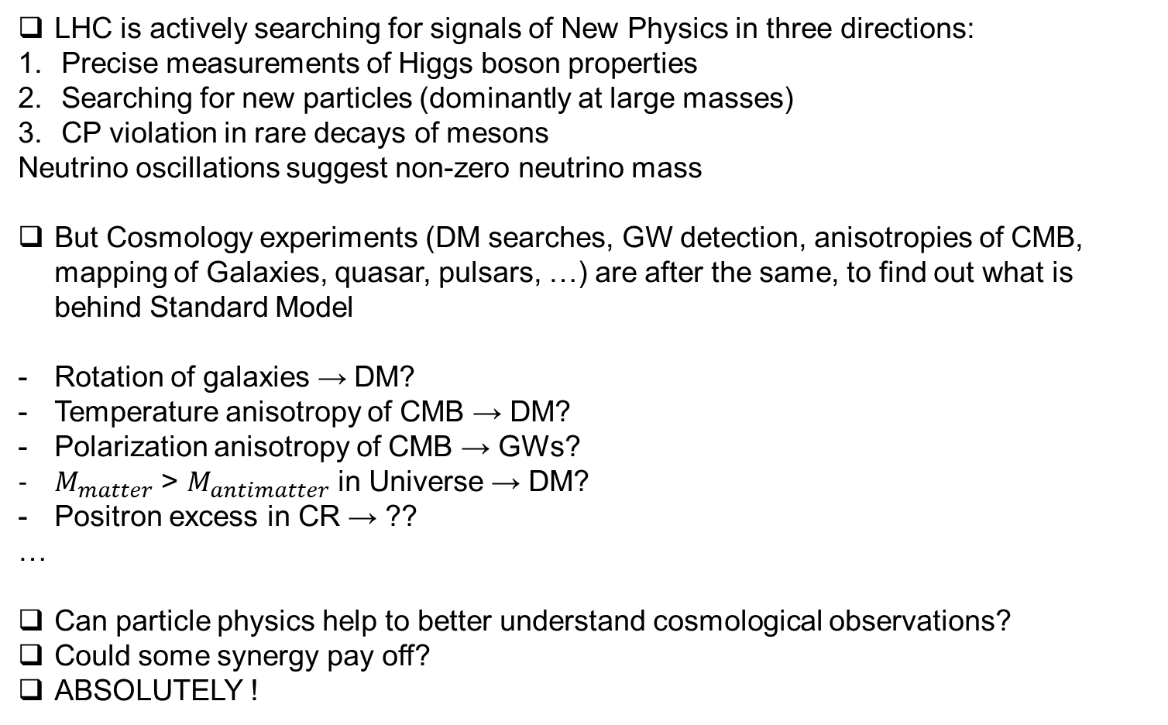
Hunt for New Physics: need to join forces
LHC is actively searching for signals of New Physics in three directions:
Precise measurements of Higgs boson properties
Searching for new particles (dominantly at large masses)
CP violation in rare decays of mesons
Neutrino oscillations suggest non-zero neutrino mass
But Cosmology experiments (DM searches, GW detection, anisotropies of CMB, mapping of Galaxies, quasar, pulsars, …) are after the same, to find out what is behind Standard Model
Rotation of galaxies → DM?
Temperature anisotropy of CMB → DM?
Polarization anisotropy of CMB → GWs?
$M_{matter}$ > $M_{antimatter}$ in Universe → DM?
Positron excess in CR → ??
…
Can particle physics help to better understand cosmological observations?
Could some synergy pay off?
ABSOLUTELY !

Slide 79
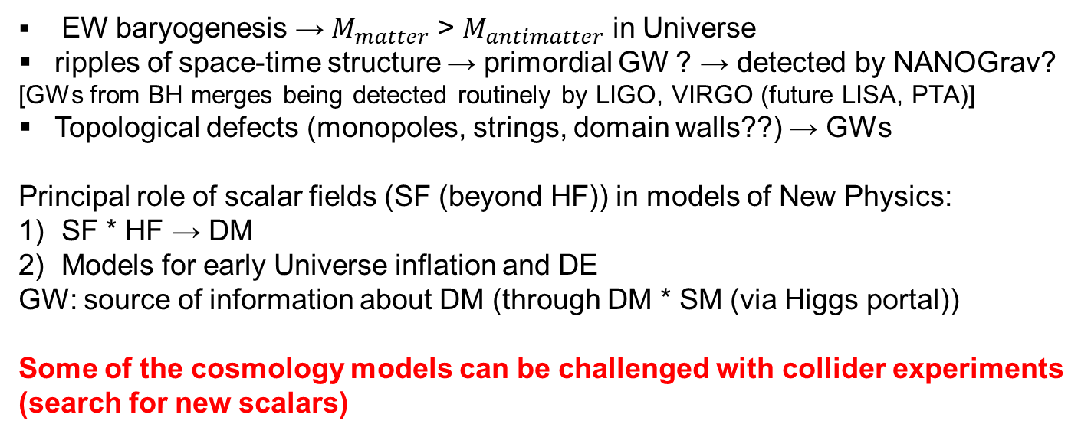
Hunt for New Physics: need to join forces
Spontaneous EW symmetry breaking (responsible for particle masses) happened when
Universe was dense and hot.
Symmetrical phase Broken phase in cosmological plasma
Structure of Higgs field (HF)
SM with one HF: smooth phase transition
BSM with more HFs: phase transition of 1st order (= violent process)
Cosmic phase transitions provide connections between particle physics and cosmology:
EW baryogenesis → $M_{matter}$ > $M_{antimatter}$ in Universe
ripples of space-time structure → primordial GW ? → detected by NANOGrav?
[GWs from BH merges being detected routinely by LIGO, VIRGO (future LISA, PTA)]
Topological defects (monopoles, strings, domain walls??) → GWs
Principal role of scalar fields (SF (beyond HF)) in models of New Physics:
SF * HF → DM
Models for early Universe inflation and DE
GW: source of information about DM (through DM * SM (via Higgs portal))
Some of the cosmology models can be challenged with collider experiments
(search for new scalars)

Slide 80
Selection of phenomenology papers
(where my input was essential)

Slide 81

PDG: Review of Particle Physics
Chapter 20 in PRD 110 (2024) 3, 30001
Chapter 20 in PTEP 2020 (2022) 083C01
Chapter 20 in PTEP 2020 (2020) 083C01
Asked by PDG to write a new chapter about
“High energy Soft QCD and Diffraction”
Responsible for experimental part, selection of figures,
editing work.

Slide 82



Exclusive Higgs boson
EPJC 53 (2008) 231
JHEP 10 (2007) 090
IJMPA 29 (2014) 1446012 (review)
$$pp →pIPIPp →p □ H □ p$$
$b, W^{+}$, $τ^{+}$
$\overline{b}, W^{−}$, $τ^{−}$
beam
LHC magnets
H
Station at 420m
necessary!
220m
p’
p’
220m
AFP Detector
420m
Flagship process for FP420 project (to install Forward Proton Detectors
in ATLAS and CMS).
If Higss boson detected, then its quantum numbers are known (0++) and
Yukawa coupling Hbb can be measured.

Slide 83


Exclusive Higgs boson
1) Protons remain undestroyed and can be
detected in forward detectors
2) Rapidity gaps between leading protons
and Higgs decay products
Advantages:
I) Roman Pots give much better mass
resolution than central detector
II) J_{Z} = 0, CP-even selection rule:
- strong suppression of QCD bg
- produced central system is 0⁺⁺
III) Access to main Higgs decay modes:
bb, WW, tautau → information about
Yukawa coupling
SM Higgs: low signal yield → try MSSM
$b, W^{+}$, $τ^{+}$
$\overline{b}, W^{−}$, $τ^{−}$
Pile-up is issue for Diffraction at LHC!
[CMS-Totem: Prospects for Diffractive and Fwd physics at LHC]
Find a CEP resonance and you have
confirmed its quantum numbers!!
Log S/B_{pu}
Rejection
power
But can be kept under control !
Offline cuts

Slide 84
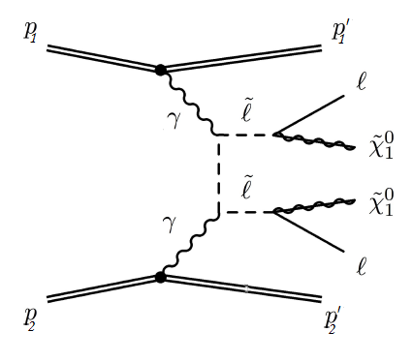

Dark Matter searches in Exclusive Mode
JHEP 04 (2019) 010
PRL 123 (2019) 14, 141801
$$pp →pγγp →p □ \tilde{l^{+}}\tilde{l^{−}} □ p$$
beam
LHC magnets
DM
p’
p’
AFP Detector
Motivation for use of AFP at high luminosities
Became topic of PhD thesis

Slide 85
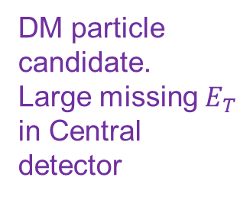
Inclusive slepton searches
Slepton: spin=0 partner of lepton
- decays to fermionic DM + leptons with BR=100%
DM annihilation corridor
AFP chance to contribute
ISR jet (for trigger purposes)
Both
protons
break
up
DM particle
candidate.
Large missing $E_{T}$
in Central
detector
Leptons precisely
measured in
Central detector
Model
dependent
ATLAS compressed mass scenarios 1911.12606

Slide 86
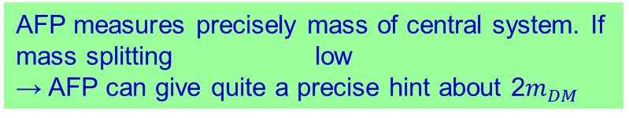
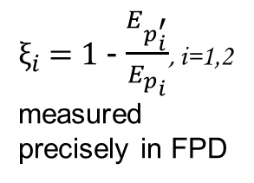
DM searches with AFP
Outgoing proton 4-momentum
measured in FPD
$ξ_{i}$ = 1 - $\frac{E_{p_{i}^{′}}}{E_{p_{i}}}$, i=1,2
measured
precisely in FPD
Lepton 4-momentum
measured in Central detector
Incoming photon
4-momentum can
(in principle) be
measured via AFP
}
4-momentum of system of
2 DM particles could be constrained
from photon & lepton 4-momenta
Model
independent
AFP measures precisely mass of central system. If mass splitting low
→ AFP can give quite a precise hint about 2$m_{DM}$

Slide 87
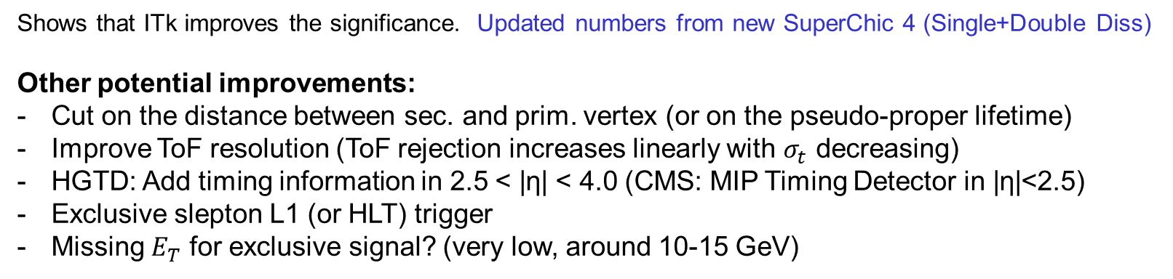

Integrated event yields for L=300${fb}^{−1}$
|η| < 2.5
|η| < 4.0
0.4
0.3
0.2
0.1
0.08
0.05
Shows that ITk improves the significance. Updated numbers from new SuperChic 4 (Single+Double Diss)
Other potential improvements:
Cut on the distance between sec. and prim. vertex (or on the pseudo-proper lifetime)
Improve ToF resolution (ToF rejection increases linearly with $σ_{t}$ decreasing)
HGTD: Add timing information in 2.5 < |η| < 4.0 (CMS: MIP Timing Detector in |η|<2.5)
Exclusive slepton L1 (or HLT) trigger
Missing $E_{T}$ for exclusive signal? (very low, around 10-15 GeV)

Slide 88
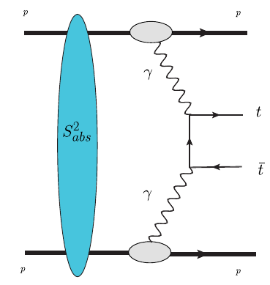
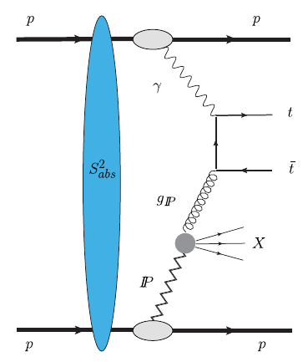
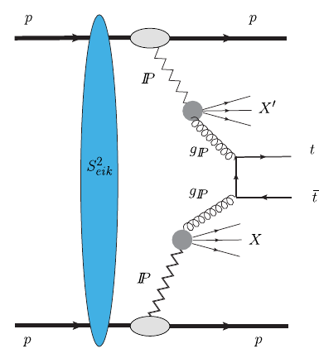


Top quark production in Exclusive mode
PRD 102 (2020) 7, 074014
PRD 105 (2022) 11, 114002
Photon – Photon
Photon – Pomeron
Pomeron – Pomeron
$$pp →pγγp →p □ t\overline{t} □ p$$
beam
LHC magnets
$$t\overline{t}$$
p’
p’
AFP Detector
Source of New Physics
Best Measurable at low luminosities
Feasible at HL-LHC as well

Slide 89

Fully leptonic decay:
$t\overline{t}$ → $bl^{+}ν$ $\overline{b}l^{−}\overline{ν}$

Slide 90



$t\overline{t}$: Simulation of experimental output
For $N_{tracks}$< 20 and lumi scenario (5,10):
good separation of signal ($γIP$ + $IPIP$) from combinatorial
background
Is it possible to measure $γIP$ and $IPIP$ separately??
It’s challenging!
Significance worsens with
worsening time resolution
(of course)

Slide 91
New Physics in (Semi)exclusive ttbar
SM: Top pair production in diffractive photoproduction never measured!
Single top production: direct measurement of CKM matrix element Vtb, study Wtb vertex
BSM:
Photon-photon
Similarly for
Photon-Pomeron
& Pomeron-Pomeron

Slide 92


Di-photon resonance search in exclusive mode
JHEP 07 (2023) 234
At least 1 proton tagged required → signal is a sum
of pure exclusive and Single-Dissociation
$$pp →pγγp →p □ γγ □ p$$
beam
LHC magnets
$$γγ$$
p’
p’
AFP Detector
Source of New Physics
Novel technique for modeling combinatorial background

Slide 93
Di-photon resonance search with FPD
Predicted signal event yields from SuperChic 4.1+Pythia 8.2
PRD 107 (2023) 033001
Acceptance
Background: estimated by mixed events (shifted events).
→ novel technique at LHC to model the combinatorial bg.

Slide 94
4) Data-driven estimate of combinatorial bg
Combinatorial background can be estimated by the so called EVENT MIXING:
combine protons from the nth event with central data from the (n+i)th event
Protons and leptons are uncorrelated, as in background
run the analysis with event shifts of i = 2, 3, 4….N and then take the average of the resulting
distributions, bin by bin
used in AFP exclusive publications
PRL 125 (2021) 261801, JHEP 07 (2023) 234
Such data, e.g. for i=1, can be
used as blinded data!
(So no need to define control
regions and verification regions)

Slide 95
Di-photon resonance search with FPD
Exclusion limits

Slide 96
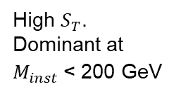
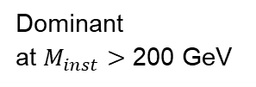
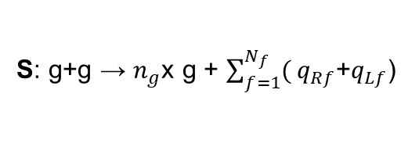
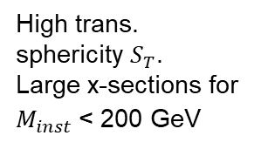
QCD instanton searches with proton tagging
EPJC 83 (2023) 1, 35
Single-tag and Double-tag signatures studied
S: g+g → $n_{g}$x g + $\sum_{f=1}^{N_{f}}{(}q_{Rf}$+$q_{Lf}$)
BG1: minijets
BG2: Multi-parton int.
High trans.
sphericity $S_{T}$.
Large x-sections for
$M_{inst}$< 200 GeV
Dominant
at $M_{inst}>$ 200 GeV
High $S_{T}$.
Dominant at
$M_{inst}$< 200 GeV
Reach $M_{inst}$< 200 GeV and suppress MPI? Go to large rapidity gaps (or proton tagging)!
beam
LHC magnets
p’
AFP Detector
p’
Interplay between soft QCD and hard QCD
Challenging and long sought object (HERA, now at LHC)

Slide 97

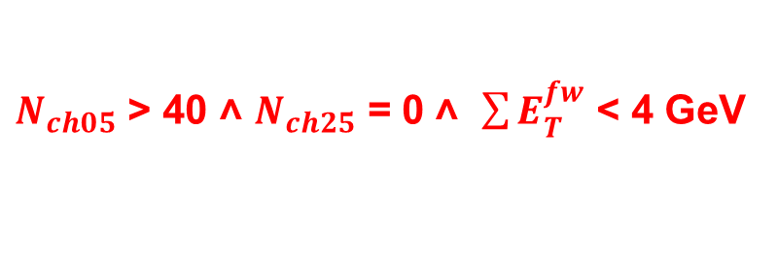

Single-tag: results at generator level
Inclusive searches very challenging. Study what requiring
one large rapidity gap (0 < η < 2) brings and be as realistic
as possible → include:
MPI
Pile-up
Detector simulation
$N_{ch05}$ > 40 ˄ $N_{ch25}$ = 0 ˄ $\sum{E_{T}^{fw}}$ < 4 GeV
$M_{inst}$ > 60 GeV: S/B = 2.3
$M_{inst}$ > 100 GeV: S/B = 2.1

Slide 98
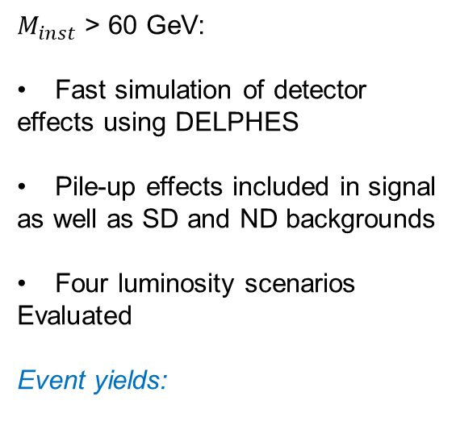
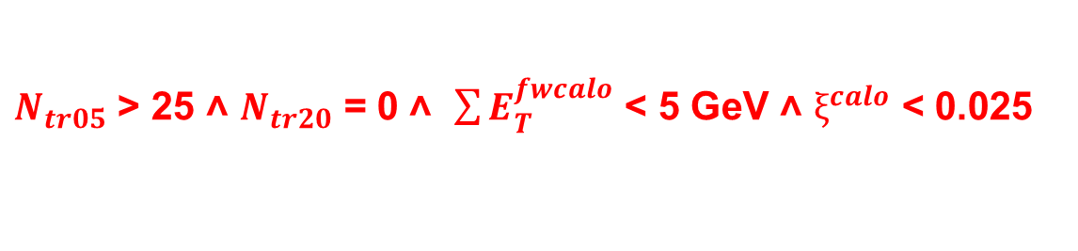

Single-tag: results at detector level
$N_{tr05}$ > 25 ˄ $N_{tr20}$ = 0 ˄ $\sum{E_{T}^{fwcalo}}$ < 5 GeV ˄ $ξ^{calo}$ < 0.025
$M_{inst}$ > 60 GeV
$M_{inst}$ > 60 GeV:
Fast simulation of detector
effects using DELPHES
Pile-up effects included in signal
as well as SD and ND backgrounds
Four luminosity scenarios
Evaluated
Event yields:

Slide 99

Gluon Wigner function using Exclusive process
PRD 96 (2017) 3, 034009
Phys.Rept. 1084 (2024) 3 (review)
Jet 1
Jet 2
$$pPb →pγX →p □ jj □ X$$
beam
LHC magnets
jet jet
p’
p’
AFP Detector
Included in:
prospects for measuring quarkonia@HL-LHC
opportunities for photon-energy frontier
Yellow Report for future Electron Ion Collider
CDR of Spin Detector
CMS measurement (published)

Slide 100
Measuring Wigner distribution in diffractive photoproduction
Belitsky, Ji, Yuan (2003);
Lorce, Pasquini (2011)
5D Tomography: Wigner distribution = the mother distribution
TMD
GPD
Form factor
PDF
charge

Slide 101
SUMMARY on (Semi) Exclusive Processes
Advantages:
simple final state:
i) two intact protons that can be detected in forward proton detectors
(cheap to build)
ii) final state of interest and no additional activity
2) Important constraints on the final state – kinematics matching
-- time of flight
-- large rapidity gaps / track veto
3) Useful to search for New Physics
4) But even in SM, theorists need measurements of several inputs (soft
survival, gluon un-integrated functions, Sudakov formfactors, …)
Disadvantages:
1) Low production cross sections
2) Combinatorial background

Slide 102
B A C K U P S L I D E S

Slide 103

Suppressing Pile-up: Time-of-Flight
JINST 16 (2021) 01, P01030
$$pp →p □ X □ p$$
beam
LHC magnets
p’
X
p’
AFP Detector
Performance of ToF detector for generic double-tag process
Pile-up suppression, time resolution and granularity of ToF@HL-LHC

Slide 105
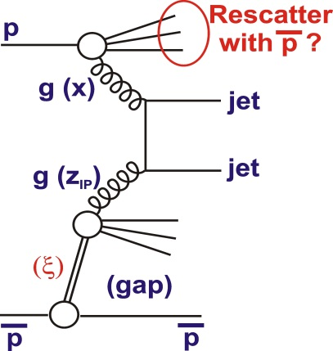


Soft survival probability S²
Exclusive final state in central detector. But protons may interact
in addition. S² = probability of no additional inelastic p-p interactions
(no so called Underlying Event)
Historically S² introduced to explain Tevatron measurements:
HERA (ep collisions): precise measurements of diffractive PDFs (PDFs under condition
that proton remains intact) → such dPDFs are universal for ep interactions.
2) However: Tevatron ($p\overline{p}$ collisions) measured 10x smaller dPDFs than HERA-based
dPDFs predictions for Tevatron conditions. Explanation: rescattering of proton with
anti-proton.
S² << 1.0 typical for hadron-hadron collisions.
S² ~ 0.1 measured for dijets at LHC
ATLAS: Phys.Lett.B 754 (2016) 214
CMS: Phys. Rev. D 87 (2013) 012006
S² is process and kinematics dependent,
see next slide
Predictions
based on
HERA dPDFs
CDF data
Momentum fraction
of parton in Pomeron

Slide 106

S²: for example γγ → ll
EPJC 80 (2020) 925
$S^{2}(EL)$ > $S^{2}\left(SD\right)$ > $S^{2}\left(DD\right)$ : expected, since
$b_{┴}(EL$) > $b_{┴}(SD$) > $b_{┴}(DD$).
$Q^{2}$ ~ 0 → $b_{┴}(EL$) large → $S^{2}$ ~ 1

Slide 107



Evidence of exclusive dijets at Tevatron
CDF Collaboration
PR D77 (2008) 052004
E_{Tjet} > 10 GeV &
R_{JJ} >0.8:
CED with
significance of 6σ
Data consistent with KMR predictions
Suppression of bƃ production as expected
D0 collaboration
PL B705 (2011) 193

Slide 108


Slide 109
Exclusive γγ → ll (without FPDs)
JHEP 01 (2012) 052
JHEP 11 (2012) 080
Run 1:
Veto on additional activity in
the whole detector
Low pile-up
Run 2:
z-vertex veto: no additional tracks
and vertices in a +-1mm region
around primary vertex
Standard pile-up
PLB 777 (2018) 303
PLB 749 (2015) 242

Slide 110
Exclusive γγ → ll (with FPDs)

Slide 111

Summary on Exclusive Higgs
M_{H} [GeV] | σ (bb) [fb] | σ (WW*) [fb] | Acc (420+420) | Acc(420+220)
120 | 1.9 | 0.37 | 0.20 | 0.17
130 |  | 0.70 | 0.15 | 0.24
140 | 0.6 | 0.87 | 0.11 | 0.31
160 | 0.045 | 1.10 | 0.04 | 0.43
180 | 0.0042 | 0.76 | 0.01 | 0.53
AFP 220/420:
2.5mm/4mm
from the beam
(1mm dead space)
Cross-sections
by KMR group
Experimental analyses:
CMS:
H→bb: fast simulation, 100 < M_{H} < 300 GeV, d₂₂₀~1.5mm, d₄₂₀~4.5mm, Acc=Acc(ξ,t,φ)
- published in CMS-Totem document CERN/LHCC 2006-039/G-124
- signal selection efficiencies used in MSSM studies
(EPJC 53 (2008) 231, EPJC 71 (2011) 1649, EPJC 73 (2013) 2672)
ATLAS:
H→bb: 1) gen.level + smearing of basic quantities, M_{H} = 120 GeV
- one MSSM point (tanβ = 40): JHEP 0710 (2007)090
2) fast simulation, M_{H} = 120 GeV: ATL-COM-PHYS-2010-337
3) Dedicated L1 trigger for H→bb: ATL-DAQ-PUB-2009-006
H→WW: fast + full simulation, M_{H} = 160 GeV:
ATL-COM-PHYS-2010-337
All analyses on H→bb get very similar yields for signal and background
EPJC 45 (2006) 401
Due to stringent cuts to suppress PU bg, experimental
efficiencies for SM Higgs and hence significances
are modest. Try MSSM !

Slide 112

Summary on Exclusive SM/BSM Higgs
CEP Higgs production has a decent potential compared to standard LHC searches:
excellent mass resolution
- good S/B
complementary information about Higgs sector in MSSM
complementary information about quantum numbers (a few events are enough and no need for coupling to vector bosons)
information about CP-violation effects
information about Yukawa Hbb coupling
Since the Higgs boson discovery, many BSM scenarios were scrutinized by ATLAS and CMS in
numerous channels:
Heavy Higgs boson excluded for $m_{H}$< 400 GeV, except for a few fine-tuned points in Mh125
alignment scenario. In $M_{H}^{125}$scenario, mass of light CP-even Higgs < 125 GeV and discovered
Higgs is the heavy CP-even MSSM Higgs (triggered by CMS observation of 3σ excess at 96 GeV in γγ channel – still to be confirmed by full Run2 data. ATLAS sees weaker excess).
IJMP A29 (2014) 1446012
Allowed MSSM phase space is very limited. LHC analyses show that the discovered Higgs is more and more SM like. Event yield for the exclusive SM Higgs is low but may be increased by tuning the selection procedure (we know the mass of Higgs). There is room for improvement.
2) Whether Higgs is SM or MSSM, the low-mass exclusive Higgs needs stations at 420 m.

Slide 113

(Semi) exclusive processes
Proton detected in Forward Proton Detector (FPD)
IP or γ
IP or γ
Semiexclusive production
Exclusive
production
Semileptonic decay:
$t\overline{t}$ → $j j$ $b \overline{b}$ $l ν$
Large rapidity gap
detected in central detector
Photon – photon
Photon – Pomeron
Pomeron – Pomeron

Slide 114

Signal selection and Background rejection cuts
Usual semileptonic cuts used in
inclusive ATLAS & CMS analyses:
Reasonable S/B, purities, trigger
efficiencies
Remaining backgrounds < 10%
FPD acceptance (assuming 100%)
Exclusivity cut:
Number of tracks close to the primary vertex and outside ttbar system must be low
(not sufficient to remove the incl.ttbar+PU → use Time-of-Flight (ToF) in FPD)
Delphes with proper input cards takes care of applying central detector acceptances,
efficiencies, b-tagging, pile-up mixing…

Slide 115








Top-pair production in (semi)exclusive processes
Photon – photon
Photon – Pomeron
Pomeron – Pomeron
Cross section:
Photon flux: Diffractive PDFs:
(constrained by HERA data)
Survival factor:

Slide 116


Use SuperChic4 for Exclusive γγ → ll
$$pp →pγγp →p □ l^{+}l^{−} □ p$$
beam
LHC magnets
No Forward
Proton detectors
$l^{+}l^{−}$
p’
p’
Better modeling of Single and Double Dissociation
Better modeling of LRG veto condition
Fully kinematically-dependent soft survival $S^{2}$

Slide 117
SUPERCHIC
MC event generator for Central Exclusive Processes (CEP). Common platform for:
1) QCD-induced CEP
2) Photon-Photon CEP
3) Photoproduction
For pp, pA and AA collisions
In LHE, HEPMC format – can be interfaced with Pythia, Herwig, …
Applies Structure Function calculation: parameterizes all physics that goes on in the
γp→X vertex and uses precisely measured q/g PDFs from DIS data → get precision x, Q²
for photon.
Used in numerous LHC and Tevatron data analyses
E.g. photon-photon CEP
All are elastic. SuperChic 4 provides Single-Dissociation (SD) and Double-Dissociation
(DD) to dilepton production. SD/DD to other processes to be implemented soon.

Slide 118


SUPERCHIC 4
Based on modern Structure Function approach (gives precision photon x, $Q^{2}$) – uniquely suited to
deal with situation where we ask for limited hadronic activity / intact protons in photon interactions.
SuperChic 4 generates (semi)-exclusive dilepton events and interfaces to Pythia for showering /
hadronization of dissociated system:
Showering: take LO q→qγ vertex
and generate outgoing quark acc.
to momentum conservation,
preserving photon 4-momentum
Then simply impose veto at particle level after passing to Pythia.
Survival factor $S^{2}$ = probability of no additional inelastic hadron-hadron interactions
Depends on $σ^{inel }$in soft regime, so on
understanding of proton+strong interactions
in non-perturbative regime.
Phenomenological model tuned on wealth
of elastic and inelastic data.
Depends on type of process (EL/SD/DD)
and precise kinematics.

Slide 119


SUPERCHIC 4: (Semi)-Exclusive $l^{+}l^{−}$
Basic observable: fraction of events that pass
veto on additional particles in certain region
Very relevant experimentally: e.g. in selection of
exclusive events without proton tagging.
Example: z-vertex veto: no additional tracks (so |η|<2.5) in region |$z_{vtx}$ - $z_{trk}$| < 1 mm.
Like in
BUT: events where proton dissociation is outside the veto region pass this requirement!
Proton-dissociation background reduced by the cut on dilepton $p_{T}$ and the exclusive
signal extracted by subtracting SD and DD backgrounds using outdated models.
SuperChic 4 provides more exact and more inclusive modelling.

Slide 120

SUPERCHIC 4: Results
$S^{2}(EL)$ > $S^{2}\left(SD\right)$ > $S^{2}\left(DD\right)$ : expected, since
$b_{┴}(EL$) > $b_{┴}(SD$) > $b_{┴}(DD$).
$Q^{2}$ ~ 0 → $b_{┴}(EL$) large → $S^{2}$ ~ 1
Comparison to data : ATLAS 7 TeV semi-exclusive
dilepton selected by z-vertex veto on tracks.
DD subtracted from data using an outdated model.
Overall a good description by SuperChic 4.

Slide 121




Diffractive dijet production
Altinoluk, Armesto, Beuf, Rezaeian (2015)
YH, Xiao, Yuan (2016)
Jet 1
Jet 2
Proton recoil momentum
Dijet relative momentum
Fourier transform of
dominated by
for small-
`Elliptic’ Wigner distribution:
correlation between and expected at small-x

Slide 122




Measuring Wigner in ultra-peripheral pA collisions
YH, Xiao, Yuan (2016)
preferably small
Use the Weiszäcker-Williams photons in UPC!
Hagiwara, Hatta et al. (2017)
1) Integrate over all $Φ_{P} \& Φ_{Δ}$ angles → term ~AB disappears
2) Measure x-sec as a function of $P_{⊥}$ & integrated over $Δ_{⊥}$
and vice versa → get A($p_{⊥}$,$Δ_{⊥}$)
3) Measure ($Φ_{P}$-$Φ_{Δ}$)-dependence of x-sec in bins of $P_{⊥}\& Δ_{⊥}$ → B($p_{⊥}$,$Δ_{⊥}$)
4) From $S_{0}$ and $S_{1}$ get Wigner function
photon flux
Effect visible only at low
scales → dijets at LHC not
favorable
- try pions or D-mesons
A
B
A
B
BK model (proton target)
MV model (nuclear target)

