Slide 1
Radiation-hydrodynamics of star-disc collisions
Author: Taj Jankovič (Institute of Physics of the Czech Academy of Sciences, CZ)
Collaborators: Clément Bonnerot (University of Birmingham, UK)
Sergey Karpov (Institute of Physics of the Czech Academy of Sciences, CZ)
Aleksej Jurca (University of Nova Gorica, SLO)
11.5.2026

Slide 2
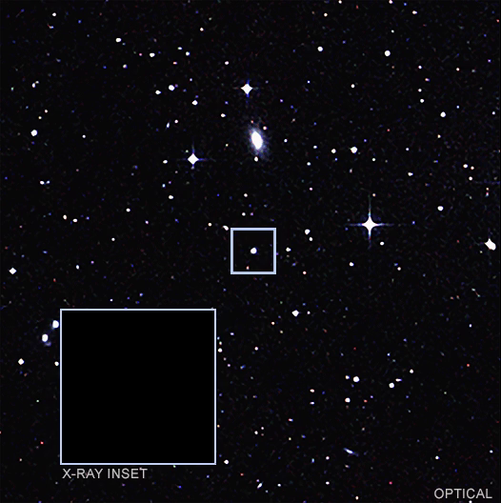
Quasi-periodic eruptions (QPEs)
X-ray: NASA/CXO/CSIC-INTA/Miniutti+2019; Optical: DSS

Slide 3
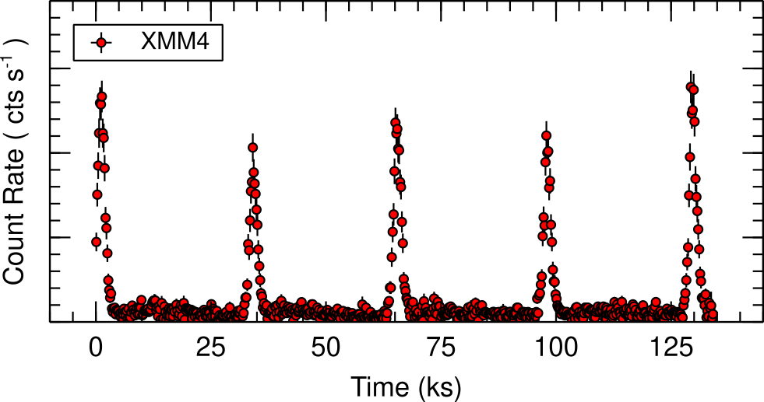
Quasi-periodic eruptions (QPEs)
Miniutti+2022
X-ray: NASA/CXO/CSIC-INTA/Miniutti+2019; Optical: DSS
X-ray bursts occurring every ≈ 10 hours and lasting ≈ 1 hour.
“Long-short” patterns between consecutive flares.

Slide 4
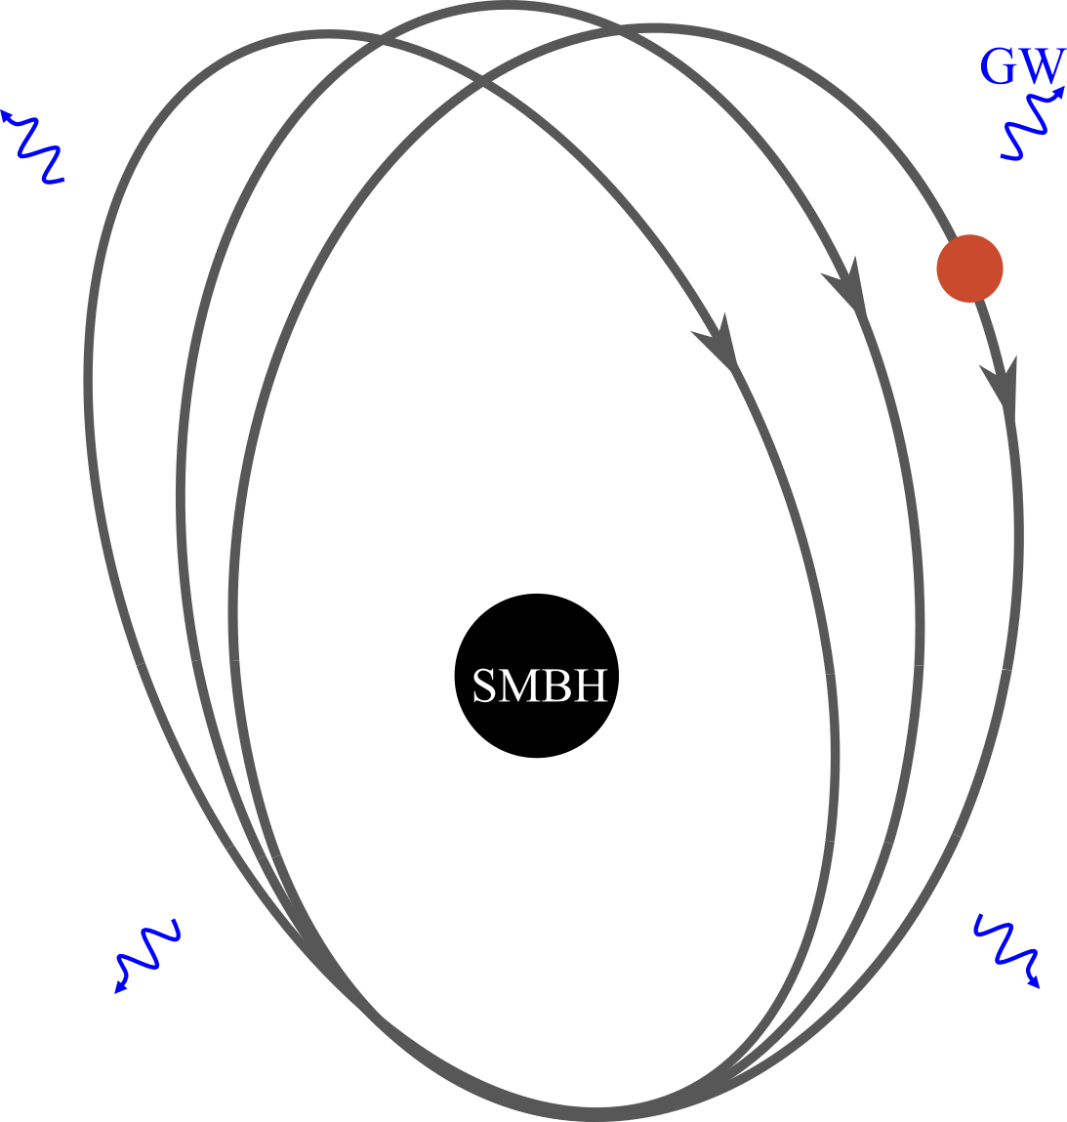
Star-disc collisions model
GW (τGW ≈ 10⁶ yr)

Slide 5
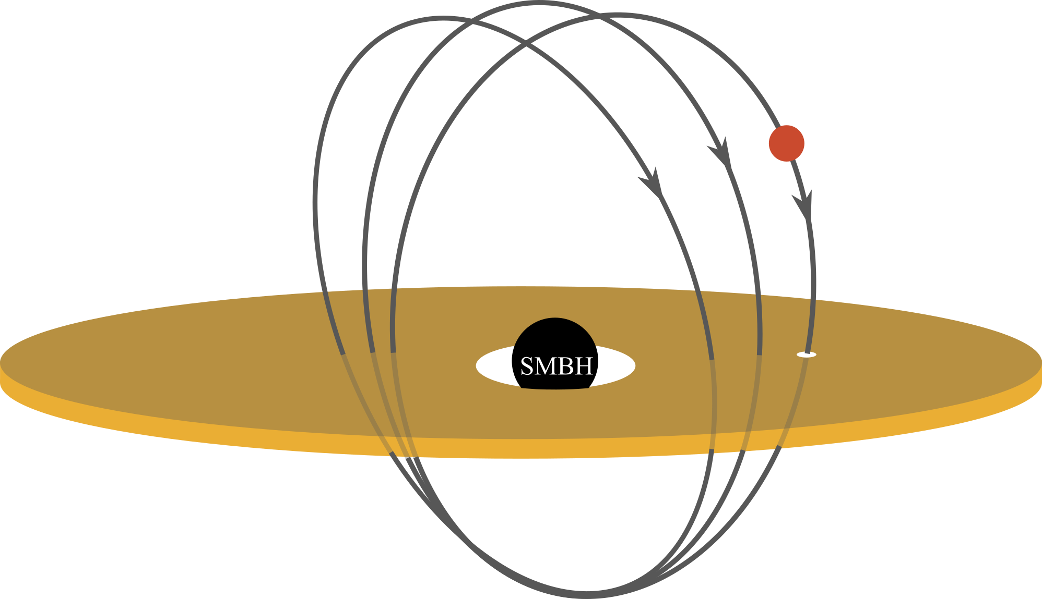
Star-disc collisions model

Slide 6
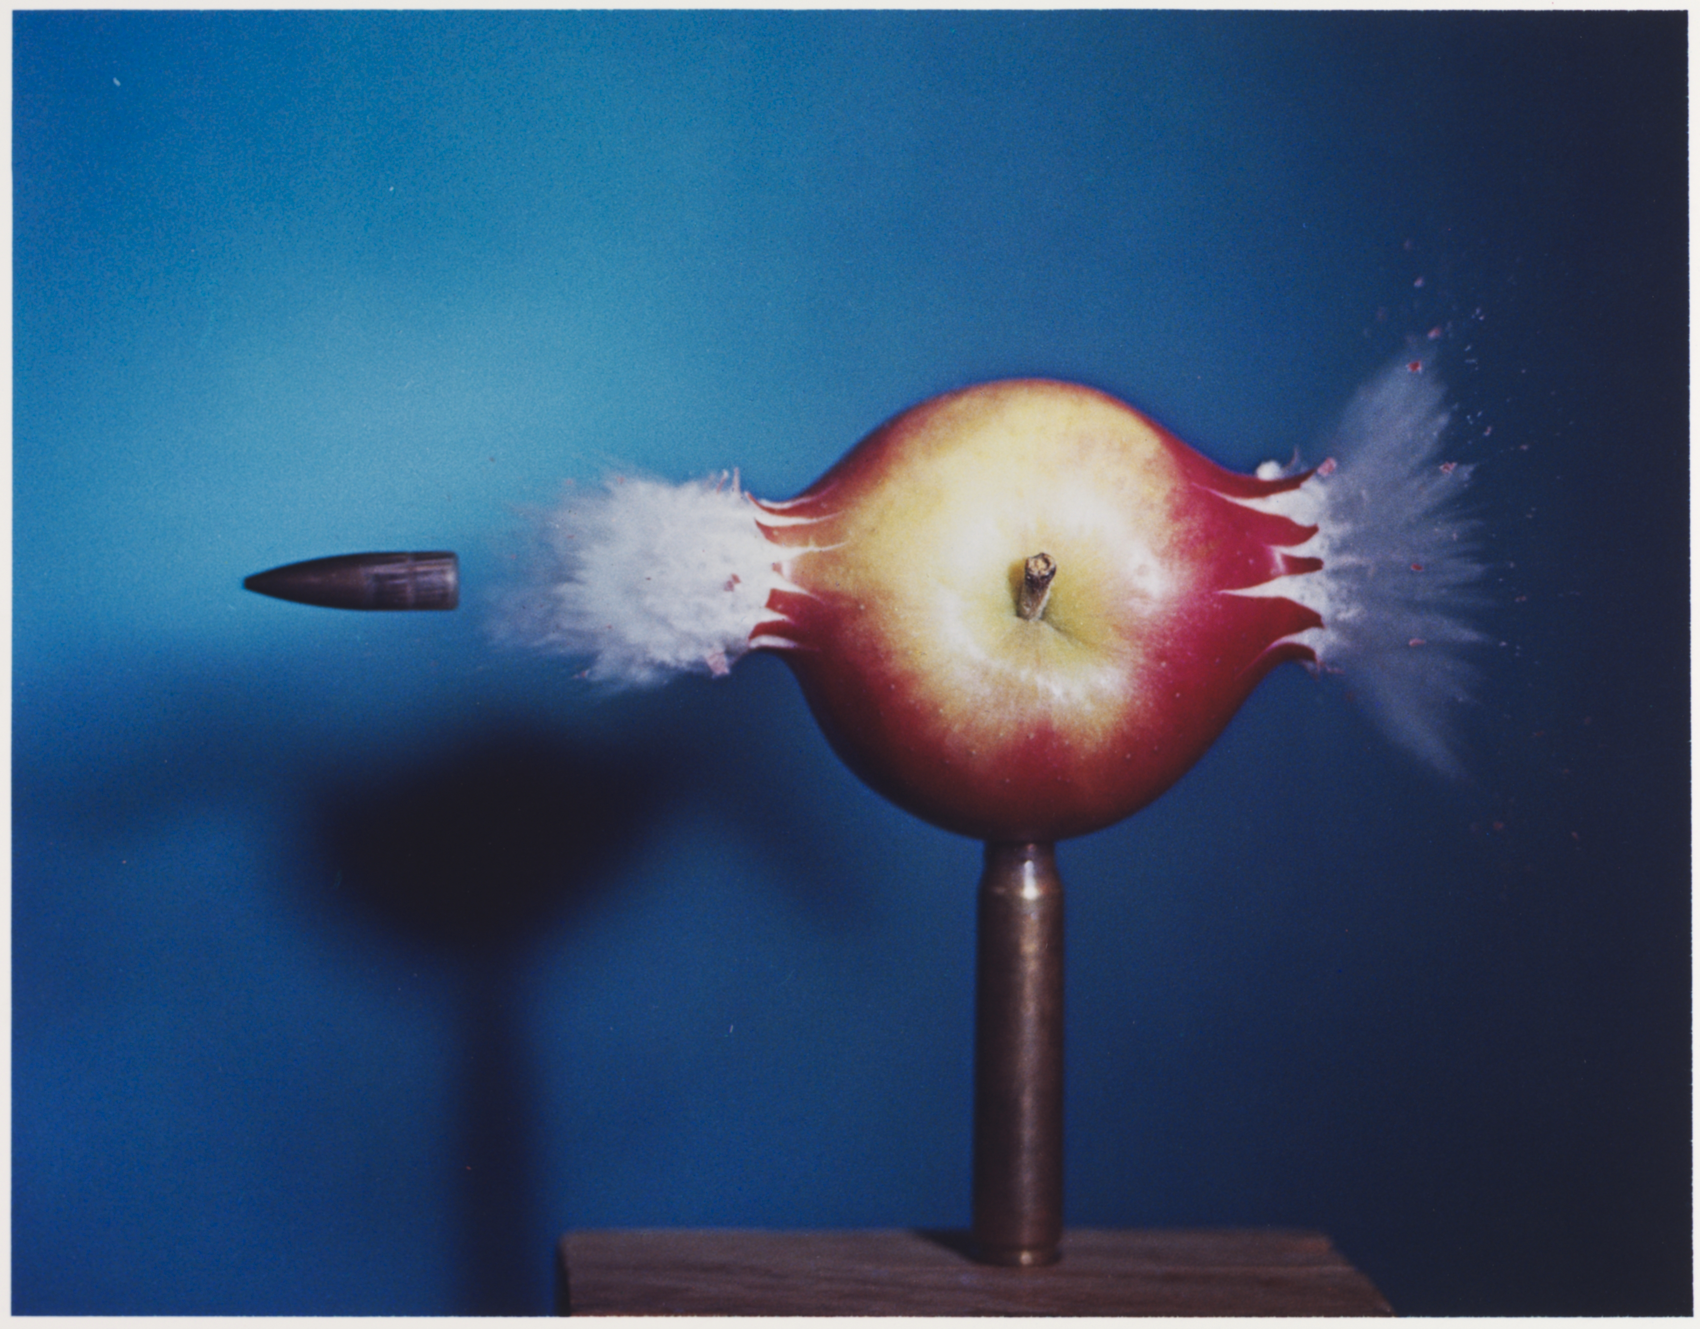
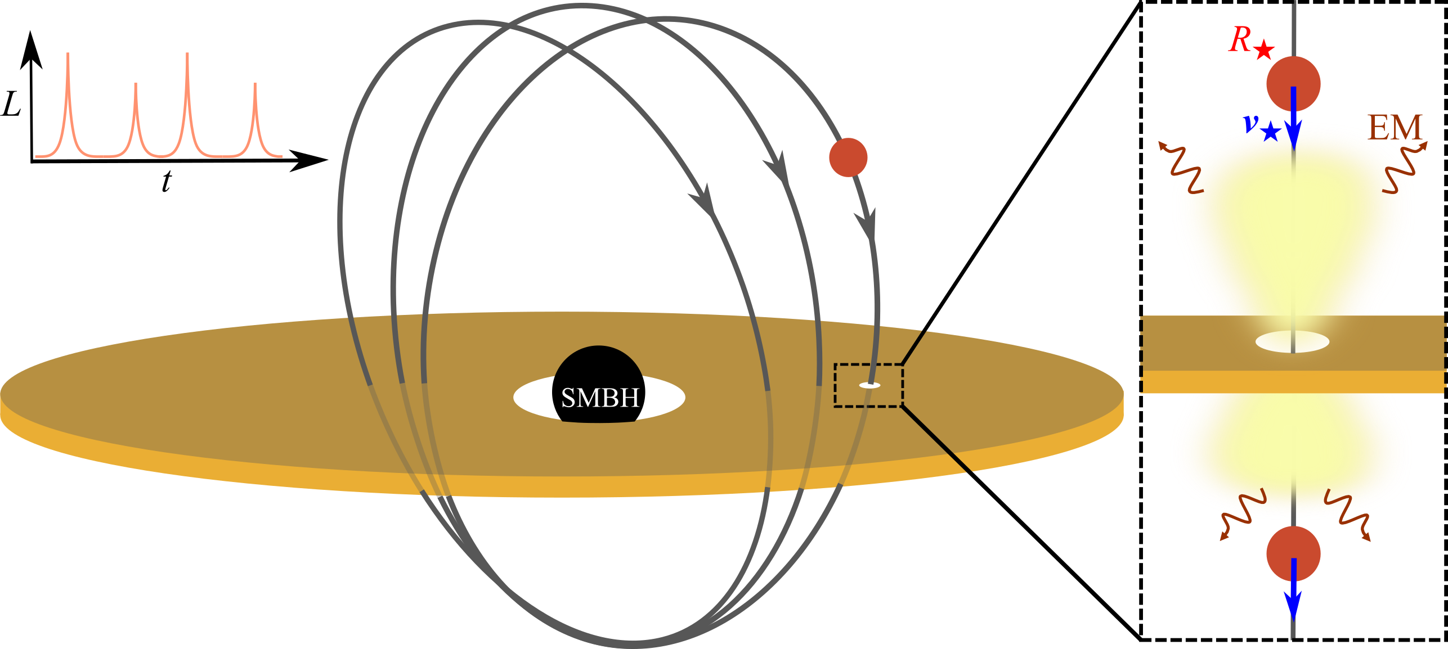
Star-disc collisions model
Credit: Gift of the Harold and Esther Edgerton Family Foundation

Slide 7

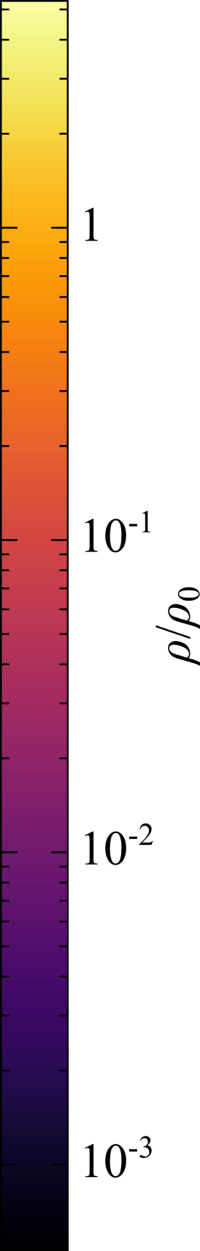
3D radiation-hydrodynamics simulation
tcr = 2(H+R★)/v★ = 3 min
R★
t/tcr = 0
v★
H = 3R☉
ρ0
M0d
ez
ex
ey
Disc: Stationary, uniform density (mass M0 = 10⁻⁷ M☉), no gravity.
Star: Solid sphere, R★ = 1R☉, v★ = 0.1c, no gravity.

Slide 8
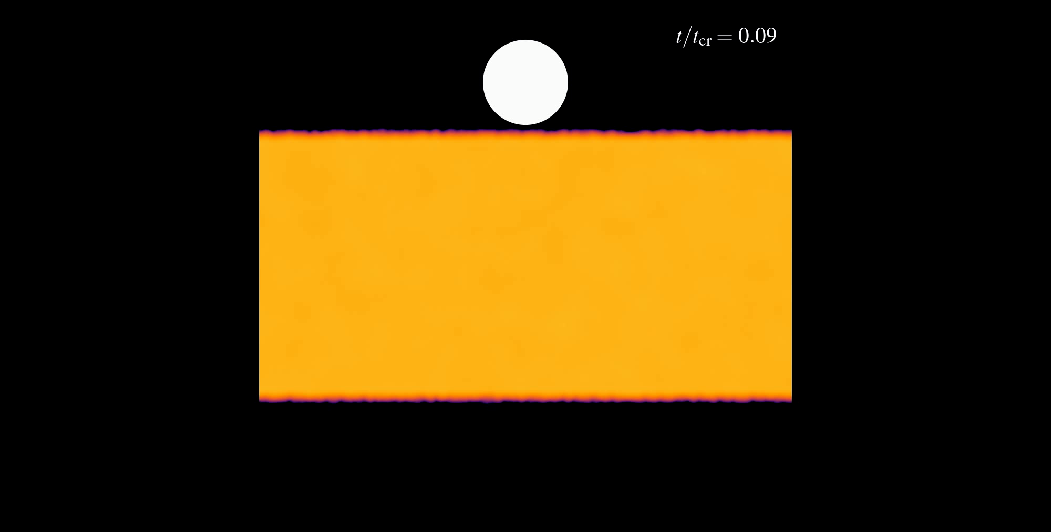

Slide 9
Effect of system parameters
R★
v★
Stellar velocity
Disc surface density
Stellar radius
Vertical disc density profile
Inclination of the stellar orbit

Slide 10
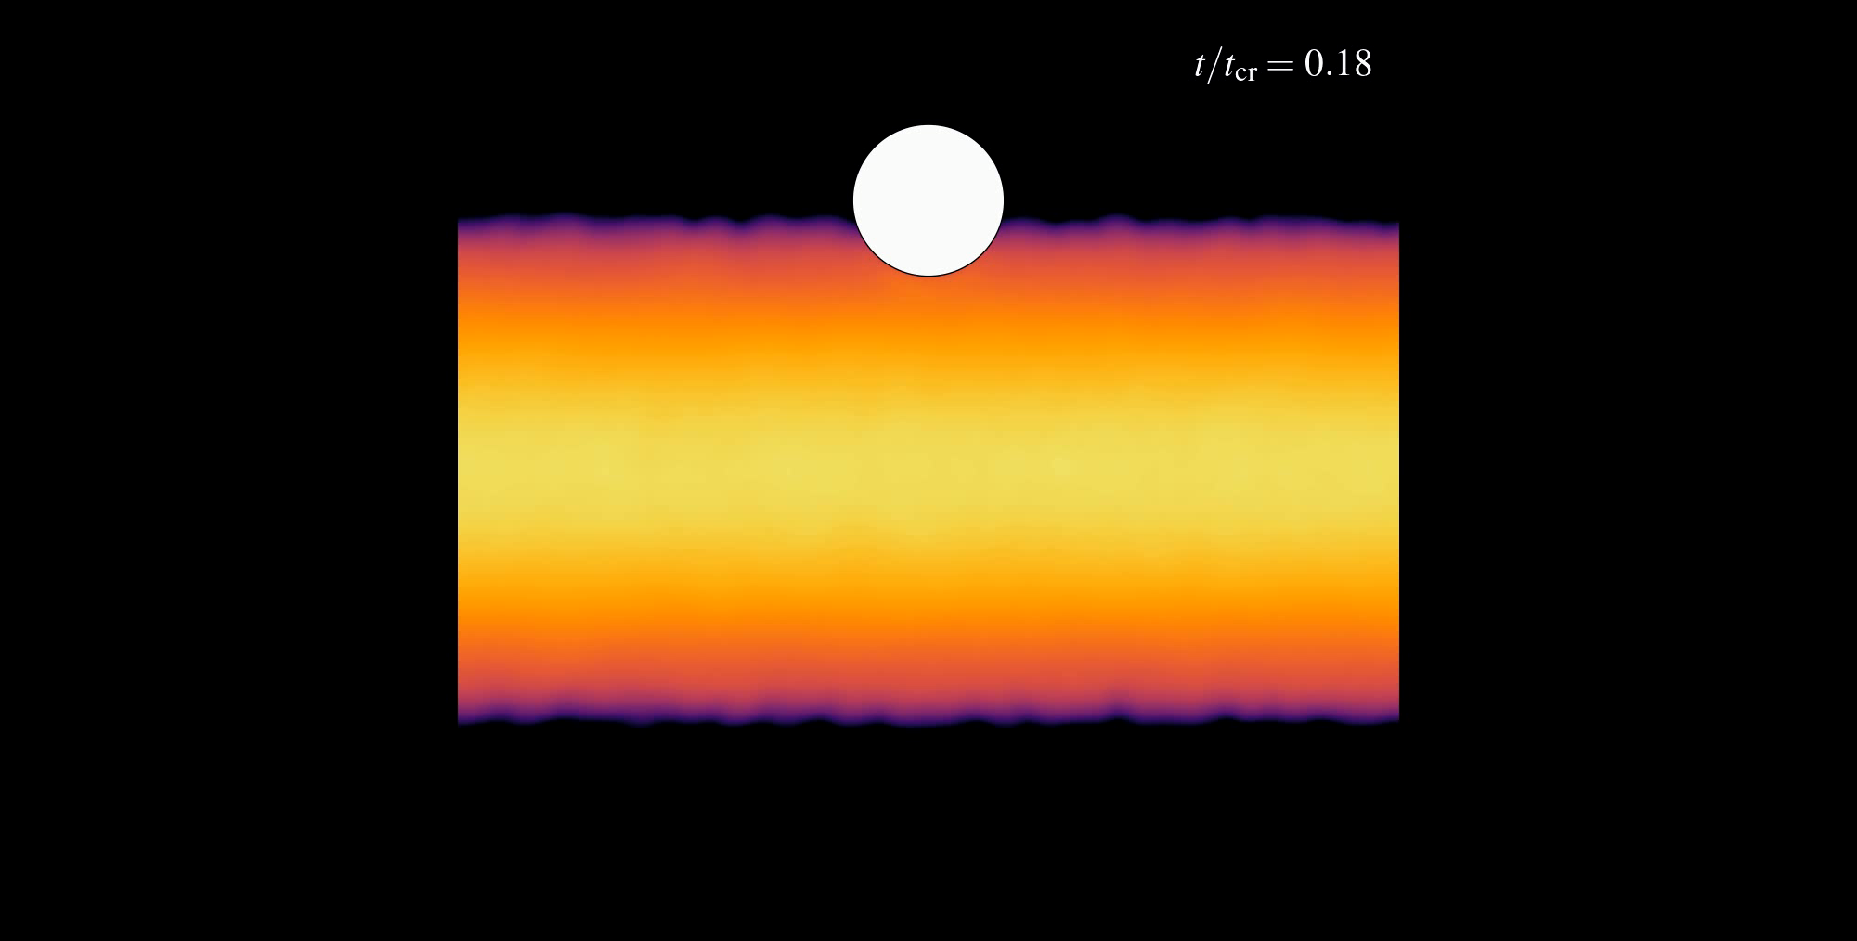

Slide 11
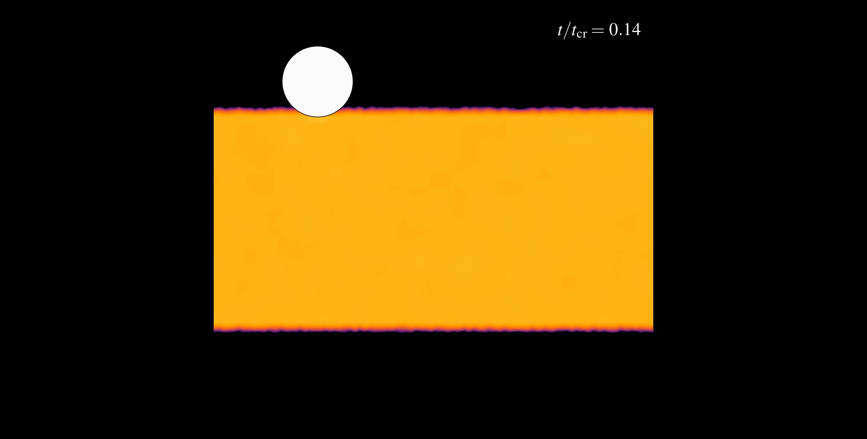

Slide 12
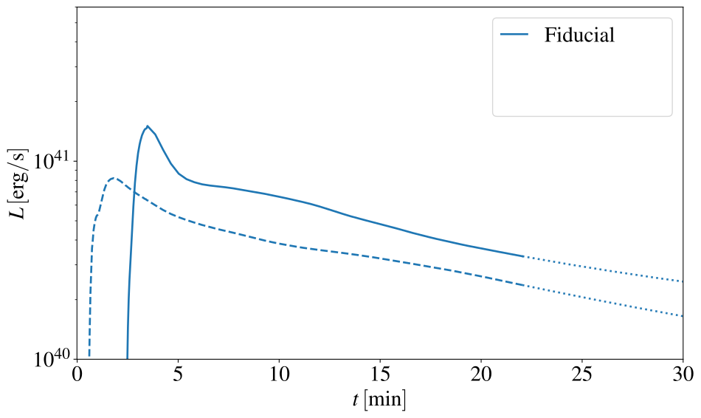
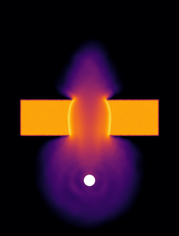
Lightcurve
Peak of L ∼ 10⁴¹ erg/s.
Forward outflow ∼2x higher L.

Slide 13
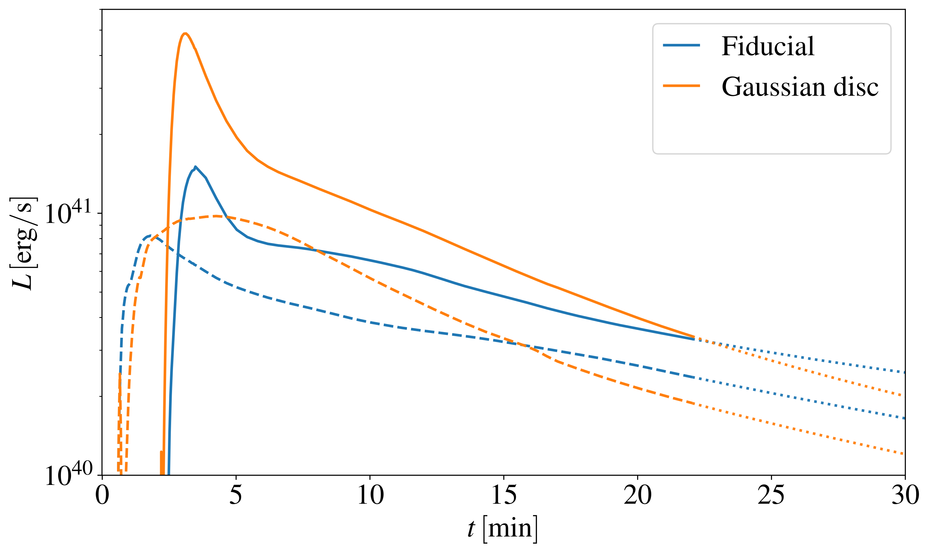
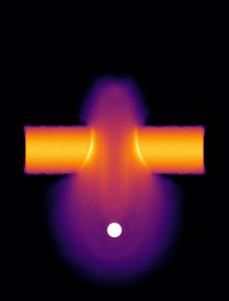
Lightcurve for a Gaussian density profile disc
Brighter forward outflow.
Shorter flare durations.

Slide 14
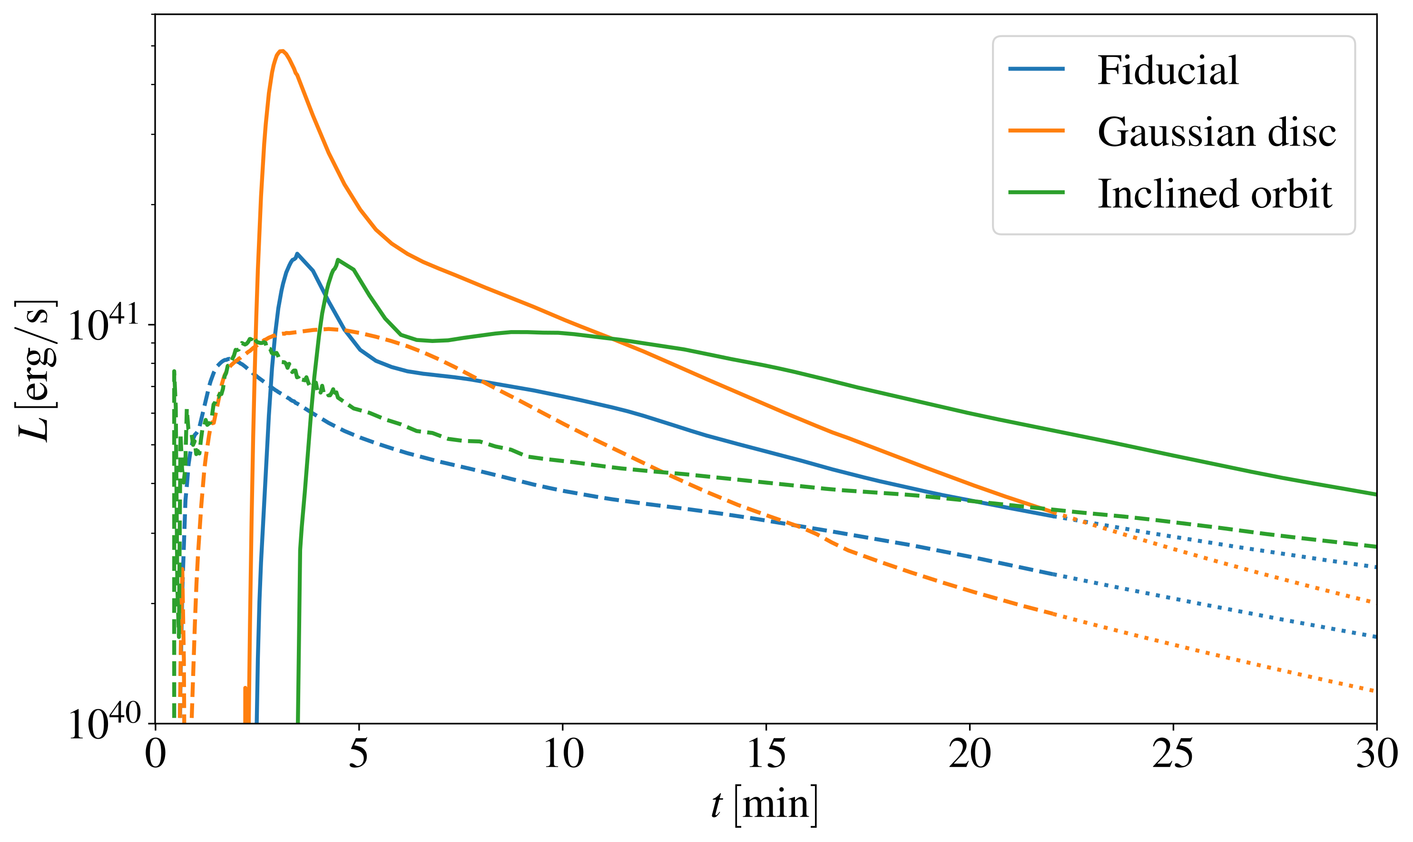
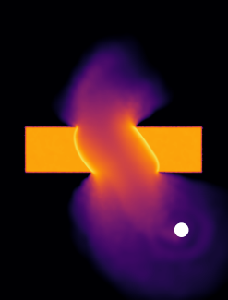
Lightcurve for less inclined stellar orbit
Brighter backward outflow.
Longer flare durations.

Slide 15
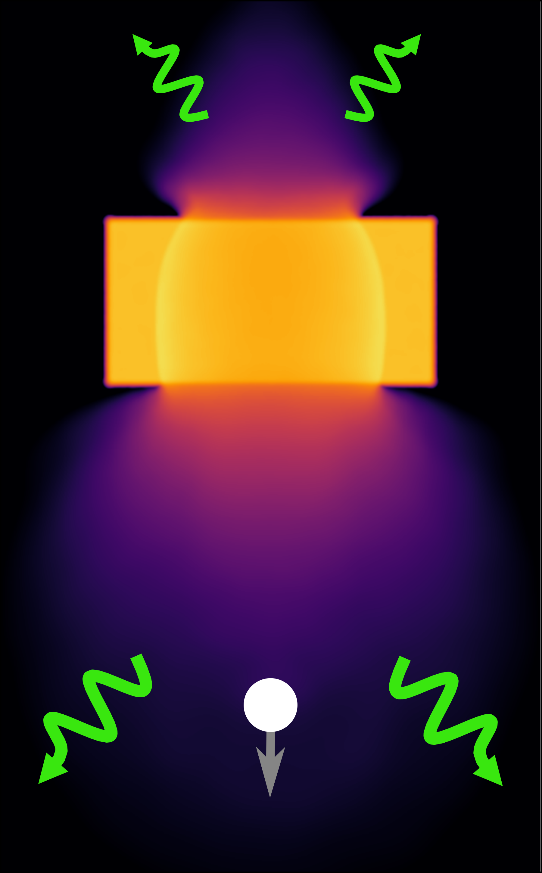
Summary
The collision drives asymmetric outflows of gas.
Forward outflow carries more momentum.
Forward outflow is typically brighter.
Collision is strongly affected by system parameters.
Star-disc collisions can explain main features of observed QPEs.

Slide 16
Questions?:)

Slide 17
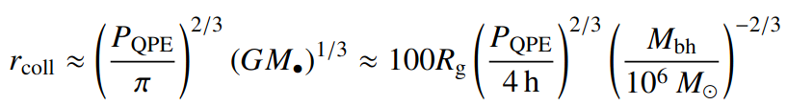
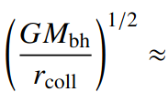
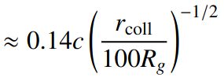


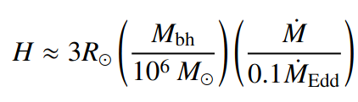
Star-disc collisions model

Slide 18
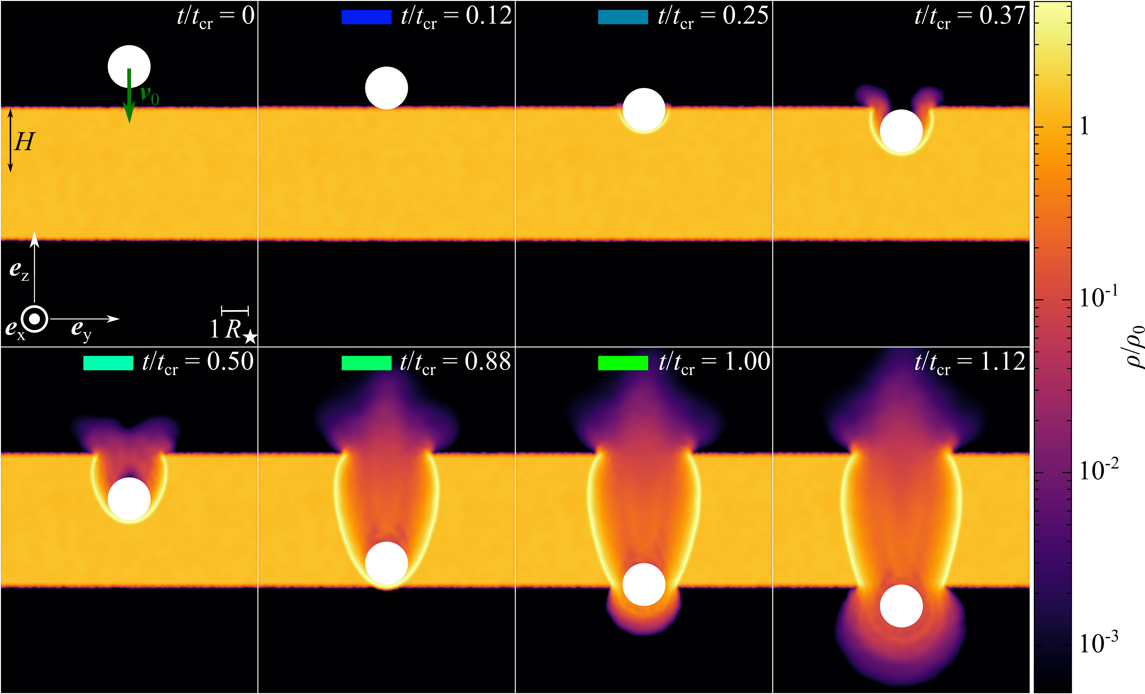

Slide 19
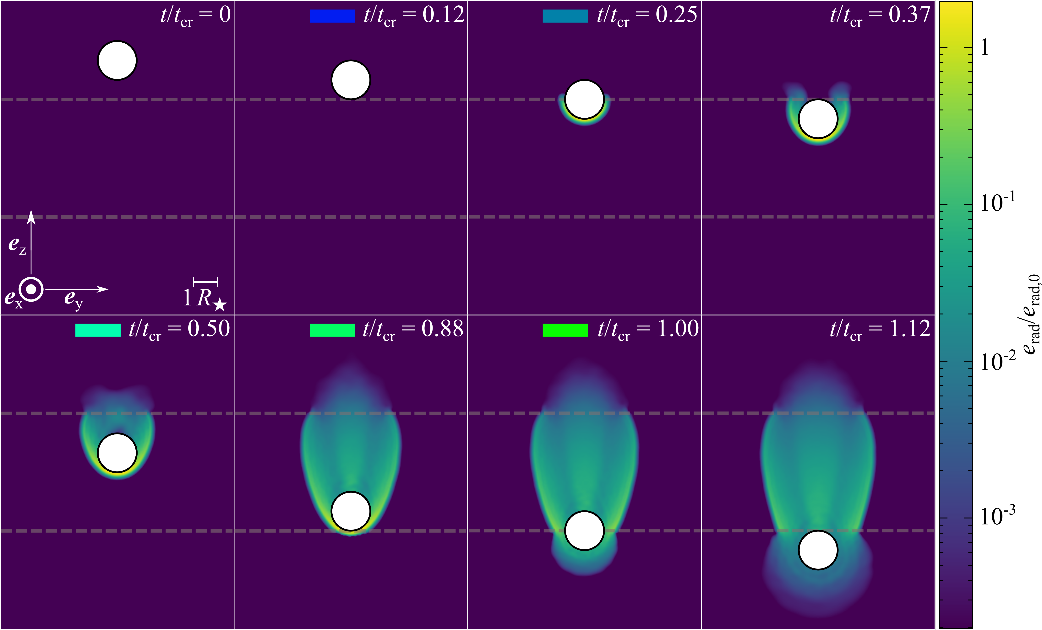

Slide 20
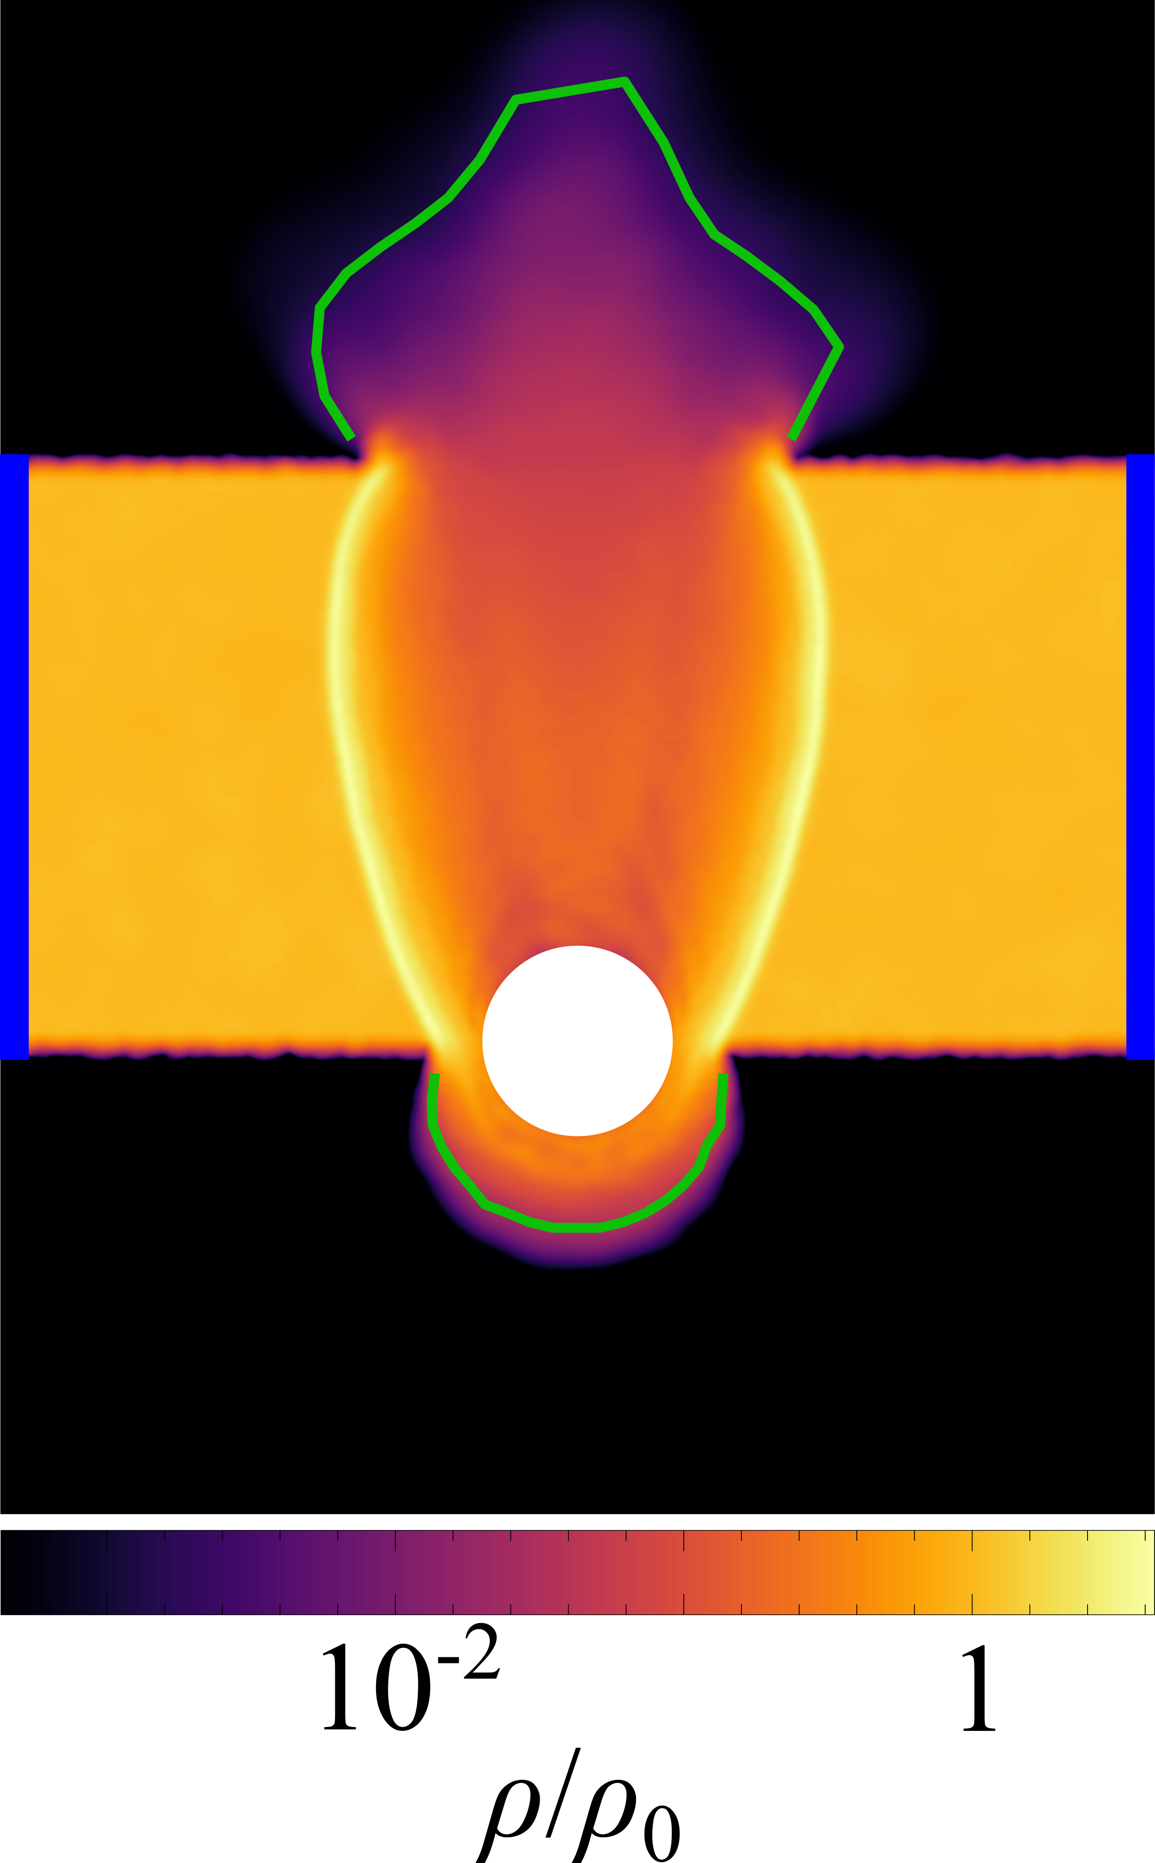
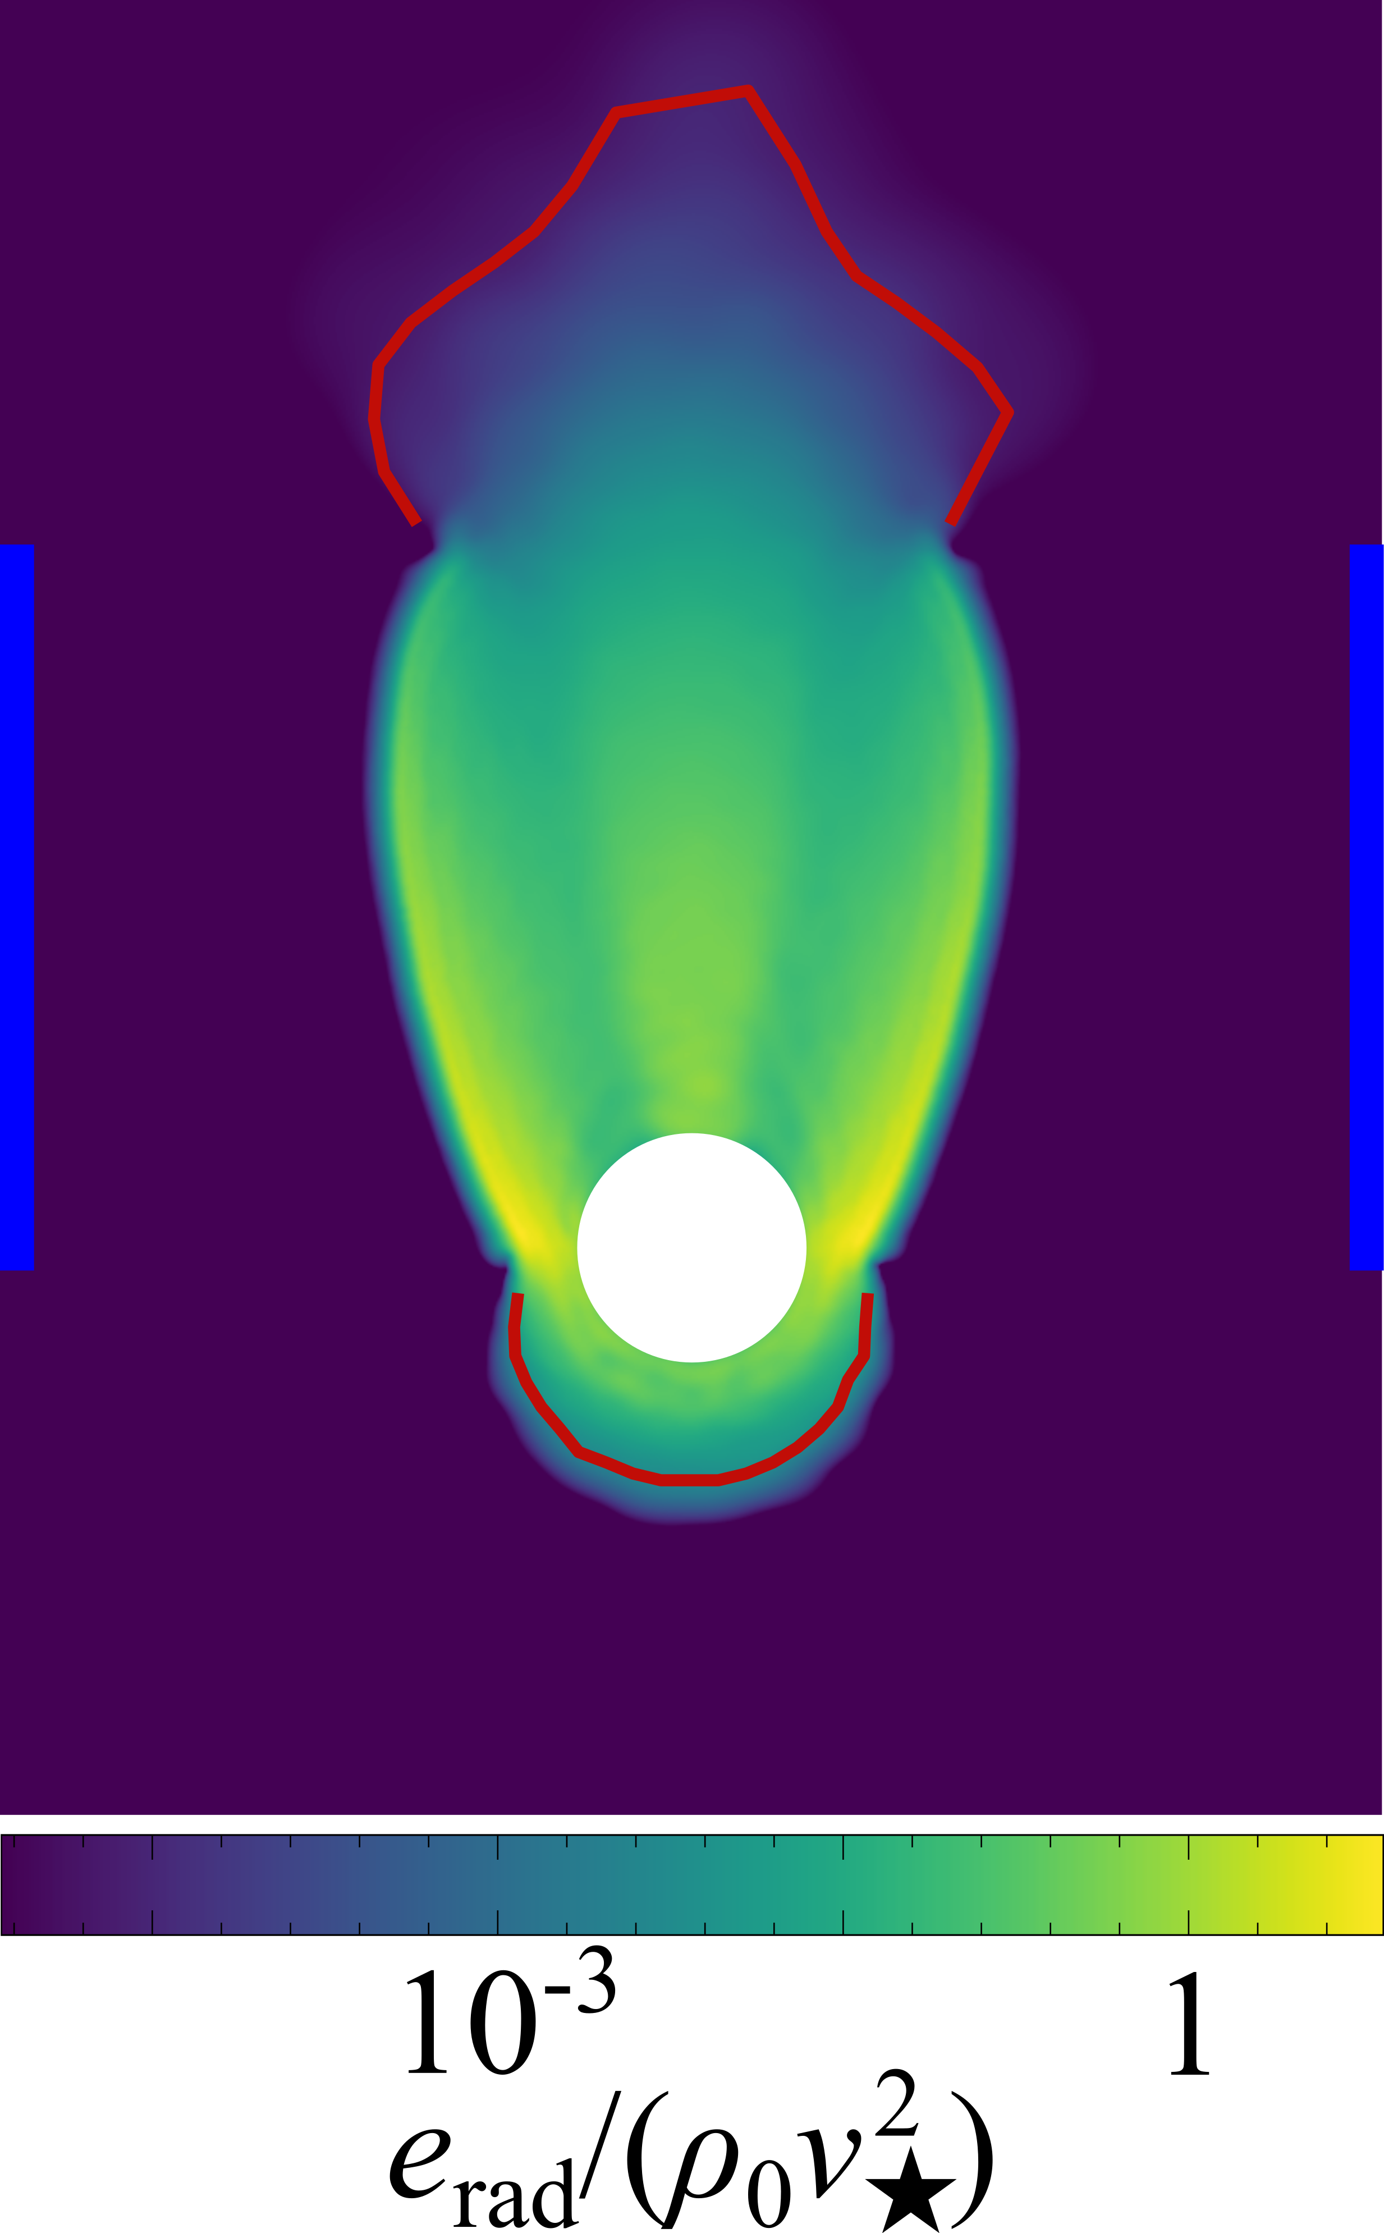
Lightcurve
τ = 1
t/tcr = 1.0
τ = 1
Radiation transported via advection and diffusion.
Luminosity: Integrate total radiation flux across the photosphere (optical depth τ = 1).

Slide 21
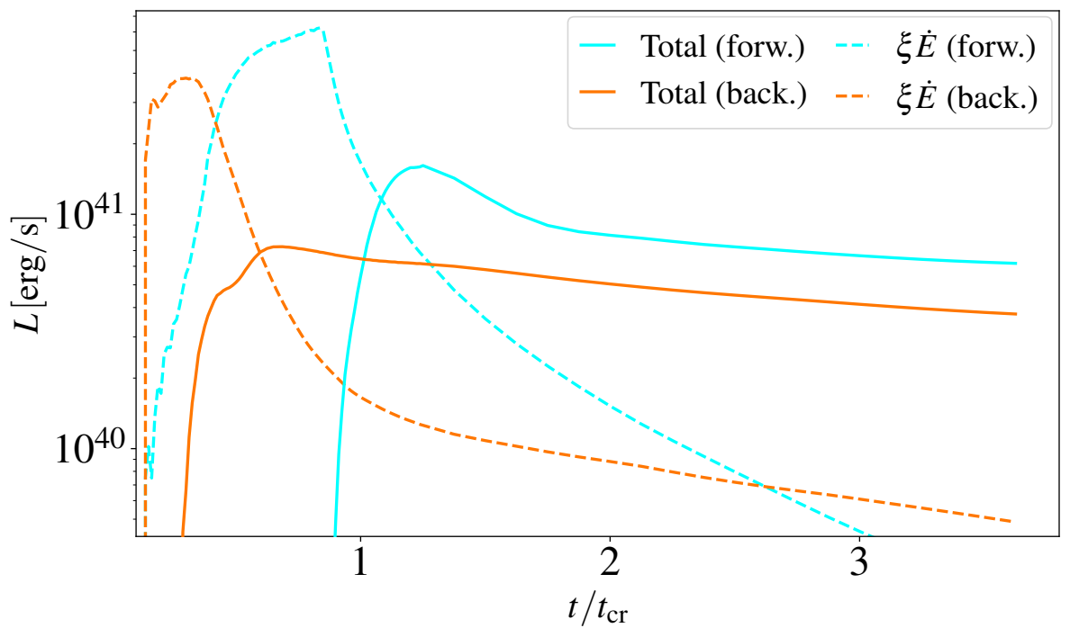
Lightcurve
Similar adiabatic losses.
Forward ejected gas ∼2x higher shock heating rate E.
.
adiabatic losses
.
L ∼ ηE0
shock heating rate

Slide 22
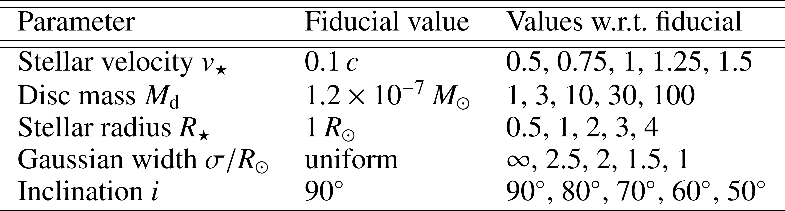
Effect of system parameters

Slide 23
tcr = 2(H+R★)/v★

Slide 24
Effect of system parameters

