Slide 1
Engineering Atomic Size Mismatch in High-Entropy Garnets and Perovskites: A Novel Pathway to Enhance Functional Properties
Core Objective:
Designing next-generation luminescent materials through atomic size mismatch, structural disorder and energy transfer optimization for:
High-performance scintillators (high resolution X-ray imaging)
Phosphors for high-power white LEDs and Laser Diodes
Karol Bartosiewicz |Department of Optical Materials (27)

Slide 2
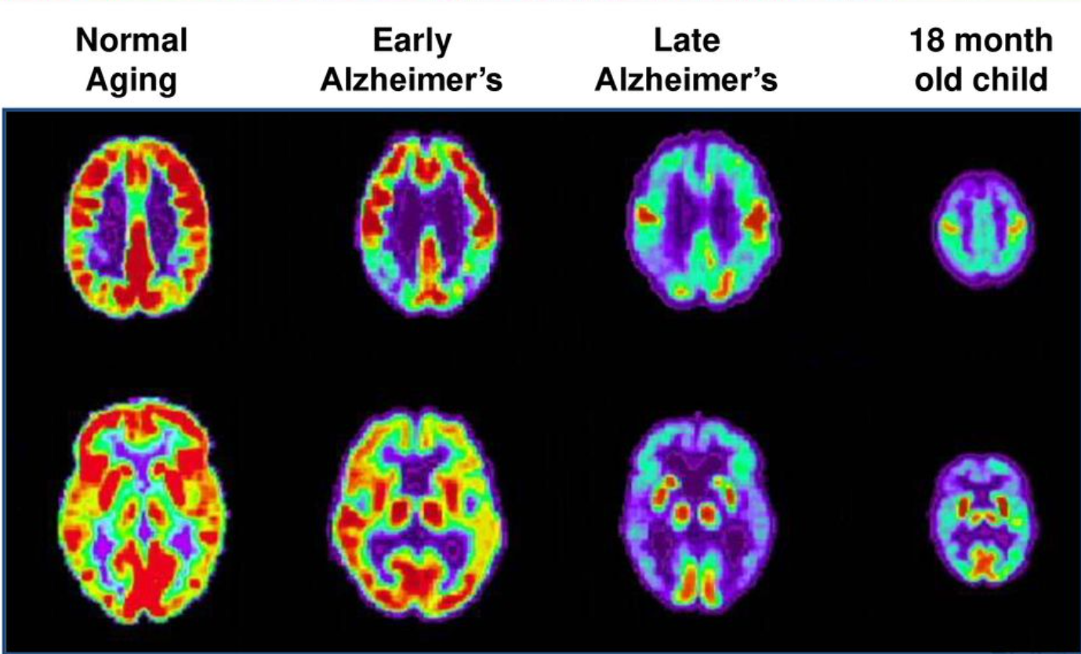
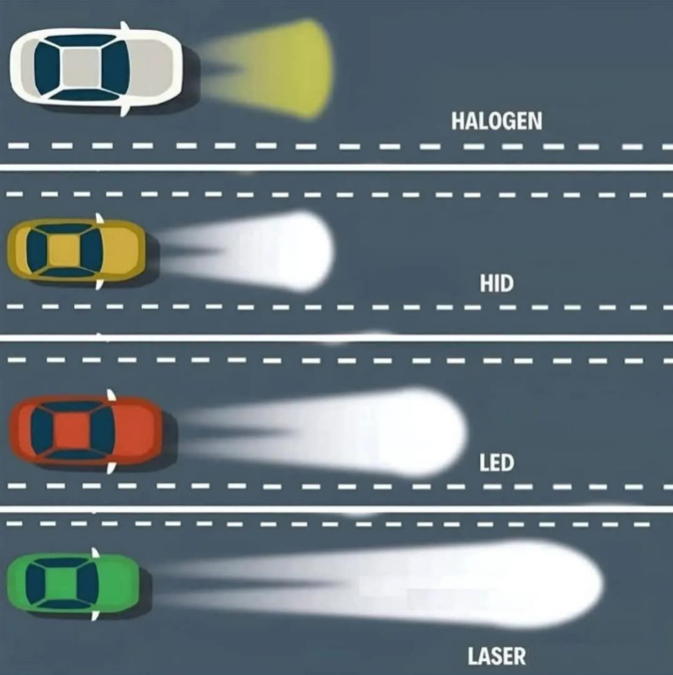
Did you know that single crystals, integral components of advanced imaging systems, not only enable early disease detection but also play a key role in modern diagnostics, helping us achieve better healthcare outcomes?
Did you know that single crystals, integral components of white laser diodes, play a crucial role in enhancing our safety by powering advanced lightning systems?

Slide 3
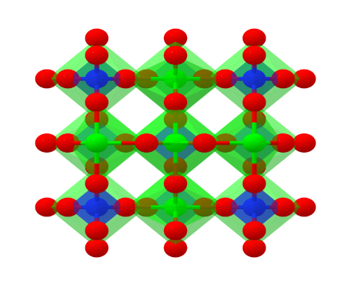
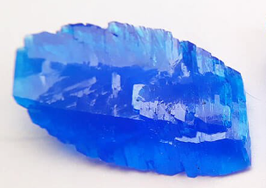
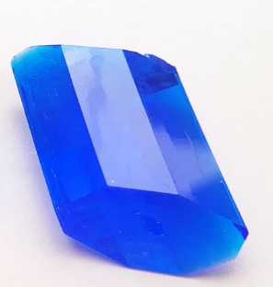
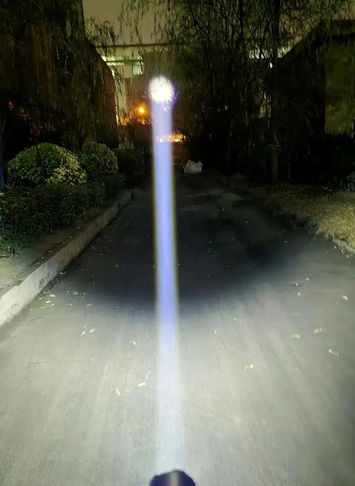
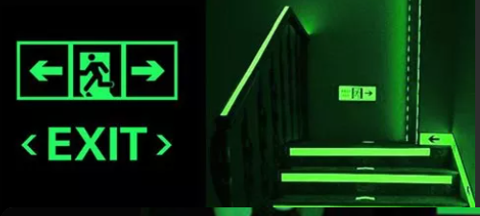
💡 What is my research about?
📐 But there is a catch:
When atomic sizes do not match, it becomes very hard to grow the crystal. My work explores:
• How much size mismatch is too much?
• What happens to the crystal structure and its ability to emit light?
I am developing a new method to grow high-performance crystals for applications such as high-power lighting, radiation detection in medical diagnostics and homeland security, and glow-in-the-dark safety markings.
These crystals, called high-entropy garnets and perovskites, are special because they mix many atoms that normally do not go well together.
Non-Engineered Crystal with Mismatching Elements
(Copper(II) sulfate)
Engineered Crystal with Mismatching Elements
(Copper(II) sulfate)
glow-in-the-dark safety markings
high-power white light LD

Slide 4


🌍 Why is it important?
• Challenge:
We know how to grow crystals “from matching atoms”, but we do not fully understand how atomic size mismatches change their integrity, growth possibility and functionality
🚫 Uncontrolled mismatches: Chaotic combinations → no functional potential
• Scientific Gap:
We lack a map showing how far we can stretch the composition before the crystal fails or loses function.
• Impact:
discover a new composition with better properties for detecting gamma rays (used in medicine & physics)
develop long-lasting glow materials for emergency lighting, Phosphors for high-power white LDs lightning technology
✅ Controlled precision: Strategic alignment → unlocks breakthrough functionalities
• Contribution:
my work will define new design rules for creating next-generation luminescent materials built from mismatched elements.

Slide 5
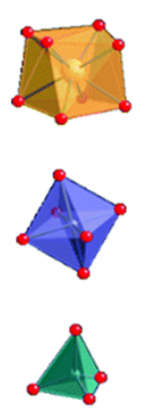
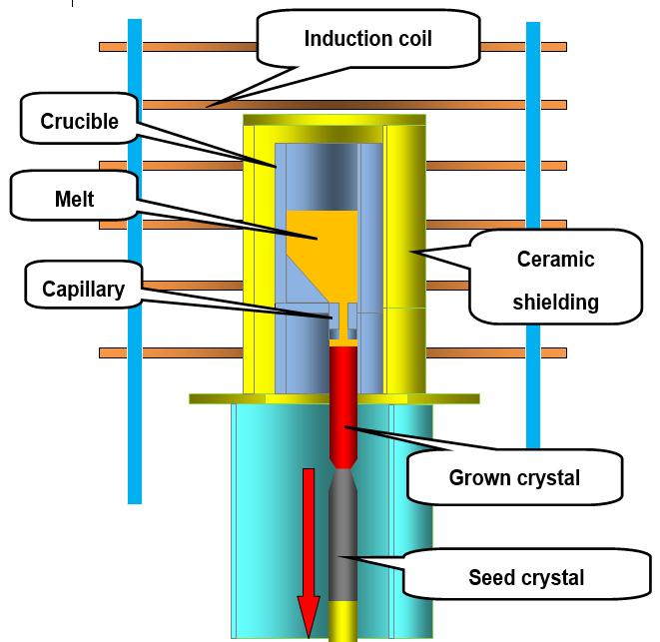
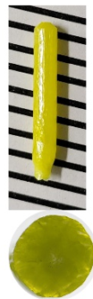
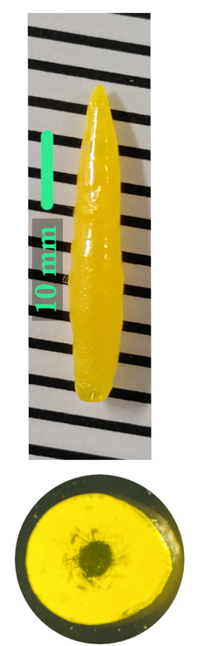
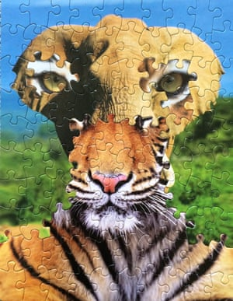
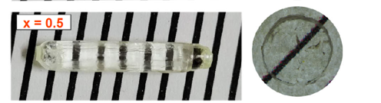
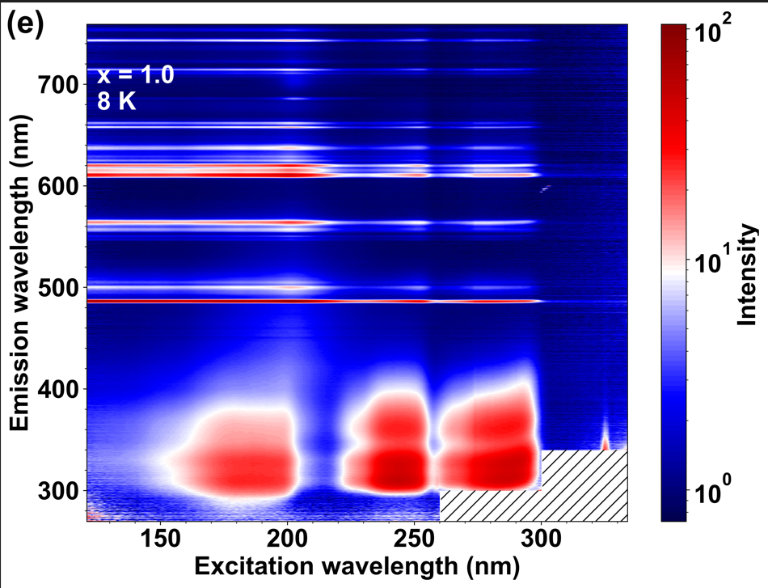
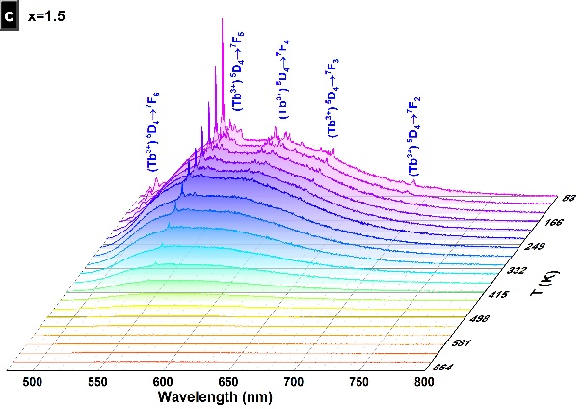

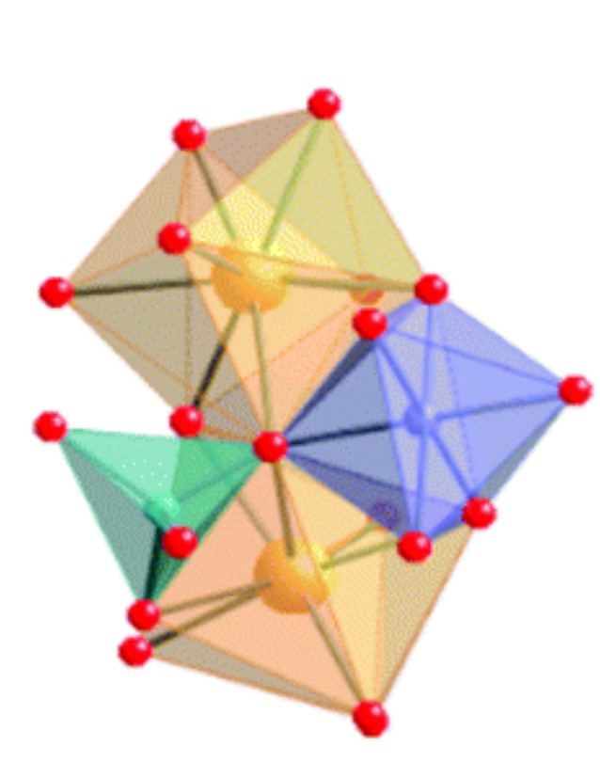
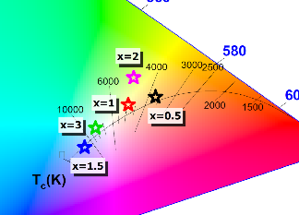
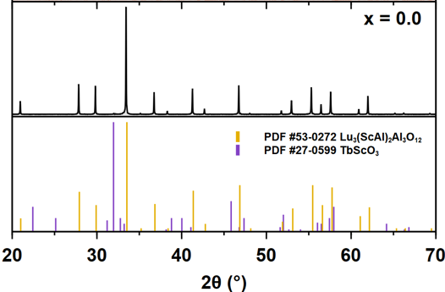
How I am doing the research
RE₃ M’₂ M’’₃ O₁₂
gas flow
Examples of grown crystals
CN=8
RE³⁺
CN=6
M’³⁺
CN=4
M’’³⁺
RE = Lu, Y, Eu, Nd, Gd, Tb, Nd, Ce, Pr, La
Ordering mismatching atoms: Precision alignment → tailored properties, breakthrough functionalities.
Simplified scheme of micro-pulling down method
M = Al, Ga, Sc
Al_{VI}=0.745 Å
Al_{VI}=0.535 Å
RE³⁺
Sc³⁺
0.21 Å
Al³⁺

Slide 6
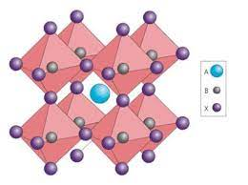
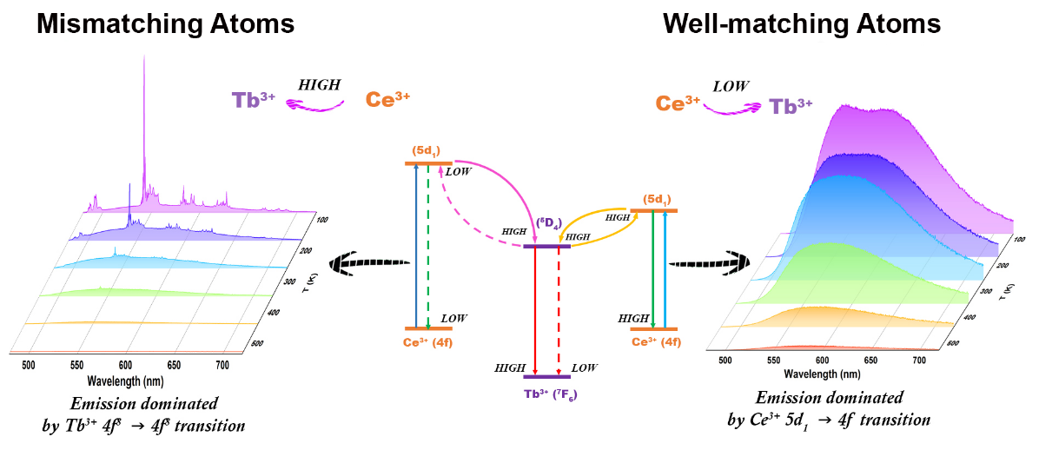
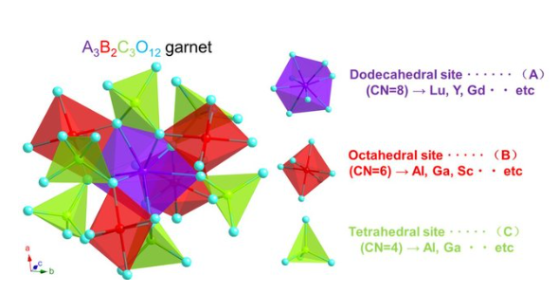
🔬 What I Expect to Find / Develop
1
4
Discovery of new structure-property relationships linking atomic mismatch to:
Enhanced persistent luminescence
Improved scintillation performance
Tailored photo-conversion colour-cordites and colour temperature
Enhanced thermal stability of luminescence intensity
Critical thresholds of atomic size ratios and concentrations where phase stability shifts garnet ↔ perovskite
2
Understanding of how mismatching dopants (like Pr³⁺ or Ce³⁺) induce lattice strain, phase separation, or functional enhancement.
3
Optimized crystal growth strategies using the micro-pulling down (μ-PD) method to stabilize novel compositions.

Slide 7
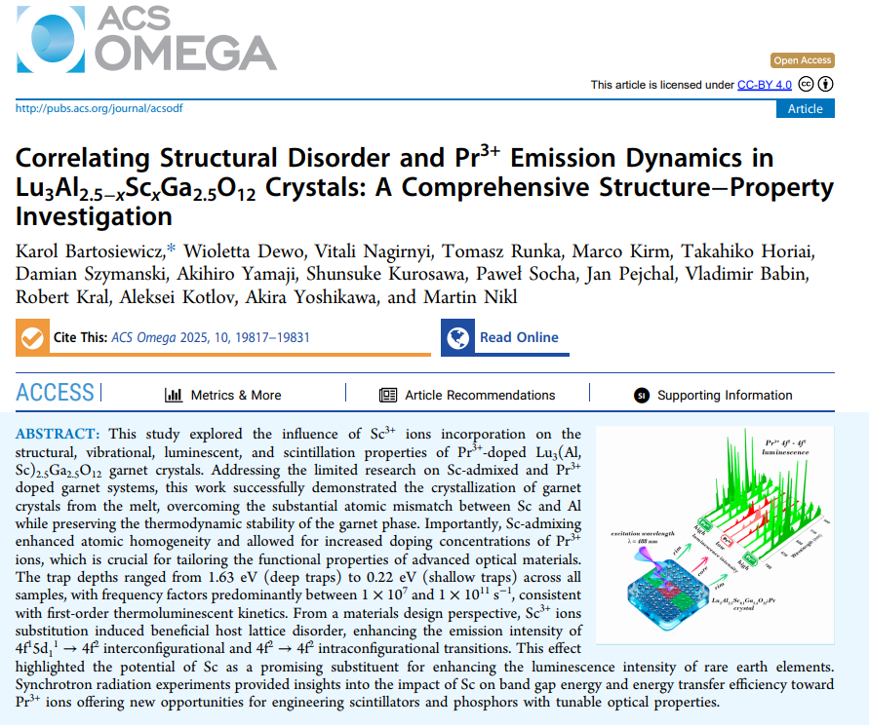
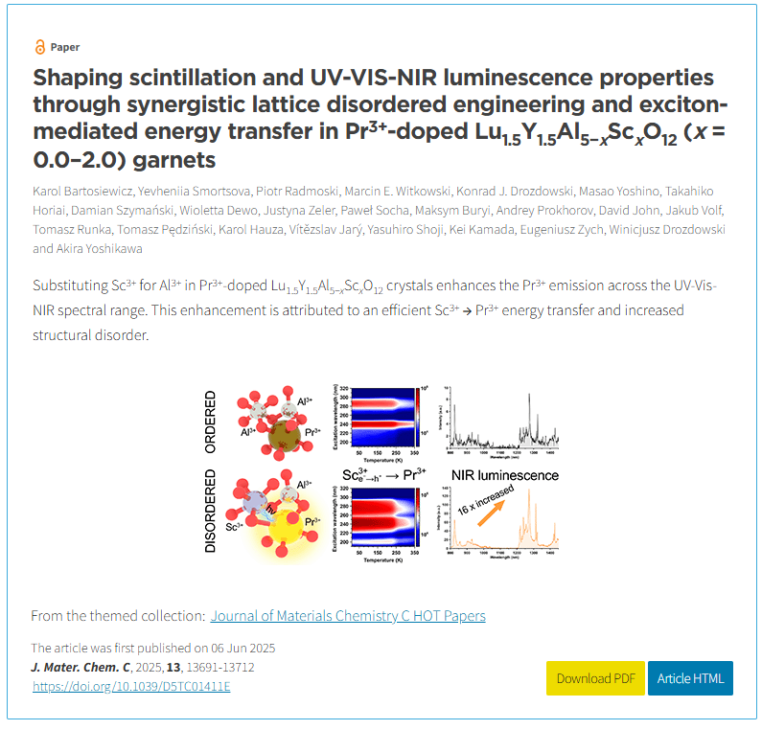
New Insights Generated by the Project
Journal of Materials Chemistry C HOT Papers

Slide 8
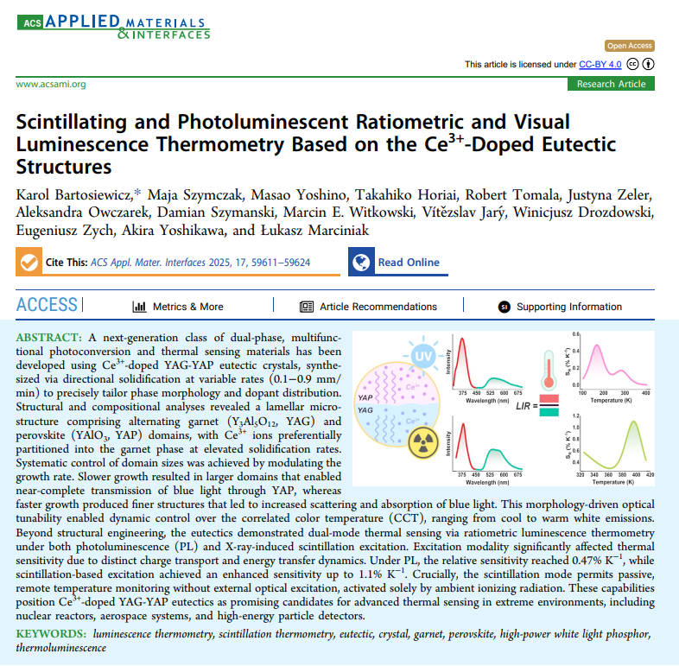
New Insights Generated by the Project

Slide 9
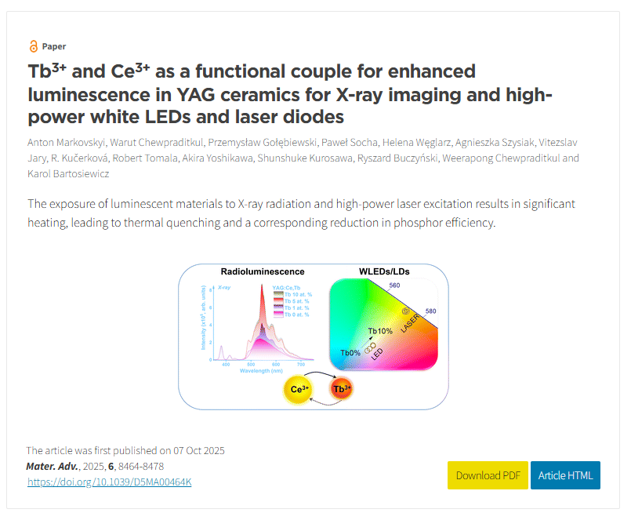
New Insights Generated by the Project

Slide 10
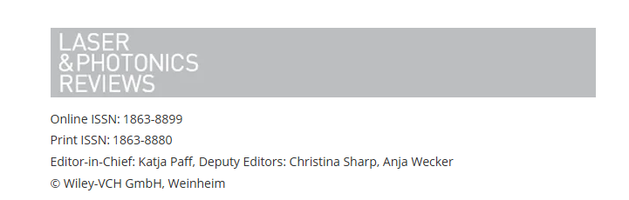
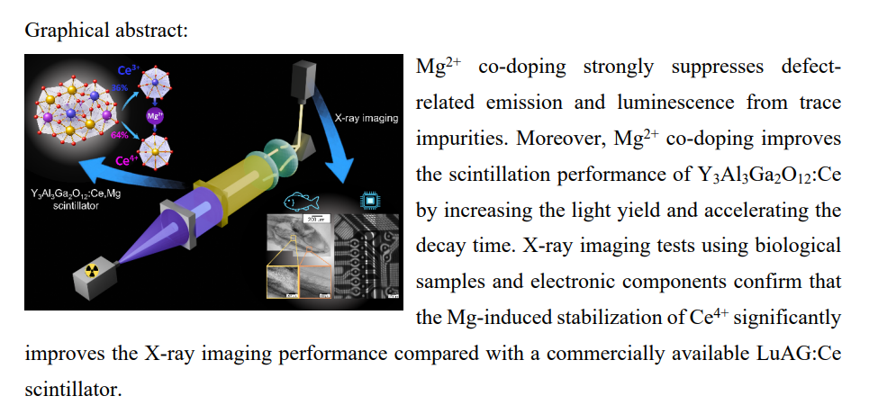
New Insights Generated by the Project
Under peer-review

Slide 11






Thank you for your attention
Karol Bartosiewicz
bartosiewicz@fzu.cz
https://www.fzu.cz/lide/karol-bartosiewicz-phd
FZUAVCR
fzu_avcr
institute-of-physics-of-the-czech-academy-of-sciences
fyzikalniustavavcr3220
fzu_avcr

