Slide 1
Non-invasive plasma diagnostics for low temperature deposition of VO₂-based thin film by magnetron sputtering (NIDEVO)
Xiao Li
Supervisor: Mgr. Zdeněk Hubička

Slide 2
Background: VO_{x} films by reactive HiPIMS （R-HiPIMS）
Metal–insulator transition (MIT)
Challenges
insulating monoclinic VO₂ (M)
Deposition of VO_{x}: Hard to stabilize the process for film growth
Multiple vanadium oxides (VO_{x}) compounds: VO, VO₂, V₂O₃, V₂O₅, etc.
T
light
metallic rutile VO₂ (R)
Plasma diagnostics
Real-time monitor
Monotonous trend of measured parameter vs Q_{O2}
a robust signal with as little scattering as possible
Applications: electronic switches, smart coatings, self-cleaning surfaces

Slide 3
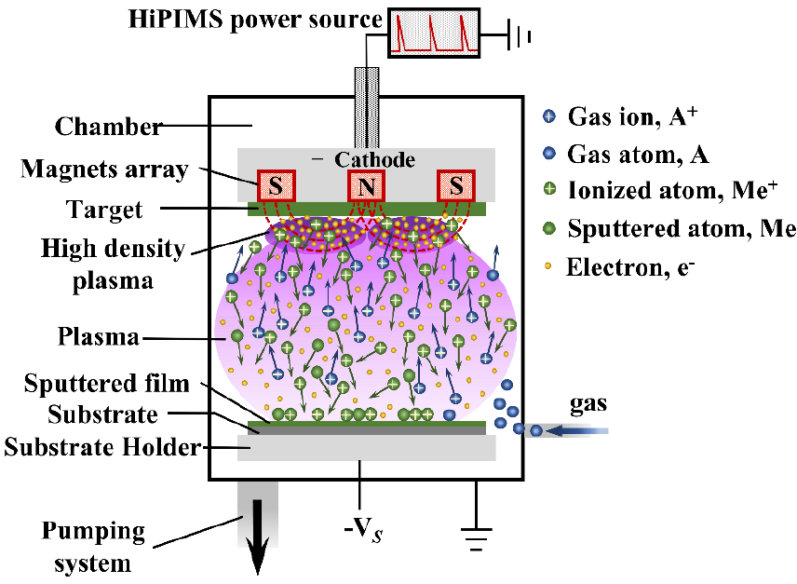
Background: VO_{x} films by reactive HiPIMS (R-HiPIMS)
HiPIMS (High Power Impulse Magnetron Sputtering):
High ionization degree
Dense structure
Smooth surface
R-HiPIMS of VO_{x}: V target+reactive gas (O₂)
Difficulties
Hysteresis effect
“pit on the road”
When does it appear?
Where does it appear?
It shifts as time
But we need it.
“Metal”
stable
“Transition”
unstable
“Compound”
stable

Slide 4

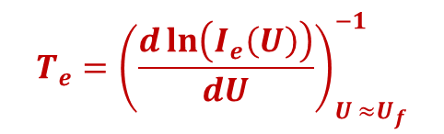
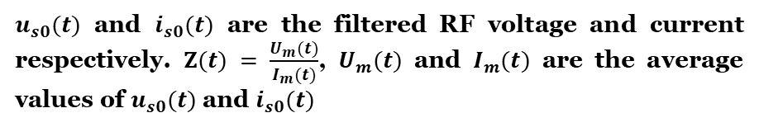
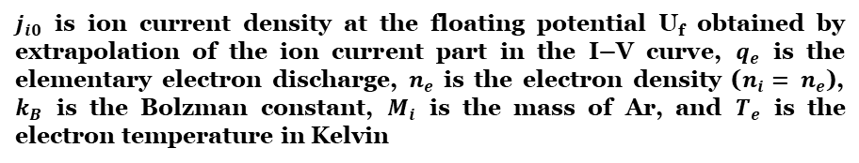
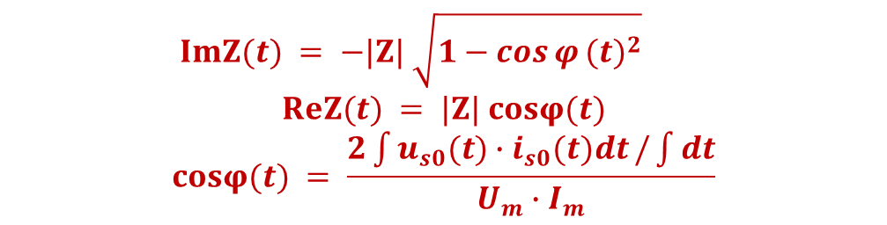
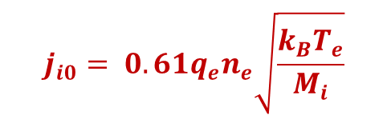

Method: RF Sobolewski probe
Plasma density n_{i} & electron temperature T_{e}
Ion flux measurement
The measured RF current and voltage signals can be transferred to Langmuir-like I–V characteristic curves in the case that the RF probe voltage frequency is much lower than the ion plasma frequency.²
Measured RF current & voltage
Phase shift correction
Sinusoidal RF current $i_{s}(t)$ and voltage $u_{s}(t)$
Sinusoidal RF current 𝒊_𝒔 (𝒕) and voltage 𝒖_𝒔 (𝒕)
Ion flux Γ_{i}(t)
Based on the Sobolewski theory, the ion flux to the substrate Γ_{i}(t) is the probe current value at a time when the RF voltage on the space charge sheath around the probe is at the minimum value. ¹(RF signal frequency is much lower than the ion plasma frequency)
$$T_{e}={\left(\frac{d\ln\left(I_{e}\left(U\right)\right)}{dU}\right)}_{U ≈U_{f}}^{−1}$$
$$j_{i0}= 0.61q_{e}n_{e}\sqrt{\frac{k_{B}T_{e}}{M_{i}}}$$
$j_{i0}$ is ion current density at the floating potential U_{f} obtained by extrapolation of the ion current part in the I–V curve, $q_{e}$ is the elementary electron discharge, $n_{e}$ is the electron density ($n_{i}= n_{e}$), $k_{B}$ is the Bolzman constant, $M_{i}$ is the mass of Ar, and $T_{e}$ is the electron temperature in Kelvin
$i_{s}(t)$
$u_{s}(t)$
Sheath impedance （serial mode）
Γ_{i}(t)
$$ImZ(t) = −|Z| \sqrt{1−{\cos{φ}(t)}^{2}}$$
$$ReZ(t) = |Z| cosφ(t)$$
$$cosφ(t) = \frac{2\int{u_{s0}(t)∙i_{s0}(t)dt}/\int{dt}}{U_{m}∙I_{m}}$$
$u_{s0}(t)$ and $i_{s0}(t)$ are the filtered RF voltage and current respectively. $Z(t) = \frac{U_{m}(t)}{I_{m}(t)}$, $U_{m}(t)$ and $I_{m}(t)$ are the average values of $u_{s0}(t)$ and $i_{s0}(t)$
¹ M. A. Sobolewski, Appl. Phys. Lett. 72, 1146 (1998).
² P. Sezemsky et al., Plasma Sources Sci. Technol. 28 (2019) 115009.

Slide 5
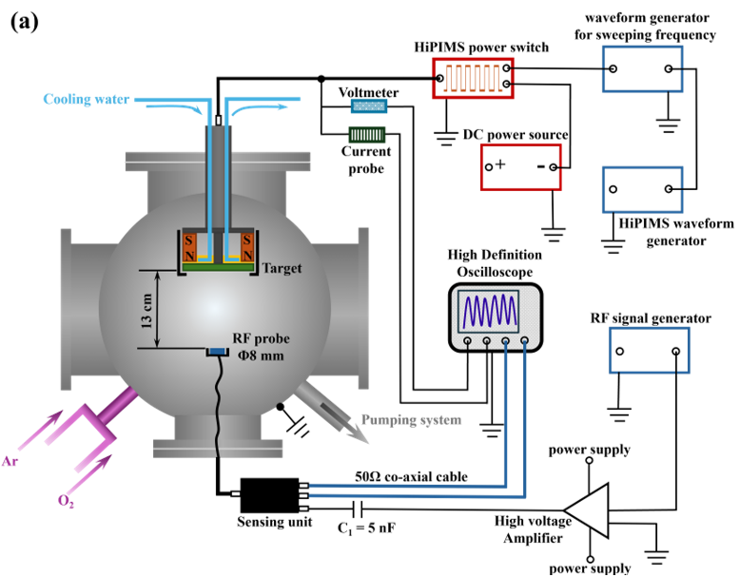
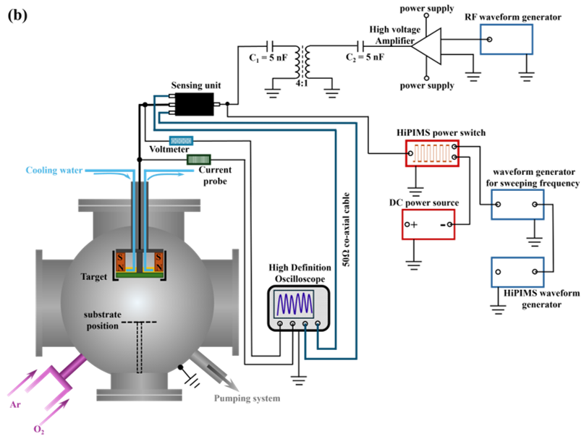
Experiment: invasive probe& non-invasive probe setups
Invasive probe
Non-invasive probe
f_{RF}: 350 kHz
f_{RF}: 350 kHz
P_{HiPIMS} = 100 W p = 2 Pa f_{HiPIMS} varies
Q_{Ar}= 40 sccm τ_{on} = 20 µs Q_{O2}: 0-2.4 sccm

Slide 6
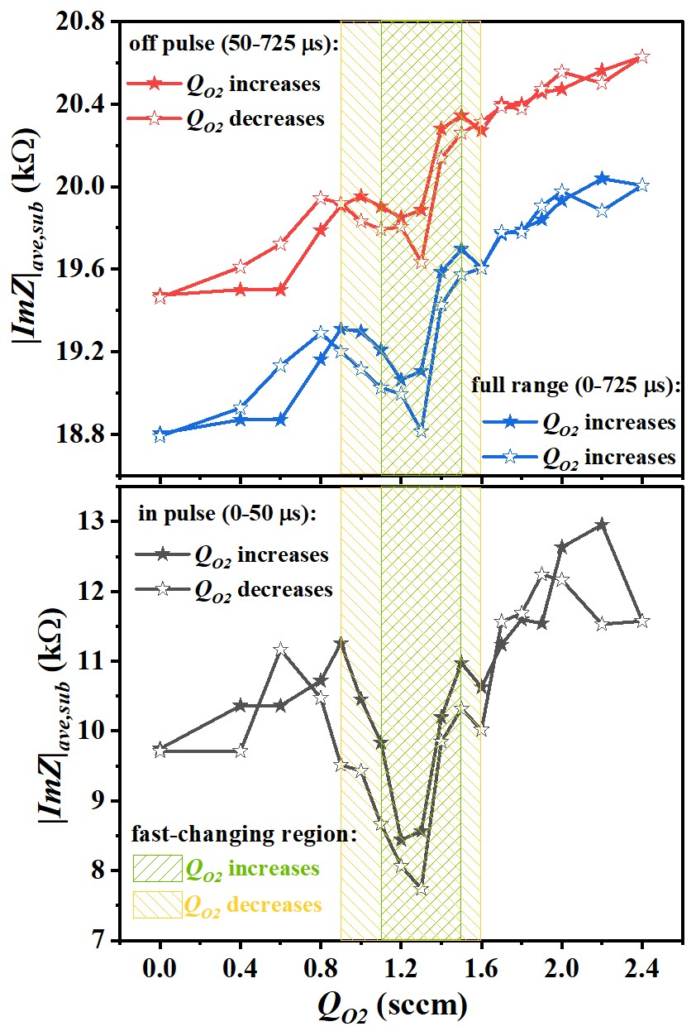
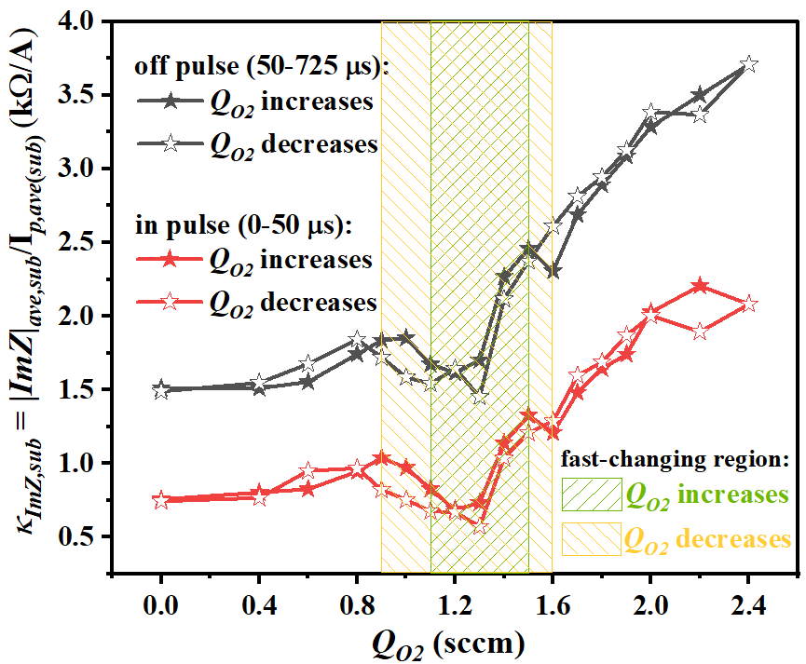
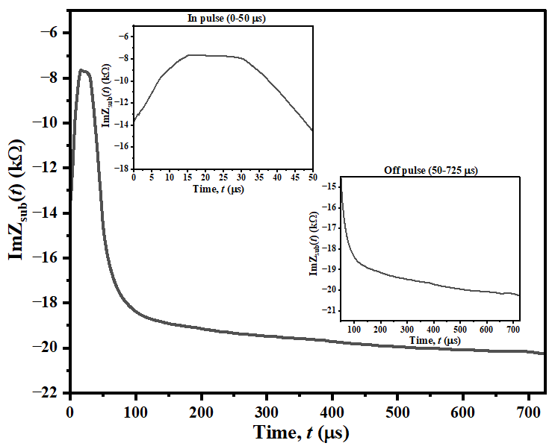
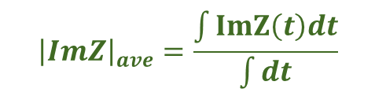
Results: sheath impedance measured at the substrate side
$${\left|ImZ\right|}_{ave}=\frac{\int{ImZ\left(t\right)dt}}{\int{dt}}$$
Clear trend, but not that smooth
κ_{ImZ,sub} = |ImZ|_{ave,sub}/ I_{p,ave(sub)}
Example of the ImZ_{sub}(t) curves measured at the substrate side. The zoomed-in in-pulse (0-50 us) and off-pulse (50-725 us) ImZ_{sub}(t) curves are inserted as well.
The in-pulse (0-50 µs) and off-pulse (50-725 µs) average imaginary part of sheath impedance value |ImZ|_{ave,sub} to the average cathode current per pulse I_{p,ave(sub)} ratio, κ_{ImZ,sub} = |ImZ|_{ave,sub}/I_{p,ave(sub)} as a function of Q_{O2} obtained at the substrate side.
The in-pulse (0-50 µs), off-pulse (50-725 µs), and full-range (0-725 µs) imaginary part of sheath impedance value |ImZ|_{ave,sub} as a function of Q_{O2} obtained at the substrate side.
Slightly smoother trend
Clear trend for R-HiPIMS process control

Slide 7
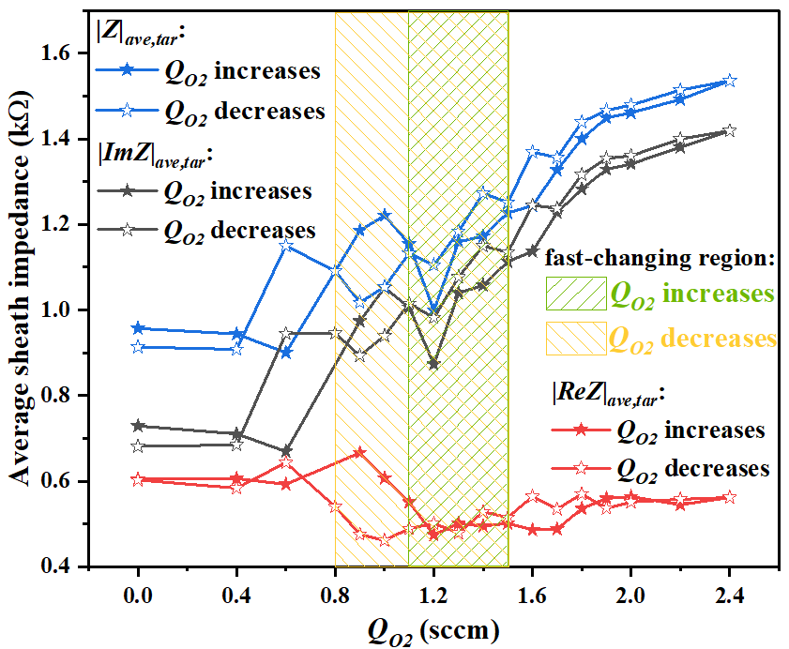
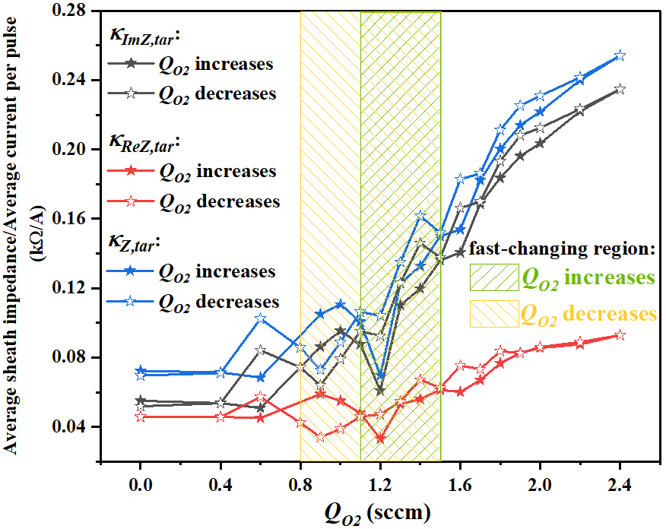
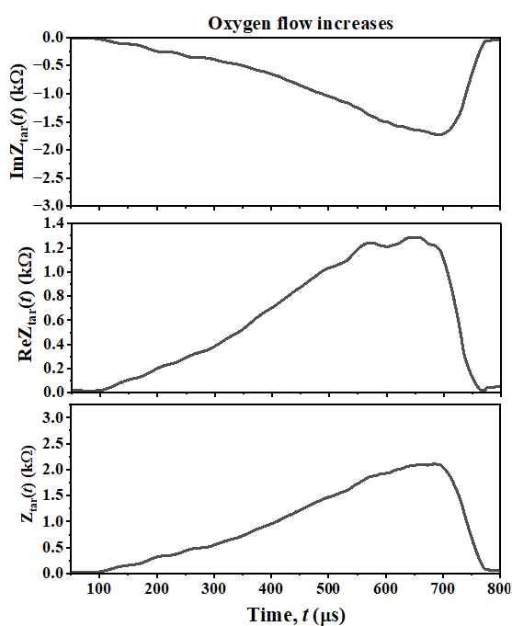
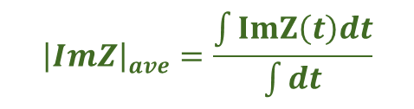

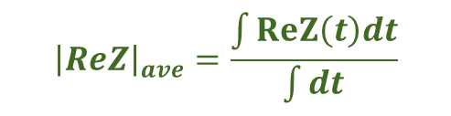
Results: sheath impedance measured at the target side
$${\left|ImZ\right|}_{ave}=\frac{\int{ImZ\left(t\right)dt}}{\int{dt}}$$
$${\left|ReZ\right|}_{ave}=\frac{\int{ReZ\left(t\right)dt}}{\int{dt}}$$
$${\left|Z\right|}_{ave}=\frac{\int{Z\left(t\right)dt}}{\int{dt}}$$
κ_{ImZ,tar} = |ImZ|_{ave,tar}/I_{p,ave(tar)}
κ_{ReZ,tar} = |ReZ|_{ave,tar}/ I_{p,ave(tar)} κ_{Z,tar} =
|Z|_{ave,tar}/ I_{p,ave(tar)}
The off-pulse (50-800 µs) average value of imaginary part, real part of sheath impedance |ImZ|_{ave,tar}, |ReZ|_{ave,tar}, as well as the total sheath impedance value |Z|_{ave,tar} as a function of Q_{O2} obtained at the target side.
The off-pulse (50-800 µs) average imaginary part and real part of sheath impedance value |ImZ|_{ave,tar} and |ReZ|_{ave,tar}, as well as the total sheath impedance value |Z|_{ave,tar} to the average current per pulse I_{p,ave(tar)} ratio, κ_{ImZ,tar}, κ_{ReZ,tar}, and κ_{Z,tar} as a function of Q_{O2} obtained at the target side.
Example of the off-pulse (50-800 µs) imaginary part and real part of sheath impedance ImZ_{tar}(t), ReZ_{tar}(t), as well as the total sheath impedance Z_{tar}(t) curves measured at the target side
|ImZ|_{ave}&|Z|_{ave} show clear trend
× |ReZ| is not appropriate
|ImZ|_{ave} and|Z|_{ave} have close value, no big change of trend
|ReZ| show slightly better trend

Slide 8
Highlights
Novel non-invasive plasma diagnostics successfully implemented for the deposition process
New discovery of the hysteresis behavior for VO_{x} deposition.
Promising parameter (the sheath impedance, especially the imaginary part of sheath impedance) to locate the transition regime and prepare for future R-HiPIMS process regulation is found.
Results summarized in: X. Li, I. Venkrbcová, D. Lundin, M. Čada, Z. Hubicka, Plasma Sources Science and Technology, 35 (2026) 035003. “Plasma characterization for reactive HiPIMS process regulation of vanadium oxides”. https://doi.org/10.1088/1361-6595/ae4731.

Slide 9





Thank you for your attention
Xiao Li
xiaoli@fzu.cz
www.fzu.cz
FZUAVCR
fzu_avcr
institute-of-physics-of-the-czech-academy-of-sciences
fyzikalniustavavcr3220
fzu_avcr
Division of Optics (4)
Department of Low-Temperature Plasma (25)
Group of plasma diagnostics and thin film analysis (2505)

