Slide 1
Kinetic simulations of oblique high-Mach number shocks propagating in Alfvénic turbulence
Eloise Moore
Collaborators: Karol Fulat, Mahmoud Al-Awashra, Michelle Tsirou, Martin Pohl
Discussions and synergies on astrophysical plasma with PIC simulations | Prague 2026

Slide 2
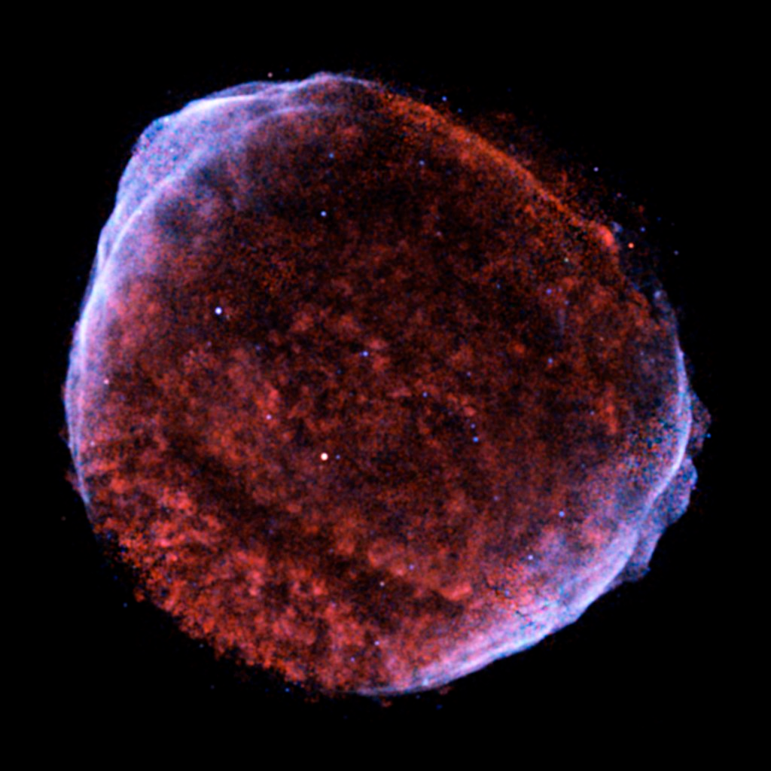
Supernova remnants
Supernova remnants candidate for galactic cosmic rays (see e.g. Reynolds 2008 for a review)
Fast shocks (vsh ≳ 1000 km/s) suitable sites for particle acceleration via diffusive shock acceleration (DSA)
Shocks are collisionless and propagate with high sonic Mach numbers
Signals of electron acceleration: non-thermal X-ray shells indicating synchrotron emission (e.g. Reynolds & Chevalier 1981)
Chandra X-ray image of SN1006. Exposure: 61 hours
Red: 0.5-0.91 keV, Cyan: 0.91-1.34 keV, Blue: 1.34-3.00 keV
Credit: NASA/CXC/Rutgers/J.Hughes et al.

Slide 3
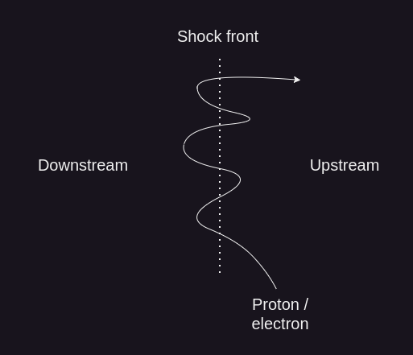
Particle acceleration at shocks
Acceleration to high energies via DSA
Simplest case: shock modelled as infinitesimally thin discontinuity
Energy gain ~ v/c with each crossing of the shock
To enter DSA, particle Larmor radius should be larger than the shock thickness
Thermal electrons cannot participate in DSA – the electron injection problem

Slide 4
Electron dynamics at oblique shocks
Oblique shocks: turbulent foreshock region where various beam instabilities are driven
Electron density Bohdan et al. (2022)
Bohdan et al. (2022) investigated the nature of beam instabilities within the foreshock from PIC simulations of collisionless oblique shocks propagating towards homogeneous upstream plasma
mi/me | n0 | v0 /c | vth,e / c | θbn | λse | Ωi ⁻ ¹
50 | 40 | -0.2 | 0.0444 | 60 | 8 | 13000 δt
Simulation parameters
Instabilities & non-linear structures modify electron dynamics – provides scattering and are capable of providing heating & acceleration

Slide 5
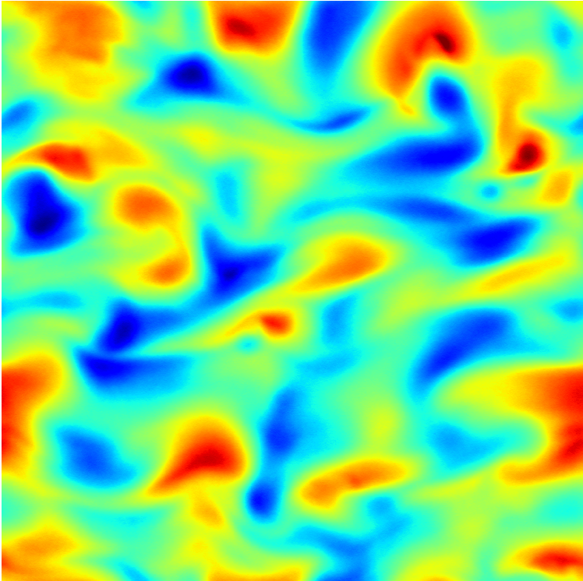
… so what’s missing?
Plasma is ubiquitous in astrophysical environments, but is rarely homogeneous, especially on kinetic scales
  We need to include turbulence in the upstream region of shock simulations!
Turbulence can:
  Provide additional particle scattering towards & around the shock
  Modify the shock structure
  Modify properties of instabilities and non-linear structures in the foreshock region

Slide 6
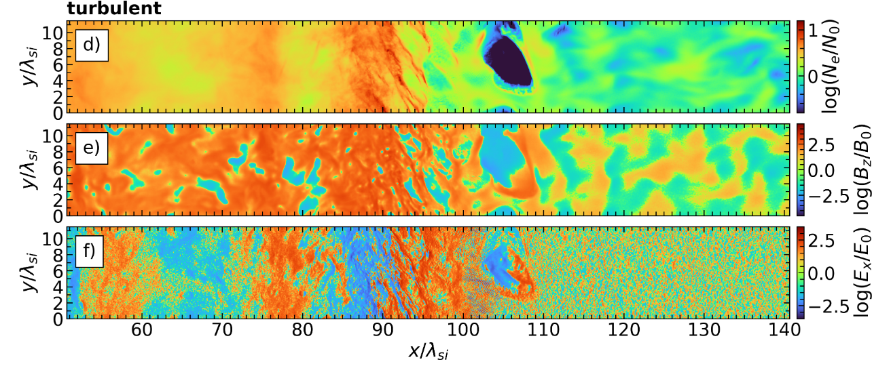
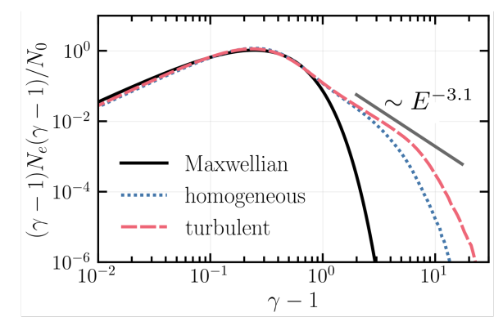
Oblique shock simulations with compressive turbulence
Previous work by Karol Fulat has shown that electrons are accelerated more efficiently with pre-existing compressive turbulence in the upstream
PIC simulation of oblique high-Mach number shocks with compressive turbulence.
(Fulat, Moore et al. 2026 accepted)
mi/me | n0 | v0 /c | vth,e / c | θbn | λse | Ωi ⁻ ¹
100 | 20 | -0.2 | 0.05722 | 60 | 20 | 48000 δt
Simulation parameters
<number>

Slide 7
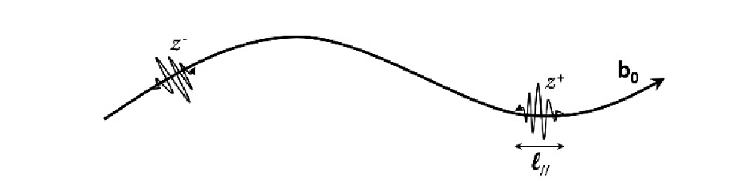
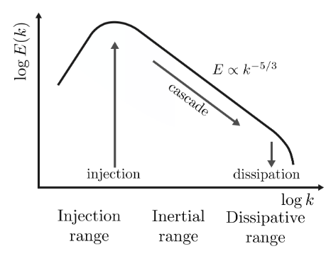
Alfvénic turbulence
One of the main forms of electromagnetic turbulence
Transverse, non-compressive turbulence resulting from the interaction between counter-propagating Alfvén waves
        Wavepackets are deformed non-linearly when they collide ⇒ generates turbulence!
Propagation of Alfvén wave packets (Galtier 2022)
Alfvén waves propagate parallel to the direction of the magnetic field ⇒ perturbations transverse to direction of propagation resulting in anisotropic energy cascade (k⊥ ≫ k∥)
Source: Karol Fulat (2024, thesis)

Slide 8
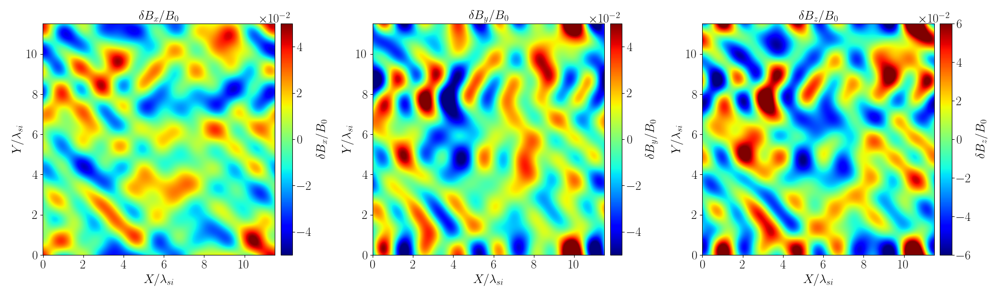
Implementation of EM turbulence
Decaying electromagnetic turbulence similar to that of kinetic Alfvén wave turbulence
Consider 50 perturbations in the magnetic field each of a given wavenumber and phase inserted in upstream rest frame
mi/me | n0 | v0 /c | vth,e / c | θbn | λse | Ωi ⁻ ¹
100 | 20 | -0.2 | 0.05722 | 60 | 20 | 48000 δt
Simulation parameters
Initial magnetic field perturbations at t = 0 Ωi ⁻¹

Slide 9
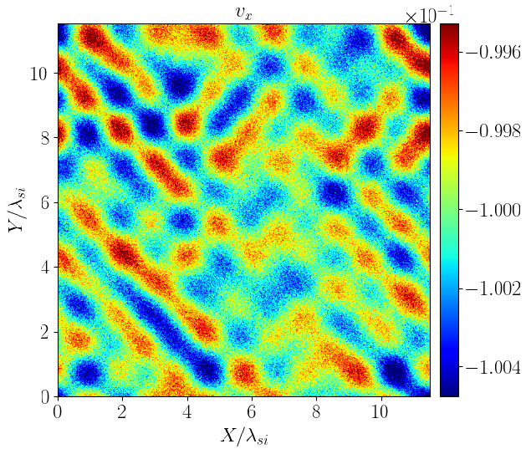
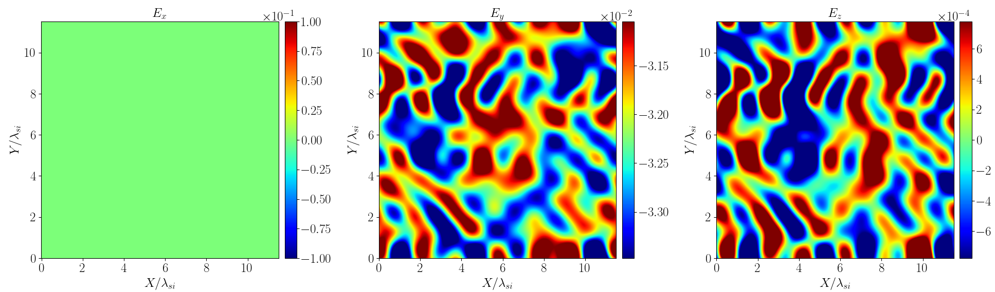
Implementation of EM turbulence
Self-consistent current initialised by shifting the ion distribution by ∇ × δB in the upstream rest frame to avoid rapidly growing electric field
Motional electric field carried by electrons E = −v0 × (B 0 + δB) initialised in simulation frame
Initial ion x- velocity at t = 0 Ωi ⁻¹
Initial electric field at t = 0 Ωi ⁻¹

Slide 10
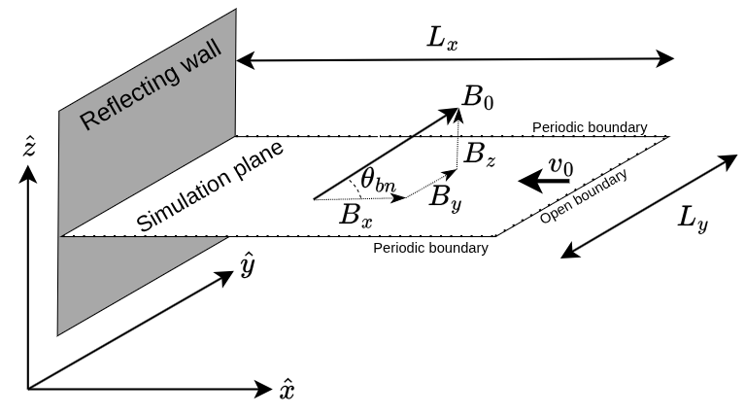
Shock simulation setup
Simulation schematic
2D3V particle-in-cell code THATMPI, based on TRISTAN
Reflecting wall setup to create a shock
4 simulations:
  Homogeneous
  Turbulent (fluctuations δ B/B ~
  [5%, 20%, 80%])
Aim to run for ~ 15 Ωi ⁻ ¹, currently at
13.65 Ωci ⁻ ¹
Simulation parameters
mi/me | n0 | v0 /c | θbn | Ly | λse | Ms | MA | Ωi ⁻ ¹
100 | 20 | -0.2 | 60 | 12 | 20 | 36 | 32 | 48000 δt

Slide 11
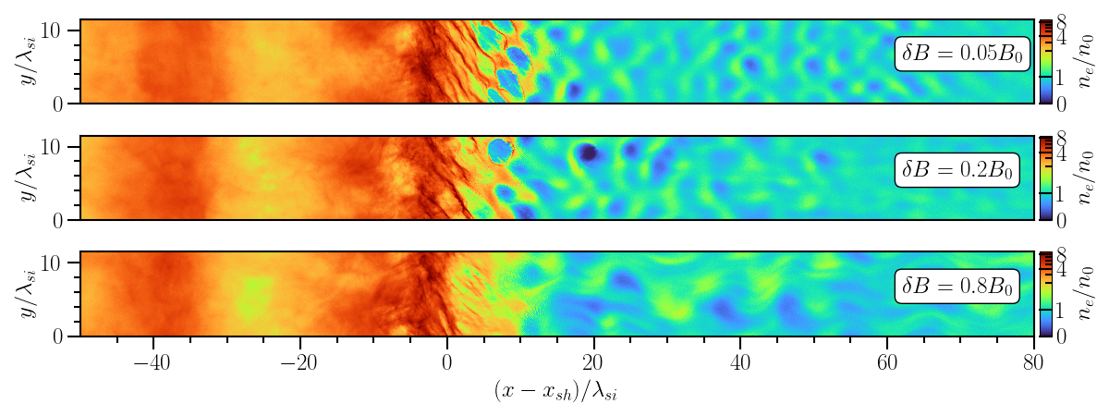
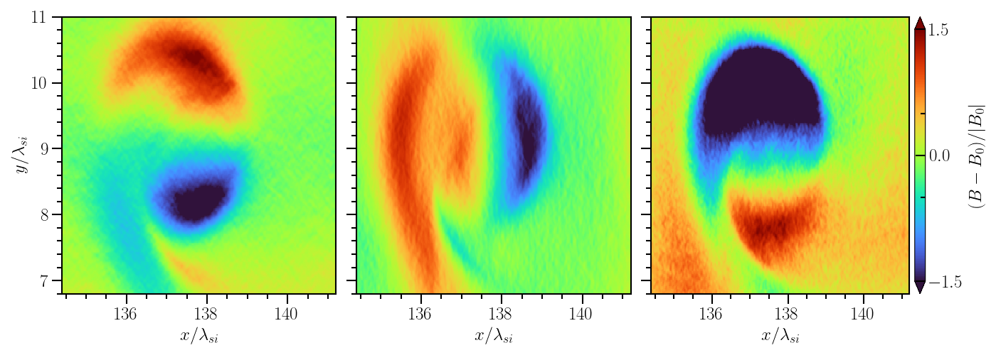
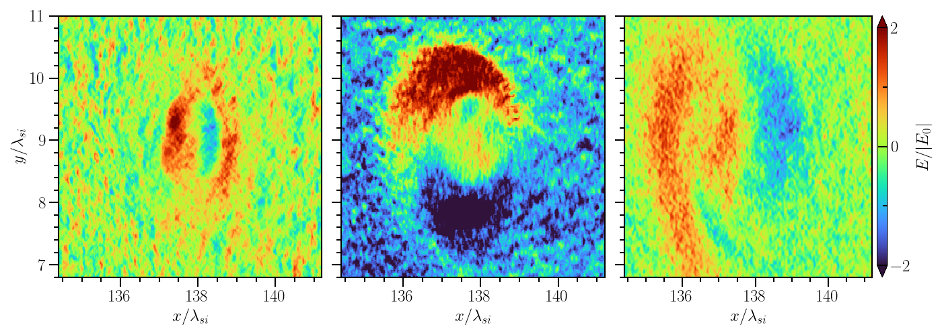
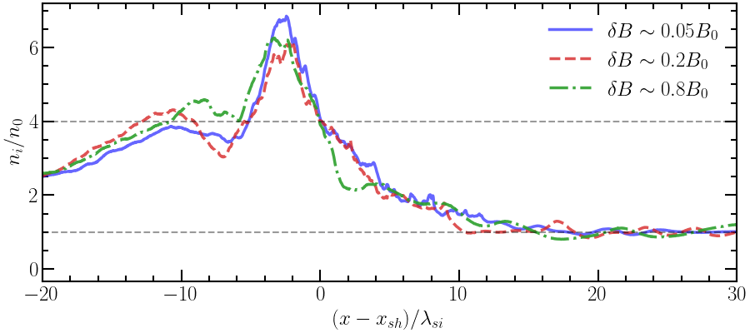
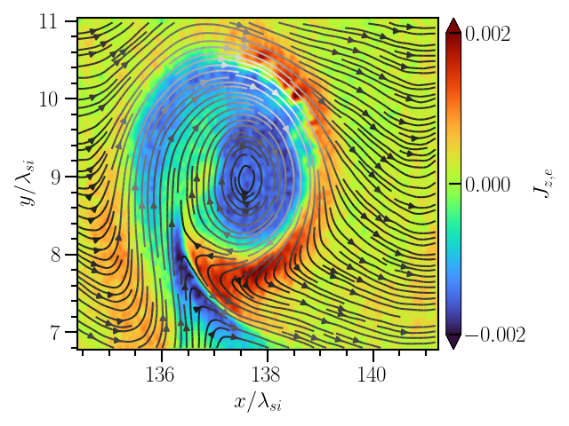
Shock structure: density
Consistent with Morris et al. (2023); Fulat et al. (2026)

Slide 12
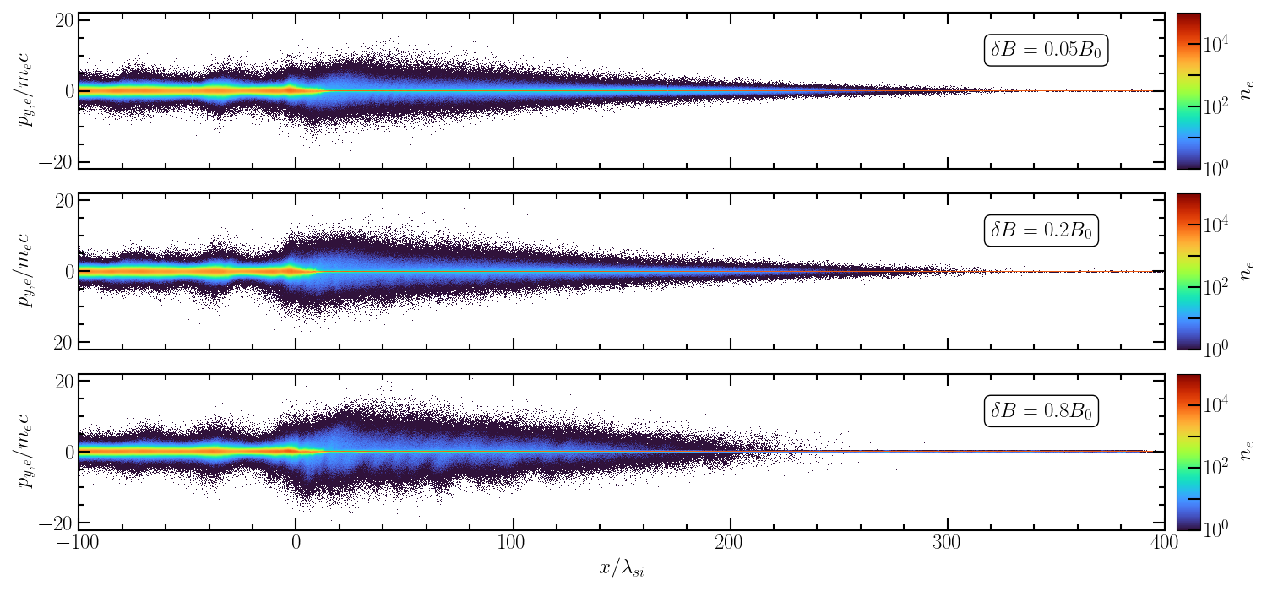
Electron phase space
Shorter foreshock in δB ~ 0.8B0 but wider distribution
Wider spread in core distribution between (x − xsh) ∈ [0, 20] λsi for δ B ~ [0.05, 0.2]B0
Narrower core distribution in downstream for
δB ~ 0.8B0

Slide 13
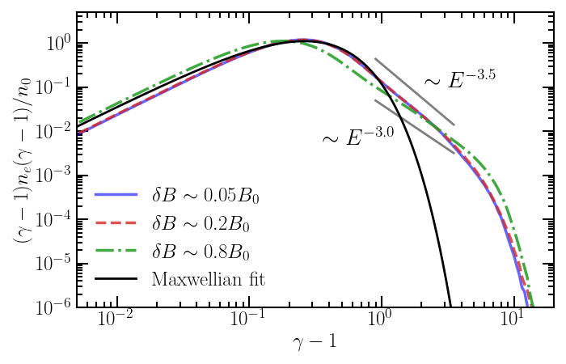
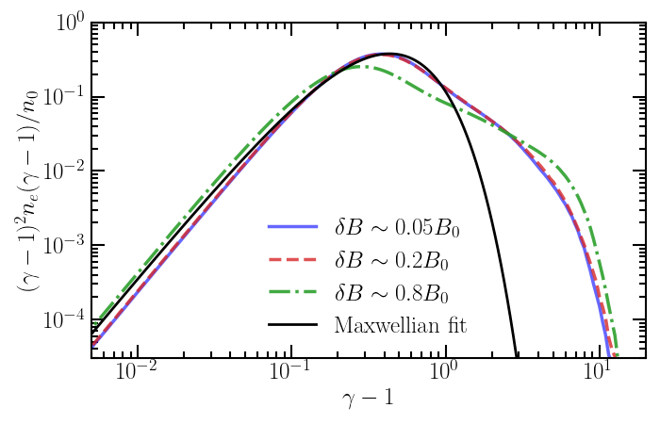
Electron energy spectrum
Energy spectrum taken in the downstream (region 40−80 λsi behind shock)
Electrons are accelerated more efficiently and to slightly higher energies in δ B ~ 0.8B0 but the downstream temperature is lower

Slide 14
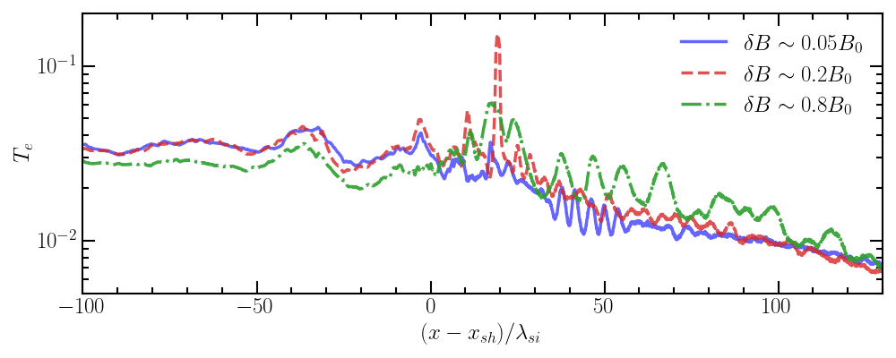
Electron temperature profile

Slide 15
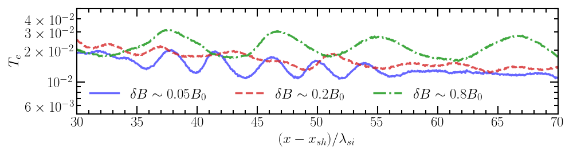
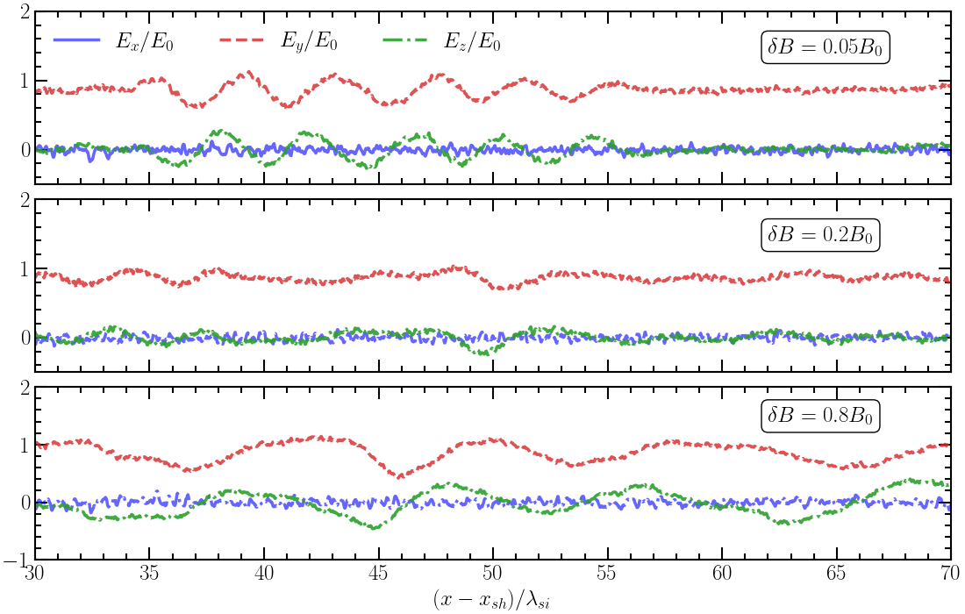
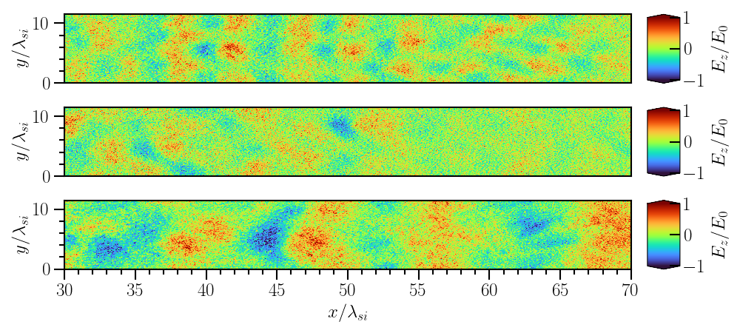
Feature at (x − xsh) ~ 30 − 70 λsi
Wavelike fluctuations in temperature for δB ~ 0.05B0 and δB ~ 0.8B0 correlate with polarised wavelike fluctuations in E & B
~4λsi
~10λsi

Slide 16
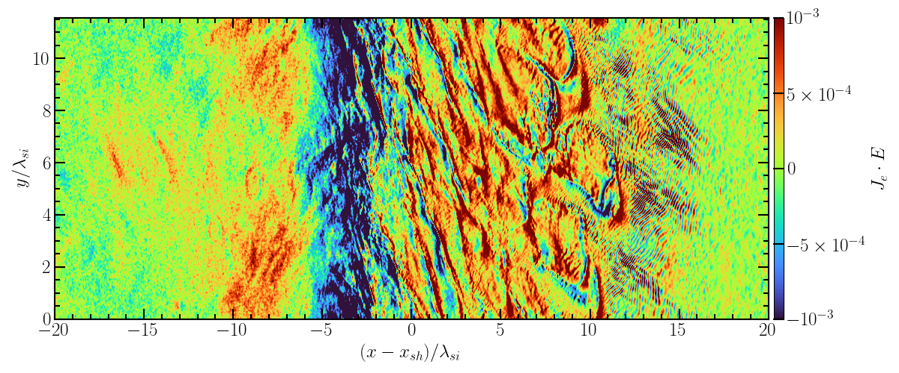
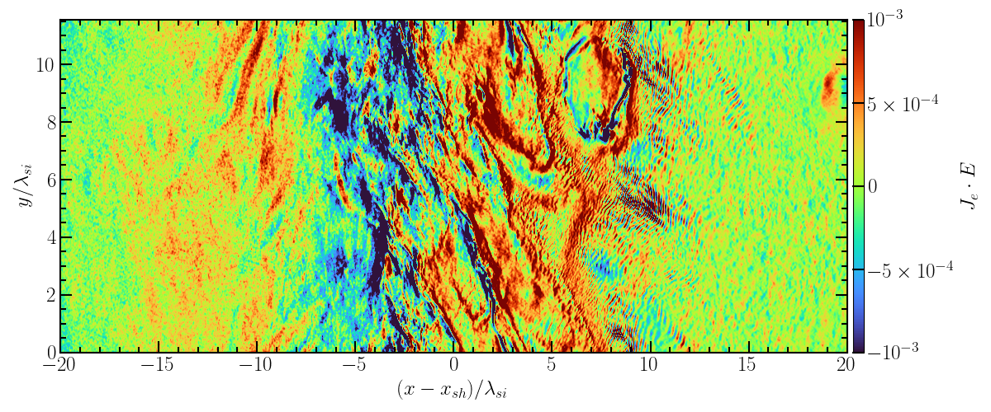
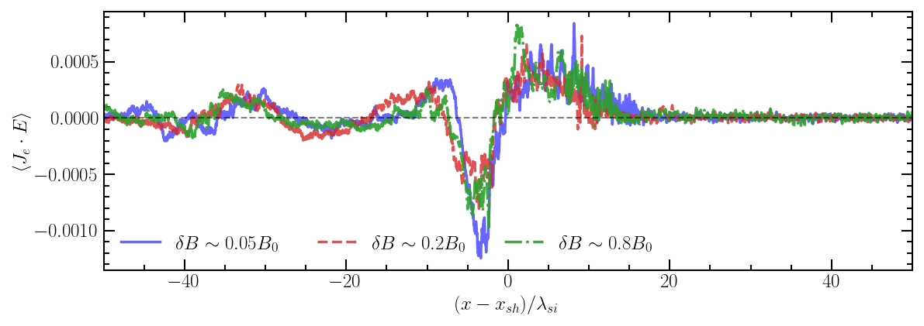
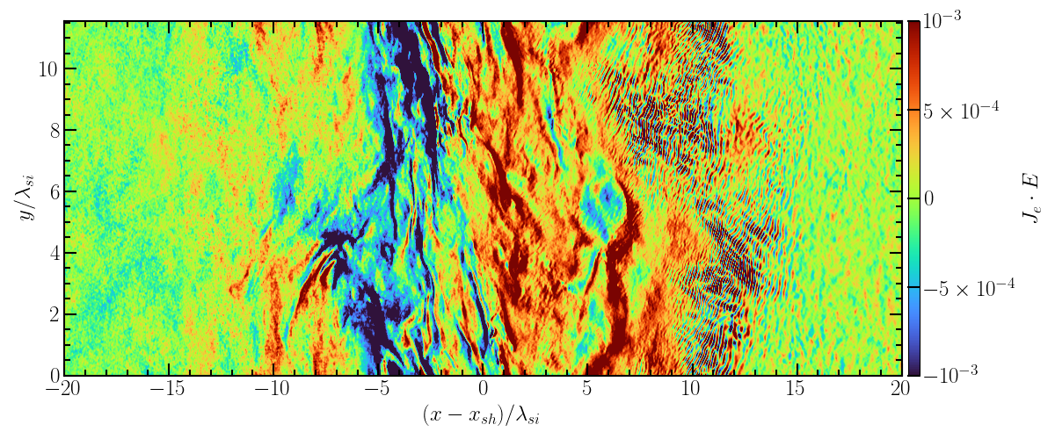
Electron heating
Je ⋅ E > 0 : Electric field does work on the electrons
Je ⋅ E < 0 : Electrons do work on the field
Electron heating

Slide 17
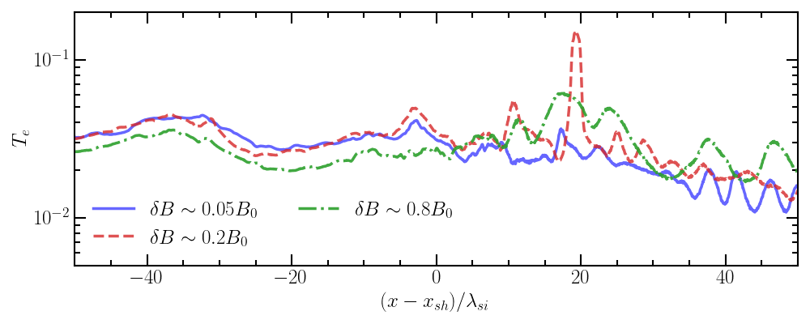
Electron heating (?)
Reduction in temperature for δB ~ 0.8B0 is not explained by Je ⋅ E maps & profiles
Some other transfer of energy process that is not present in lower turbulence amplitudes?

Slide 18
Summary
I have developed a framework for stable, self-consistent electromagnetic turbulence for use in Particle-In-Cell shock simulations
Currently running shock simulations with electromagnetic turbulence of varying turbulence amplitudes (fluctuations δ B/B0 ~ [5%, 20%, 80%])
      Whistler waves (+ cavities) and Weibel filaments present in the foreshock, but are weakened in higher amplitude turbulence
      Higher amplitude turbulence results in a higher maximum electron energy and has a harder spectrum comparable to compressive turbulence but a lower downstream temperature
      Investigating source of reduction of electron temperature in downstream
Thanks for listening!

Slide 19
BACKUP SLIDES

Slide 20
Driven vs. decaying turbulence
Driven turbulence
  Turbulent energy continuously injected at larger scales to mimic MHD cascade
  May lead to artificial heating of particles and thus enhanced acceleration efficiency
  e.g. Langevin antenna (Tenbarge et al. 2014)
Decaying turbulence
  Wavelike structures imposed by initial condition and left to evolve in the simulation
  May struggle to reach a steady state
  e.g. Grošelj et al. 2019, Comisso et al. 2019, Bresci et al. 2022

Slide 21
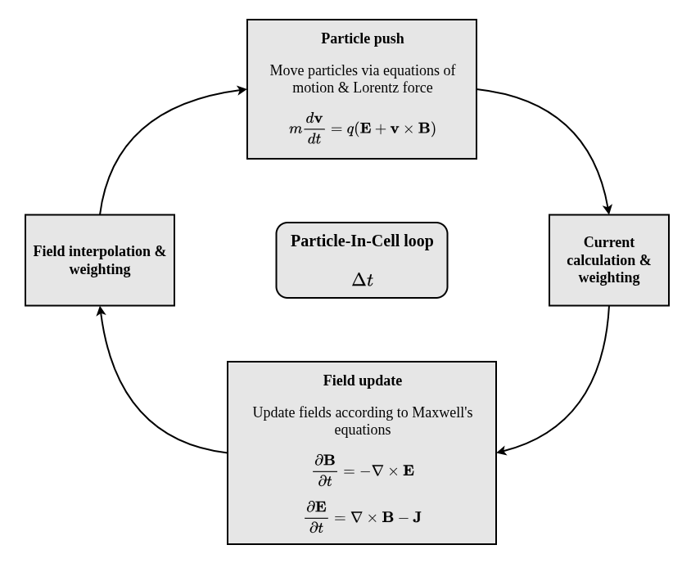
The Particle-In-Cell Method
Plasma represented by ensemble of macro-particles (representing many particles in a real plasma) injected with an initial distribution function (e.g. Maxwellian)
Electric & magnetic fields are solved self-consistently via Maxwell’s equations
Particle motion by Lorentz force computed through leapfrog algorithm
PIC = Particle-In-Cell

Slide 22
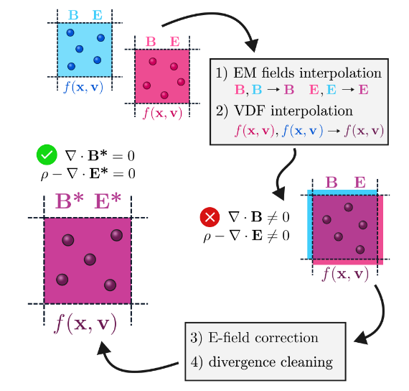
Slab matching in THATMPI
Pre-generate turbulent slabs using periodic box simulations
Fields interpolated within a “transition zone” with weights imposed by their position in the simulation grid. Particle distribution functions recomputed using first 3 moments of distribution function
Corrections made to ensure Gauss’ law satisfied, and ∇ ⋅ B = 0

Slide 23
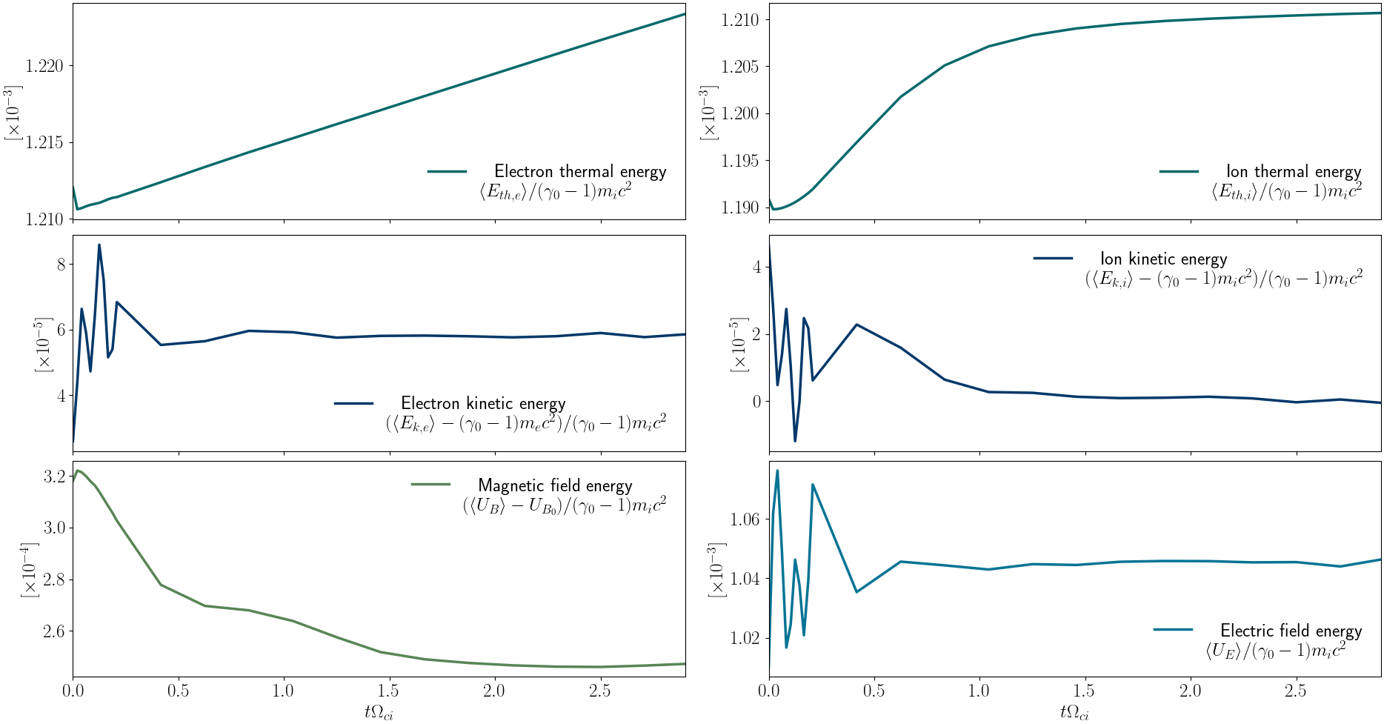
Long-term evolution of turbulence

Slide 24
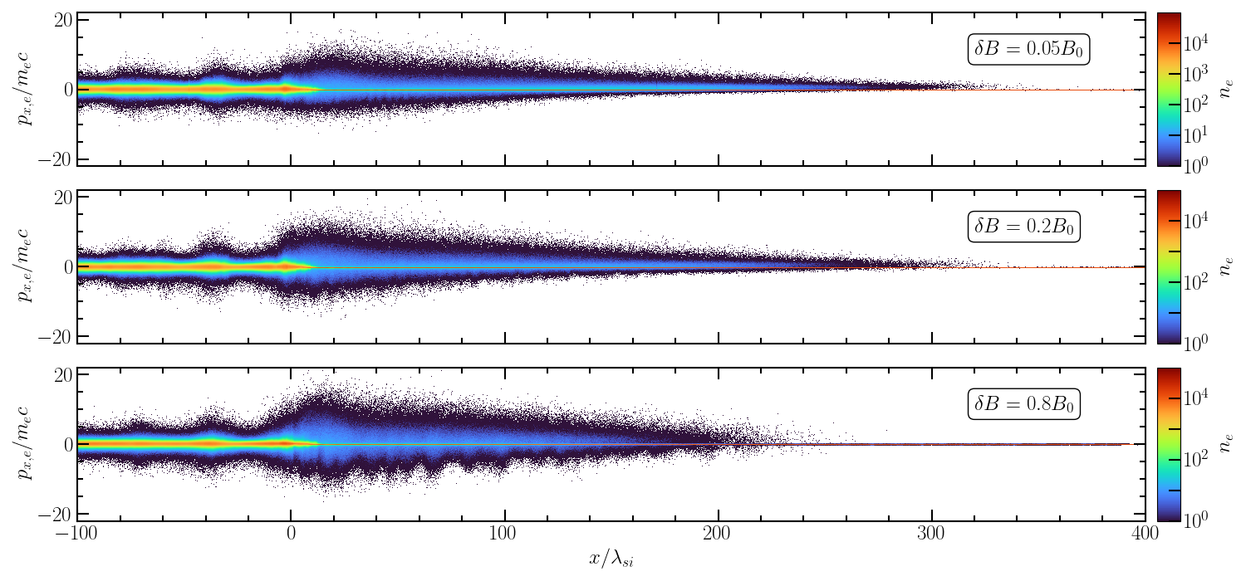
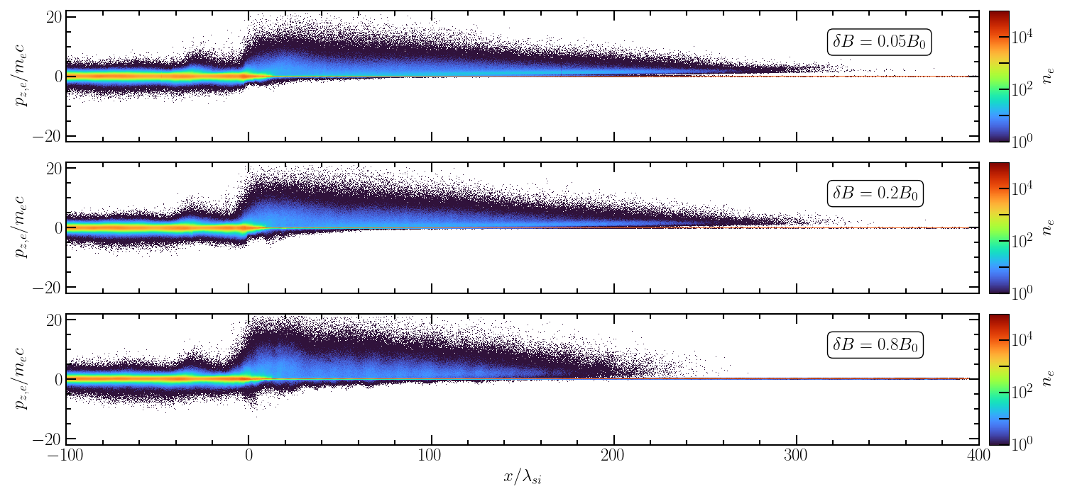
Electron phase space (px & pz)

Slide 25
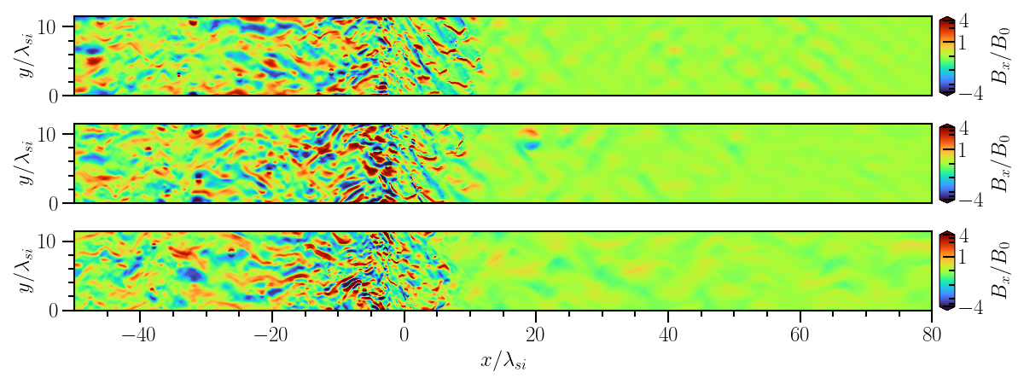
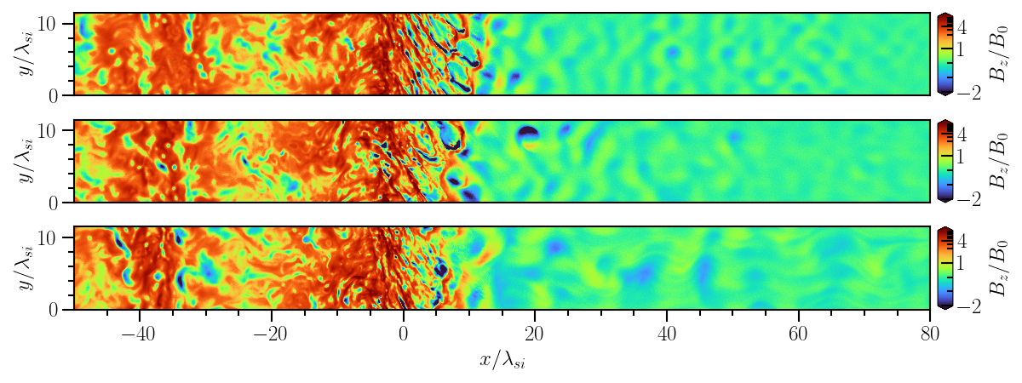
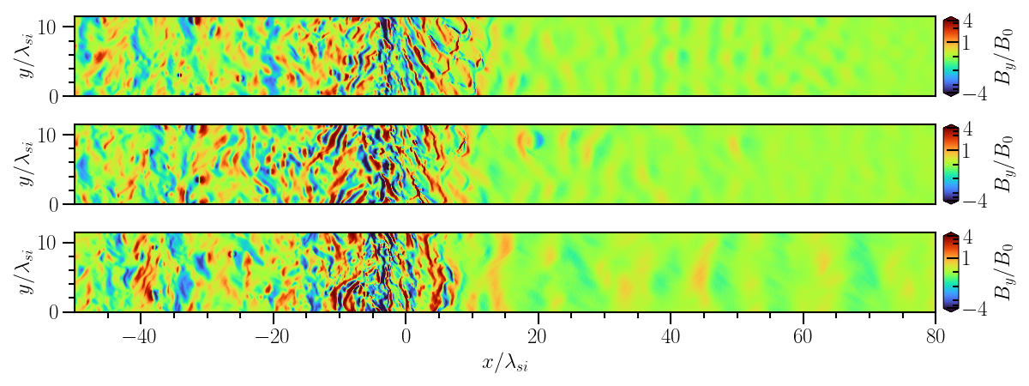
Magnetic field maps

Slide 26
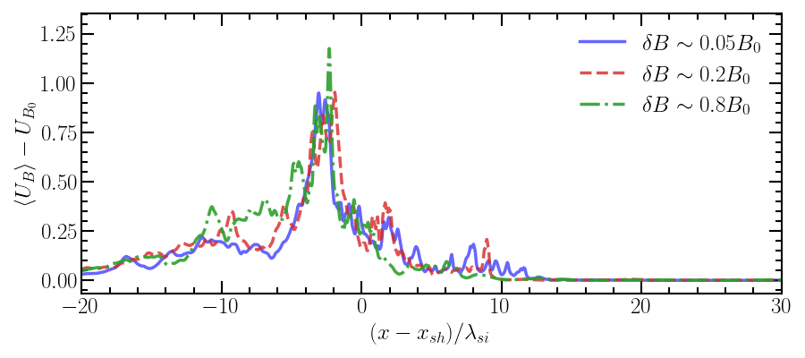
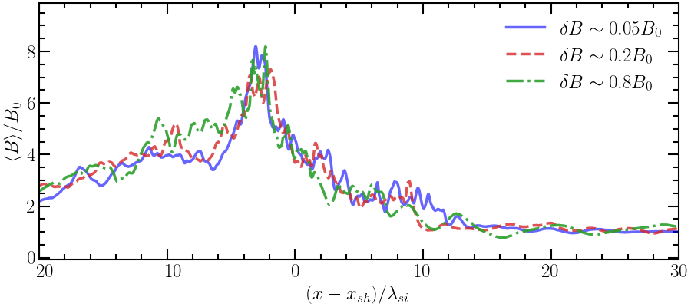
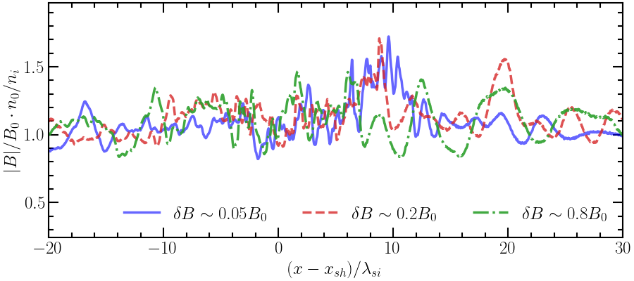
Magnetic field profiles

Slide 27
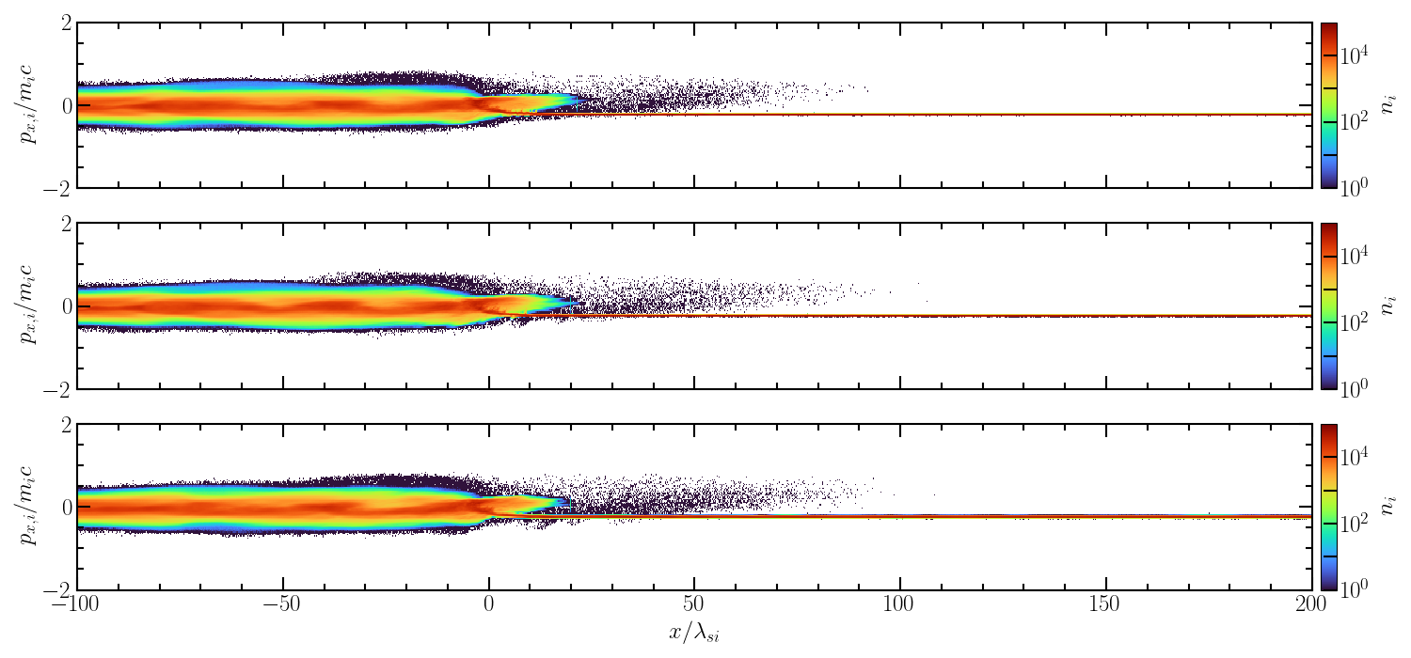
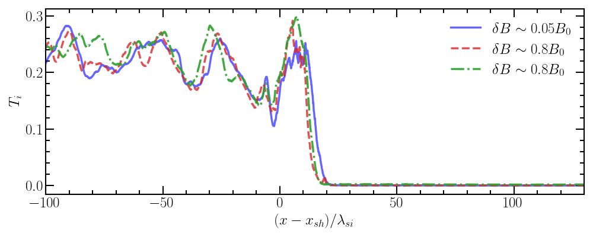
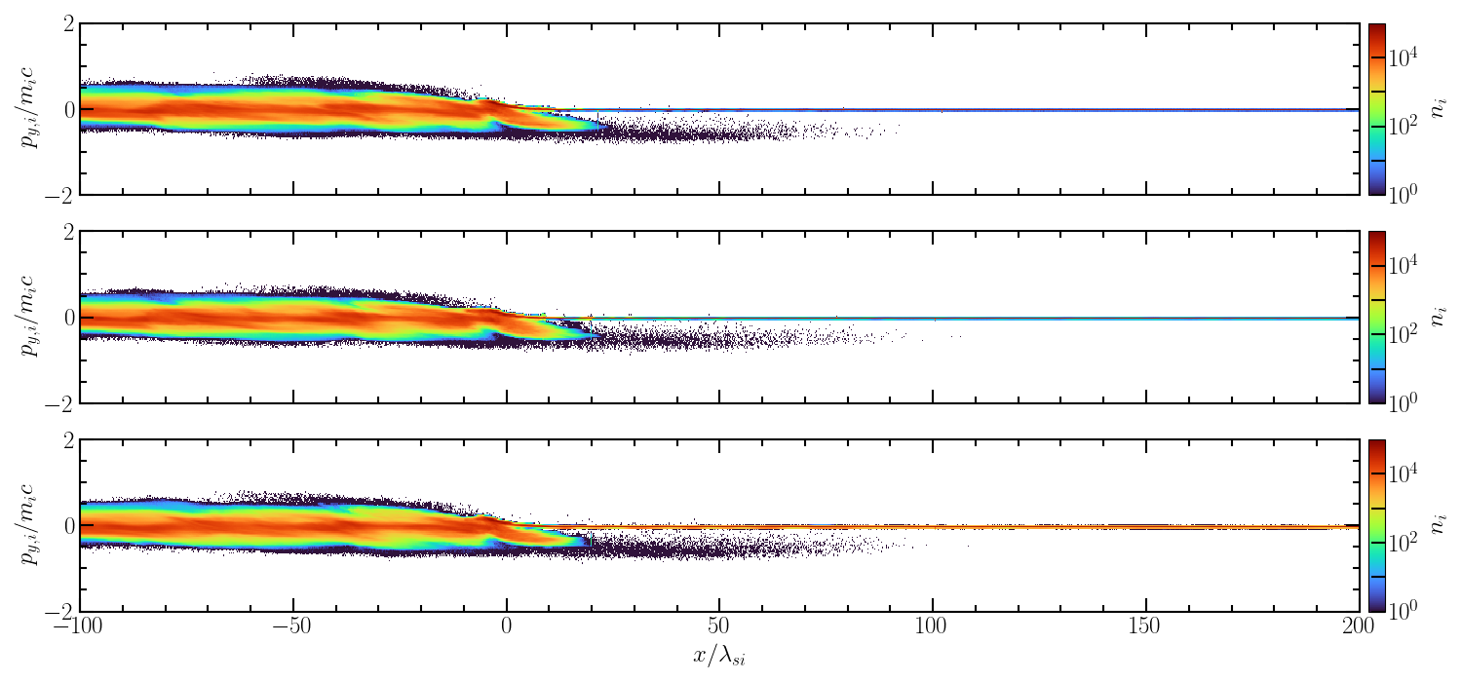
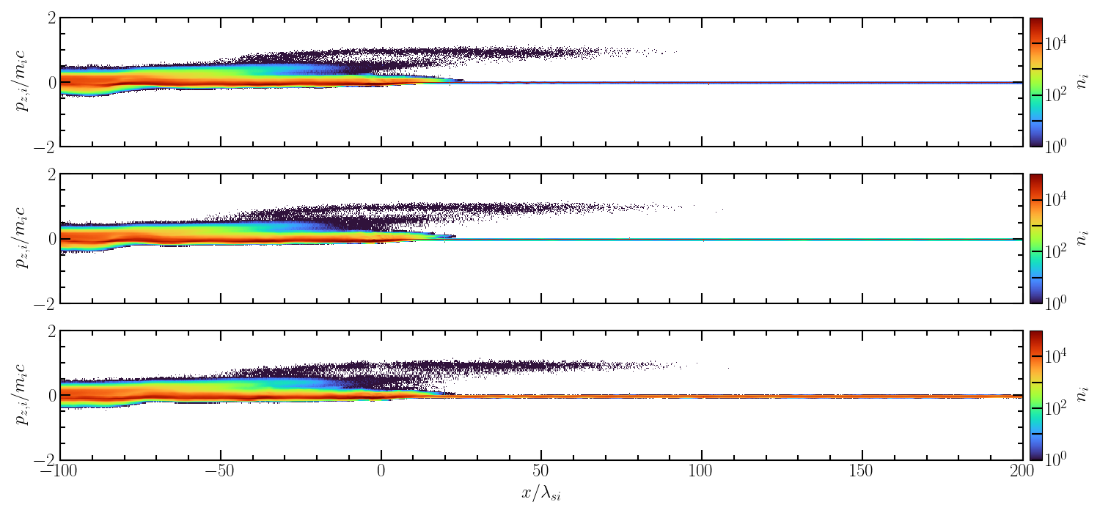
Ion profiles

Slide 28

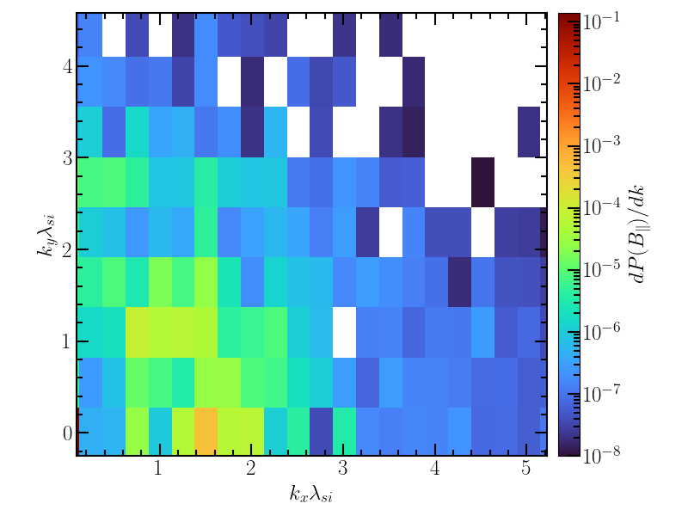
Polarisation - δB ~ 0.05B0
Peak in power at kxλsi = 1.5 – consistent with λ ~ 4λsi

