Slide 1
THATMPI
The road to an updated main branch
Gabriel Torralba Paz, Eloise Moore and Mahmoud Alawashra
(in presenting order)

Slide 2
Presentation idea
Gabriel: Andrzej’s modifications, domain strategies, test example of this with different number of processors like what Artem did
Mahmoud: positrons, momentum space modification, field solvers, Current filter.
Eloise: turbulence + matching
User handbook (all of us?)
Future implementations: shock location calculation, field averaging for particle tracing, arbitrary particle species number.
Availability ETA

Slide 3
THATMPI update by Andrzej
Gabriel Torralba Paz

Slide 4
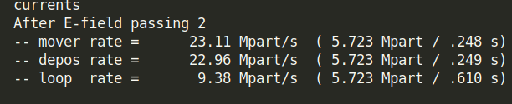
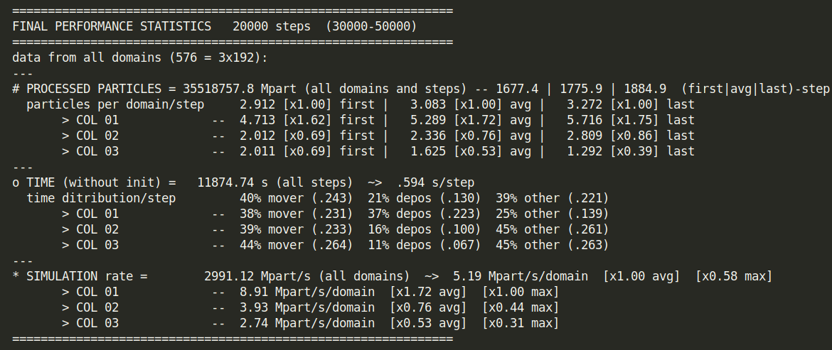
Performance metrics
Per time step:
  Mover (most expensive)
  Current deposition (2nd most expensive)
  Total loop
Final performance:
  Statistics per column
  Fastest, average, slowest
  Important quantity: Mpart/s/dom
Performance metrics at runtime
  For each time step:
  At the end of the simulation:
Cannot be turned off, but the overhead is negligible

Slide 5
Domain assignment
1 | 1 | 2 | 2 | 3 | 3
1 | 1 | 2 | 2 | 3 | 3
1 | 1 | 2 | 2 | 3 | 3
Three possible assignments:
  Rectangular
    The usual strategy
  Mirror
    Leftmost-rightmost domains share memory
    Very useful for shock simulations
  Cyclic-shift
    Domains assigned in a spiral
    Not very useful right now
Can be activated when calling mpirun by adding -dstrategy strat_name.
Rectangular
1 | 2 | 3 | 3 | 2 | 1
1 | 2 | 3 | 3 | 2 | 1
1 | 2 | 3 | 3 | 2 | 1
Mirror
1 | 1 | 1 | 1 | 2 | 2
1 | 3 | 3 | 3 | 3 | 2
1 | 3 | 3 | 2 | 2 | 2
Cyclic-shift

Slide 6
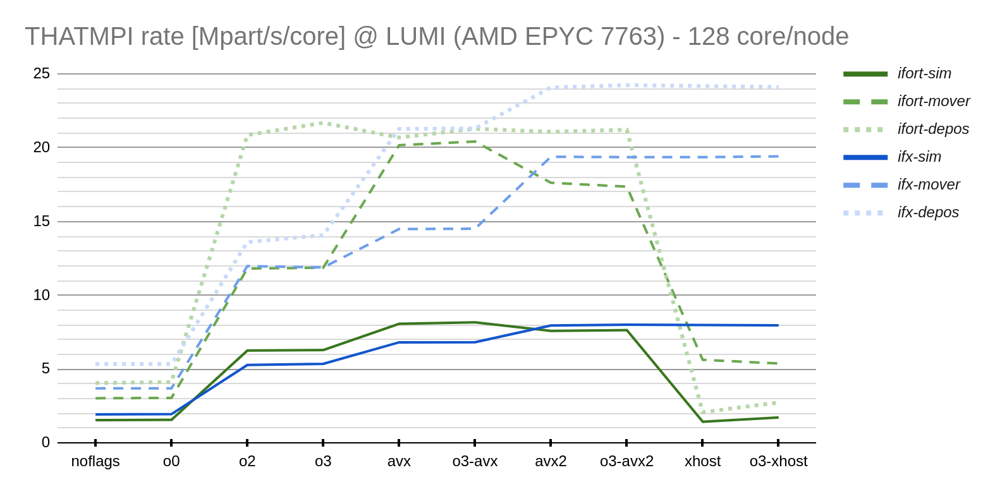
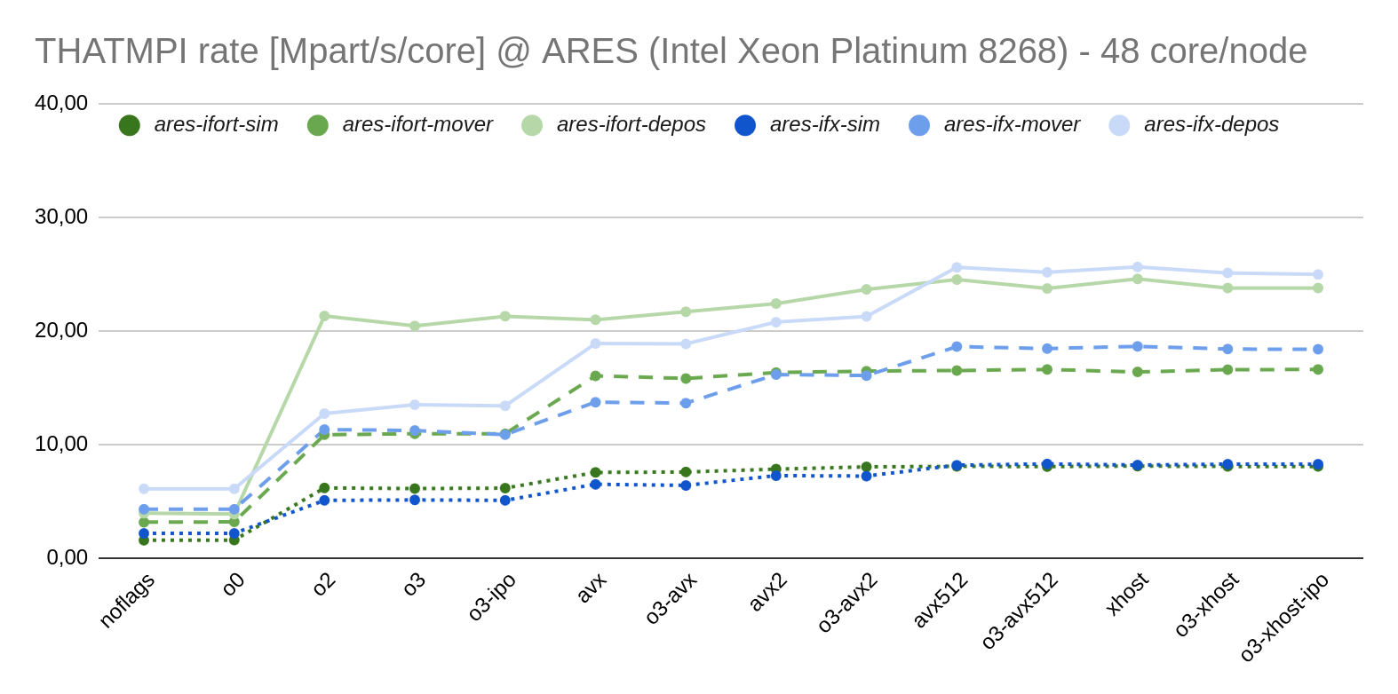
Benchmarks
It is imperative to use the correct Intel-Fortran compilation flags.
  Intel CPU: -xHost optimises everything tailored to the CPU used.
  AMD CPU: Use -O3 and -avx (avx2 or avx512, it requires testing). Don’t use -xHost!
  See charts below (higher is better)

Slide 7
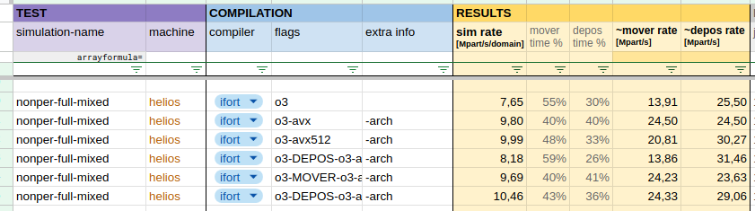
Benchmarks (bonus)
It occurs that particle mover and current deposition perform better with different optimisation flags
  Deposition: avx512
  Mover: avx

Slide 8
Extra features
Makefile has new arguments for quick debugging, testing, cleaning the binaries…
  The Makefile has been overall updated
New utility scripts located in utils/: logging, comparing, … (see Markdown file in the same directory)
Command line interface arguments for the code
  Quick access to some specific simulation options
Particle tracing may not work with OpenMP
Currently spectra is not tested with OpenMP

Slide 9
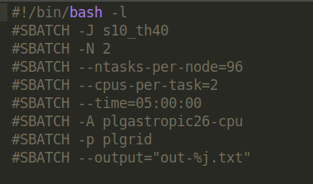

Using OpenMP
Only requires modifying the run script.
Don’t forget to set these environment variables!

Slide 10
Using OpenMP (use cases)
Helios: 192 cores per node
Np=2x192 (even case)
  Number of nodes (N) = 2
  Processes per node (ntasks-per-node) = 96
  Cores per process (cpus-per-task) = 2
  MPI processes (mpirun -n) = 192
  Domain sharing (mpirun -dp) = 2x1
Np=3x192 (odd case)
  Number of nodes (N) = 3
  Processes per node (ntasks-per-node) = 64
  Cores per process (cpus-per-task) = 3
  MPI processes (mpirun -n) = 192
  Domain sharing (mpirun -dp) = 3x1

Slide 11
Using OpenMP (use cases)
Np=5x192 (non-divisible case)
  Number of nodes (N) = 6
  Processes per node (ntasks-per-node) = 32
  Cores per process (cpus-per-task) = 6
  MPI processes (mpirun -n) = 192
  Domain sharing (mpirun -dp) = 5x1
It is still possible to use OpenMP
Requires an idle core
  Dpx=5 but core-per-task=6
We request more nodes (N) than we need
Np=8x192 (less cores per process than Npx)
  Number of nodes (N) = 8
  Processes per node (ntasks-per-node) = 48
  Cores per process (cpus-per-task) = 4
  MPI processes (mpirun -n) = 384
  Domain sharing (mpirun -dp) = 4x1
Larger Dpx is not necessarily better!
  Keep all threads in a single NUMA-node.
  Dpx<Npx may be better for large Npx

Slide 12
Using OpenMP (reasoning)
What is my Np? 7x192
I want to use OpenMP. Since Npx=7, I will need -dp=7x1
  Note that one can use different dp for a specific Npx
I then need Np/dp=(7x192)/(7x1)=192 processes (mpirun -n 192)
I need as many CPUs per task that divides the number of cores in a node
  Select cpus-per-task >= dp that divides NUMA-size. In this case, cpus-per-task=8
I then require 8 nodes (1536 cores) because num_cpus=cpus-per-task*num_tasks=8*192=1536
Np=7x192 (example)
  Number of nodes (N) = 8
  Processes per node (ntasks-per-node) = 24
  Cores per process (cpus-per-task) = 8
  MPI processes (mpirun -n) = 192
  Domain sharing (mpirun -dp) = 7x1

Slide 13
Best practices
DOCUMENT THE CODE
The code and binaries should remain separately from the simulation.
  The code is located in e.g. scratch/user/thatmpi/
  The simulations are located in e.g. scratch/user/my_sims/sim_X/
  Inside sim_X/, you find diag/, partd/, config/, … but NOT bin/, src/, …
Use Git
  Create as many branches as you want, preferably locally. If others need to test, push the branch
If using a new cluster:
  Verify code performance and find the best compilation flags
  Compilation process (HDF5 library location, available compilers, …)
  Adjust job parameters, verify NUMA architecture (related to OpenMP).

Slide 14
Turbulence module
Eloise Moore

Slide 15
Turbulence in THATMPI
Implemented both compressive and electromagnetic turbulence
Changes made:
  Added the TYPES: data_compressive_wave.f90 and data_EM_wave.f90
  Update data_global_params.f90: Simulation_params with turbulence parameters, and Simulation_config with turbulence toggle features
  New namelist “&TURBULENCE” for the setup.nml file for initialising turbulence parameters
  Implemented two new field initialisation subroutines in sub_fields.f90: init_fields_compressive_turb and init_fields_EM_turb
  Implemented new particle injection subroutine in sub_particles.f90: jet_injection_turbulence
    Shift in particle distributions determined by config%turb_type
  Implemented turbulence initialisation in init.f90: init_turbulence
    Initialisation determined by config%turb_type, and is run with
    config%turbulence = .TRUE.

Slide 16
Turbulence in THATMPI
Important notes
Turbulence (compressive & electromagnetic) is only compatible for electron-ion plasma and will not work with positrons
Currently only tested for non-relativistic plasma and the injection routine is non-relativistic
Designed for use in periodic box simulations - for use in shock simulations you will need to prefabricate turbulent slabs and then add them using the matching code

Slide 17
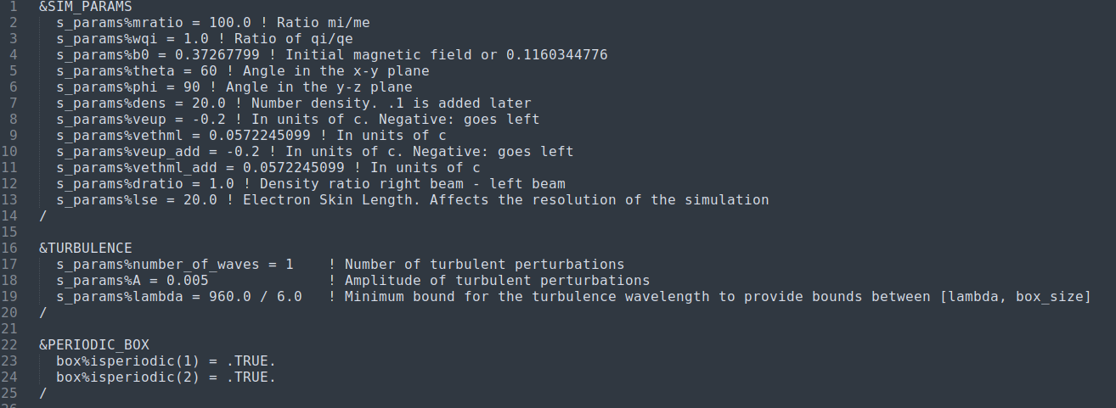
How to use turbulence - initialising turbulence parameters in setup.nml
Example sim_params
For use in a periodic box

Slide 18
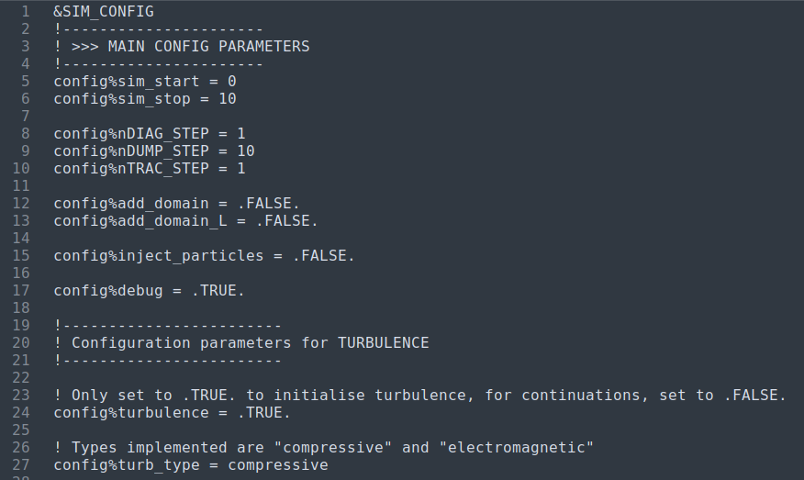
How to use turbulence - toggling on/off turbulence initialisation and turbulence type in the config
Example config parameters
Only set config%turbulence to .TRUE. when initialising the simulation

Slide 19
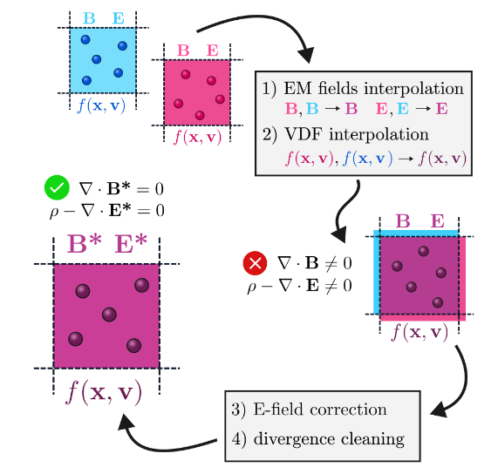
Plasma slab matching in THATMPI
Matching subroutines created by Karol Fulat are now fully integrated into the Master version
Includes update which fixes the particle global ID mismatch with generated particles
Modification to set size of transition region in the config file using config%trans_zone
Source: Karol Fulat (thesis 2024)

Slide 20
Plasma slab matching in THATMPI
Important notes
Matching is only compatible with the “rectangular” domain strategy
When commencing a simulation with plasma slab matching, the start timestep will be equal to the timestep of the particle dump files of the prefabricated plasma slabs
  To compute the true timestep of the simulation this must taken into account
Prefabricated slabs must be created with IO_SCHEME=0, but the shock simulation can use any IO_SCHEME

Slide 21
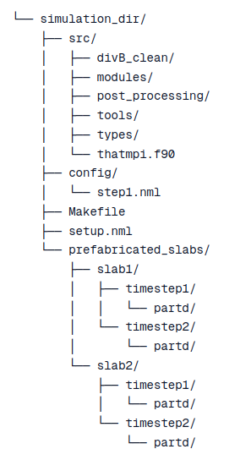
Setup of turbulent slabs in a simulation
Generate plasma slabs in separate periodic box simulations using IO_SCHEME=0
Within your shock simulation directory, create a subdirectory prefabricated_slabs/ with the structure shown to the left
Copy over partd files corresponding to the timesteps that you wish to use in your shock simulation
  The raw .hdf5 files should be contained within the partd/ directory for the given timestep

Slide 22
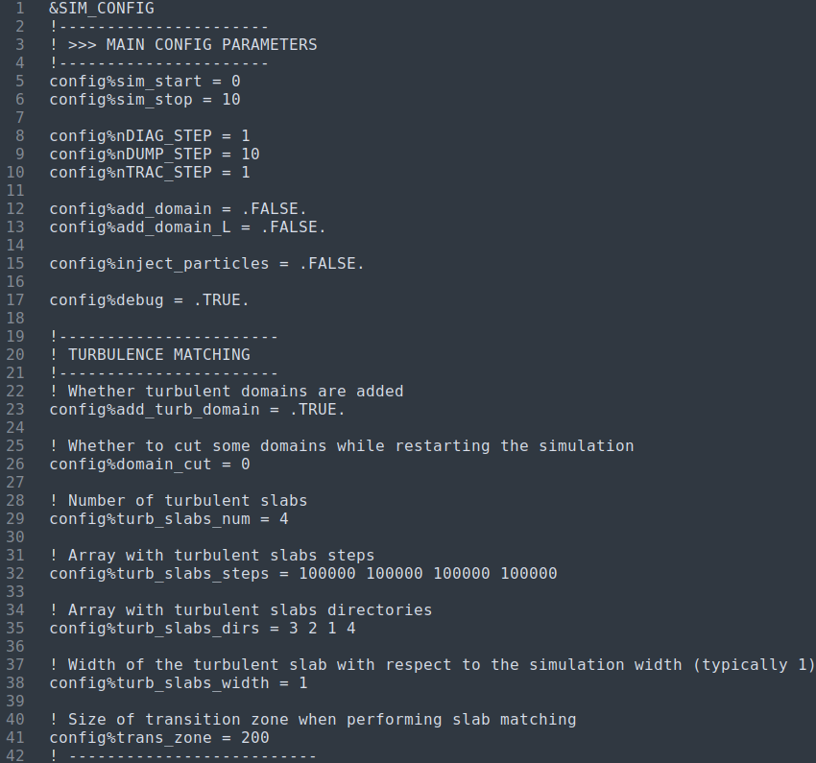
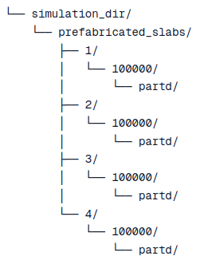
How to use matching - initialisation in the config
Timestep of the turbulent slabs’ partd files (they can be different if required)
Example config parameters
Directory name corresponding to each slab within prefabricated_slabs/

Slide 23
Momentum and positrons
Mahmoud Alawashra

Slide 24
THATMPI in momentum
Changed the definition of u, v, w in types/data_particles.f90 from being the velocity to four velocity (momentum divided by the mass); u_x = \gamma*v_x.
Changed the entire source code to be consistent with that; changes were made heavily in the file modules/sub_particles.f90.
We kept the definition of s_params%veup as initial upstream velocity unchanged.
The new code has been tested with periodic box and reflective wall setups.

Slide 25
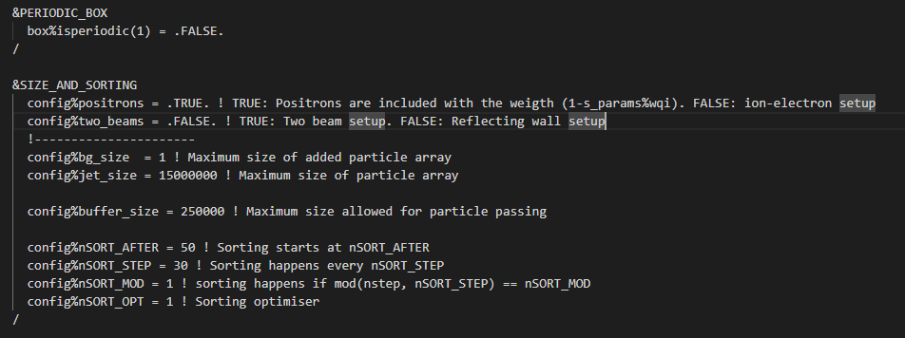
Third species (positrons) in THATMPI
Added third TYPE (Particles) array to types/data_domain.f90 so we have now ions, lecs, poss.
Modified the source code accordingly with many changed in modules and post_processing.
The third species array is
only used once
config%positrons is set to
TRUE in the setup.nml
file.

Slide 26



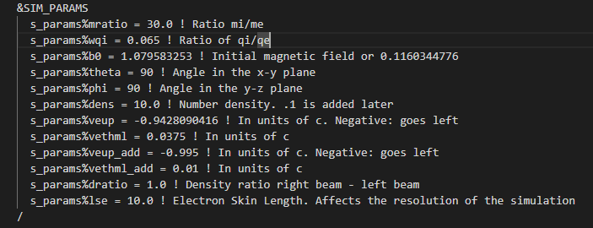
Third species (positrons) in THATMPI
If the third species is added we introduce new weights for particles that preserves the global charge neutrality:
The weights are controlled by the parameter s_params%wqi in the setup.nml

Slide 27
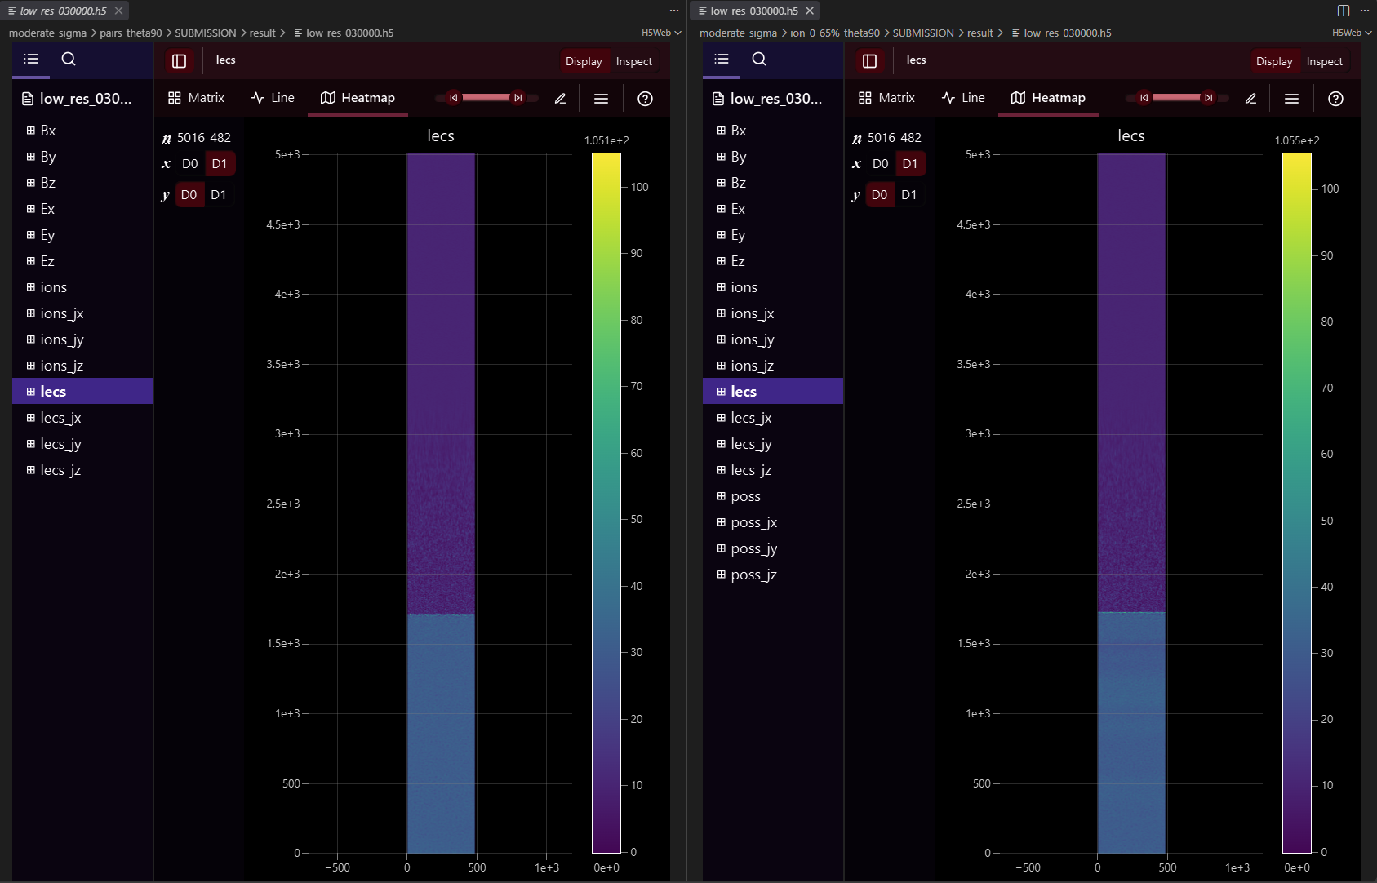
Third species (positrons) in THATMPI (post processing)

Slide 28
Field solvers in THATMPI
Default field solver is second order field solver.
Fourth order field solver was added by Gabriel and performs better for mildly relativistic setup.
I added an improved solver with generalized stencil developed in (Blinne et al. 2018). This method minimize the the difference between the phase and group numerical velocities and the speed of light c.

Slide 29
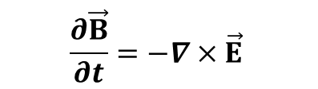
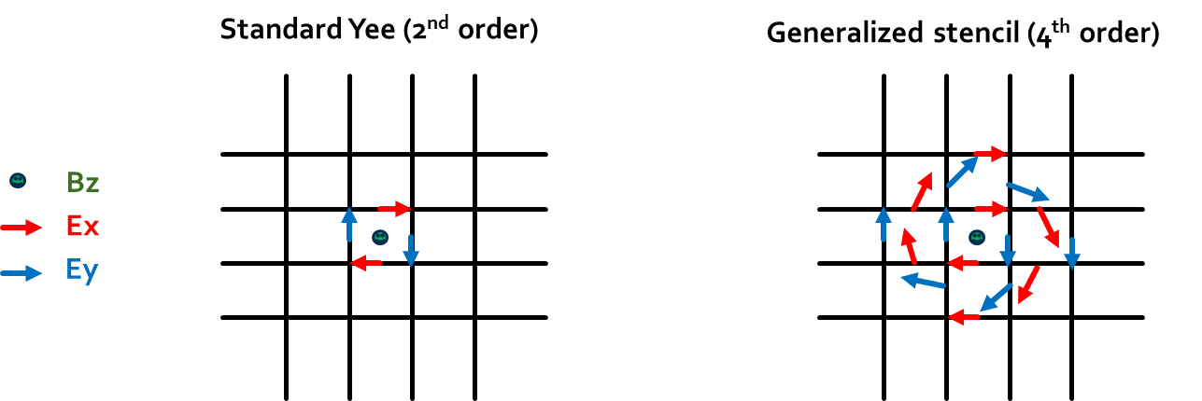
Generalized stencil formulation for Maxwell–Faraday equation. (Blinne et al. 2018)
Only for Faraday’s law:

Slide 30
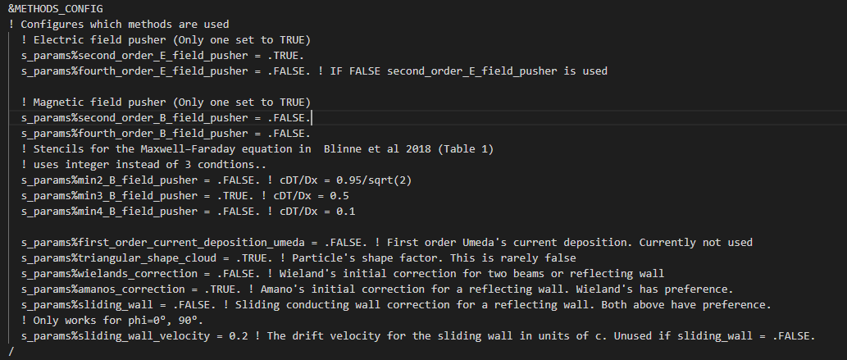
Generalized stencil formulation for Maxwell–Faraday equation. (Blinne et al. 2018)
Setup.nml file

Slide 31
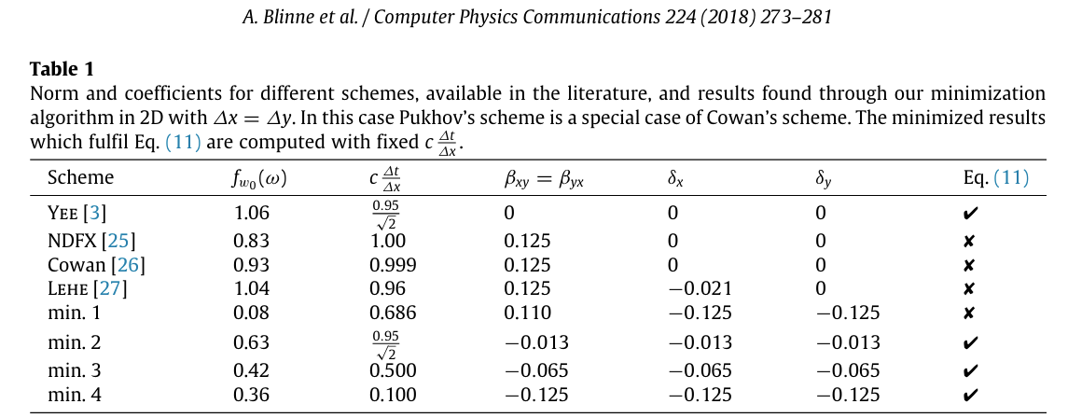
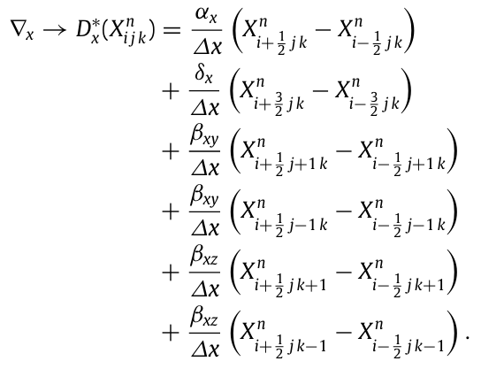
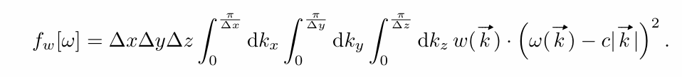
Generalized stencil formulation for Maxwell–Faraday equation. (Blinne et al. 2018)

Slide 32
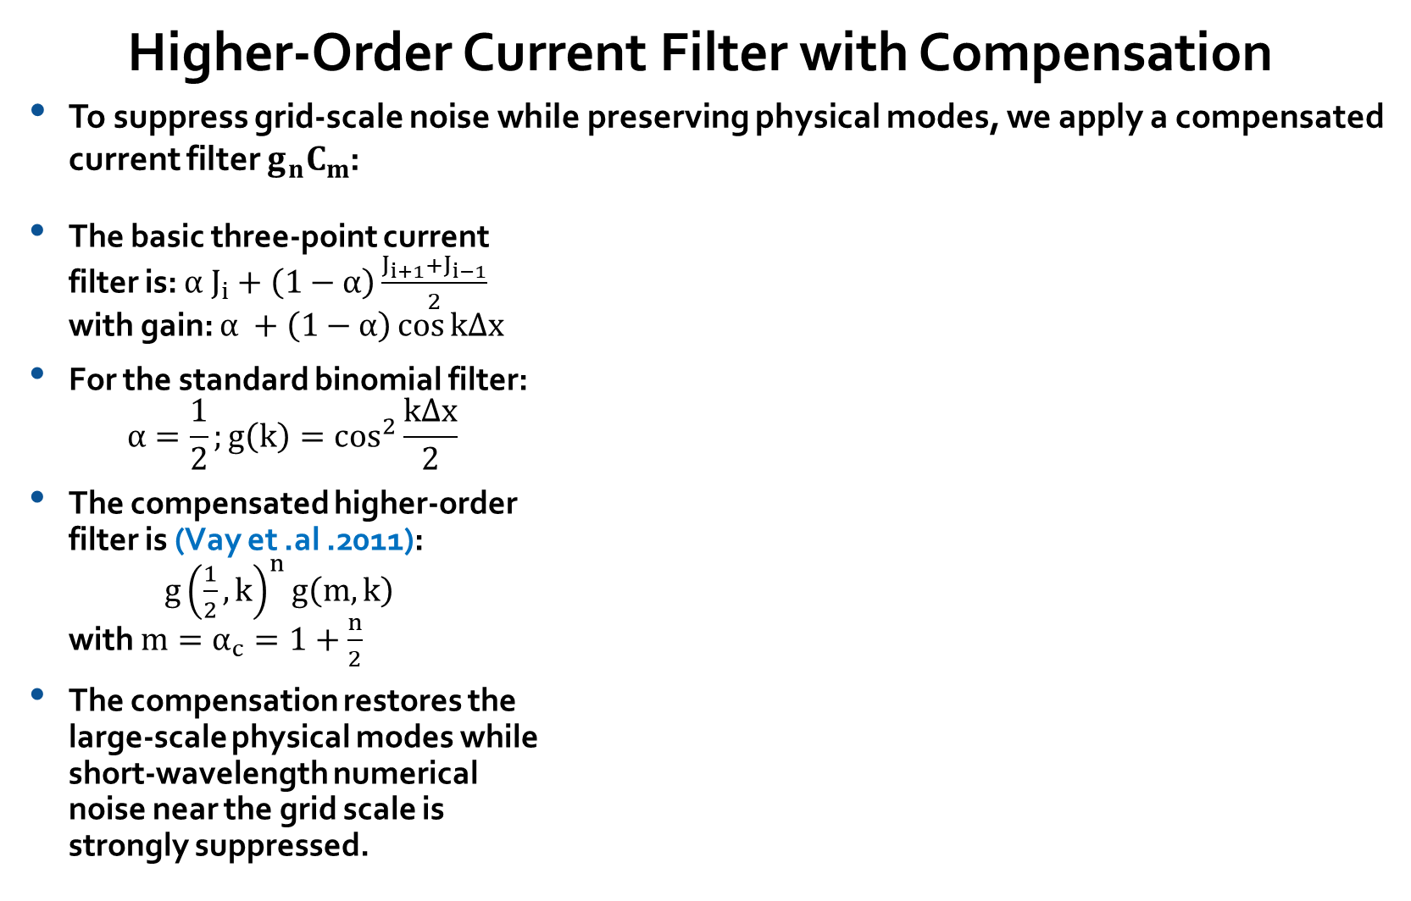
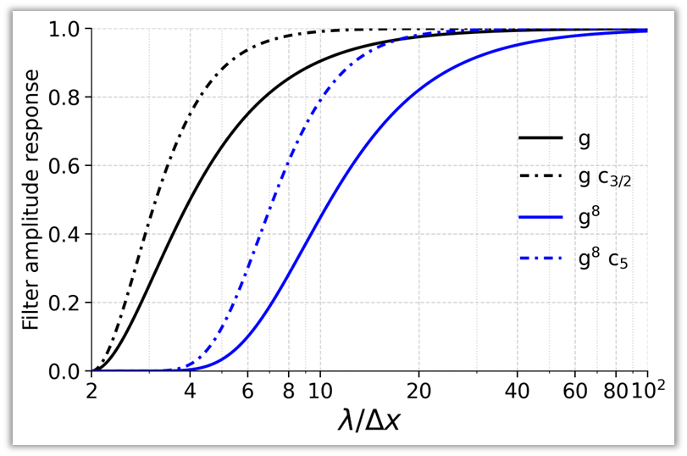

Slide 33
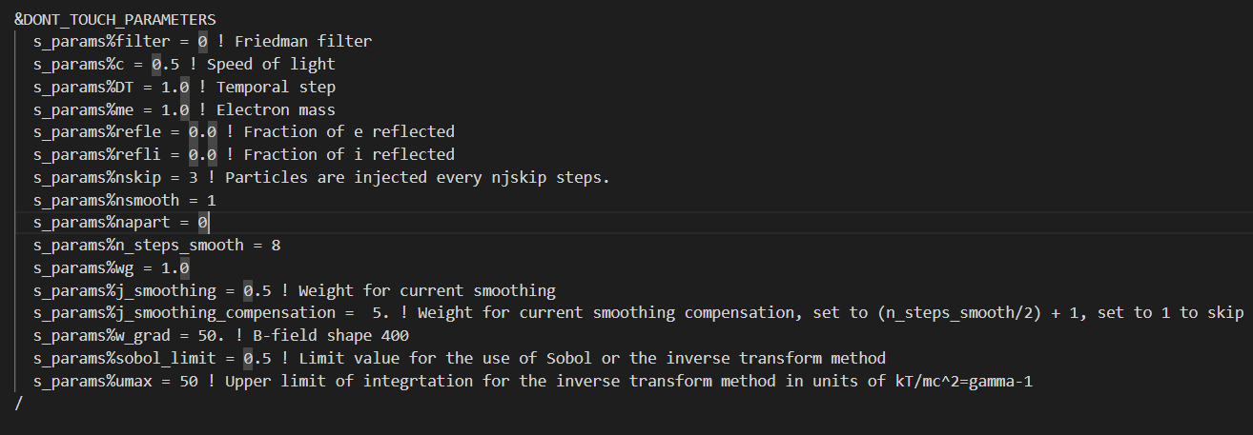
Setup.nml file

Slide 34
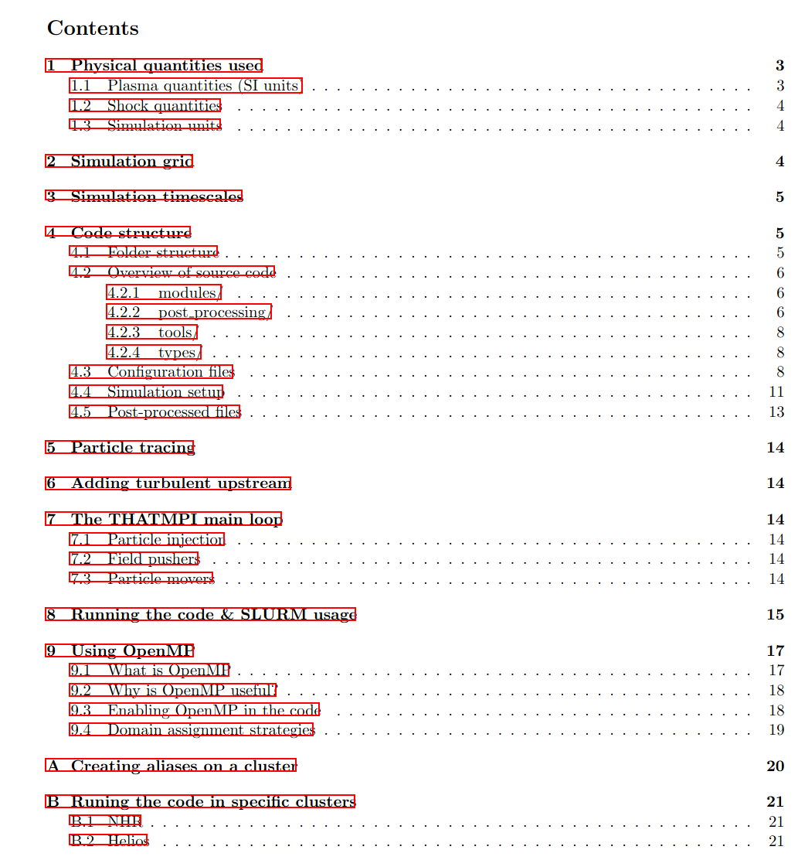
User Handbook
We are preparing a user handbook useful for newcomers and those who have not used the code in a long time
  The handbook will be finished soon… Hopefully before the year ends, and will be available on the Gitlab
Any propositions for a new topic to explain in the handbook?

Slide 35
Future implementations in the code
Shock location calculation
  Compute the location of the shock given reflected particles
  Sharp density and magnetic field transition may help?
Field-averaging for particle tracing
  Electromagnetic fields (especially E) are noisy when computed at particle locations.
  Average over previous steps e.g. 10 to smooth out field data.
  Care with the proper time step at which the field is computed!
Arbitrary number of species
  Allow for species with different properties e.g. positrons, cosmic rays, …
  Particle species are saved in a list whose length is the number of species
  Trivial looping for e.g. particle pusher. DO loop over number of species in list

Slide 36
Thanks for your attention
Questions, comments, remarks, suggestions, complaints, observations, objections, propositions, cheese (?)

