Slide 1
The Kinetic Heart of Cosmic Accelerators
Artem Bohdan
Max Planck Institute for Plasma Physics, Garching, Germany

Slide 2
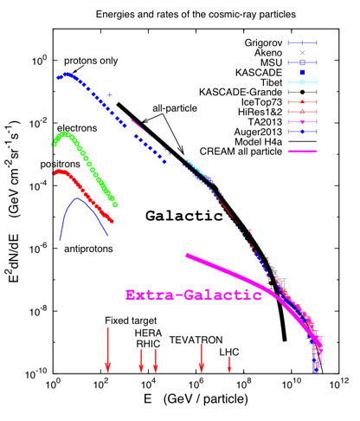
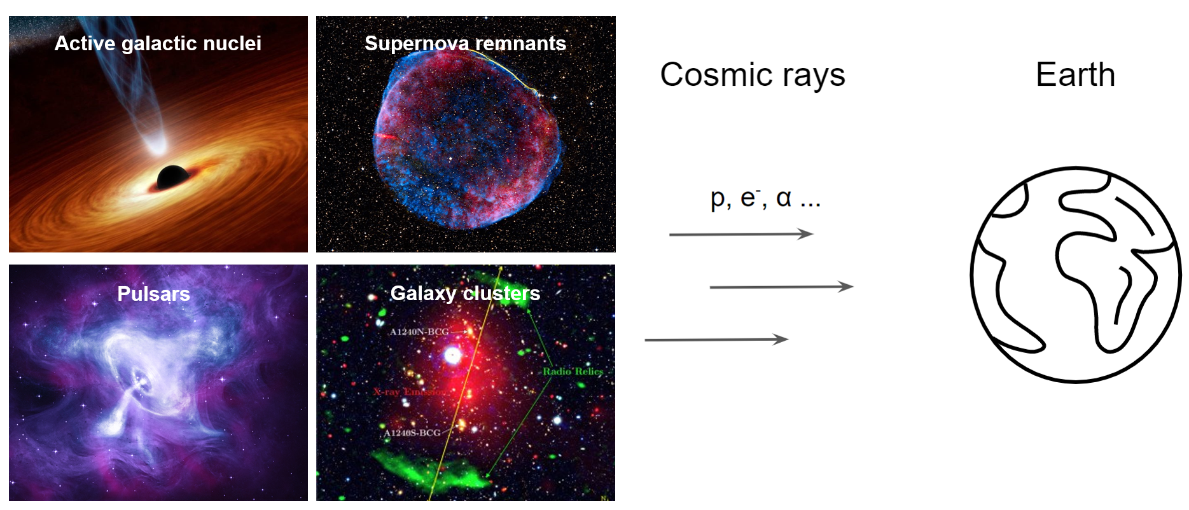
Cosmic Rays

Slide 3
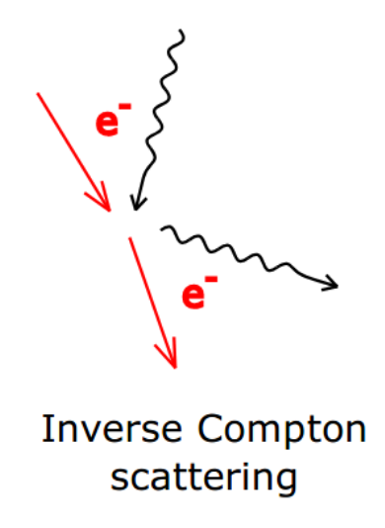
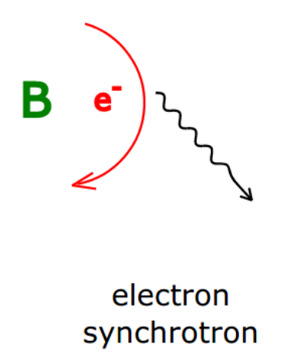
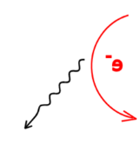
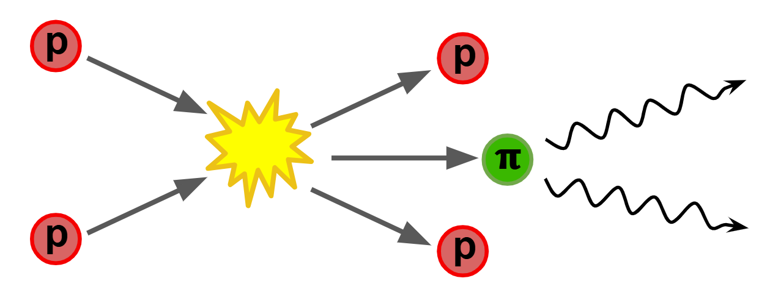

Nonthermal emission
Synchrotron
Inverse Compton
Synchrotron Self Compton
synchrotron photon
Leptonic
Hadronic
Synchrotron
Pion Decay

Slide 4
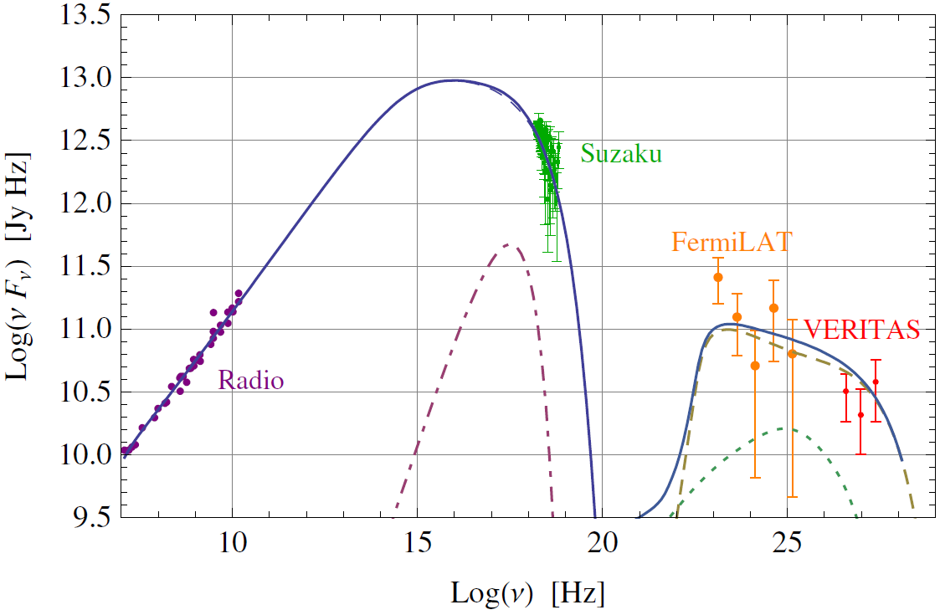
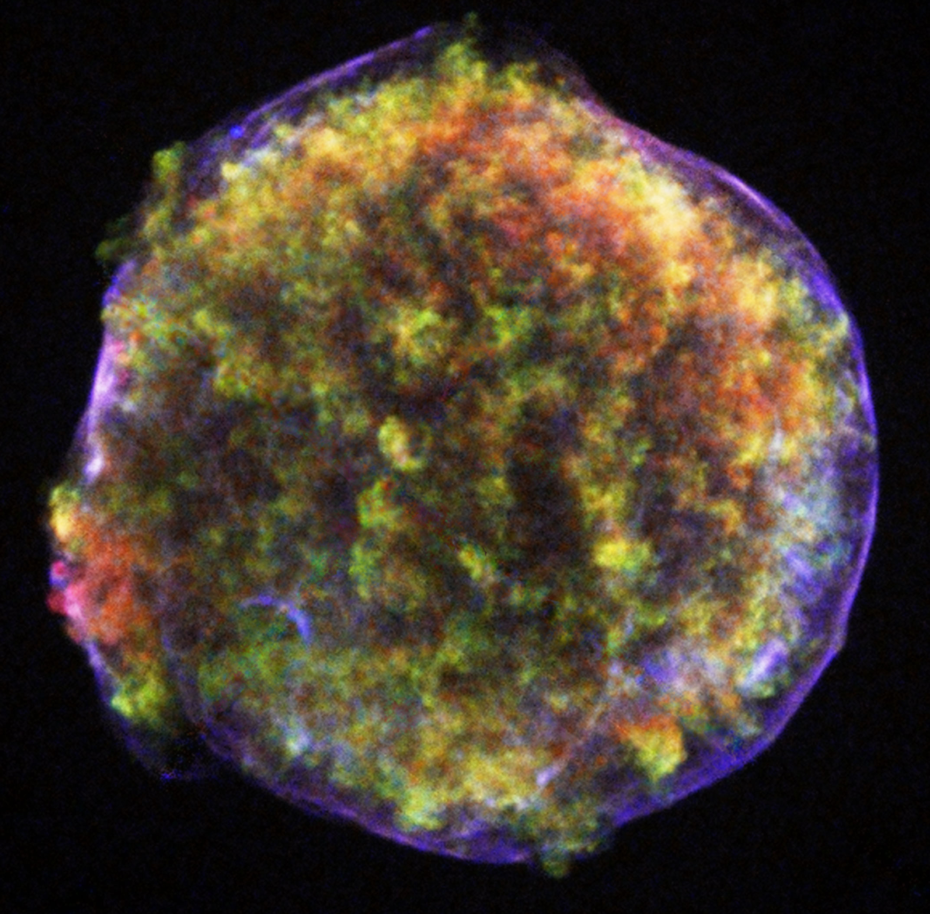
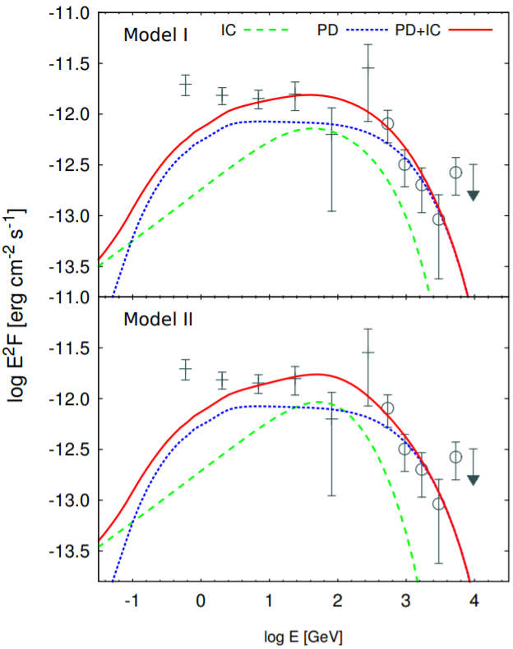
Tycho’s SNR
Hadronic model (Morlino & Caprioli 2012)
SNR SN 1006
SNR 0509-67.5
SNR Cassiopeia A
Mix of hadronic and leptonic models (Wilhelm et al. 2020)

Slide 5
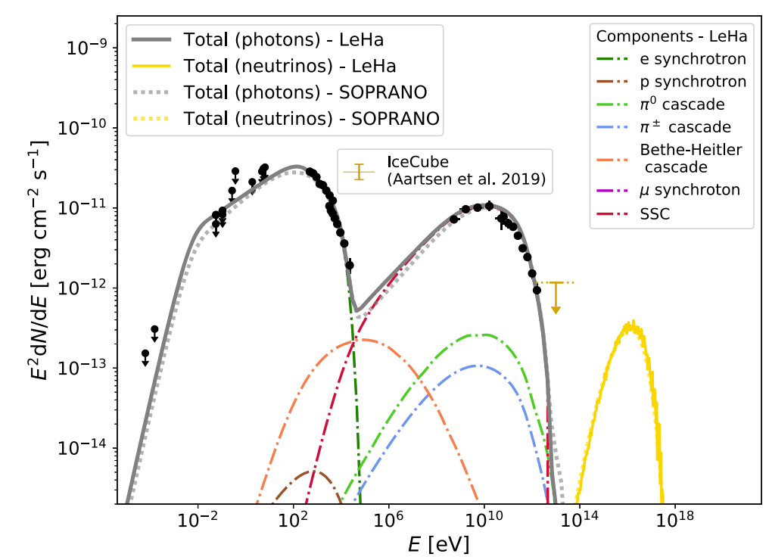
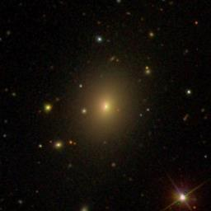
Mrk501 blazar
Abe et al., ApJS 266 (2023) 37
1. Purely leptonic model
(e-/e+, up to ~10¹² eV)
2. Purely hadronic model
(protons up to ~10¹⁹ eV)
3. Lepto-hadronic model
(e-/e+, up to ~10¹² eV, and
protons up to ~10¹⁶ eV)

Slide 6
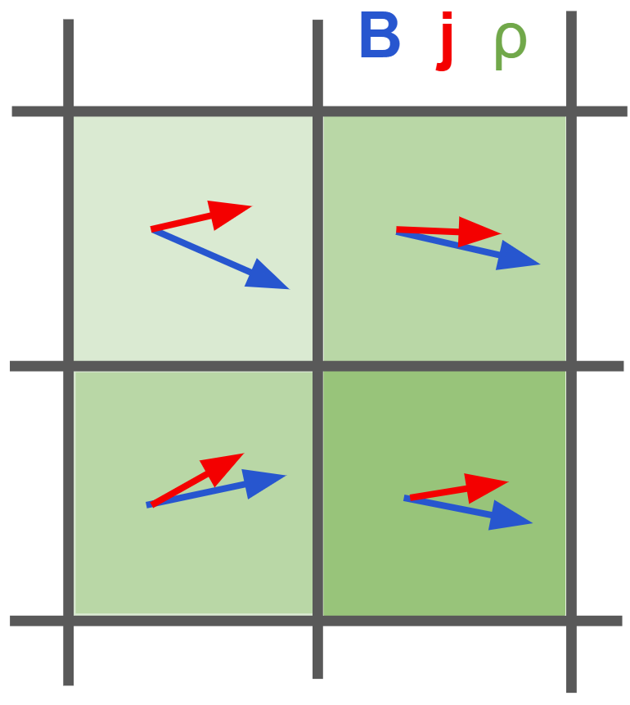
From MHD to PIC
MHD

Slide 7
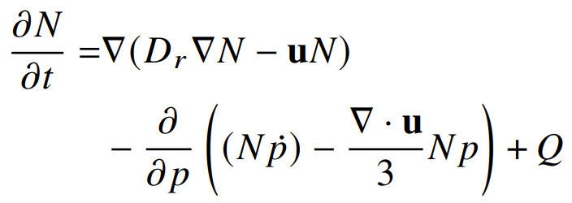
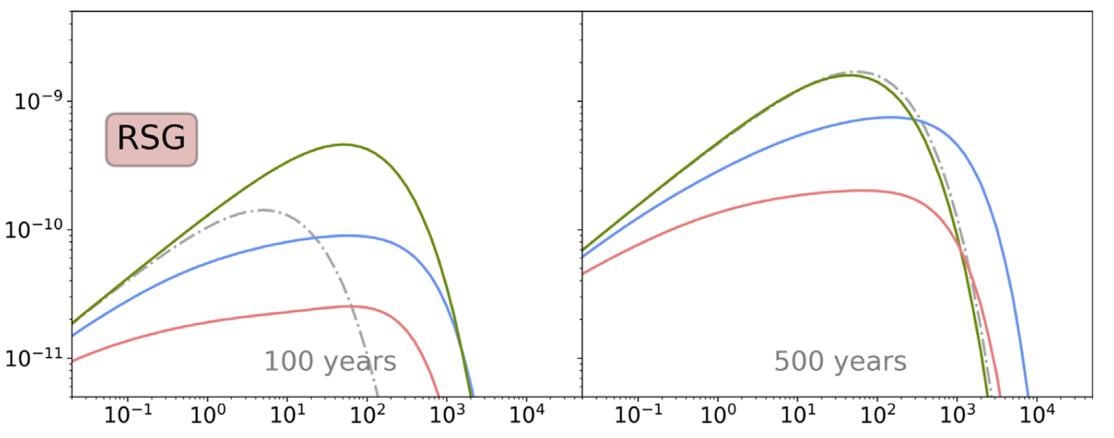

From MHD to PIC
MHD
MHD + particle transport

Slide 8
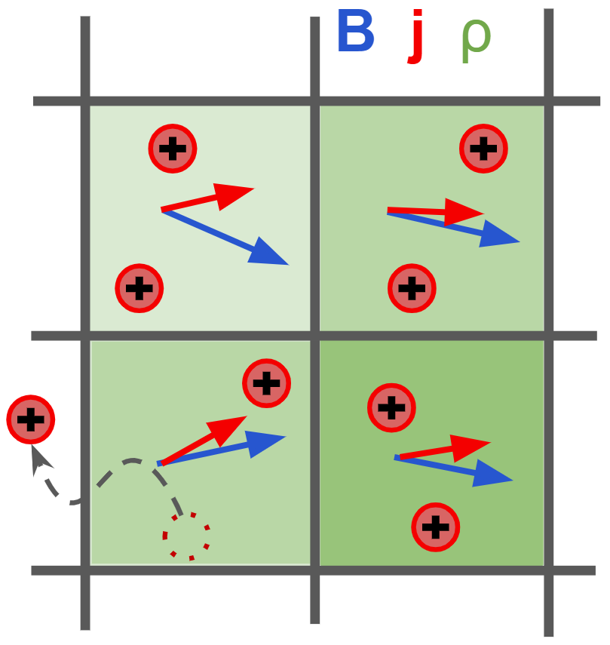
From MHD to PIC
MHD
MHD + particle transport
MHD - PIC

Slide 9
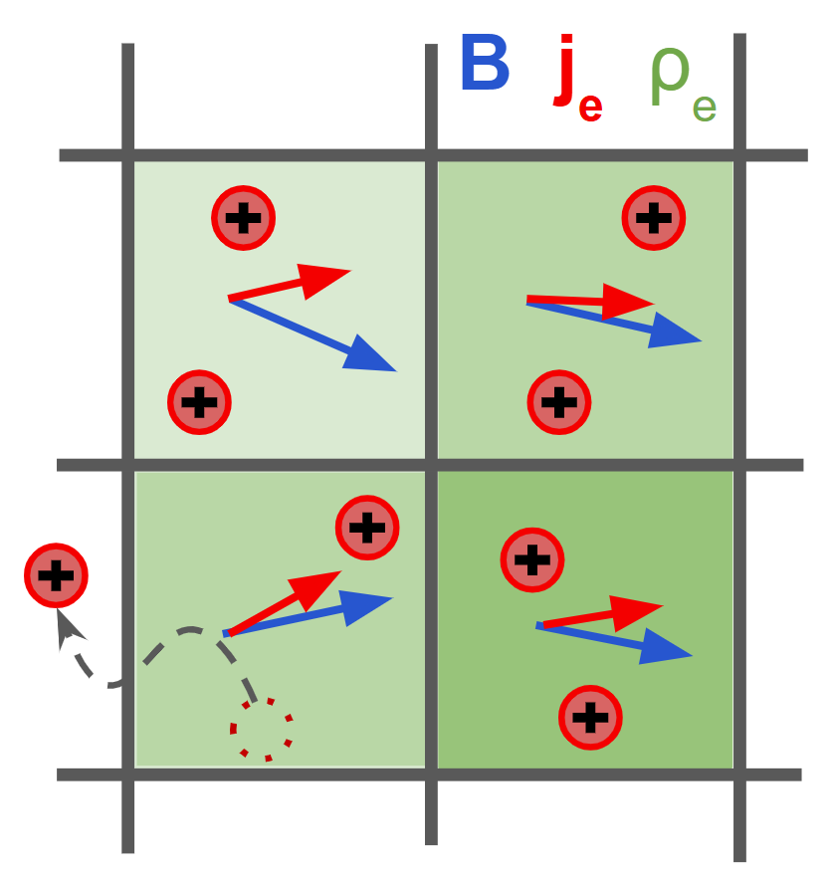
From MHD to PIC
MHD
MHD + particle transport
MHD - PIC
Hybrid PIC

Slide 10
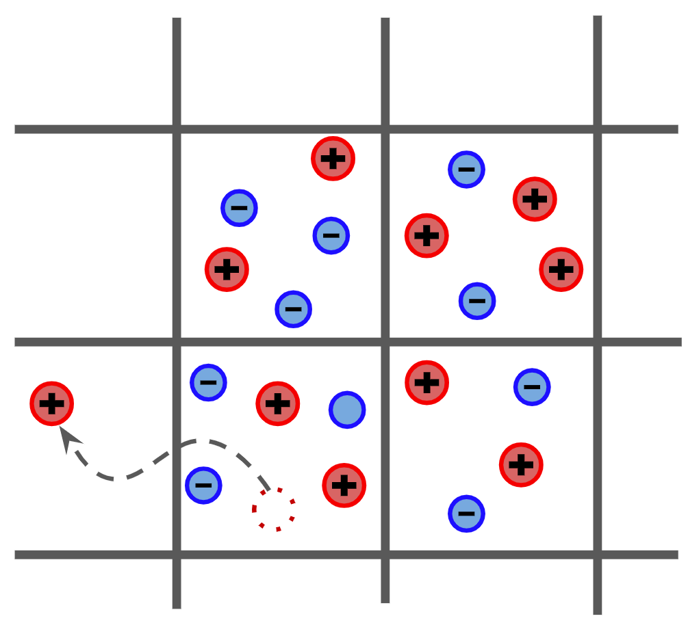
From MHD to PIC
MHD
MHD + particle transport
MHD - PIC
Hybrid PIC
PIC

Slide 11
From MHD to PIC
MHD
MHD + particle transport
MHD - PIC
Smaller scales
More physics
Hybrid PIC
PIC
Larger scales
Less physics

Slide 12
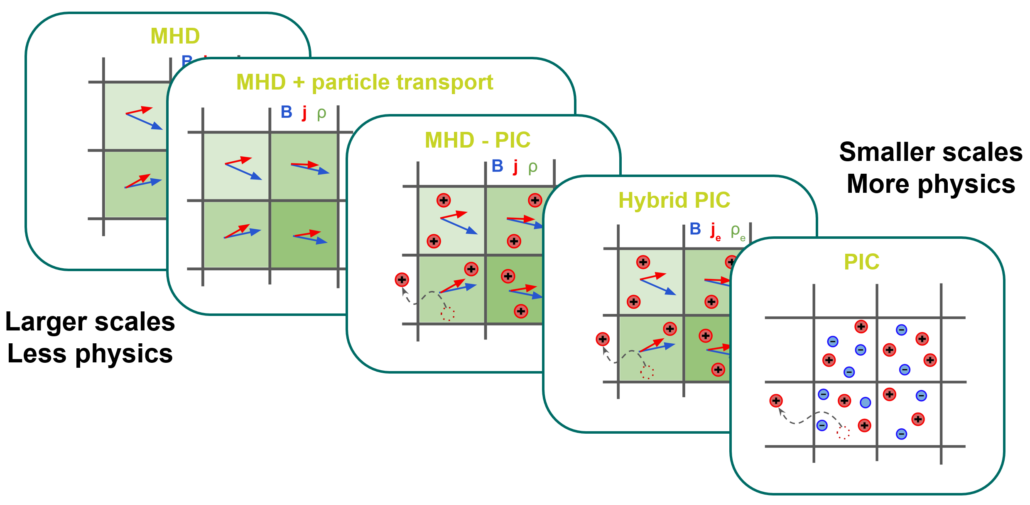
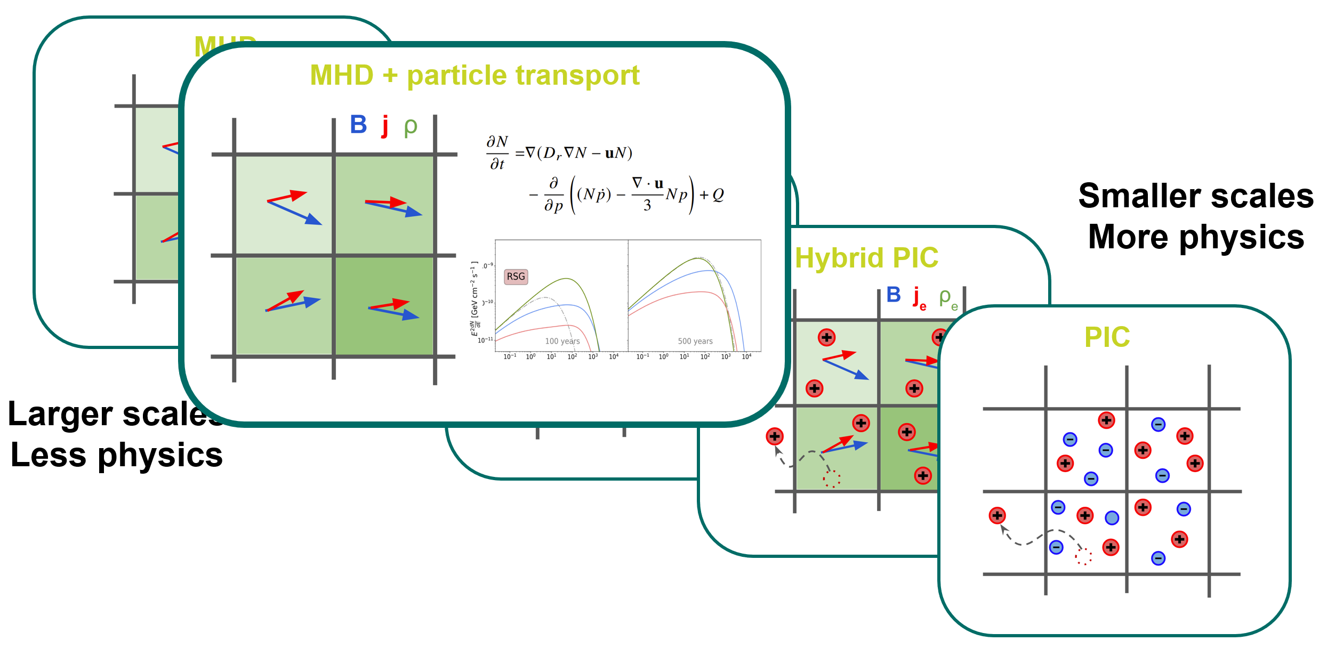
Nonthermal emission modeling: Tycho’s SNR

Slide 13
Nonthermal emission modeling: Tycho’s SNR

Slide 14
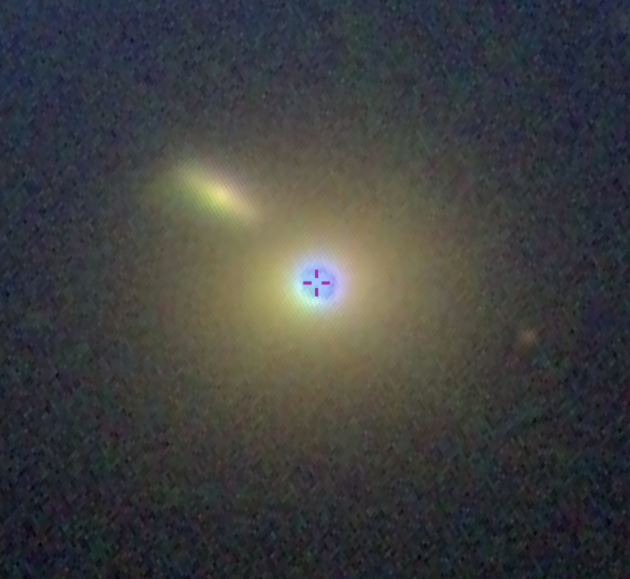
Nonthermal emission modeling: Mrk421 blazar

Slide 15
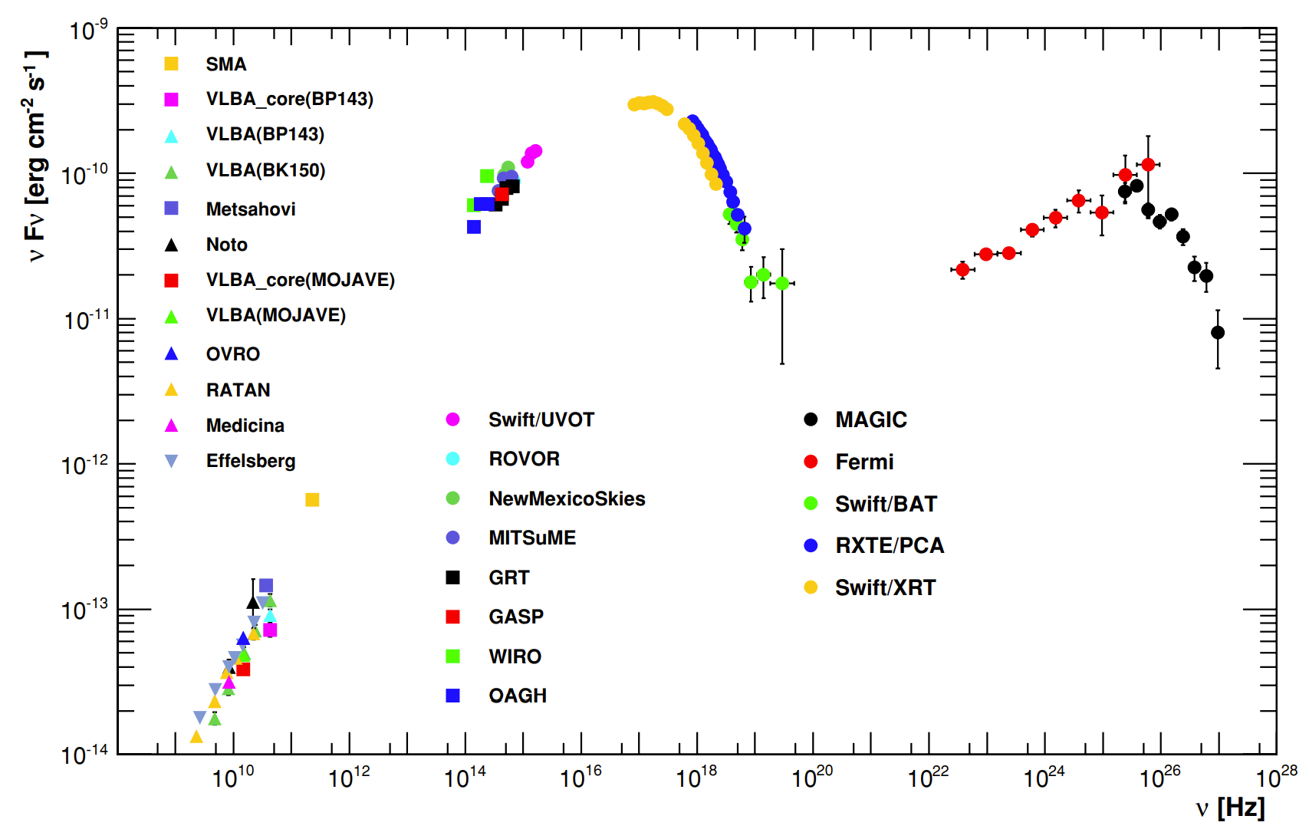
Nonthermal emission modeling: Mrk421 blazar

Slide 16
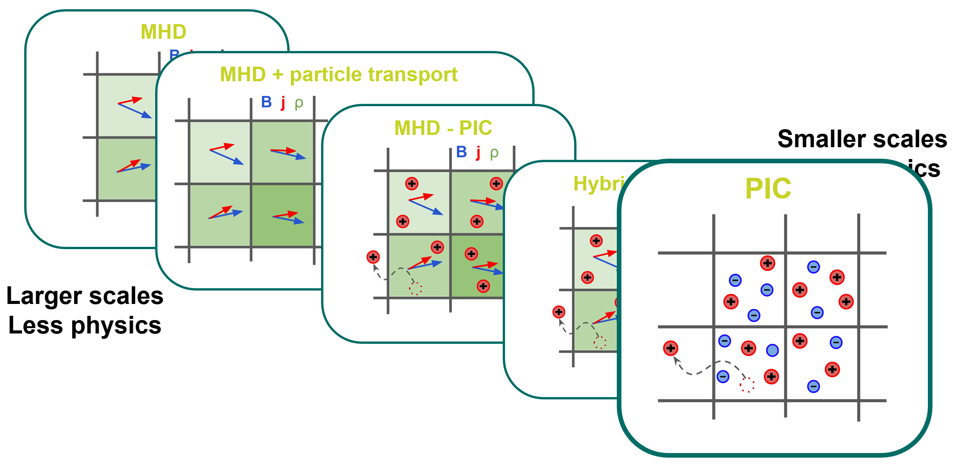
Nonthermal emission modeling: Mrk421 blazar

Slide 17
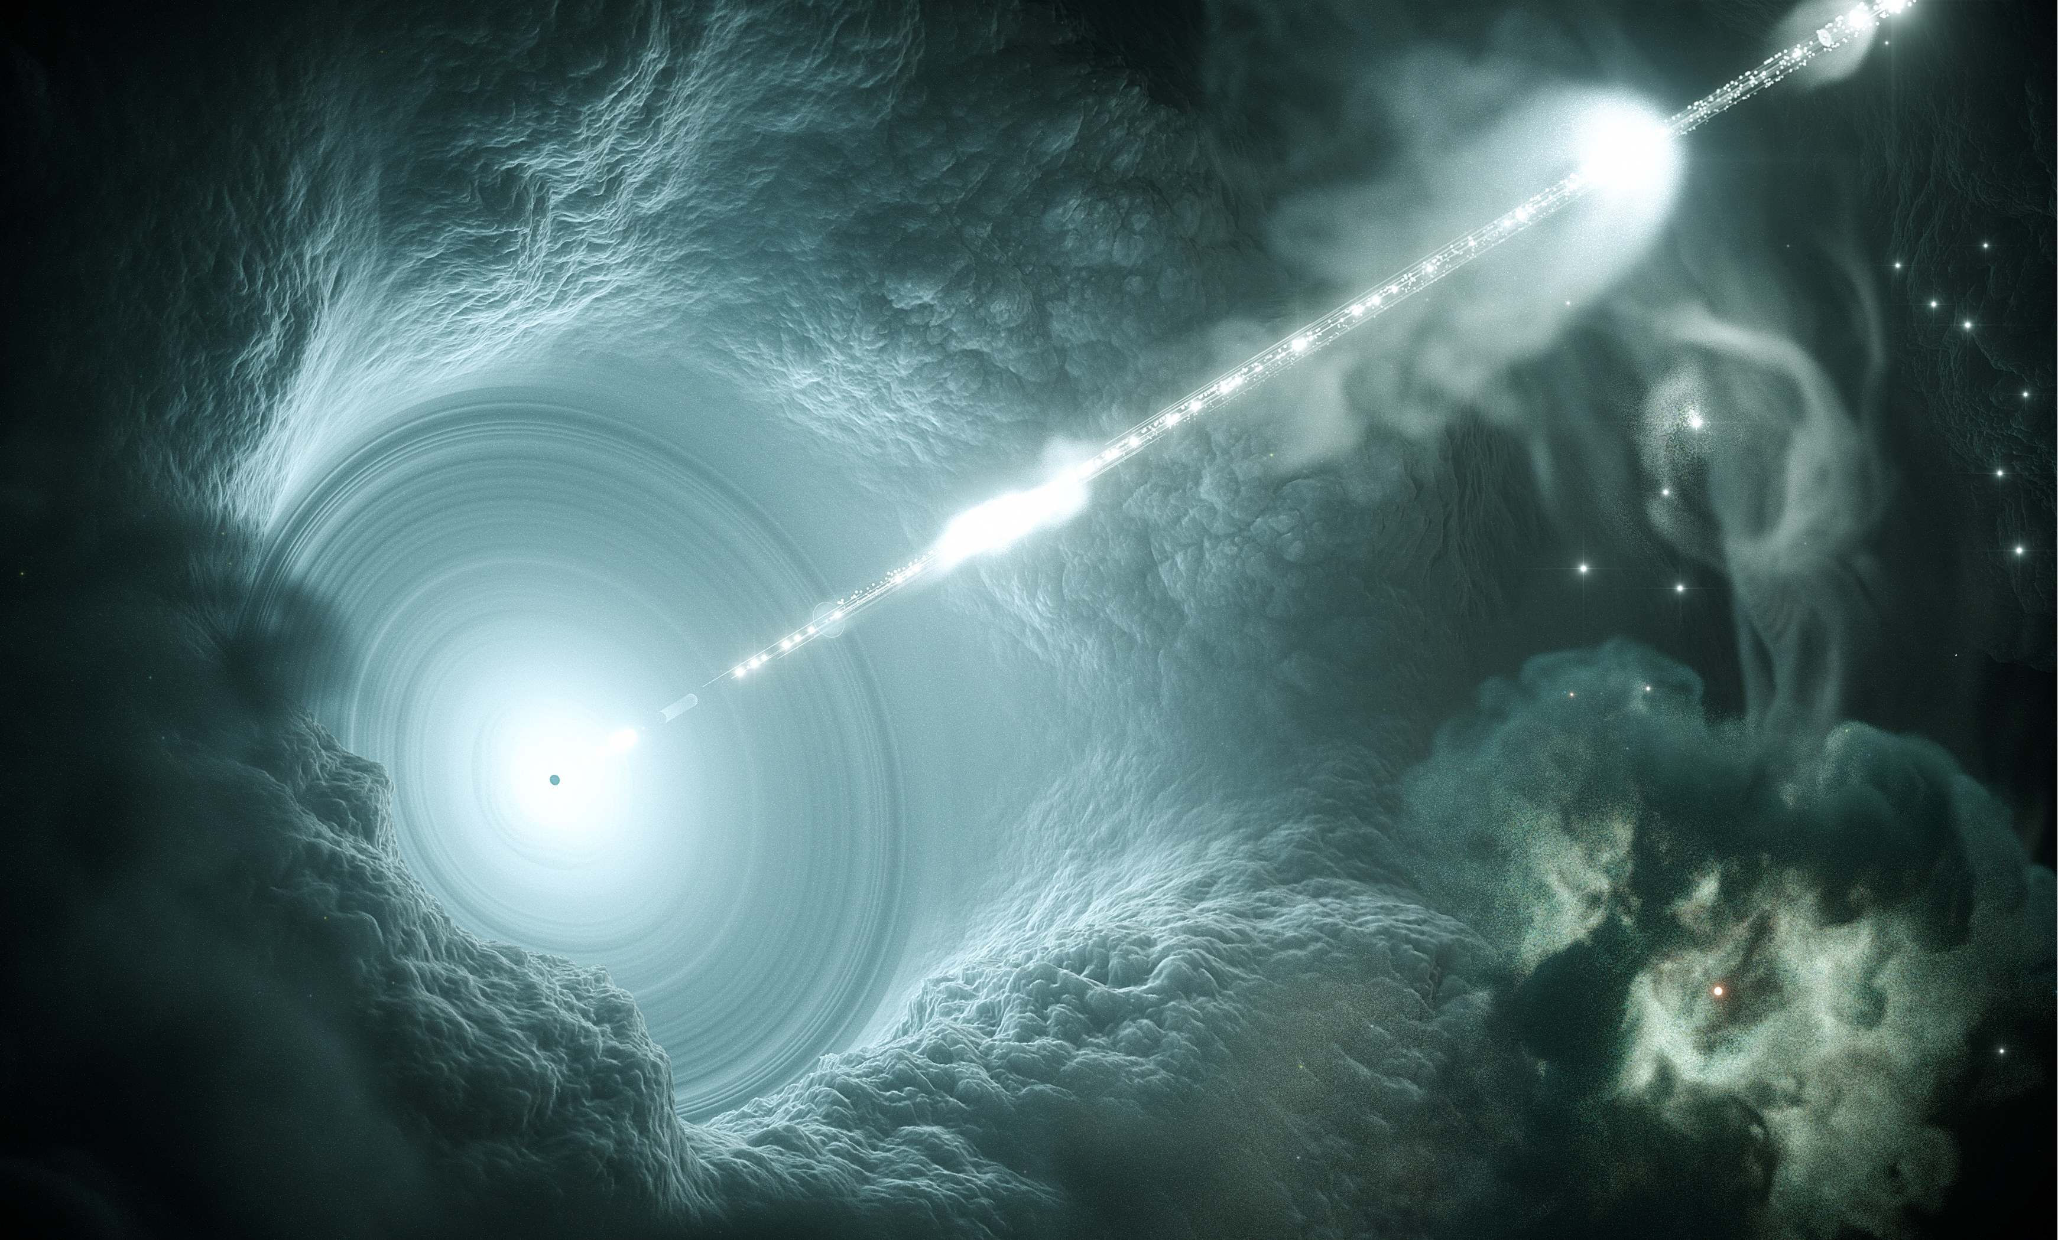


Blazars – An “extreme” flavour of AGNs
Non-thermal emission
up to >TeV
Super massive
Black Hole
(10⁶-10⁹ solar masses)
Observed at small angle relative to the jet axis
→ Strong relativistic beaming
→ Doppler factor δ ≳ 10
Relativistic plasma jet
kpc – Mpc scale
Credit: DESY, Science Communication Lab
Notes:
What are blazars?
They consist of a SMBH, 10⁶ 10⁹ solar masses
The SMBH is launching a relativistic jet, on kpc Mpc scale.
Those jets emit non-thermal radiation from radio to TeV

Slide 18
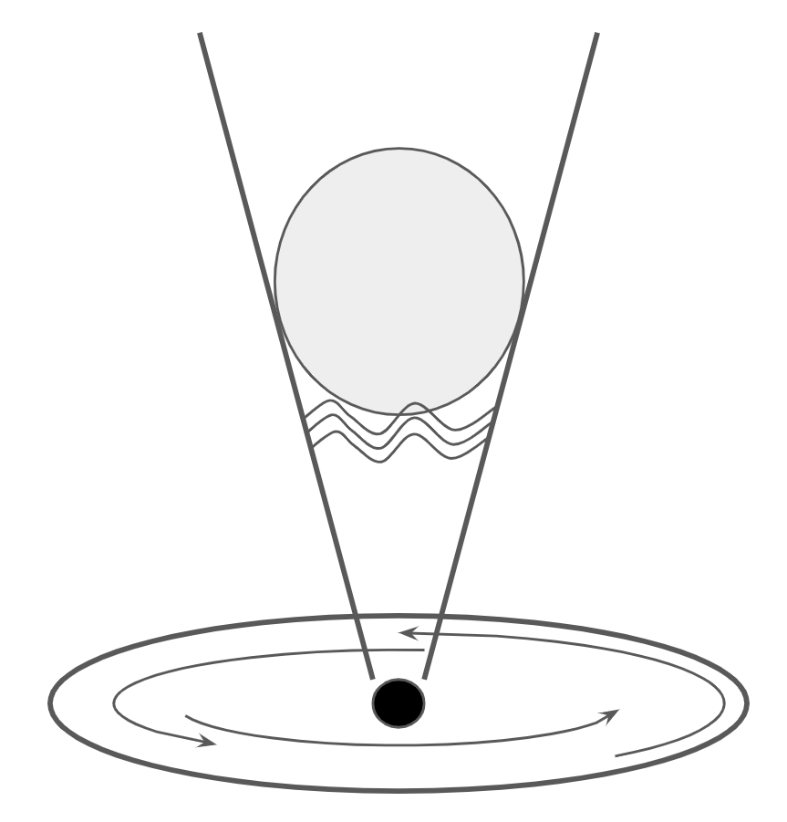
Blazar emission and shocks in AGN jets
Broadband SED
(Mrk421)
Jet
Black box
Emission zone
Acceleration site
(shock? reconnection? stochastic?)
Black hole
Accretion disk
(Abdo et al. 2011)

Slide 19
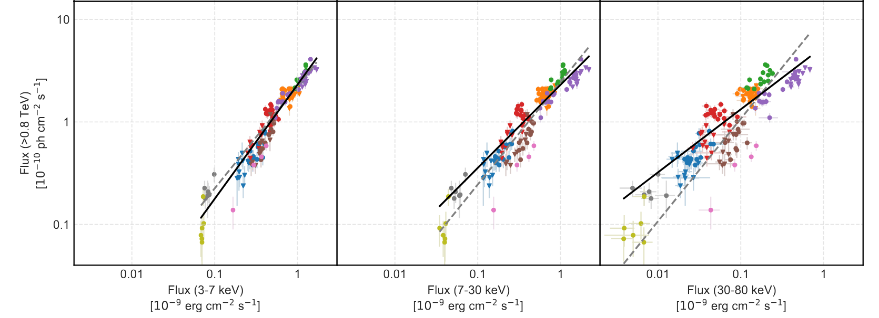
Blazar emission and shocks in AGN jets
synchrotron photon
Correlation between the two “humps”
supports the “leptonic” model
>0.8TeV vs 3-7kev
>0.8TeV vs 7-30kev
>0.8TeV vs 30-80kev
(Acciari et al. 2020)
(Abdo et al. 2011)

Slide 20
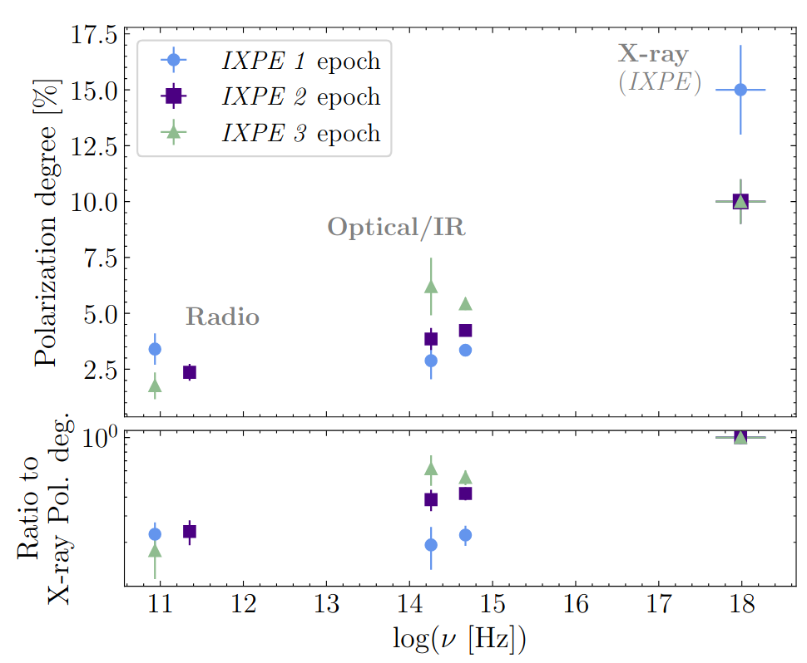
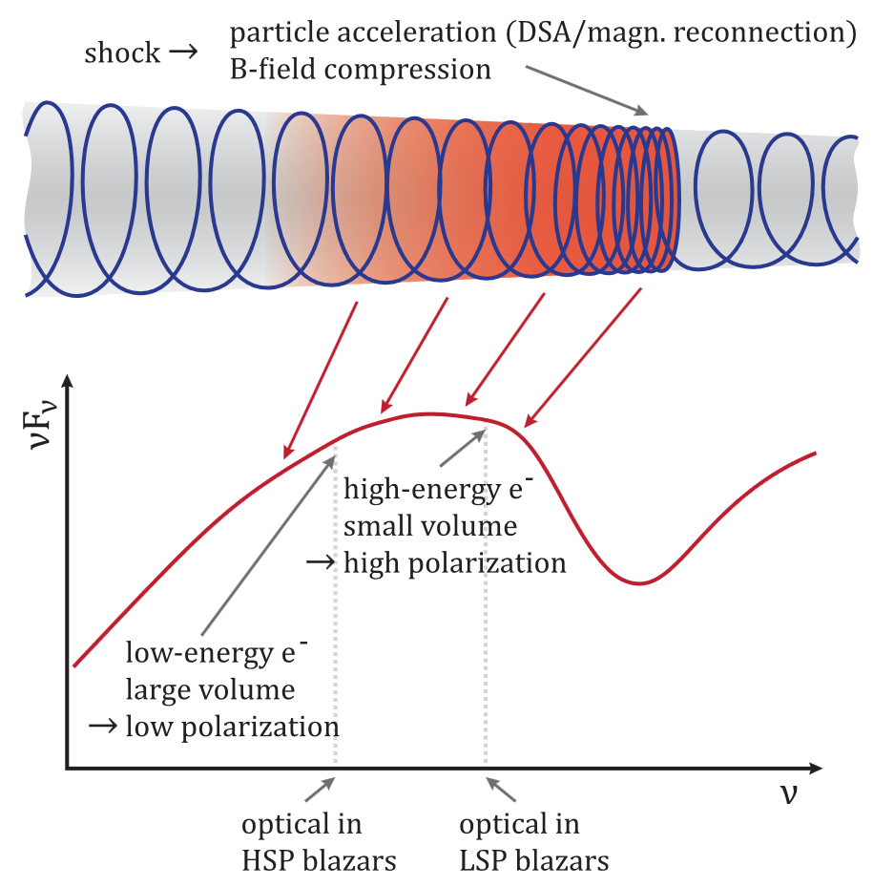
Clues from X-ray polarization
Pol. angle
(MAGIC Collab. 2024)
(sketch from Angelakis et al. 2016)

Slide 21
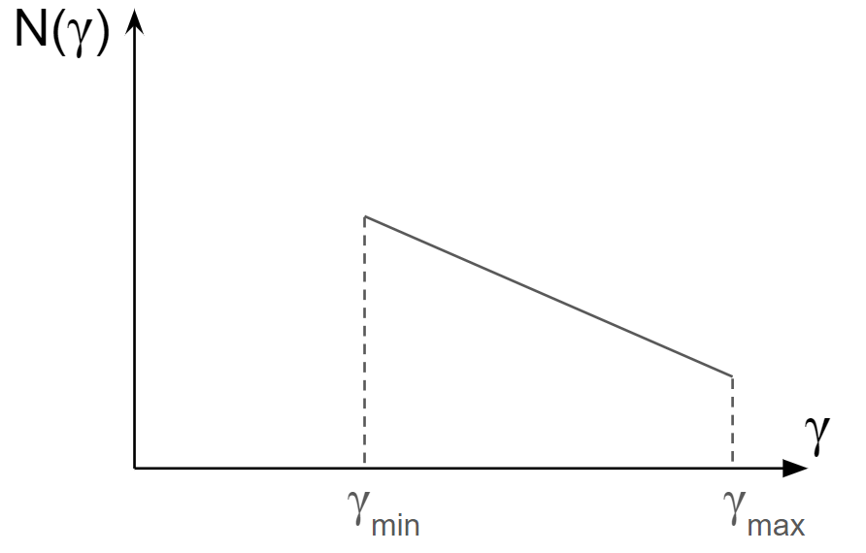
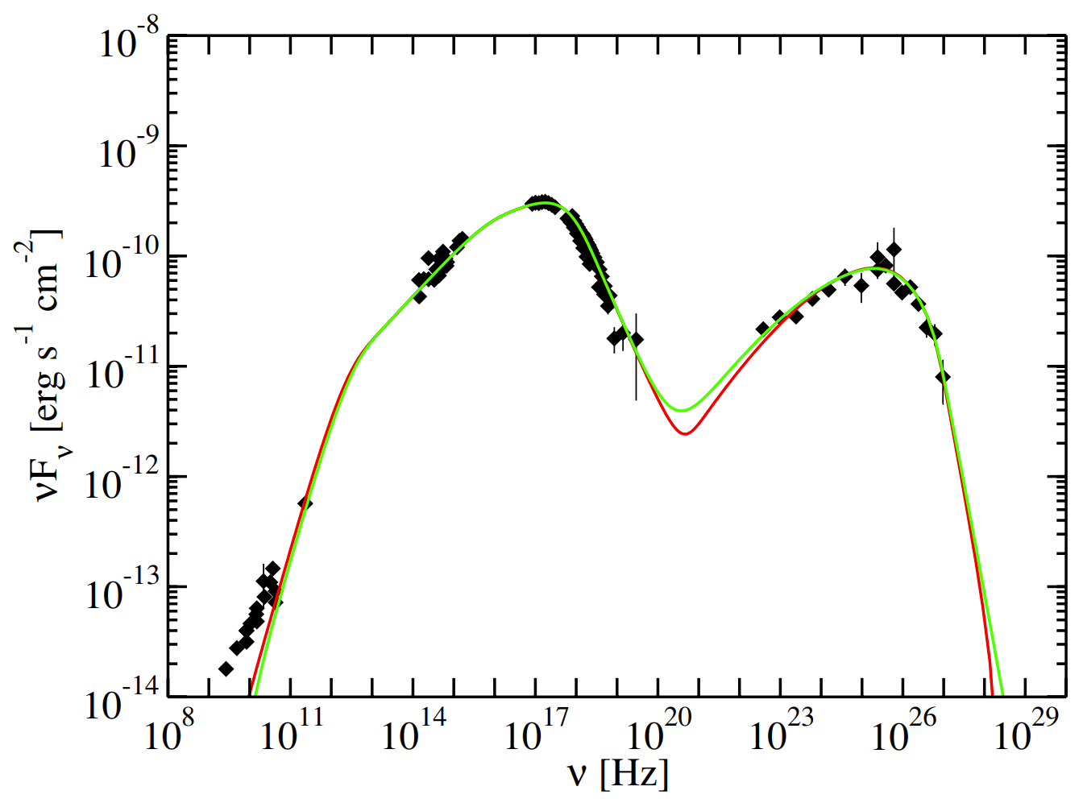
Blazar emission and shocks in AGN jets
Used electron distribution
Emission of Mrk421 + synchrotron self-Compton model

Slide 22
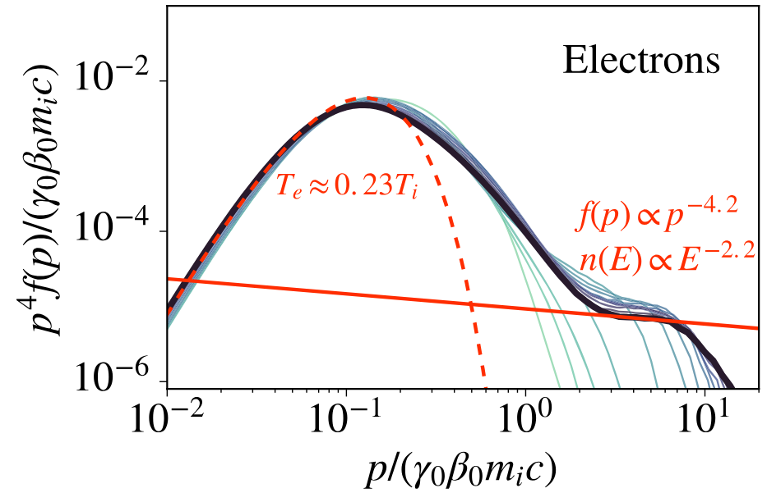
Blazar emission and shocks in AGN jets
Used electron distribution
Emission of Mrk421 + synchrotron self-Compton model
Realistic electron distribution
(Crumley et al. 2019)

Slide 23
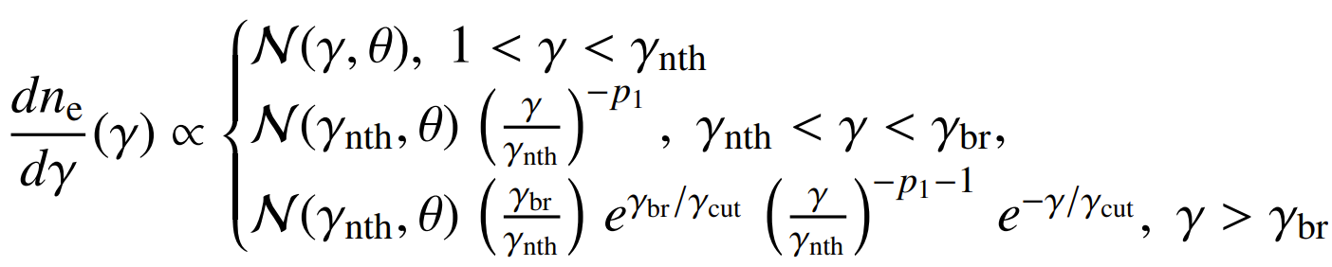
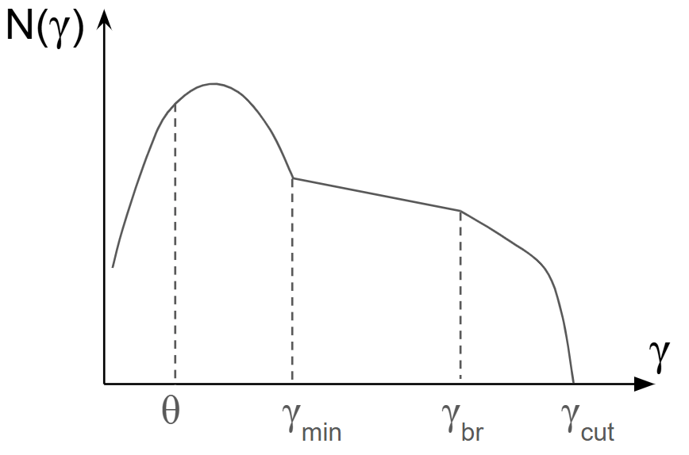
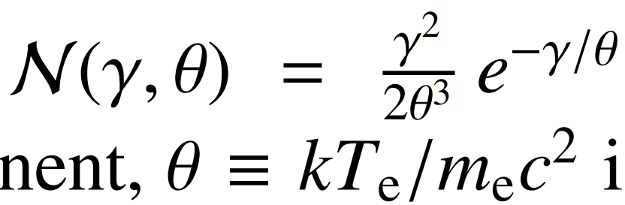

Using realistic electron energy distribution
Where is the Maxwell distribution
and is the dimensionless temperature.

Slide 24
Using realistic electron energy distribution
Where is the Maxwell distribution
and is the dimensionless temperature.

Slide 25
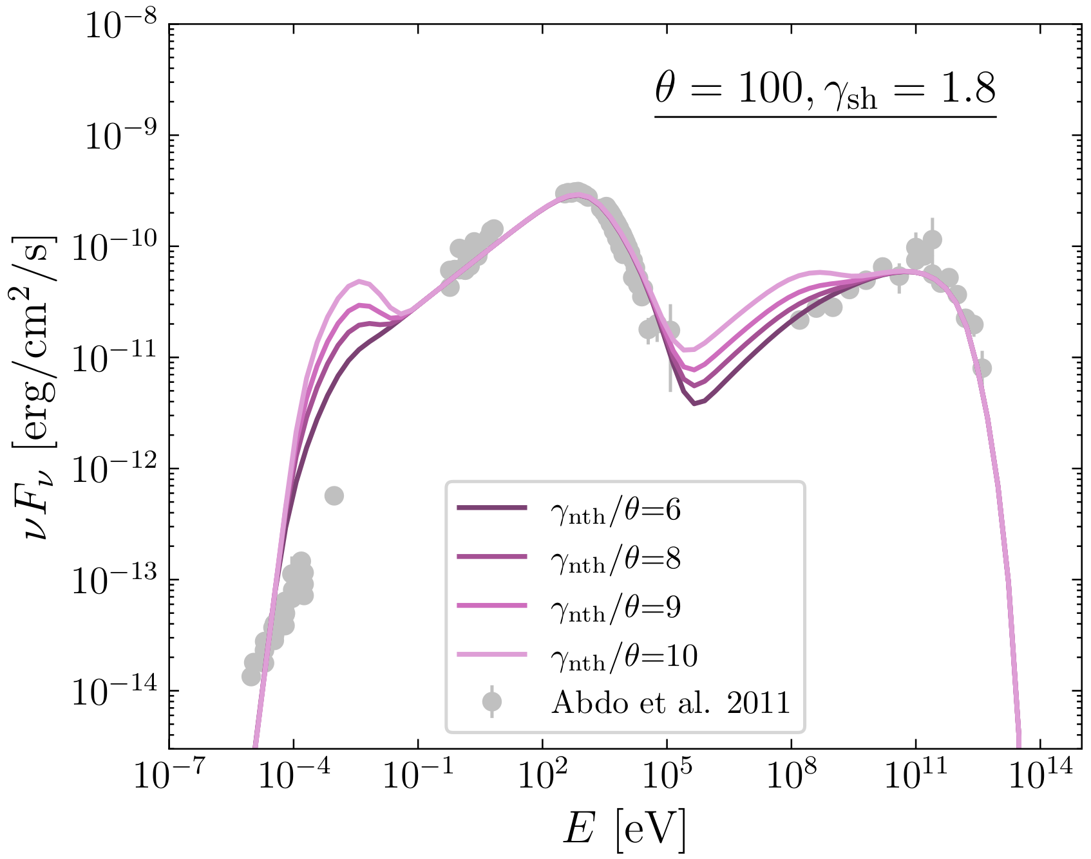
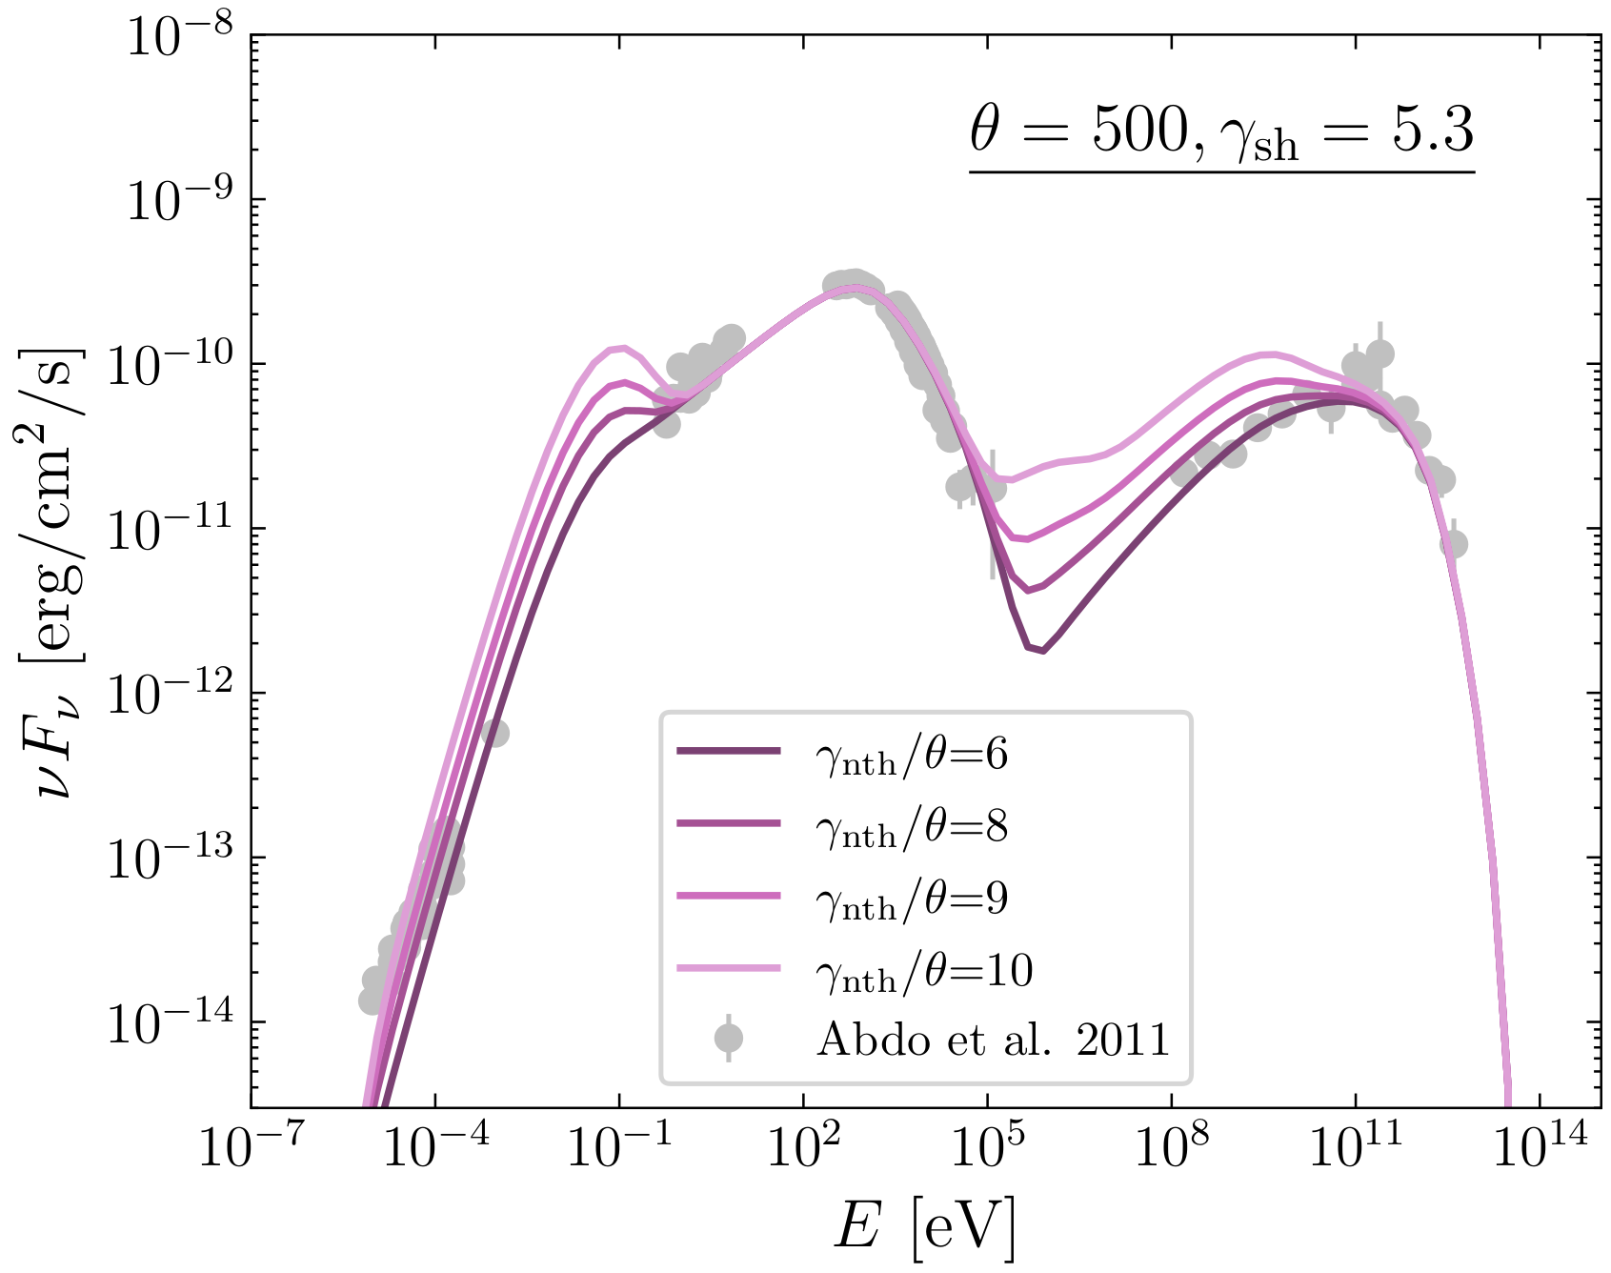
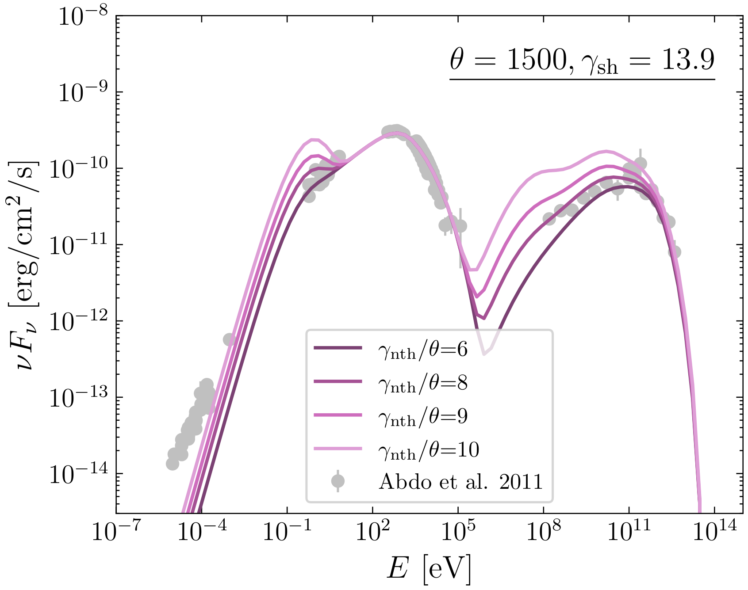
Using realistic electron energy distribution
Scan different θ and ɣ_{nth}/θ values, and find with
a χ²-test the allowed range

Slide 26
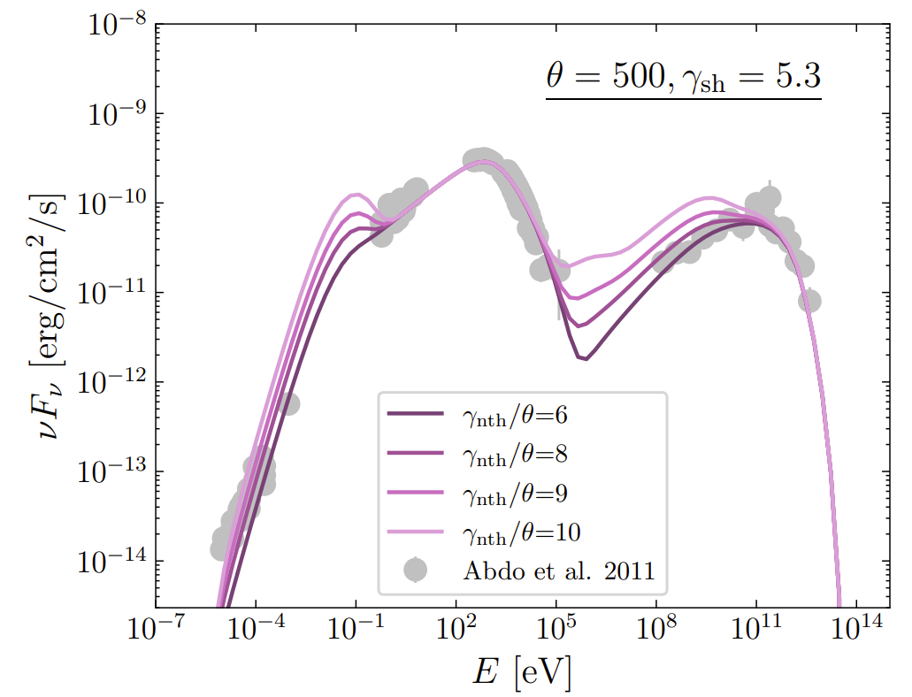
Using realistic electron energy distribution
Where is the Maxwell distribution
and is the dimensionless temperature.
Best-fit parameters:
Temperature θ ≈ 500
Nonthermal population ɣ_{nth} /θ ≈ 8
Power-law index p₁ ≈ 2.4
Electron density n ≈ 1 cm⁻³
Magnetic field B ≈ 0.05 G

Slide 27
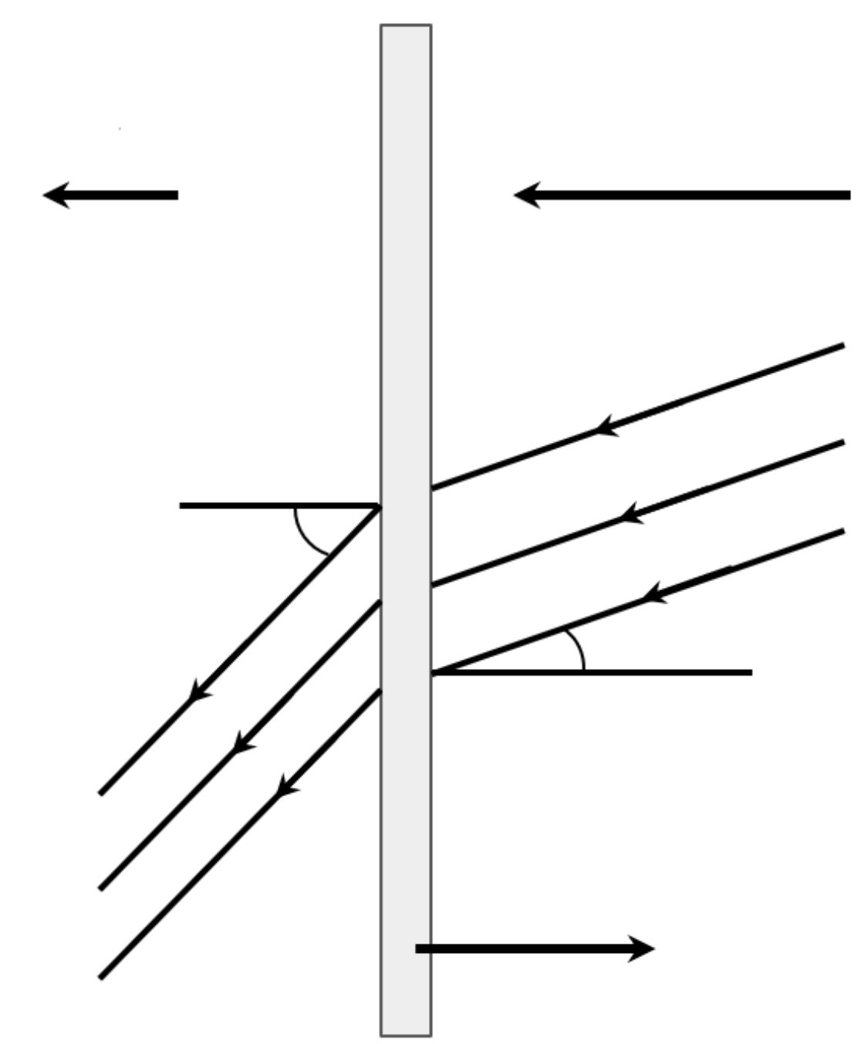
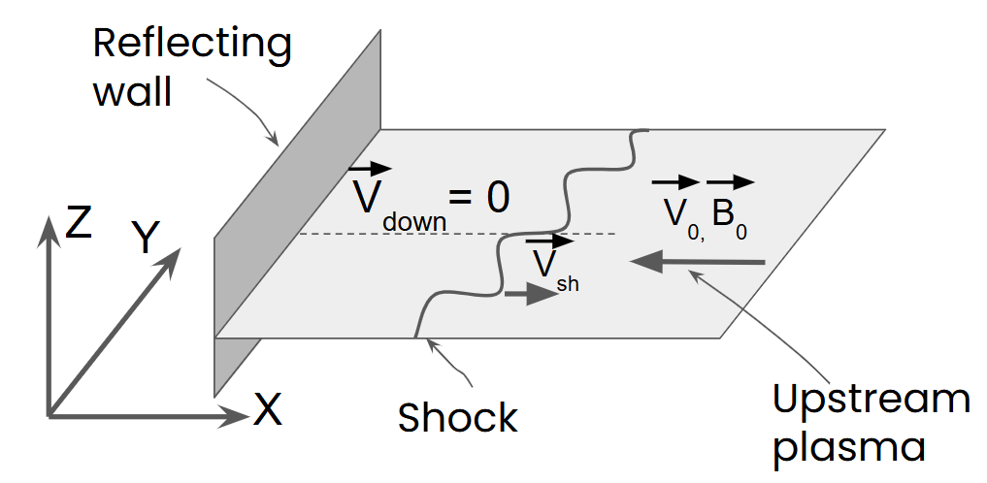
Shock physics
Shock reference frame
Downstream reference frame
(shock simulations)
Downstream Shock Upstream
u₂
u₁
B₁
ρ₂,T₂,P₂
ρ₁,T₁,P₁
ϑ₂
Velocity transformation
ϑ₁
B₂
n
In the downstream/simulation reference frame all the upstream kinetic energy goes to:
(1) thermal ions and electrons (2) high-energy particles (3) fields.

Slide 28
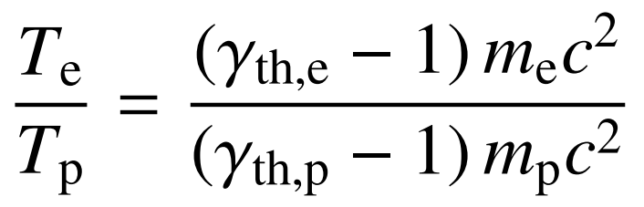
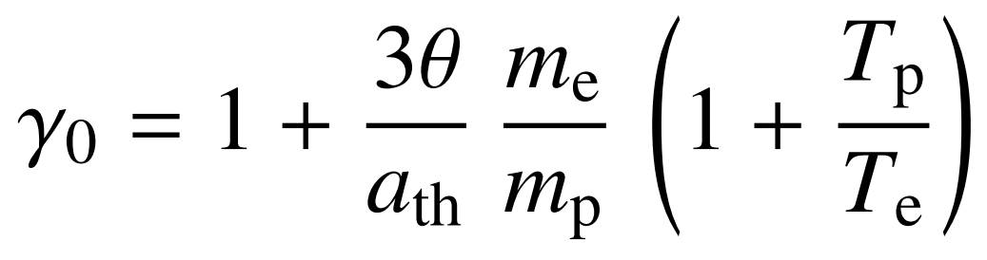
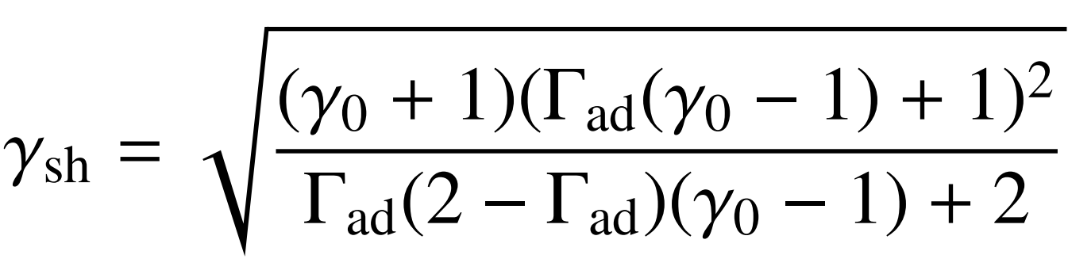
Upstream gamma factor and electron temperature
In the simulations reference frame about 80% of the upstream kinetic energy goes to thermal ions and electrons (assuming efficient electron and ion acceleration):
(largely unknown, but here we use T_{e}/T_{i} ≈ 0.5)
≈ 4 in case of θ ≈ 500
≈ 5.3

Slide 29
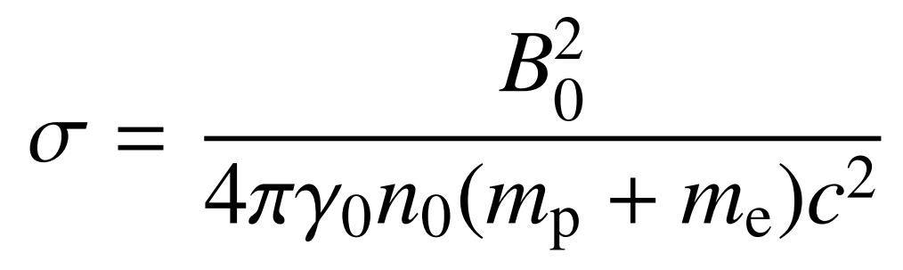
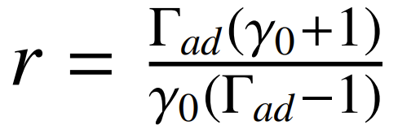
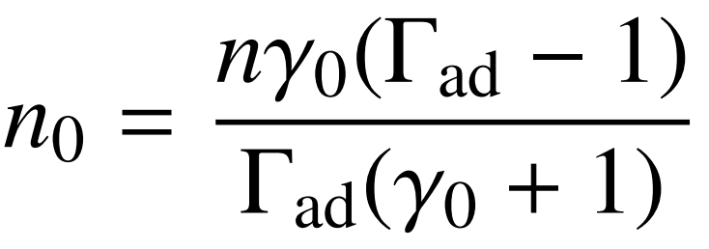
Plasma magnetization: plasma density
where n₀ and B₀ are the upstream values, however the best fit model gives the downstream values.
The upstream plasma density can be derived using the shock compression ratio
Therefore

Slide 30
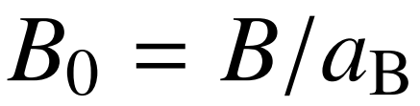
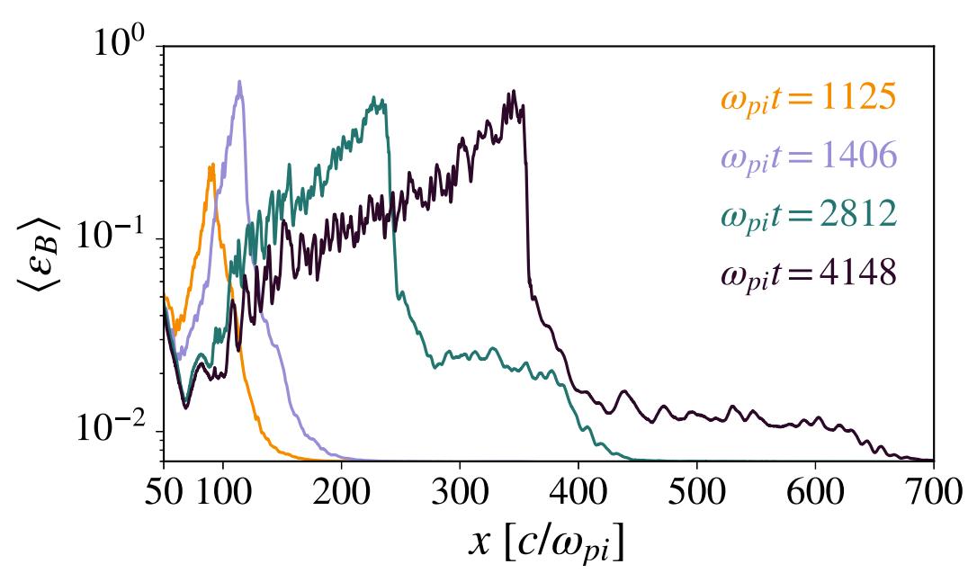
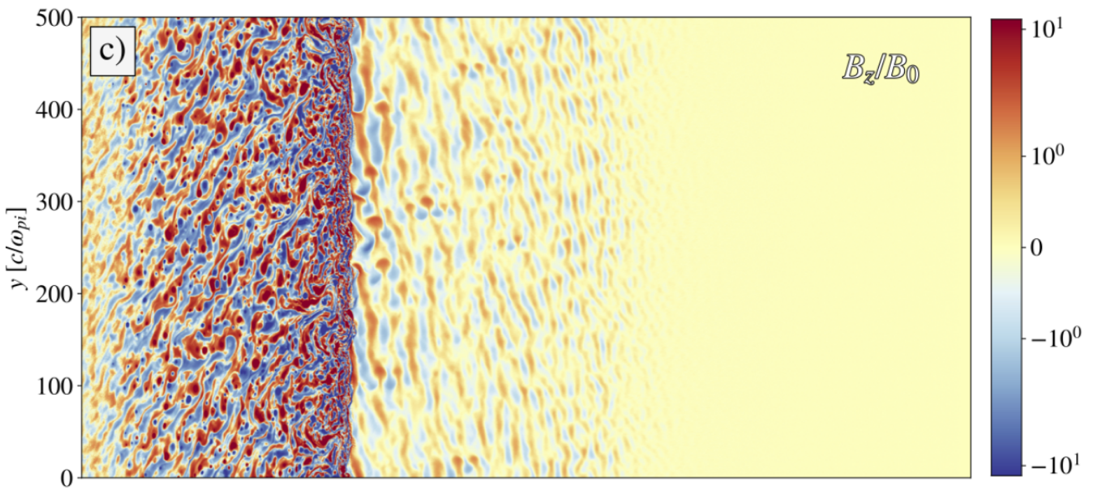
Plasma magnetization: magnetic field
, where represents magnetic field amplification in front of the shock, compression in the shock and decay behind the shock
(Crumley et al. 2019)

Slide 31
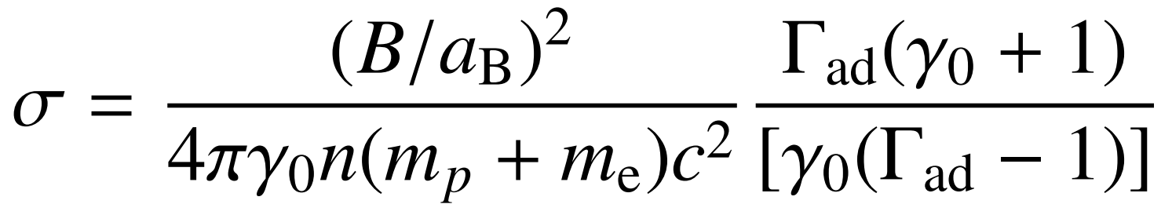
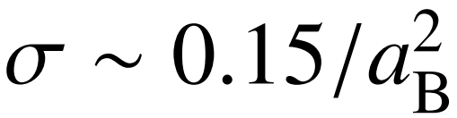
Plasma magnetization
(for the best-fit model)

Slide 32
Shock parameters for the best-fit model
Best-fit parameters:
Temperature θ ≈ 500
Nonthermal population ɣ_{nth} /θ ≈ 6
Power-law index p₁ ≈ 2.4
Electron density n ≈ 1 cm⁻³
Magnetic field B ≈ 0.05 G
Shock parameters:
The upstream Lorentz factor in d.r.f. ɣ₀ ≈ 4
The shock Lorentz factor ɣ_{sh} ≈ 5.3
Magnetization σ ≈ 0.15/a_{B}
Assumptions:
Fraction of energy in thermal particles a_{th} ≈ 0.8
Downstream temperature ratio T_{e}/T_{i} ≈ 0.5
Magnetic field amplification a_{B} is a free parameter

Slide 33
Shock parameters for the best-fit model
Best-fit parameters:
Temperature θ ≈ 500
Nonthermal population ɣ_{nth} /θ ≈ 6
Power-law index p₁ ≈ 2.4
Electron density n ≈ 1 cm⁻³
Magnetic field B ≈ 0.05 G
Shock parameters:
The upstream Lorentz factor in d.r.f. ɣ₀ ≈ 4
The shock Lorentz factor ɣ_{sh} ≈ 5.3
Magnetization σ ≈ 0.15/a_{B}
Assumptions:
Fraction of energy in thermal particles a_{th} ≈ 0.8
Downstream temperature ratio T_{e}/T_{i} ≈ 0.5
Magnetic field amplification a_{B} is a free parameter
PUBLISHED

Slide 34
Shock parameters for the best-fit model
Best-fit parameters:
Temperature θ ≈ 500
Nonthermal population ɣ_{nth} /θ ≈ 6
Power-law index p₁ ≈ 2.4
Electron density n ≈ 1 cm⁻³
Magnetic field B ≈ 0.05 G
Shock parameters:
The upstream Lorentz factor in d.r.f. ɣ₀ ≈ 4
The shock Lorentz factor ɣ_{sh} ≈ 5.3
Magnetization σ ≈ 0.15/a_{B}
Assumptions:
Fraction of energy in thermal particles a_{th} ≈ 0.8
Downstream temperature ratio T_{e}/T_{i} ≈ 0.5
Magnetic field amplification a_{B} is a free parameter
Things to test with PIC simulations
(1) Short simulations
Downstream temperature ratio T_{e}/T_{i}
Fraction of energy in thermal particles a_{th}
(2) Long simulations
Nonthermal population ɣ_{nth} /θ
Power-law index p₁
Magnetic field amplification a_{B}
PUBLISHED

Slide 35

Scanned parameters
60+ 2D3V PIC simulations
The shock Lorentz factor ɣ₀ = 1.5 , 2 , 4 , 8 , 16
The upstream plasma magnetization σ = 10⁻¹ , 10⁻² , 10⁻³ , 10⁻⁴
The shock obliquity θ_{Bn} = 0°, 25°, 50°

Slide 36



Shock simulations

Slide 37

Shock simulations

Slide 38



Compression ratio and adiabatic index
ɣ₀ = 1.5
σ = 0.01
ɣ₀ = 4
σ = 0.01
ɣ₀ = 16
σ = 0.01

Slide 39

Parallel shocks (θ_{Bn} = 0°)

Slide 40




Parallel shocks θ_{Bn} = 0° ɣ₀ = 1.5

Slide 41

Oblique subluminal shocks (θ_{Bn} = 25°)

Slide 42




Oblique shocks θ_{Bn} = 25° ɣ₀ = 16

Slide 43

Oblique superluminal shocks (θ_{Bn} = 50°)

Slide 44

Long shock simulation t=5000 omega_pi
θ_{Bn} = 0°
ɣ₀ = 4
σ = 0.01

Slide 45

The electron-to-ion temperature ratio, long term evolution
Shock parameters:
ɣ₀ = 4
σ = 0.01
Ions are sort of nonrelativistic, but electrons are relativistic, therefore T_{e}/T_{i} ≠ ε_{e}/ε_{i}

Slide 46

Magnetic field amplification
θ_{Bn} = 0°
ɣ₀ = 4
σ = 0.01

Slide 47



θ_{Bn} = 0°
σ = 0.0001
Magnetic field amplification
θ_{Bn} = 0°
σ = 0.01
ɣ₀ = 4
σ = 0.01

Slide 48
Conclusions
(1) Connection of nonthermal emission and PIC simulations is possible
(2) A lot of simulations needed to determine T_{e}/T_{i} , a_{th}, ɣ_{nth} /θ, p₁ , a_{th}

Slide 49
Thank you
Dr. Axel Arbet-Engels
Max Planck Institute for Physics
MAGIC and CTA group
aarbet@mpp.mpg.de
Dr. Artem Bohdan
Max Planck Institute for Plasma Physics
Tokamak Theory division
Plasma Astrophysics group
artem.bohdan@ipp.mpg.de

