Slide 1
Competing Instabilities at Perpendicular Shocks:
From Waves to Filaments
Valentine Devos, Artem Bohdan, Frank Jenko

Slide 2
Outline
1
Collisionless shocks
Why shocks without collisions, and why electrons matter
2
Competing instabilities
Proton cyclotron / whistler pathway vs Weibel filamentation
3
Method
Particle-in-cell simulations and linear dispersion solvers
4
Results
From waves to filaments across M_{A} = 8.5 – 23
5
Discussion & outlook
Linear theory, robustness, electron energisation

Slide 3
Part I
Collisionless shocks
Why shocks and why electrons matter

Slide 4
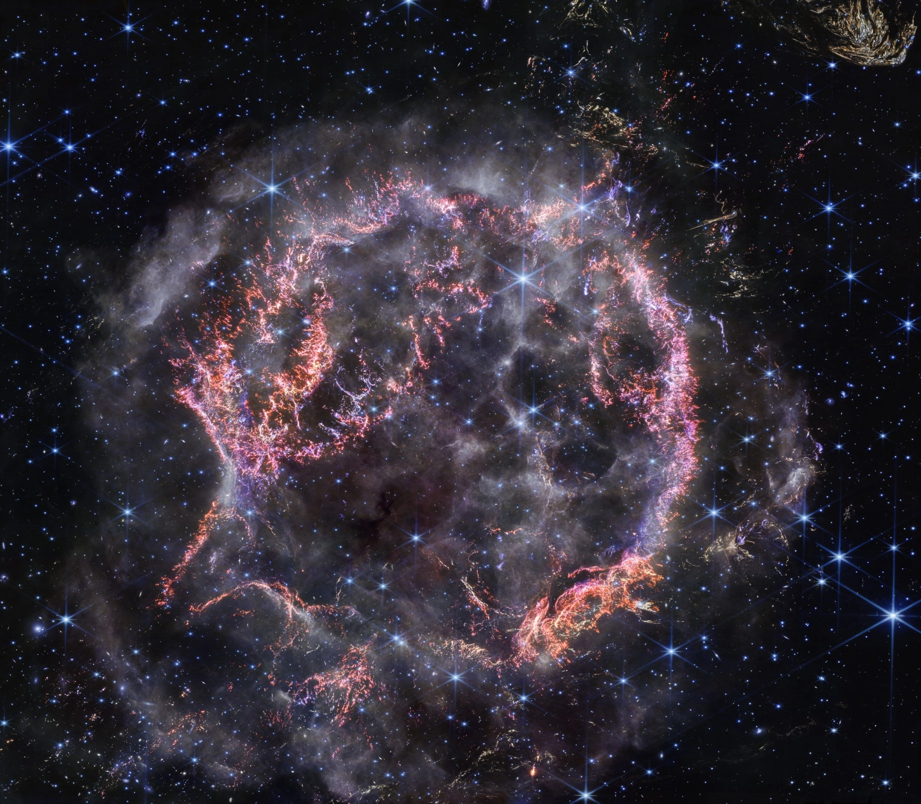
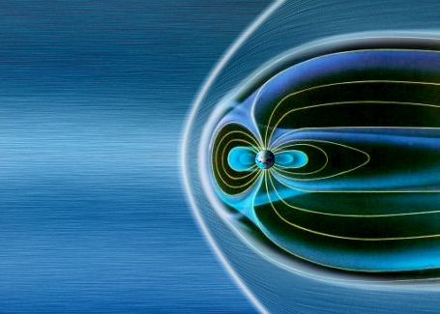

Astrophysical Context
Collisionless shocks are everywhere in space, with very different Mach numbers
Earth’s bow shock and magnetosphere
Supernova remnants
Credit: ESA/AOES Medialab
Credit: NASA, ESA, CSA, STSCI
3 → 20
20 → 500
$$MA=\frac{u_{sh}}{u_{A}}$$

Slide 5
Supercritical shocks reflect ions
→ Above a critical Mach number, the shock reflects part of the incoming ions
Ramp
Foot
B₀ ↑
Subcritical (M_{A} < M_{A}* ≈ 2.7): dissipation by resistivity and dispersive waves is enough
Supercritical (M_{A} > M_{A}*): a fraction of incoming ions (typically ~20 %) is reflected at the ramp
Reflected ions gyrate upstream, build the foot, then are swept downstream
→ Beams and temperature anisotropy: free energy for instabilities
All shocks in this talk: M_{A} = 8.5 – 23 ≫ M_{A}*
reflected ion
transmitted ions
Downstream
Upstream

Slide 6
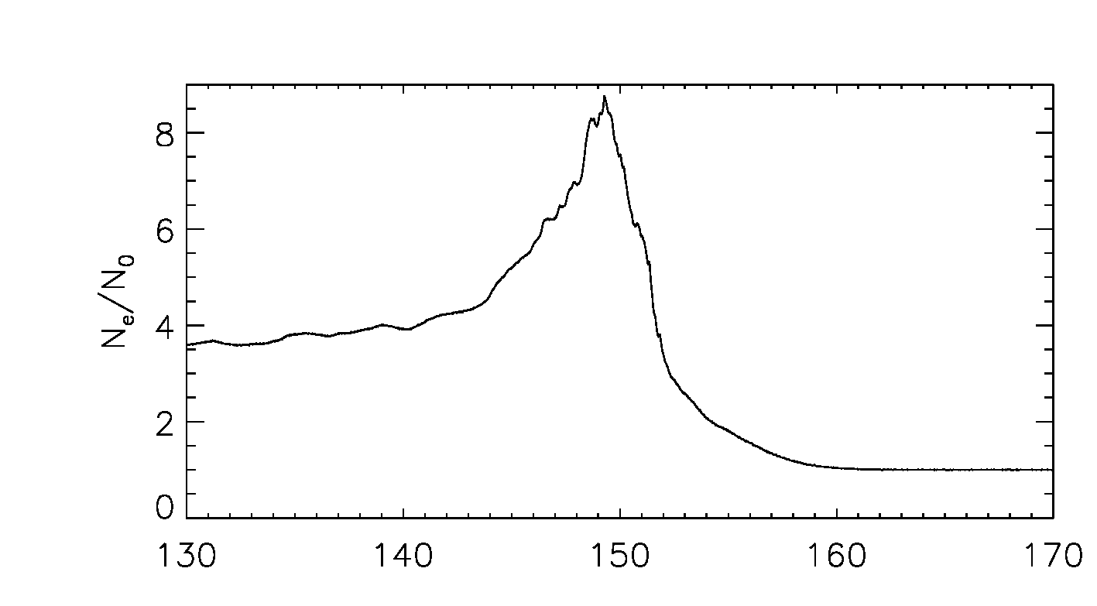
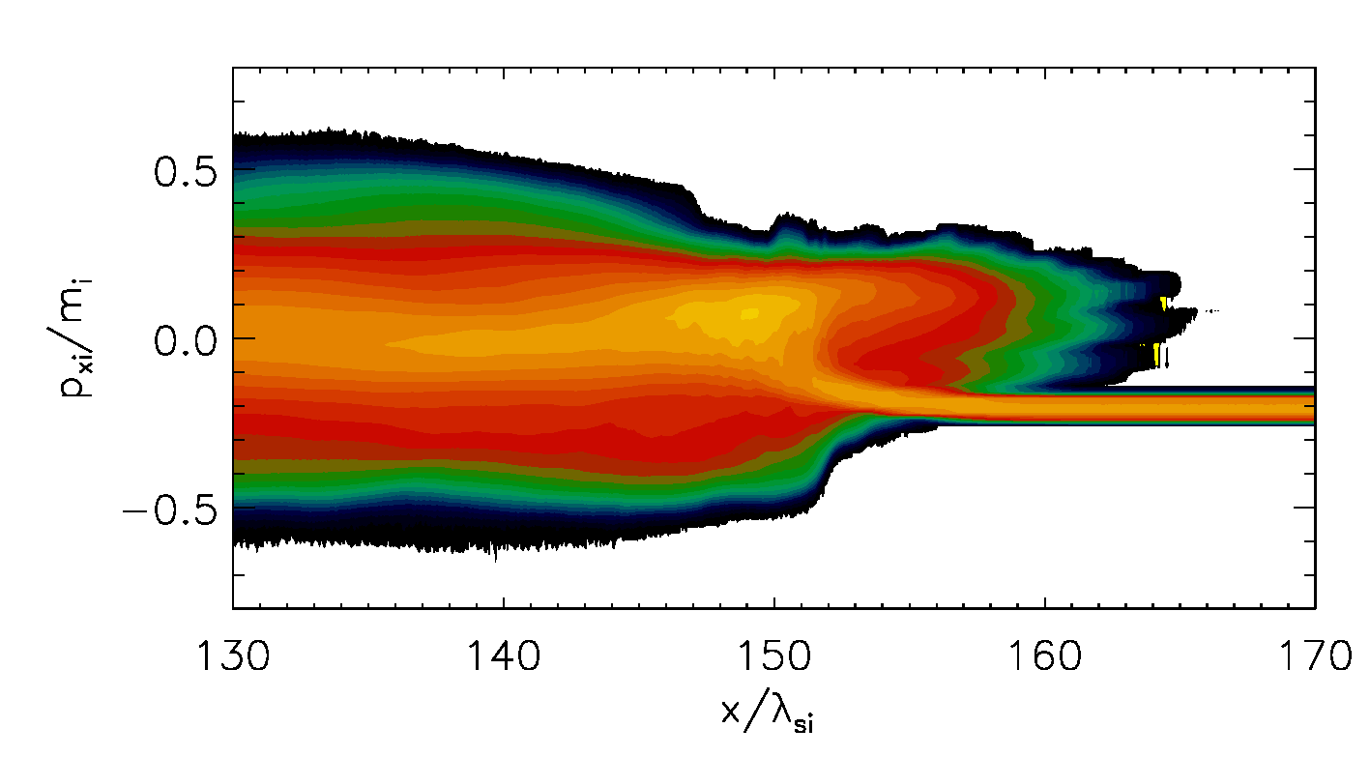
Shock structure
Supercritical, collisionless, perpendicular shock
Overshoot
Free Energy Sources in Perpendicular Shocks
• Shock compression → particle anisotropy + magnetic amplification
• Reflected ions → counter-streaming
Ramp
Downstream
Foot
Upstream
Competing Instability Channels
Low–moderate Mach:
→ anisotropy-driven → Proton Cyclotron instability
Higher Mach:
→ beam / filamentation-driven → Weibel instability

Slide 7
Why do we care about electrons?
→ Electrons are what we see, but the shock gives its energy to the ions
1
2
3
We observe electrons
Radio-to-X-ray synchrotron and thermal X-ray emission of supernova remnants are produced by electrons, not ions.
Ions carry the energy
With m_{i}/m_{e} = 1836, the incoming kinetic energy sits almost entirely in the ions. Electrons must gain energy through collective fields.
The injection problem
To enter diffusive shock acceleration, electrons need ion-scale gyroradii: they must first be pre-heated or pre-accelerated at the shock.
Key diagnostic: the downstream temperature ratio T_{e}/T_{i}. How much of the energy do electrons get?

Slide 8
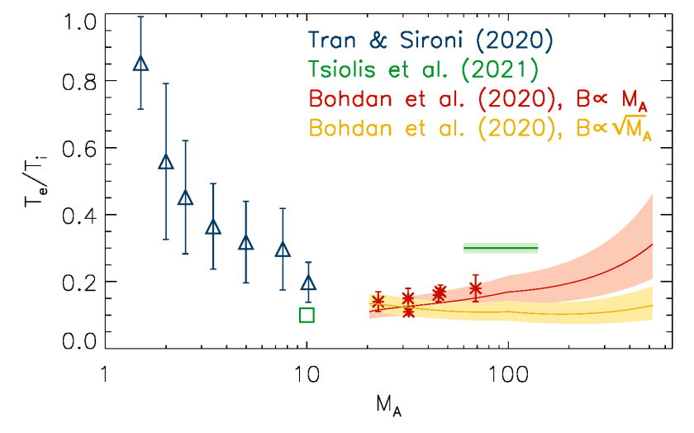
Open question: the intermediate Mach regime
Electron heating changes with Mach number, but the transition is poorly constrained
Intermediate Mach numbers
Which instability dominates, and where is the transition?
How does it affect electron energisation?
Raymond et al. 2023

Slide 9
Part II
Competing instabilities
Proton cyclotron / whistler vs Weibel

Slide 10
Kinetic instabilities in a nutshell
→ A non-Maxwellian plasma is a reservoir of free energy
Free energy
Non-Maxwellian distributions: temperature anisotropy T⊥ ≠ T∥, beams, counter-streaming
Linear growth
Small fluctuations grow as δB ∝ e^{γt}; γ(k) from the kinetic dispersion relation
Wave–particle interaction
Waves scatter and heat particles, reduce anisotropy, isotropise beams
Saturation
The distribution relaxes toward marginal stability; energy has changed hands
At a shock, time is limited
An instability matters only if it grows fast enough while the plasma crosses the shock transition: compare the growth rate γ with the transit time.

Slide 11
Instabilities – Proton Cyclotron / Whistler Instability pathway
Shock Front
M_{A} ≲ 10
B
Proton temperature anisotropy (T_{ꓕ}>T‖) drives PCI
PCI transfers energy from ions → electrons → triggers electrons anisotropy
Electron anisotropy drives Whistler waves (ω ~ Ω_{e})
Propagates along B₀
Efficient in moderately magnetized / lower-Mach shocks
Proton Cyclotron/ Whistler Waves
Proton/Electron anisotropy

Slide 12
Instabilities – Weibel (filamentation) instability
Shock Front
M_{A} ≳ 20
Ions
Driven by counter-streaming ions (reflected vs incoming)
Non-propagating (ω ≈ 0)
Generates current filaments and transverse B
Current
Dominant when flow energy exceeds magnetic tension
Electrons
B

Slide 13
Not the only players in the shock transition
→ Why we focus on the ion-scale competition: PCI/whistler vs Weibel
Buneman
Electrostatic, electron scale. Reflected ions vs incoming electrons in the foot. Strong at high M_{A}; linked to electron shock surfing.
Modified two-stream (MTSI)
Oblique, whistler-like waves in the foot. Heats electrons at moderate M_{A}; suppressed at high M_{A}.
Mirror mode
Oblique, ion scale, driven by T⊥ > T∥. Competes with the proton cyclotron instability at low M_{A}.
Electron-scale modes grow fast but saturate early: they heat particles without significantly altering the slower ion-scale instability.
PCI (≡ Alfvén ion cyclotron) and Weibel are two limits of the same ion-scale branch: γ/Ω_{i} ≲ 1 vs γ/Ω_{i} ≫ 1.
Nishigai & Amano (2021)

Slide 14
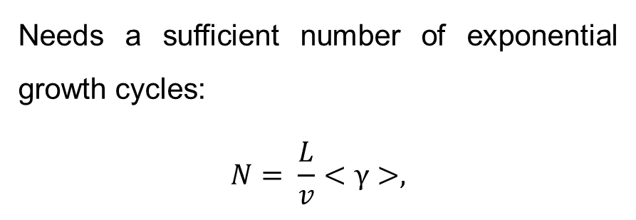


Theoretical expectations
PCI-Whistler Pathway
Weibel Condition
PCI: proton anisotropy threshold (Gary 1993)
→ triggers Whistler (Guo 2018)
Whistler: Condition on the electron temperature anisotropy
Needs a sufficient number of exponential growth cycles:
$$N= \frac{L}{v}<γ>,$$
$$\frac{T_{pꓕ}}{T_{p‖}}−1>\frac{1.1}{β_{i‖}^{0.55}}$$
      L = size of unstable region,
      v = advection speed of the plasma element
      <γ> = average growth rate
      N = number of e-foldings while crossing the unstable foot–ramp region (amplitude ∝ eN), computed for Weibel (NW) and PCI (NPCI )
$$\frac{T_{eꓕ}}{T_{e‖}}−1>\frac{0.21}{β_{e‖}^{0.6}}$$

Slide 15
Part III
Method
Particle-in-cell simulations and linear solvers

Slide 16
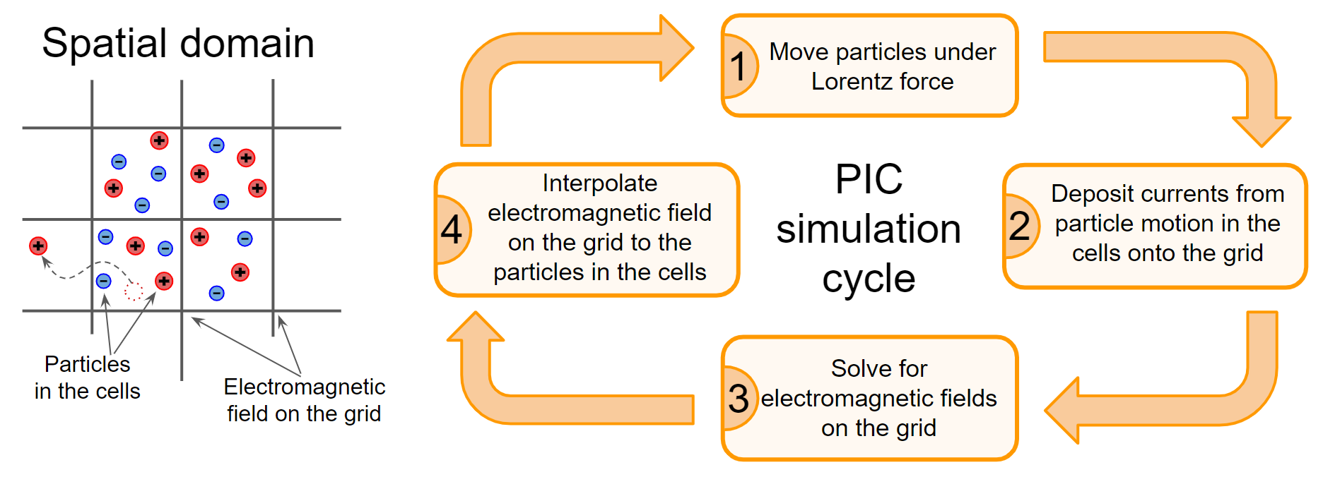

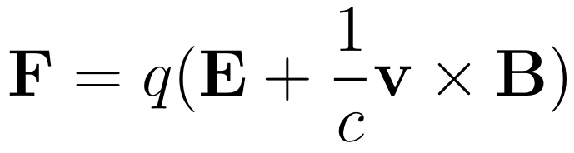
PIC simulation
Vlasov equation
Lorentz force for particles
Maxwell equations on the grid
THATMPI code (Two-and-a-Half-Dimensional Advanced Stanford code with Message Passing Interface).
This code is a 2D3V-adapted and modified version of the relativistic electromagnetic PIC code TRISTAN (Three-Dimensional Stanford) [1] with Message Passing Interface-based (MPI) parallelization [2]
[1] Buneman, 1993
[2] Niemiec et al., 2008

Slide 17
PIC simulation - setup
Injection method; box with a reflective wall and a plasma beam. Perpendicular magnetic field.
Shock
B0
Reflective wall
Open boundary
y
Beam: v_bulk, v_th
x
Downstream
Upstream
Periodic boundaries

Slide 18
Parameters
Main parameters
Mass ratio | 100
Angle with the magnetic field | 90° in x-y plane
Particles per cell | 20
Electron skin depth | 20 cells
Set of simulations
Plasma beta: β = 2 (βₑ = β_{i} = 1), plus a second set with βₑ = 0.25
5 Alfvénic Mach numbers: M_{A} = 8.5, 11, 15, 19, 23

Slide 19
Numerical solvers
For PCI: WHAMP (Waves in Homogeneous Anisotropic Multicomponent Plasmas)
For Weibel: custom Fortran code for 2 counter-streaming populations of ions + electrons
Roennmark 1982

Slide 20
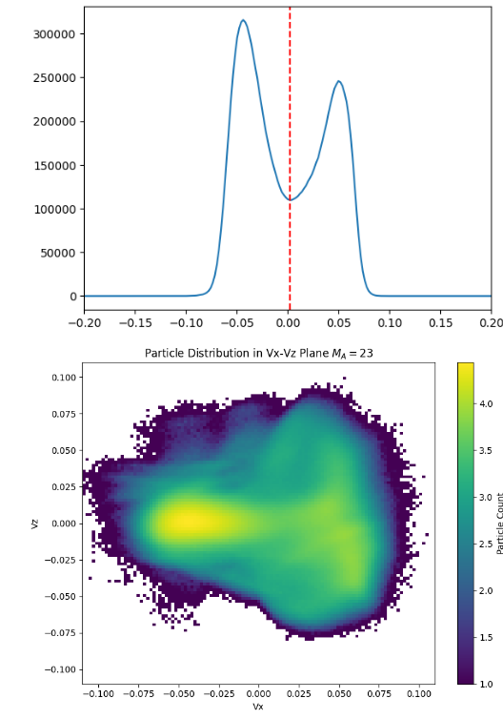
Population separation
Incoming and reflected ions are separated at the minimum of f(v_{x}) (red dashed line).
Each population gives its own density, drift and temperatures, which are the inputs of the dispersion solvers.

Slide 21
Part IV
Results
From waves to filaments across Alfvénic Mach numbers 8.5 – 23

Slide 22
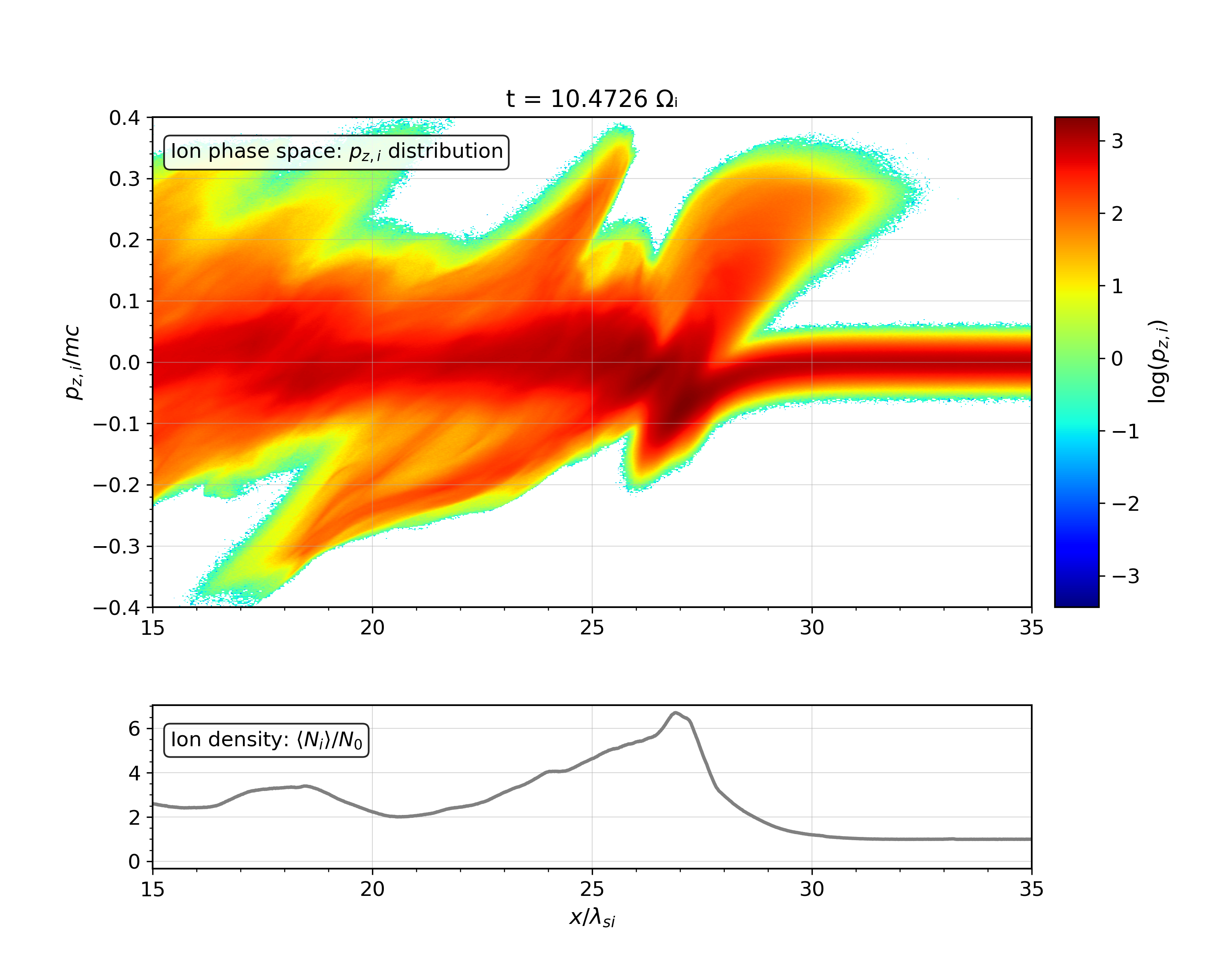
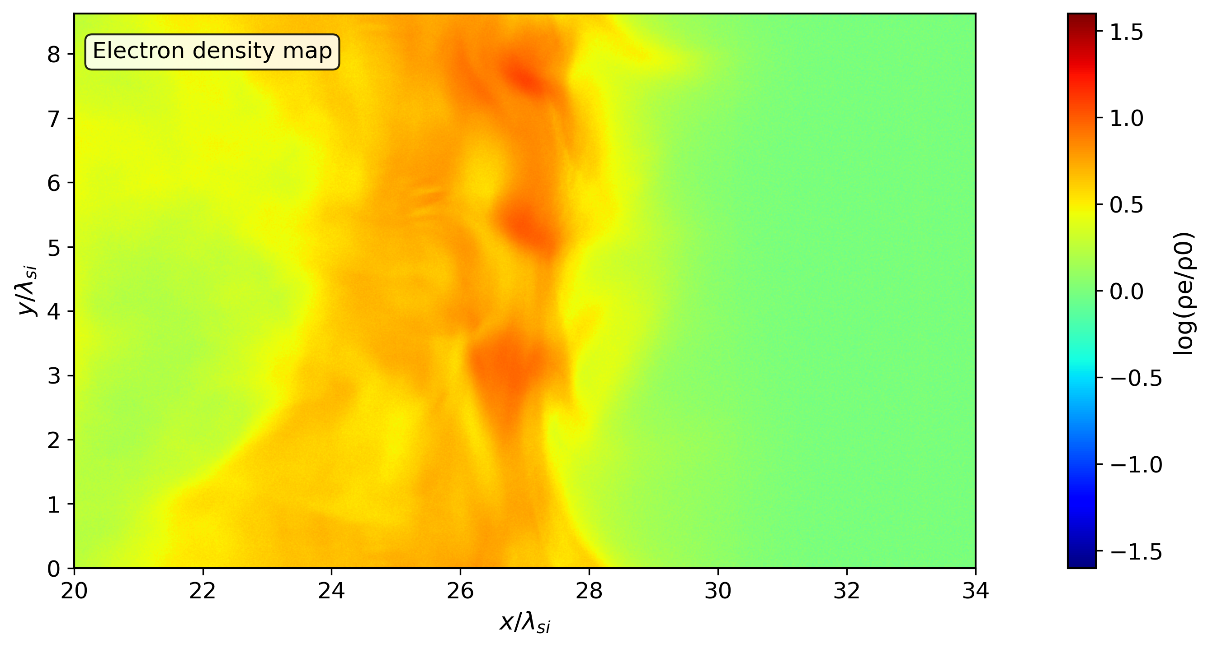
Low Mach number (β = 2, M_{A} = 8.5): ion-scale ripples

Slide 23
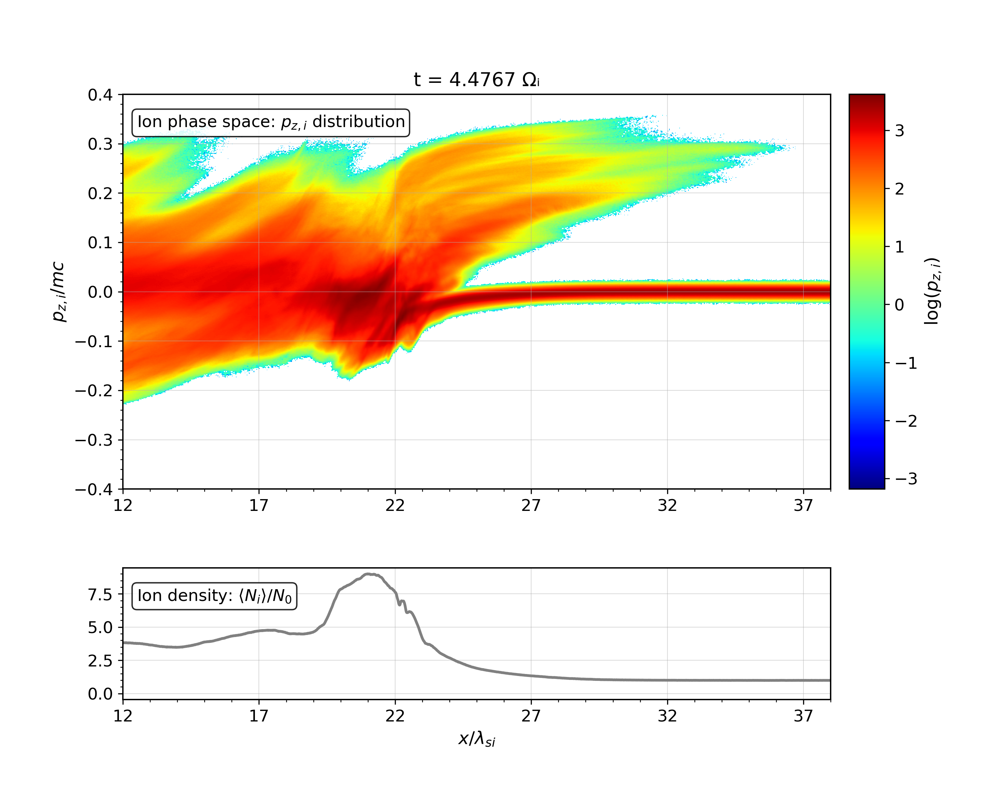
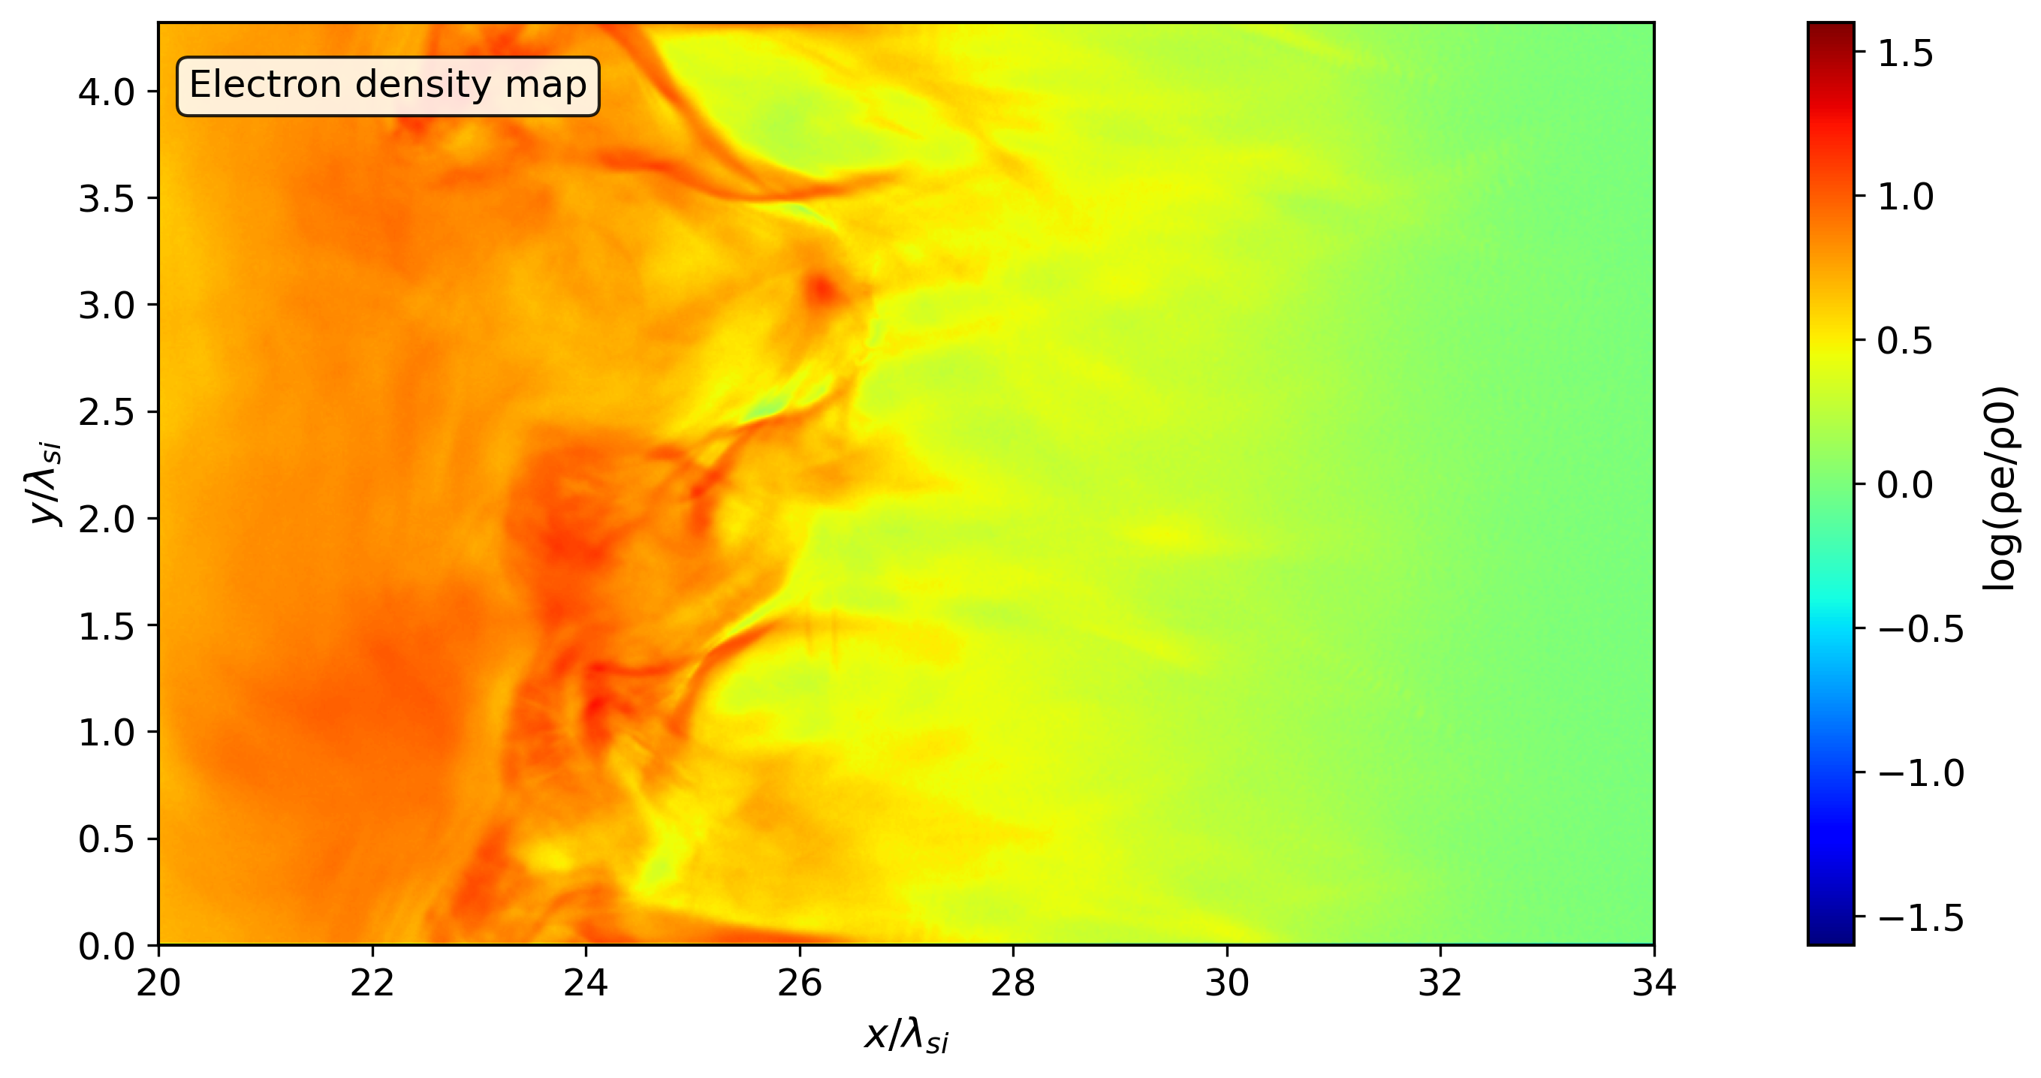
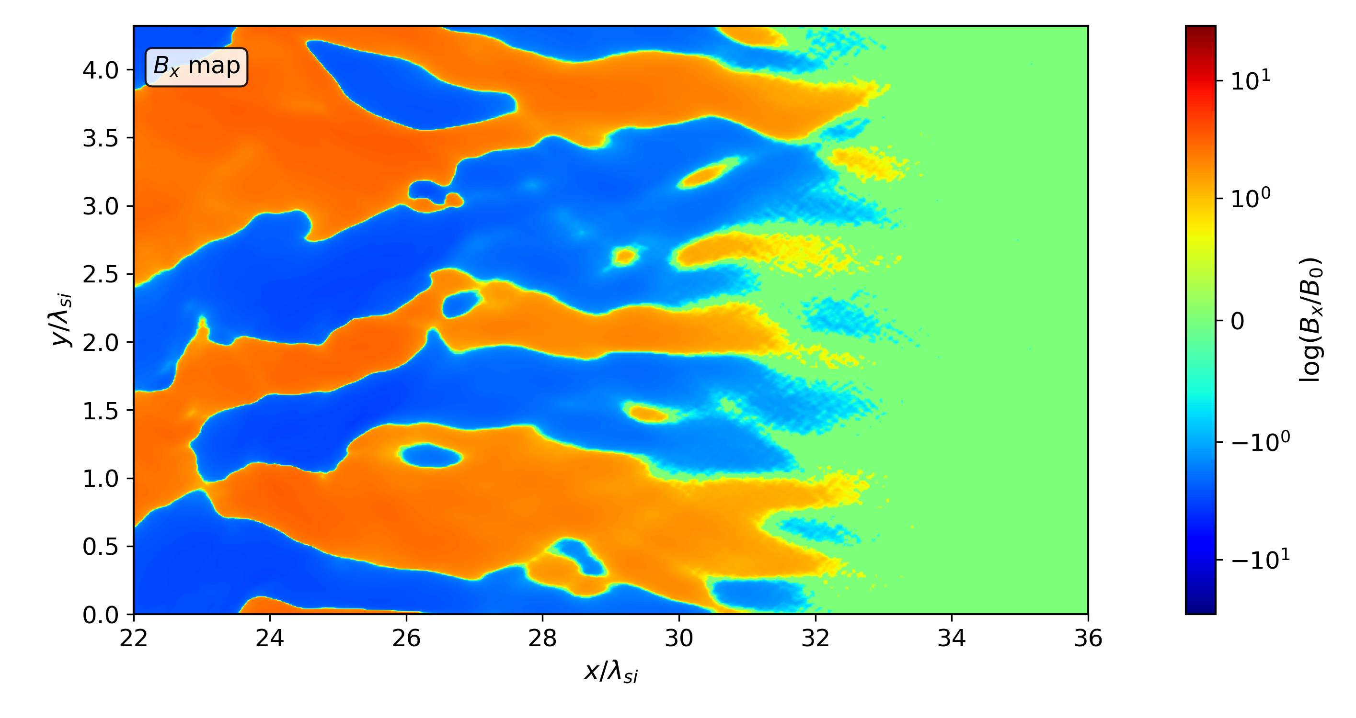
High Mach number (β = 2, M_{A} = 23): current filaments

Slide 24
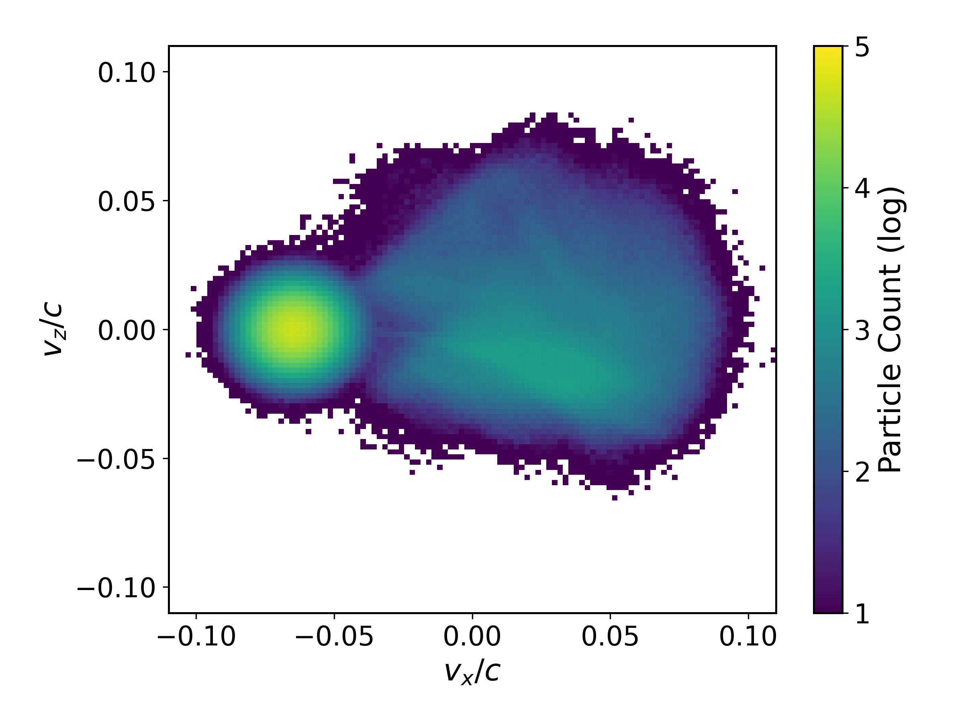
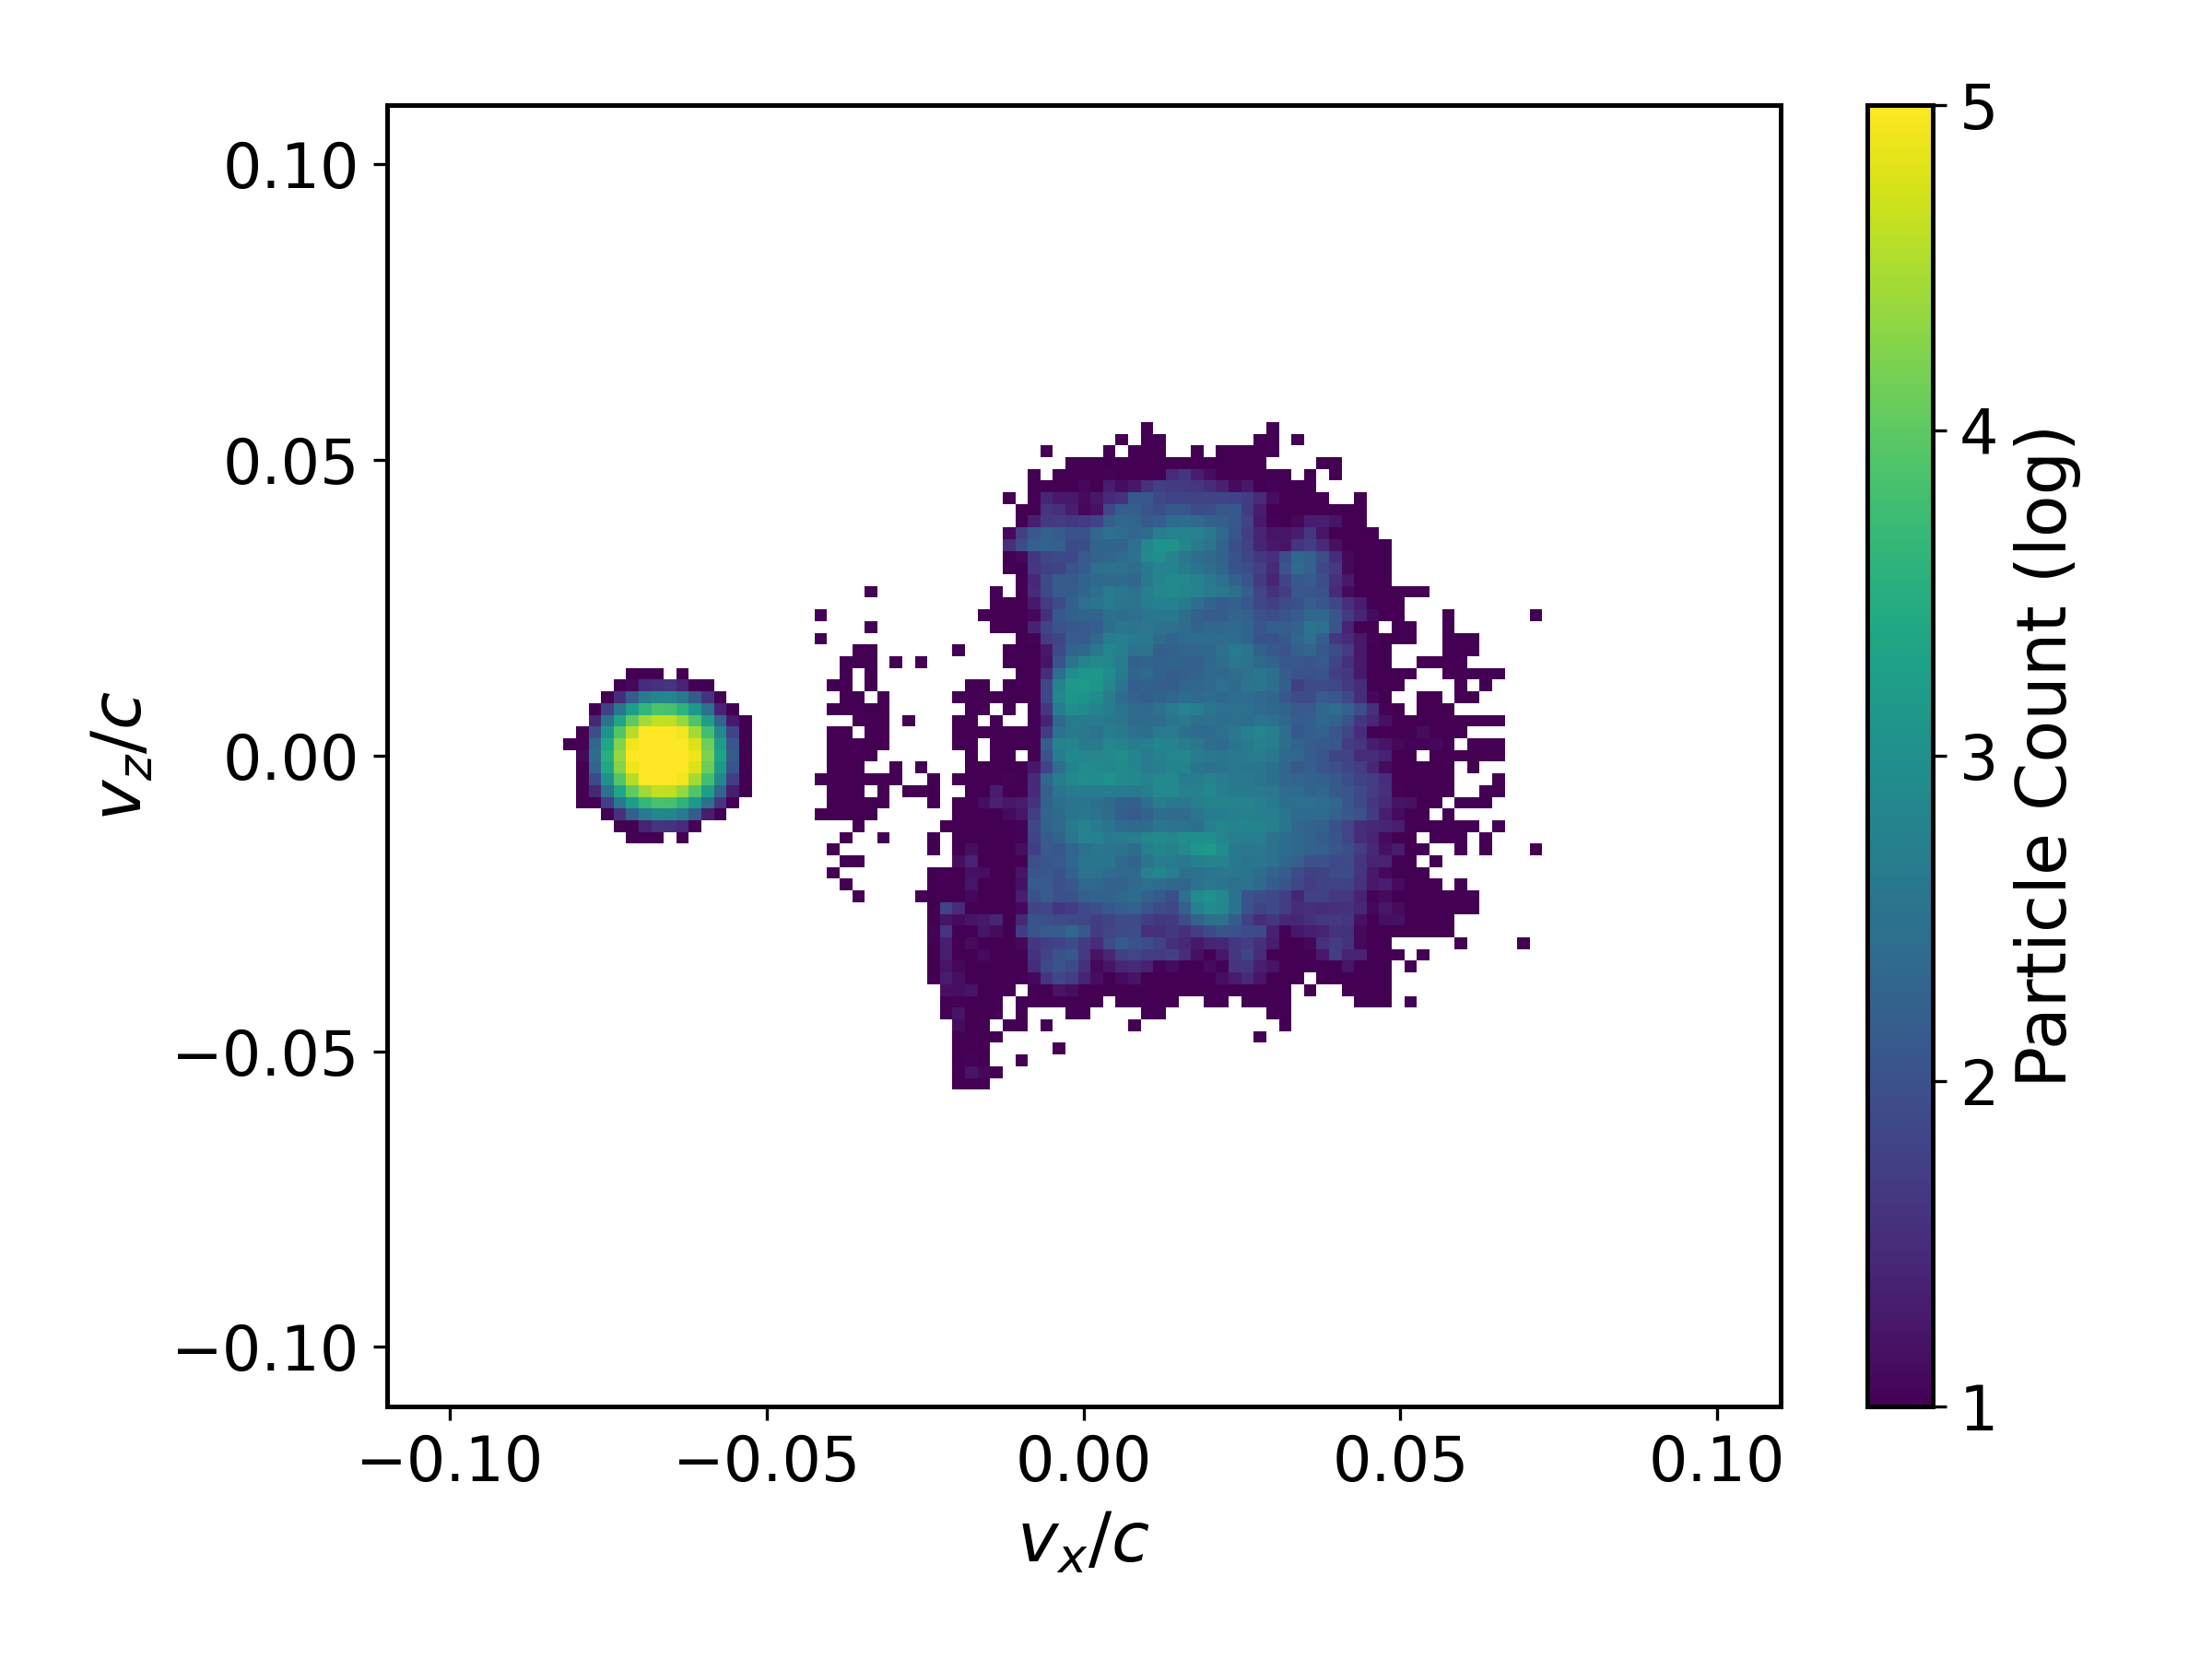
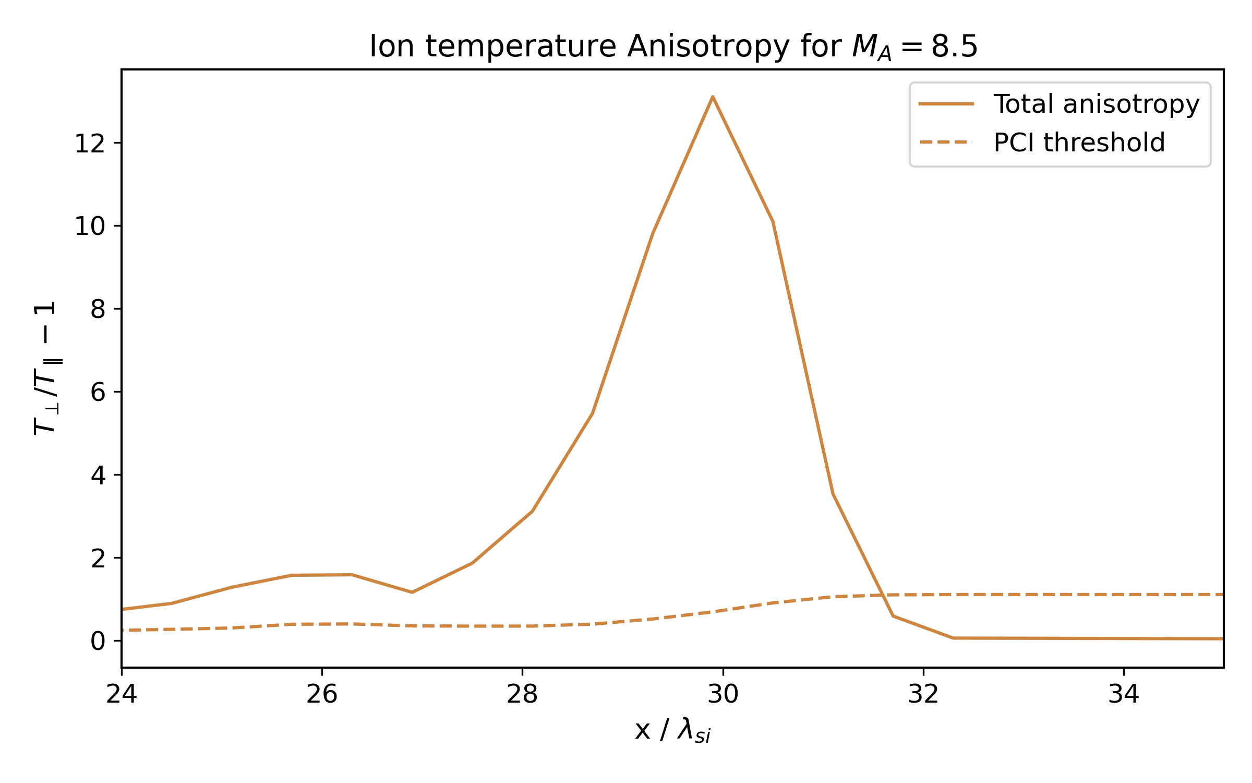
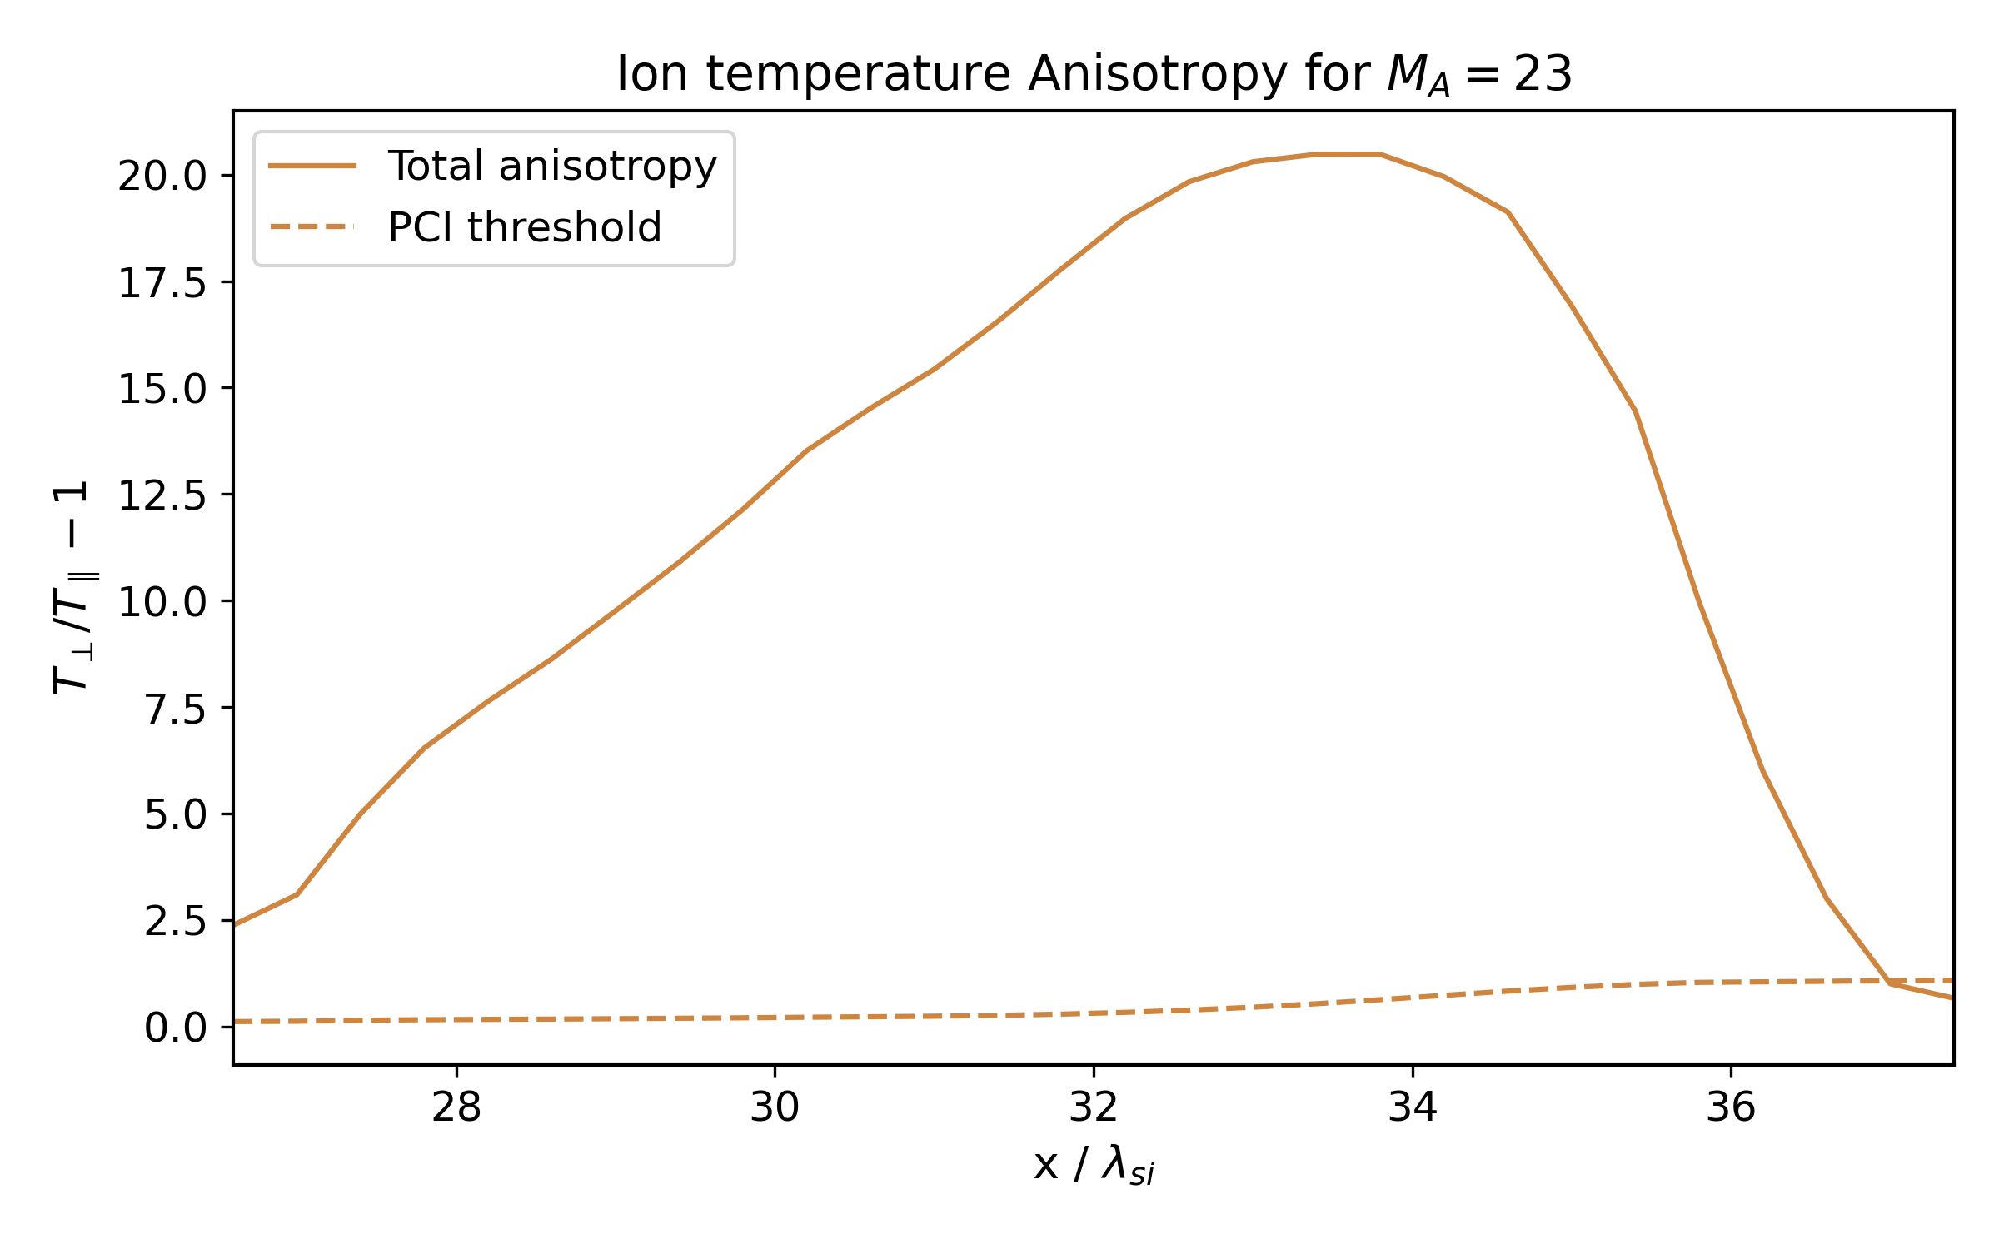
Ion Distributions & PCI threshold

Slide 25
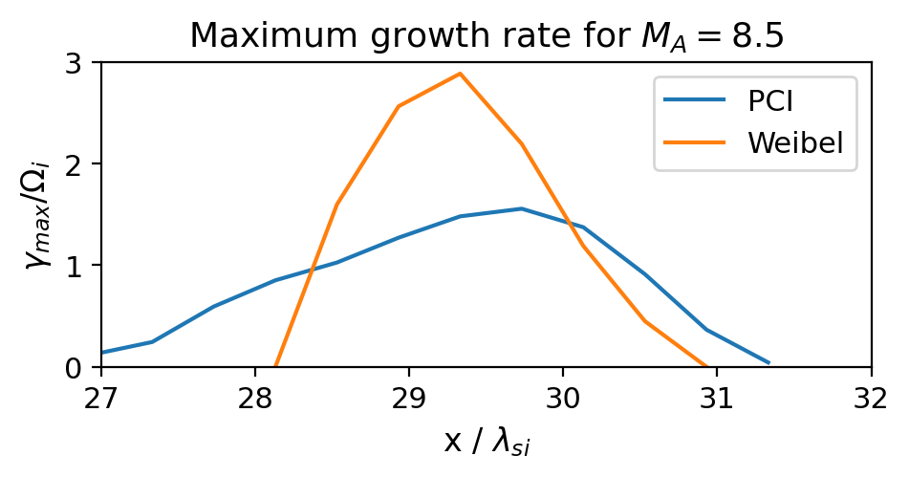
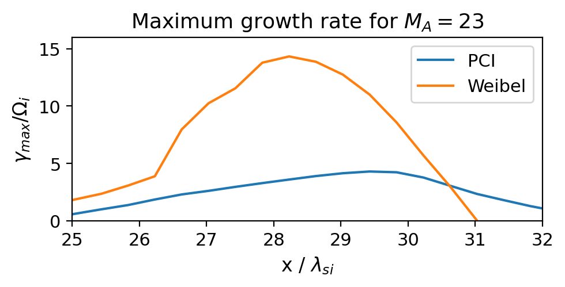
Ion Distributions & PCI and Weibel Growth Rate

Slide 26
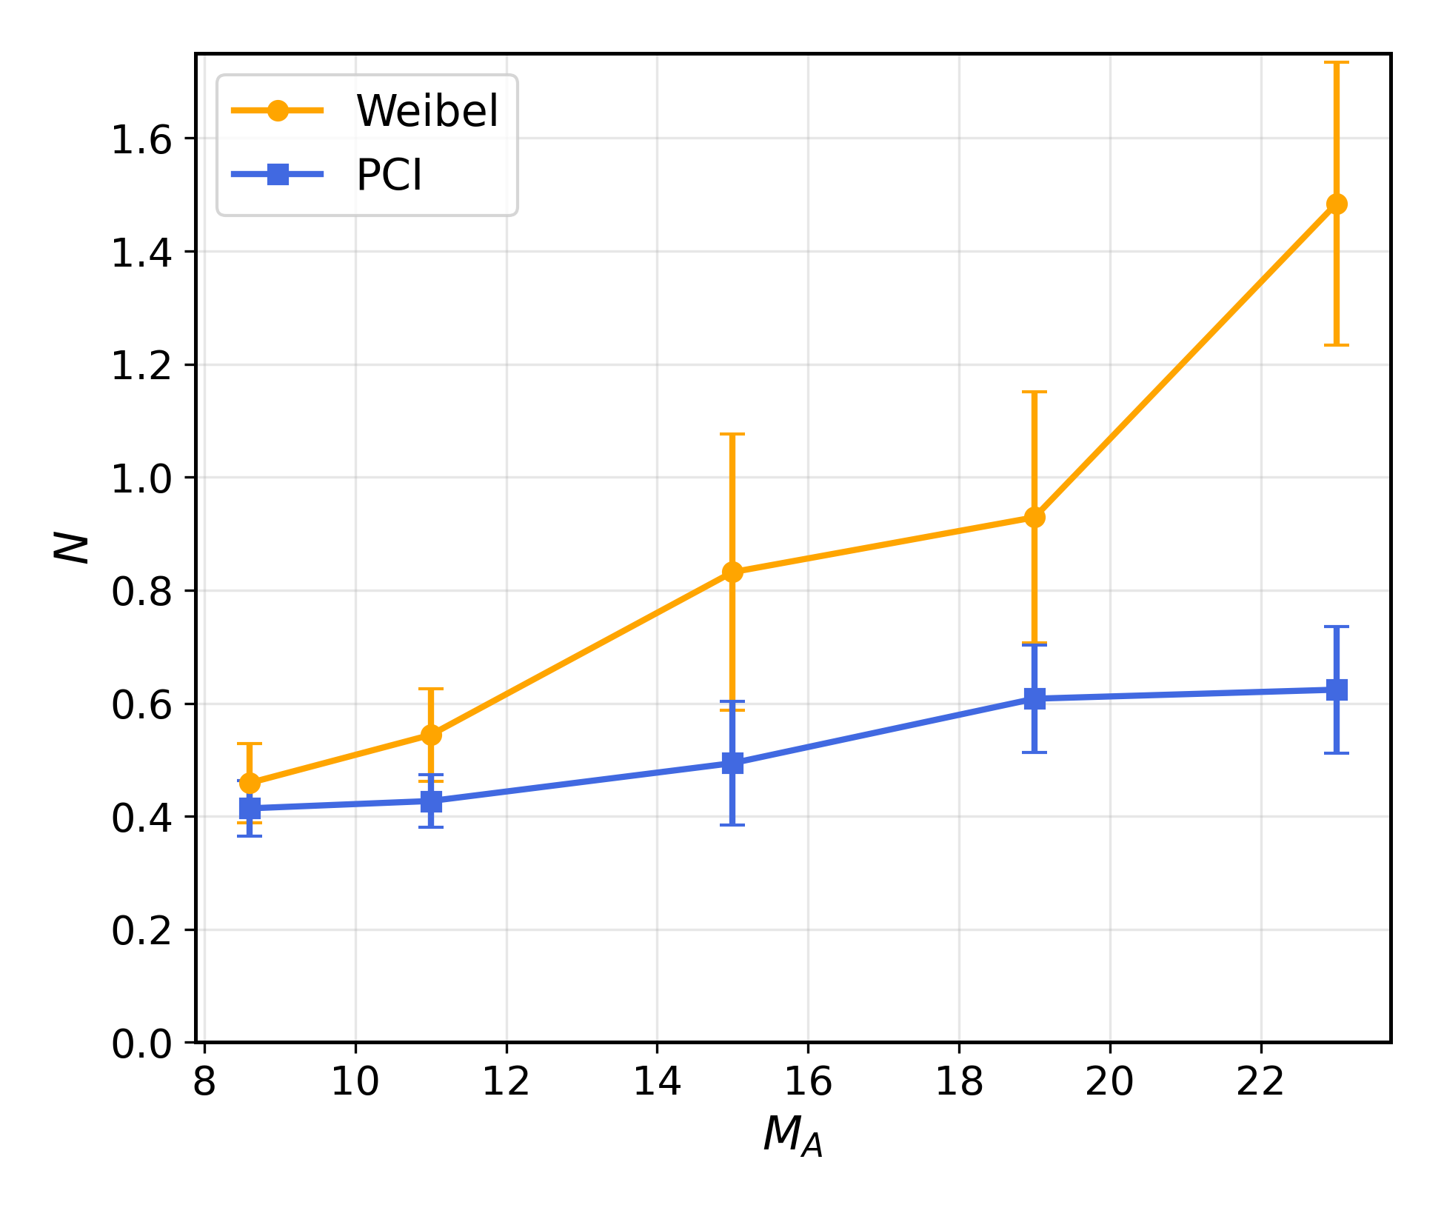
Growth numbers over time
→ e-foldings while crossing the unstable foot-ramp region, averaged over time
N_{W} ≈ 0.46,
N_{PCI} ≈ 0.41
at M_{A} = 8.5; both marginal, comparable
N_{W} ≈ 1.5,
N_{PCI} ≈ 0.6
at M_{A} = 23: Weibel dominates
N_{W} ∝ M_{A}: γ_{W} ≈ 0.1 ω_{pi}, unstable region ∝ r_{i}
N_{PCI} nearly flat: bounded by Ω_{i}, threshold rises with β_{∥i}

Slide 27
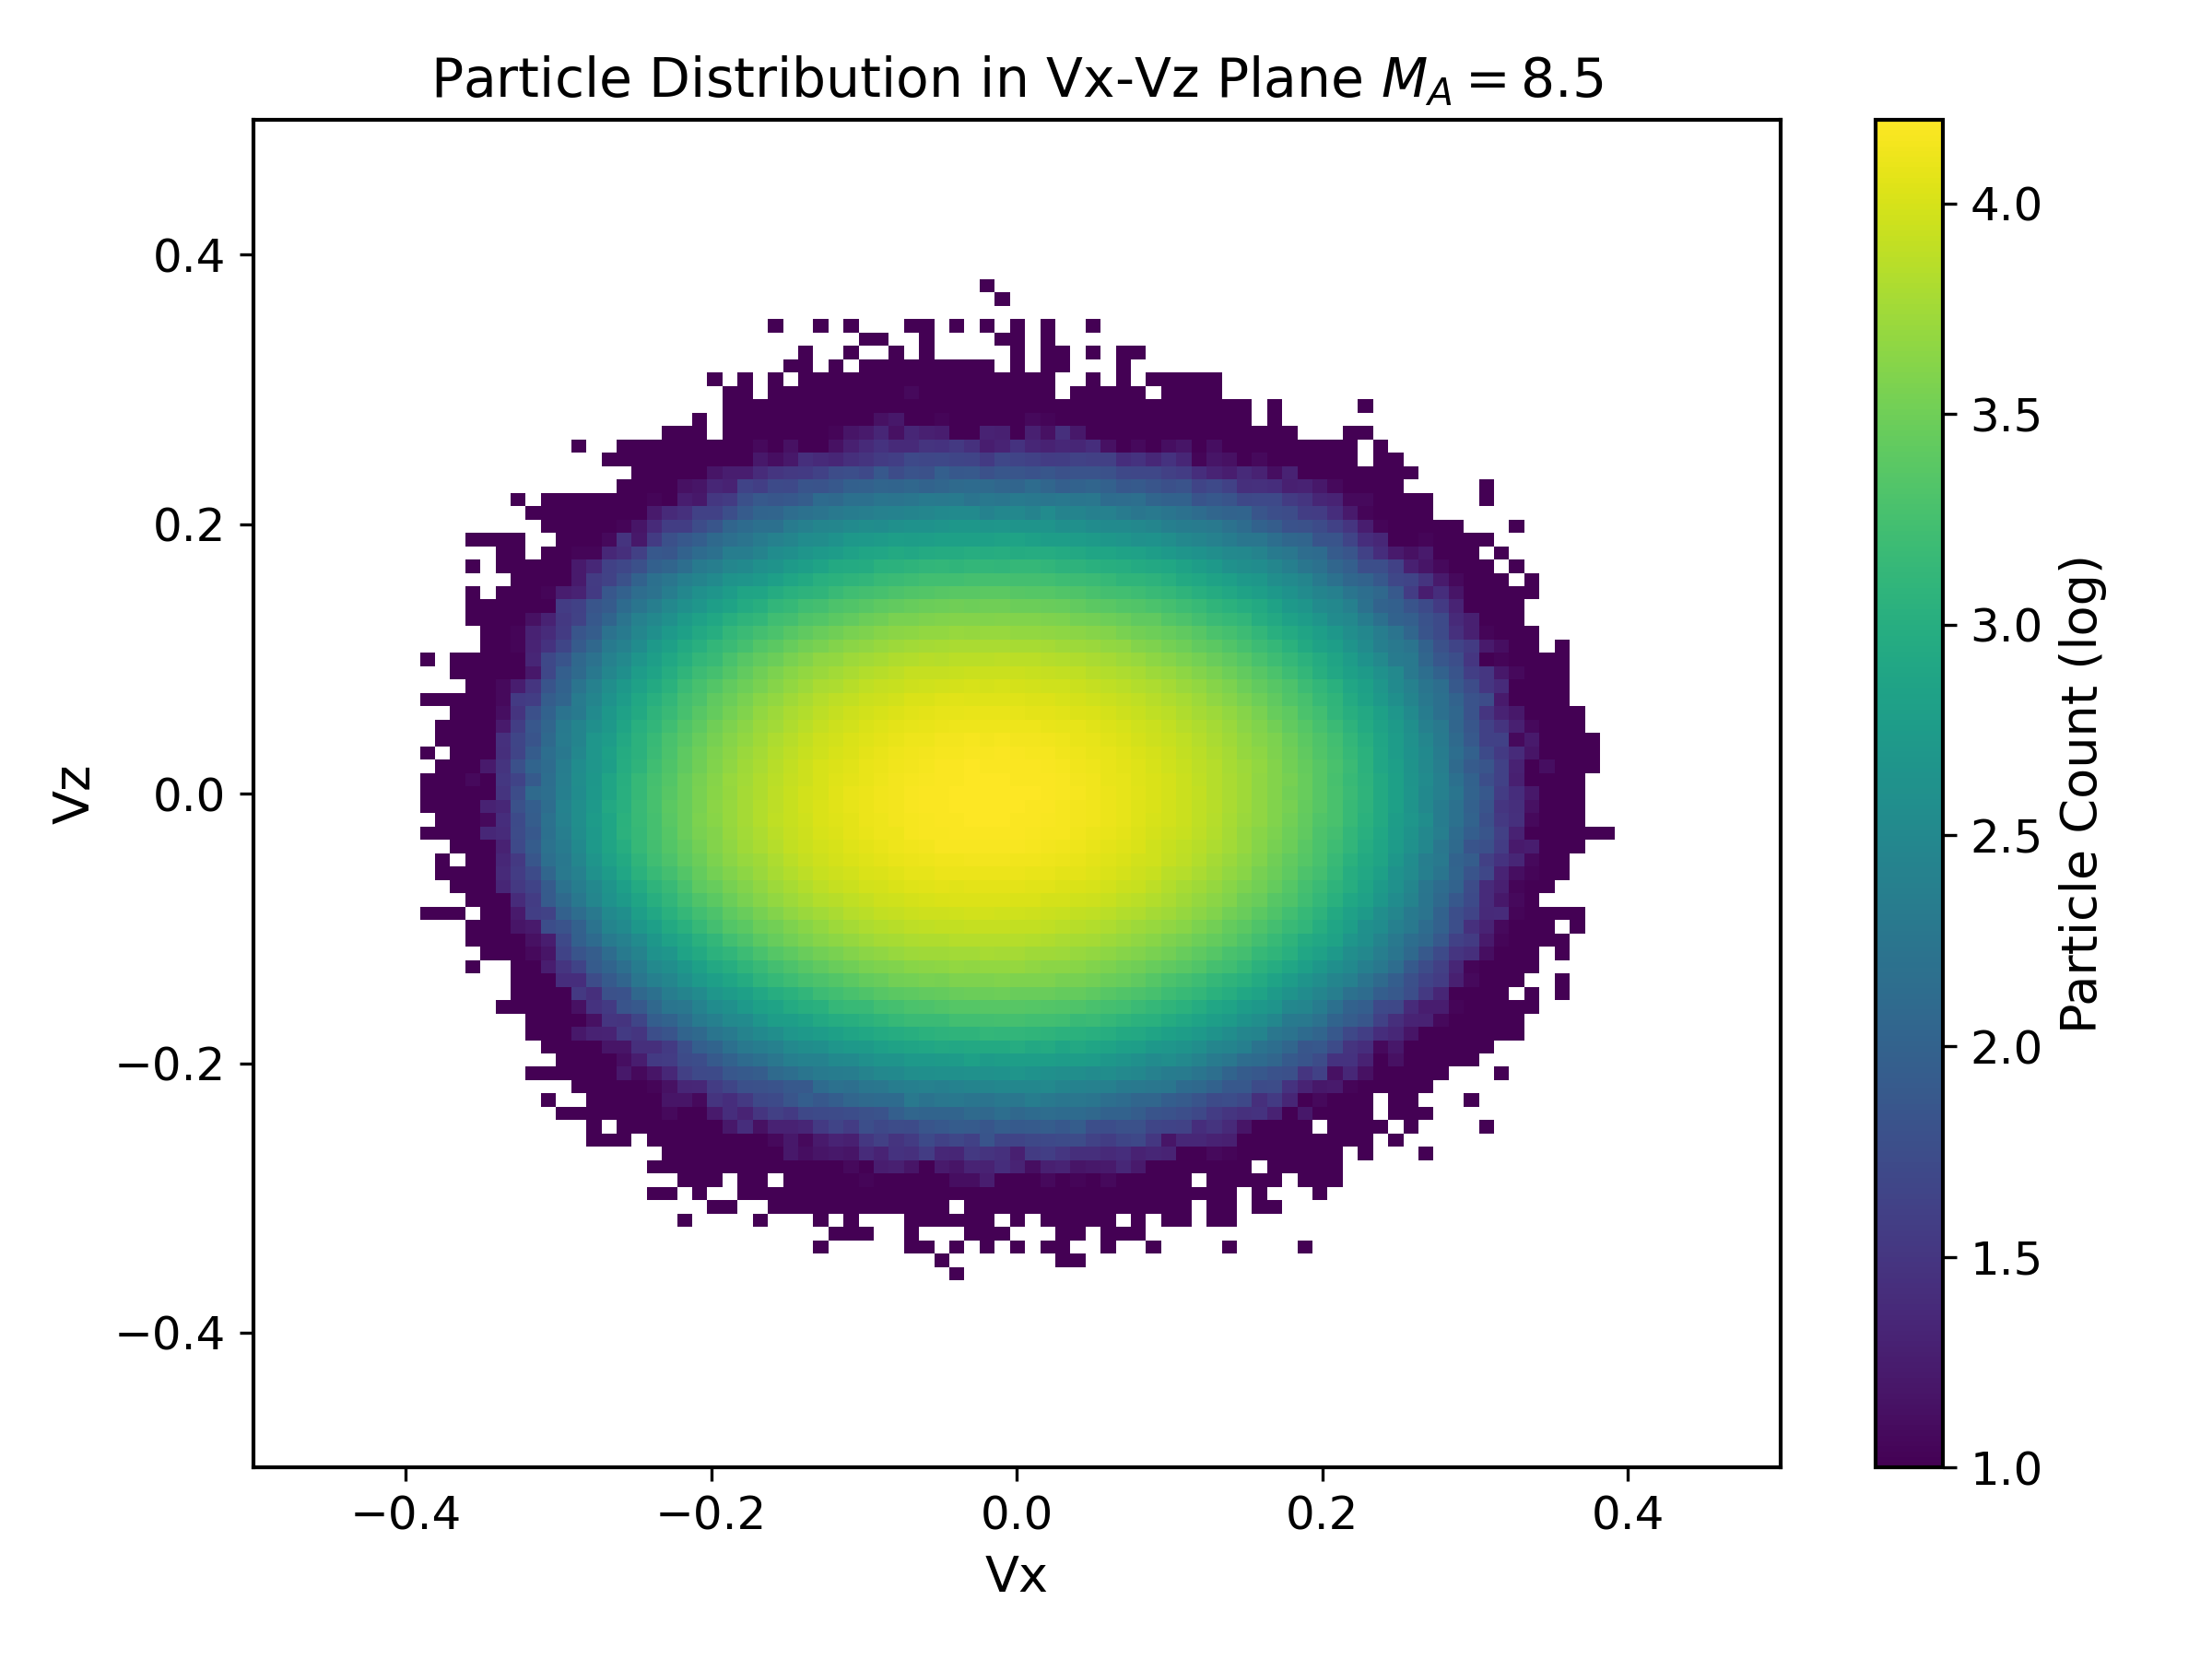
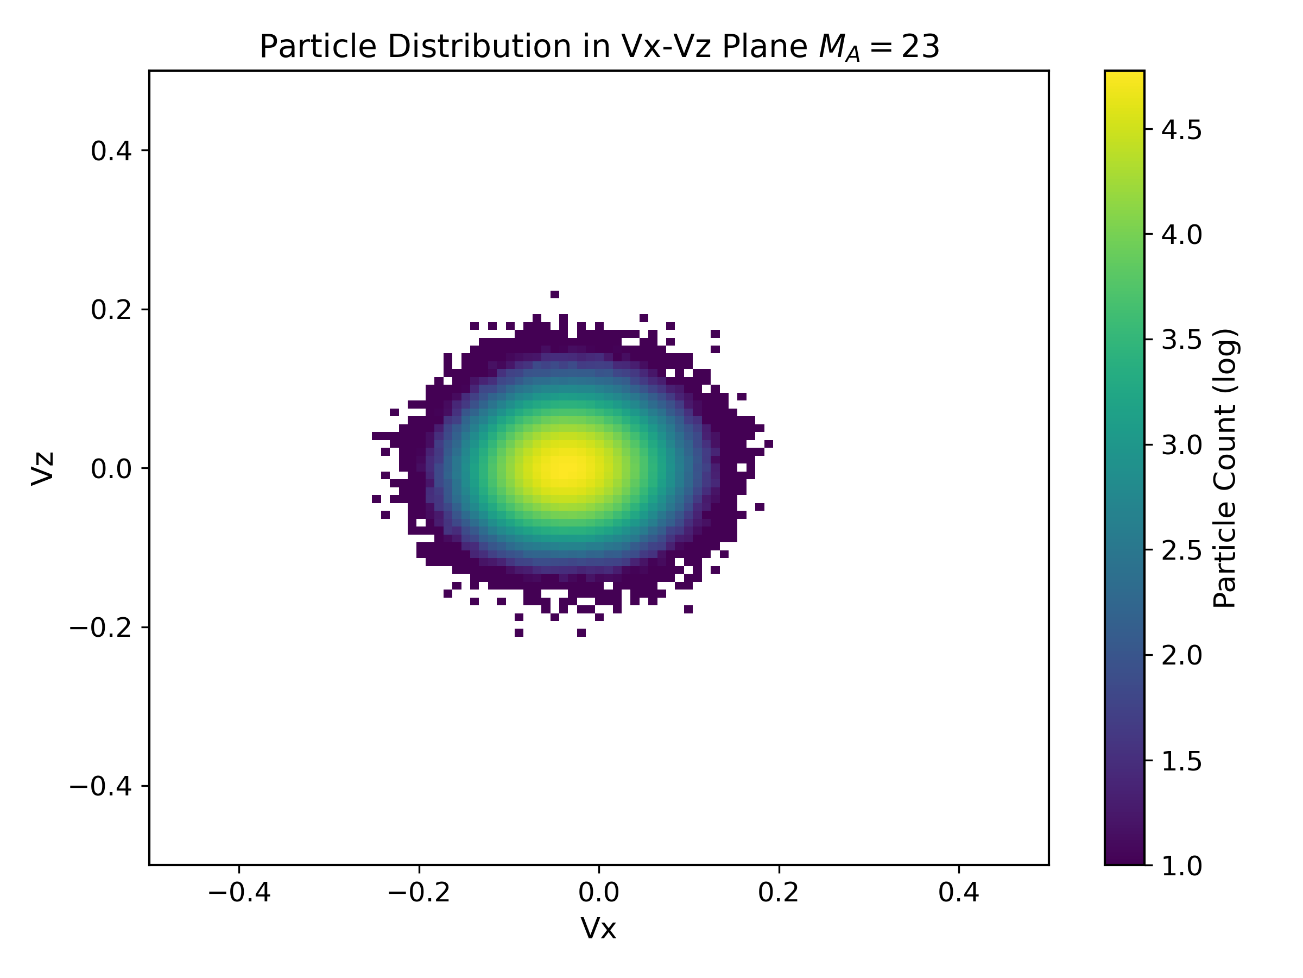
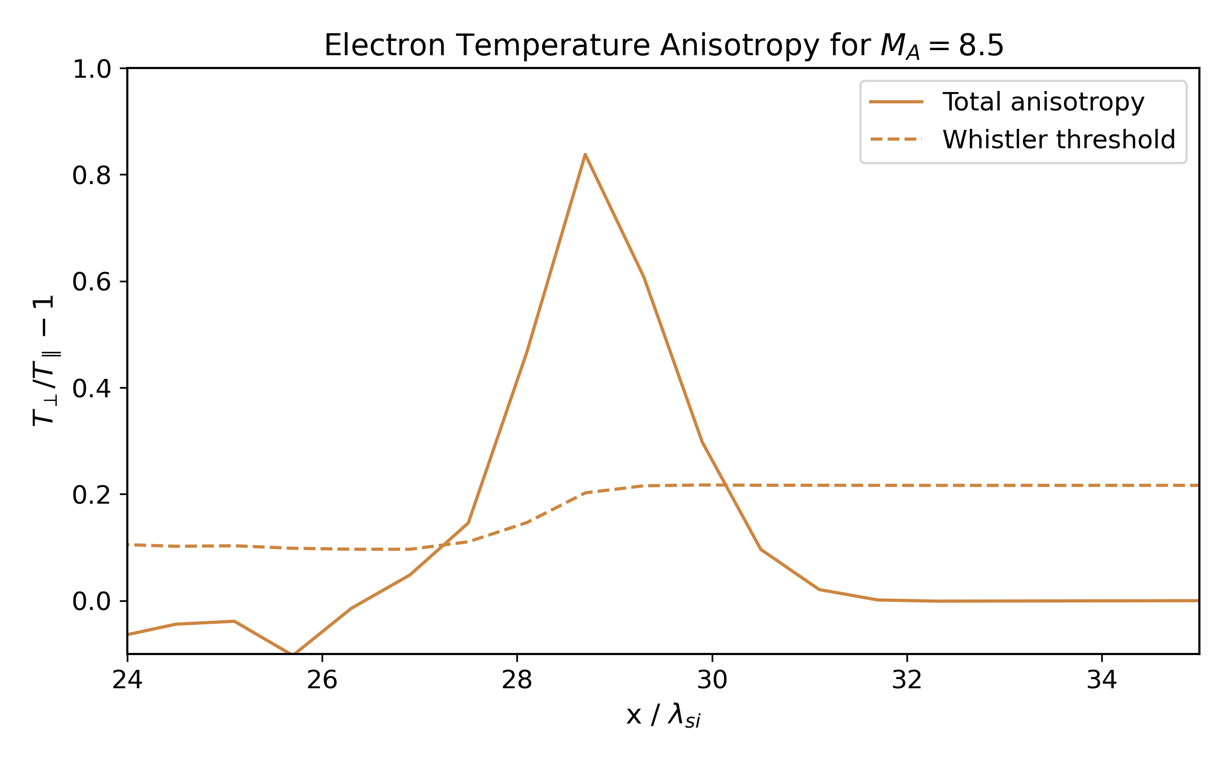
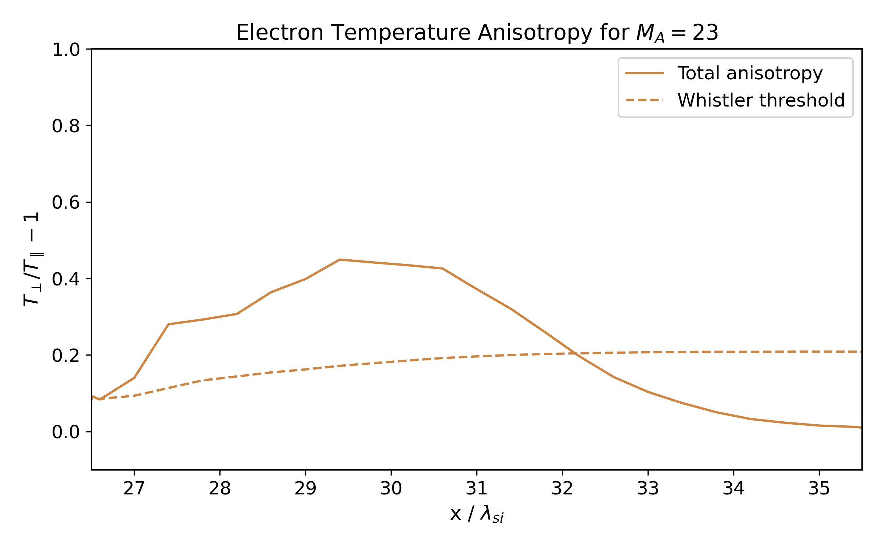
Electron Distributions & Whistler threshold

Slide 28
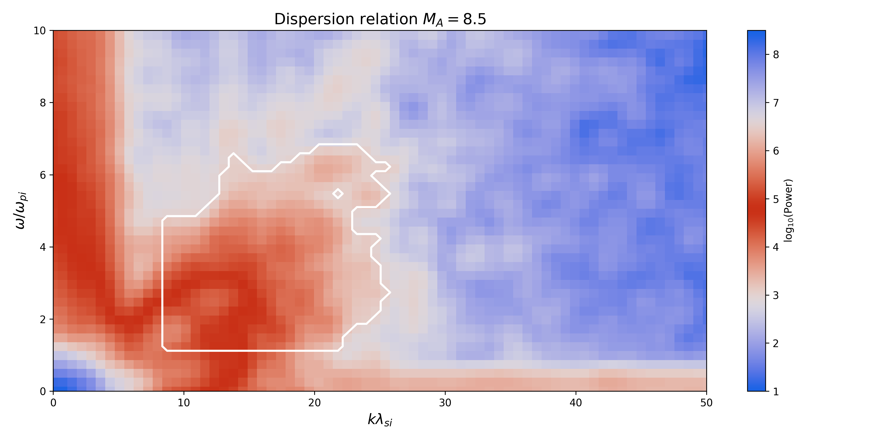
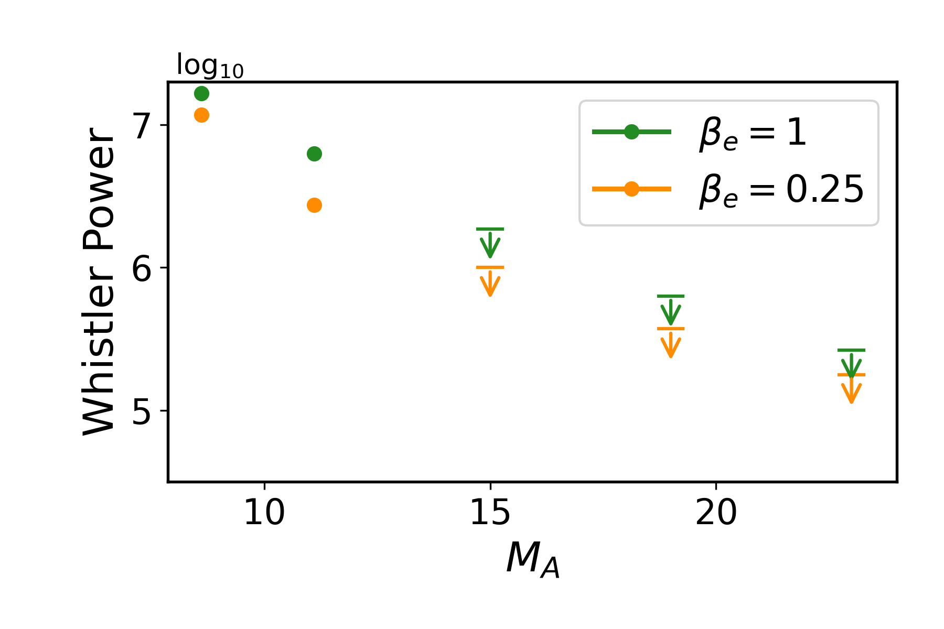
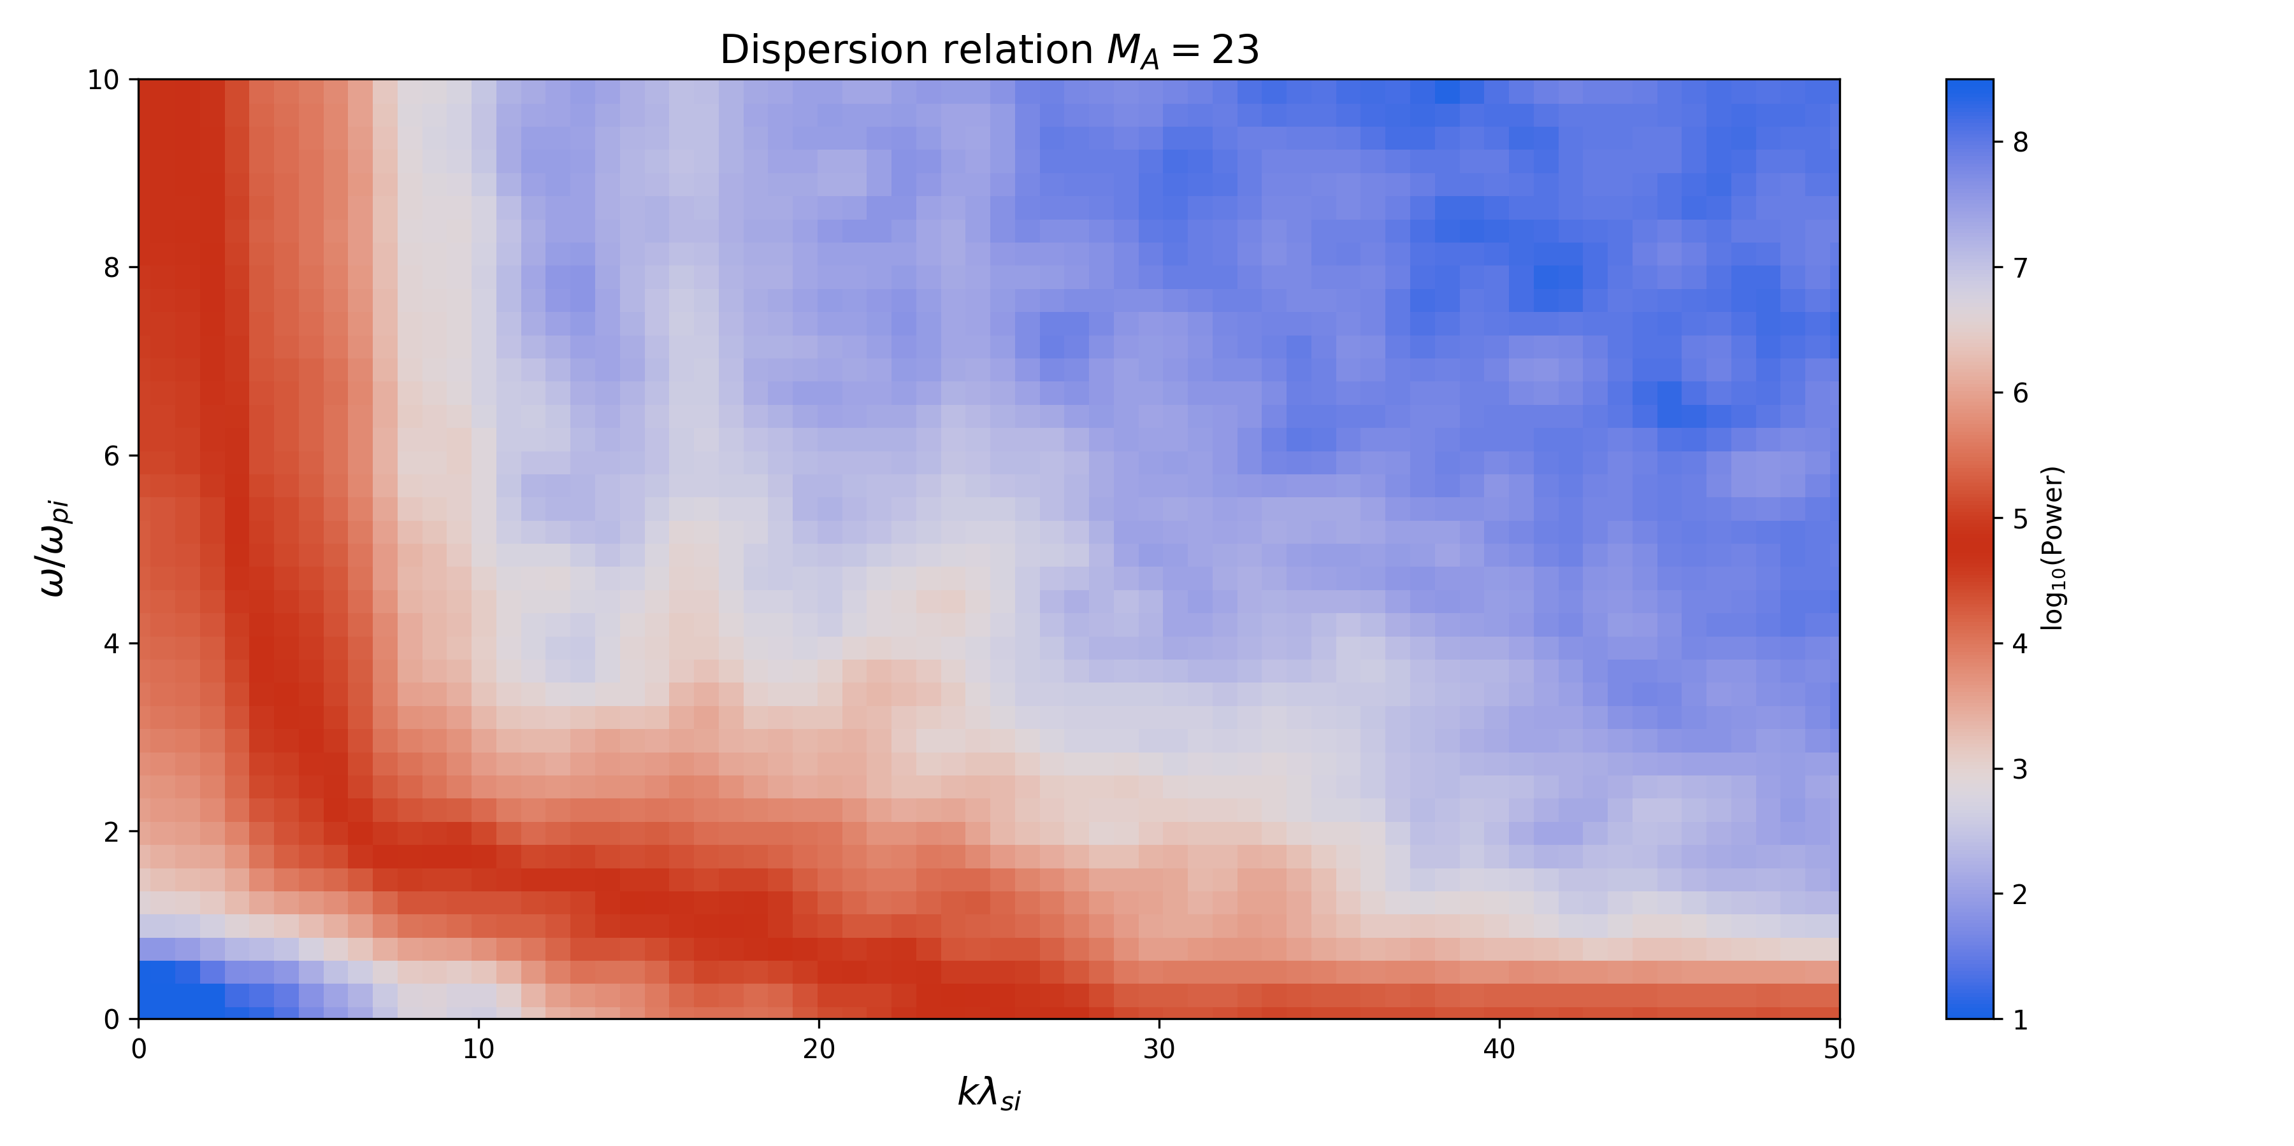
Dispersion Relation & Whistler Power
provides a diagnostic of PCI presence

Slide 29
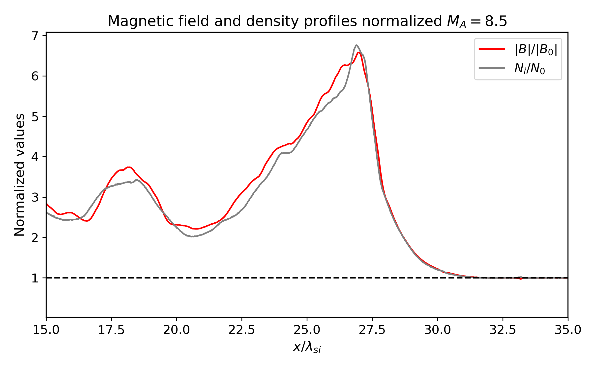
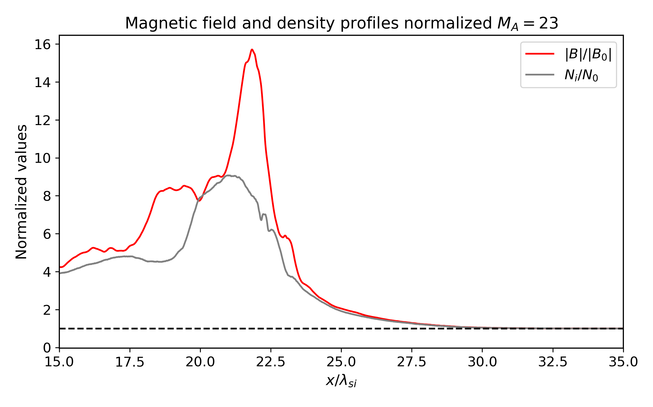
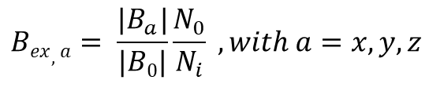
Magnetic Field Amplification
provides a diagnostic of instability-driven turbulence in the shock foot
Computation of the Non-compressional Magnetic Field Amplification
$$Bex,a= \frac{|B_{a}|}{|B0|}\frac{N_{0}}{N_{i}} , with a=x,y,z$$

Slide 30
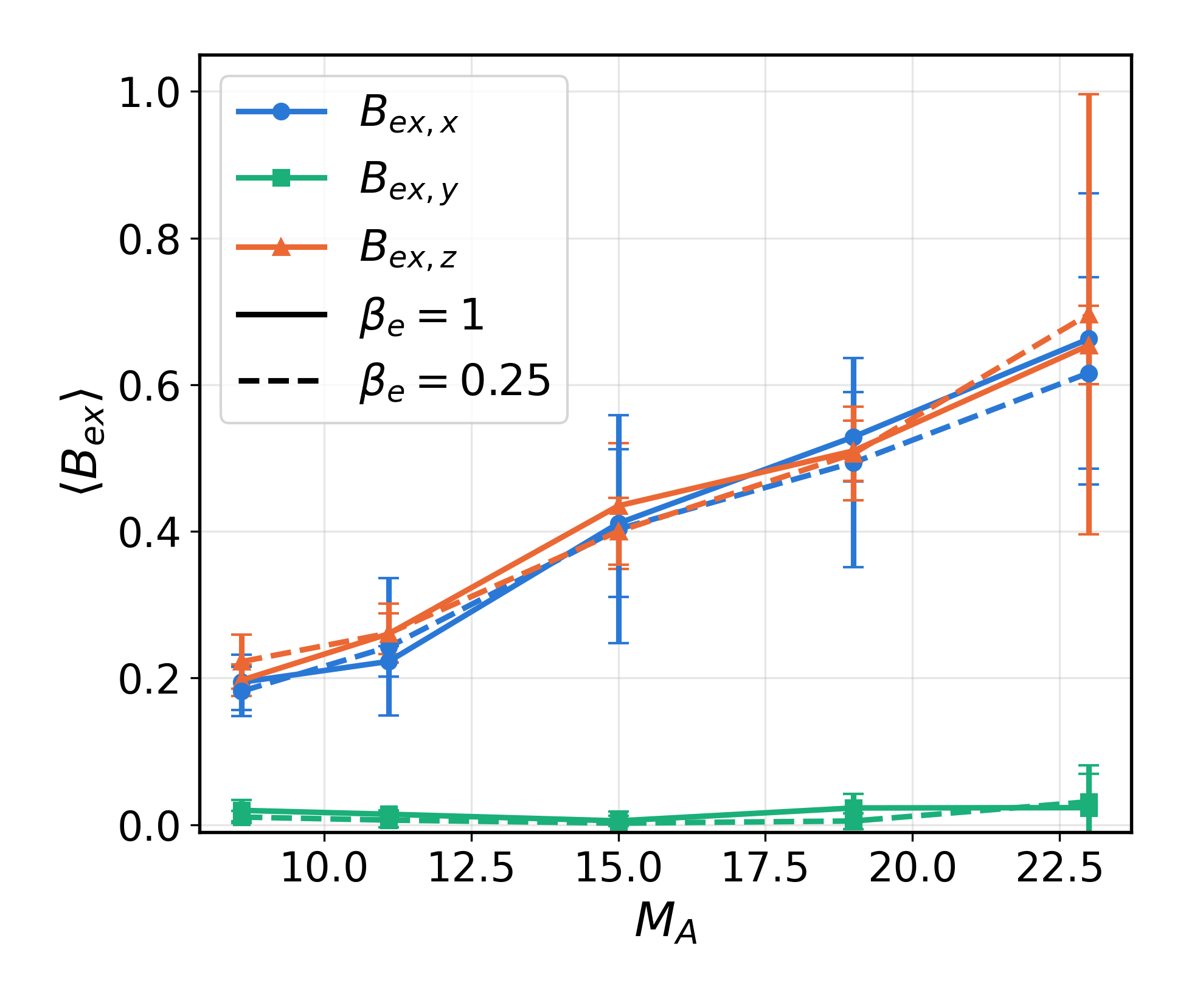
Magnetic field amplification: βₑ dependence
→ Non-compressional amplification grows with M_{A} for both electron betas
Transverse components B_{ex,x} and B_{ex,z} rise from ≈ 0.2 (M_{A} = 8.5) to ≈ 0.65 (M_{A} = 23)
β_{e} = 1 (solid) and β_{e} = 0.25 (dashed) agree within the error bars at most M_{A}
→ Field amplification is controlled by M_{A}

Slide 31
Transition from PCI / Whistler to Weibel

Slide 32
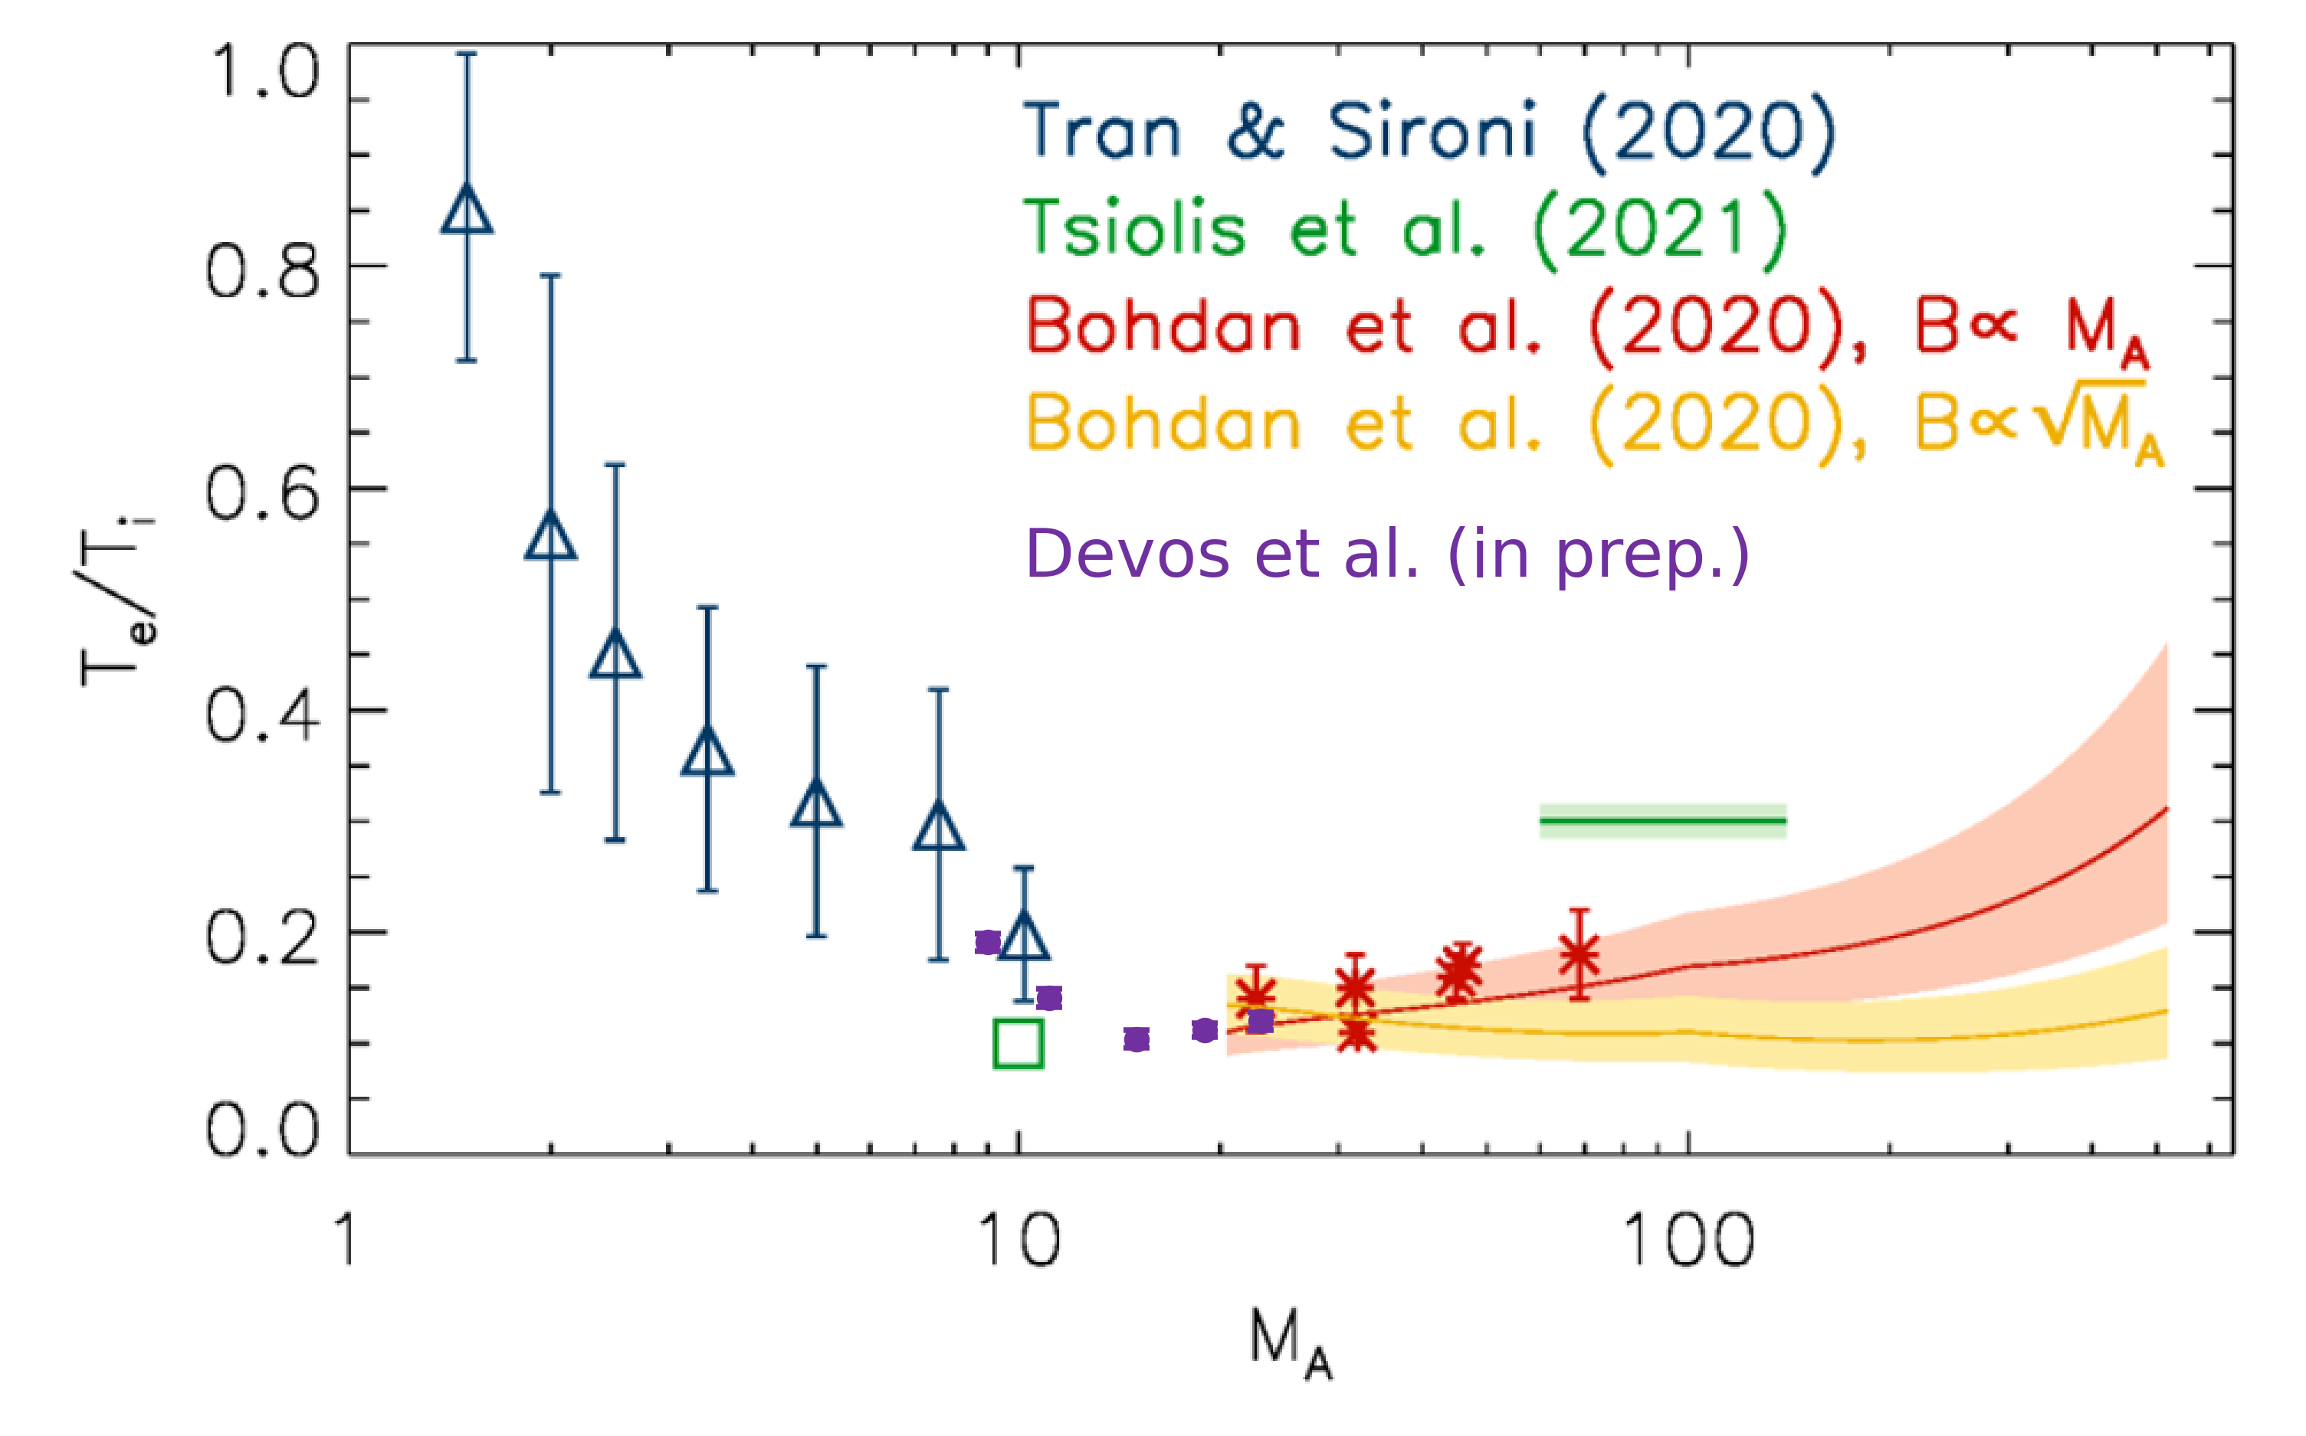
Electron heating: Tₑ/Tᵢ vs Mach number (preliminary)
→ Closing the loop with the observational question
Method
Select a downstream region, a few λ_{si} behind the ramp
For each species, remove the bulk flow: T_{s} = m_{s}⟨|v − ⟨v⟩|²⟩ / 3
Average over several time steps, then take T_{e}/T_{i}
With m_{i}/m_{e} = 100, compare trends with M_{A} rather than absolute values

Slide 33
Part V
Discussion & outlook
Linear theory, robustness, electron energisation

Slide 34
Comparison with linear theory
→ Two independent approaches, one consistent picture
Linear theory: Nishigai & Amano (2021)
Homogeneous plasma with a gyrotropic ring of reflected ions
PCI (AIC) continuously transitions to Weibel as M_{A} increases
Growth peak exceeds Ω_{i} for M_{A} ≳ 10
Fully Weibel-dominated when M_{A} and M_{s} ≳ 20–40
This work: self-consistent shock PIC
Local plasma parameters measured inside the shock transition
N_{W} ∝ M_{A} (0.46 → 1.5),
N_{PCI} nearly flat (0.4 → 0.6)
Weibel decisively dominant at M_{A} ≈ 20–23
Weibel-like behaviour sets in progressively and dominates for M_{A} ≳ 20

Slide 35
How robust are these results?
→ Reduced mass ratio, shock speed, electron beta, 2D
Mass ratio m_{i}/m_{e} = 100
Whistler heating efficiency varies by < 30 % for m_{i}/m_{e} = 49–1600 (Guo et al. 2017, 2018). Ion anisotropy profiles are similar for 100 and 1836 (Boula et al. 2024). Weibel: set by beam density and drift, so a weak dependence is expected.
Shock velocity
All diagnostics are normalised to Ω_{i} and λ_{si}: the results depend on M_{A} and β, not on v_{sh} (Boula et al. 2024).
Electron beta
β_{e} = 1 vs β_{e} = 0.25: same trend in magnetic field amplification (new runs).
Dimensionality
2D3V with in-plane B₀, which captures k ∥ B₀ modes. Fully 3D effects (filament merging, oblique modes) are beyond this setup.

Slide 36
Implications for electron energisation
 | Low Mach | High Mach
 | M_{A} ≲ 10 | M_{A} ≳ 20
Ion-scale instability | PCI + whistler | Weibel filamentation
Fluctuations | Coherent, propagating waves | Quasi-static filaments, δB ~ B₀
Electron scattering | Resonant pitch-angle scattering | Non-resonant; Buneman / shock surfing
Electron heating | Whistler pre-heating | Open: Tₑ/Tᵢ under study
Injection | Whistlers provide the scattering SSDA needs | Does SSDA survive filaments and reconnection?
Hypotheses to be tested with Tₑ/Tᵢ(M_{A}) and electron spectra. SSDA: Katou & Amano (2019); Amano et al. (2020).

Slide 37
Summary
Key results
PCI–whistler pathway dominates at low M_{A} (≲ 10)
Whistler power drops by more than an order of magnitude from M_{A} = 8.5 to 23 (both βₑ)
Weibel instability takes over at high M_{A} (≳ 20)
N_{W} ∝ M_{A} (0.46 → 1.5), while N_{PCI} stays nearly flat (0.4 → 0.6)
Magnetic field amplification increases with M_{A}, for both βₑ = 1 and 0.25
Consistent with linear theory (Nishigai & Amano 2021)
Te/Ti bridges previous studies with a shallow minimum in the transition range (preliminary)

Slide 38
Outlook
Next steps
Electron heating across the transition: Tₑ/Tᵢ(M_{A}) over many time steps, and downstream electron spectra
Particle tracing: where and how do electrons gain energy?
Low M_{A}: whistler scattering, stochastic shock drift acceleration (SSDA)
High M_{A}: Buneman-driven shock surfing, Weibel filaments
Does SSDA survive in Weibel-dominated shocks?
Comparison with laboratory experiments (see Valentina’s talk)
Thank you!
Questions?

