Slide 1
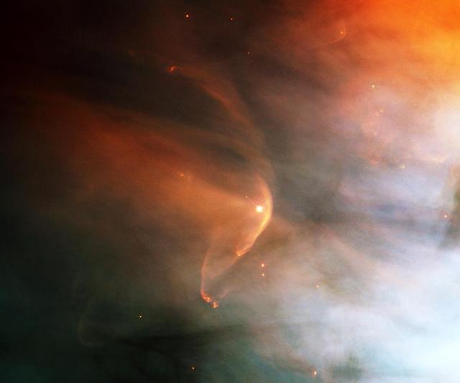
Study of magnetic field amplification on Earth’s bow shock: MMS observations and PIC simulations.
Discussions and synergies on astrophysical plasma with PIC simulations – Prague 2026
Valentina Villaflor¹
Artem Bohdan², Frank Jenko³
valentina.villaflor@ipp.mpg.de¹, artem.bohdan@ipp.mpg.de², frank.jenko@ipp.mpg.de³

Slide 2

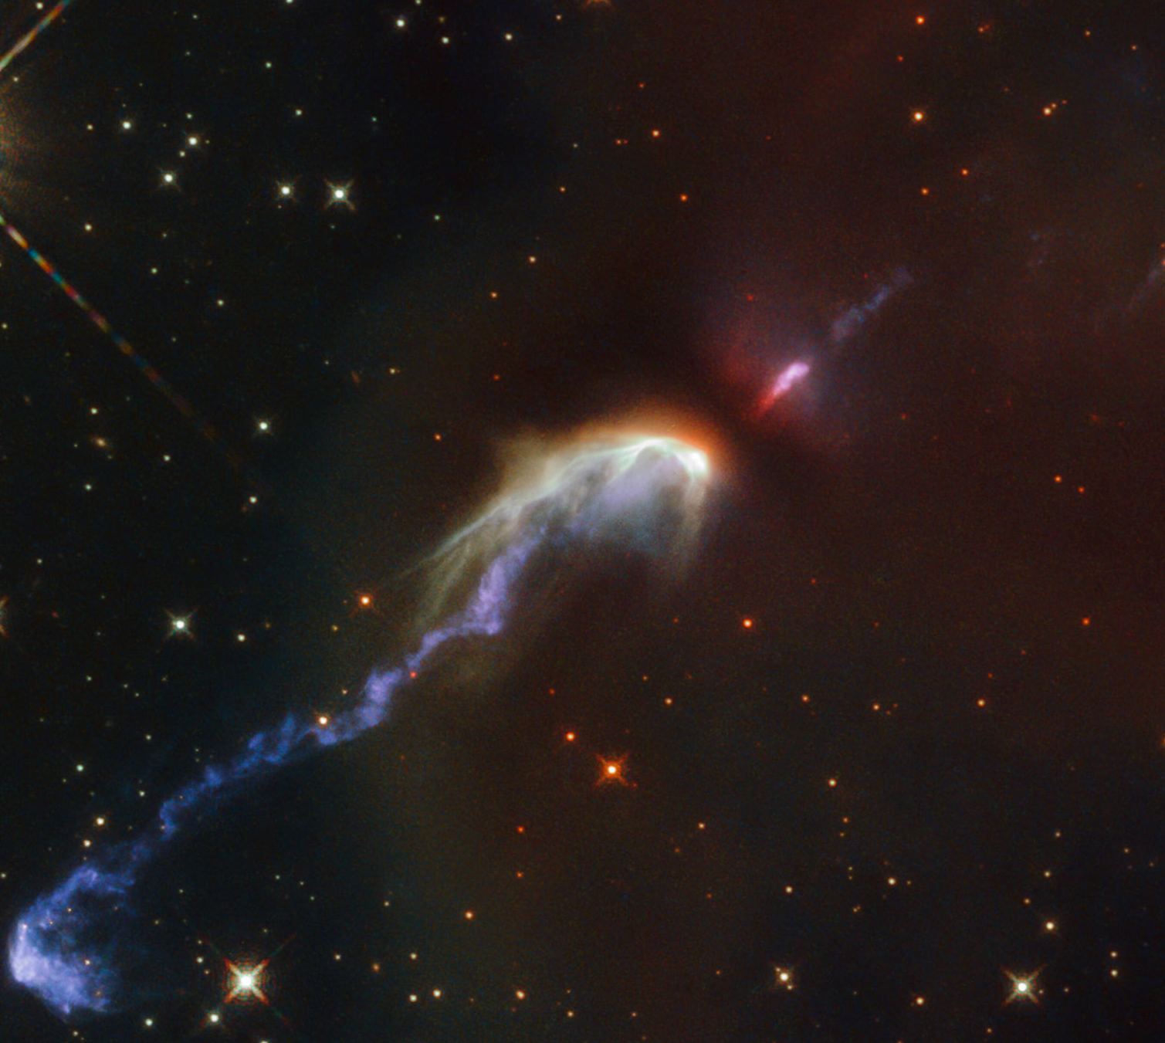
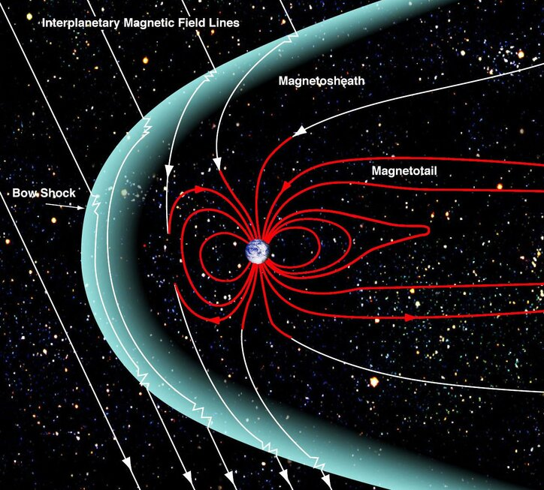
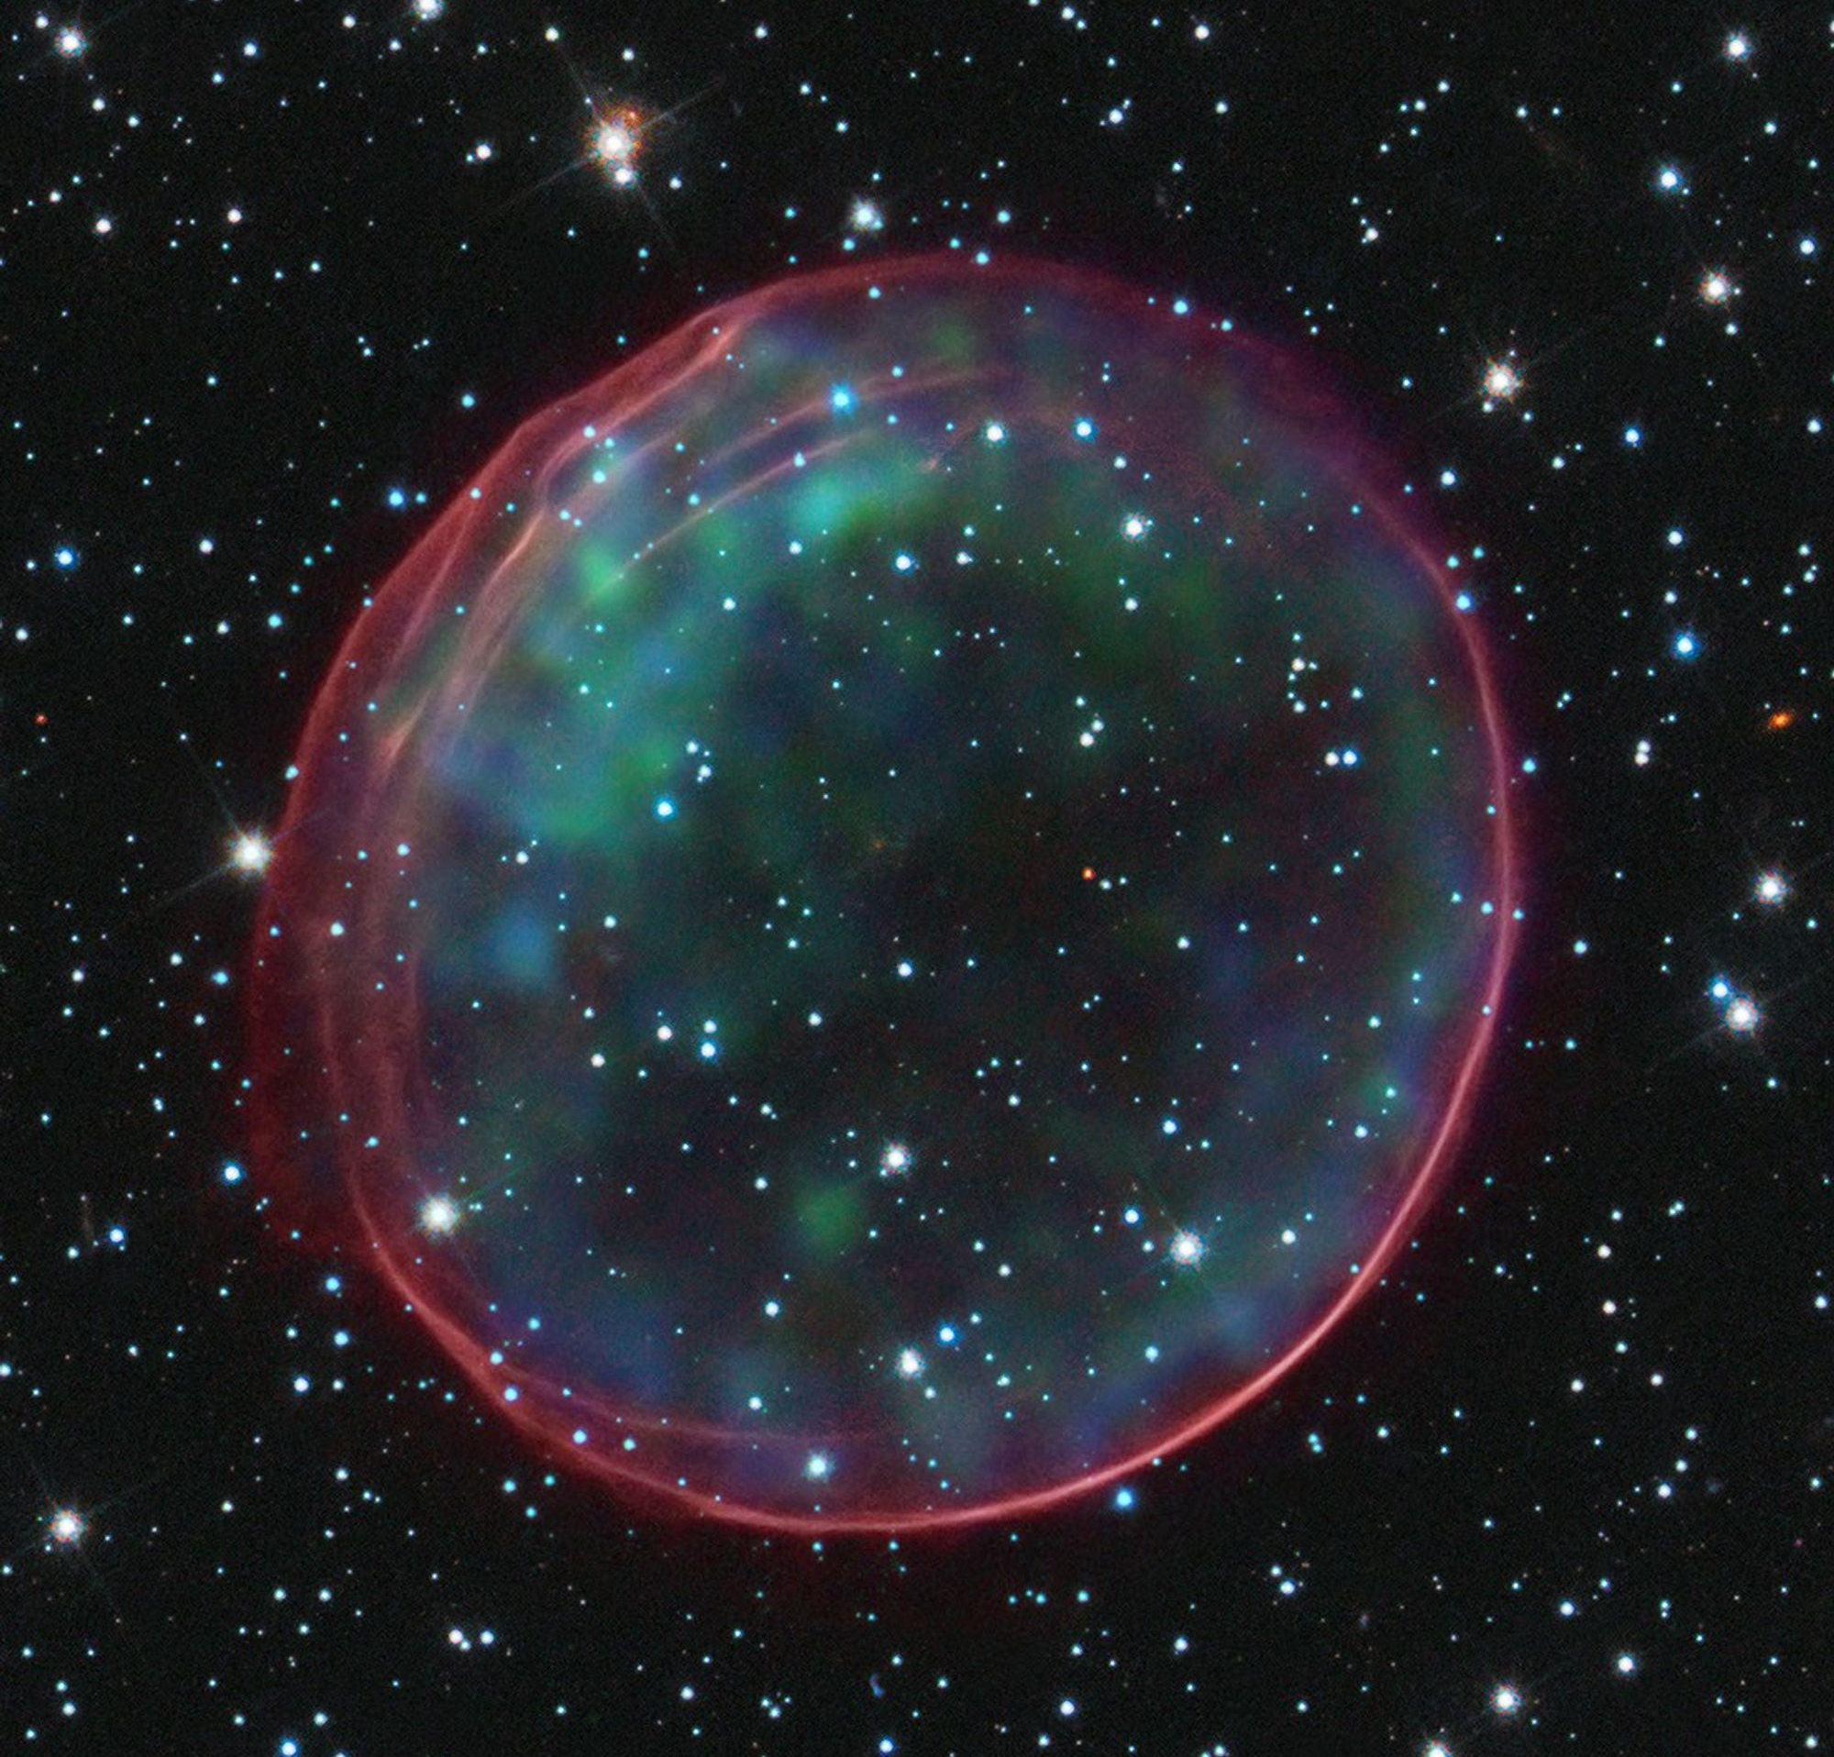
Collisionless Shocks
In collisionless shocks the main dissipation pathway involves nonlinear interactions of charged particles and electromagnetic fluctuations.
In our solar system we can study planetary bow shocks with several missions:
In
Maven (Mars) - 2013
Cassini (Saturn) - 1997
MMS (Earth) - 2015

Slide 3
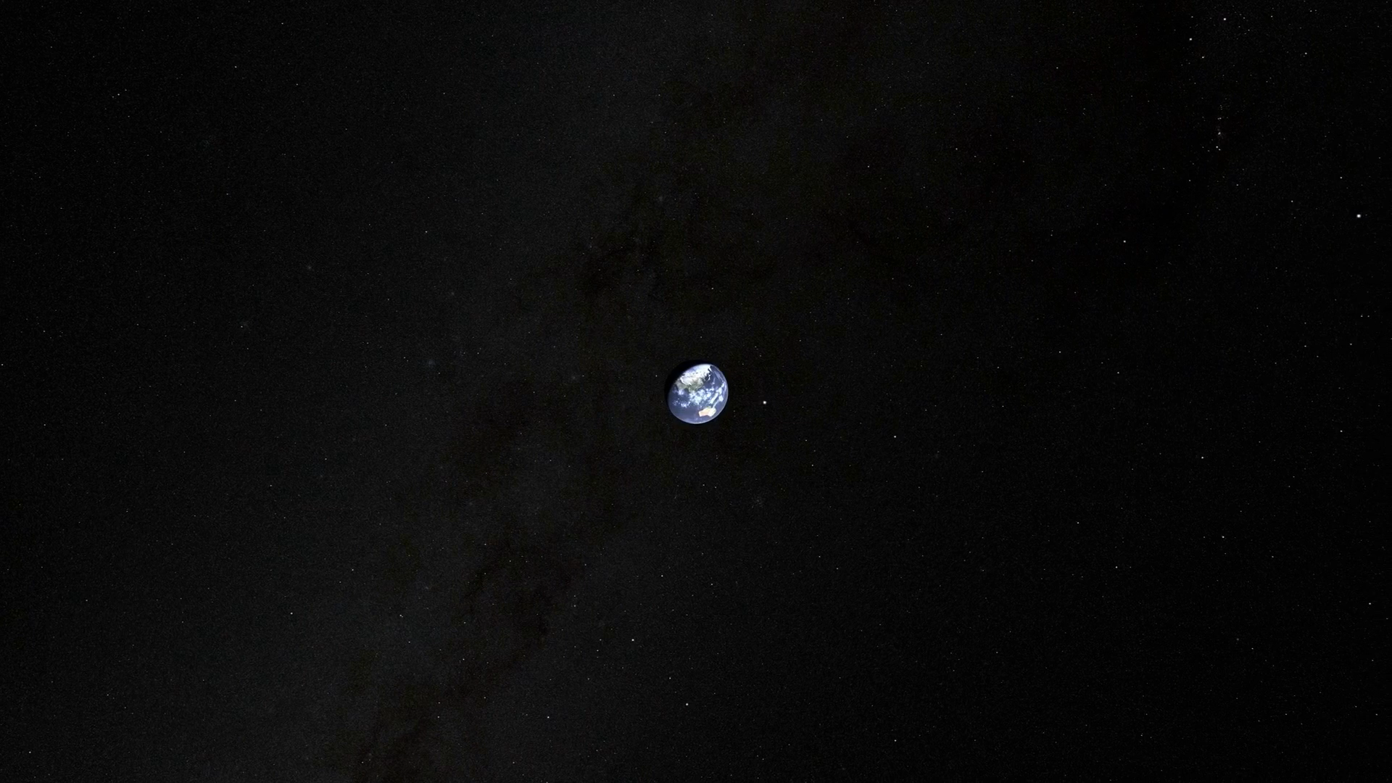
Earth's bow shock in a geomagnetic storm
NASA SVS 2023.

Slide 4
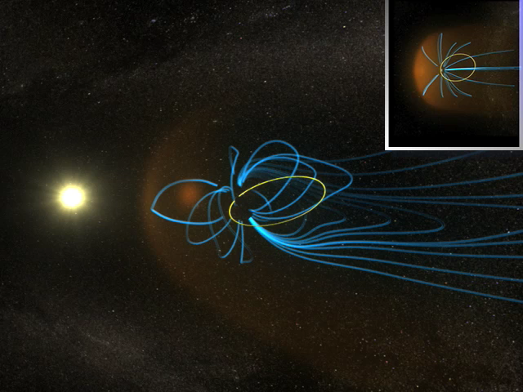

Why Earth's Bow Shock? The MAGNETOSPHERIC MULTISCALE MISSION (MMS)
Compared to earlier heliospheric missions, its cadence can resolve both ion and electron scales.

Slide 5
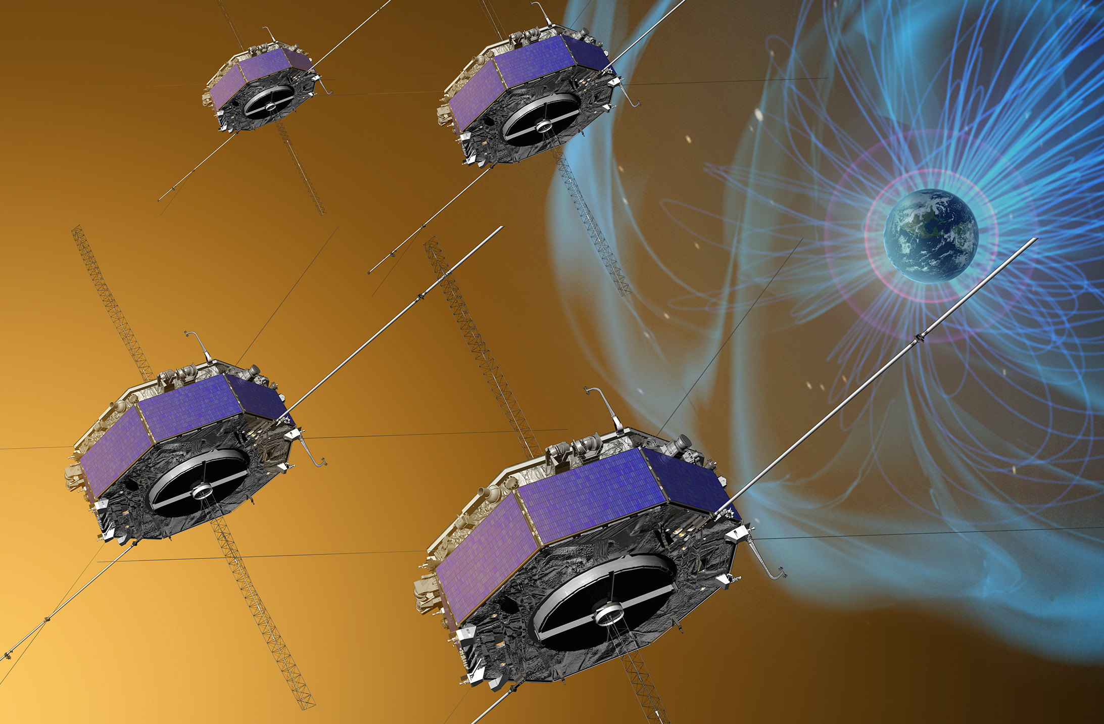
Why Earth's Bow Shock? The MAGNETOSPHERIC MULTISCALE MISSION (MMS)
Compared to earlier heliospheric missions, its cadence can resolve both ion and electron scales.

Slide 6
MMS MISSION MATCHES THE PHYSICS SCALES OF
THE MEASURED REGION

Slide 7

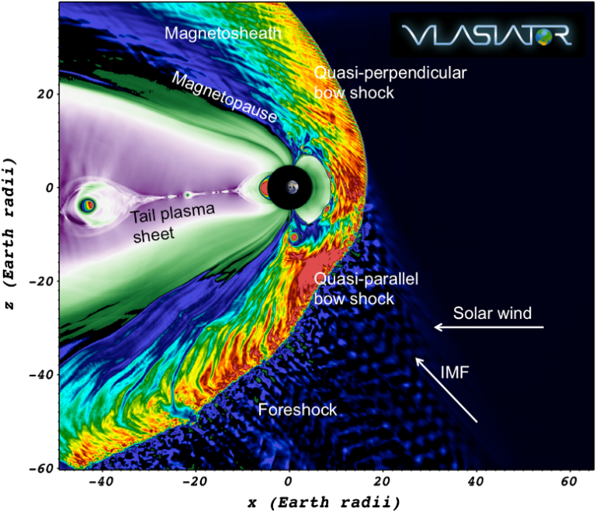
Why Earth's Bow Shock? The MAGNETOSPHERIC MULTISCALE MISSION (MMS)
Compared to earlier heliospheric missions, its cadence can resolve both ion and electron scales.
Four spacecraft formation to study bow shock structure.
We select quasi-perpendicular shocks with burst mode data (high cadence).

Slide 8
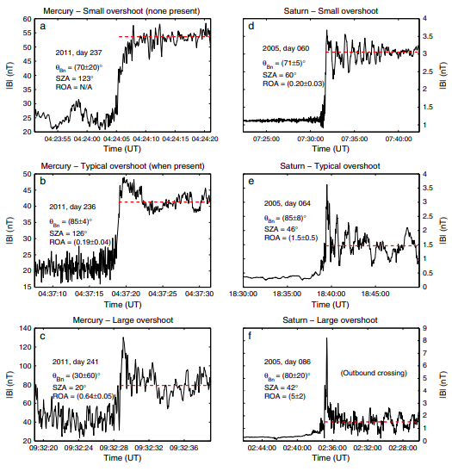
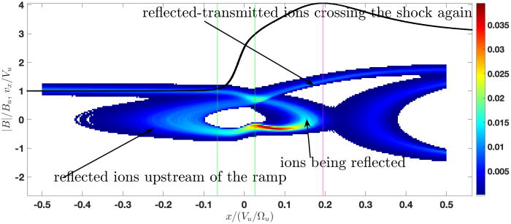
MAGNETIC OVERSHOOT STUDIES IN PLANETARY
BOW SHOCKS
Gedalin et al. (2023)
Magnetic
Magnetic overshoot amplitude has been linked to increasing Mach number
Masters et al. (2013)

Slide 9
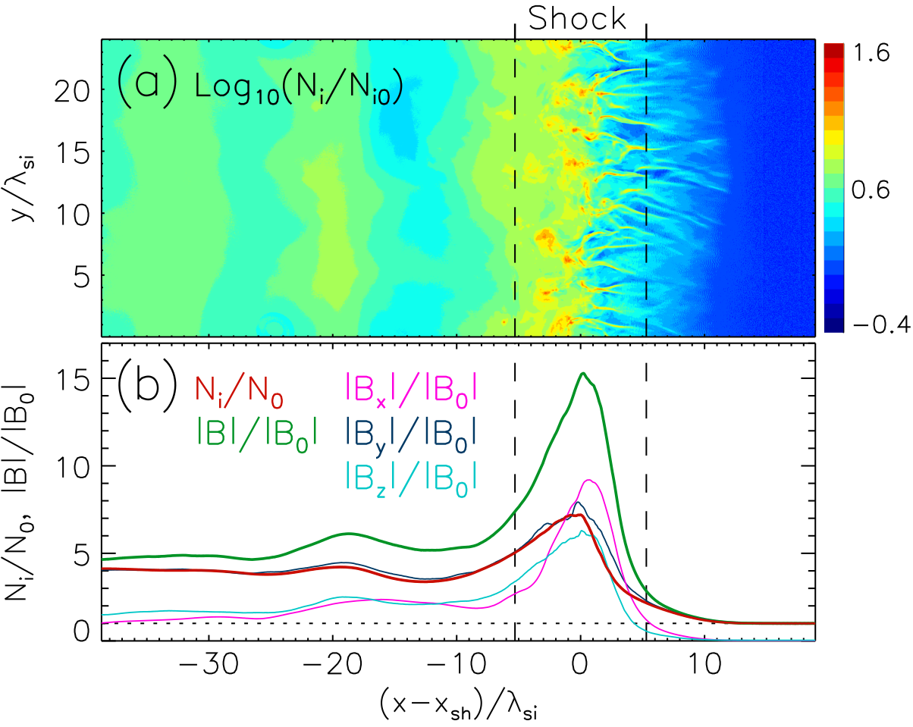
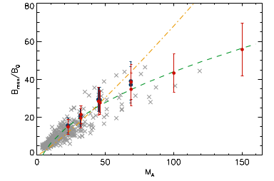
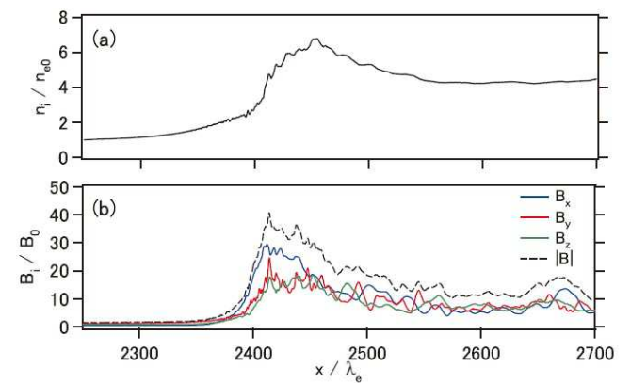
MAGNETIC OVERSHOOT has been studied in pic simulations: weibel instability
Bohdan et al (2021).
Kato et al (2010).
Ion Weibel instability, is driven directly by the counter- streaming of the reflected and incoming ion beams, and producing quasi-static filamentary currents and magnetic fields.
Magnetic field is amplified beyond compression.
In agreement with planetary bow shock observations.

Slide 10
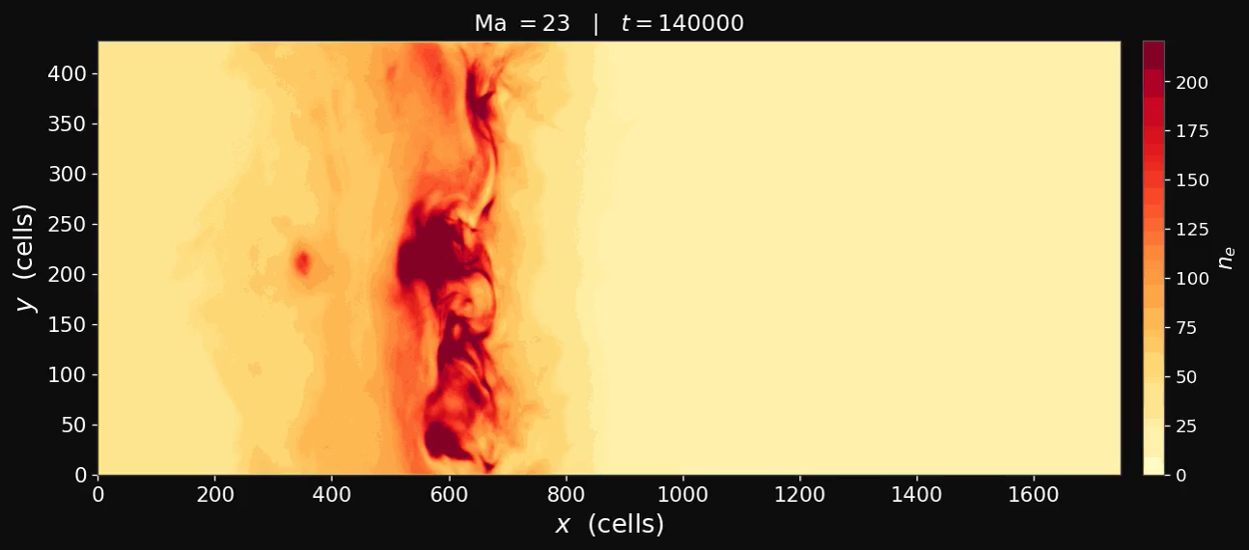
Weibel INSTABILITY in simulations

Slide 11
DATA CORRECTIONS

Slide 12
Electrons are measured at higher energies
Spacecraft potential
Secondary electron removal
Extrapolation to zero energy
Distribution function normalization

Slide 13
Electrons are measured at higher energies
Spacecraft potential
Secondary electron removal
Extrapolation to zero energy
Distribution function normalization

Slide 14
UV ELECTRONS CONTAMINATE LOWER ENERGY
CHANNELS
Spacecraft potential
Secondary electron removal
Extrapolation to zero energy
Distribution function normalization

Slide 15
UPSTREAM AND DOWNSTREAM DISTRIBUTIONS
ARE FITTED TO OBSERVED VDFS
Spacecraft potential
Secondary electron removal
Extrapolation to zero energy
Distribution function normalization
Upstream fit
Downstream fit

Slide 16
ELECTRON DENSITY IS MEASURED FROM
WAVE ACTIVITY UPSTREAM
Spacecraft potential
Secondary electron removal
Extrapolation to zero energy
Distribution function normalization

Slide 17
ELECTRON DENSITY IS MEASURED FROM
WAVE ACTIVITY UPSTREAM
Spacecraft potential
Secondary electron removal
Extrapolation to zero energy
Distribution function normalization

Slide 18
ELECTRON DENSITY IS MEASURED FROM
WAVE ACTIVITY UPSTREAM
Spacecraft potential
Secondary electron removal
Extrapolation to zero energy
Distribution function normalization

Slide 19
CORRECTED PLASMA MOMENTS, ELECTRON DENSITY AND TEMPERATURE
Density is usually underestimated and temperature is usually overestimated!

Slide 20
MAGNETIC PROFILE AND NON-CORRECTED MEASURED NUMBER DENSITY
Corrections are performed across all four spacecrafts, peak magnetic field and number density is an average between them!

Slide 21
MAGNETIC PROFILE AND CORRECTED MEASURED NUMBER DENSITY
Corrections are performed across all four spacecrafts, peak magnetic field and number density is an average between them!

Slide 22
SHOCK NORMAL DETERMINATION at earth's bow shock
Mach number, plasma beta, normal
Farris et al. (1991) fitted 351 bow shock
Crossing seen by ISEE-1.
R is the distance from Earth to the shock surface.
The shape is nearly the same between events.

Slide 23
MACH NUMBER distribution at earth's bow shock
Mach number, plasma beta, normal

Slide 24
Plasma beta distribution at earth's bow shock
Mach number, plasma beta, normal

Slide 25
How do we connect simulations and observations?

Slide 26
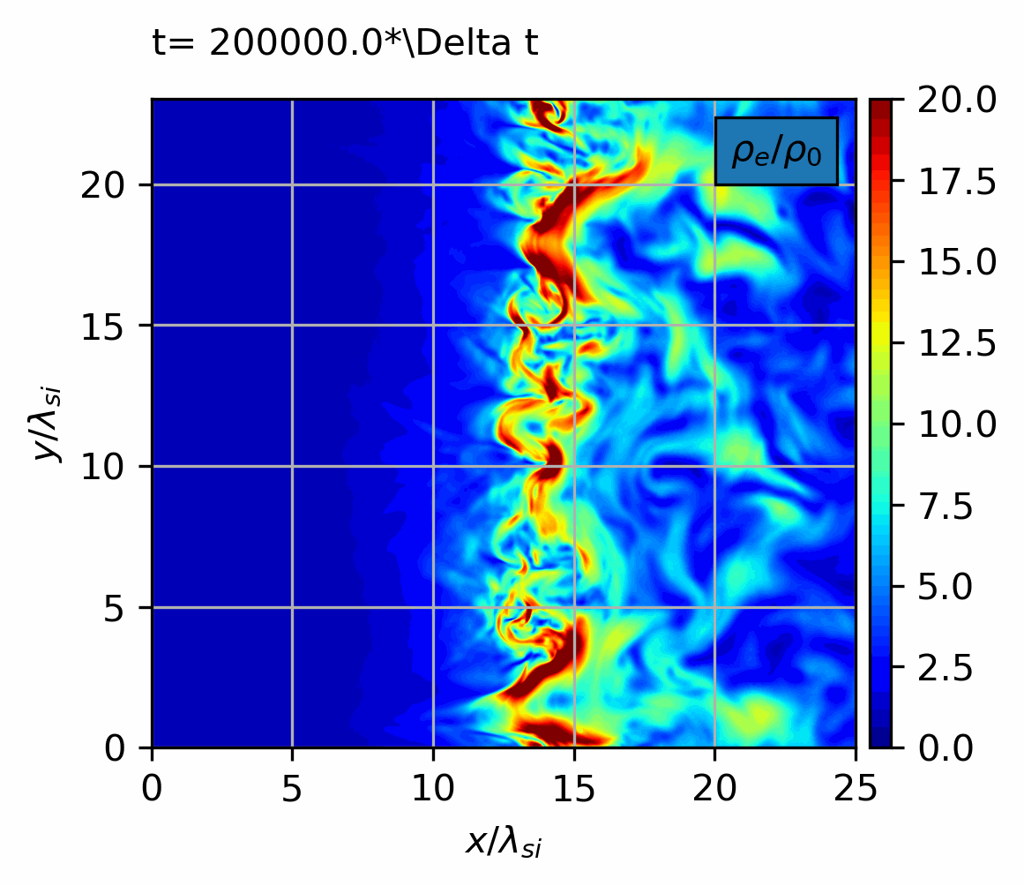
Sampled trajectories from high mach number simulations
Ma = 25
Trajectories are sampled within
the simulation.
A maximum magnetic field and number density are computed.
Same quantities are derived for observations.

Slide 27
Results

Slide 28
Magnetic field amplification comparison: observed data
A total of 233 cases were successfully analyzed from which 177 cases are quasi-perpendicular .
Magnetic field amplification becomes significant around Mach number 10.

Slide 29
Magnetic field amplification comparison: observed data and pic simulations
A total of 233 cases were successfully analyzed from which 177 cases are quasi-perpendicular .
Magnetic field amplification becomes significant around Mach number 10.

Slide 30
Magnetic field amplification comparison: observed data and pic simulations
A total of 233 cases were successfully analyzed from which 177 cases are quasi-perpendicular .
Magnetic field amplification becomes significant around Mach number 10.

Slide 31
An observed high Mach number example
(Ma = 26.6)

Slide 32
An observed high mach number example
(Ma = 26.6)
Reflected
Core beam

Slide 33
observed example agrees with a non propagating wave with linear polarization
The signal is visible and coherent for all 4 spacecrafts
It’s a linearly polarized structure
Its Doppler shifted frequency to the plasma frame is zero.

Slide 34
Summary
Discussions and synergies on astrophysical plasma with PIC simulations – Prague 2026
Magnetic field amplification has been observed for Earth's bow shock in close agreement to PIC simulations.
Data corrections are relevant to identify magnetic field amplification.
A further example coincides with the relevant properties for Weibel instability.

Slide 35
Extra slides

Slide 36
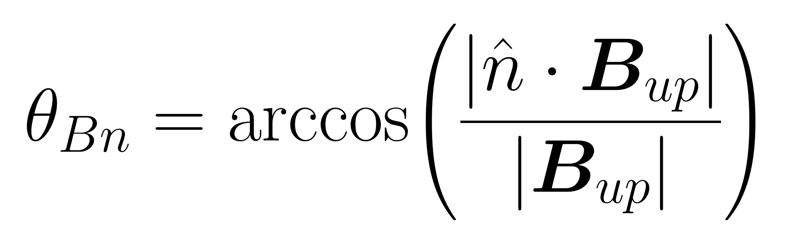
Aberration
Angle between magnetic field and normal

