Slide 1

Kinetic Simulations of moderate Relativistic Pair Shocks with Trace Ion Admixture
Discussions and synergies on astrophysical plasma with PIC simulations - Prague 2026
Mahmoud Alawashra
Martin Pohl, Eloise Moore,
& THATMPI team

Slide 2
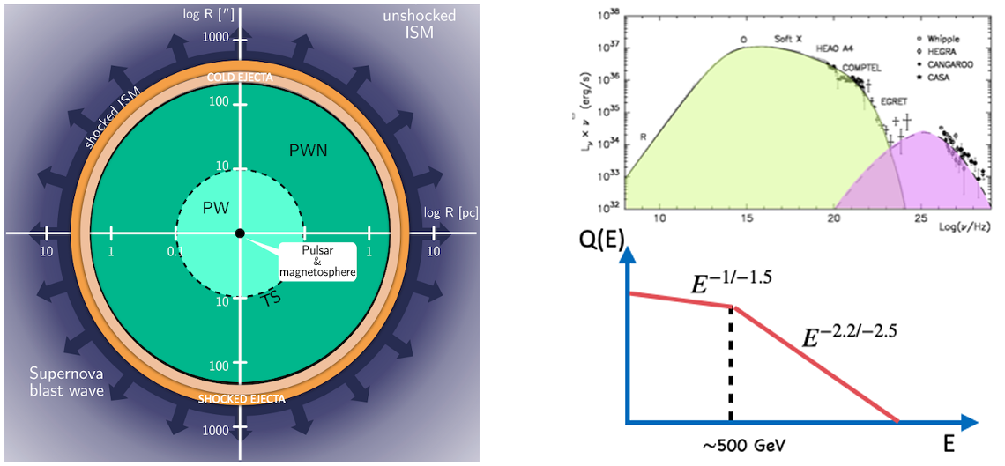
Particle acceleration in PWNe
Crab modelling suggests particle-acceleration efficiencies of order 30% (Bucciantini et al 2011). The wind termination shock (TS) is a proposed acceleration site, with 10³ < γ < 10⁷.
Amato (2024) arXiv:2402.10912v1

Slide 3
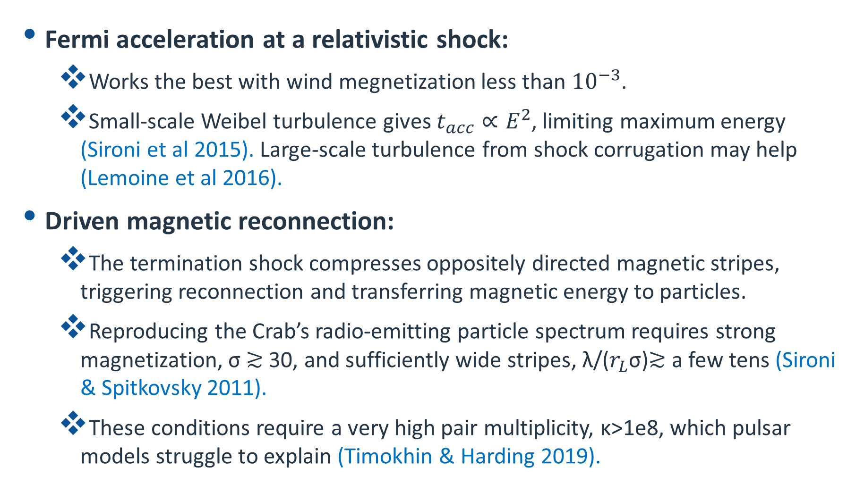
Acceleration mechanisms in PWNe
Fermi acceleration at a relativistic shock:
  Works the best with wind megnetization less than ${10}^{−3}$.
  Small-scale Weibel turbulence gives $t_{acc}∝E^{2}$, limiting maximum energy (Sironi et al 2015). Large-scale turbulence from shock corrugation may help (Lemoine et al 2016).
Driven magnetic reconnection:
  The termination shock compresses oppositely directed magnetic stripes, triggering reconnection and transferring magnetic energy to particles.
  Reproducing the Crab’s radio-emitting particle spectrum requires strong magnetization, σ ≳ 30, and sufficiently wide stripes, λ/($r_{L}$σ)≳ a few tens (Sironi & Spitkovsky 2011).
  These conditions require a very high pair multiplicity, κ>1e8, which pulsar models struggle to explain (Timokhin & Harding 2019).

Slide 4
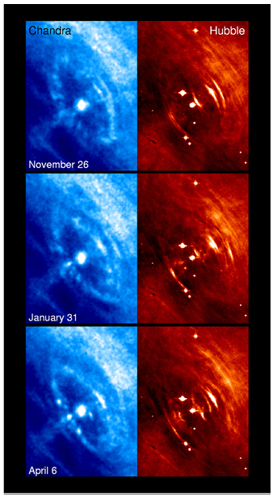
Acceleration mechanisms in PWNe
Resonant ion-cyclotron absorption:
  Pairs absorb cyclotron waves emitted by gyrating ions downstream of the shock. Higher ion energy fractions produce harder particle spectra and greater acceleration efficiency (Hoshino et al 1992, Amato & Arons 2006).
  Ion-driven compressions can also enhance the magnetic field and pair density, producing moving bright synchrotron arcs; a proposed explanation for the Crab’s wisps (Gallant & Arons 1994, Spitkovsky & Arons, 2004).
Amato (2024)

Slide 5
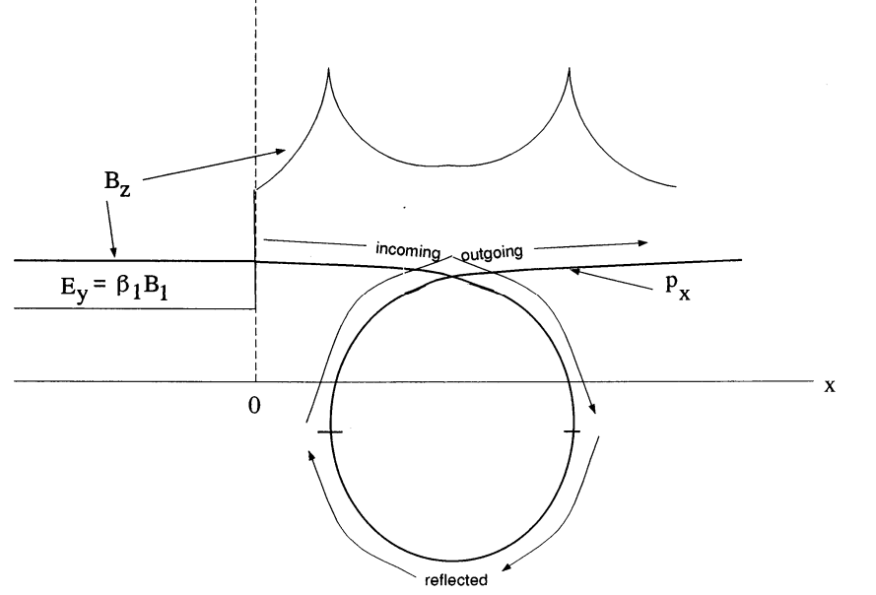
Ion-Gyration theory of the Crab’s Wisps
At the termination shock, the stronger magnetic field sets ions into gyration, creating overlapping incoming, reflected, and outgoing streams.
Ion currents enhance the magnetic field at the orbit turning points, producing bright synchrotron structures; a proposed explanation for the Crab’s wisps (Gallant & Arons, 1994).
Gallant & Arons (1994)

Slide 6
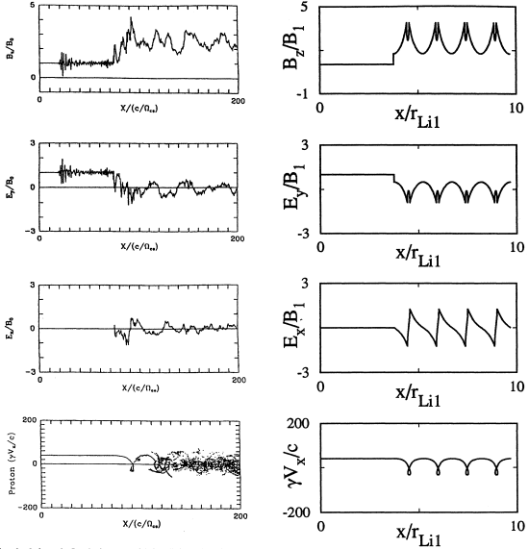
Ion Reflection and Magnetic Compression: PIC vs. Theory
Both models show ion reflection and magnetic-field enhancements downstream, while the PIC simulation develops fluctuations that disrupt the regular, repeating structure.
PIC 1D: Hoshino et al 1992
mi/me = 20, gamma =40
sigma = 0.345, Ni/Ne =0.2
Theory: Gallant & Arnos 1994

Slide 7
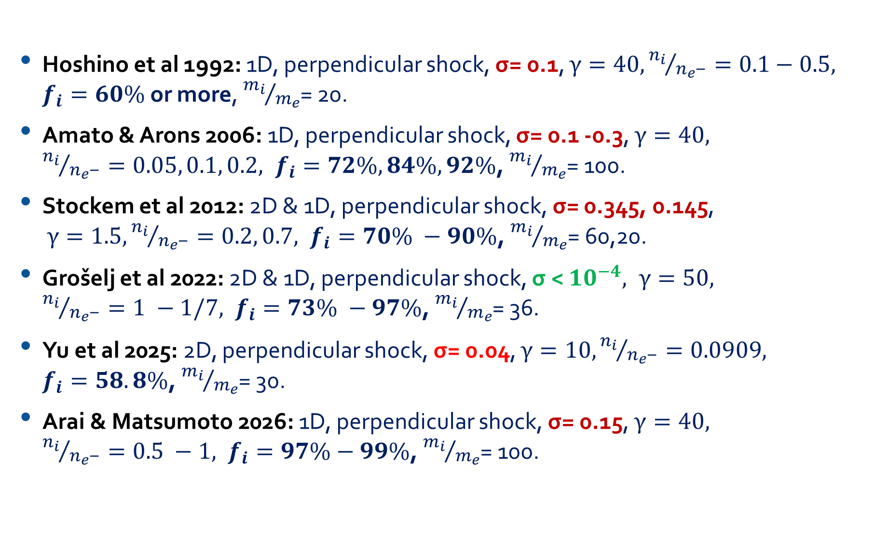
Previous PIC ion-pair shock simulations
Hoshino et al 1992: 1D, perpendicular shock, σ= 0.1, $γ=40, {n_{i}}/{n_{e^{−}}}=0.1−0.5, f_{i}=60\%$or more, ${m_{i}}/{m_{e}}$= 20.
Amato & Arons 2006: 1D, perpendicular shock, σ= 0.1 -0.3, $γ=40,$
${n_{i}}/{n_{e^{−}}}=0.05, 0.1, 0.2, f_{i}=72\%, 84\%, 92\%$, ${m_{i}}/{m_{e}}$= 100.
Stockem et al 2012: 2D & 1D, perpendicular shock, σ= 0.345, 0.145,
$γ=1.5, {n_{i}}/{n_{e^{−}}}=0.2, 0.7, f_{i}=70\% −90\%$, ${m_{i}}/{m_{e}}$= 60,20.
Grošelj et al 2022: 2D & 1D, perpendicular shock, σ < ${10}^{−4}, γ=50,$
${n_{i}}/{n_{e^{−}}}=1 −1/7, f_{i}=73\% −97\%$, ${m_{i}}/{m_{e}}$= 36.
Yu et al 2025: 2D, perpendicular shock, σ= 0.04, $γ=10, {n_{i}}/{n_{e^{−}}}=0.0909,$
$f_{i}=58.8\%$, ${m_{i}}/{m_{e}}$= 30.
Arai & Matsumoto 2026: 1D, perpendicular shock, σ= 0.15, $γ=40,$
${n_{i}}/{n_{e^{−}}}=0.5 −1, f_{i}=97\%−99\%$, ${m_{i}}/{m_{e}}$= 100.

Slide 8
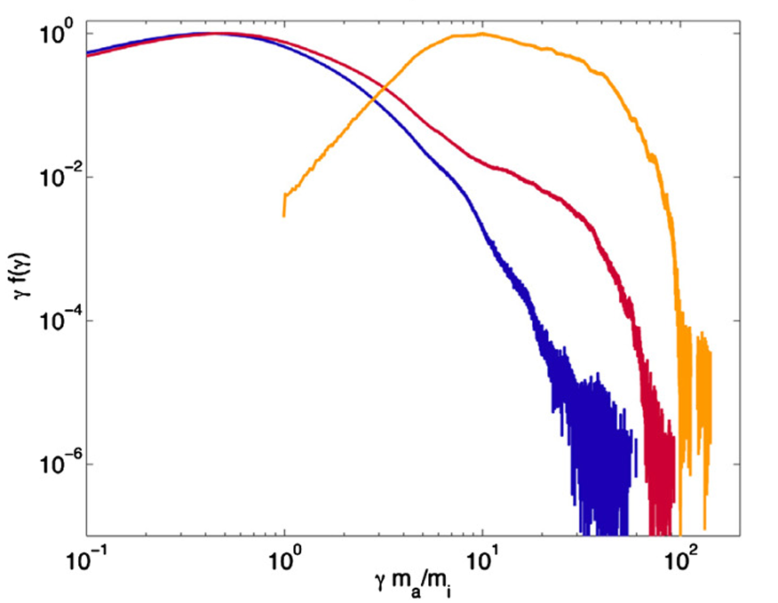
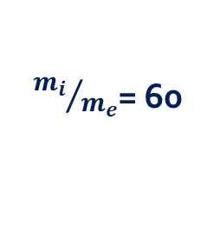
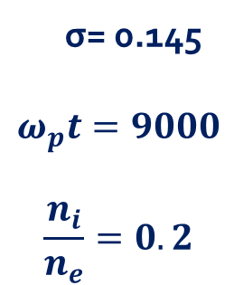
Relativistic magnetized pairs shocks with ion loading
Gyrating ions transfer energy to pairs by emitting magnetosonic waves that electrons and positrons absorb resonantly.
Positrons are accelerated more efficiently because the waves’ left-handed polarization favors their energization, producing a stronger nonthermal tail than for electrons.
This mechanism could accelerate particles at pulsar-wind termination shocks if pairs dominate in number and ions dominate the energy.
σ= 0.145
$$ω_{p}t=9000$$
$$\frac{n_{i}}{n_{e}}=0.2$$
${m_{i}}/{m_{e}}$= 60
electrons
positrons
ions
Stockem et al (2012)

Slide 9
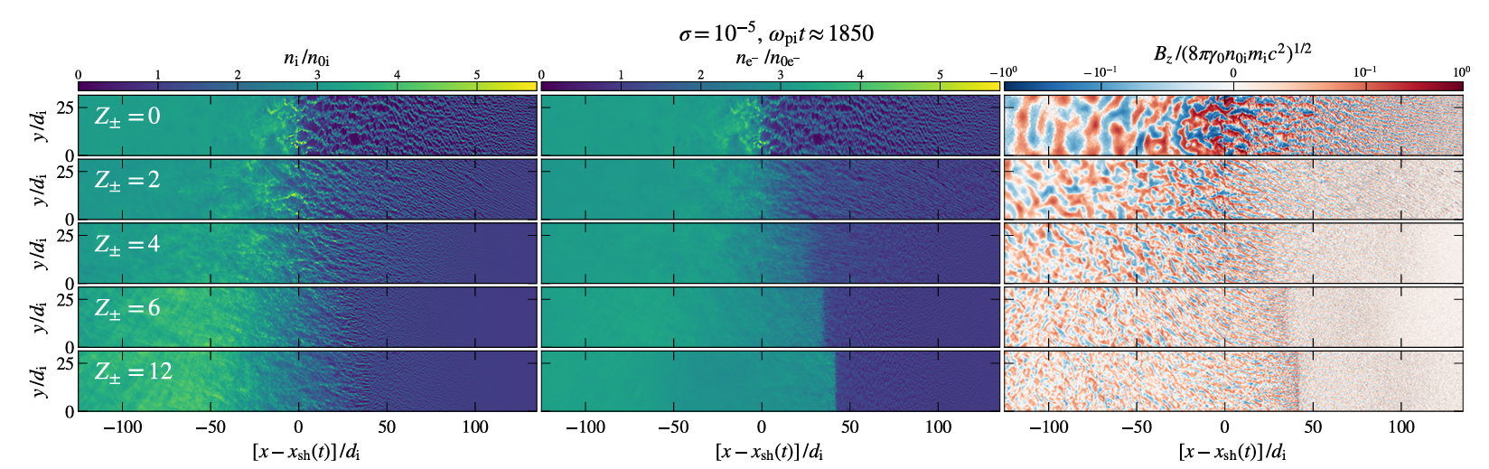

Relativistic unmagnetized e-ion shocks with pairs loading
$$z_{±}=\frac{2n_{e+}}{n_{i}}$$
Grošelj et al (2022)
Pair loading reduces the strength and spatial scale of the self-generated Weibel turbulence.
As pair loading increases, the shock transition becomes smoother and less turbulent.

Slide 10
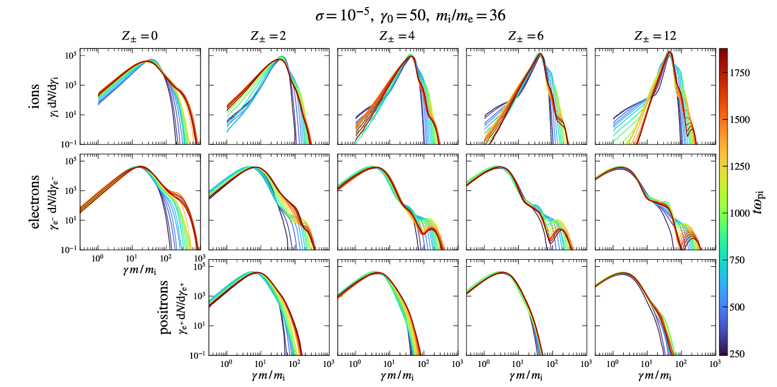
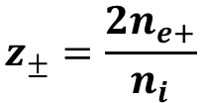
Relativistic unmagnetized e-ion shocks with pairs loading
Grošelj et al (2022)
$$z_{±}=\frac{2n_{e+}}{n_{i}}$$
Pair loading limits nonthermal particle acceleration for ions.
For sufficiently pair-loaded shocks, ions become mostly thermal, while electrons/positrons can still form a nonthermal tail.

Slide 11
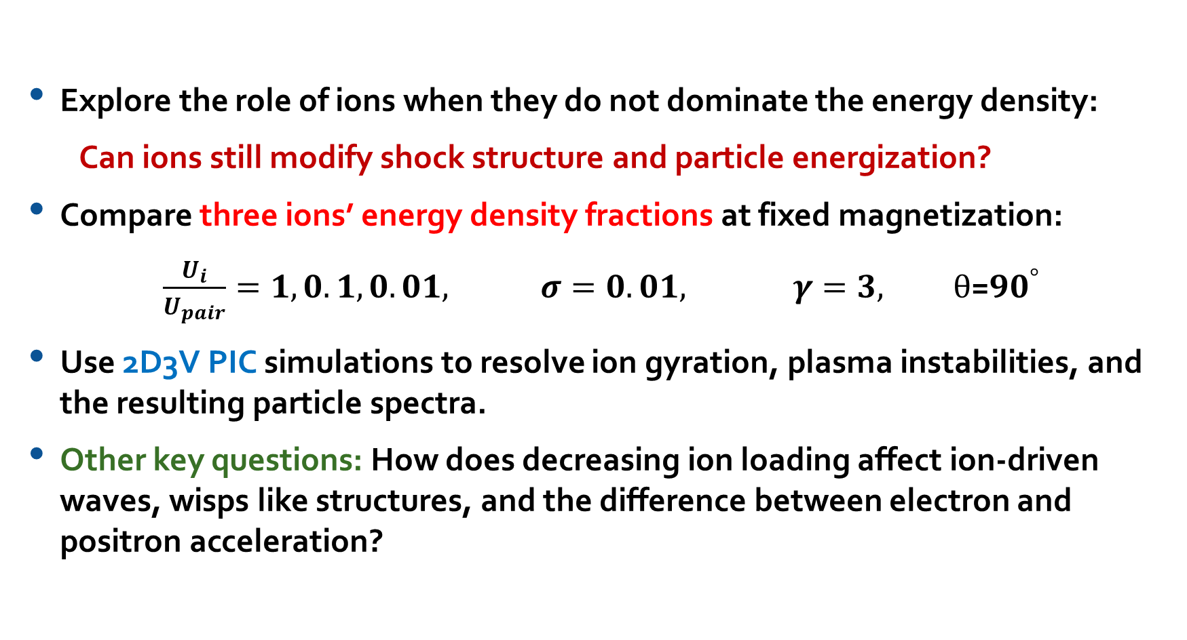
Motivation: Low-Ion-Loaded Pair Shocks
Explore the role of ions when they do not dominate the energy density:
Can ions still modify shock structure and particle energization?
Compare three ions’ energy density fractions at fixed magnetization:
$\frac{U_{i}}{U_{pair}}=1, 0.1, 0.01, σ=0.01, γ=3, θ$=${90}^{°}$
Use 2D3V PIC simulations to resolve ion gyration, plasma instabilities, and the resulting particle spectra.
Other key questions: How does decreasing ion loading affect ion-driven waves, wisps like structures, and the difference between electron and positron acceleration?

Slide 12
Simulations setup
Reflective wall set up with Amano’s wall correction.
Setup:
  Ion-Pair plasma with different ion densities relative to the eles: 6.5%, 0.65%, 0.065%.
  Bulk Lorentz factor: $γ_{0}=3.$
  Thermal velocity: $v_{th}=0.0375$ c.
  Magnetization: $σ={10}^{−2}$ with perpendicular configuration.
  Ion to electron mass ratio is 30.
  Planed to run for 65 $Ω_{i}^{−1}$($\sim 10k ω_{pe}^{−1}$).
  Alfvénic Mach number is $\sim$ 47.4.
Numerical resolution and methods:
  $∆$x = $\frac{1}{10}λ_{se}$ with $λ_{D}=0.36$ $∆$x, and cΔt/ Δx = 0.5.
  N = 10 particles per cell per spices.
  Field solver: min3 from Blinne et al. (2018) .
  Current filter: 8 pass of binomial filter with compensation.
  Triangular cloud particle's shape factor.

Slide 13
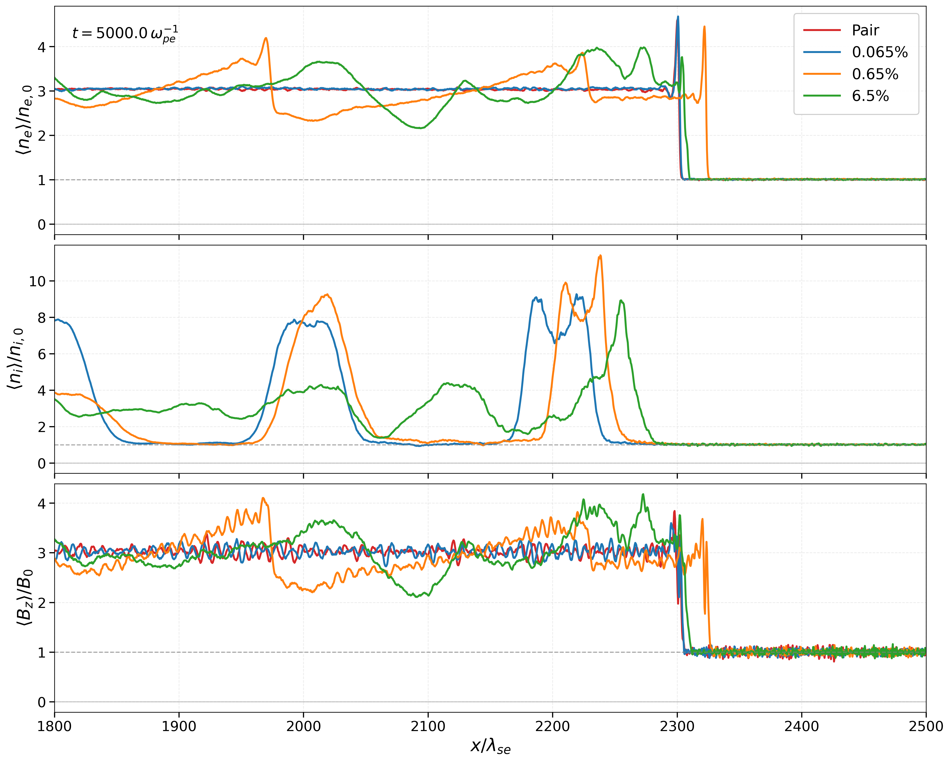
Impact of Ion loading on shock structure and magnetic compression

Slide 14
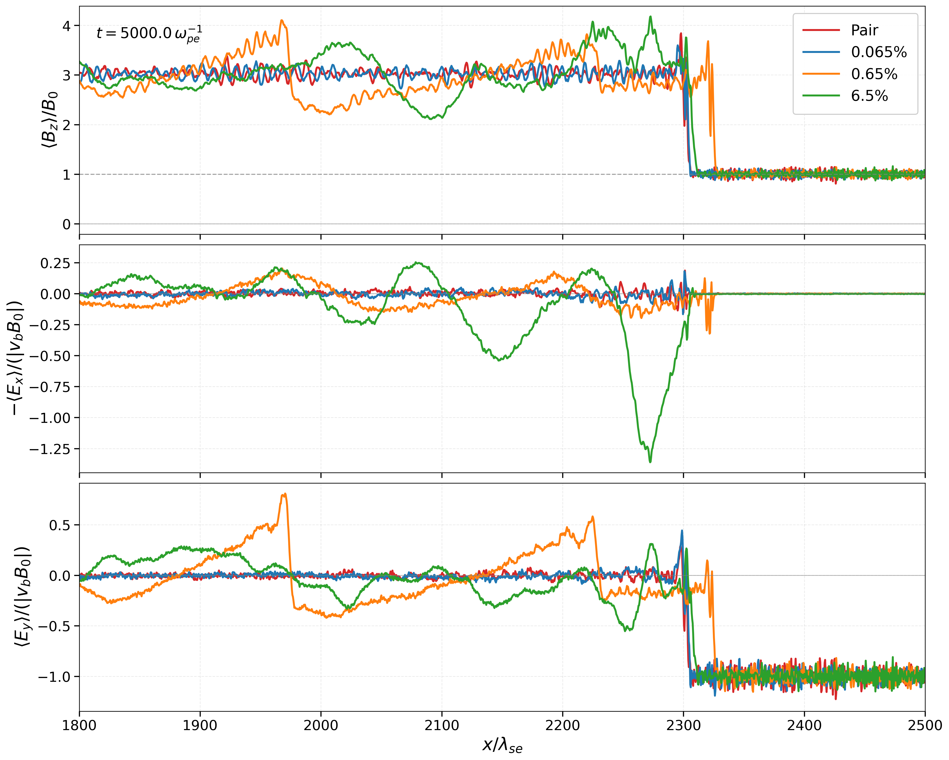
Impact of Ion loading on electric and magnetic field structure

Slide 15
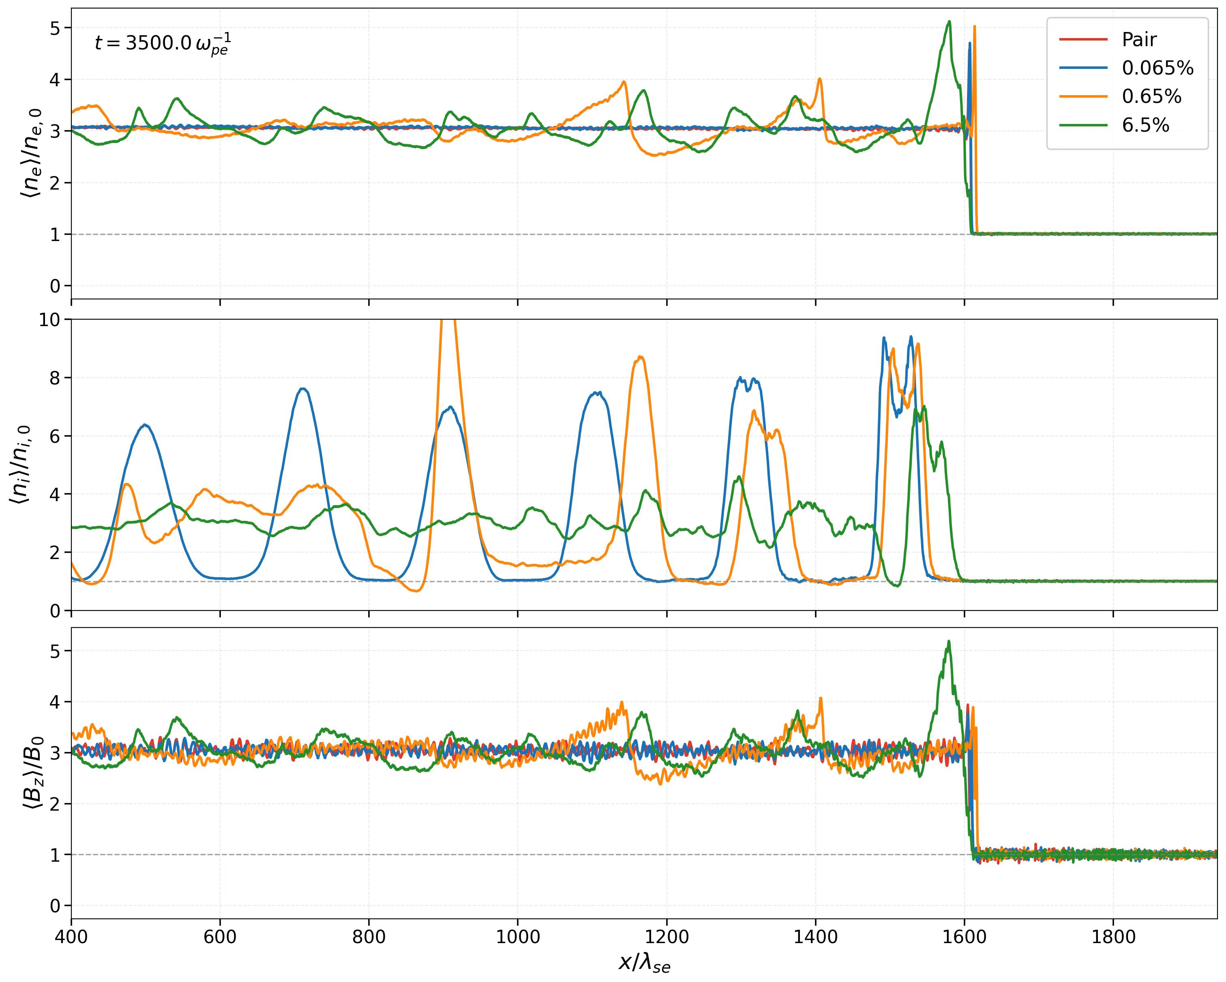

Slide 16
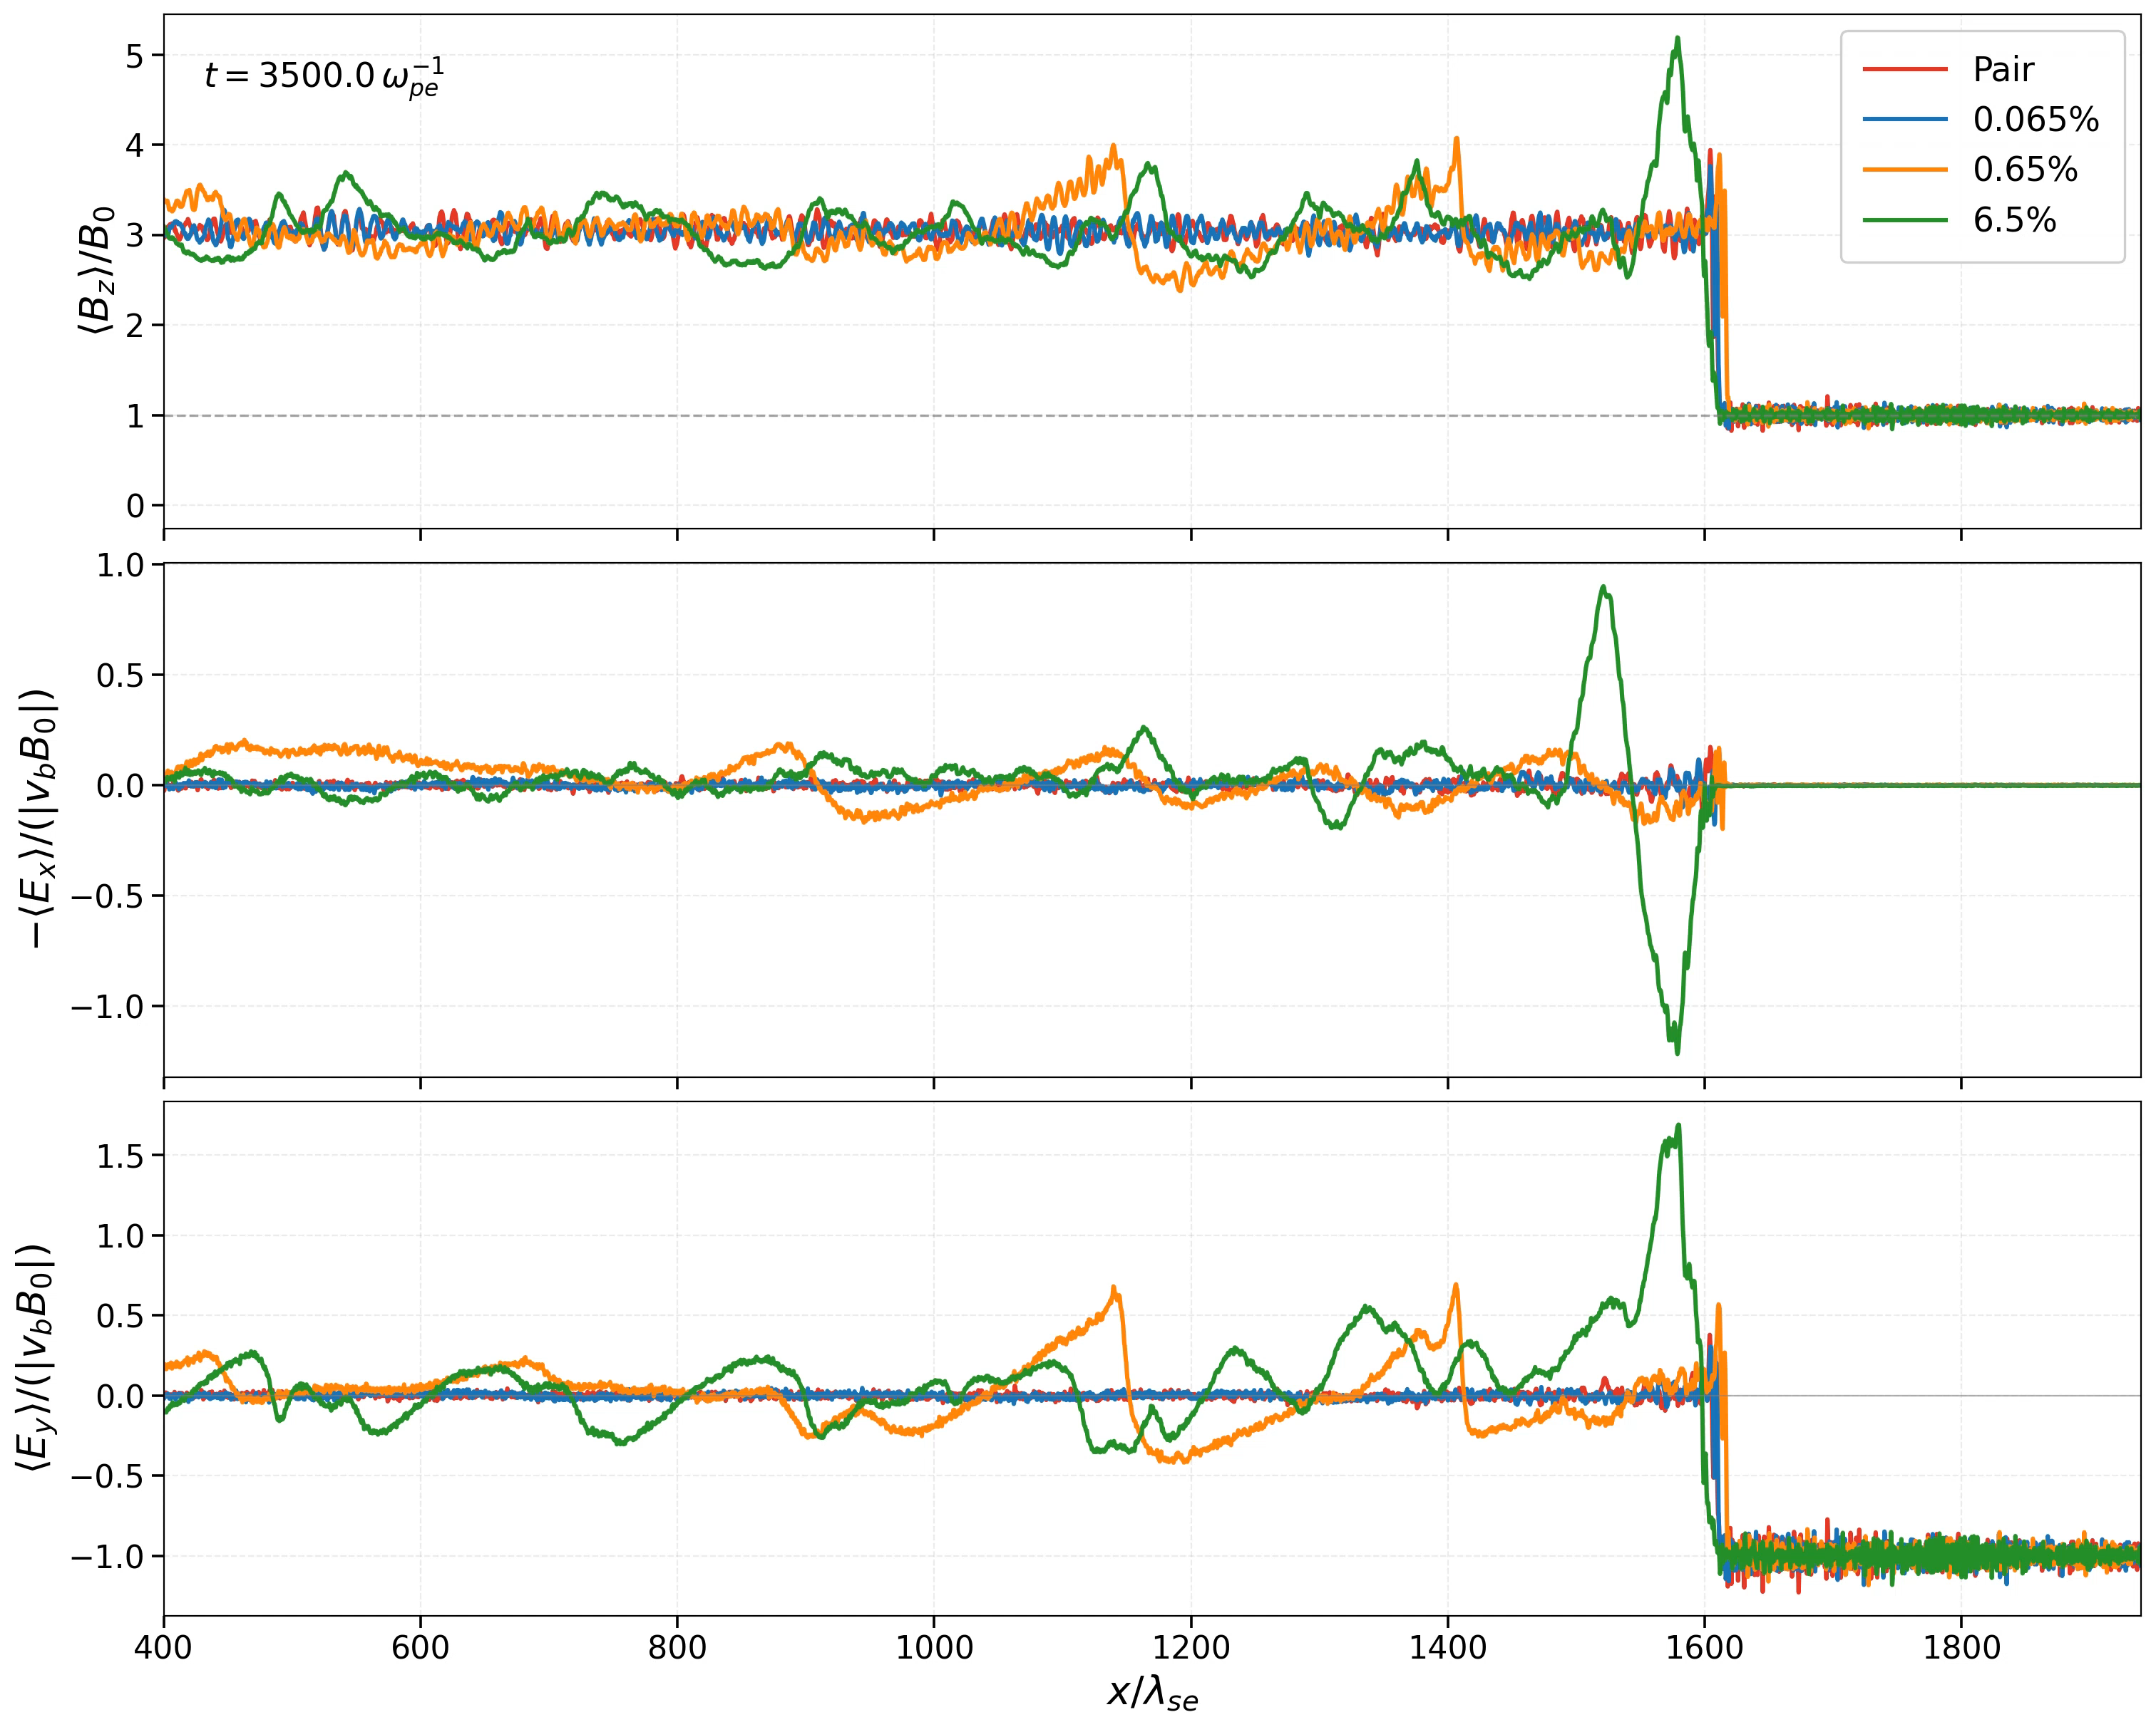

Slide 17
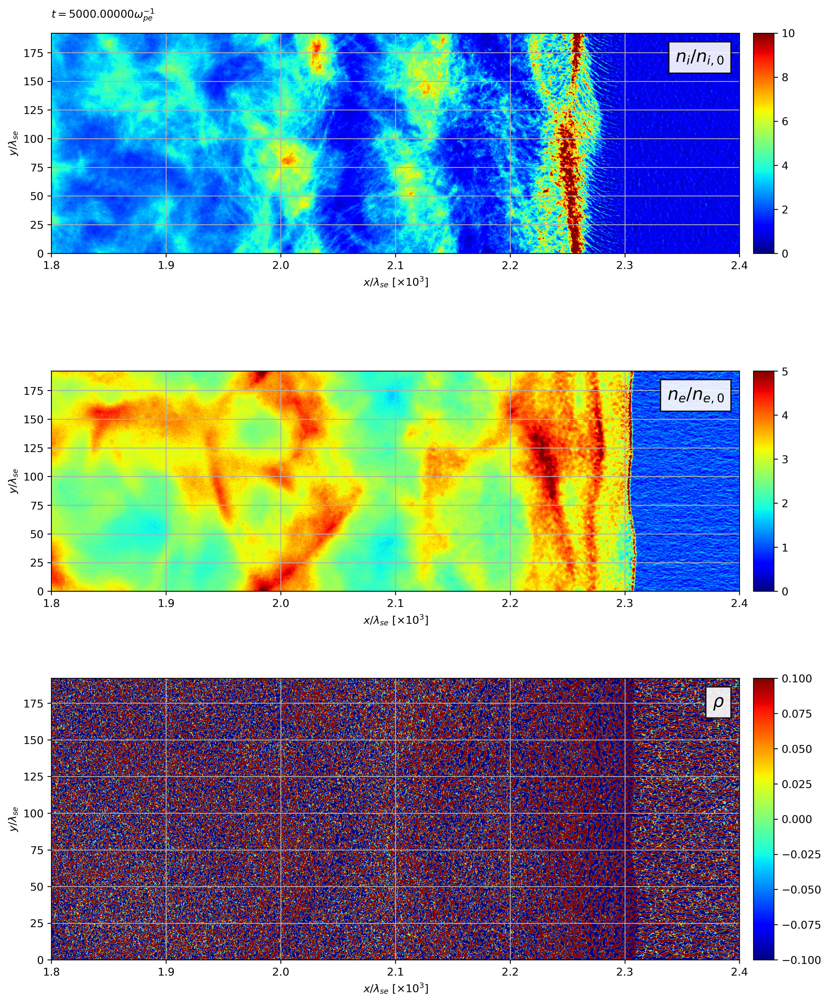
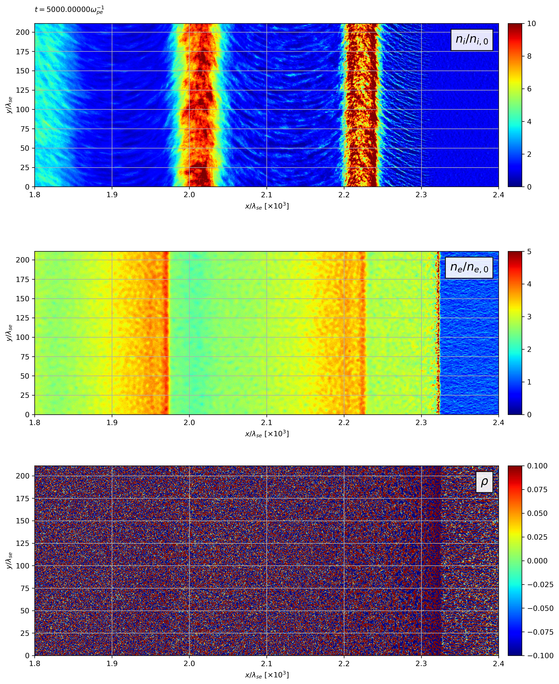
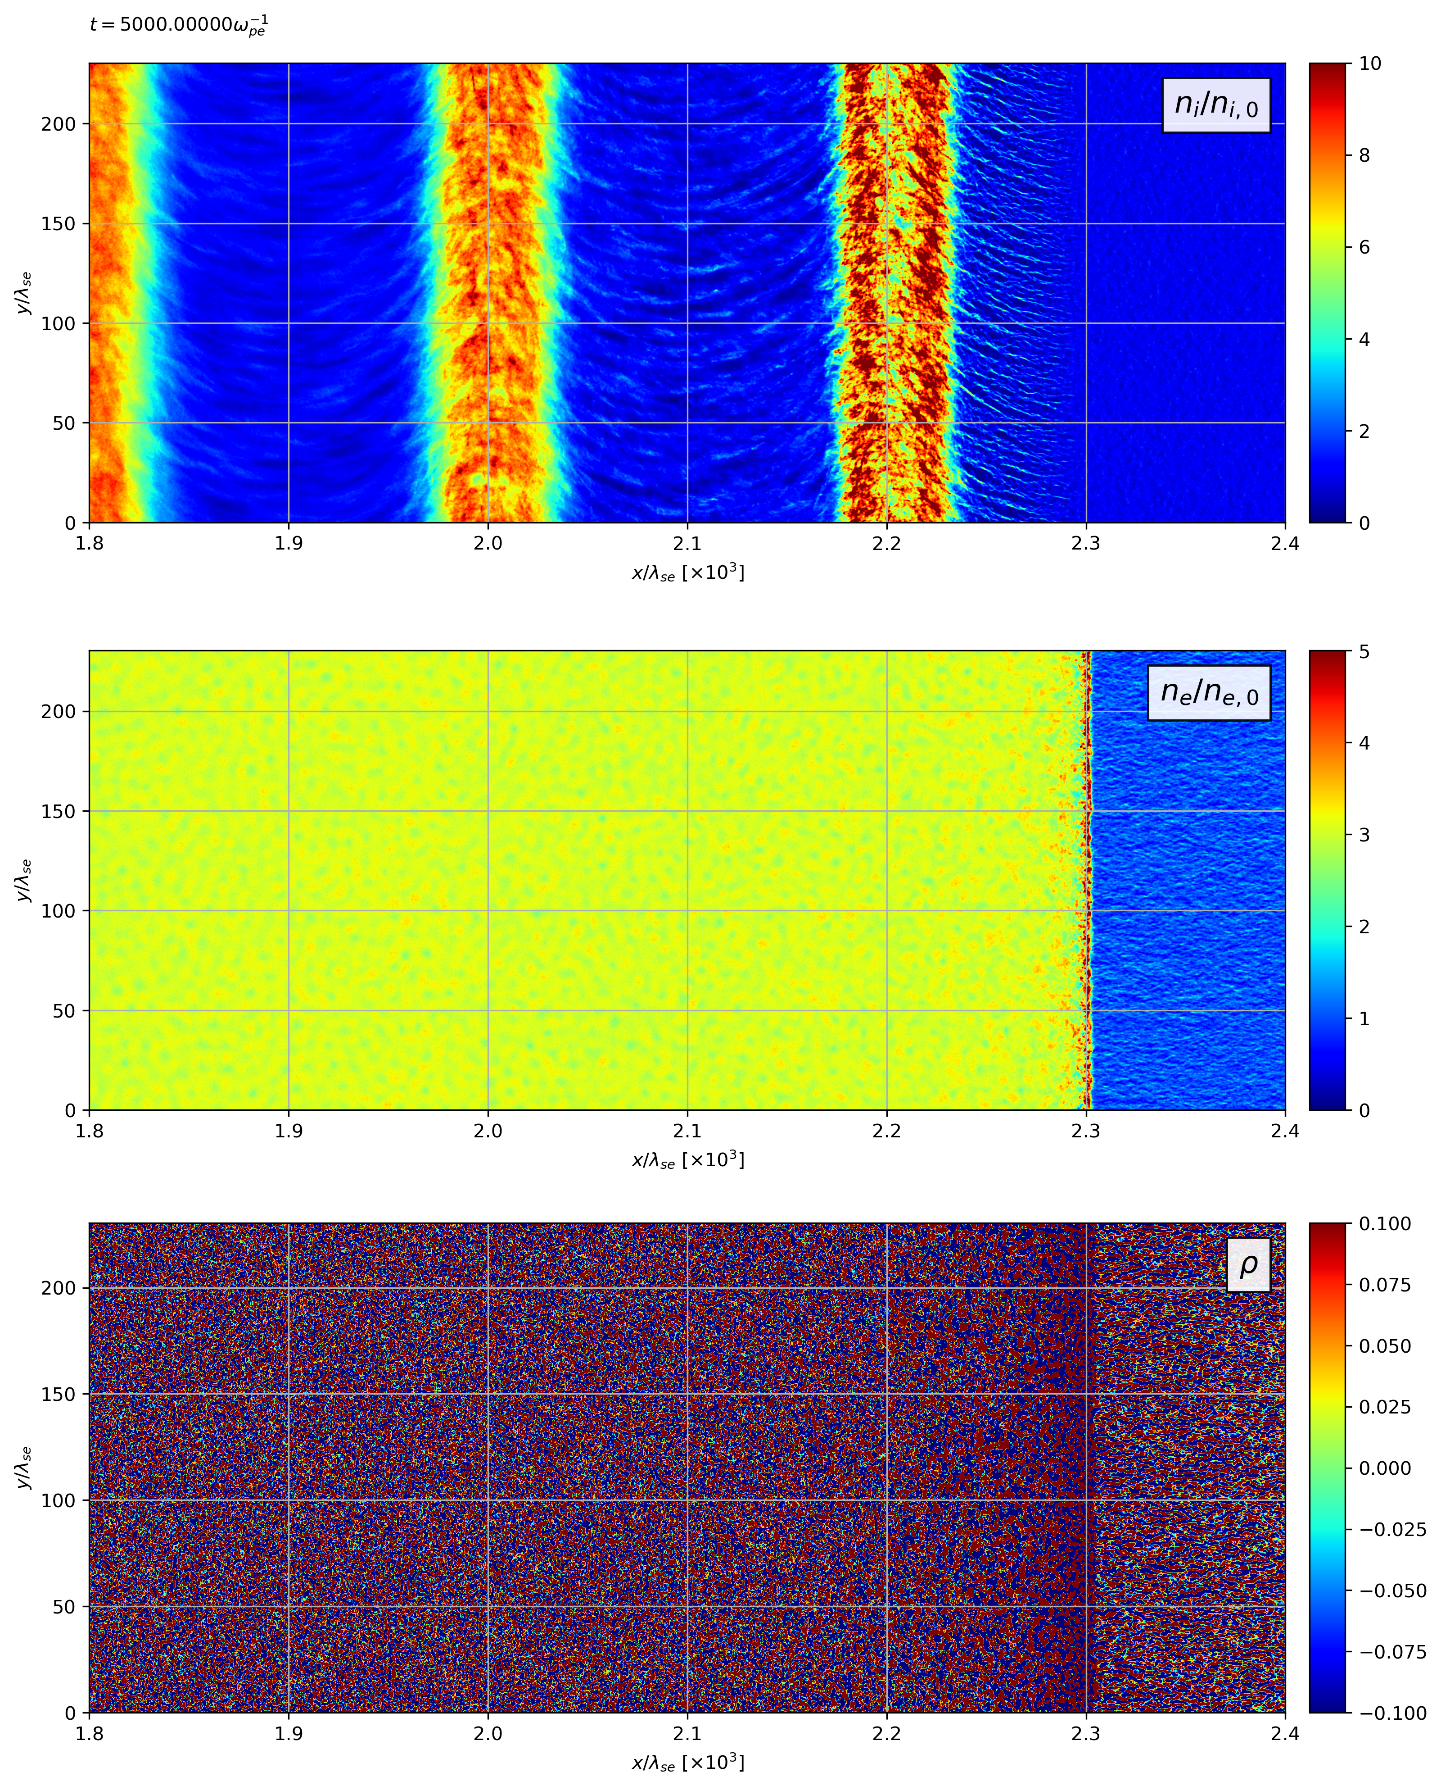
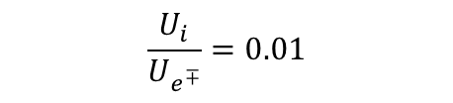
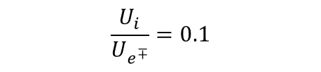
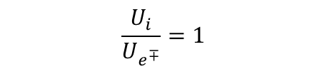
Effect of Ion loading on two-dimensional density structure
$$\frac{U_{i}}{U_{e^{∓}}}=1$$
$$\frac{U_{i}}{U_{e^{∓}}}=0.1$$
$$\frac{U_{i}}{U_{e^{∓}}}=0.01$$

Slide 18
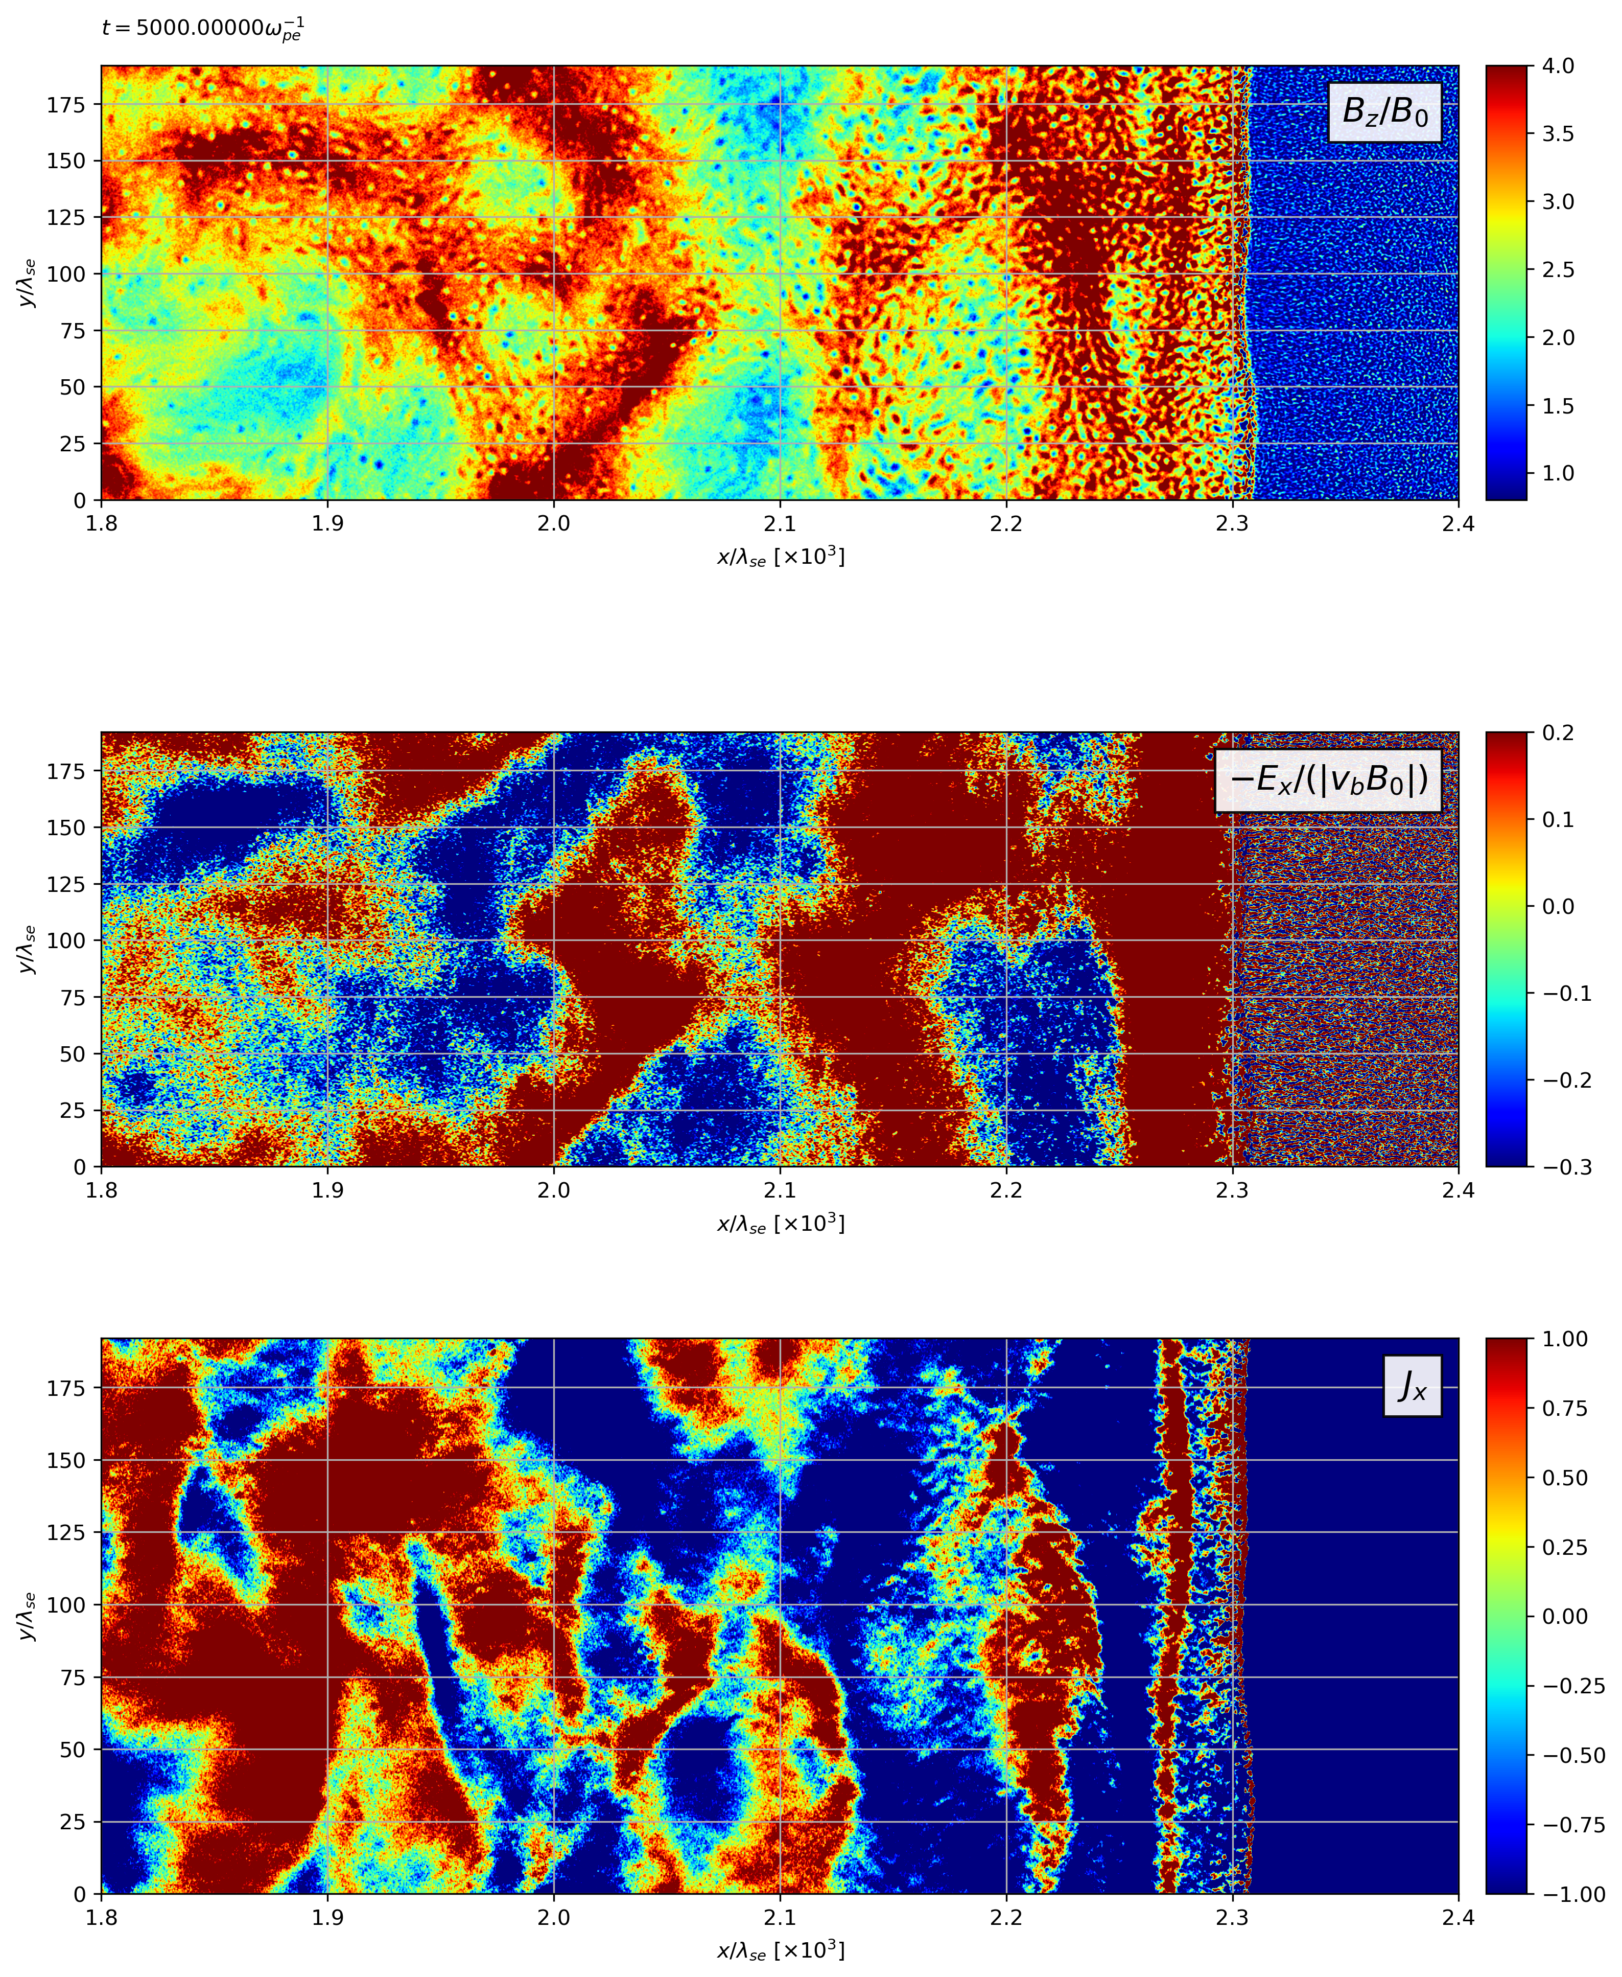
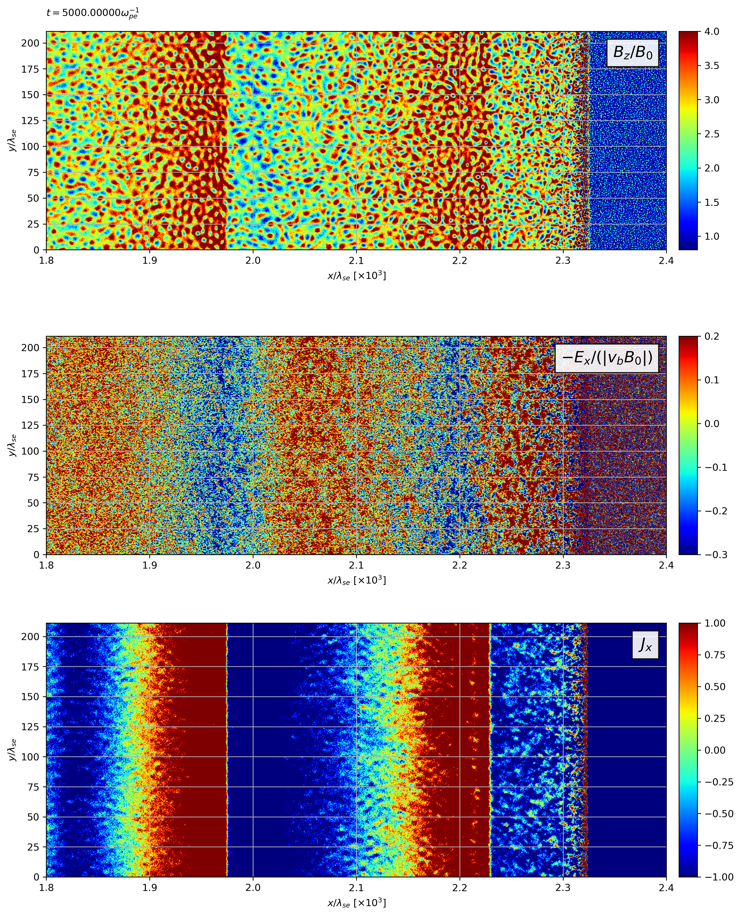
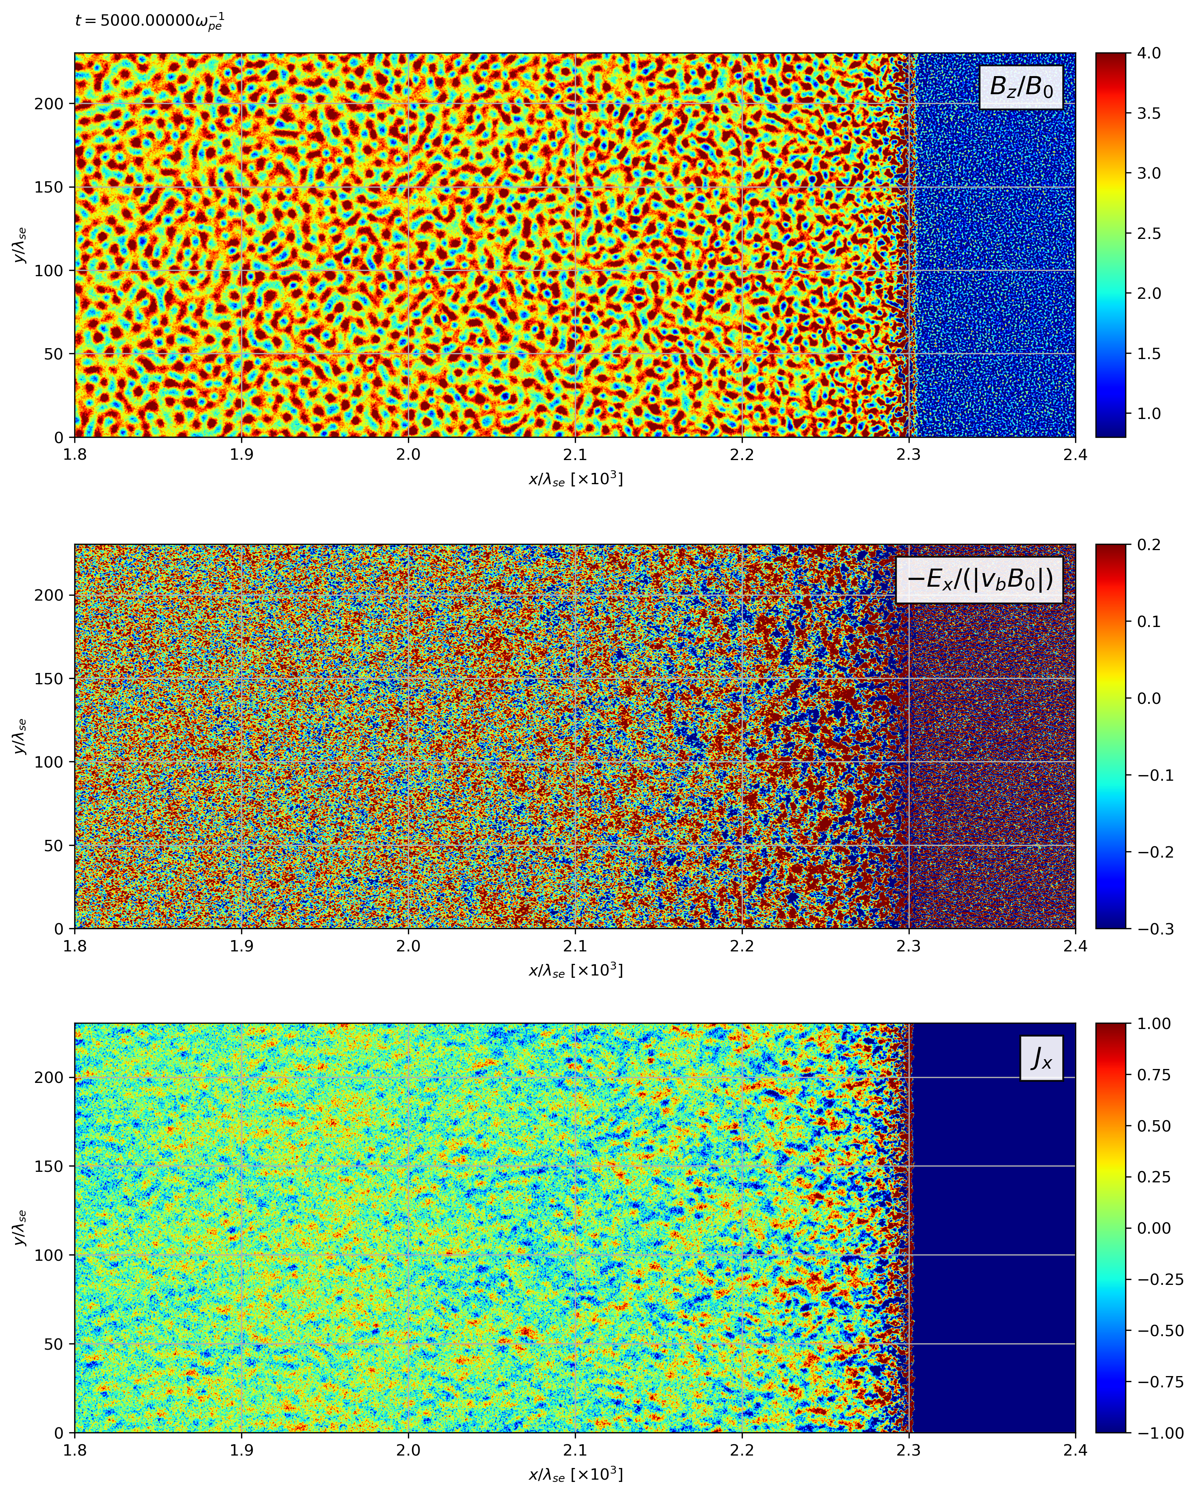
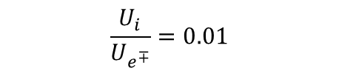
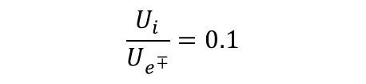
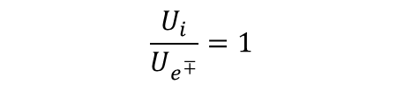
Ions form larger field structures
$$\frac{U_{i}}{U_{e^{∓}}}=1$$
$$\frac{U_{i}}{U_{e^{∓}}}=0.1$$
$$\frac{U_{i}}{U_{e^{∓}}}=0.01$$

Slide 19
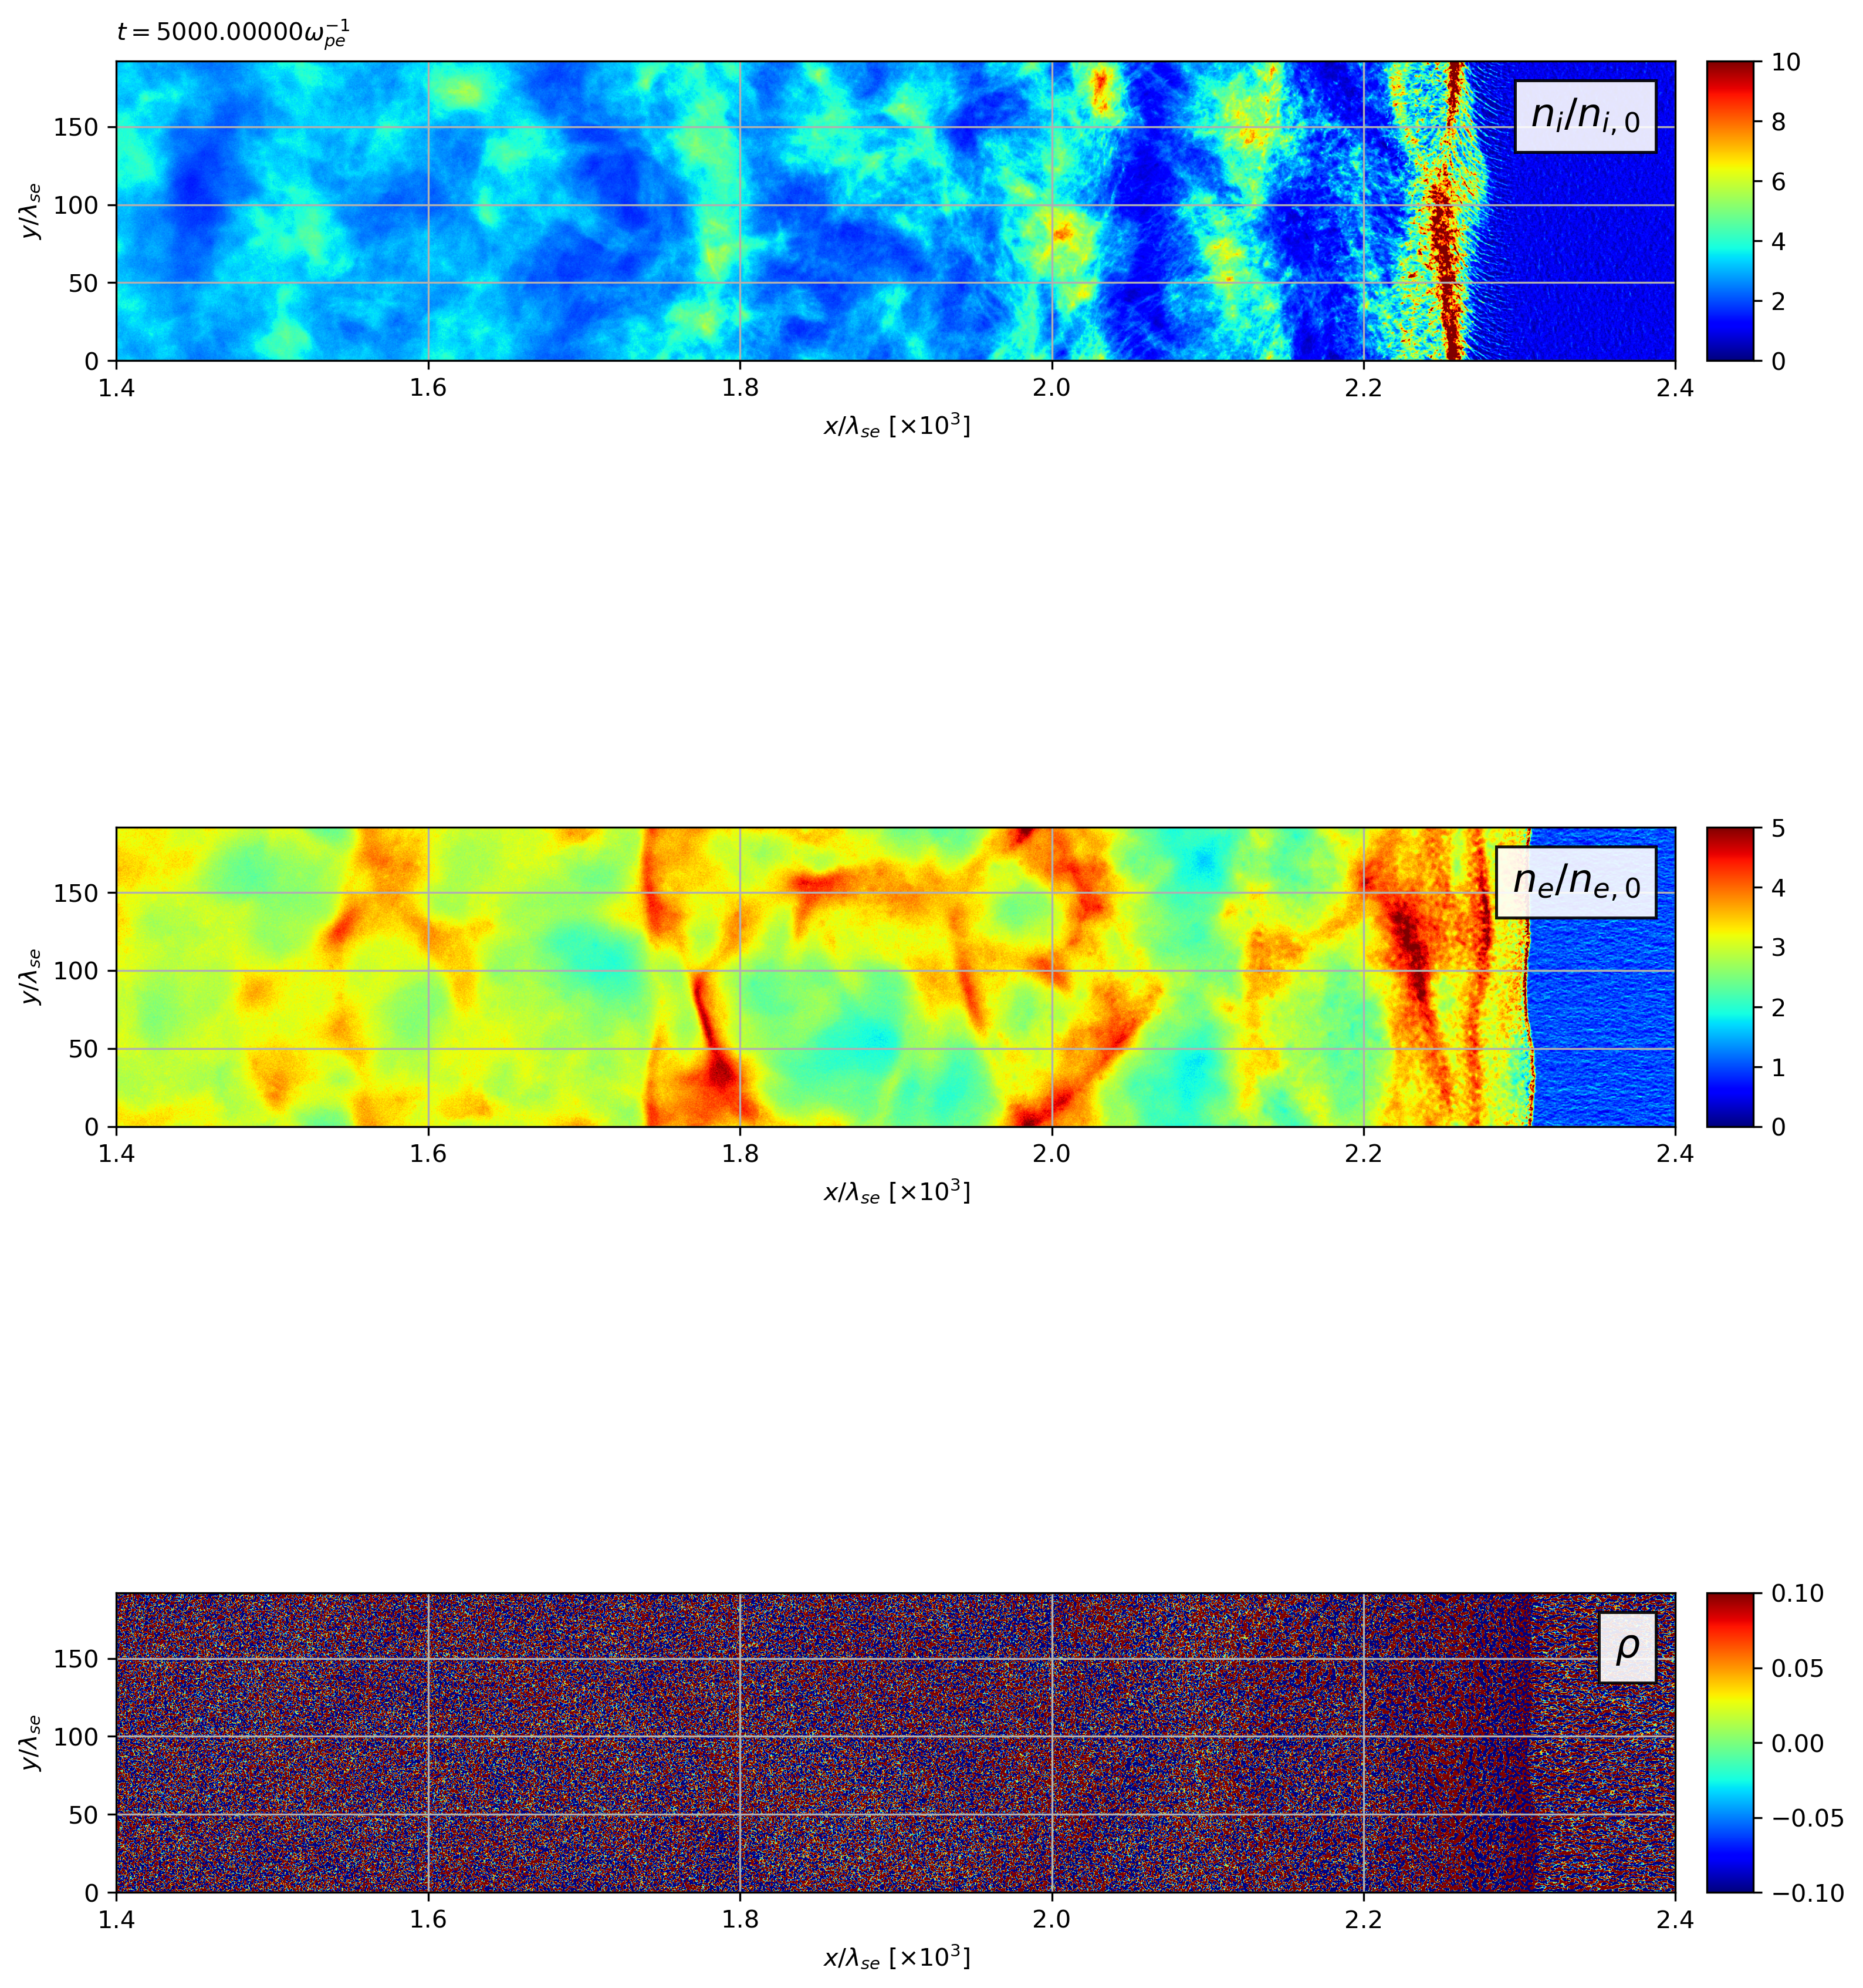
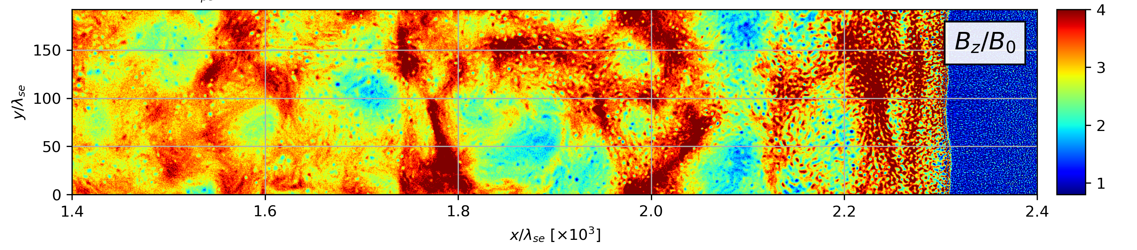
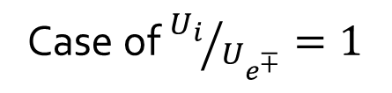
Wisp-like compressions
Case of ${U_{i}}/{U_{e^{∓}}}=1$

Slide 20
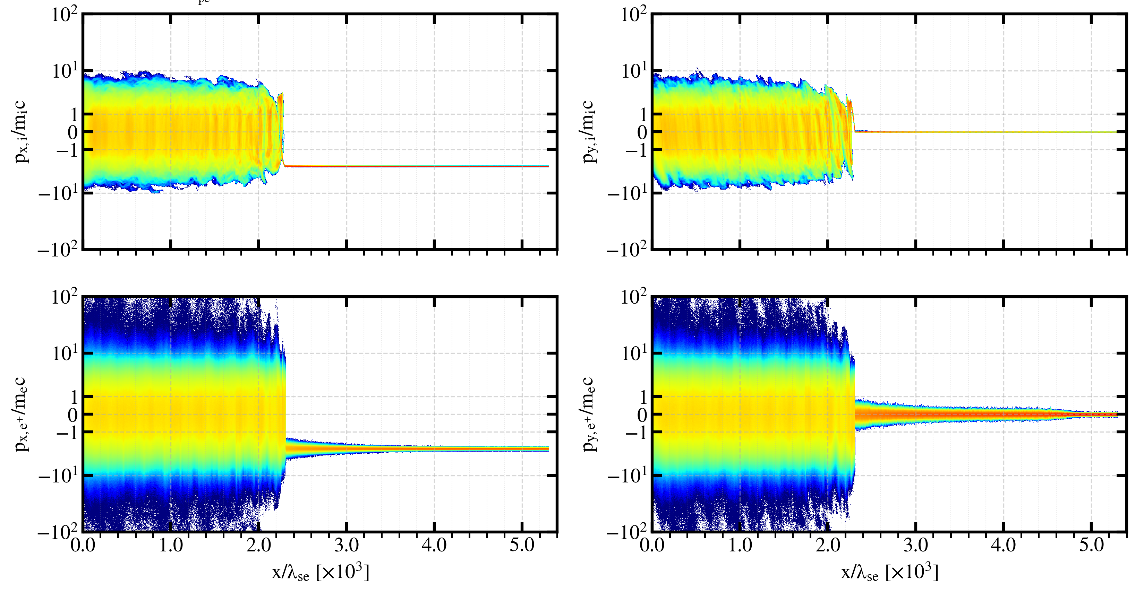
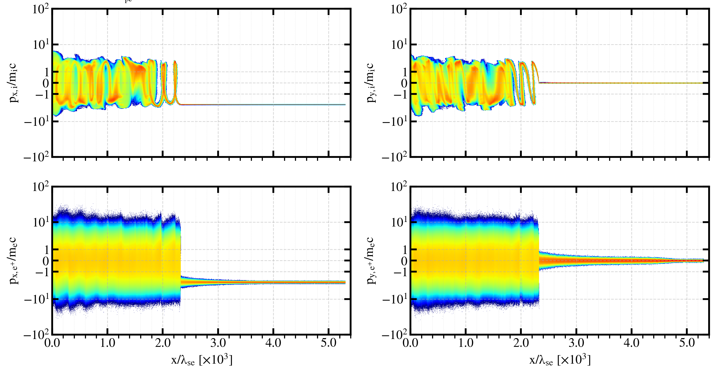
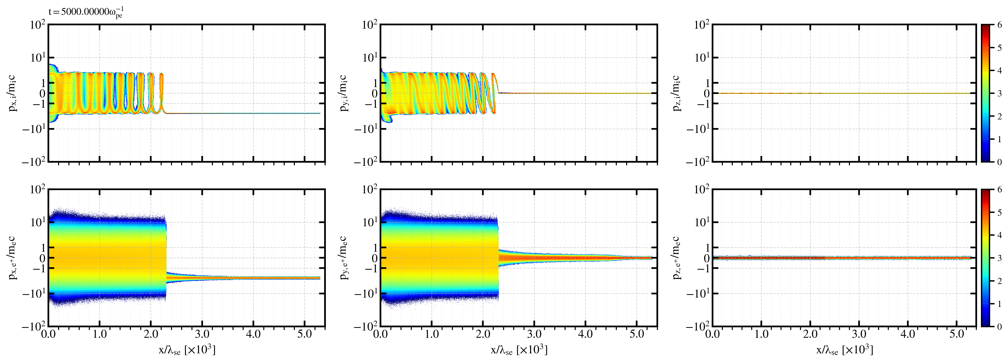
Positrons’ energization and ions’ bunching
$${U_{i}}/{U_{e^{∓}}}=1$$
$${U_{i}}/{U_{e^{∓}}}=0.1$$
$${U_{i}}/{U_{e^{∓}}}=0.01$$

Slide 21
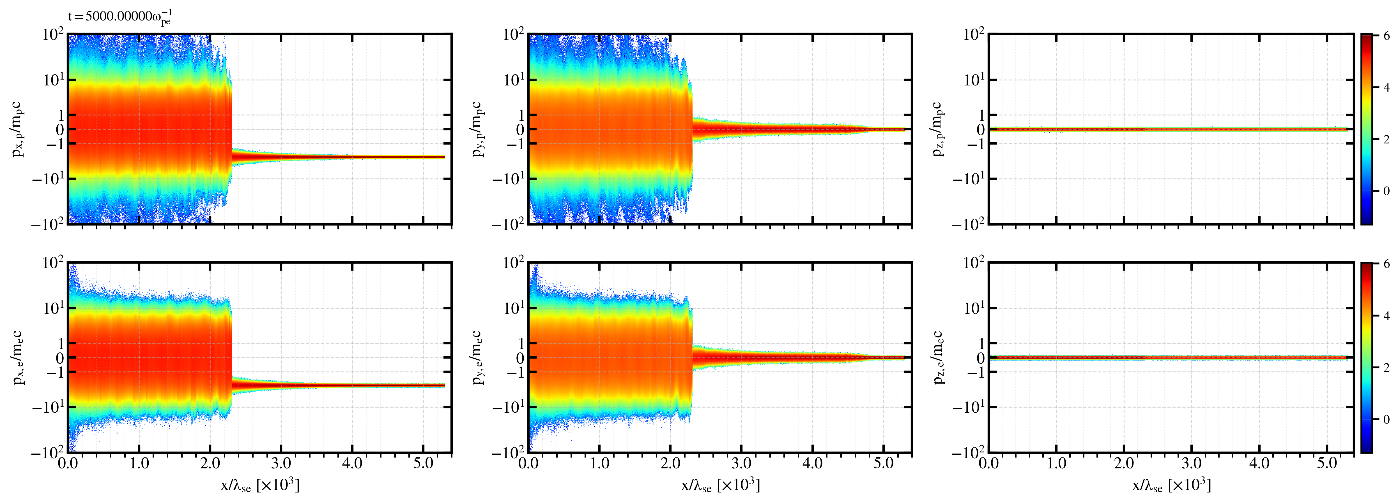
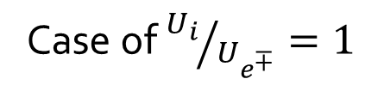
Positrons are accelerated more than electrons
Case of ${U_{i}}/{U_{e^{∓}}}=1$

Slide 22
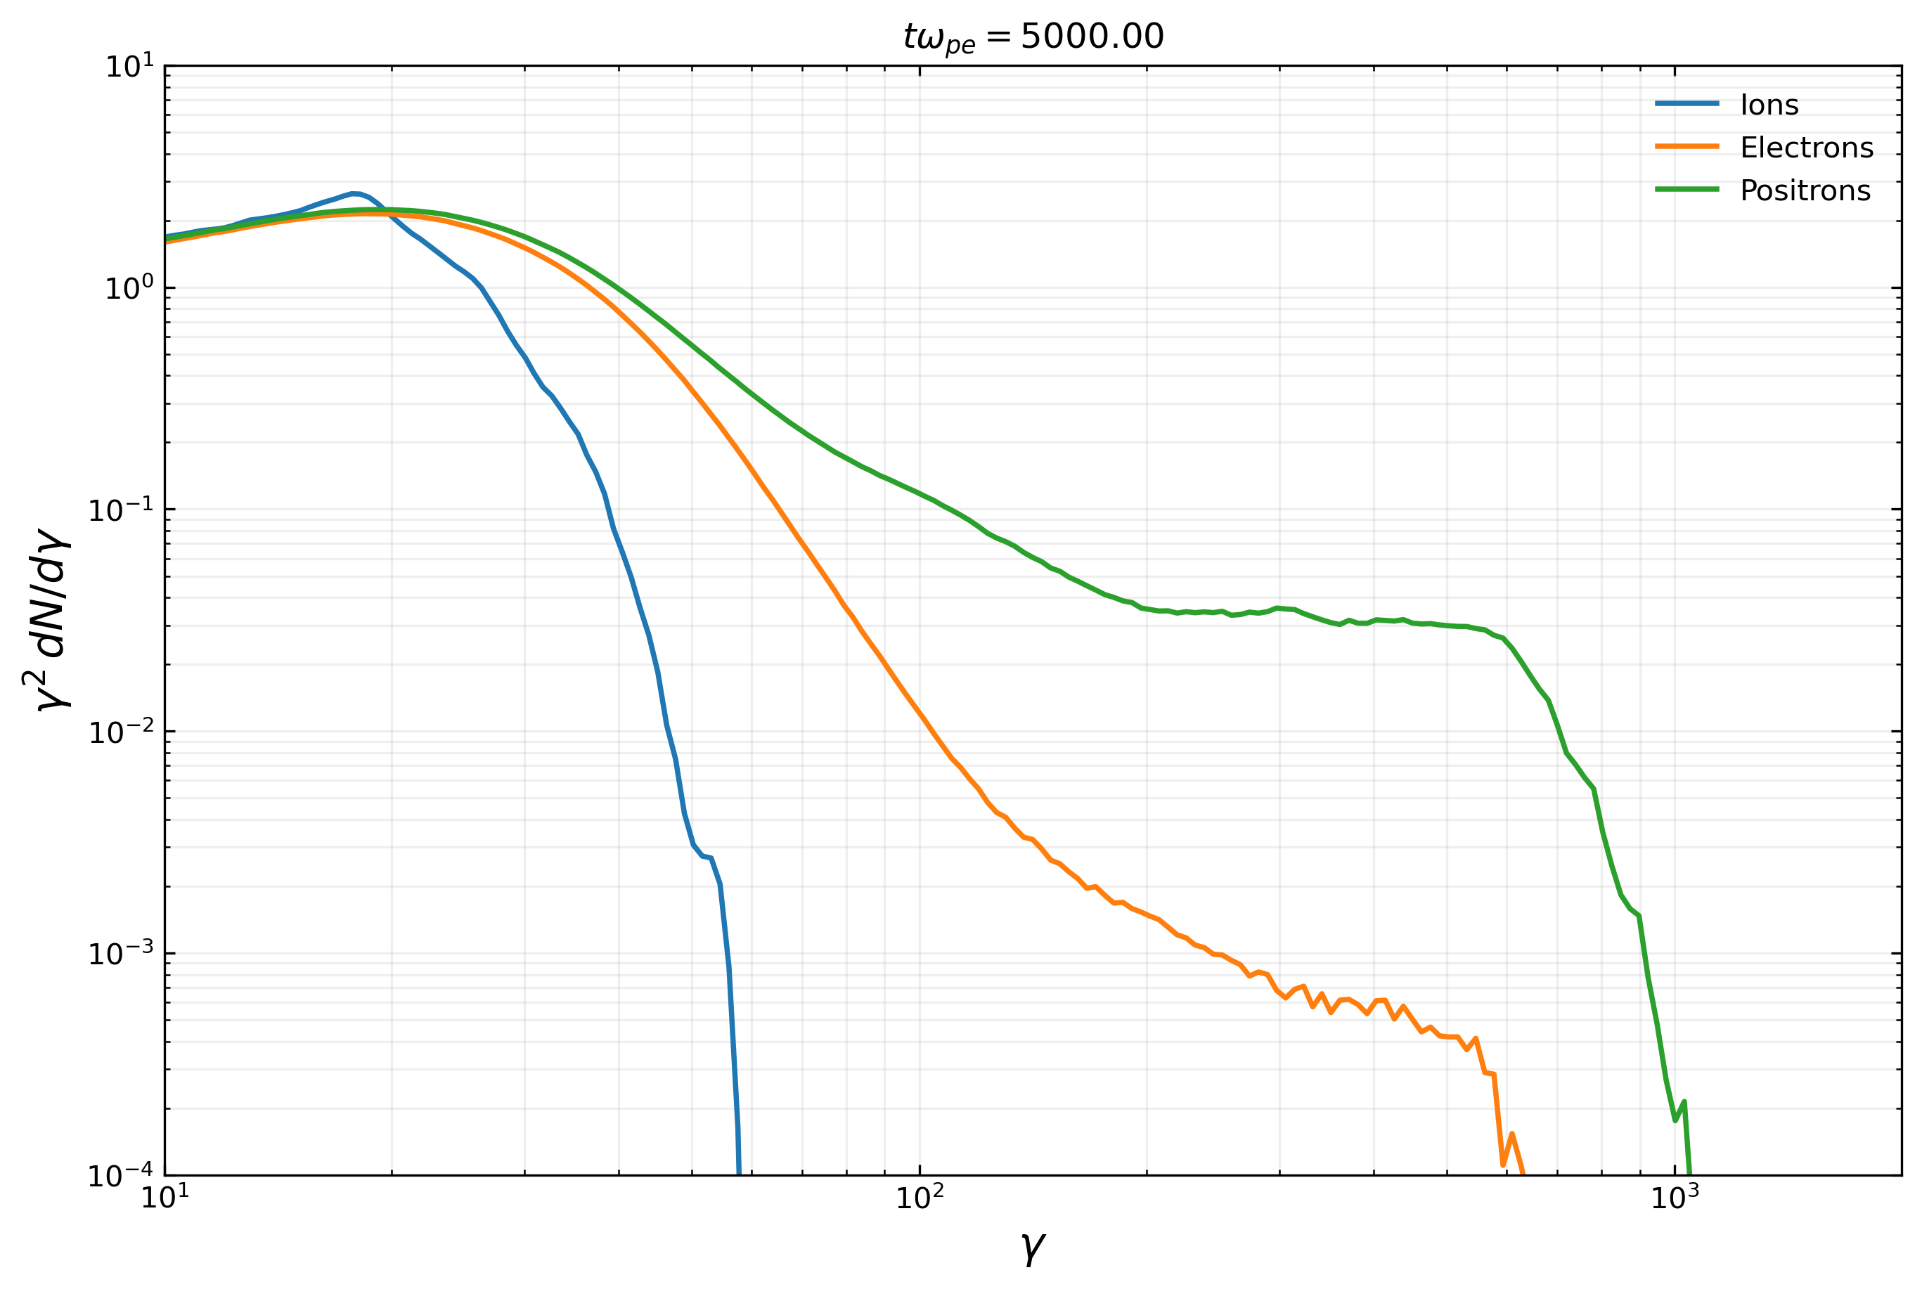
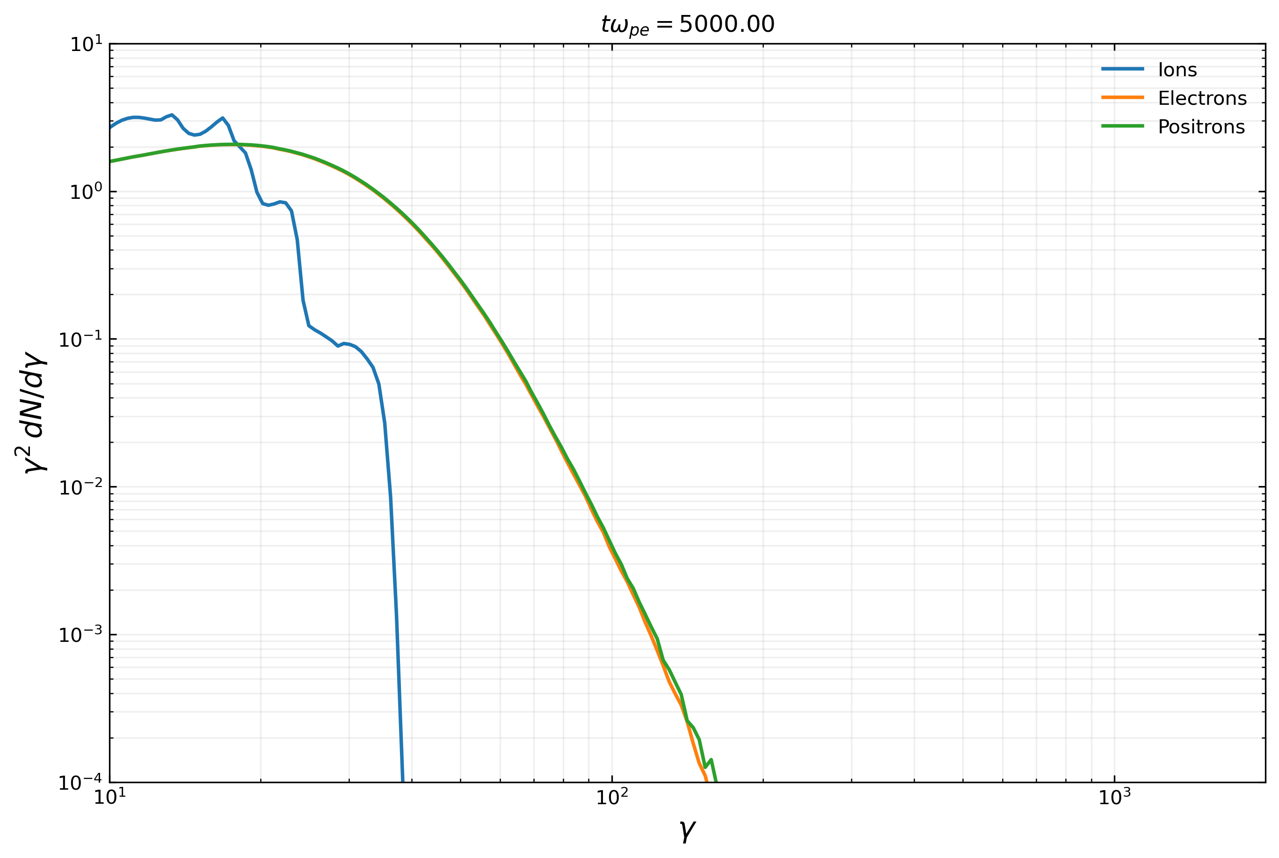
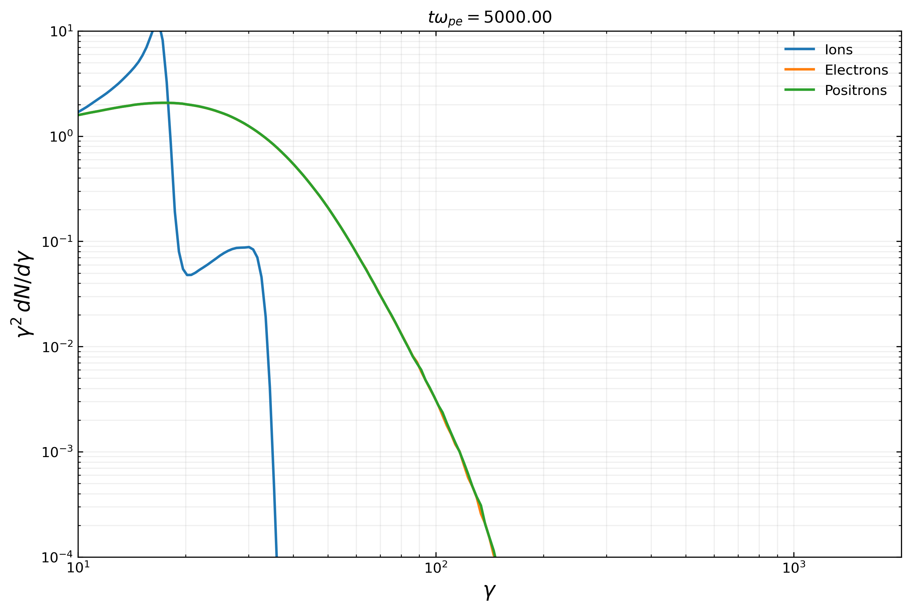
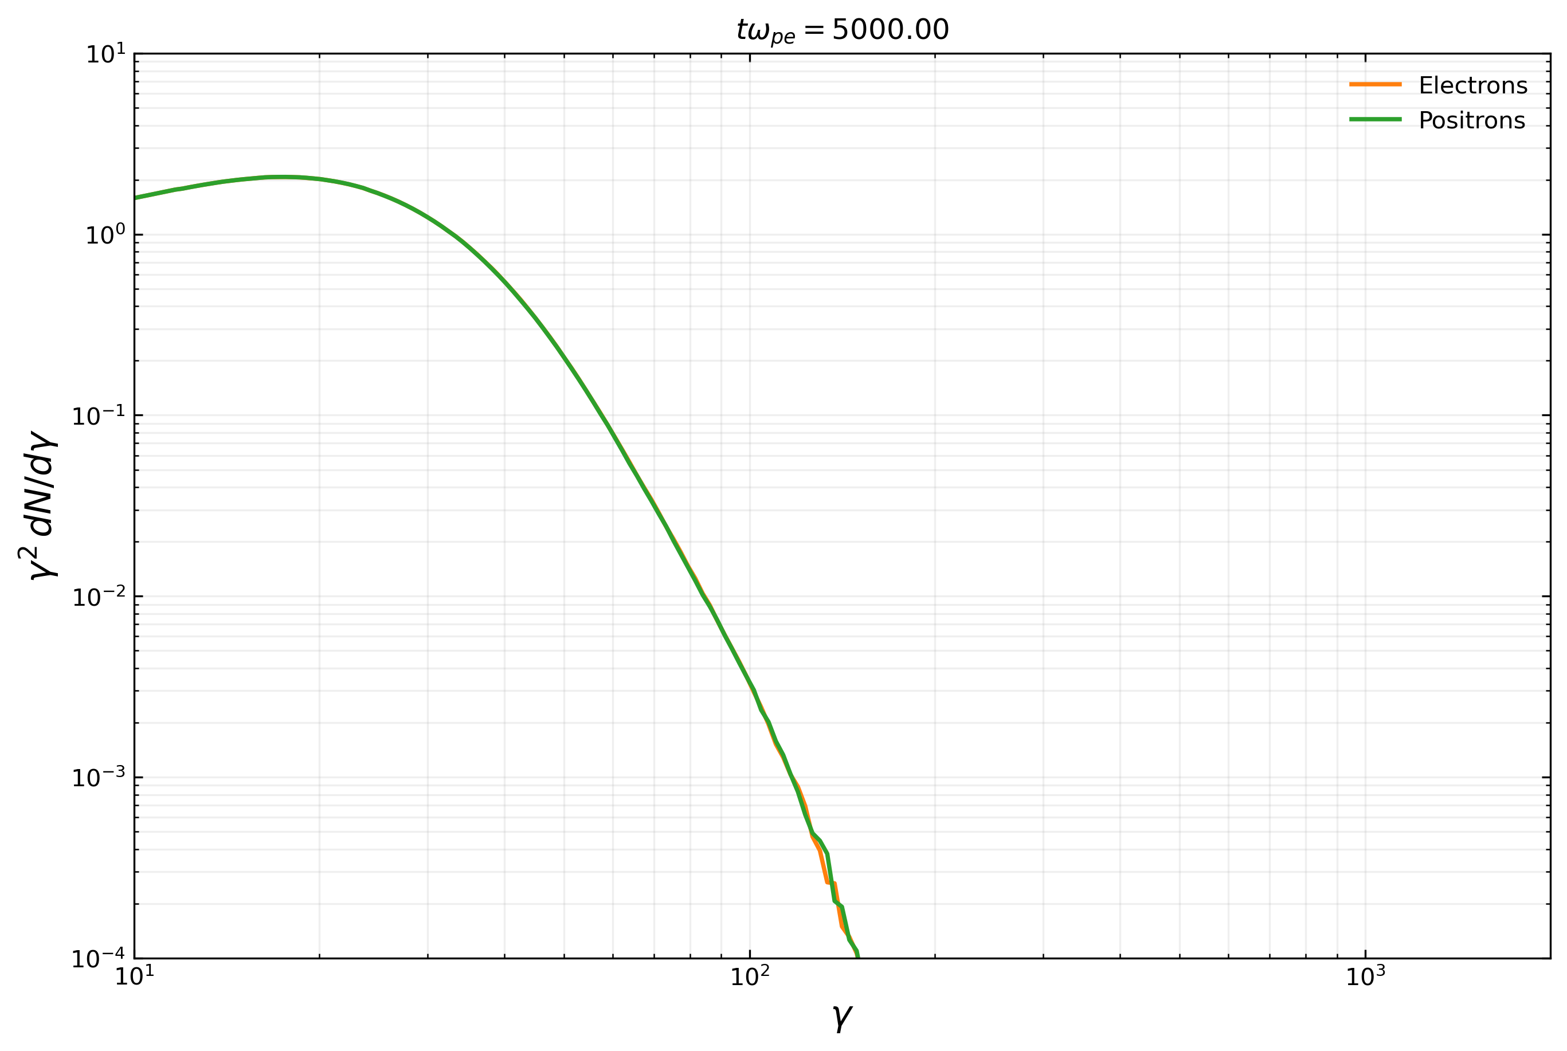
Impact of Ion loading on particle energy spectra

Slide 23
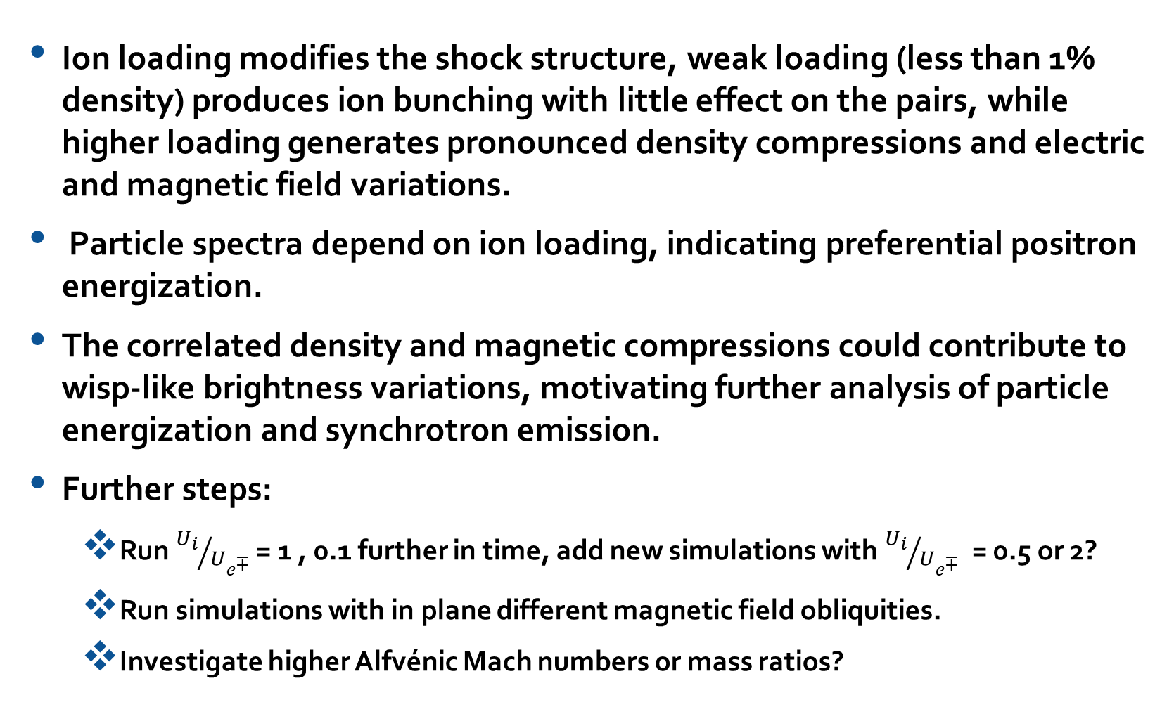
Conclusions & Outlook
Ion loading modifies the shock structure, weak loading (less than 1% density) produces ion bunching with little effect on the pairs, while higher loading generates pronounced density compressions and electric and magnetic field variations.
Particle spectra depend on ion loading, indicating preferential positron energization.
The correlated density and magnetic compressions could contribute to wisp-like brightness variations, motivating further analysis of particle energization and synchrotron emission.
Further steps:
  Run ${U_{i}}/{U_{e^{∓}}}$ = 1 , 0.1 further in time, add new simulations with ${U_{i}}/{U_{e^{∓}}}$ = 0.5 or 2?
  Run simulations with in plane different magnetic field obliquities.
  Investigate higher Alfvénic Mach numbers or mass ratios?

Slide 24
Thank you

